Slide 1
DT!
LO: to take inspiration from design throughout history.
C: Anderson Shelters

Slide 2




Air Raids
During the Second World War, enemy aircraft dropped bombs on Britain in an effort to destroy ports, industrial areas and major cities.
The Germans wanted to damage these areas to make it difficult for the British to transport weapons.
They also wanted to break the British morale and scare them into defeat.
The first air raid took place on 7th September 1940 in London, killing 2000 people in one night.

Slide 3

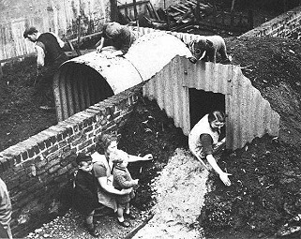
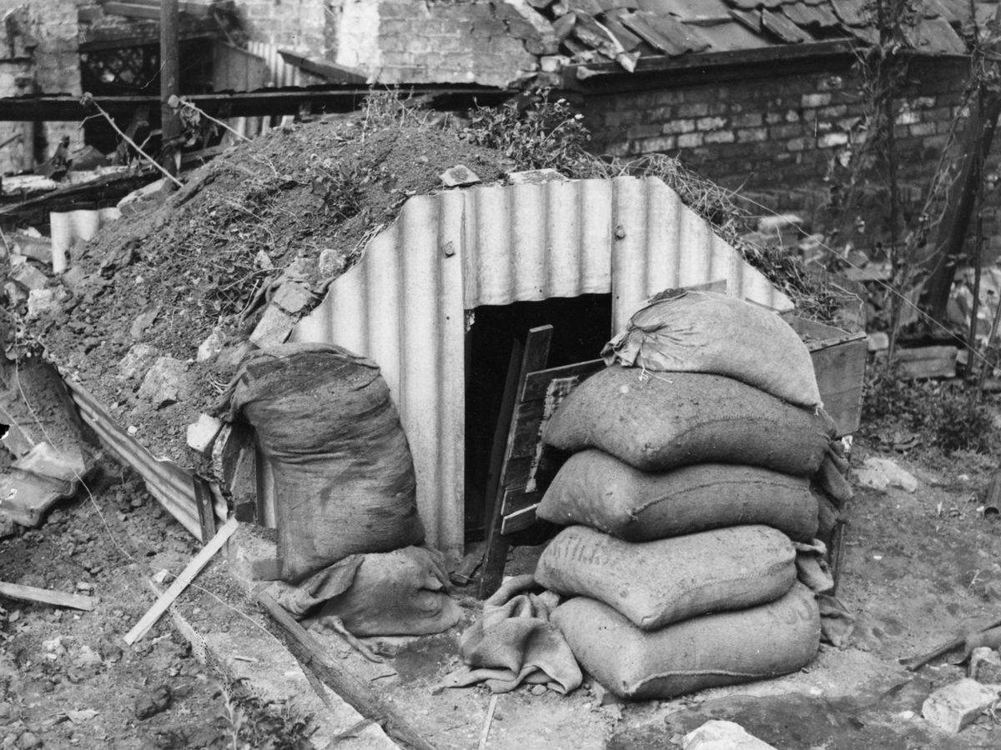
Air Raid Shelters
Air raid shelters were created so people could try to protect themselves from the night-time bombings.
When the air raid siren sounded, people would go to various shelters or places in their home to protect themselves. Listen to the air raid siren.

Slide 4
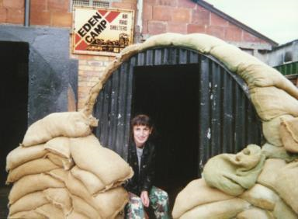
Bomb Shelters
Air Raid Shelters were also known as Bomb Shelters and were created to protect people during bomb attacks from the enemy air craft.

Slide 5
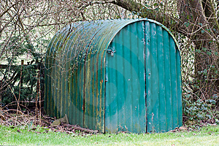
Anderson Shelter
This type of shelter was used by people in Britain.
They were named after Sir John Anderson.
They were made out of corrugated iron sheets which were bolted together.
There were steel plates at either end.
It was green in order to camouflage in the garden.

Slide 6
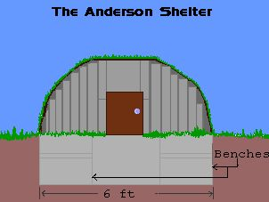
How it was made:
An Anderson Shelter was a steel hut half in the ground and half out.
The top was covered with soil and sand to protect it from bomb blasts.

Slide 7
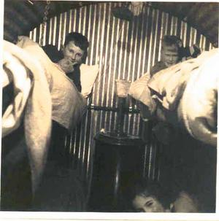
Anderson Shelters
It measured 6ft 6in by 4ft 6in
(1.95m by 1.35m)
Six people could sleep in it.
Inside, there were usually benches or beds along one or two of the walls.
It would be difficult to sleep in them because of the noise of the bombs.
The entrance was protected by a steel shield and earthen blast wall.

Slide 8
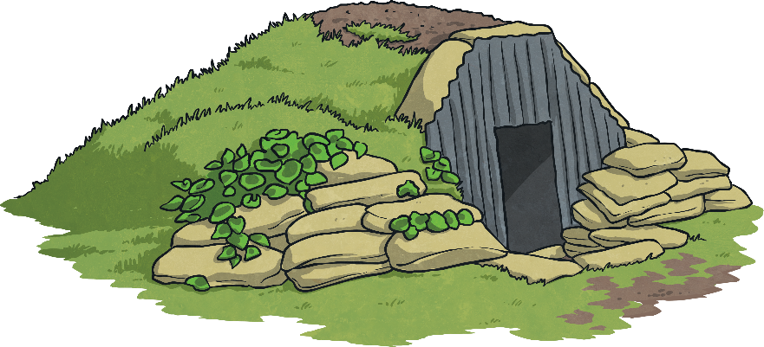
Over 2 million families had one of these shelters in their garden during WW2.
Anderson shelters were given to anyone earning less than £5 a week by the government.
For men earning more than that, they could be bought for £7.

Slide 9
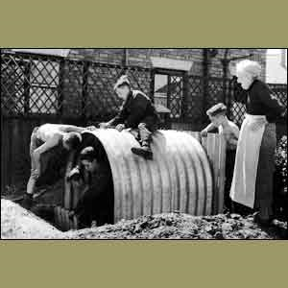
Helping to make the shelter up - notice how deep it was set in the ground.

Slide 10

Covered with soil....
Why do these shelters look different?

Slide 11
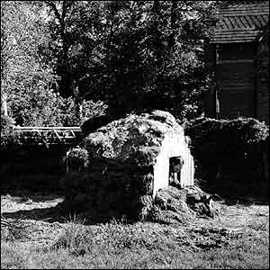
Problems...
Because they were partially buried, the shelters were prone to flooding.
They were also cold and damp during cold weather.
They could not protect against a direct hit by a Nazi bomb.

Slide 12
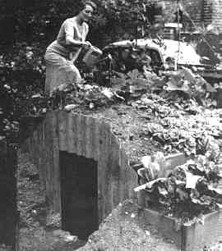
Grow your own....

Slide 13
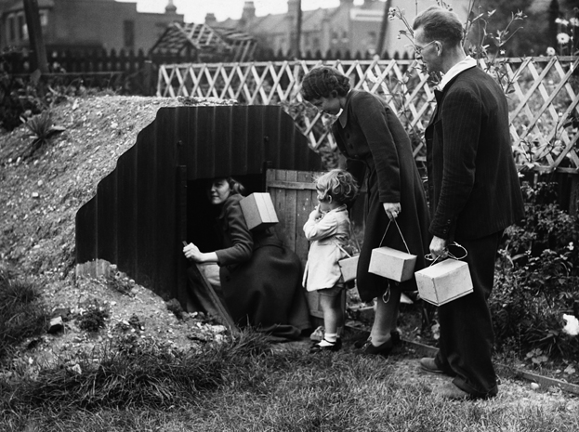
Going into the shelter…
What do you notice?

Slide 14
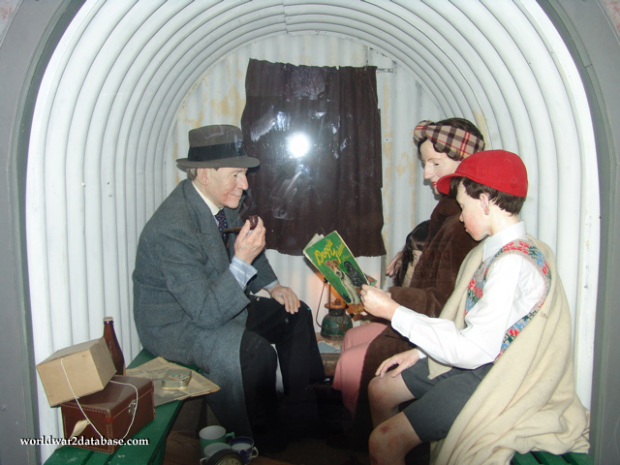
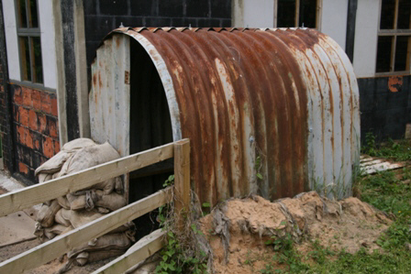
Outside and inside...

Slide 15
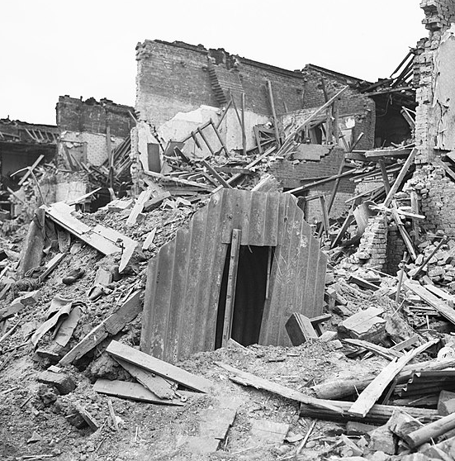
Anderson shelter Latham Street, London 1941.
Three people sheltering inside were unharmed when a bomb landed a few yards from it.

Slide 16
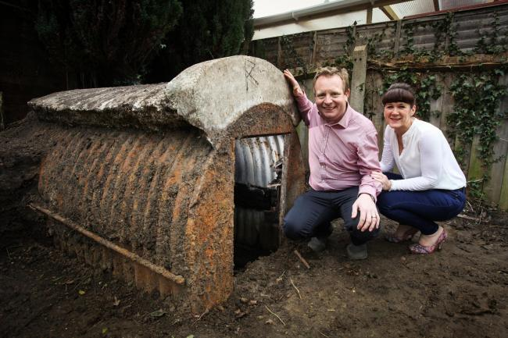
Starter
What questions do you have about the Anderson Shelters?
Do you know anyone that might still have an Anderson shelter at the bottom of their garden?
Some people still do!

Slide 17
Today, you are going to be designing and making your own Anderson shelters!
Before you can do this, you need to learn more about the Anderson Shelters and how they were made.

Slide 18
Activity
Using the internet and the handout (see class pages), research Anderson Shelters and how they were made.
You should answer the following questions:
Who created them? When were they created?
What was the purpose of them?
What were they made out of?
How big were they? Where would they be built?
What was in them? How many people could fit in them?
Were they a nice place to stay in? Why?
Who had them? How much were they?
What characteristics would the shelter need to have? What did they need to be able to do?
How did people brighten up or use the outside of the Anderson shelter?
Draw and label and Anderson Shelter.

Slide 19
Websites
https://kidskonnect.com/history/anderson-shelter/
http://www.andersonshelters.org.uk/
http://www.primaryhomeworkhelp.co.uk/war/shelters.htm
https://primaryfacts.com/506/anderson-shelter-facts/
http://projectbritain.com/calendar/February/anderson.html
https://historyforkids.org/anderson-shelter-facts-and-information/

Slide 20
LO: To design, make, evaluate and improve.
To take inspirations from design throughout history.
C: Anderson Shelters

Slide 21
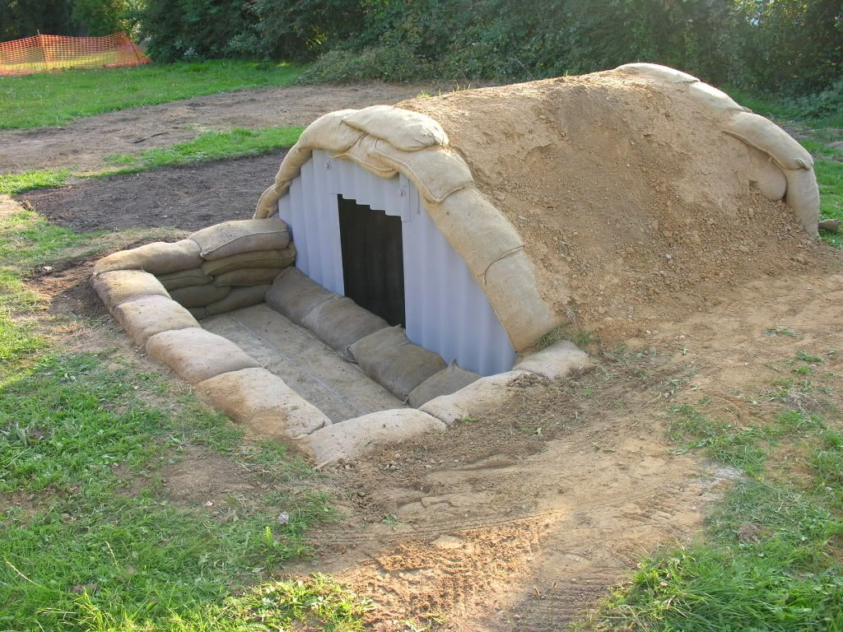
Do you know why the roof of the Anderson shelter is curved?

Slide 22
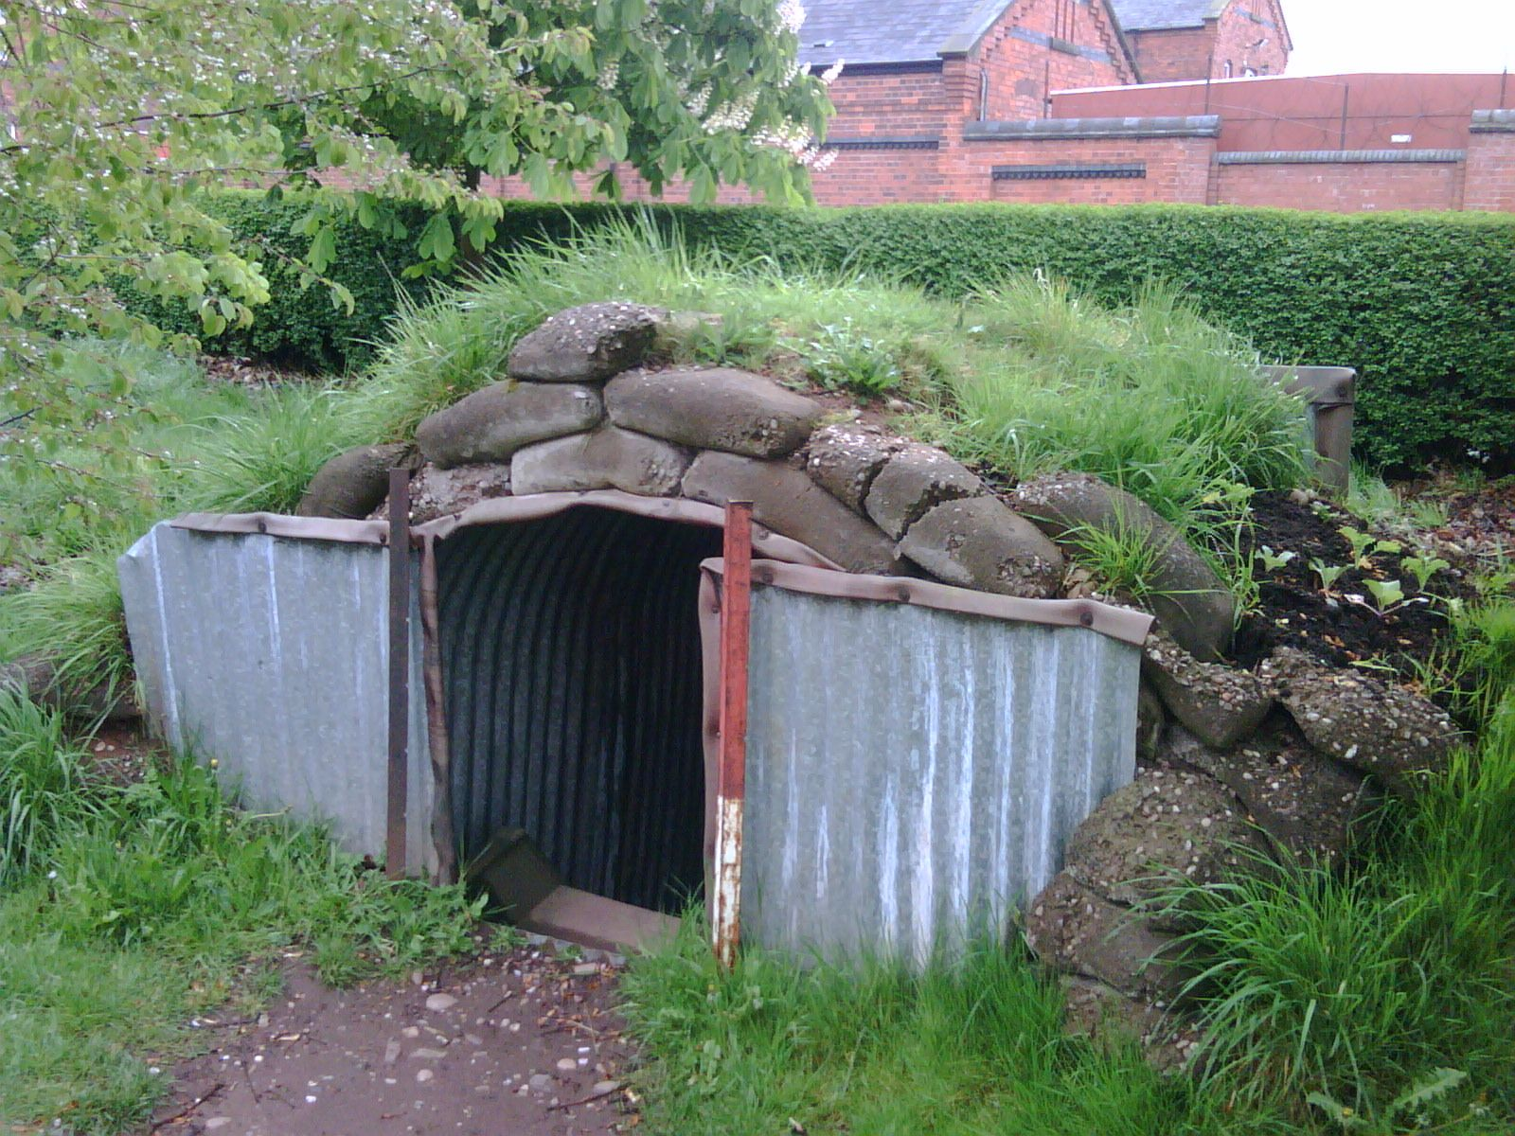
The job of the shelter is to protect people from debris and shrapnel.
Where might this debris and shrapnel have come from? Above!
Therefore, the curved shape of the roof is actually much stronger than a flat roof.

Slide 23
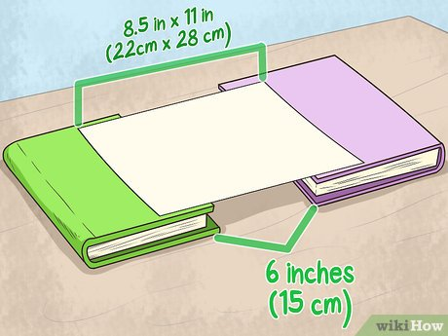
Challenge!
Can you create the strongest possible bridge using a single sheet of A4 paper to cover a 15cm gap, e.g. between two tables or chairs?
Use small items (e.g. coins, pencils etc.) to test your ideas until you find a design that is your strongest.
You can try lots of different ideas and designs!

Slide 24
Activity
Experiment with creating the strongest possible bridge using a single sheet of A4 paper to cover a 15cm gap.
Try lots of different designs and explore how you can change the shape of the paper using different folds.

Slide 25
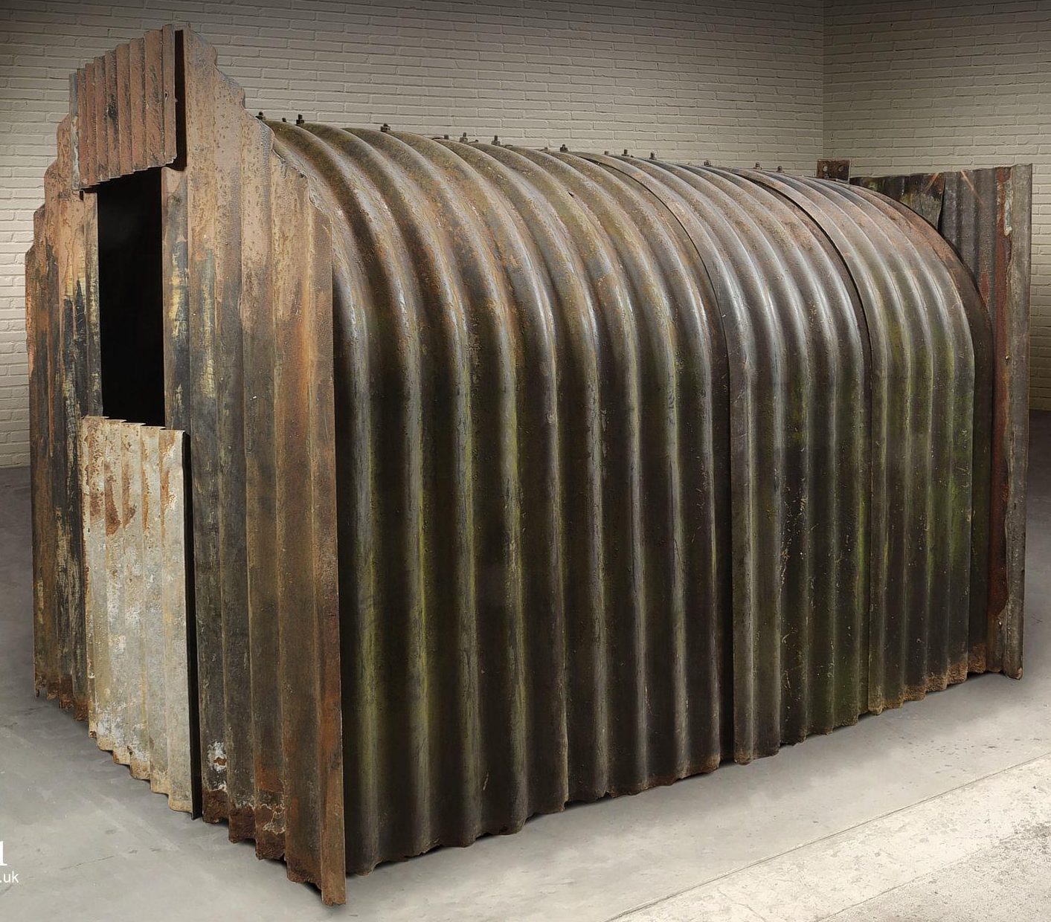
Mini Plenary
Notice the corrugated design of the sides of the Anderson Shelter.
Corrugated: (of a material or surface) shaped into a series of parallel ridges and grooves so as to give added rigidity and strength.
By folding the paper, you can create a very strong structure.
Watch: https://www.youtube.com/watch?v=qFZGmHbjLS
Spend a few more minutes exploring how you can change the shape of the paper using different folds.

Slide 26

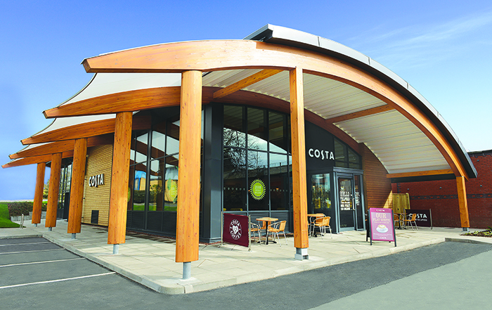

Plenary
Can you think of any other structures that use curves in them to create strength?
e.g. the Eiffel Tower, arched bridges etc.

Slide 27
LO: To design, make, evaluate and improve.
To take inspiration from design throughout history.
C: Anderson Shelters

Slide 28
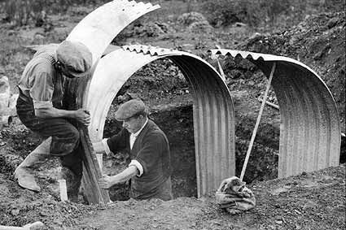
Starter
Watch: https://www.youtube.com/watch?v=Mu0ad17Yb98

Slide 29

Create a bubble map of the recycled materials that you have at home that you could make your shelters from, e.g. cardboard, egg boxes etc.
The most important thing when choosing the materials is: will they be strong enough to make a structure from?

Slide 30
Activity
Using different recycled materials. Test how suitable each material is for use.
Use the questions in the table to guide your testing.
When it comes to testing the strength of the material, make a small hole in the material and then, use items like books or weighty objects to try and rip a section of the material open.
You should answer the questions in full sentences, not just write one-word answers!

Slide 31
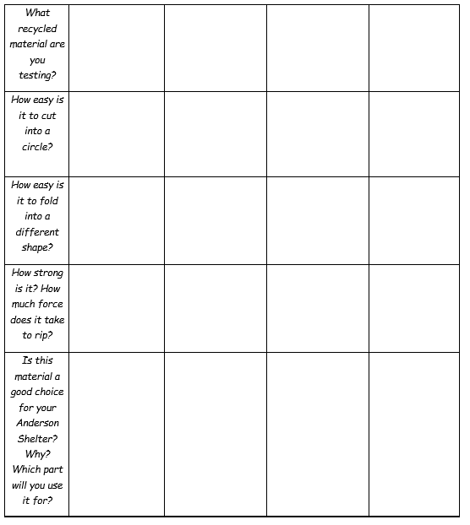

Slide 32
Plenary
Which material seemed more suitable than others?
Why?

Slide 33
LO: To design, make, evaluate and improve.
To take inspiration from design throughout history.
C: Anderson Shelters

Slide 34

Starter
Every invention is thought out on paper first, where the designer draws a picture of what they want to build and thinks about each step of the process that is necessary, including listing the materials required.

Slide 35
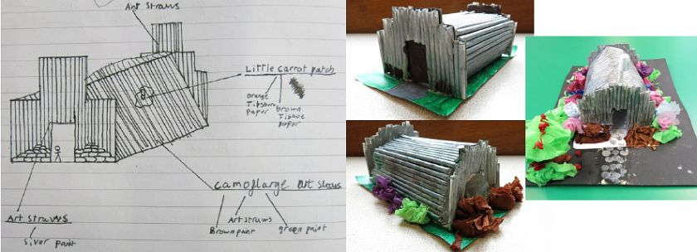
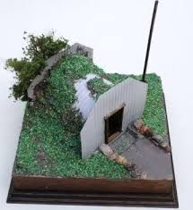
Examples of Anderson Shelters made by children:
Google Images

Slide 36
You need to create a design of your shelter.
Design requirements of your shelter:
  Able to fit a Lego man inside
  Waterproof
  Able to withstand a 1kg weight placed upon it

Slide 37

What does your design need to be able to do to be realistic?
What materials could give you the ability to meet the needs of its design? E.g. would cling film work for the roof?
What materials will you need for each part of the shelter?
What equipment will you need?
How will you make your Anderson Shelter? What order will you need to do it in? what is the step-by-step process you need to follow?

Slide 38
Activity
Draw and label the Anderson Shelter you are aiming to construct, detailing what material is going where and why.
List all of the materials, equipment and steps you will need to have and complete in order to build it.

Slide 39
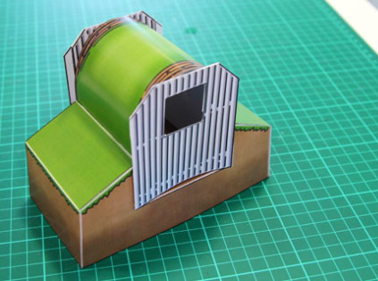
Extension
Using recycled paper, attempt to build a prototype of your shelter.
Have you learned anything that will help you to build your shelter better?

Slide 40

Plenary
Share your designs and step-by-step instructions with an adult.
They should give you feedback on your design and your step-by-step instructions.
Have you forgotten anything in your instructions?
Is there something in their design which won’t work or should be improved?

Slide 41
LO: To master practical skills.
To design, make, evaluate and improve.
C: Anderson Shelters

Slide 42
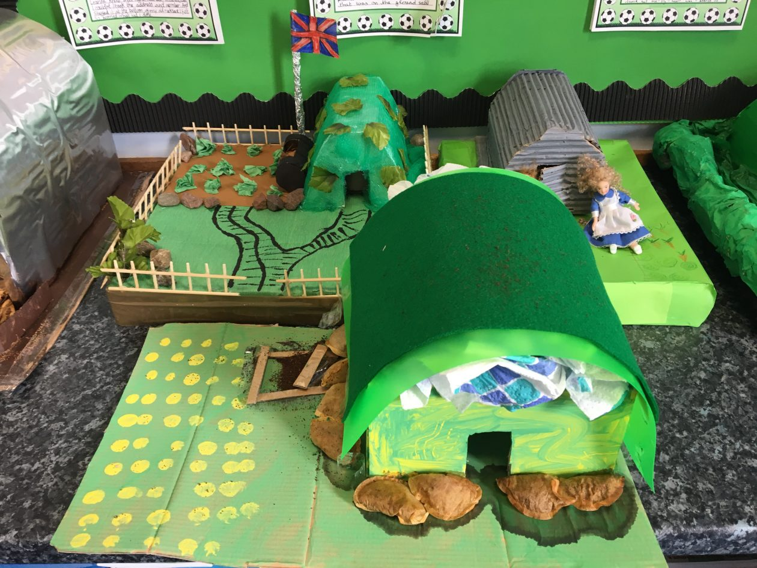
Activity
Make your Anderson Shelter using your design
and step-by-step instructions.
Remember the design brief:
  Able to fit a Lego man inside
  Waterproof
  Able to withstand a 1kg weight placed upon it.
Try to continually test these areas as you are making your shelters to ensure you meet the brief.

Slide 43

Safety!
What do you need to be careful of when making your Anderson Shelters?
E.g. cutting, using scissors etc.

Slide 44
LO: to design, make, evaluate and improve.
C: Anderson Shelters

Slide 45

Starter
Whenever you create something, there will always be mistakes made in the making and designing process. This is to be expected!
An important part of DT is learning from those mistakes so that it doesn’t happen again.

Slide 46

Reflect on and evaluate your final products
Was it a successful construction?
Did the Lego man fit? Did he stay safe? Did he stay dry?
Does your Anderson Shelter hold weight? How much weight?
Is there enough space inside for humans to live? (to scale – Lego figures)
What are the strengths of your Anderson Shelter? What worked in your design?
What could have been better in your design?
If you made an Anderson Shelter again in the future, what improvements would you make? What would you do differently next time?
Did you change anything from your original plan?
Are you pleased with your final product? Why?

Slide 47

Activity
Reflect on and evaluate your final products by answering the questions below:
Was it a successful construction? Did the Lego man fit? Did he stay safe? Did he stay dry?
Does your Anderson Shelter hold weight? How much weight?
Is there enough space inside for humans to live? (to scale – Lego figures)
What are the strengths of your Anderson Shelter? What worked in your design?
What could have been better in your design?
If you made an Anderson Shelter again in the future, what improvements would you make? What would you do differently next time?
Did you change anything from your original plan?
Are you pleased with your final product? Why?

Slide 48

Take a picture of your final product to send into school!

