Slide 1
Celebrating difference
PSHCE

Slide 2
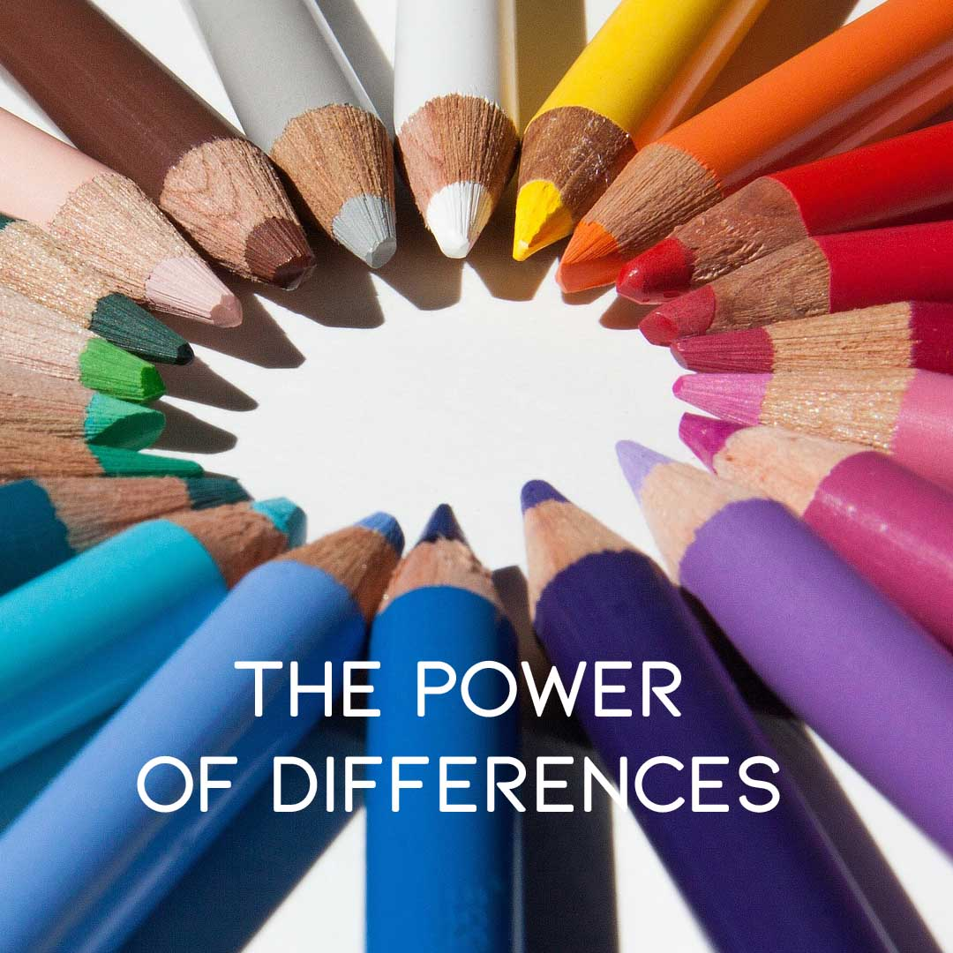
Difference can be good

Slide 3

What can you see in the picture?

Slide 4
Difference can be a source of conflict

Slide 5
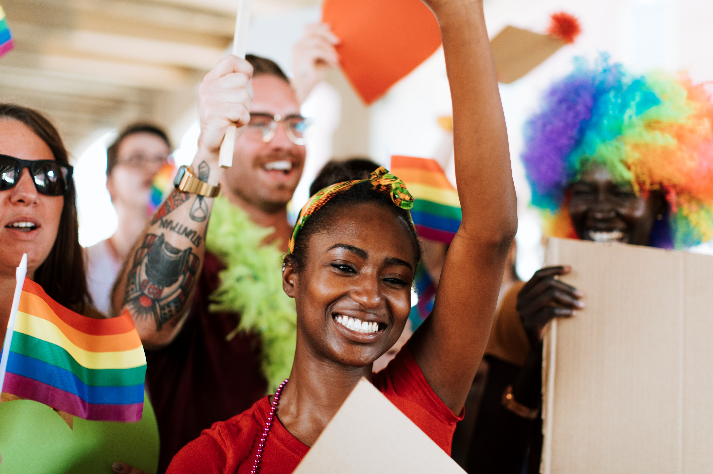
What can you see in the picture?

Slide 6
Difference can be a cause for celebration

Slide 7
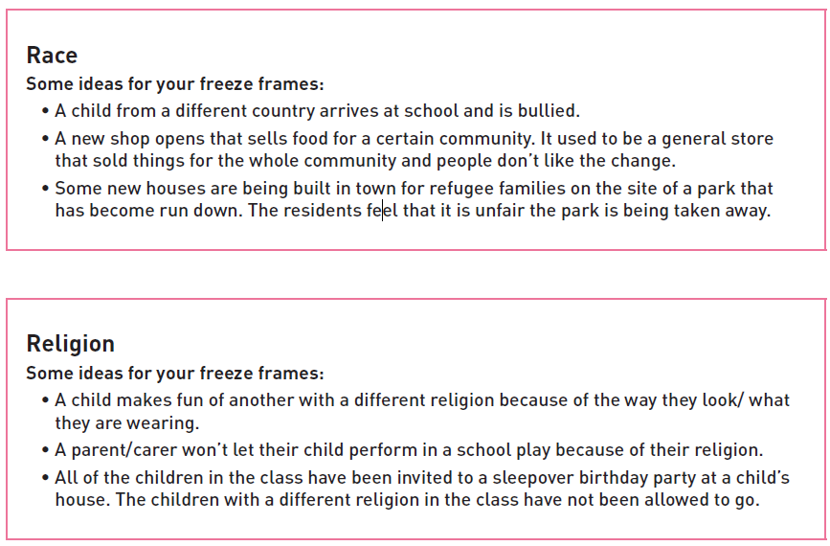
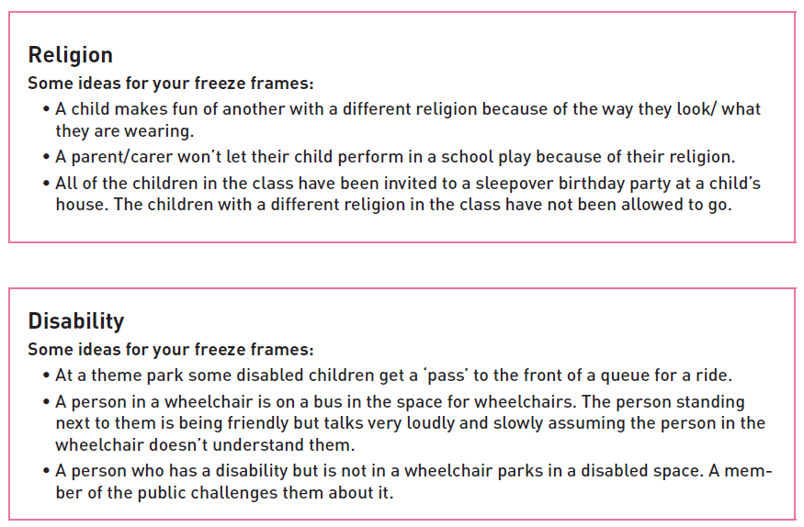
activity
Choose a card showing a type of difference which could cause conflict.

Slide 8
activity
Create a story line that will be told through a sequence of three comic strip segments.
The three focus points of this will be:
1. Set up a scenario in which the difference is the source of conflict.
2. Create an event/incident in the storyline which challenges the conflict and needs to bring the two sides/people together.
3. Devise an ending to the story to show that their initial differences have been overcome and that this is a cause for celebration.
Example:
1. Someone who is not disabled parks in a disabled space at the shopping centre blocking its use.
2. There is a power cut in the shopping centre and it has to be evacuated. The person who has parked wrongly helps the disabled person exist the centre.
3. The person who has parked realises that they have been selfish so they decide to raise money for a disabled charity by doing a half-marathon.

Slide 9
1. | 2. | 3.

