Slide 1
L.O: To build an overview of world history
C: Understand the experiences of women during WWII

Slide 2
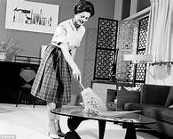
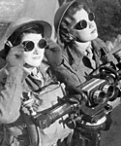
What were women doing during the battle for civilisation?
How did the role of women change during WWII?
Talk To Your Partner

Slide 3
Before the Second World War, women were expected to be 'housewives' or perhaps to do certain 'women's jobs', such as nursing or being a domestic servant or shop assistant.
The war changed the world of work for women for ever. When men went to fight, women were called upon to fill their jobs, and this included many jobs that were previously thought of as unsuitable for women.
Women were called up for war work from March 1941.

Slide 4
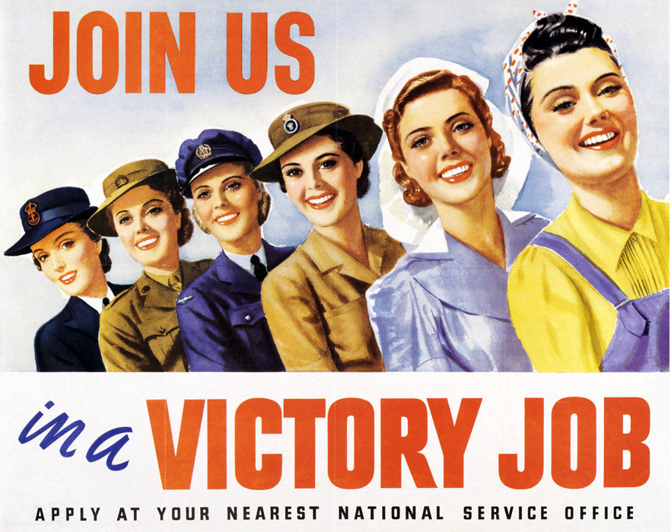
From Spring 1941, every woman in Britain aged 18-60 had to be registered, and their family occupations were recorded.
Each was interviewed, and required to choose from a range of jobs, although it was emphasised that women would not be required to bear arms.
However, many women were eventually to work - and die - under fire.

Slide 5
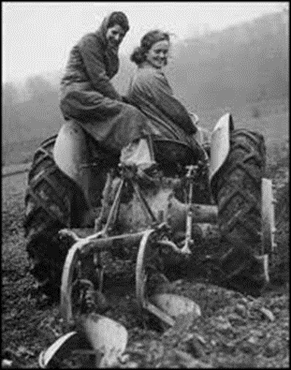
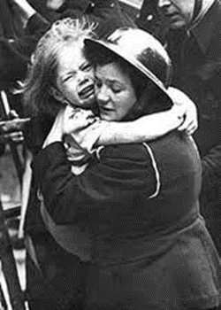
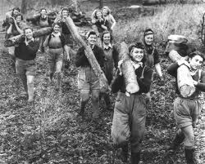
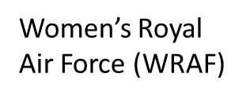
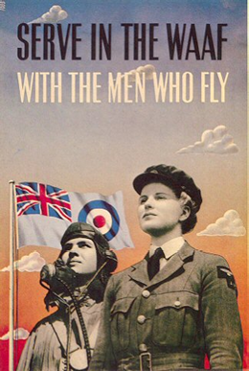


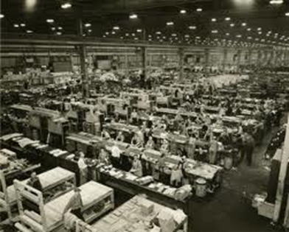
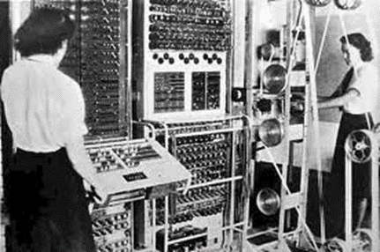
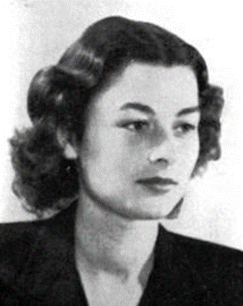
What jobs do you think women did?
Women’s Voluntary Service
Talk To Your Partner
Women’s Land Army
Women’s Timber Corps
Factory Workers

Slide 6
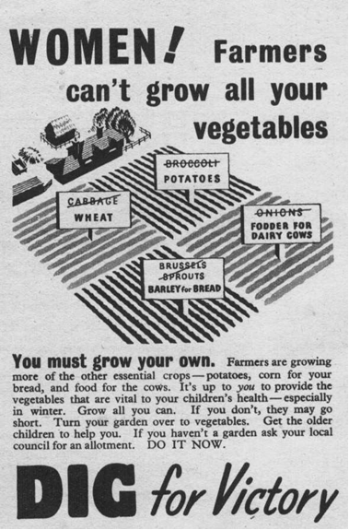
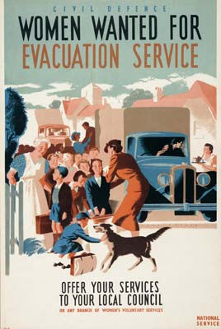
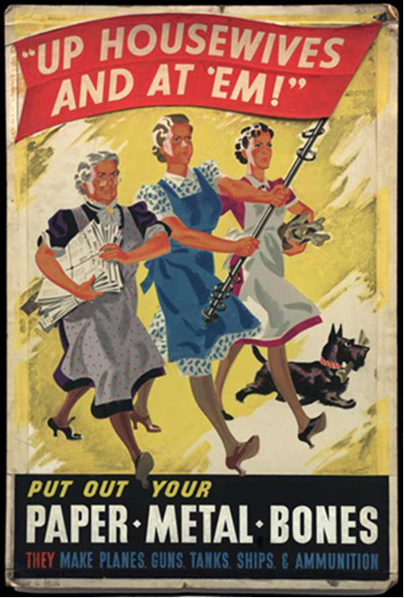
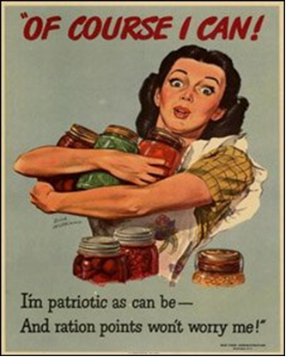
Posters were produced to encourage women to join the fight against Hitler

Slide 7
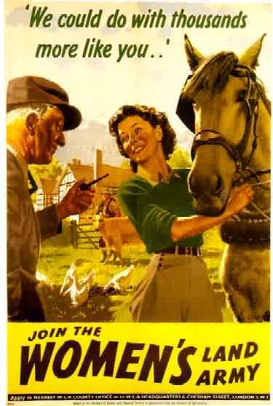
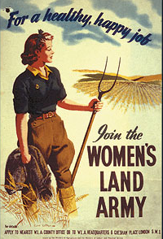
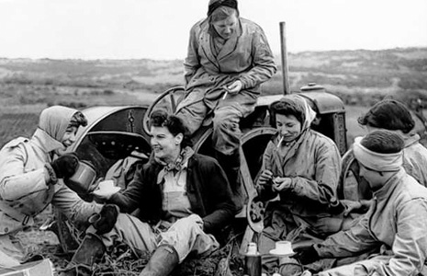
The Land Army
With the country at war and all able-bodied men needed to fight, there was a shortage of labour to work on farms. An advertising slogan read, 'For a healthy, happy job join The Women's Land Army'. In reality, the work was hard. The girls of the land army looked after animals, ploughed the fields, dug up potatoes, harvested the crops, killed the rats, dug and hoed for 50 hours a week.

Slide 8
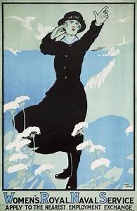
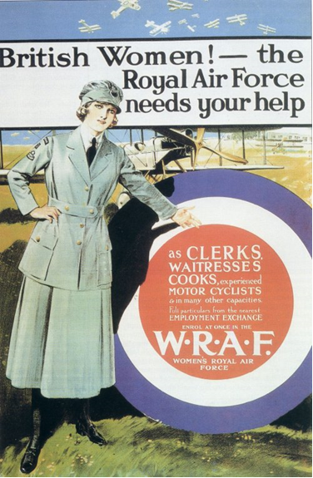
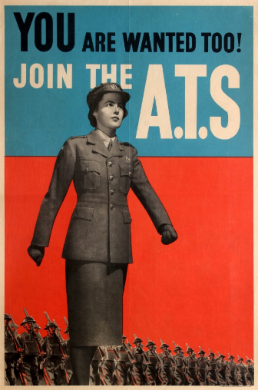
The Armed Forces
Women were conscripted in December 1941. They were given a choice of working in industry or joining the armed forces – the Auxiliary Territorial Service (ATS), the Women's Auxiliary Air Force (WAAF) or the Women's Royal Naval Service (WRNS).

Slide 9
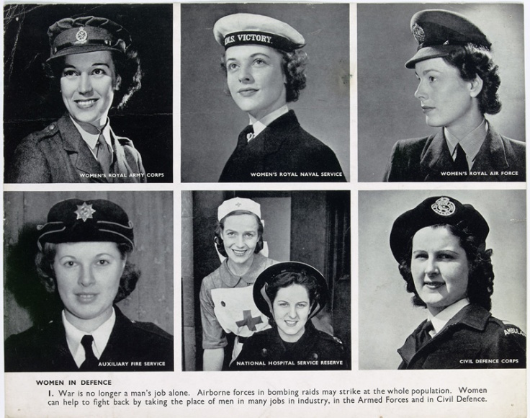
Women in the forces
The Auxiliary Territorial Service (ATS) was formed in 1938. The vast majority of women in the ATS served in anti-aircraft command, on searchlights - the 93rd Searchlight Regiment were all female. They also worked in mixed batteries on anti-aircraft guns, but were not officially allowed to fire them.
The Women's Royal Naval Service (WRNS) was reformed in the spring of 1939. Women aged 18-50 and living near naval ports could apply. The WRNS maintained ships of the Royal Navy and were involved in some of the most secret planning for D-Day.
The Women's Auxiliary Air Force (WAAF) was created in July 1939. Among other duties, they maintained and flew barrage balloons.
Some, mainly from the voluntary First Aid Nursing Yeomanry, worked with the Special Operations Executive, dropping into enemy territory and working as saboteurs, couriers and radio operators.
https://www.bbc.co.uk/programmes/p00rzljn

Slide 10
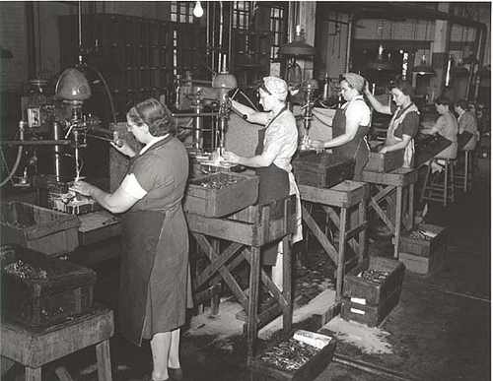
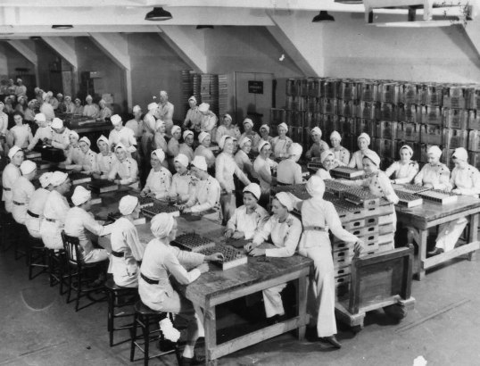
Other roles
Flexible working hours and nurseries soon became commonplace to accommodate the needs of working women. Women worked in ship building, manufacturing, on the railways, canals and on buses. Women built Waterloo Bridge in London.

Slide 11
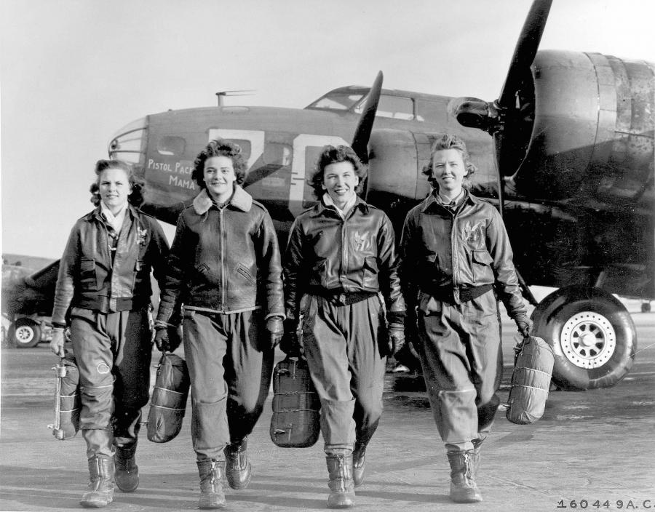
Women in 1945 at the end of the war
Recruitment posters showed women as glamorous and independent, and images of women, especially in uniform, were used to sell everything from cigarettes to shoes.
Why do you think this is?
Women's contributions to the war effort were highlighted in newspapers and magazines, and auxiliary forces paraded regularly through towns. As the war ended, however, printed publications took for granted the return of women to the home.

Slide 12
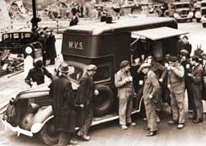
Women in 1945
It was understood throughout the war that what Britain's women were doing was really 'a man's job'. So many of them were dismissed from their work once peace was declared.
Government policy encouraged men to return to their pre-war occupations, and wartime nurseries were closed.
For lots of women, this was difficult. They had got used to working and leading independent lives, and they were keen for the liberation of women to continue.
However, recognition of the contribution of the auxiliary forces came quickly, after the war was over, with the creation of permanent women's forces in 1949.
And post-war food shortages meant that the Women's Land Army continued until 1950.

Slide 13
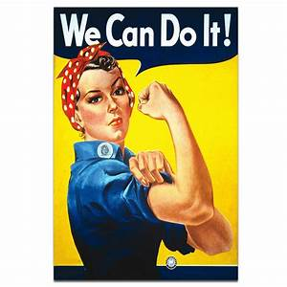
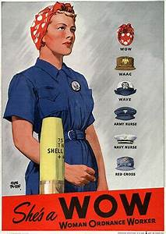
Women in 1945
Imagine yourself in the place of a woman, who had done so much to help the war effort, and once war was over, you were told to go back to your previous life of being a ‘housewife’ doing ‘women’s work’.
Think of a phrase or a slogan that expresses your emotions. The best examples will be written on the flip chart.
After we did so much…
We have had independence and we…
We demand…

Slide 14
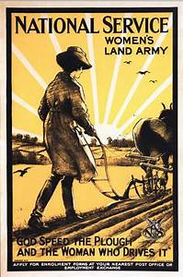
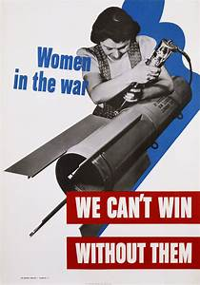
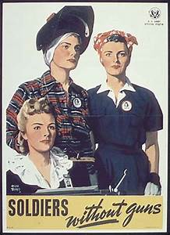

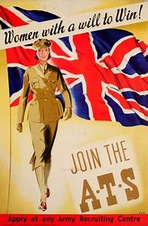
Task:
Create your own poster showing the work women did in World War Two – include a slogan expressing your pride at your contribution, making a demand for better treatment after the end of the war, or both.

Slide 15
Plenary
How has the role of women changed in today’s society?
If another war was to happen, what role would women play?

