Slide 1
L.O: To build an overview of world history.
C: Nazi anti-Semitism and the Holocaust.

Slide 2
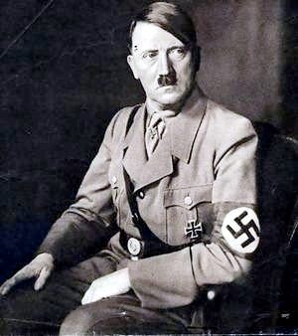
The war was especially traumatic for some sections of humanity – different people were targeted for their culture, race and ethnic origin.
Tell your partner who you think Hitler and the Nazis targeted and explain why.

Slide 3

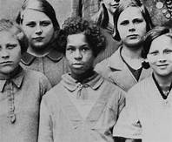
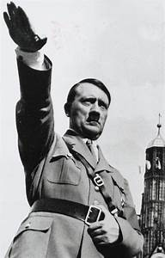
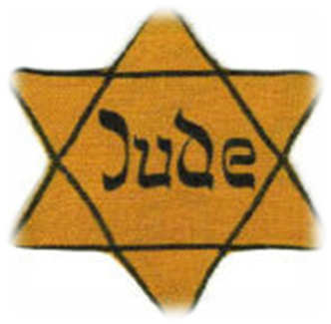
Gypsies (Roma) – they were ‘racially inferior’.
The disabled – they would produce ‘unfit’ children who would be burden to society.
Polish – they had defeated them in 1939. Therefore, they were classed as ‘inferior’ to Germans.
Black people – they would ‘pollute’ the pure German blood if they mixed with Germans.
Criminals of any sort – they were not obedient and lacked discipline.
Homosexuals – this was a criminal act and they would not aid the proliferation of
the German race.
Communists – their political beliefs were a danger to Germany.
Jewish people – their ‘ultimate enemy’.

Slide 4
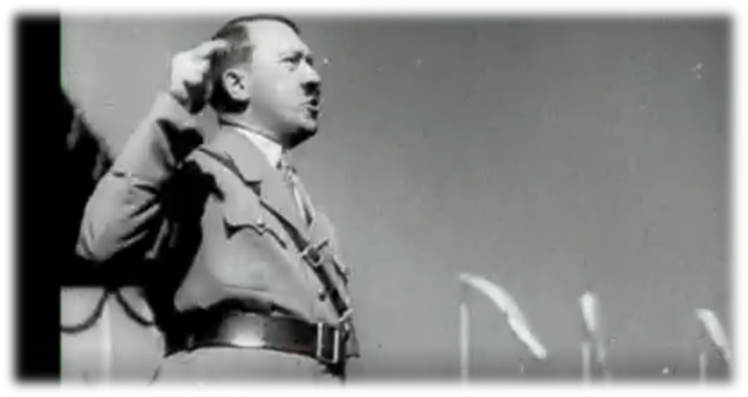
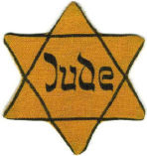
Adolf Hitler believed that German Aryans, who were white with blond hair and blue eyes, were the ‘master’ race and that all other people were lesser races. It was Hitler’s plan to get rid of as many of these lesser races as possible to make Germany great again. He wanted Germany to be a pure Aryan race and he particularly wanted to ‘cleanse’
Germany of all Jews.

Slide 5
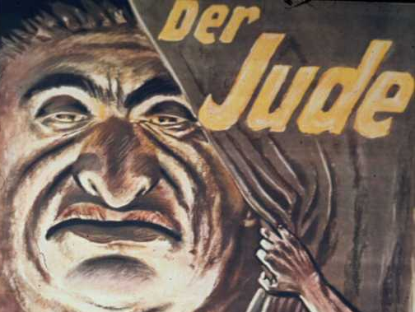
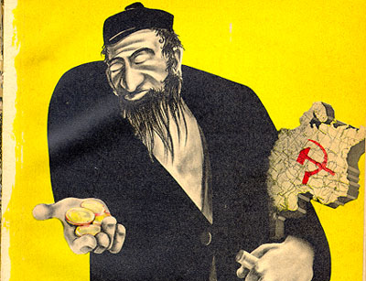
Why Did Hitler Hate Jewish People?
Hitler believed that Jews were to blame for Germany’s problems.
He blamed them for :
1: His failure to get into art college.
2 : Taking the jobs of ‘real Germans’
when he was unemployed, penniless and homeless.
3:Being part of the Communist conspiracy to take over Germany.

Slide 6
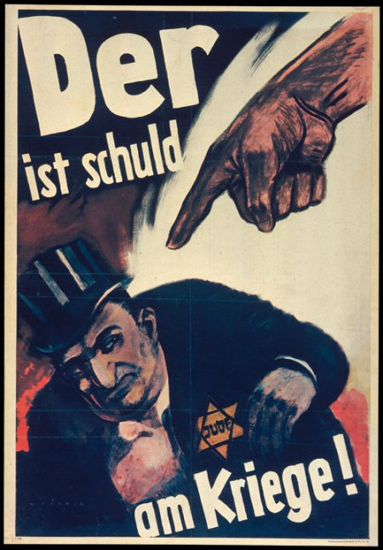
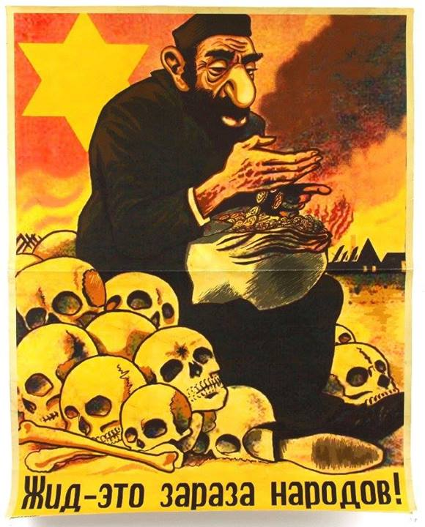
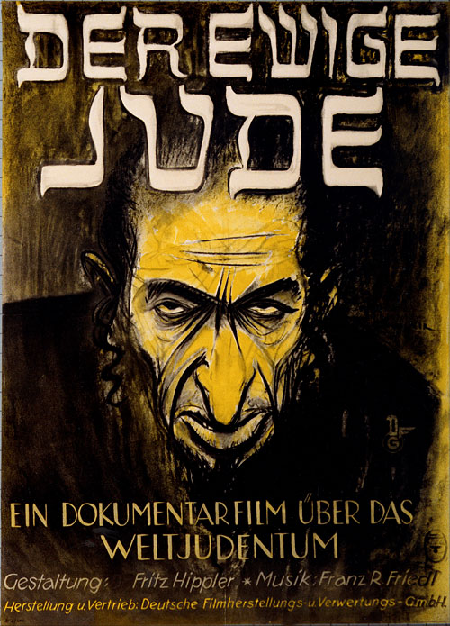
P
R
O
P
A
G
A
N
D
A

Slide 7
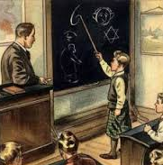
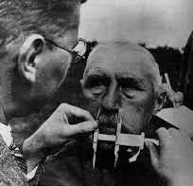
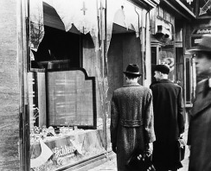
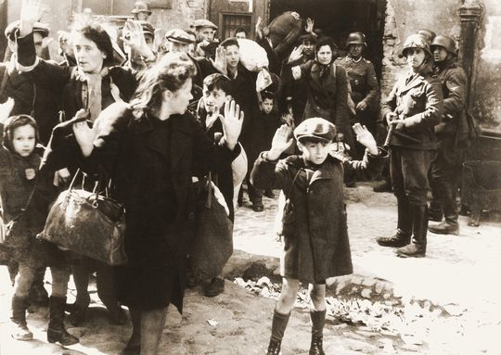
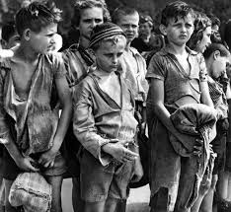
Escalating Persecution
The Nazis anti-Semitic ideas were clear.
Once Hitler took power in 1934, he began to act on his plans to eliminate Jews from German society.
As the Nazi dictatorship strengthened measures taken against the Jews would get more and more severe.

Slide 8
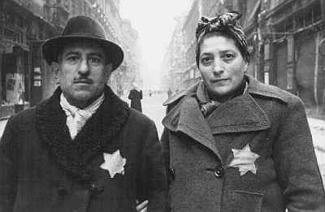
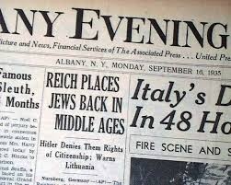
The Nuremberg Laws: 1935
After becoming the undisputed leader of Germany in 1934, Hitler and the Nazis immediately began to discriminate and persecute the Jewish population throughout Germany.
The Nuremberg Laws ordered all Jews to be registered and wear a Star of David whenever in public.
Jews were removed from key jobs and political positions and forbidden from marrying ‘pure Germans’.

Slide 9
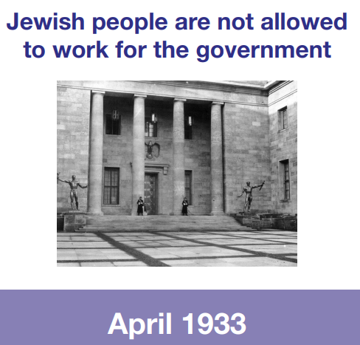
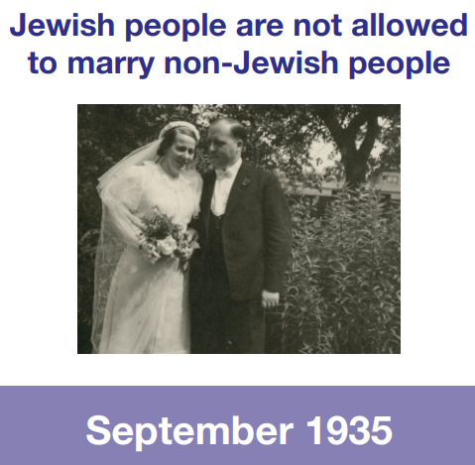
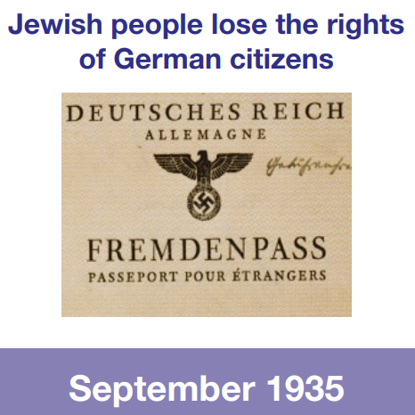
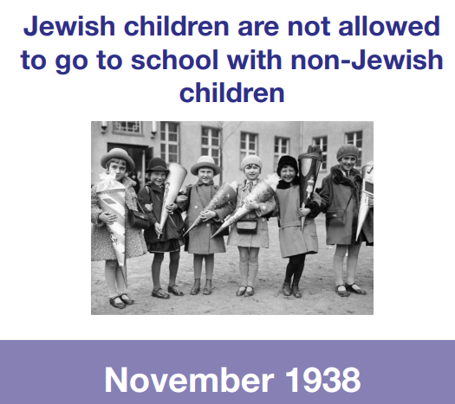
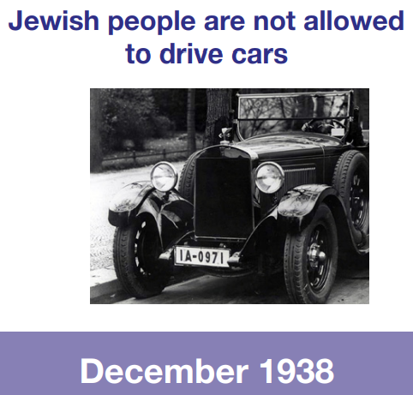
Some of the laws aimed at the German Jewish population

Slide 10
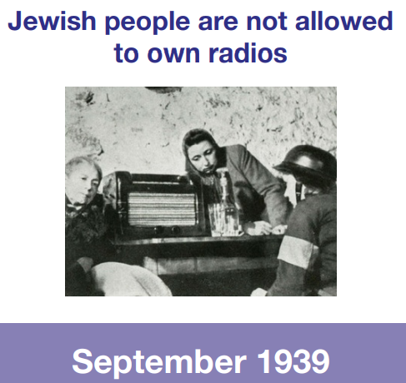
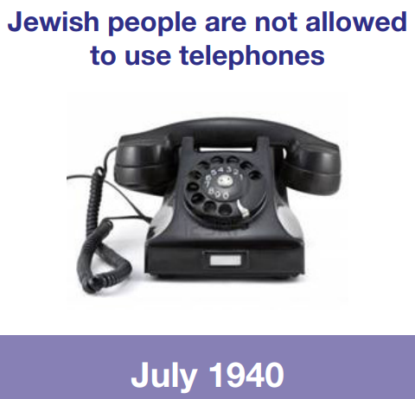
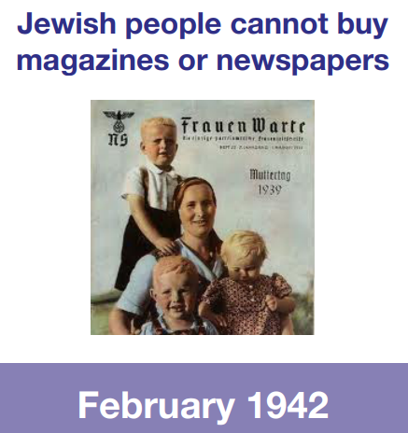
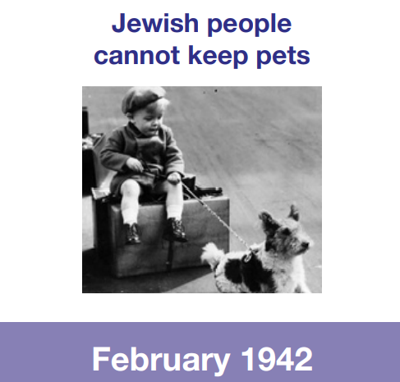
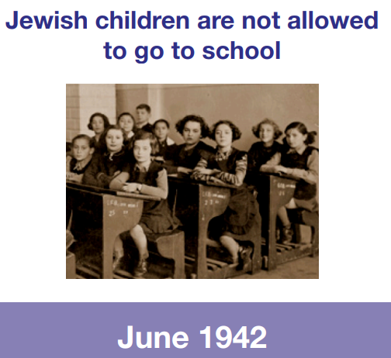
Some of the laws aimed at the German Jewish population

Slide 11
What do you notice about these laws? What are their aims?

Slide 12
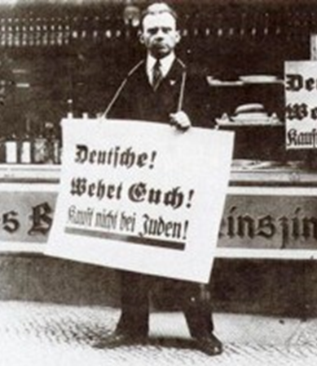
As soon as Hitler came to power, he began making life difficult for Jews. Jewish shops were marked with the star of David so that people wouldn’t shop in them.
And then, in November 1938, a Jewish boy murdered a German officer in France. This was used as an excuse to attack the Jews.
In one night, over 1000 synagogues were burned, and Jewish homes, schools and shops were vandalized. Lots of Jews were killed.

Slide 13
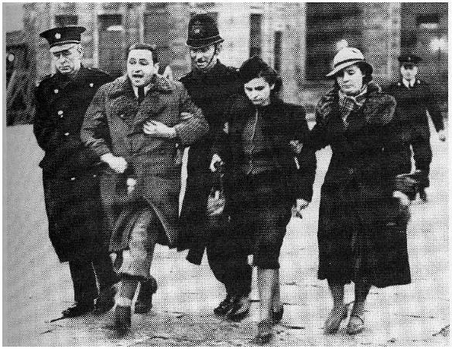
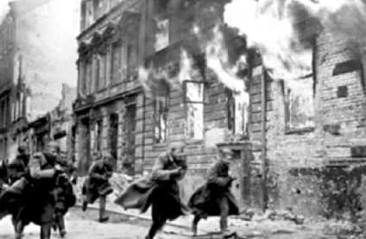
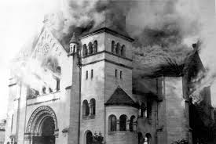
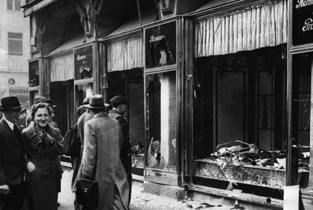
This was known as Kristallnacht : Nov 1938
SS men started the attacks on the 9th of November. The police were ordered not to stop this. Over two days and nights more than 1,000 synagogues and 7500 business were burned or damaged. 91 Jews were killed and 30,000 Jewish males were sent to the new concentration camps.
This event became known as Kristallnacht or ‘Crystal Night’ or ‘Night Of Broken Glass.’
This name symbolised the final shattering of Jewish existence in Germany.

Slide 14
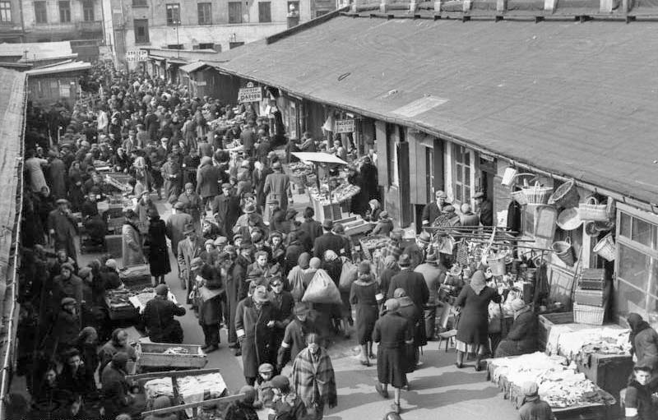
The Warsaw Ghetto
The Nazis swept across many countries in Eastern Europe and they created ghettos, essentially sealing off entire cities by building walls around them.
This was another way to kill off the Jews. The ghettos were crowded and thousands died of disease and starvation.
The largest ghetto was the Warsaw Ghetto in Poland.
There was an uprising to liberate the ghettos, but many Jews were sent to concentration camps as a result.

Slide 15
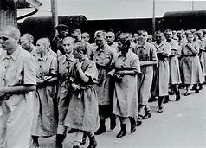
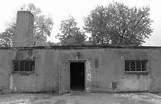
Soon, there were lots of concentration camps, where people had to work for the Nazis.
Hitler wanted to make sure his enemies wouldn’t ‘contaminate’ society. The Nazis systematically killed Jews in the concentration camps.
Many were killed in gas chambers. They were told that they would have a shower, so they undressed and went into a chamber where they would be gassed to death.
By the end of the war, more than 6 million Jews had been killed. This was known as ‘The Final Solution’.

Slide 16
Task
The thing that makes me feel angry is… because…
The thing that makes me feel sad is… because…
The thing that makes me feel scared is… because…
Red Pen: Over time, the Jewish laws became… this was because…

Slide 17
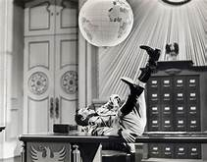
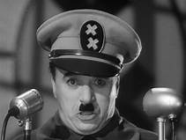
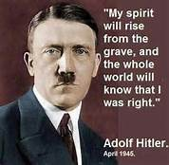
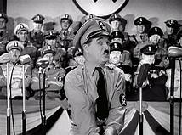
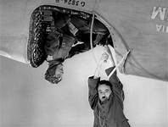
Plenary
Charlie Chaplin was a silent movie star; he made comedies. One of his most famous films is called ‘The Great Dictator’. He made this in 1940, at the height of the war. He played Hitler as a buffoon: a silly, comic character. Once he learned the full horror of what was happening (it wasn’t known for a long time), he regretted playing Hitler in this way – he was far more dangerous than ridiculous. At the end of the film, he makes a speech as Hitler, imagining Hitler regretting his actions and calling for peace.
https://www.youtube.com/watch?v=J7GY1Xg6X20

