Slide 1
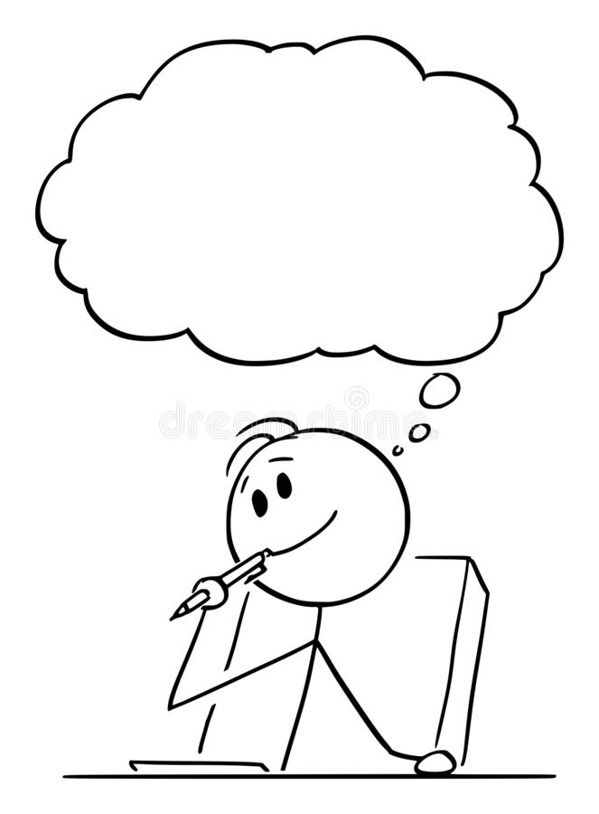
Semi-Colons
Can you remember what this writing feature is?
When should you use it?
How should you use it?

Slide 2
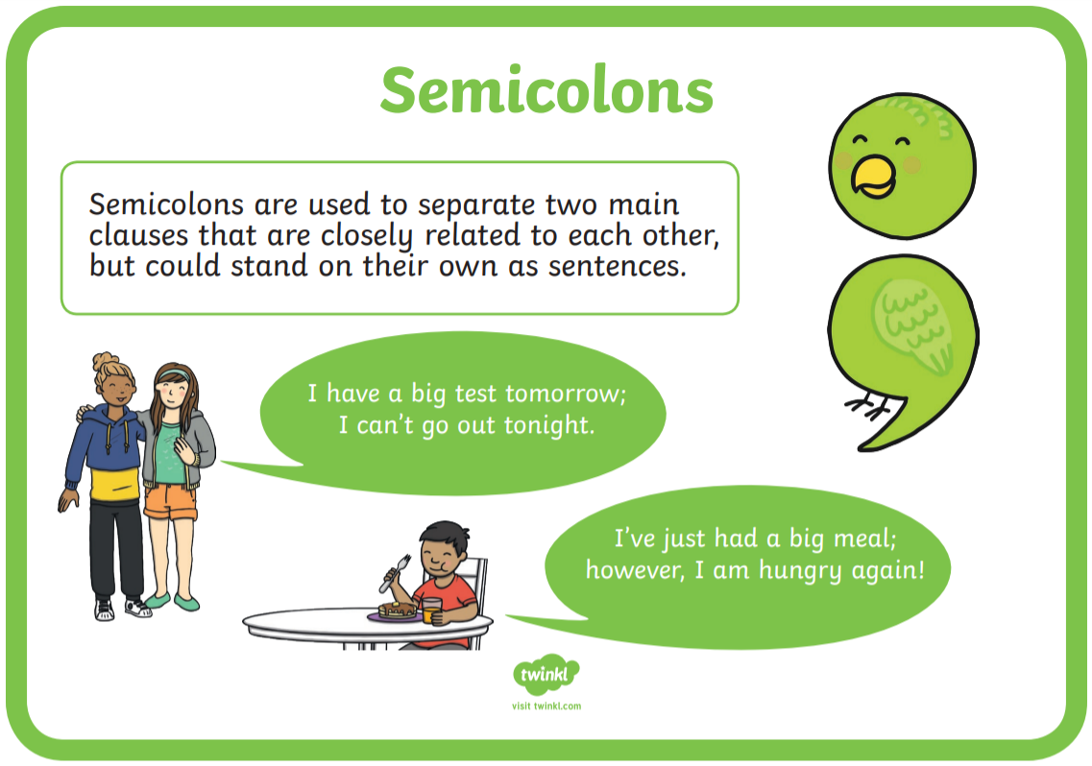
Semi-Colons
A semi-colon is a punctuation mark that is used to separate two independent (main) clauses that are closely related.
The clauses must be on the same theme and not be joined together with a conjunction; the semi-colon takes the place of the conjunction within the sentence.
It was cold; the sun was shining.
I love to sing; my brother loves to dance.

Slide 3
Commas
Can you remember what this writing feature is?
When should you use it?
How should you use it?

Slide 4
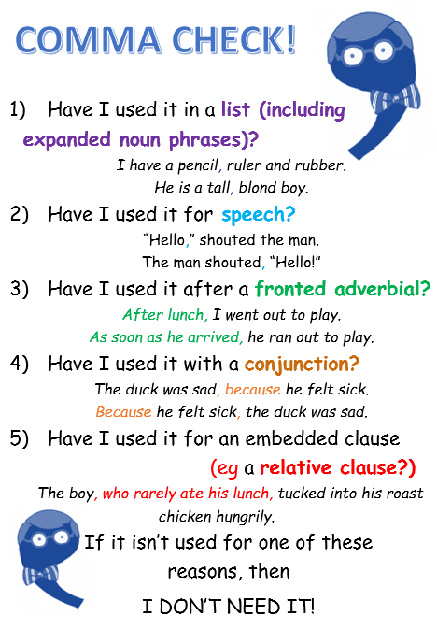
Commas
A comma is a punctuation mark that separates items in a list and marks the divisions within sentences.

Slide 5
Expanded Noun Phrases
Can you remember what this writing feature is?
When should you use it?
How should you use it?

Slide 6
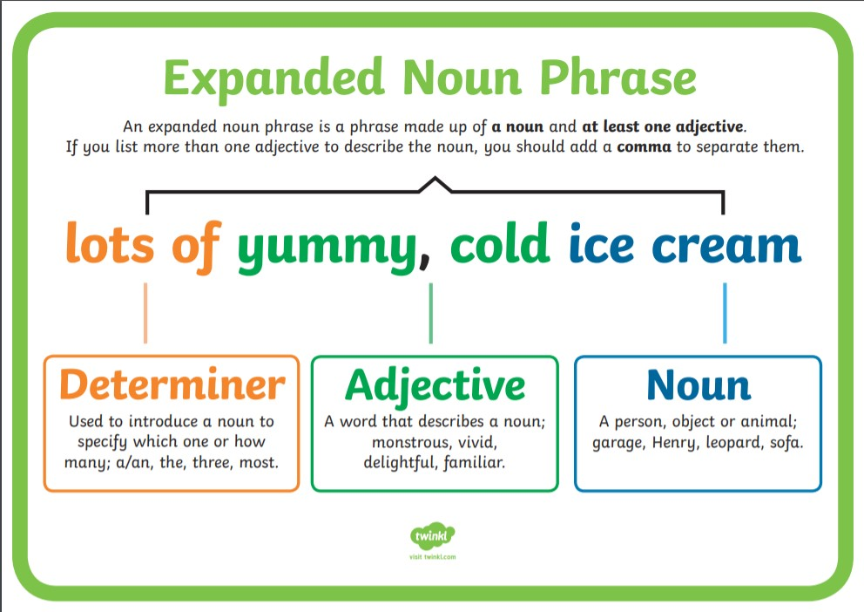
Expanded Noun Phrases
Expanded noun phrases tell you more about the noun.
It is a phrase made up of a noun and at least one adjective.
If you list more than one adjective to describe the noun, you should add a comma to separate them.
A determiner is needed to introduce a noun to specify which one or how many.

Slide 7
Simple, Compound and Complex Sentences
Can you remember what this writing feature is?
When should you use it?
How should you use it?

Slide 8
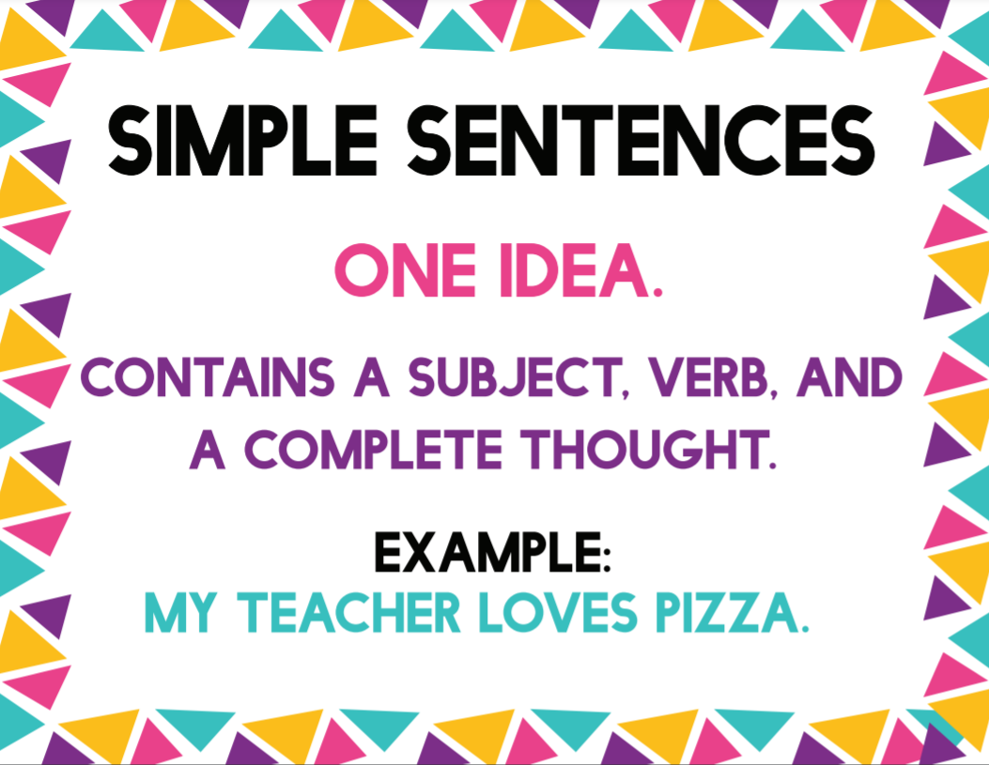
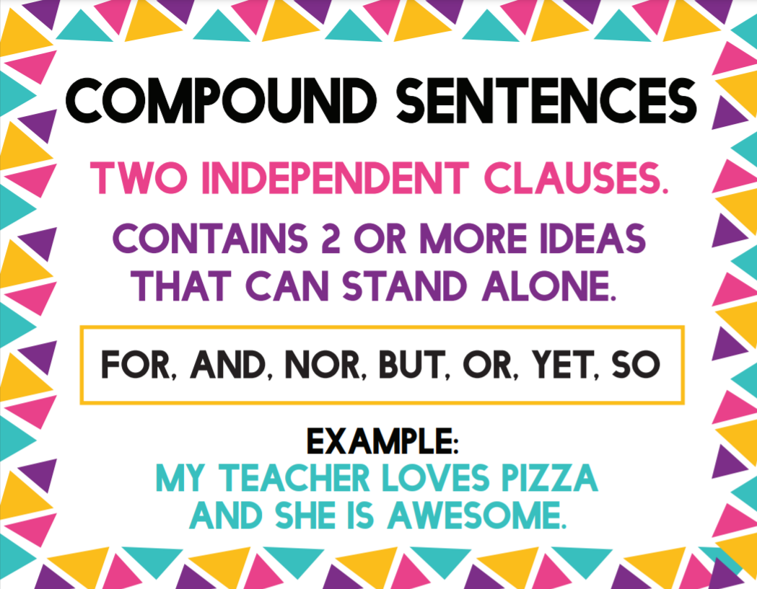
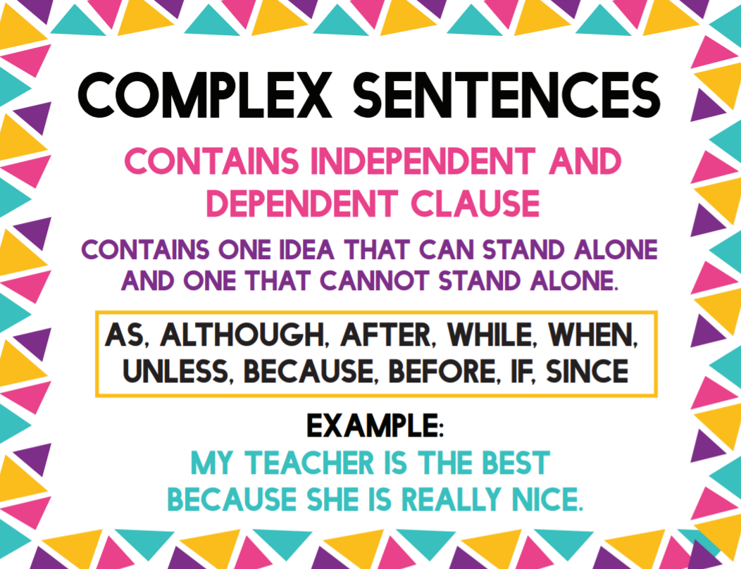
Simple, Compound and Complex Sentences
A simple sentence has just one clause.
A compound sentence joins simple sentences together with coordinating conjunctions.
A complex sentence joins clauses together using subordinating conjunctions.

Slide 9
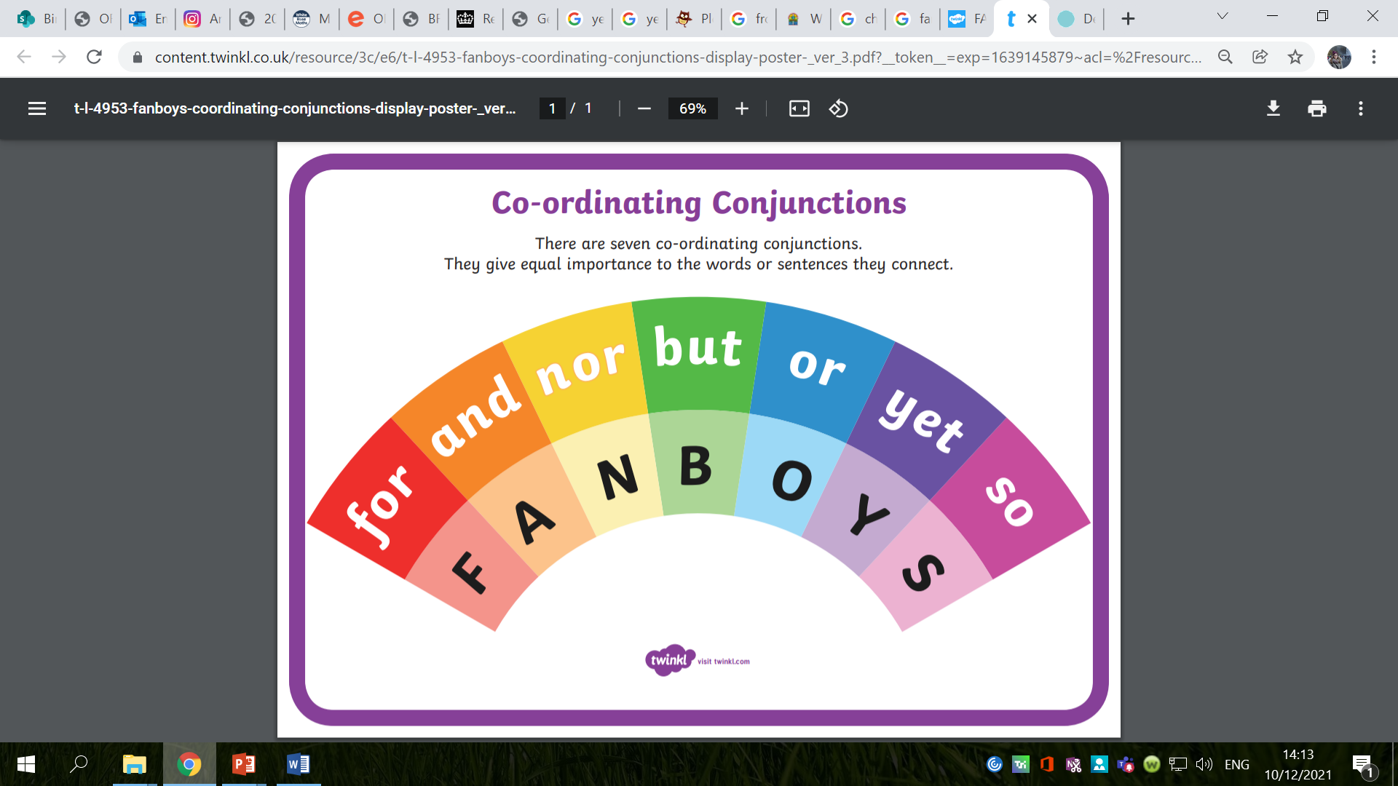

Slide 10
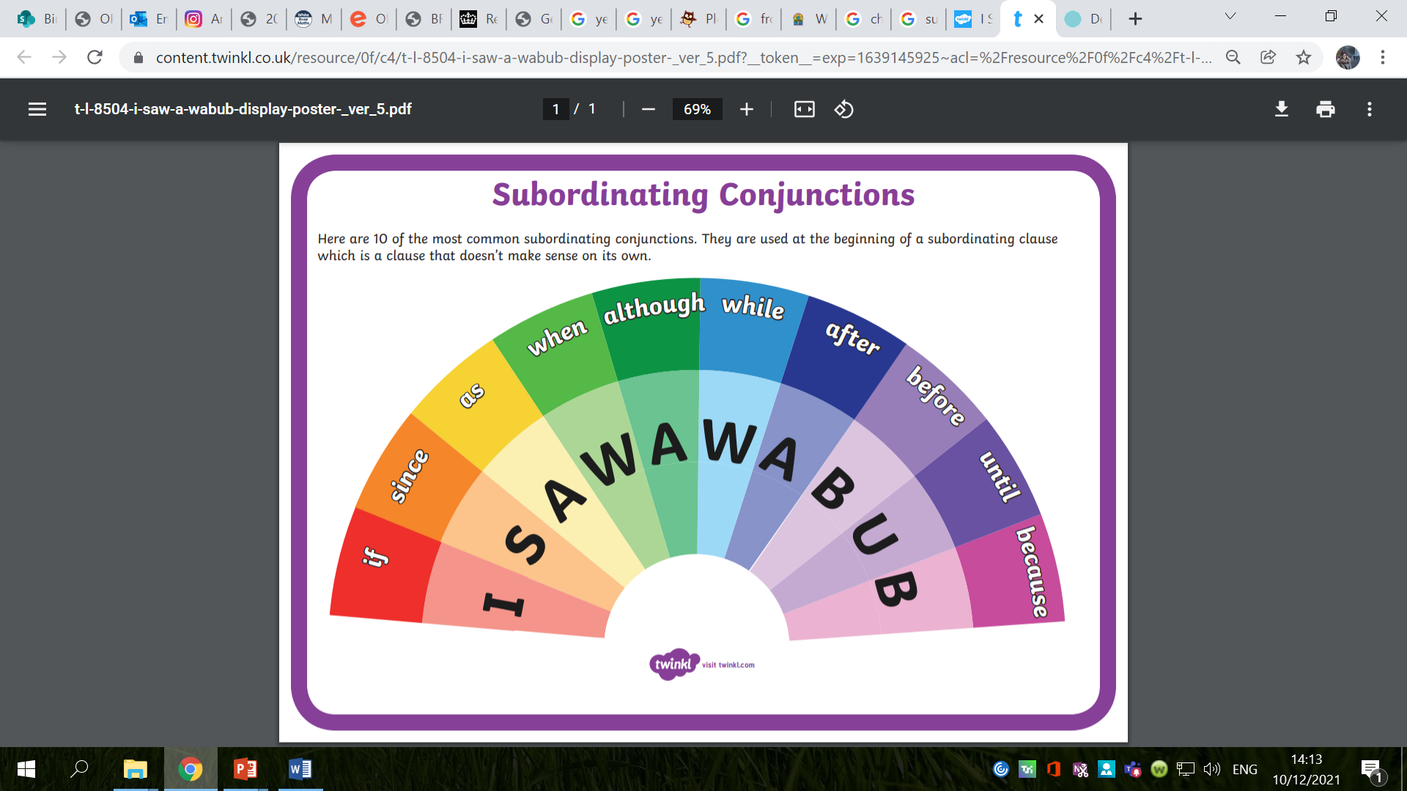

Slide 11
Adverbial Phrases
Can you remember what this writing feature is?
When should you use it?
How should you use it?

Slide 12
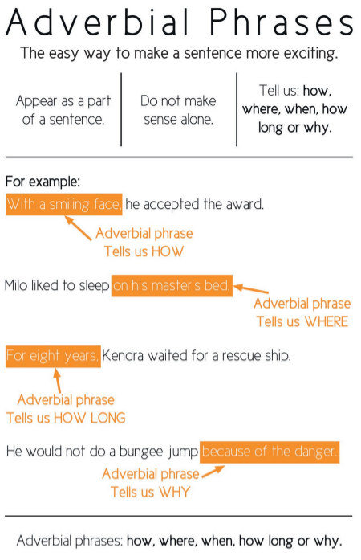
Adverbial Phrases
An adverbial phrase is like an adverb, it adds more information to the sentence, but it uses more than one word to describe the verb.
Adverbs and adverbial phrases can describe how, when or where a verb is done.

Slide 13
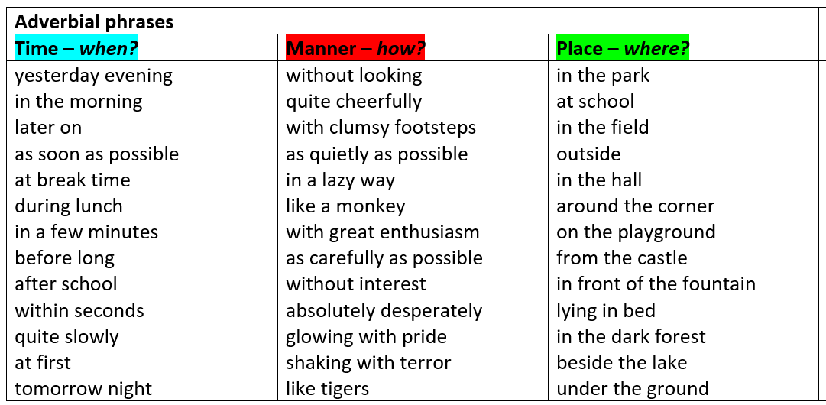

Slide 14
Colons
Can you remember what this writing feature is?
When should you use it?
How should you use it?

Slide 15
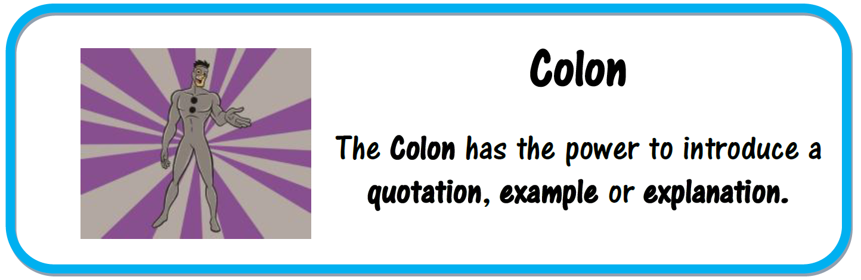
Colons
A colon is a punctuation mark that can be used to introduce a list or to separate two independent but linked clauses.
Colons are used to stress that both clauses in the sentence are closely linked and the second clause emphasises, adds clarification, or adds further detail to the first clause.
They can also be used to introduce a list.
Colons often introduce an explanation. The phrase the comes after the colon usually explains or expands on what came before it.
I love watching films after school: comedies are my favourite.
Tom hated his mum’s cooking: soggy sprouts, smelly cabbage and lumpy mashed potatoes.
He was unbelievably cold: the temperature was below freezing.

Slide 16
Relative Clauses and
Relative Pronouns
Can you remember what this writing feature is?
When should you use it?
How should you use it?

Slide 17
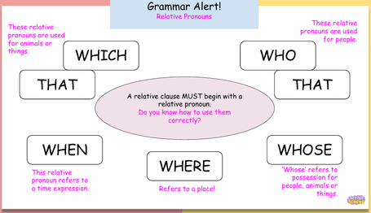
Relative Clauses and
Relative Pronouns
A relative clause is a specific type of subordinate clause that adapts, describes or modifies a noun.
It can be used to give additional information about a noun.
The relative clause is used to add information about the noun, so it must be ‘related’ to the noun.
They are introduced by a relative pronoun like 'that', 'which', 'who', 'whose', 'where' and 'when'.

Slide 18
Parenthesis
Can you remember what this writing feature is?
When should you use it?
How should you use it?

Slide 19
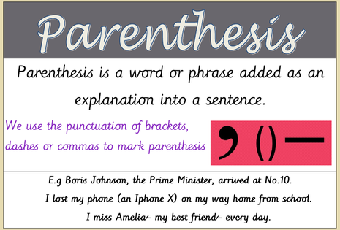
Parenthesis
Parenthesis is adding extra information to a sentence using brackets, dashes or commas.
Parenthesis adds extra information to a sentence or a paragraph but the passage should still make sense without it.

Slide 20
Passive Voice
Can you remember what this writing feature is?
When should you use it?
How should you use it?

Slide 21
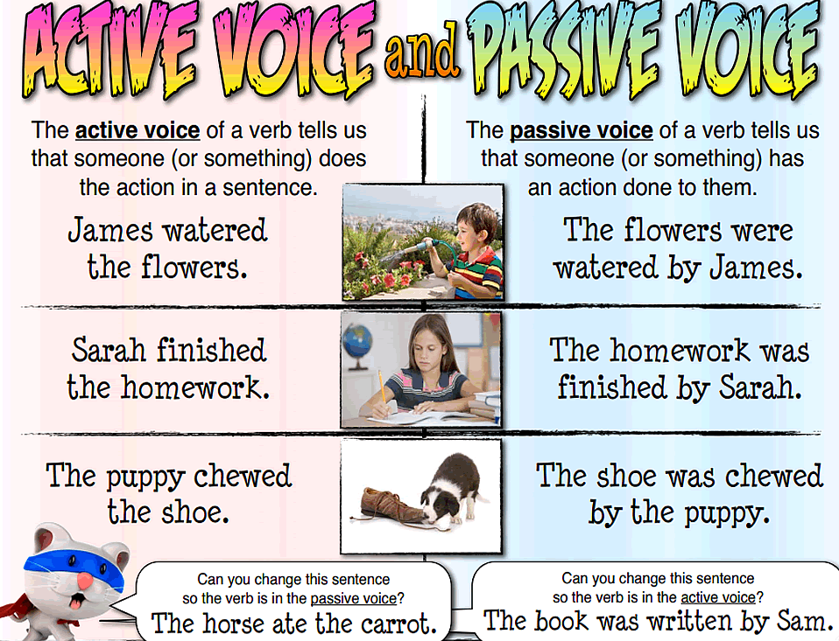
Passive Voice
A sentence is written in passive voice when the subject of the sentence has something done to it by someone or something.
The mouse was being chased by the cat.
The Christmas dinner was eaten by the children.
Top Tip: If you can add ‘by zombies’ to the end of your sentence and it makes sense – you have written in the passive voice.

Slide 22
Past Progressive Tense
Can you remember what this writing feature is?
When should you use it?
How should you use it?

Slide 23
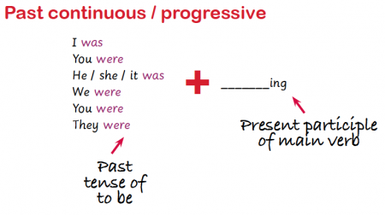
Past Progressive Tense
Where an action goes on for a period of time in the past.
The past progressive is formed by using the past for of the verb ‘to be’ as an auxiliary verb and by adding the suffix ‘-ing’ to the main verb.
My teacher was drinking a cup of tea.
We were making friendship bracelets all afternoon.

Slide 24
Perfect Form of Verbs
Can you remember what this writing feature is?
When should you use it?
How should you use it?

Slide 25
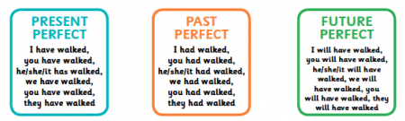
Perfect Form of Verbs
The 'perfect' tenses (present perfect, past perfect and future perfect) are usually used to talk about actions that are completed by the present or a particular point in the past or future.
To form the perfect tense we use the present / past / future form of the verb to have and the past participle of the main verb (I have walked / I had walked / I would have walked).

Slide 26
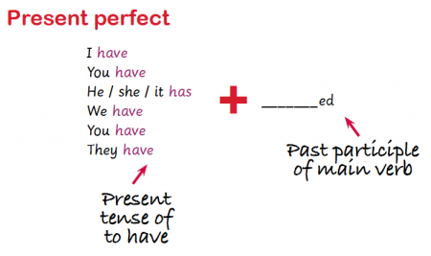
Present Perfect Tense
We use the present perfect tense to talk about our experiences in a way that does not refer to when they happened:
I have never been abroad.
We also use this tense to talk about an action which started in the past and is continuous up until now:
I have been a doctor for ten years.
We also use this tense to talk about something that has happened in the past but has a result in the present:
I have lost my passport.
(The result in the present is that I don't have my passport).

Slide 27
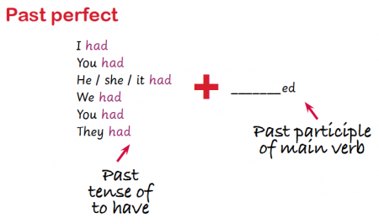
Past Perfect Tense
The past perfect is used to talk about an event that was completed in the past before something else happened:
I had just finished cooking the meal when my guests arrived.
I didn't want to watch the film, as I had already seen it.

Slide 28
Adverbs
Can you remember what this writing feature is?
When should you use it?
How should you use it?

Slide 29
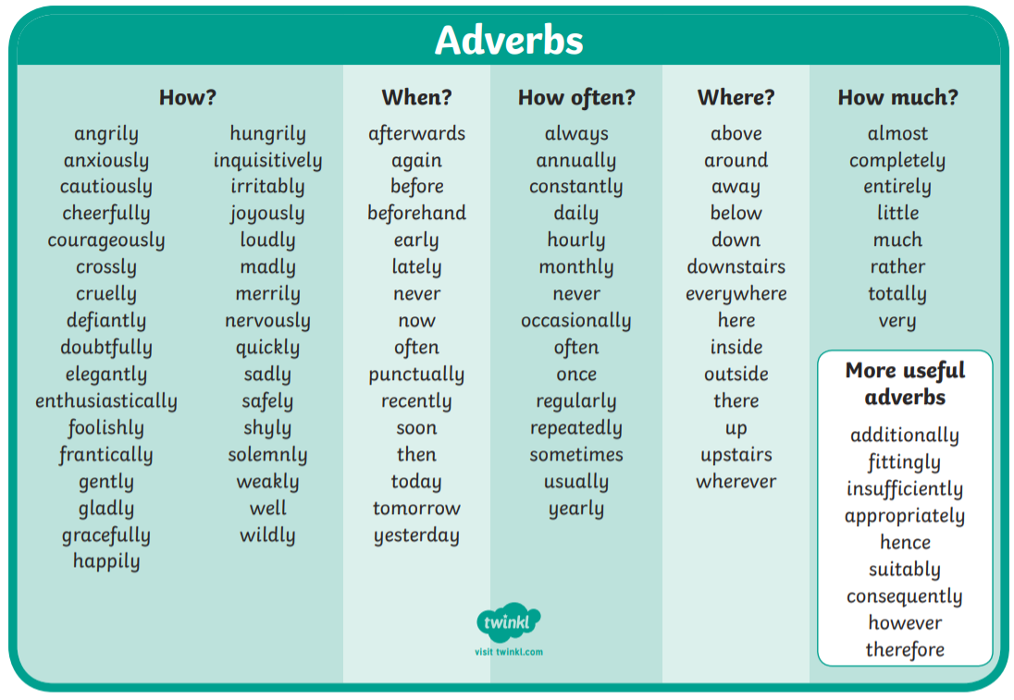
Adverbs
An adverb is a word that describes a verb (an action or a doing word). It tells you how, when, where or why something is being done.
Adverbs often end in -ly but not always! Exceptions include: fast, never, well, very, now, yesterday, here, there.
Adverbs can come before or after a verb. By changing the place of adverbs in sentences it makes a piece of writing more interesting to read.

Slide 30
Question Tags
Can you remember what this writing feature is?
When should you use it?
How should you use it?

Slide 31
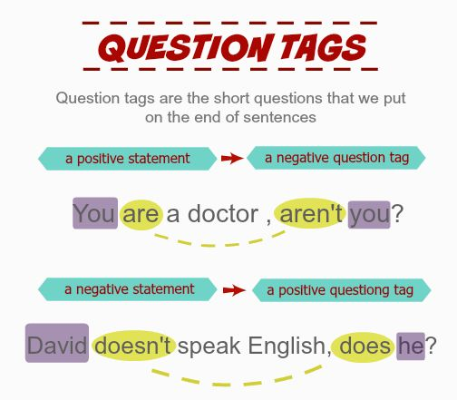
Question Tags
When a question is added to the end of a statement.
If the statement is positive, the question is negative, e.g. You can ski, can’t you?
If the statement is negative, the question tag is positive, e.g. Eddie doesn’t like spiders, does he?
Question tags are separated from the statement with a comma.

Slide 32
Prepositions of Place and Time
Can you remember what this writing feature is?
When should you use it?
How should you use it?

Slide 33
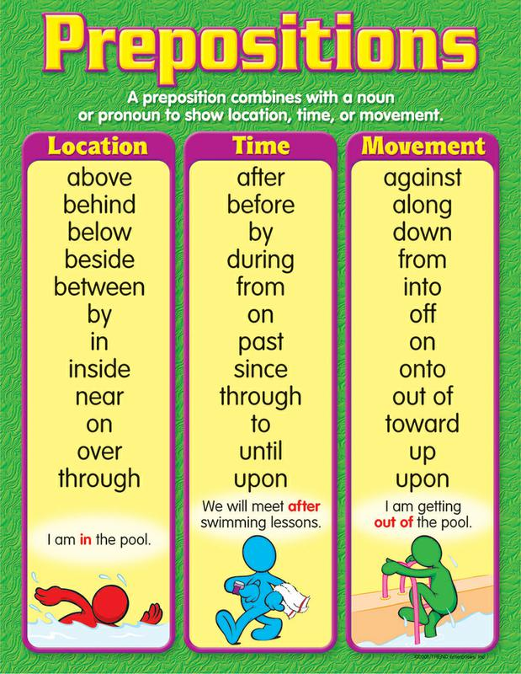
Prepositions of Place and Time
A preposition is a word that tells you where or when something is in relation to something else.
We use prepositions to explain where things are in time or space.
Prepositions tell us where something is (for example, beside, under, on, against, beneath or over) or when something is happening (e.g.: until, during, after, before or more specifically 'on Christmas Day', 'at twelve o'clock' or 'in August').

Slide 34
Possessive Apostrophes
Can you remember what this writing feature is?
When should you use it?
How should you use it?

Slide 35
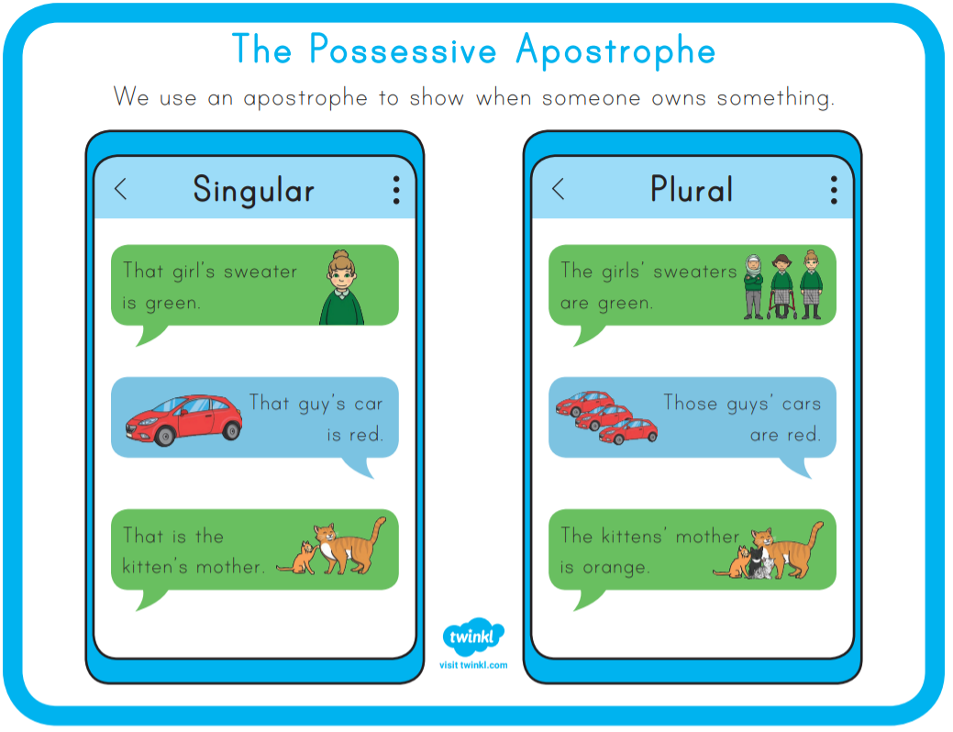
Possessive Apostrophes
An apostrophe used to show that one thing belongs to or is connected to something.
Singular noun not ending in s – add an apostrophe and s
Singular noun ending in s –
just add an apostrophe
Plural noun ending in s –
just add apostrophe
Plural noun not ending in s –
add an apostrophe and s

Slide 36
Fronted Adverbials
Can you remember what this writing feature is?
When should you use it?
How should you use it?

Slide 37
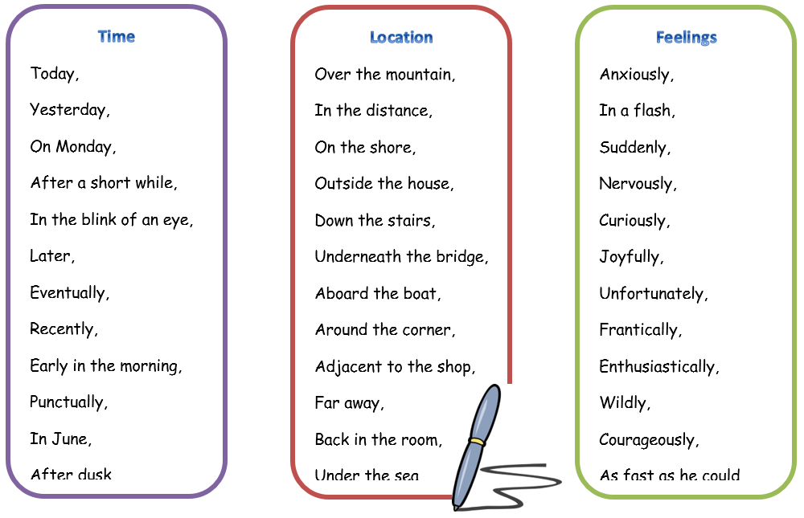
Fronted Adverbials
Adverbials are words or phrases that give more information to the sentence.
A fronted adverbial is when the adverbial word or phrase is moved to the front of the sentence, before the verb.
Earlier today, I discovered fronted adverbials.

