Slide 1
Tuesday 14th December 2021
LO: To write with purpose.
To use sentences appropriately.
To punctuate accurately.
C: Christmas Recap

Slide 2
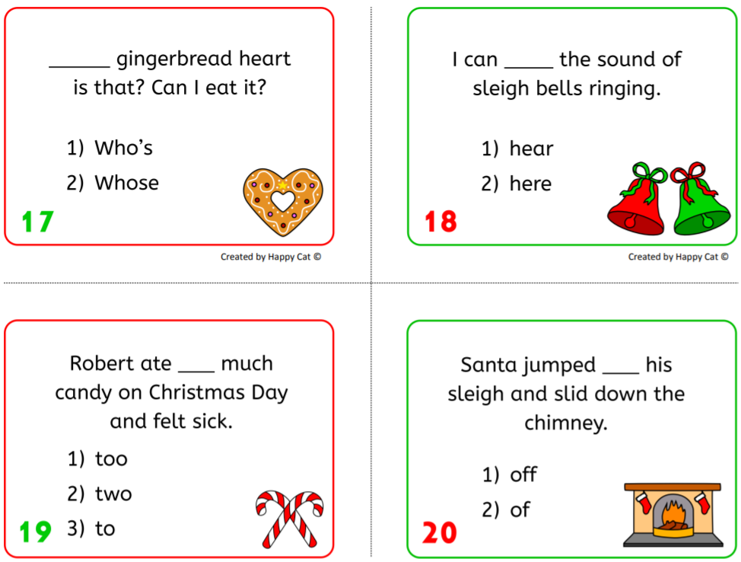
Starter
Homophones are words which are spelt and pronounced the same but have different meanings.
Choose the correct homophone to complete the Christmas sentence!

Slide 3
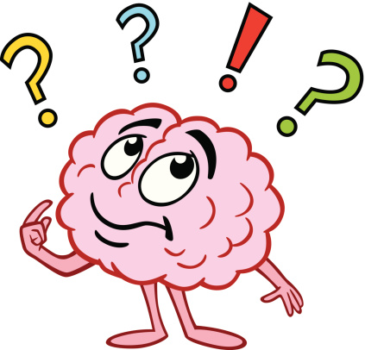
How many different features of writing have we learned or look at this year?
Create a bubble map of our ideas!

Slide 4
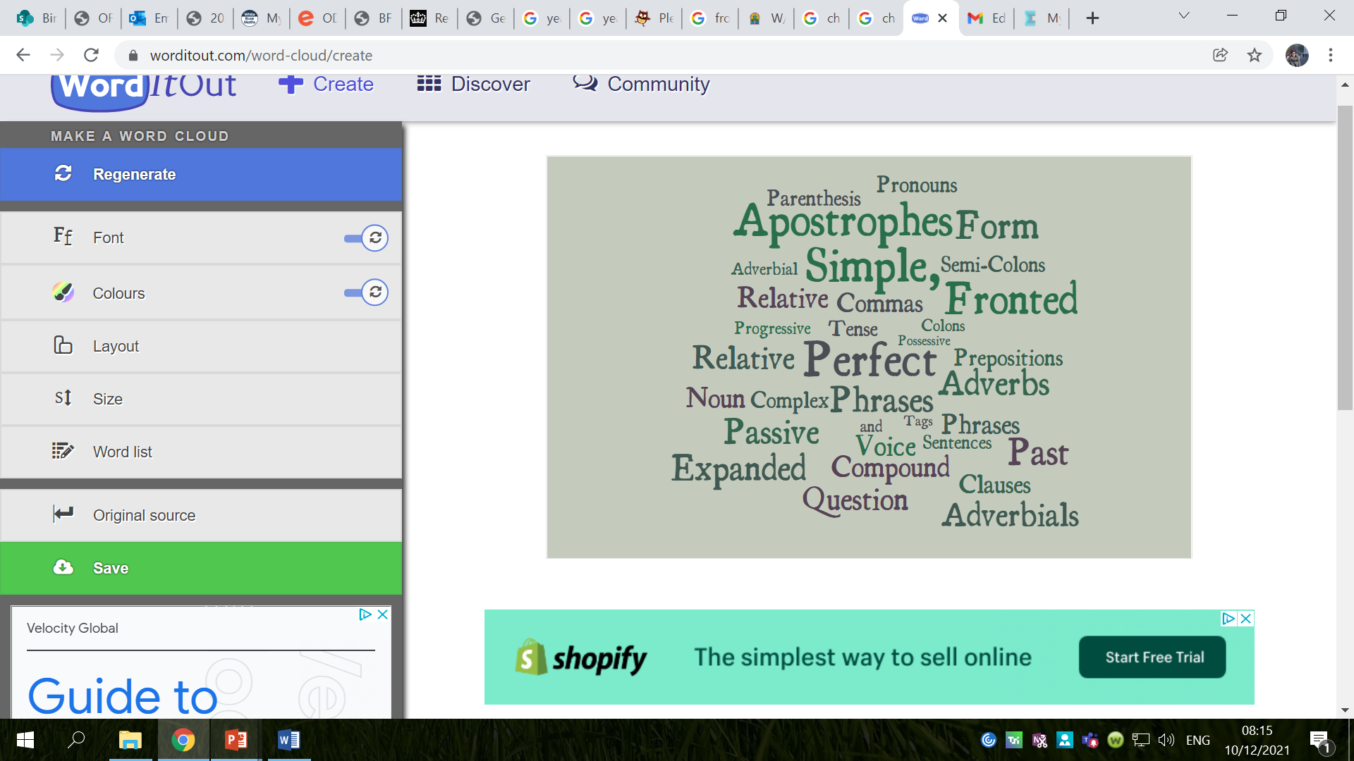

Slide 5

We are going to be writing sentences about Christmas today, using as many of these features as we can to show off our learning from this term.

Slide 6
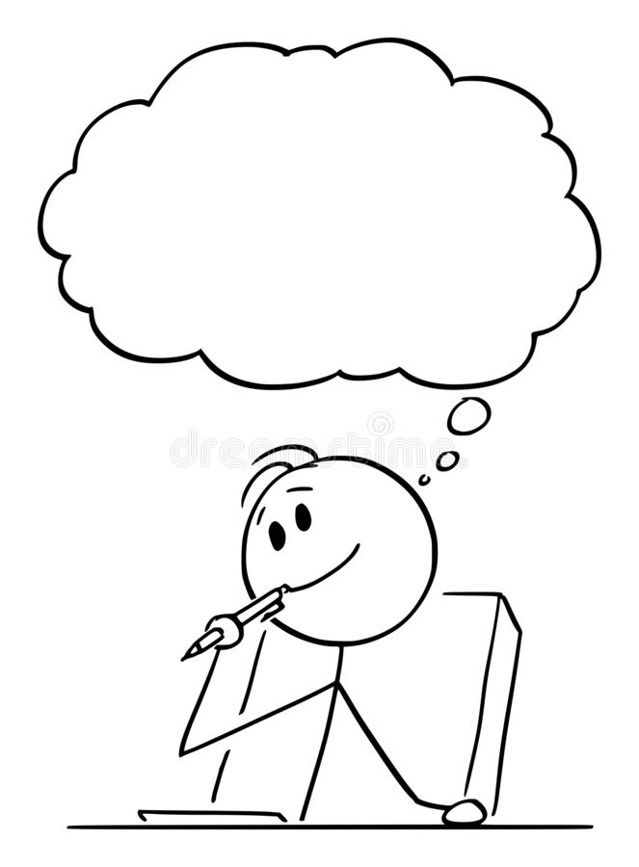
Can you remember what the writing features are?
When should you use it?
How should you use it?
If you are unsure – search for the writing feature on Century Tech and complete the nugget(s) to help you!
You can also look at the ‘English Help’ PowerPoint on our class page!

Slide 7
Activity
Write sentences about Christmas using the grammar features we have learned this term.
Snorkelling/Diving Challenge: can you use different types of sentences or different sentence starters in your work?
Red Pen:
  Can you use multiple grammar features in one sentence?
  How many grammar features can you include while still writing a cohesive, correctly punctuated sentence?

Slide 8

Plenary
Reread your sentences.
Have you used the grammar features correctly?
Do your sentences make sense?
Are your punctuated correctly?
Try to edit and improve your work!

Slide 9
Thursday 16th December 2021
LO: To write with purpose.
To use sentences appropriately.
C: Christmas Recap

Slide 10
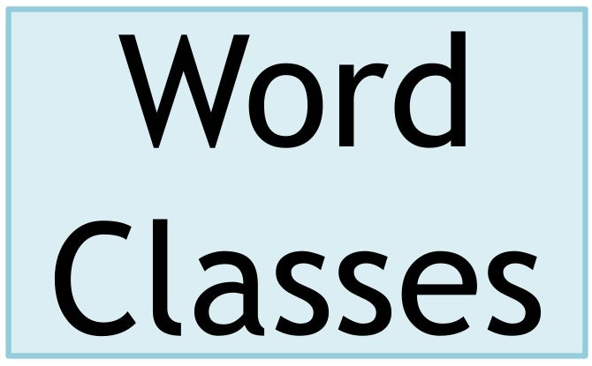
Starter
What is a ‘word class’?
Word classes refer to the different types of words that we use in a sentence. Every word belongs to a word class, which summarises how it can be used in grammar.

Slide 11
Starter
There are 8 different types of word classes. These include:
  Verbs: A verb is a word used to describe an action, state or occurrence.
  Nouns: A noun is a naming word. It is a thing, a person, an animal or a place.
  Adverbs: An adverb is simply a word that describes a verb (an action or a doing word).
  Adjectives: An adjective is a word that describes a noun.
  Determiners: Words that add detail to nouns, e.g. how many of something there is, what order they come in, or which thing is being discussed.
  Pronouns: A pronoun is a word used to replace a noun.
  Conjunctions: A conjunction connects two clauses in a sentence.
  Prepositions: A preposition is a word that tells you where or when something is in relation to something else.

Slide 12
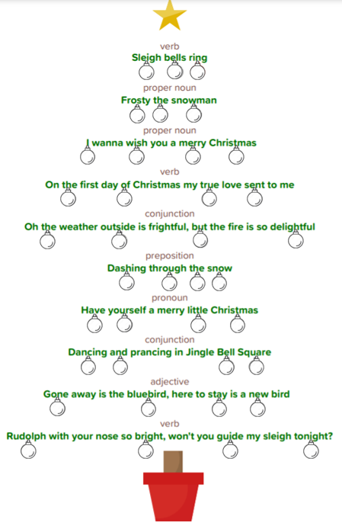
Starter
Look at the Christmas song lyrics you have been given.
Above each line, there is a word class (e.g. verb)
Find the word in the lyric that matches the word class above and colour in the bauble underneath it.
Extension: identify the word class of each word with a bauble hanging from it.

Slide 13

We are going to be writing exciting sentences today using the ‘Write Like a Ninja’ book to help us.

Slide 14

We will be using this image as a basis for our super sentences today.

Slide 15

2A – 2 Adjectives
A 2A sentence has two adjectives before the first noun, followed by two more adjectives before a second noun.
This type of sentence is useful for creating a strong visual image in the reader’s mind.
e.g. He was a tall, awkward man with an old, crumpled jacket.
It was an overgrown, messy garden with a lifeless, leafless tree.

Slide 16
Can you think of your own 2A sentence?
Make sure your sentence is structure, punctuated and spelt correctly.
Challenge: improve your vocabulary using a thesaurus.
Why are some sentences more powerful than others?

Slide 17
3---ed – Three Related Adjectives
A 3---ed sentence begins with three related words, each of which ends in -ed.
All of the words must be followed by commas.
Most -ed words for this sentence type describe emotions.
e.g. Frightened, terrified, exhausted, they ran from the creature.
Amused, amazed, excited, he left the circus reluctantly.
Confused, troubled, worried, she didn’t know what had happened.

Slide 18
Can you think of your own 3---ed sentence?
Make sure your sentence is structure, punctuated and spelt correctly.
Challenge: improve your vocabulary using a thesaurus.
Why are some sentences more powerful than others?

Slide 19
2 Pairs
A 2 pairs sentence begins with two pairs of related adjectives.
Each pair is followed by a comma and separated by the conjunction ‘and.’
e.g. Exhausted and worried, cold and hungry, they did not know how much further they had to go.
Injured and terrified, shell-shocked and lost, he wandered aimlessly across the battlefield.

Slide 20
Can you think of your own 2 pairs sentence?
Make sure your sentence is structure, punctuated and spelt correctly.
Challenge: improve your vocabulary using a thesaurus.
Why are some sentences more powerful than others?

Slide 21
Verb, Person
It is possible to start a sentence with a verb in order to give greater importance to that verb.
The verb should always be followed with a comma and then the name of a person (or a personal pronoun such as ‘he,’ ‘she,’ ‘they’ or ‘it’) and then the rest of the sentence.
e.g. Flinching, she turned quickly as the door slammed shut.
Hiding, he breathed as quietly as he could.

Slide 22
Can you think of your own verb, person sentence?
Make sure your sentence is structure, punctuated and spelt correctly.
Challenge: improve your vocabulary using a thesaurus.
Why are some sentences more powerful than others?

Slide 23
Noun: which/where/who
This sentence contains an embedded clause.
An embedded clause can be removed and the sentence would still make sense without it.
The sentence begins with a noun, followed by an embedded clause, which starts and ends with a comma.
The final part of the sentence gives some detail.
e.g. Snakes, which scare me, are not always poisonous.
My bicycle, which is covered in mud, needs cleaning with warm soap and water.

Slide 24
Can you think of your own noun: which/where/who sentence?
Make sure your sentence is structure, punctuated and spelt correctly.
Challenge: improve your vocabulary using a thesaurus.
Why are some sentences more powerful than others?

Slide 25
Ad, same ad
An ad, same ad sentence contains two identical adjectives, one repeated shortly after the other.
The first is used in the opening clause of a sentence and the second is used immediately after the comma.
Repeating adjectives like this can make them stick in the reader’s mind.
e.g. He was a smart dresser, smart because he had the money to buy the best.
She was a fast runner, fast because she needed to be.

Slide 26
Can you think of your own ad, same ad sentence?
Make sure your sentence is structure, punctuated and spelt correctly.
Challenge: improve your vocabulary using a thesaurus.
Why are some sentences more powerful than others?

Slide 27
Activity 2
Stick the image on your sheet.
For each exciting sentence type, you should write down 2 sentences.
Set your work out neatly – write and underline the name of the sentence type and then write the sentences underneath, e.g.:
2A – 2 Adjectives
He was a tall, awkward man with an old, crumpled jacket.
It was an overgrown, messy garden with a lifeless, leafless tree.
Challenge 1: Write more than 2 sentences.
Challenge 2: Experiment with vocabulary choices (using a thesaurus) to explore the strength/power of different words.

Slide 28
Red Pen
Which exciting sentence type is the most effective in your opinion?
Can you explain why?
Which sentence types were not as effective?
Why?
Did word choice have an impact on the effectiveness of the sentences?

