Slide 1
LO: to develop ideas
C: Feelings

Slide 2
What do you feel? Why?
Look at the artwork on the next few slides.
Think about the feelings they evoke.

Slide 3
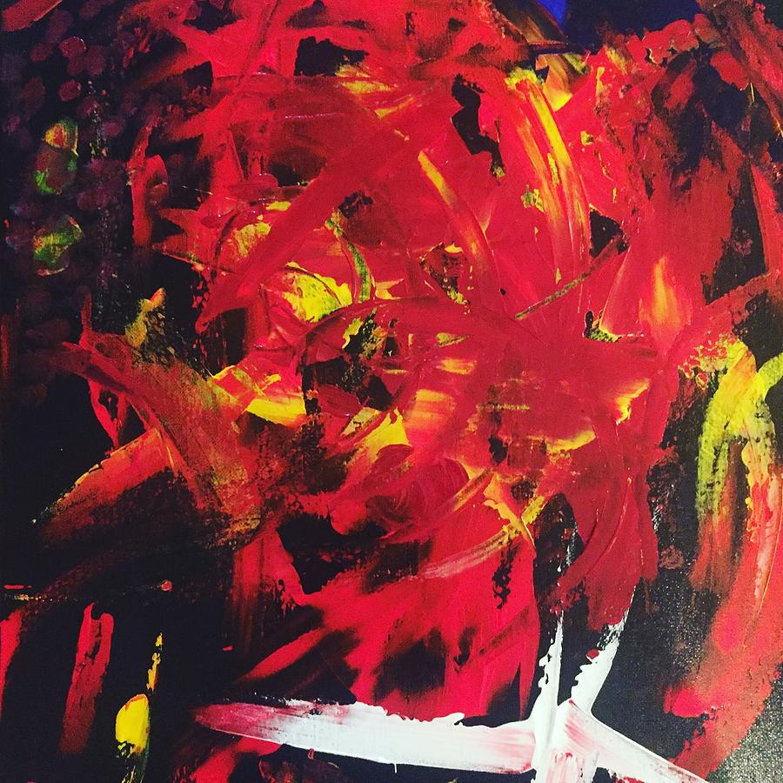
What do you feel? Why?

Slide 4
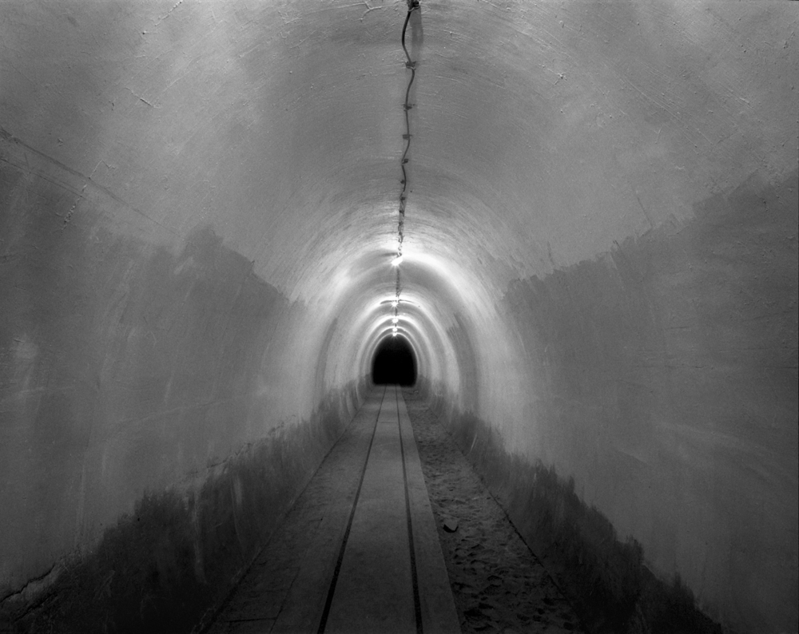
What do you feel? Why?

Slide 5
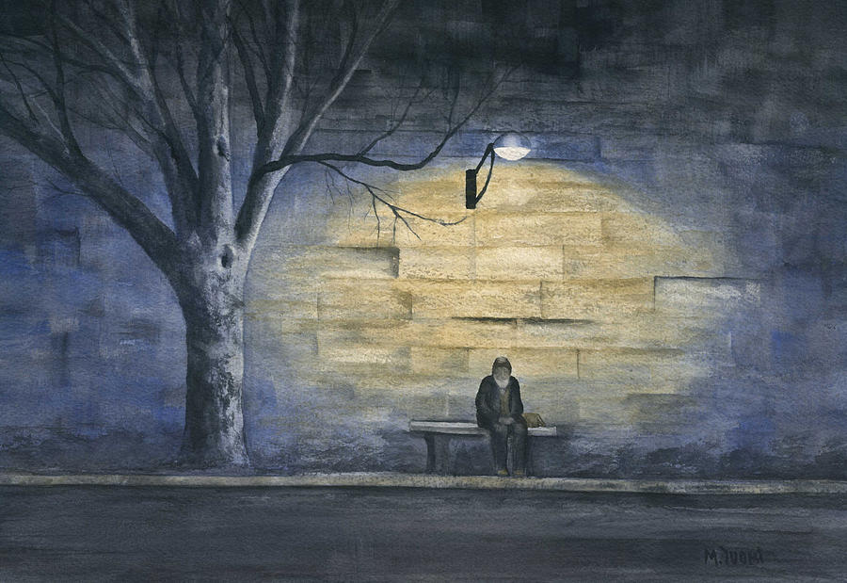
What do you feel? Why?

Slide 6
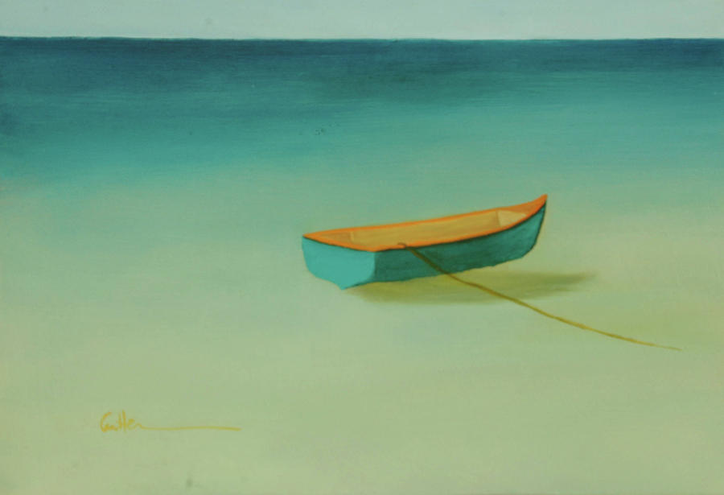
What do you feel? Why?

Slide 7
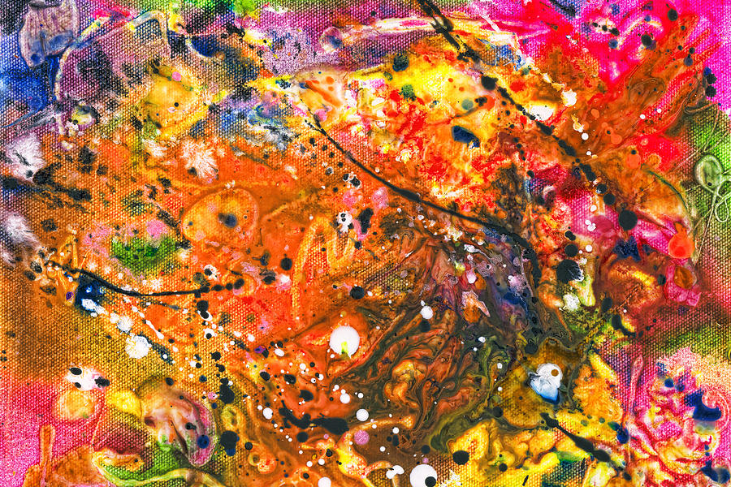
What do you feel? Why?

Slide 8
How could you show these emotions in artwork?
What? Anger Hope Fear Joy Confusion Loneliness Jealousy Calm | How? Lines Shapes Colour Darkness Texture Strokes Pressure

Slide 9
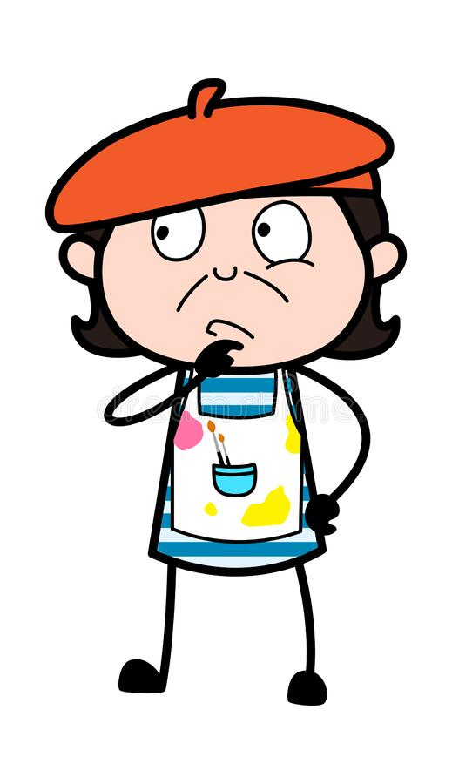
What else could you use to create different effects in your artwork?

Slide 10

Activity
Anger
Hope
For each feeling, sketch what you think that feeling would look like.
Think about:
Colour
Pressure on your pencil
The types of lines you will use etc.
Fear
Joy
Confusion
Loneliness
Jealousy
Calm

Slide 11
Plenary
In our Art topic this term, we will be studying mixed media and creating a collage on a subject we feel strongly about.
You may want to start collecting ideas, clippings and materials you think would be useful in your collage (e.g. buttons, foil, ribbon etc.)

Slide 12
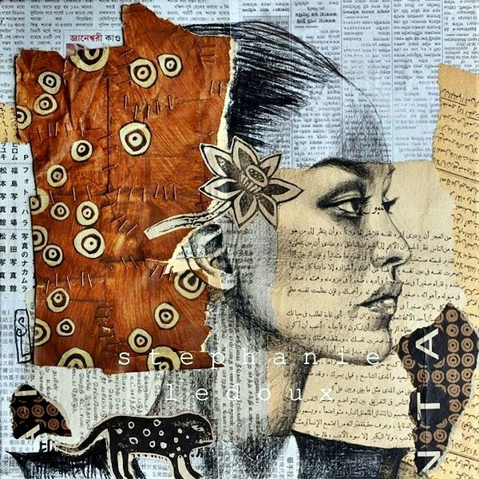
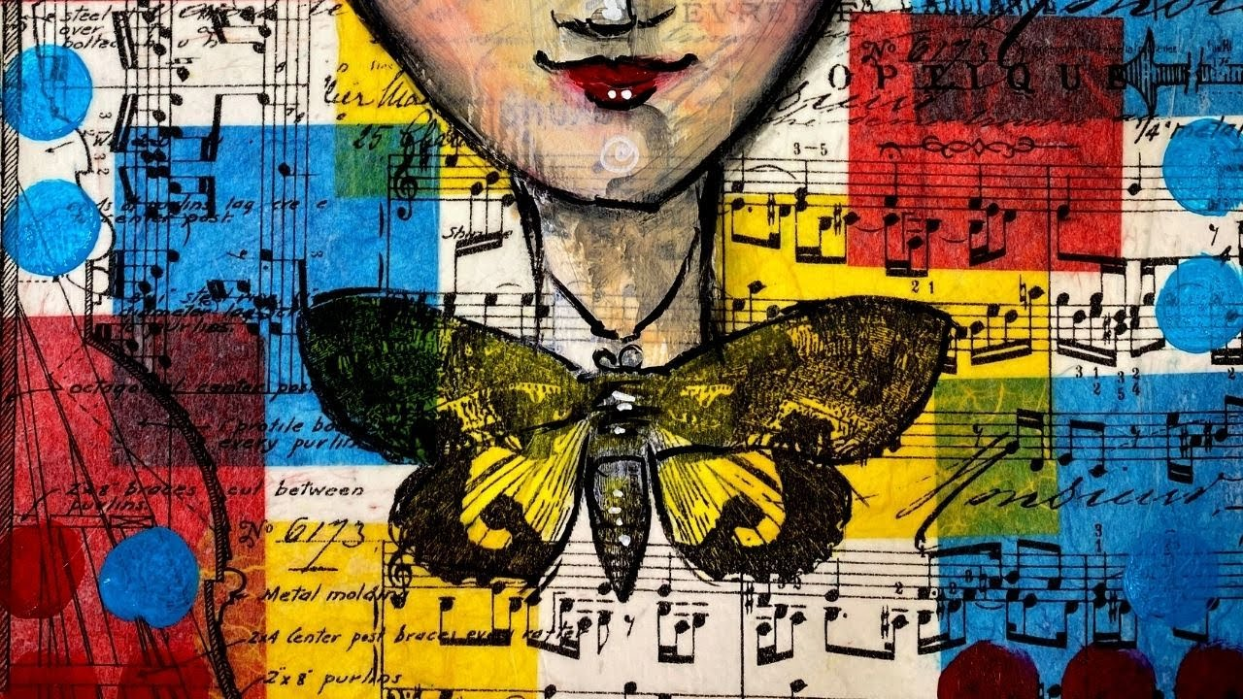
Plenary
Mixed Media: a term used to describe artworks composed from a combination of different media or materials.
Collage: a term which describes both the technique and the resulting work of art in which pieces of paper, photographs, fabric and other ephemera (things that are printed for a specific occasion or purpose and aren’t meant to last after their original use, e.g. theatre programmes, posters for events, ticket stubs, leaflets etc) are arranged and stuck down onto a supporting surface.

