Slide 1
LO: to take inspiration from the greats
C: Collage Artists

Slide 2
Collage Artists
You are going to look at some collages from famous artists around the world.
Decide what:
materials you think have been used to create the piece
techniques are the most effective and why.

Slide 3
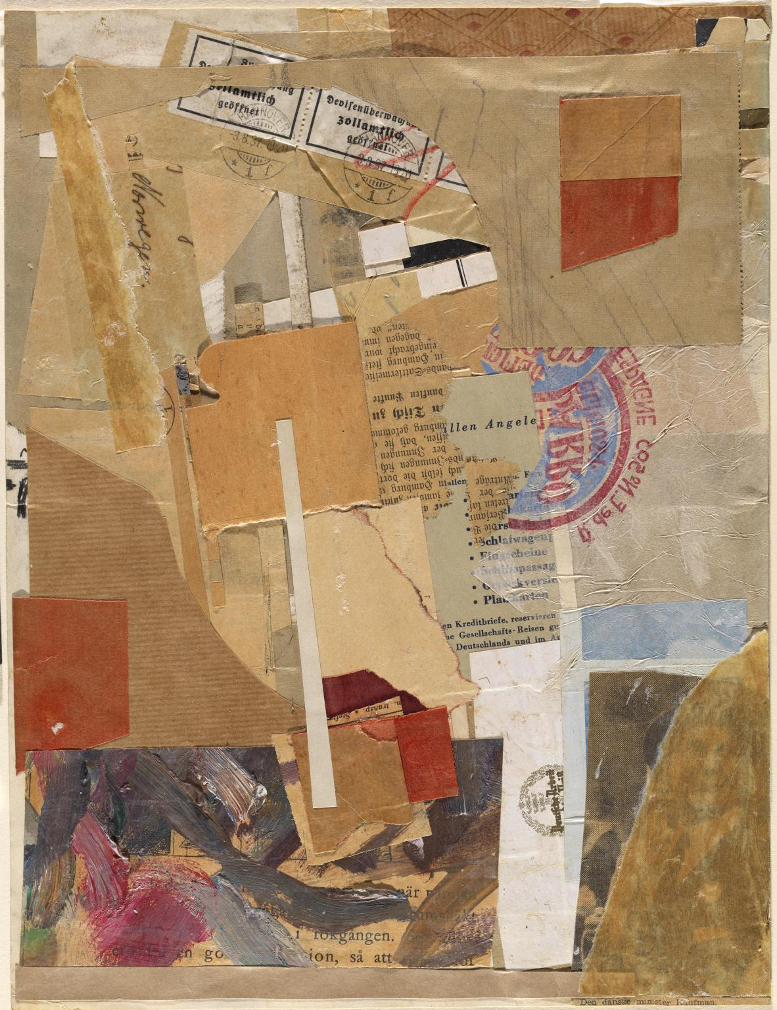
Kurt Schwitters

Slide 4
Kurt Schwitters
Opened by Customs 1937–8 is a collage made of paper, printed paper, oil paint and graphite.
The pasted-together fragments have been cut and torn from a variety of sources, including parcel paper, Nazi administrative labels, a large section of printed Norwegian text from a book or a pamphlet, a blue label for Spanish oranges (stuck face down so that the logo is seen in reverse) and a printed list of travel-related words in German, including ‘airline boarding pass’, ‘baggage insurance’ and ‘sleeper car’.

Slide 5
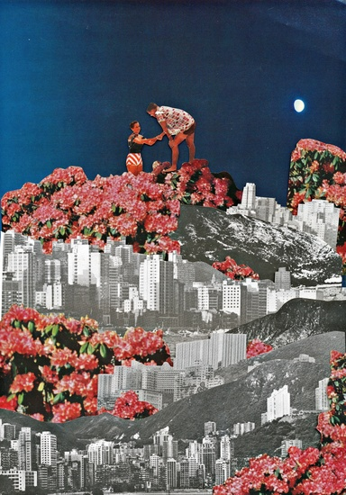
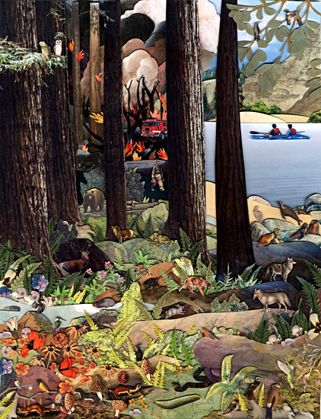
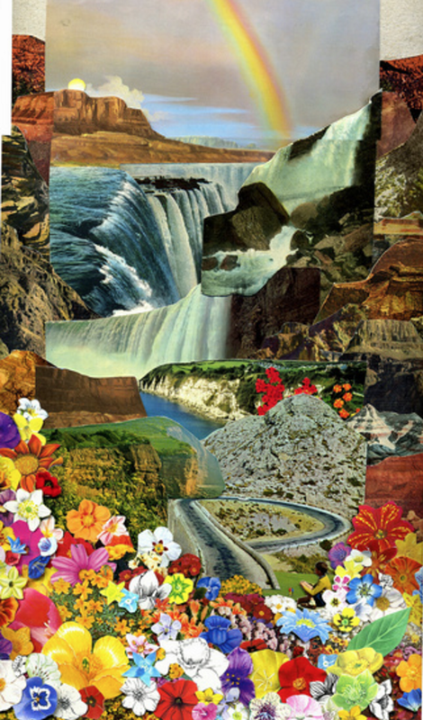
Ben Giles

Slide 6
Ben Giles
Combining 1950’s fashion spreads, medical textbooks, ancient ads, and other strange found materials, Ben Giles creates captivating, retro-futuristic collages.
“Much of what I use is from vintage books and encyclopaedias, as well as the classic National Geographic from the 1950s through the 1980s. I go through large quantities of flower and tree guides and garden books. I love hunting for, and using, physical materials, rather than printing images or creating digitally.”
Giles’ love of nature shows through in his images.

Slide 7
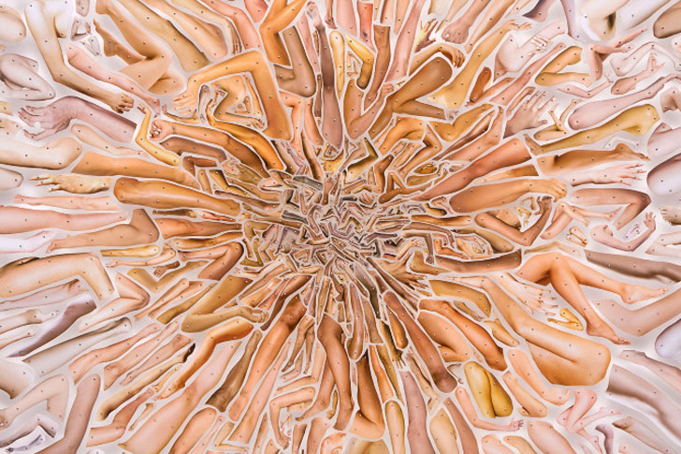
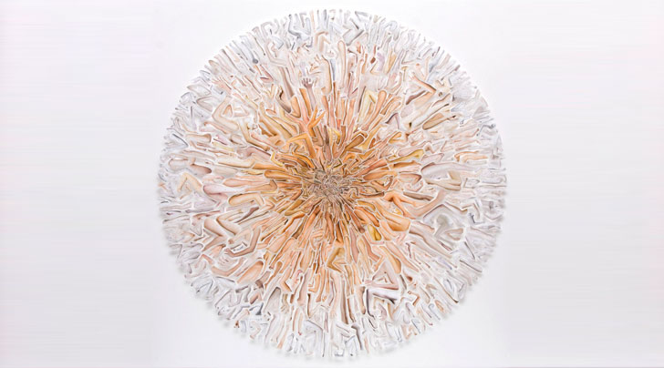
David Adey

Slide 8
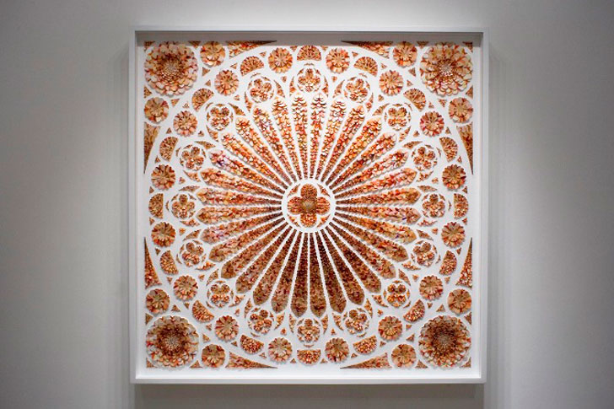
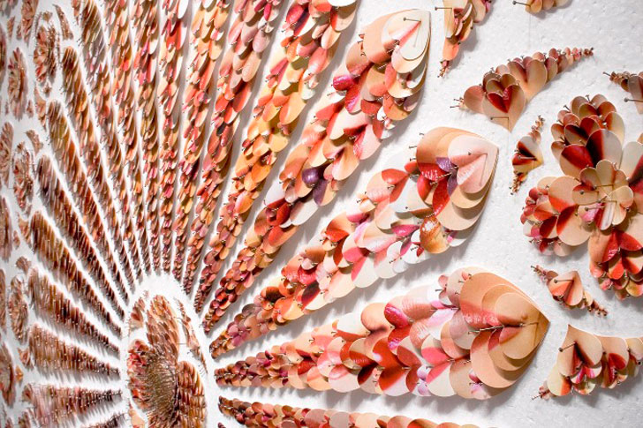
David Adey

Slide 9
David Adey
Each tiny piece of paper is pinned delicately to the board in an exact, calculated position.
Looking closer, the pictures of the individual elements begin to reveal themselves as hundreds of human body parts, cut to form hearts and figures.
Using vintage magazines and images from Google, Adey hunts for the exact hues and shapes to craft his intricate patterns.

Slide 10
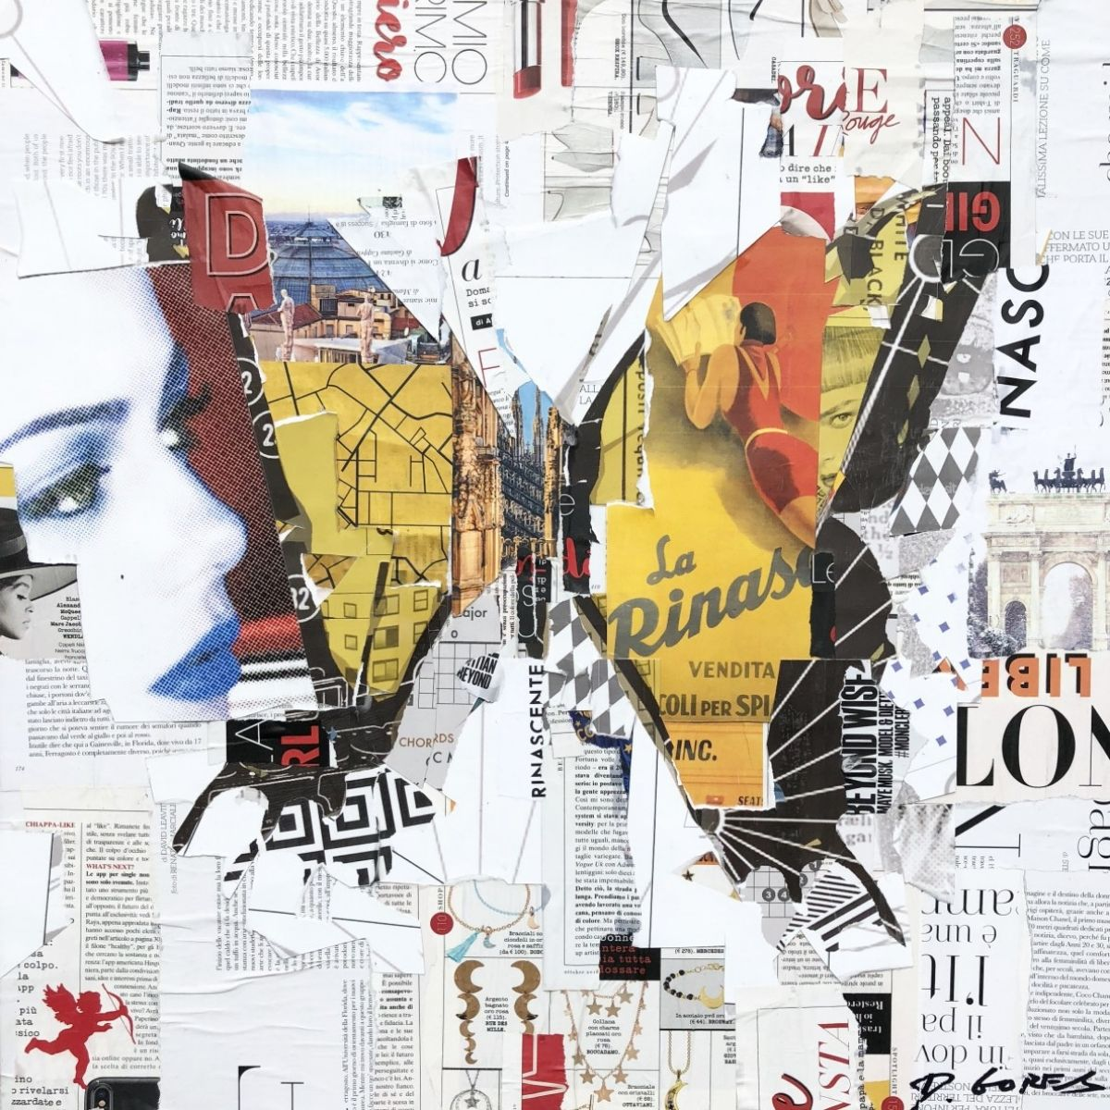
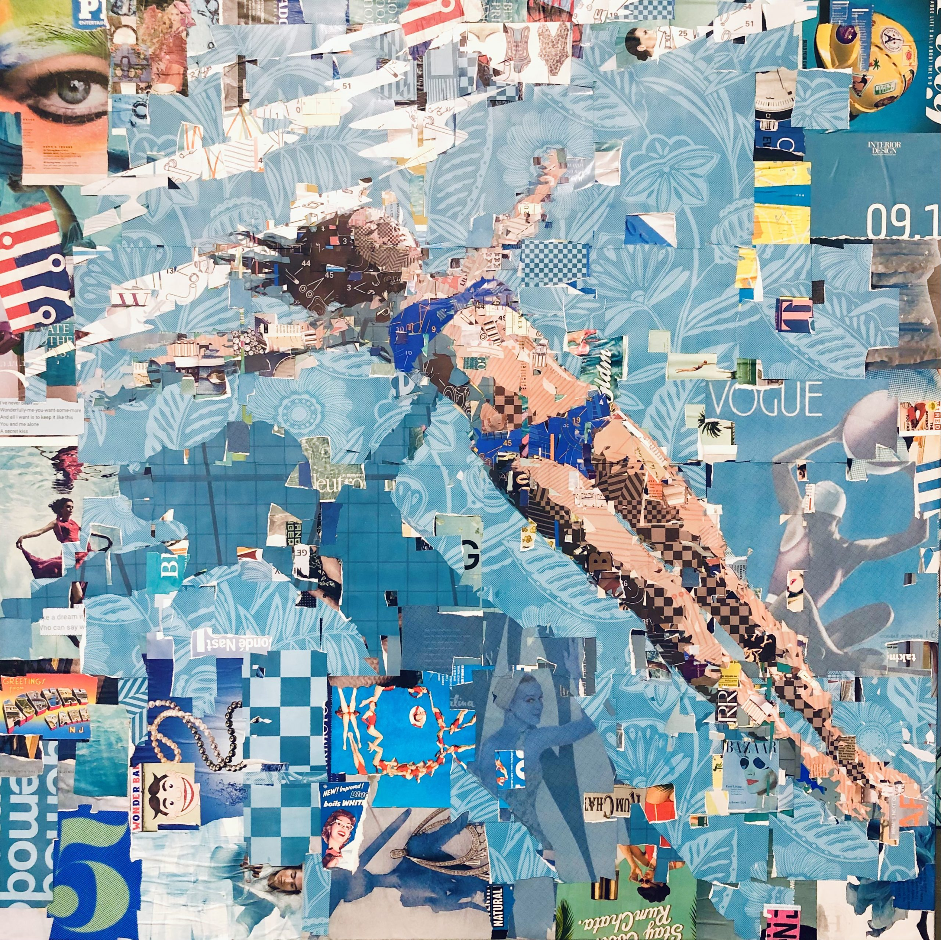
Derek Gores

Slide 11
Derek Gores
Derek Gores recycles magazines, maps, data and more in his portraits on canvas.
The balance of detail and playfulness in each piece reveals Gores’ knack for discovery and for building seemingly endless puzzles into his works.
Rearranging the scraps, he is able to form a sort of surrealist image, where from afar a nearly photo-realistic image comes into focus. However, as the viewer gets near, the small scraps reveal themselves to be other pictures, song lyrics, charts, patterns and more, and sweep your attention away.

Slide 12
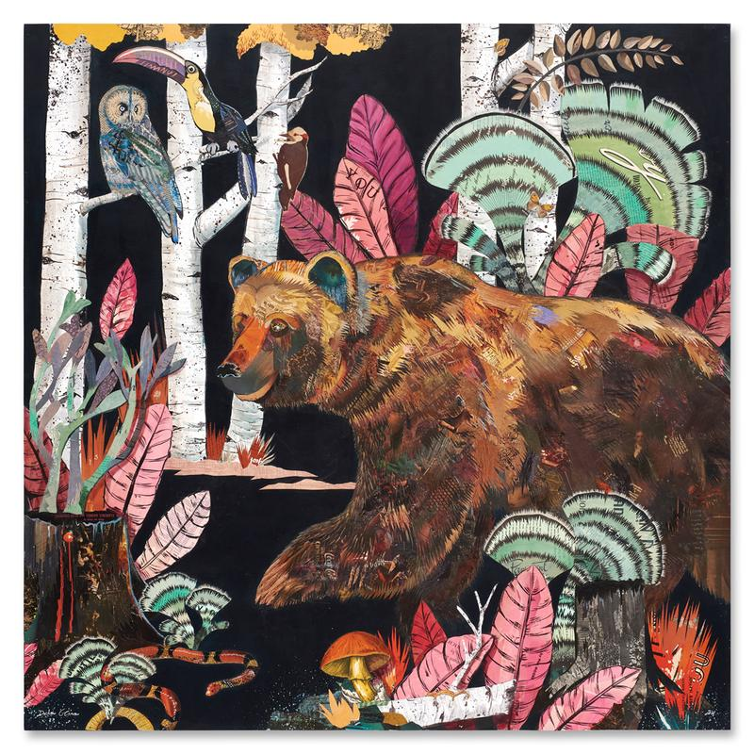
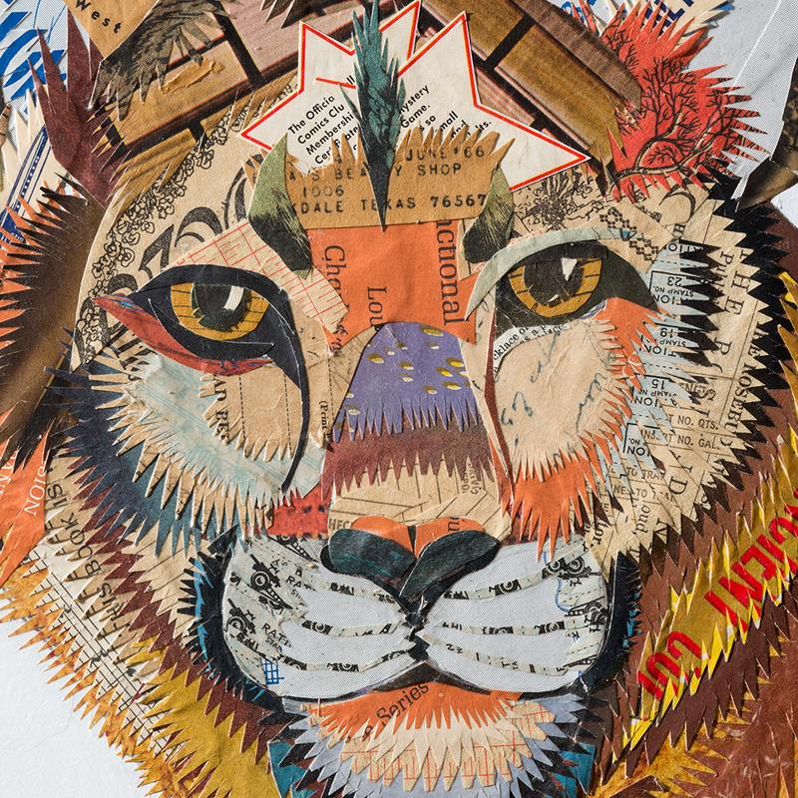
Dolan Geiman

Slide 13
Dolan Geiman
Colour, composition, and detail come to life in Geiman’s paper collages.
Carefully crafted from thousands of hand-cut papers and reclaimed materials.

Slide 14
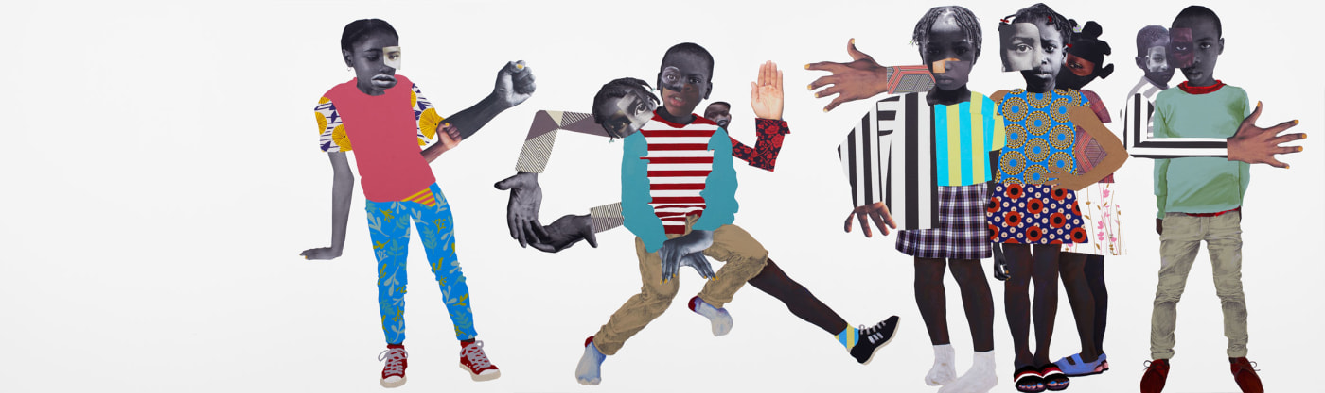
Deborah Roberts

Slide 15
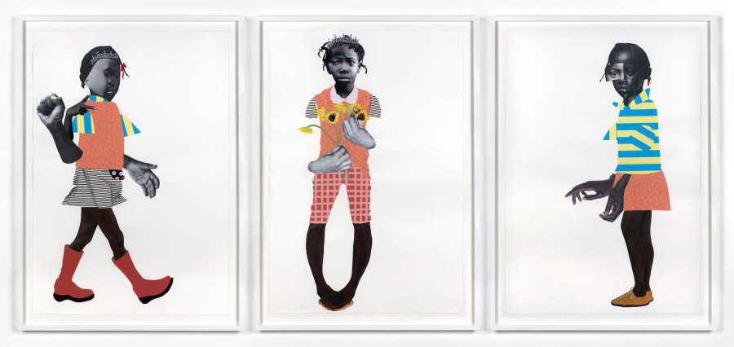
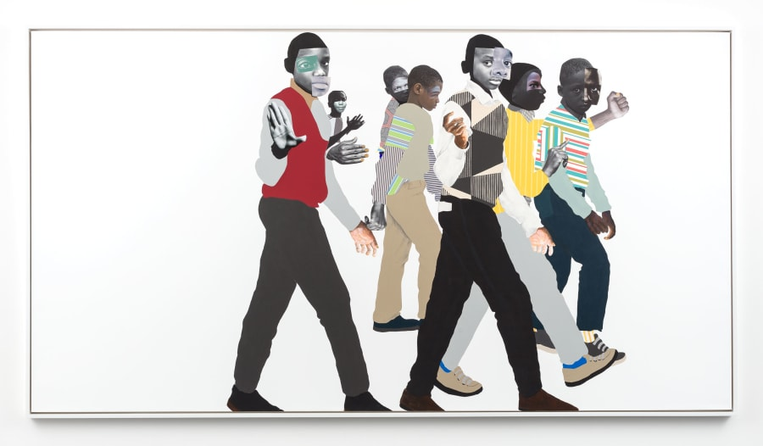
Deborah Roberts

Slide 16
Deborah Roberts
Combining collage with mixed media, Roberts' symbolic works explore themes of race, identity and gender.
Roberts' use of collage reflects the challenges encountered by young black children as they strive to build their identity.
Combining a range of different facial features, skin tones, hairstyles and clothes, Roberts explains that, “with collage, I can create a more expansive and inclusive view of the black cultural experience.”

Slide 17
Activity
Choose some of the collage pictures to stick into your sketch books.
Paddling: at least 2 pictures
Snorkelling: at least 3 pictures
Diving: at least 4 pictures
Annotate the pictures with your thoughts and ideas about the piece, any facts you learned during the lesson, suggestions about which materials might have been used, what the theme of the collage might be etc.

