Slide 1
LO: to understand evolution and inheritance
C: Inheritance

Slide 2
A characteristic is a feature of any organism.
A characteristics can be seen, like hair colour, or ‘hidden’ like your blood type.

Slide 3
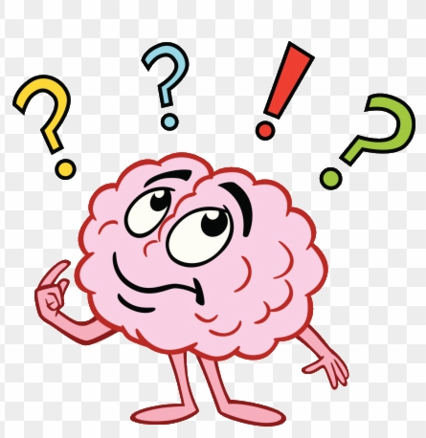
Do all humans look identical?
What about siblings?

Slide 4
Key Vocabulary
Inheritance: the name for the passing of traits, or characteristics, from parents to offspring.
Variation: occurs in a species from generation to generation. Although an offspring will have some similar characteristics to its parents, it will also have many different characteristics. This is called variation.

Slide 5
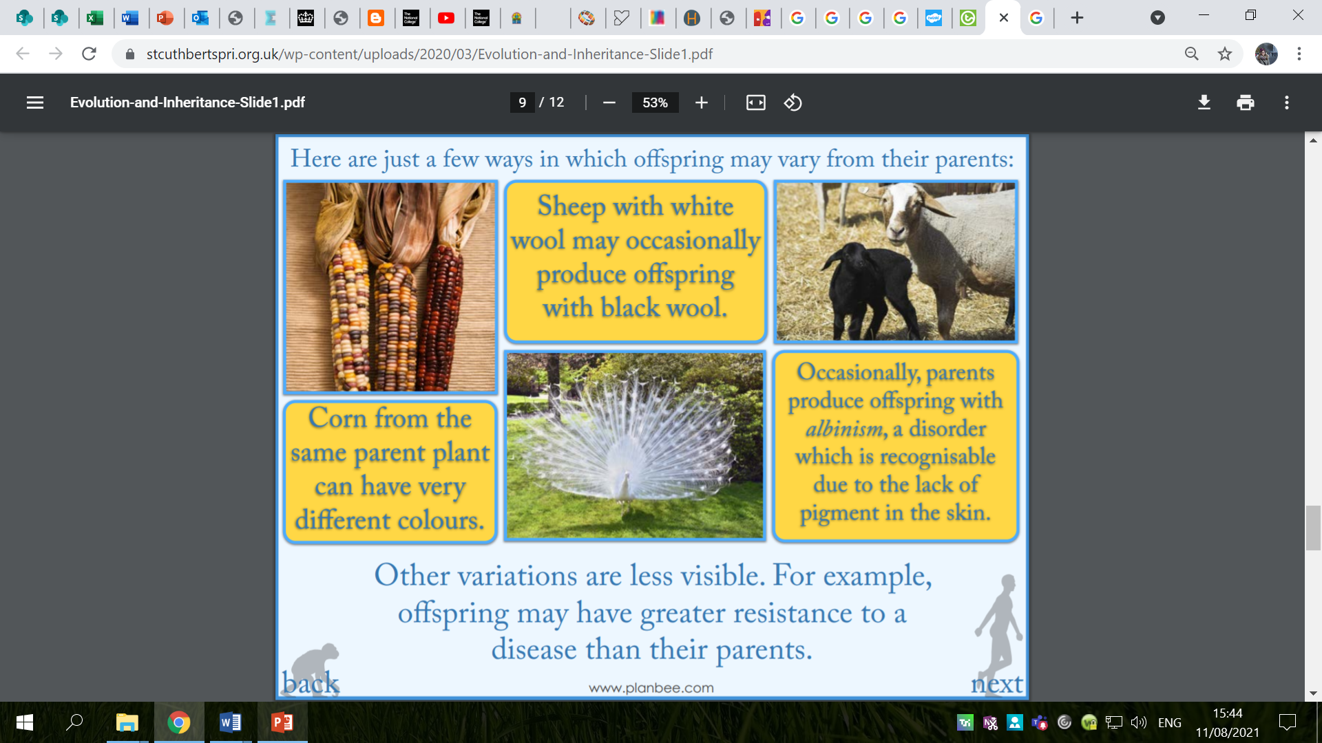

Slide 6
Do siblings look identical?
Different combinations of characteristics result in variation.
Some characteristics are inherited (come from our parents) through ‘genes’ (a sort of code), e.g. eye colour, tongue rolling and attached or unattached earlobes.
Other characteristics comes from the life choices we make and the way that we live, e.g. where we live, the food we eat, the exercise we take etc.
These are called environmental characteristics.

Slide 7
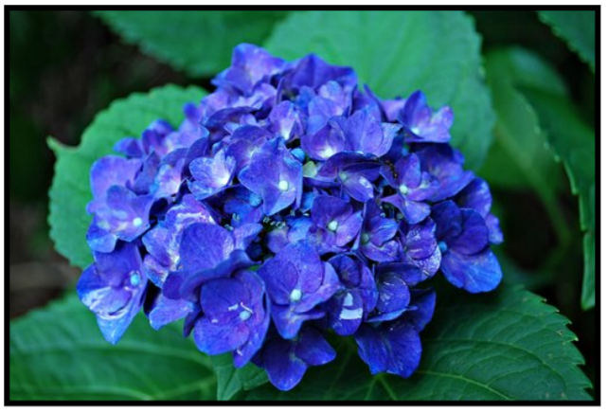
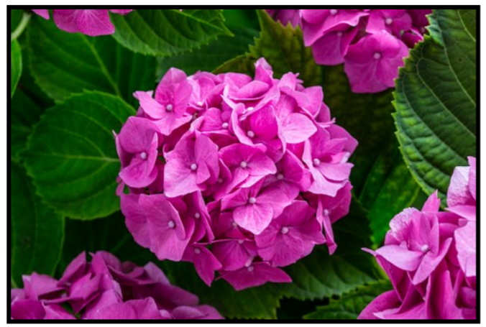

Environmental factors can impact on all living things.
Look at these pictures of hydrangeas – different soil types have affected the colours of the flowers.

Slide 8
Can you think of any characteristics which might be considered both inherited and environmental?
E.g. height, weight, intelligence, sporting ability

Slide 9
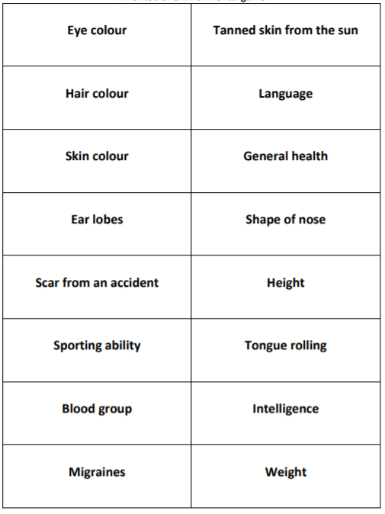
Inherited or environmental?
Sort the characteristics into two piles: inherited characteristics and environmental characteristics.

Slide 10
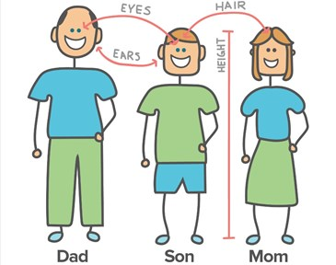
Activity 1
Draw a self portrait and label the characteristics you have inherited from your parents.
Underneath, label your environmental characteristics.

Slide 11
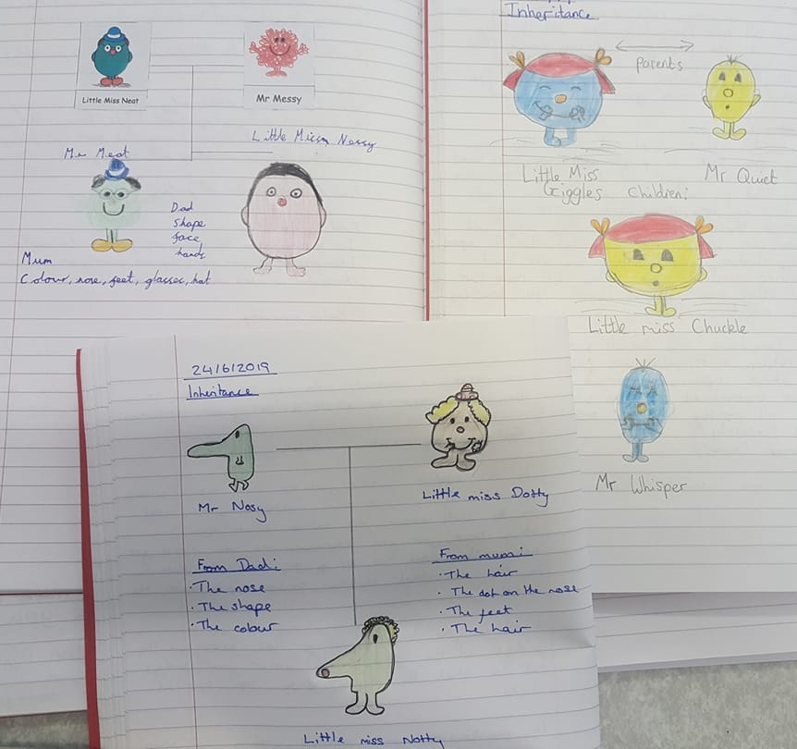
Activity 2:
Choose a Little Miss and a Mr Men character.
Draw them both out and label their names.
Draw one or two examples of how their child could look, inheriting characteristics from both parents!
Give the child/children names linked to the Mr Men / Little Miss names!

Slide 12
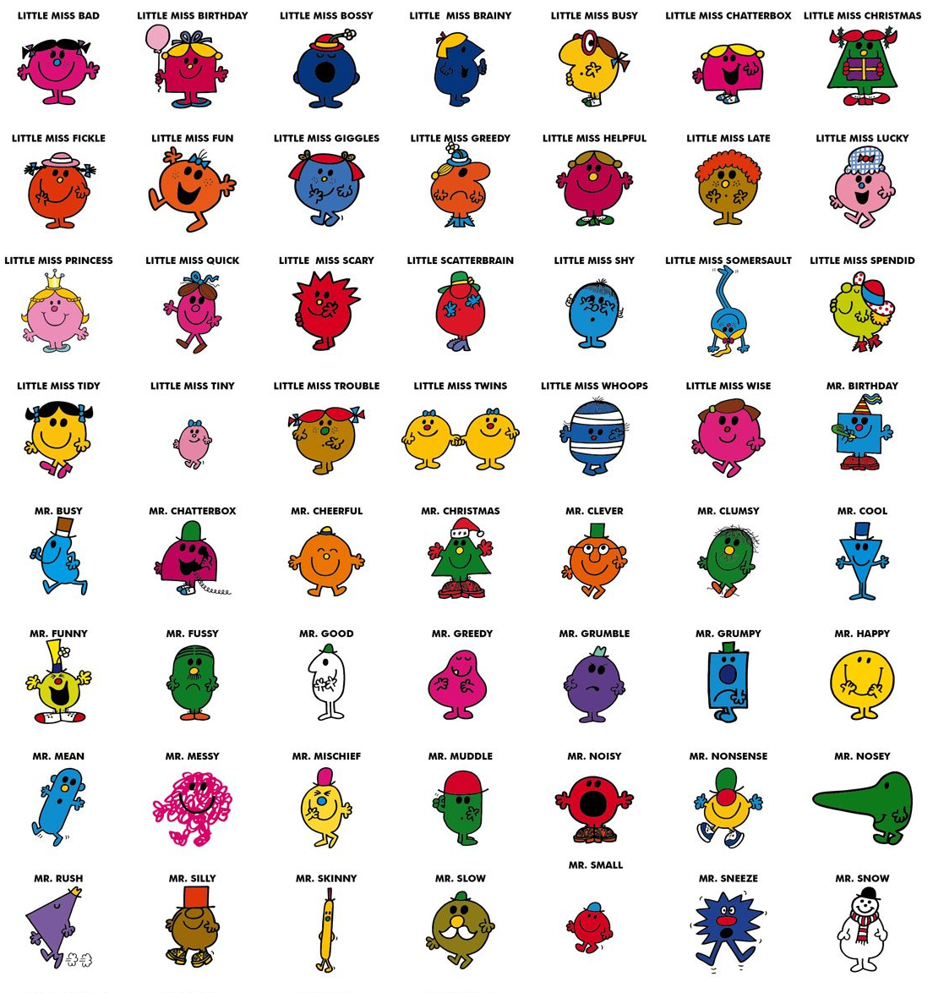

Slide 13
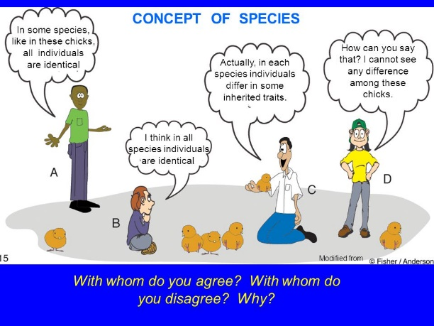
Red Pen

Slide 14
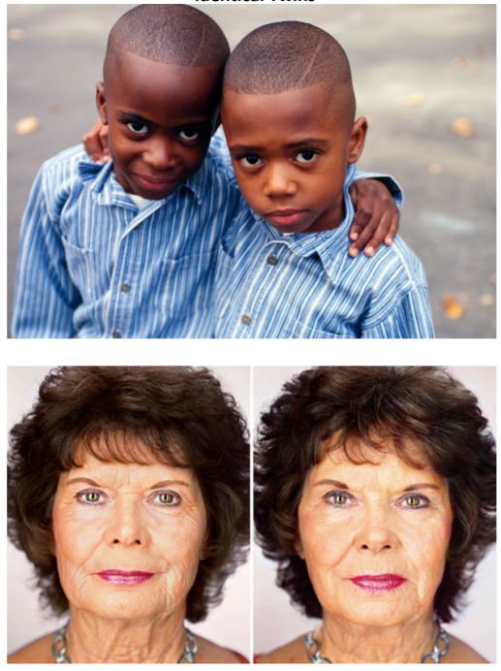
Plenary
Look at the images of identical twins.
What do you notice about their characteristics?

Slide 15
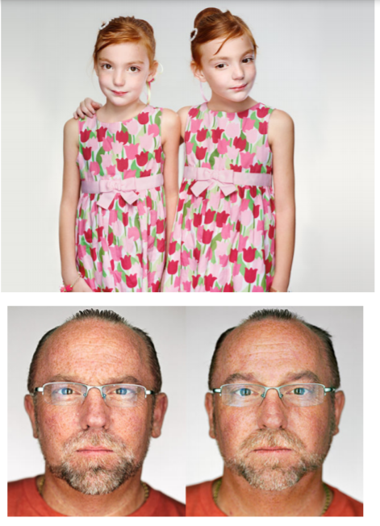
Plenary
Look at the images of identical twins.
What do you notice about their characteristics?

Slide 16
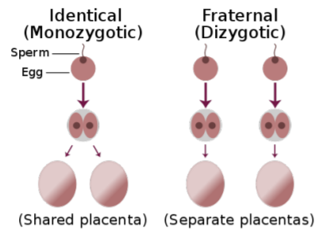
Plenary
Identical twins have the same (identical) characteristics because they have the same identical genetic ‘codes.’
They come from the same egg and sperm while fraternal twins are not identical as they are created by different eggs and sperm so inherit varied characteristics, just like other siblings who aren’t born together.

Slide 17
Plenary
Although in nature, we often think that animals look identical, they still have their own unique characteristics, e.g. coat markings, eye colour, facial features etc.

Slide 18
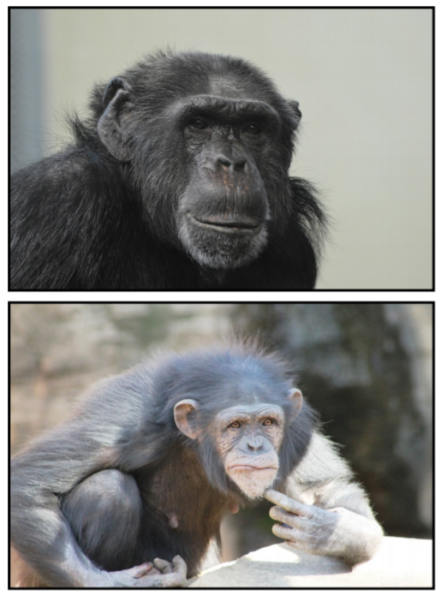
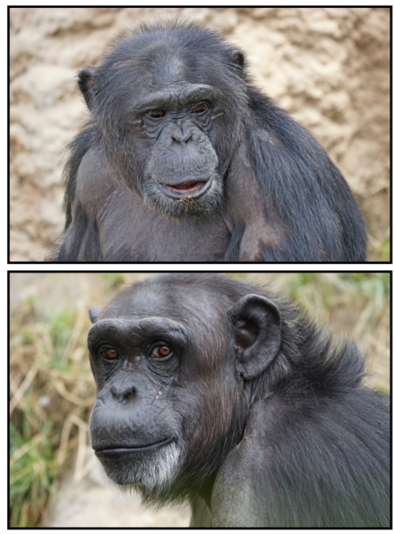
Plenary
Look at the images of the chimpanzees – how do they differ?

