Slide 1
PSHCE

Slide 2
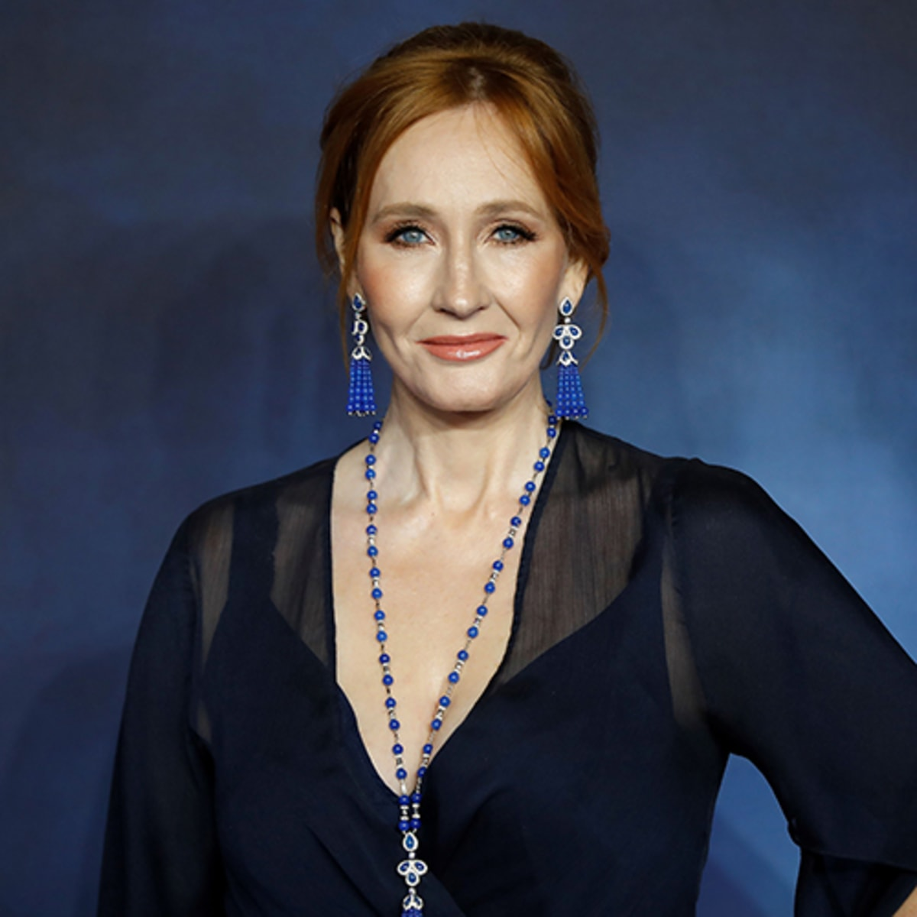
This is J.K. Rowling.
J.K. Rowling is the British author who wrote the Harry Potter series.
How do you think J.K. Rowling felt when her books were a global success?
What is your biggest achievement?

Slide 3
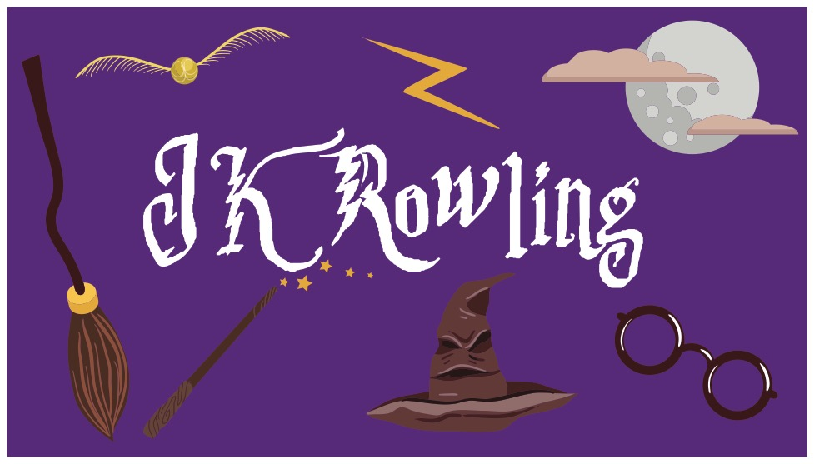
Joanne Rowling
She enjoyed writing stories in primary school and at home. Sometimes she wrote them for her little sister.
• In her teenage years, her mother became ill with Multiple Sclerosis and she had a difficult relationship with her Dad.
• She went to University.
• She married and had a child but got divorced after 3 years.
• Her Mum died before she had invented the idea of Harry Potter so she never had a chance to tell her.
• After the divorce she was living on benefits/ welfare and was very poor.
• 12 publishers rejected the first Harry Potter book.
• She is now a billionaire and her books bring pleasure to millions of people.

Slide 4
Did J.K. Rowling know she wanted to be an author when she was in primary school?
What are the clues?
Was the path to her being a successful author a smooth one?
What are your thoughts about how she kept going when things were difficult?
Did she have resilience?

Slide 5
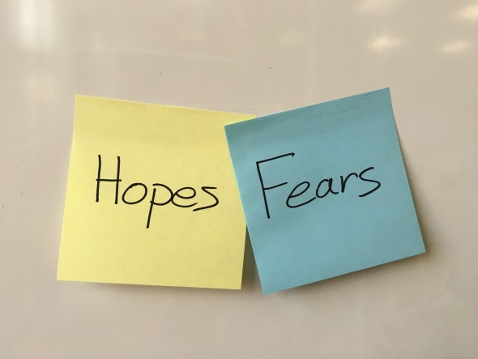
Think about your own hopes and goals for this year.
Are there any fears or worries which come with these goals?

Slide 6
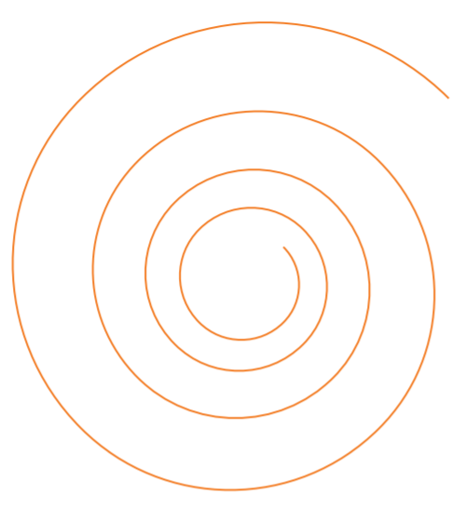
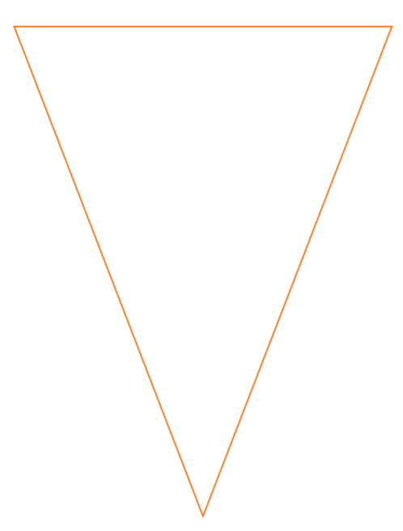
activity
Activity 1: On the spiral template, write any worries you have about the year ahead.
Cut around the spiral so it opens as a tree hanging mobile.
Hang your worry outside so the weather can blow/wash away your worries!
Activity 2: On the flag template, write or draw a hope or dream for the year ahead.

Slide 7
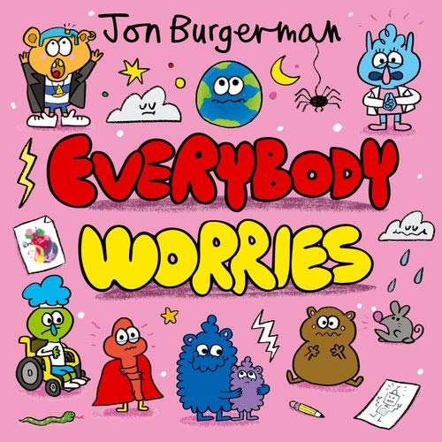
Plenary
How could your worries be overcome?
Who could you talk to about your worries?

