Slide 1
LO: to understand values
C: Islam

Slide 2
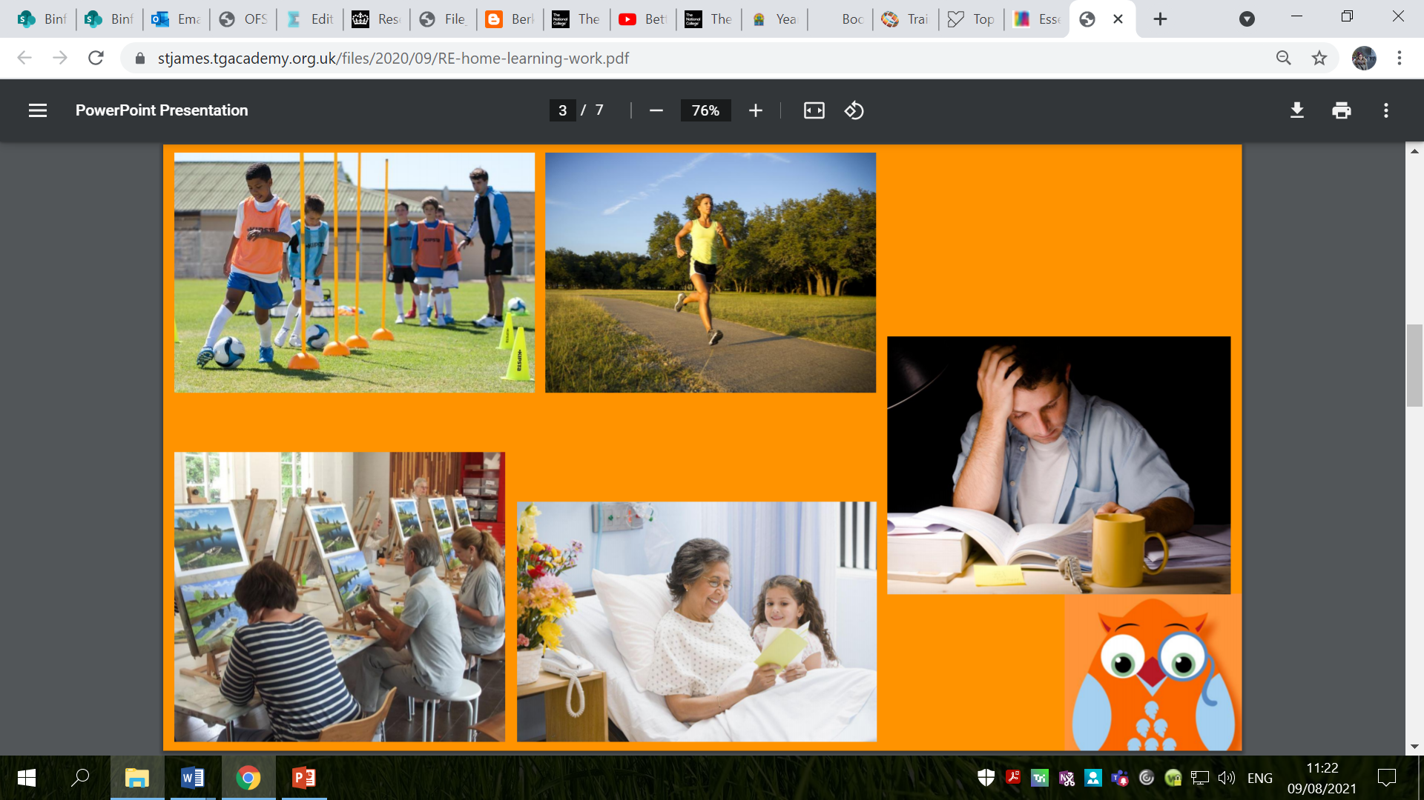
Which of these situations requires commitment? How do you know?
Completing homework
Eating sweets
Attending sports clubs
Being vegetarian
Playing in the park after school
Wearing red ties at school
Sleeping
Going to a place of worship every week
Helping out at home
Visiting a sick relative
Watching TV
Painting
Going out with friends
Praying
Learning a new skill

Slide 3

What does it mean to make a commitment?

Slide 4

Commitment
Commitment is a willingness to give your time and energy to a job, activity, or something that you believe in.
You can show commitment by doing something on a regular basis and by demonstrating loyalty, hard work and belief.

Slide 5
Is it always easy to stick to a commitment?

Slide 6
Is it always easy to stick to a commitment?
At times, it can be difficult.
Why might it be difficult?
E.g.
You are invited to a party on the same evening you usually visit your sick relative.
You are tired and it is sunny so you want to relax in the sun instead of training for the marathon.

Slide 7
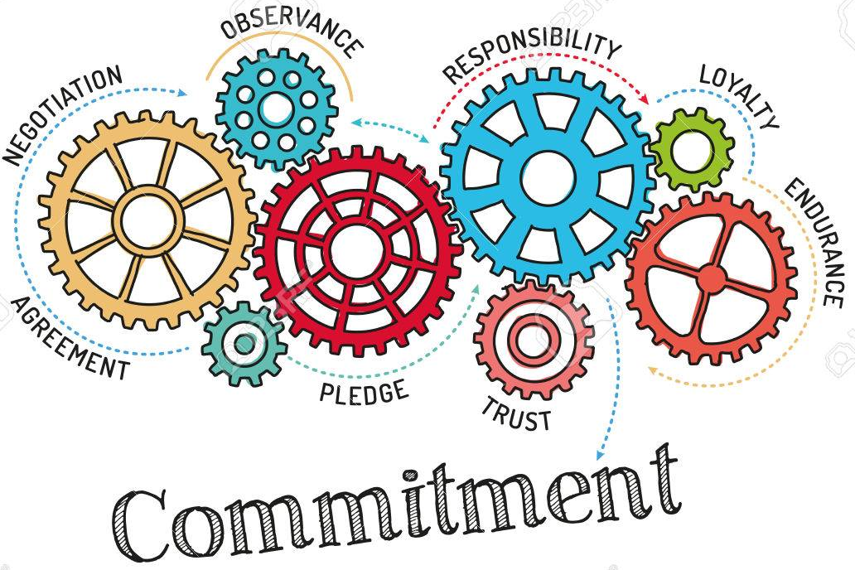
How do you show commitment in your lives?
What are the 3 ingredients needed for commitment do you think?
E.g.
Perseverance
Patience

Slide 8
How might a believer show commitment to their faith?
What might this look like in different faiths?

Slide 9
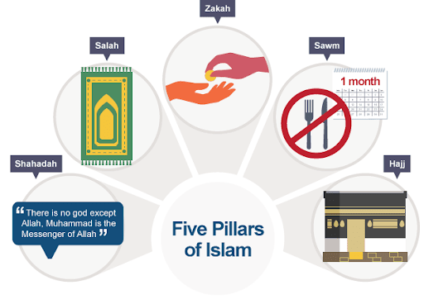
How might a Muslim show commitment to their faith?
Have you heard of the Five Pillars of Islam?
There are five religious duties expected of every Muslim which we will be exploring this half term.

Slide 10
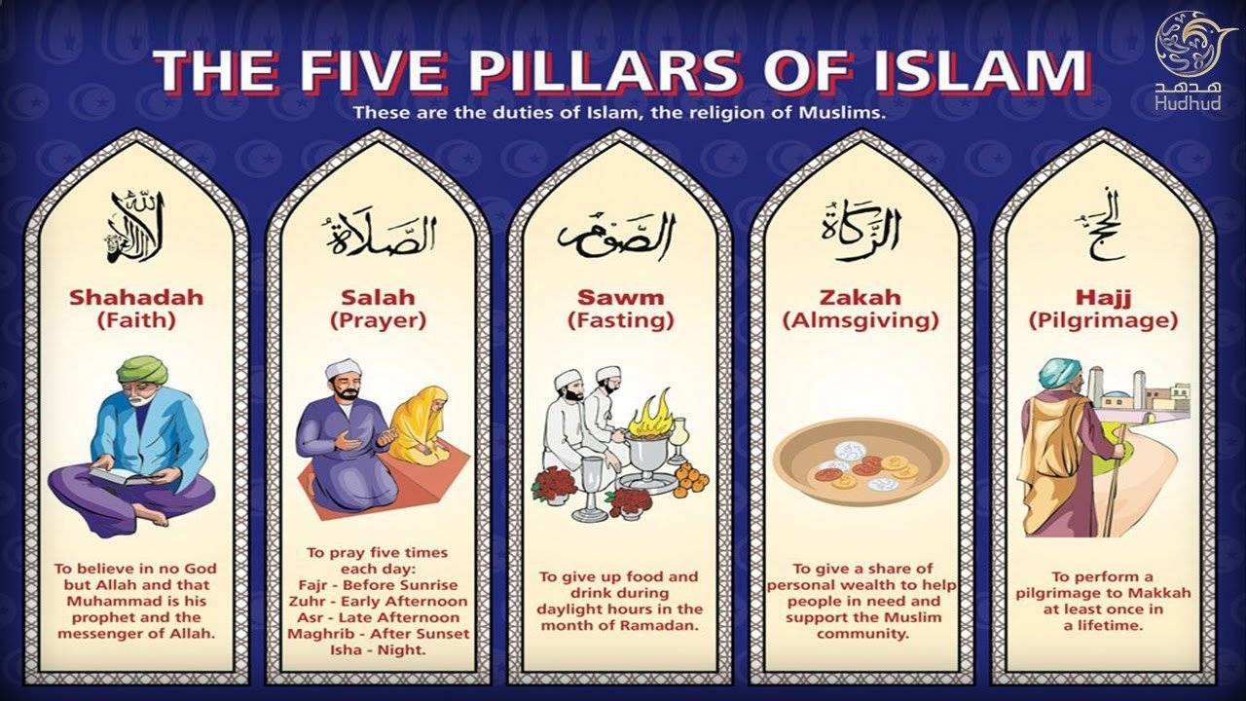
Do you have any knowledge or experience of any of these practices in your own lives, or the lives of your friends or families?

Slide 11
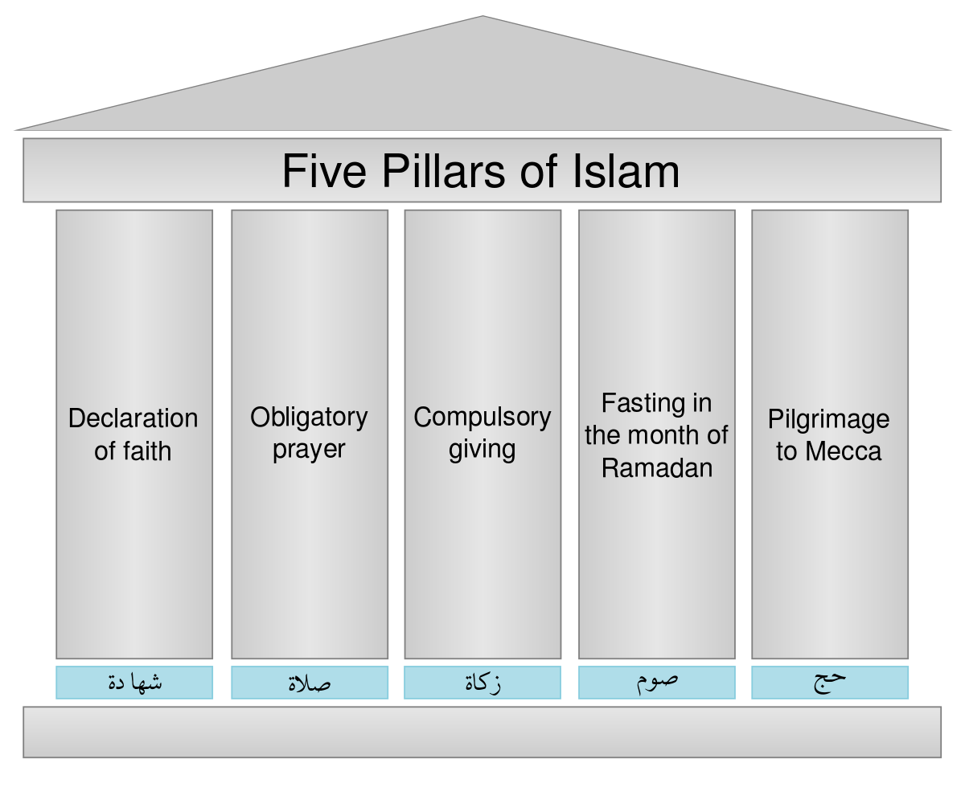
Why do you think these duties are called pillars?

Slide 12
The pillars are like the pillars that hold up a building: each one is important. Without one, the building might become lopsided or even fall down.
What are the ‘pillars’ that you base your life on?
How do you show your faith, or beliefs about the world?

Slide 13
Activity:
Paddling | Snorkelling | Diving
Think back to the commitments you have in your own lives: a commitment to a sport, club, person etc. How do you show your commitment? Make a list and explain at least 3 of the things you list. Red Pen: Why do you think that Islam has chosen these 5 particular duties as its core ‘pillars’? | Make your own house with 5 ‘pillars’ which are the practices or values you base your life upon. Red Pen: Why do you think that Islam has chosen these 5 particular duties as its core ‘pillars’? | Write a commitment statement, setting out what you base your life upon (see examples on next slide). A commitment statement is a written document used to focus on what is most important. It is a statement of values. What is important to you? Red Pen: Why do you think that Islam has chosen these 5 particular duties as its core ‘pillars’?

Slide 14
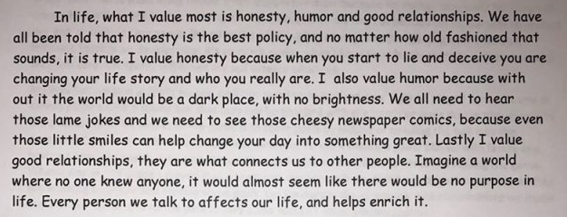

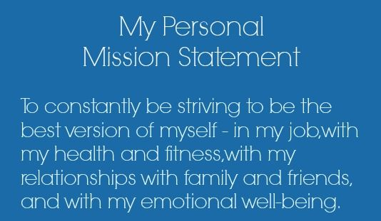
Diving – examples:
I am committed to…
I am committed to this because…
I demonstrate my commitments by…

