Slide 1
Doubling consonants

Slide 2
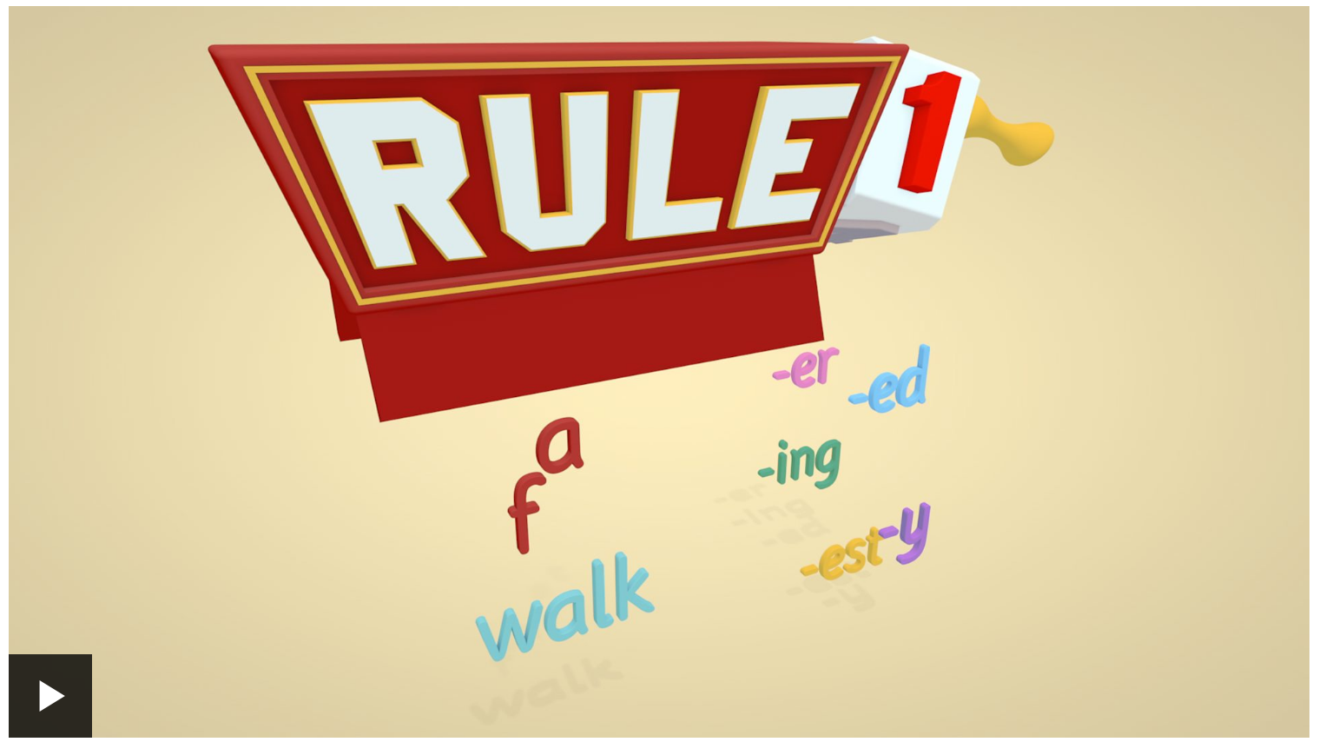
Watch to: 1:33
https://www.bbc.co.uk/teach/class-clips-video/english-ks2-wonderful-words-suffixes-part-1/zdnd7nb

Slide 3
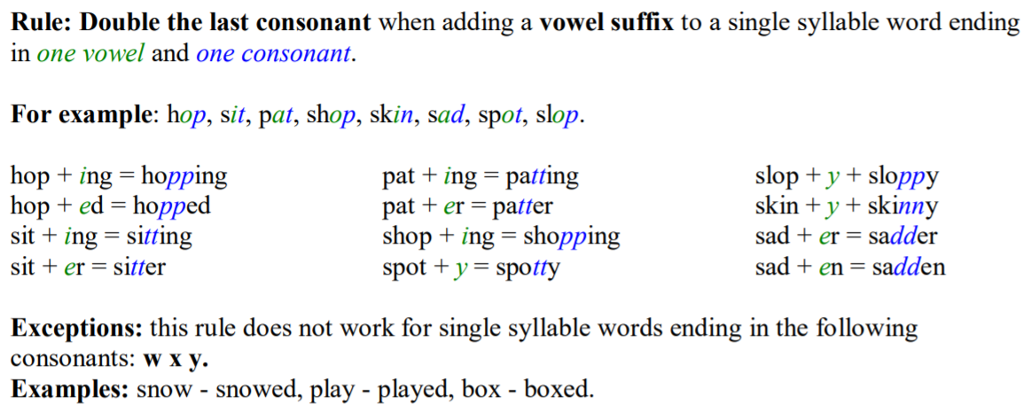

Slide 4
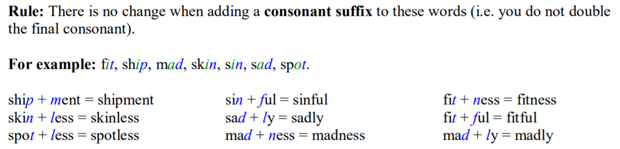

Slide 5
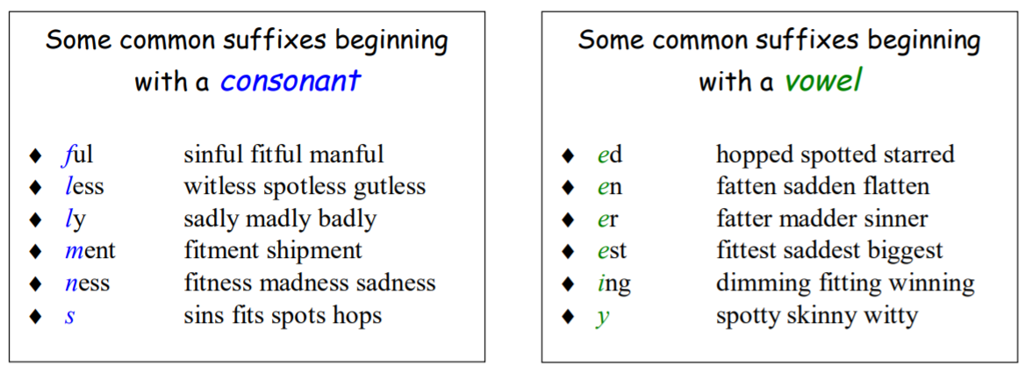

Slide 6
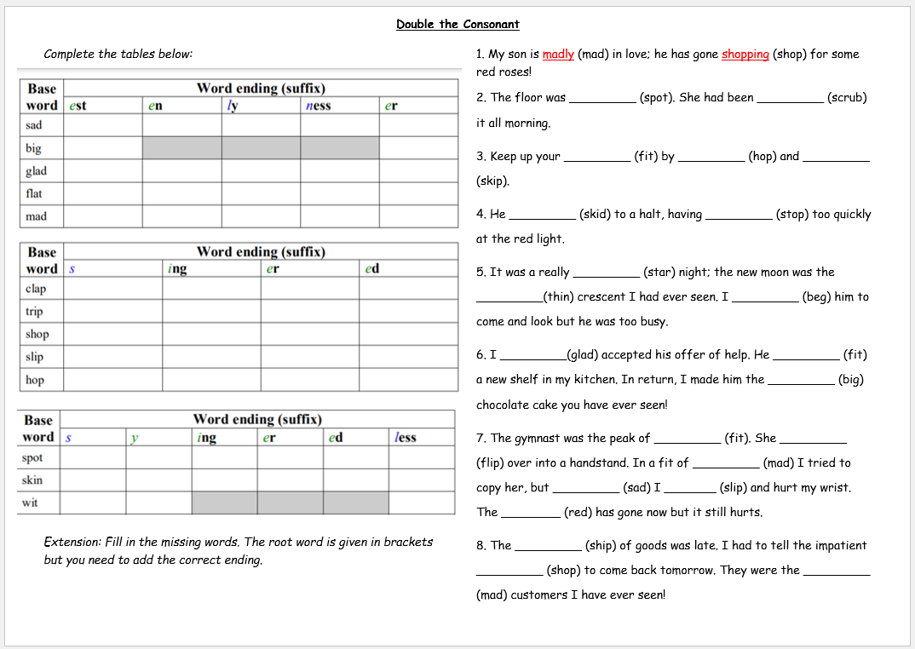
Activity:

Slide 7
Suffixes

Slide 8
Suffixes are an important element of spelling.
They are strings of letters added at the end of a word which alter the meaning of a word.
The word to which the suffix is added is called the root word.
Suffixes can be added to different types of words.

Slide 9
Watch: from 1:33 to end
https://www.bbc.co.uk/teach/class-clips-video/english-ks2-wonderful-words-suffixes-part-1/zdnd7nb

Slide 10
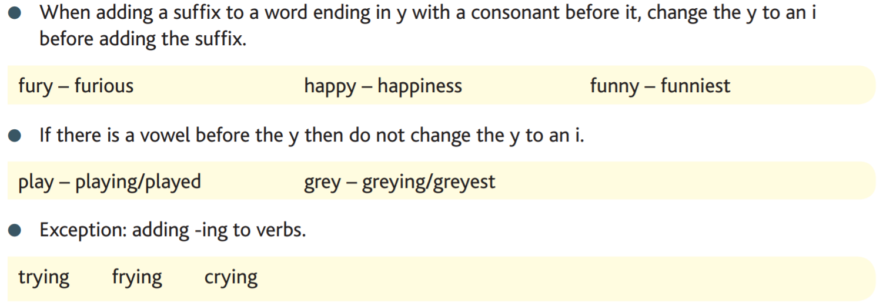

Slide 11
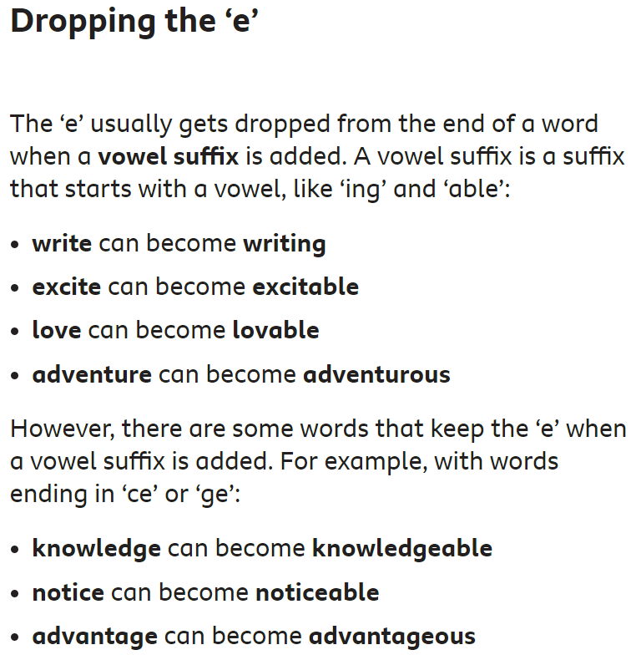

Slide 12
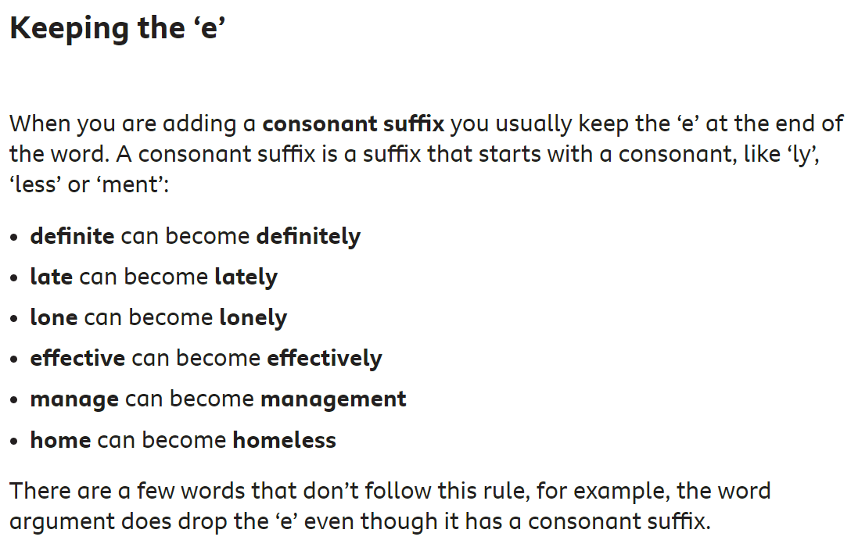

Slide 13
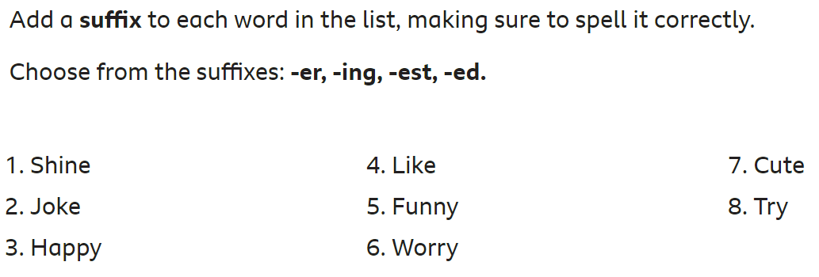
Activity:
Read each sentence carefully then add a suffix to the word in brackets so that it makes sense in the sentence.
Choose from the suffixes: -er, -ing, -est, -ed.
1. Sally was busy (write) in her diary.
2. Kim (carry) the shopping in from the car.
3. I got told off for (spy) on my sister.
4.The new sofa was much (wide) then the last one.
Extension:
Write your own sentences using the words you have created.
Try to write compound and complex sentences with interesting vocabulary.

Slide 14
plurals

Slide 15
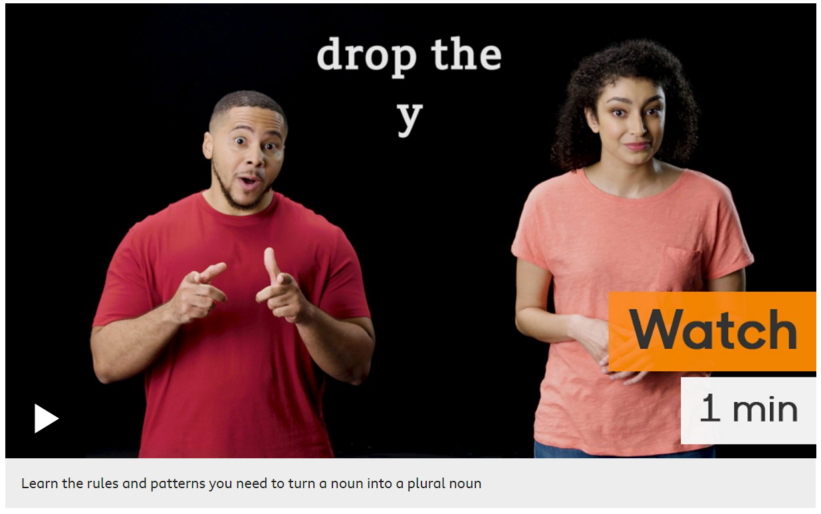
Watch:
https://www.bbc.co.uk/bitesize/topics/zbmv2sg/articles/zfqh92p

Slide 16



Singular and Plural
The word ‘singular’ means just one of something.
For example, a house or a boy.
The word ‘plural’ means more than one of something.
For example, houses or boys.
The word ‘singular’ is very similar so ‘single’.
This can help us to remember the meanings of singular and plural.

Slide 17

Singular and Plural
When we make a singular noun into a plural noun,
the spelling at the end of the noun changes.
house
houses
boy
boys
For most nouns, s or es is added to the end of the noun,
or a y is replaced with ies.
Deciding which plural spelling to use is the tricky part.

Slide 18
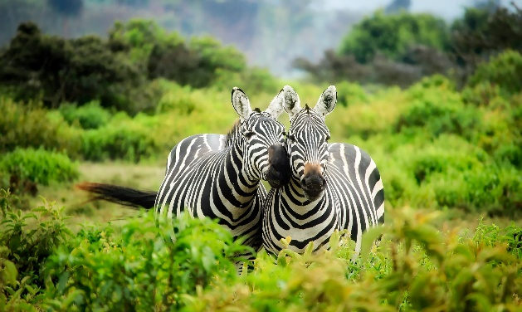
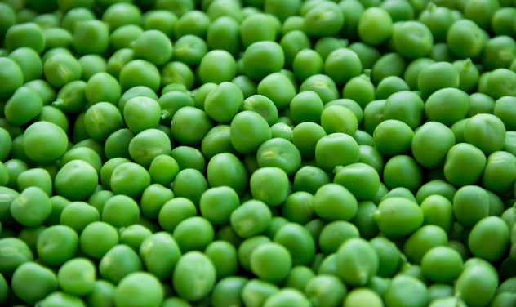
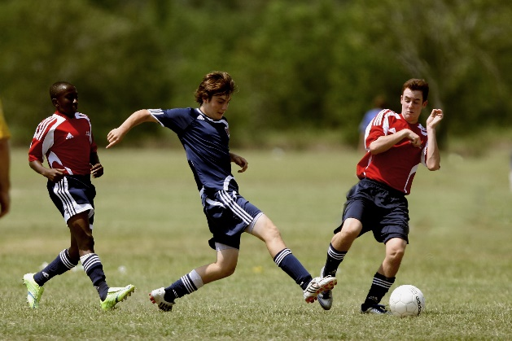
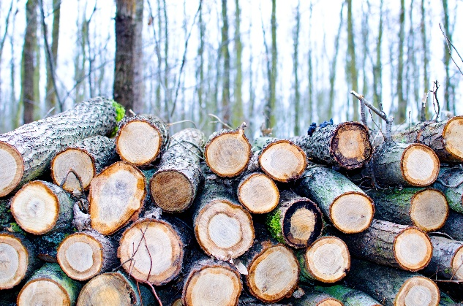
Adding ‘s’
To make most nouns plural, we simply add an ‘s’ to the end of the word.
zebras
peas
footballers
logs

Slide 19
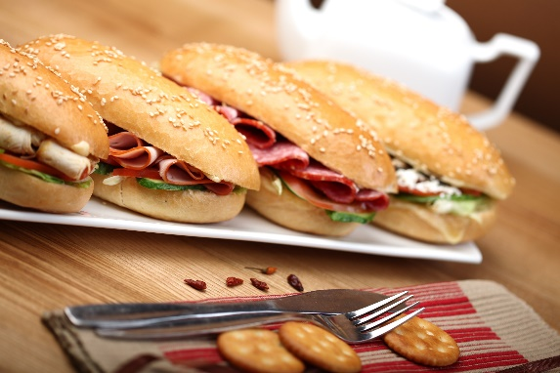

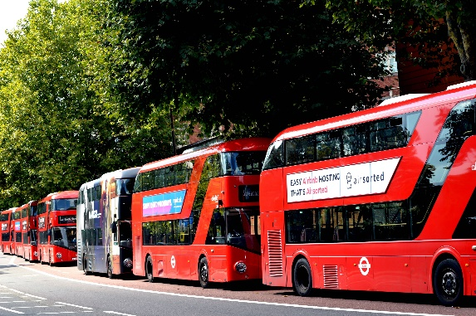
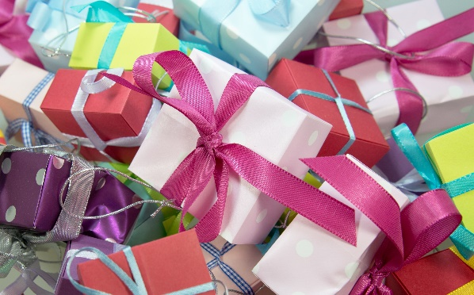
Adding ‘es’
If the noun ends in ch, sh, s, ss, x, zz or z, most of the time we add 'es'
sandwiches
glasses
buses
boxes

Slide 20
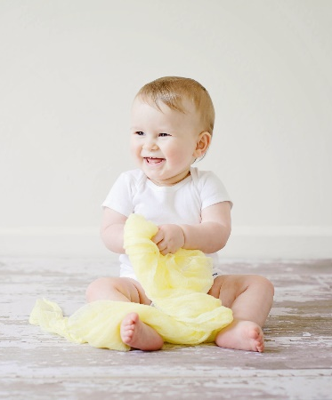
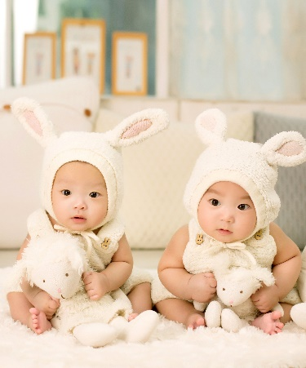
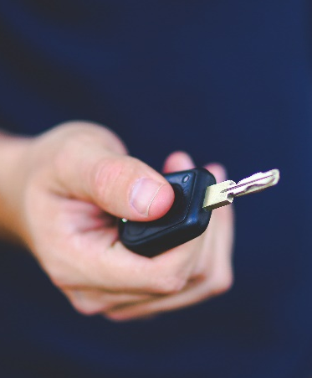
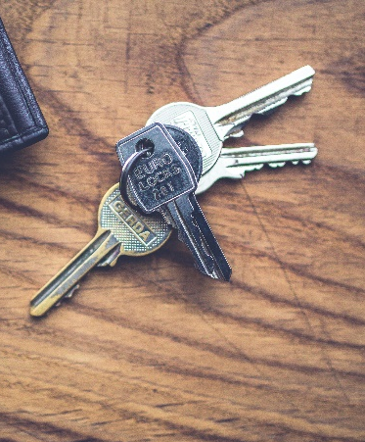

Adding ‘s’ or ‘ies’
If the noun ends in a vowel (a, e, i, o or u) and ‘y’, most of the time we add ‘s’.
However, if the noun ends in a consonant and a ‘y’, most of the time we replace ‘y’ with ‘ies’.
baby
babies
key
keys

Slide 21
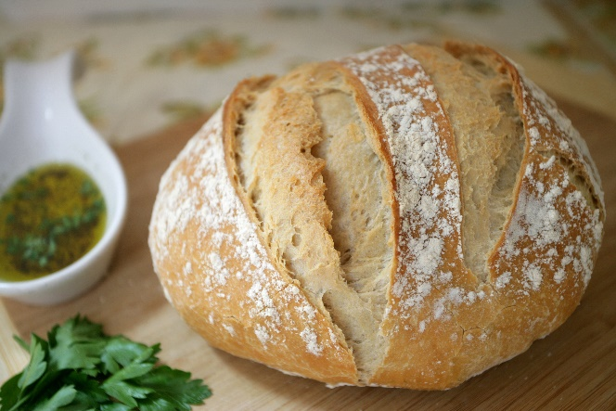
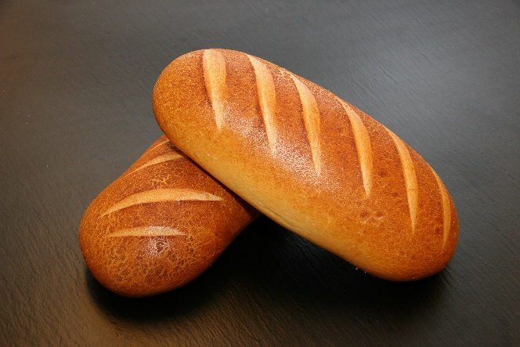

Look out for…
The English language is complicated and there are lots of exceptions to these rules.
One exception to look out for is nouns that end in ‘f’ or ‘fe’. These become ‘ves’ when they are made into plurals.
loaf
loaves

Slide 22
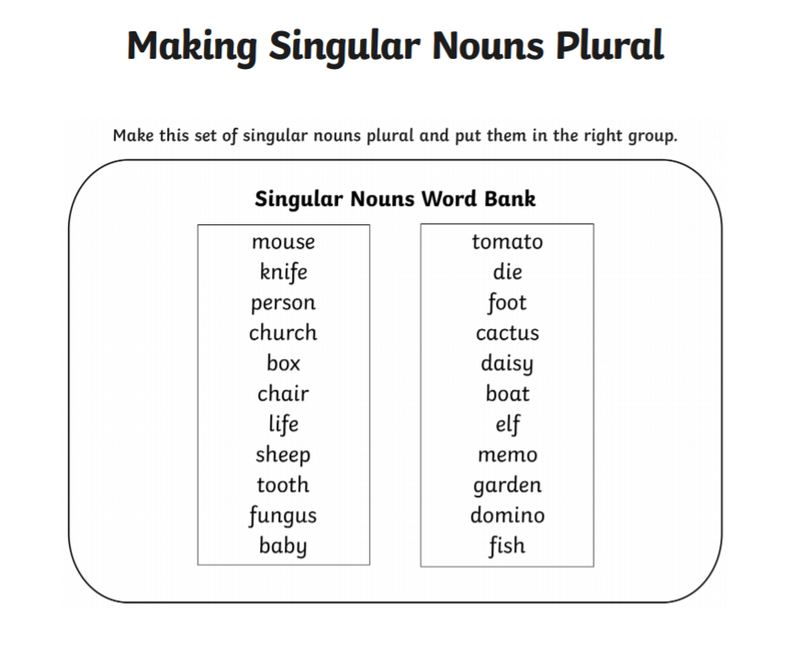
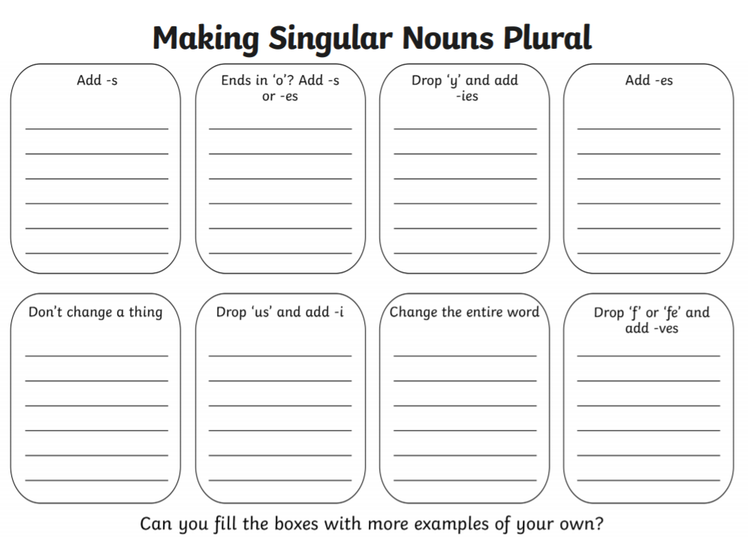
Activity: with your partner

Slide 23
homophones

Slide 24
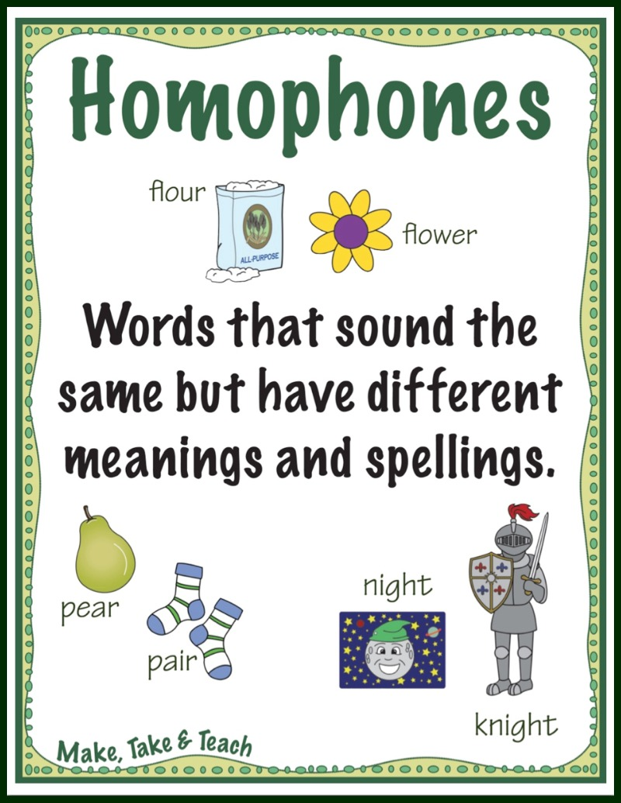

Slide 25
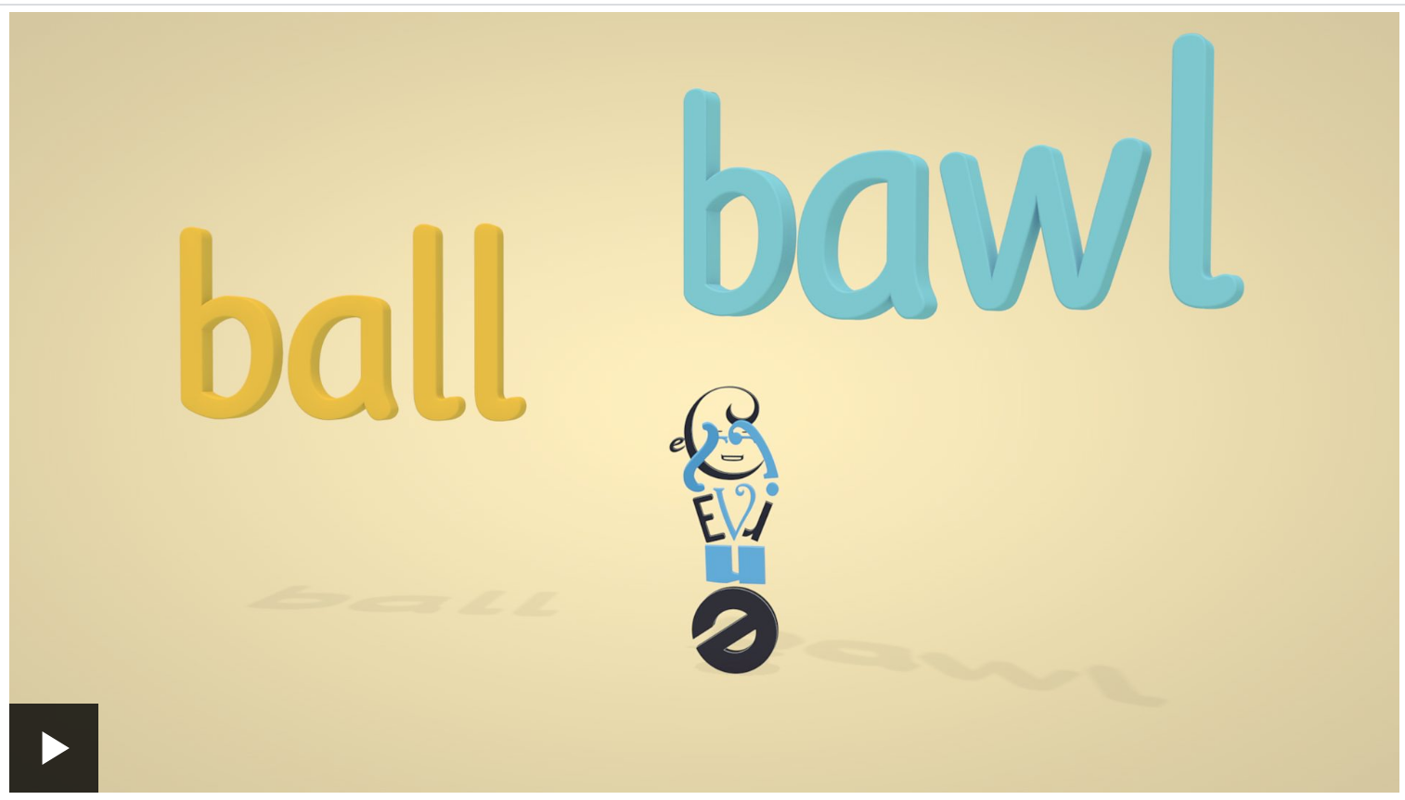
Watch:
https://www.bbc.co.uk/teach/class-clips-video/english-ks2-wonderful-words-homophones/z732t39
https://www.bbc.co.uk/teach/class-clips-video/english-ks2-wonderful-words-homophone-sentence-show/zfwygwx

Slide 26
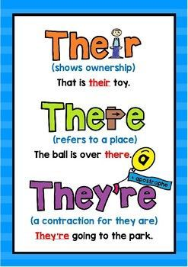

Slide 27
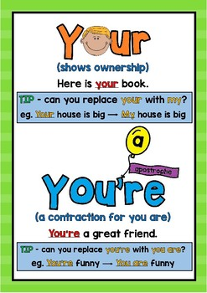

Slide 28
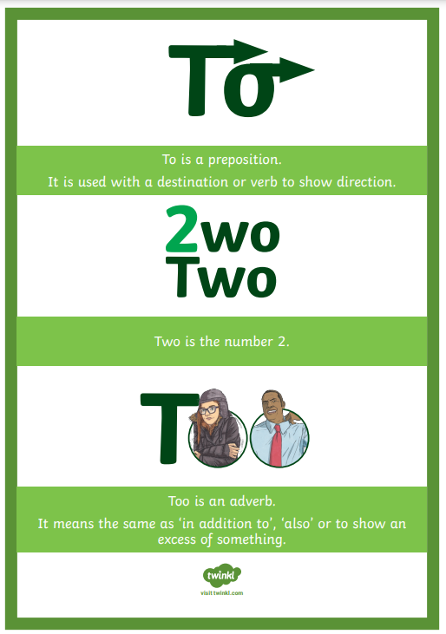

Slide 29
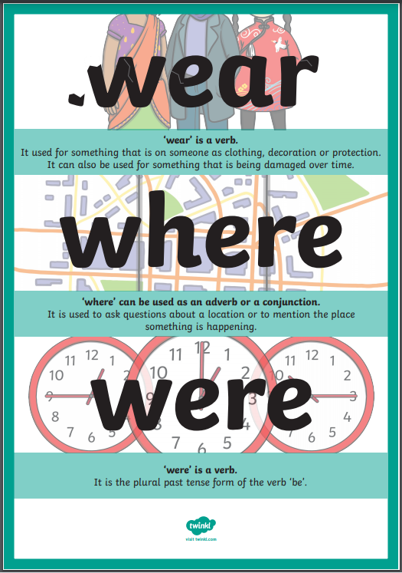

Slide 30
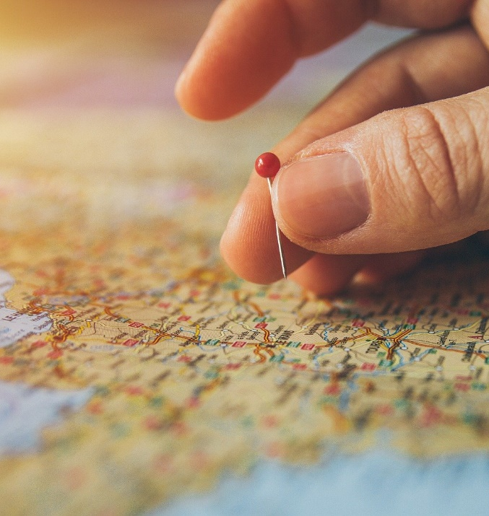
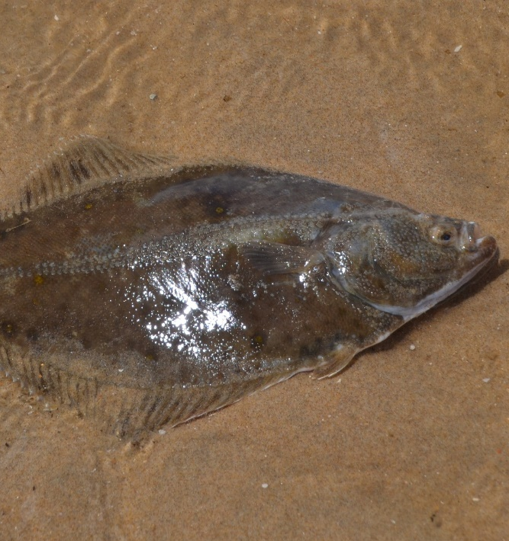
place
plaice
I used a map to find the .
The correct name for flat fish is .

Slide 31
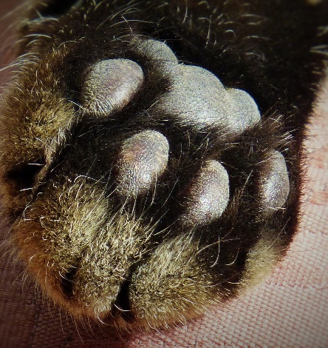

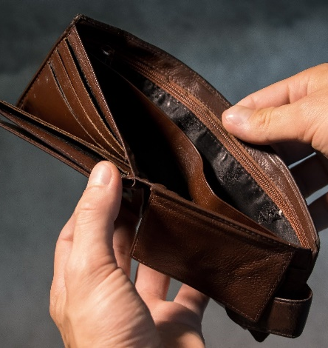
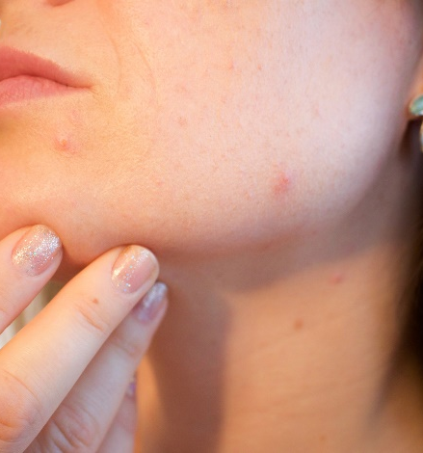
paw
pour
poor
pore
The cat lifted its .
Will you me a drink please?
people don’t have much money.
A small hole in the skin is called a .

Slide 32

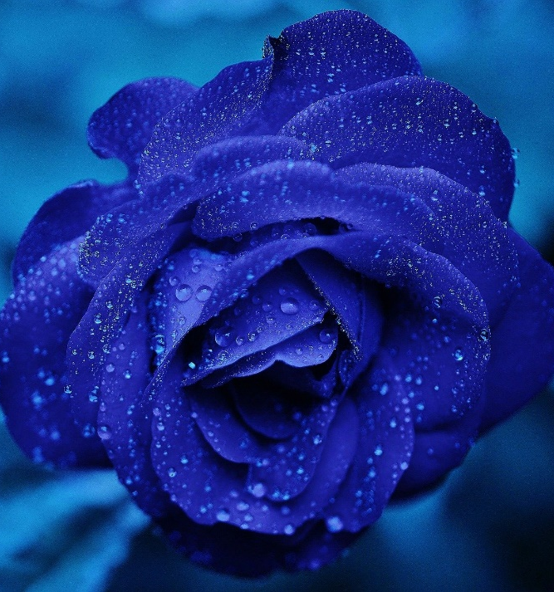
blew
blue
The wind nearly the woman off her feet.
The colour of the flower is .

Slide 33
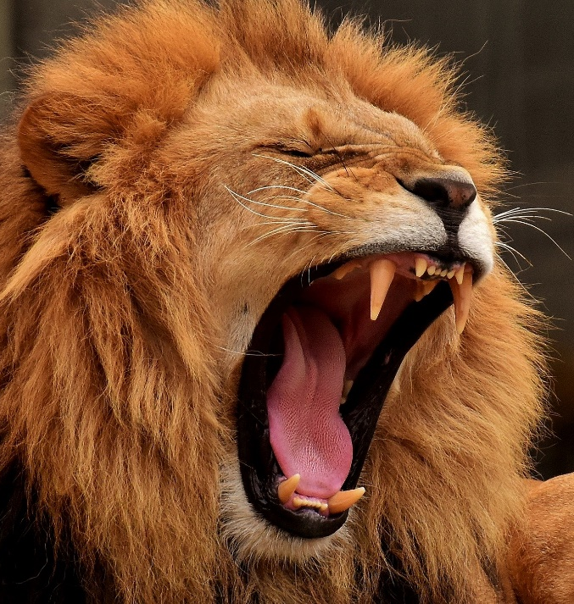
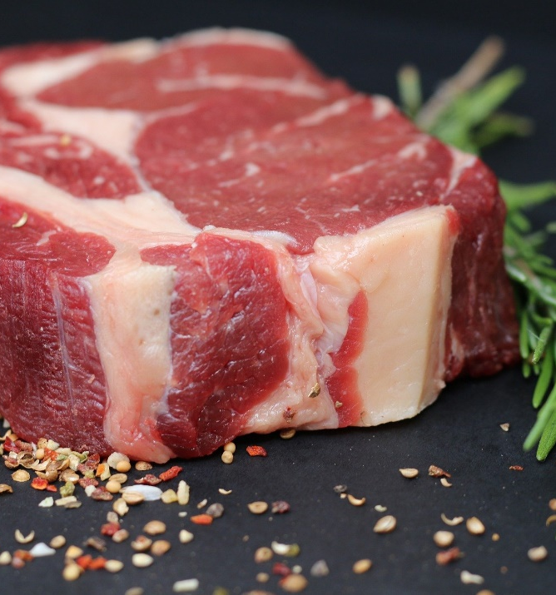
roar
raw
The lion let out a huge .
I bought some steaks to cook for tea.

Slide 34

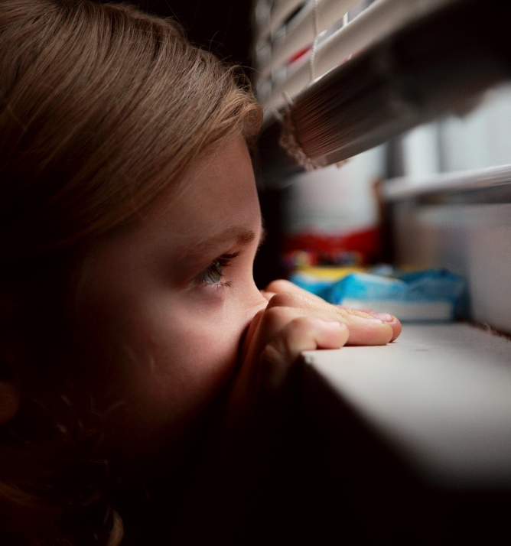
peak
peek
The climber took in the view from the mountain .
The children took a sneaky out of the window.

Slide 35
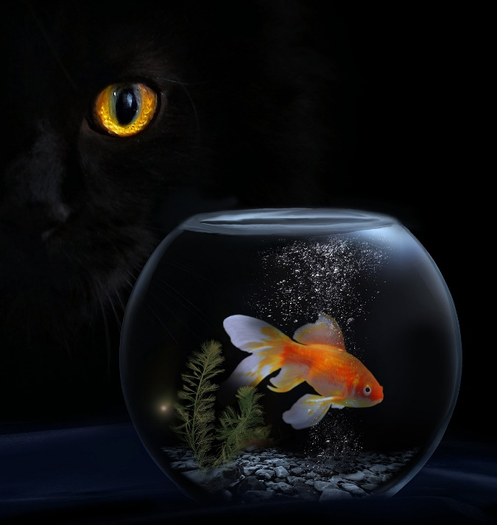
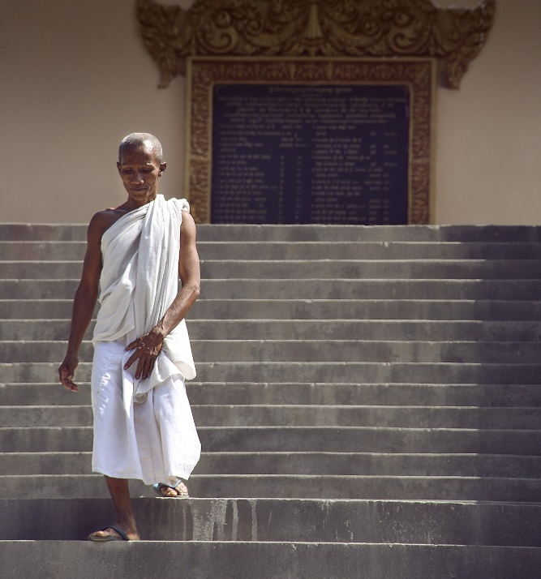
stares
stairs
The cat hungrily at the goldfish.
The man carefully went down the .

Slide 36
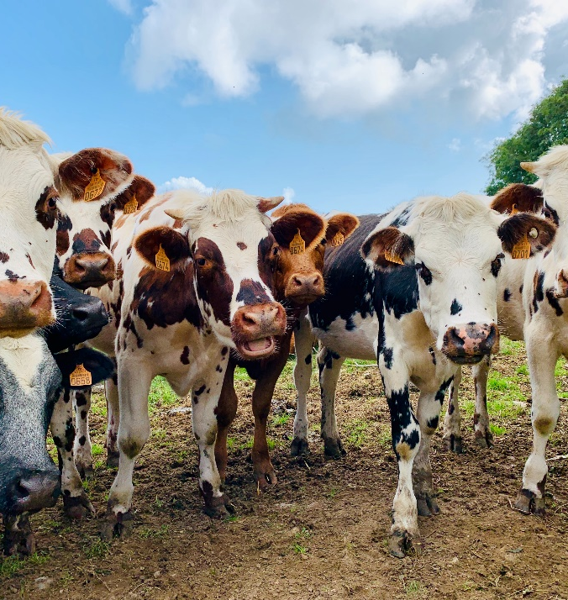
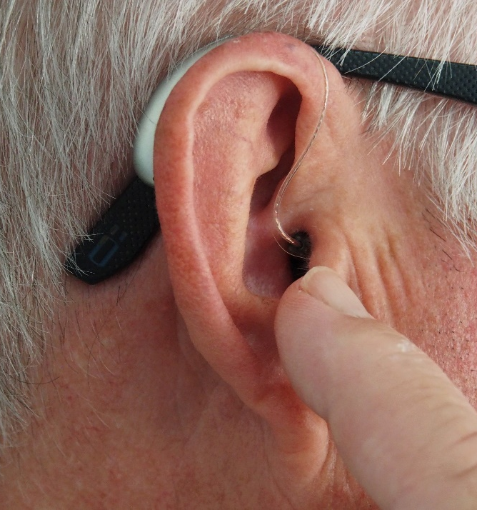
herd
heard
The farmer had a of cows.
The man a strange noise.

Slide 37
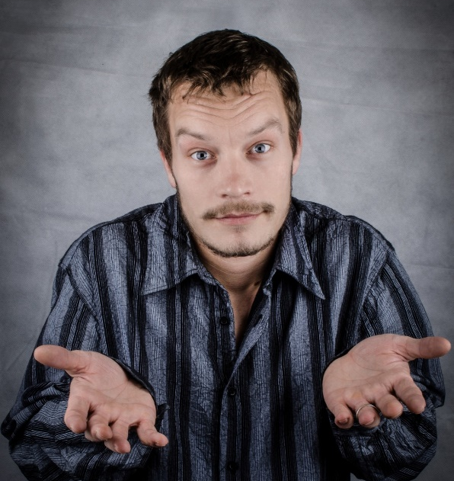
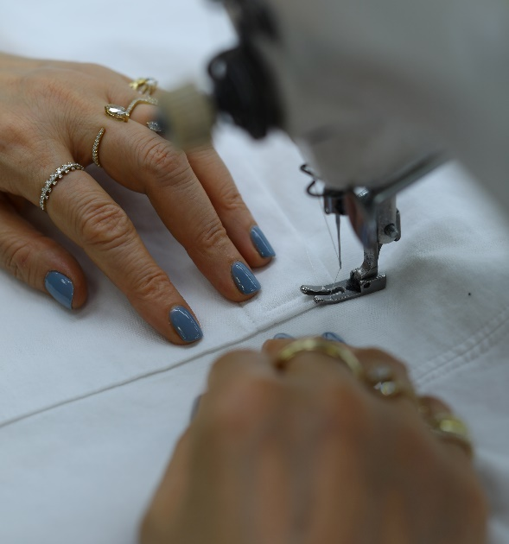
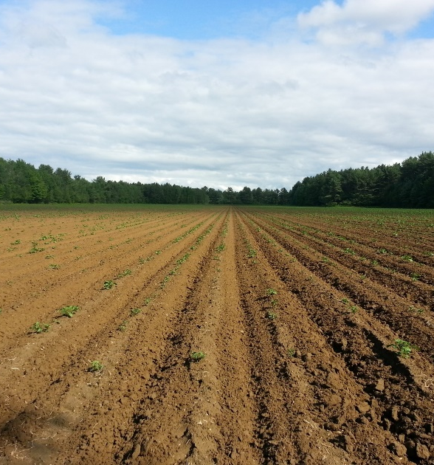
so
sew
sow
“ what?!” He said, clearly not bothered.
My aunty loves to .
The farmers used their tractors to the field.

Slide 38
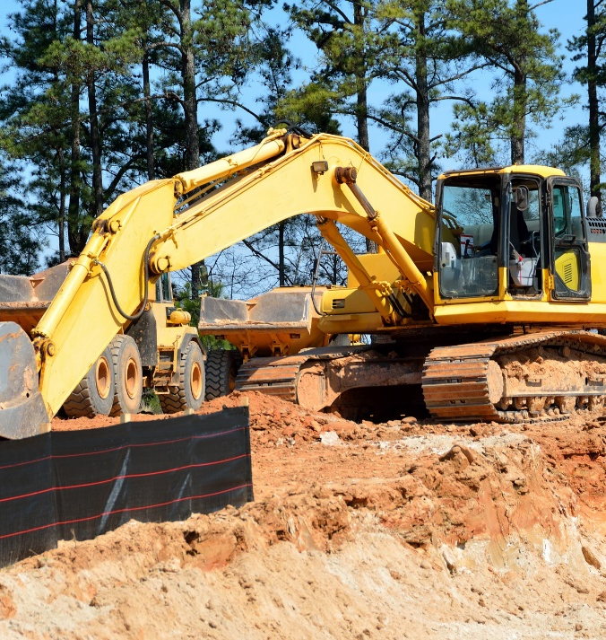
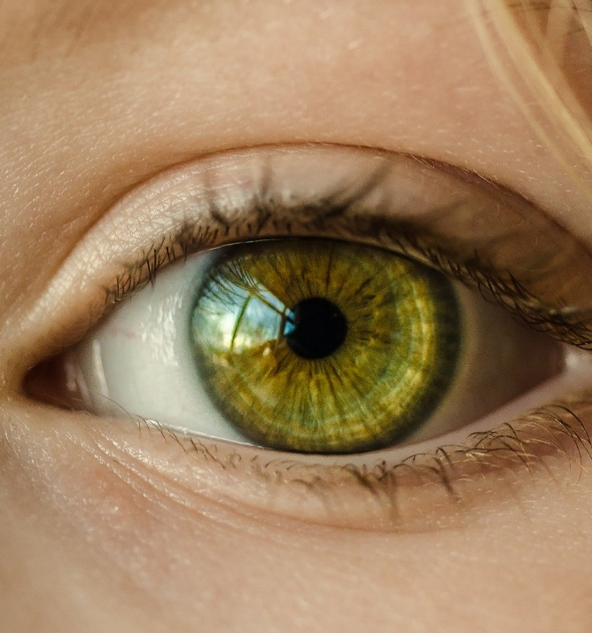
site
sight
You need to wear a hard hat on the building .
She looked around but no one was in .

Slide 39
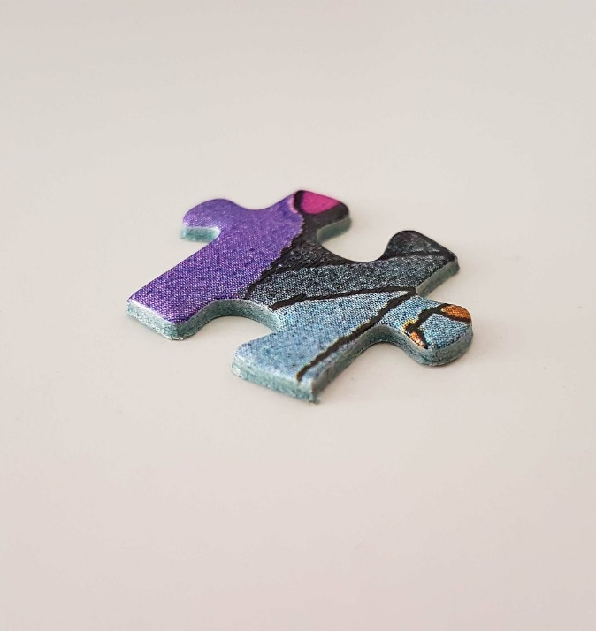

piece
peace
The missing of the puzzle was found.
Hopefully one day, we will find world .

Slide 40


brake
break
The cyclist gripped his to slow down.
The burglar tried to in to the house.

Slide 41


ate
eight
The girl a juicy apple.
The black ball in a game of pool has the number on it.

Slide 42

Activity:

Slide 43
Commonly misspelled words

Slide 44

Be careful!

Slide 45


Slide 46

Commonly misspelled words

Slide 47





Activity:
Choose some of the commonly misspelled words that you know you find difficult to spell.
Create a poster with these words and think of different ways to help you remember the correct spelling.
You may: write some of the word in a different colour to make it stand out, think of a mnemonic to help you remember the order of the letters, draw a picture using the word etc.
Keep this poster in your tray to help you in your English lessons this year.

