Slide 1
Monday 6th September 2021
LO: to write with purpose
to spell correctly
C: Pandora’s Box

Slide 2

Starter
Have you ever done something even though you were expressly told not to do it?
Why did you choose to go ahead and do it?
Were there any consequences?
What where they?
Did they have a short- or long-term impact?

Slide 3
Starter
A thought to consider: are you more likely to want to do something if you’ve been told you can’t?
Why is that?

Slide 4
Pandora’s Box
When the world was first created, people were content with no troubles or concerns. It was idyllic. The people of Earth had been moulded out of clay by the giant Prometheus and the King of the Gods, Zeus, breathed life into them. Prometheus was the teacher of mankind and the most important lesson he imparted was that man must always respect the gods.
The Earth was harmonious until one day when Prometheus tricked Zeus. Zeus was so enraged at being duped that in revenge he extinguished every heat source on Earth leaving mankind both cold and hungry. With no fire, Zeus’ special gift, humans truly suffered, shivering in the dark and eating raw meat.
Prometheus was deeply troubled and upset by the way his creation struggled every day and so, furtively, crept up to Mount Olympus and broke off a blazing beam of the sun for his people. This would allow man to cook again, keep warm and make metal tools to cultivate the land.
To Zeus, this was the final straw and, enraged, he shackled Prometheus to a rock with unbreakable chains and ordered a vulture to claw and rip at his liver. Because the giant was immortal, Prometheus’ liver regrew every night and he endured continual pain with the vulture returning at the crack of dawn every day.
But Zeus had not finished there. He punished mankind too for accepting the Gift of Fire from Prometheus. He asked the God Hephaestos, the blacksmith, to forge a beautiful woman into which the King of the Gods breathed life. Her name was Pandora - the most inquisitive woman ever.

Slide 5
Pandora’s Box
“What’s this? Why’s that? Who’s this? How do you …..?” On and on and on she went - her curiosity knew no bounds.
She was sent to Earth and to Prometheus’ brother, Epimetheus. With Pandora, Zeus gave her a beautiful locked pithos, a jar, which she was expressly asked not to open.
“Take this box and keep it safe. Be warned, you must NEVER open it otherwise grievous things will occur.”
Pandora’s eyes twinkled and her fingers twitched. Prometheus had forewarned his brother never to accept anything from Zeus. However, the day when Pandora knocked on Epimetheus’ door and he opened it, his brother’s words floated from his mind. Captivated by her beauty, he asked her name.
“My name is Pandora,” she replied. “The God Zeus has sent me here to look after you. I bring a beautiful box too.”
Fearful of Zeus and allured by her ways, Epimetheus married Pandora. This he would deeply regret as her outer beauty did not replicate within her. He soon learnt that his wife was vain and self-centred. She would constantly berate, annoy and tease her husband. She was demanding, bossy and so, so curious. And every day she would pester her husband to open the locked jar.
“No Pandora! It is forbidden.”
“What’s the point in having a beautiful jar full of wonderful things if you can’t appreciate what’s inside?” Pandora sulked. Epimetheus went as white as a sheet. Her husband’s stubbornness made Pandora even more determined, so convinced was she that the jar contained a bountiful treasure of jewels.

Slide 6
Pandora’s Box
Every day, she would gently stroke the jar and play around with the lock. She was convinced she could hear little voices inside calling, “Set us free! Set us free!”
One day, as Epimetheus slept, curiosity finally got the better of Pandora.
She would open it.
“Just one little peek won’t harm anybody,” she convinced herself.
Hardly able to breathe, heart beating with excitement, Pandora broke the lock and slowly lifted the lid. Before she could peek inside, there was a terrible wailing noise from within. Jumping back in terror, Pandora watched with horror as, out of the box streamed all sorts of horrendous creatures which buzzed and hissed and moaned.
Hate, greed, envy, anger, jealousy, cruelty, hunger, poverty, pain, sickness.
Pandora desperately tried to slam the lid down but to no avail. The creatures spread and flew everywhere, stinging and pricking humankind forever more.
But as the last destructive creature left the box, a dismayed Pandora noticed a tiny flicker of light from within which fluttered and flew upwards and away.
HOPE.

Slide 7
What type of story do you think this is?
Can you explain why?

Slide 8
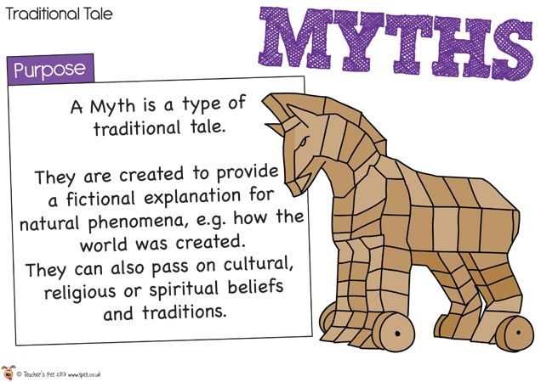
This story is a ‘myth.’
Do you know what a myth is?

Slide 9

A ‘myth’ is a traditional, ancient story that is fictional.
Myths were often written to explain natural phenomena and quite often involved gods and fantasy creatures.
In Greek, the word ‘mythos’ means story.
There are myths from every culture in the world, but the best-known ones are from Ancient Greece, Rome or from the Norse people of Northern Europe.

Slide 10
Myths usually have heroes or heroines who are gods or people with amazing strength or super powers.
The hero or heroine often has to go on a journey to outwit or do battle with a frightening beast or monster.
Gods and monsters are the two main ingredients of many myths.
Some myths try to explain how the universe of natural world was created.
These are called ‘creation myths’ or ‘nature myths.’

Slide 11
How do you know that Pandora’s box is a myth?
What are the features of myths?
Create a bubble map of your ideas.

Slide 12
There are three main purposes of Greek myths:
1. To help the Ancient Greeks understand the world in which they lived – to explain things (such as the weather or seasons) that they had no other explanation for.
2. To teach the Ancient Greeks how to behave and about consequences of actions – a moralistic purpose.
3. To give the Ancient Greeks stories about the gods and goddesses that formed their religion.
Which purpose would this myth have served for the Ancient Greeks?

Slide 13
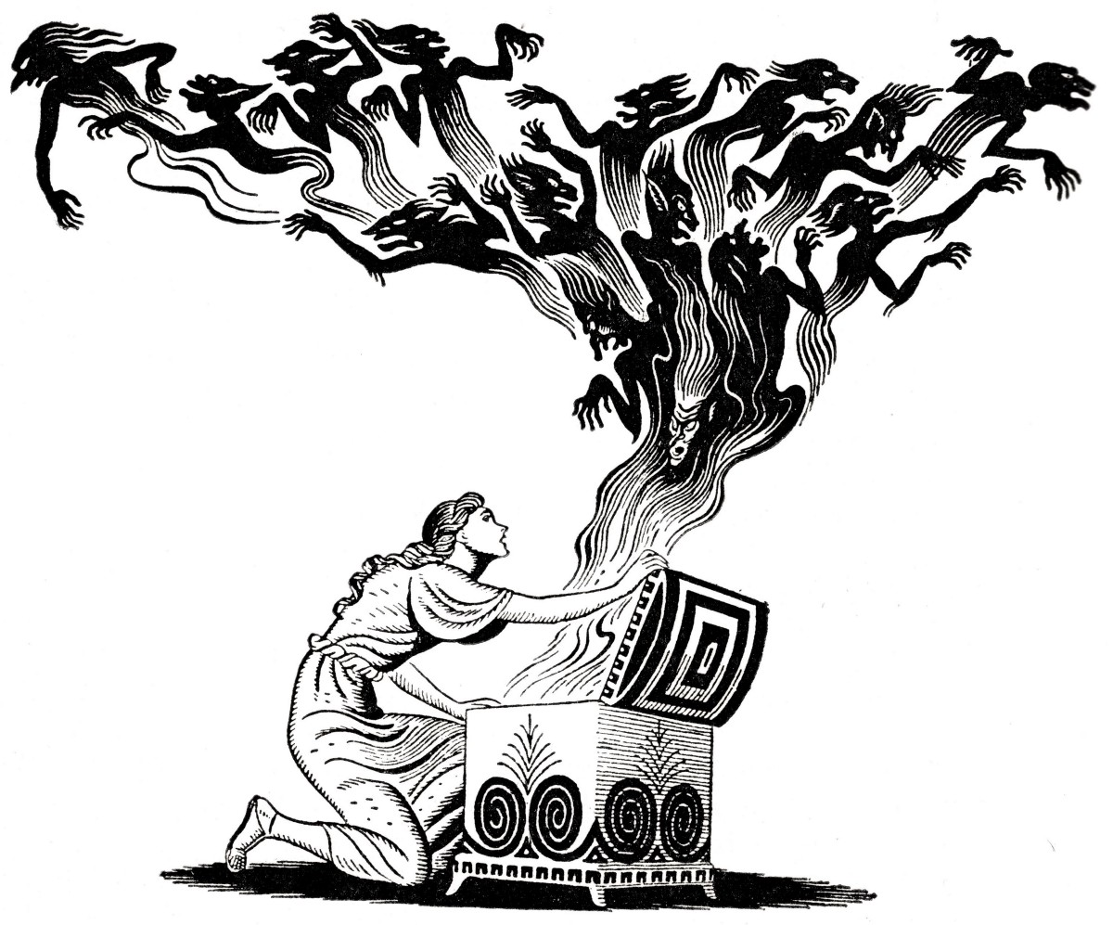
Pandora’s Box, while having a moralistic purpose (beware of your curiosity!), also explains the world and something the Ancient Greeks had no other explanation for – the beginning of time.
It is a creation myth.

Slide 14
Who might read Greek myths?
Why would they choose to read them?

Slide 15
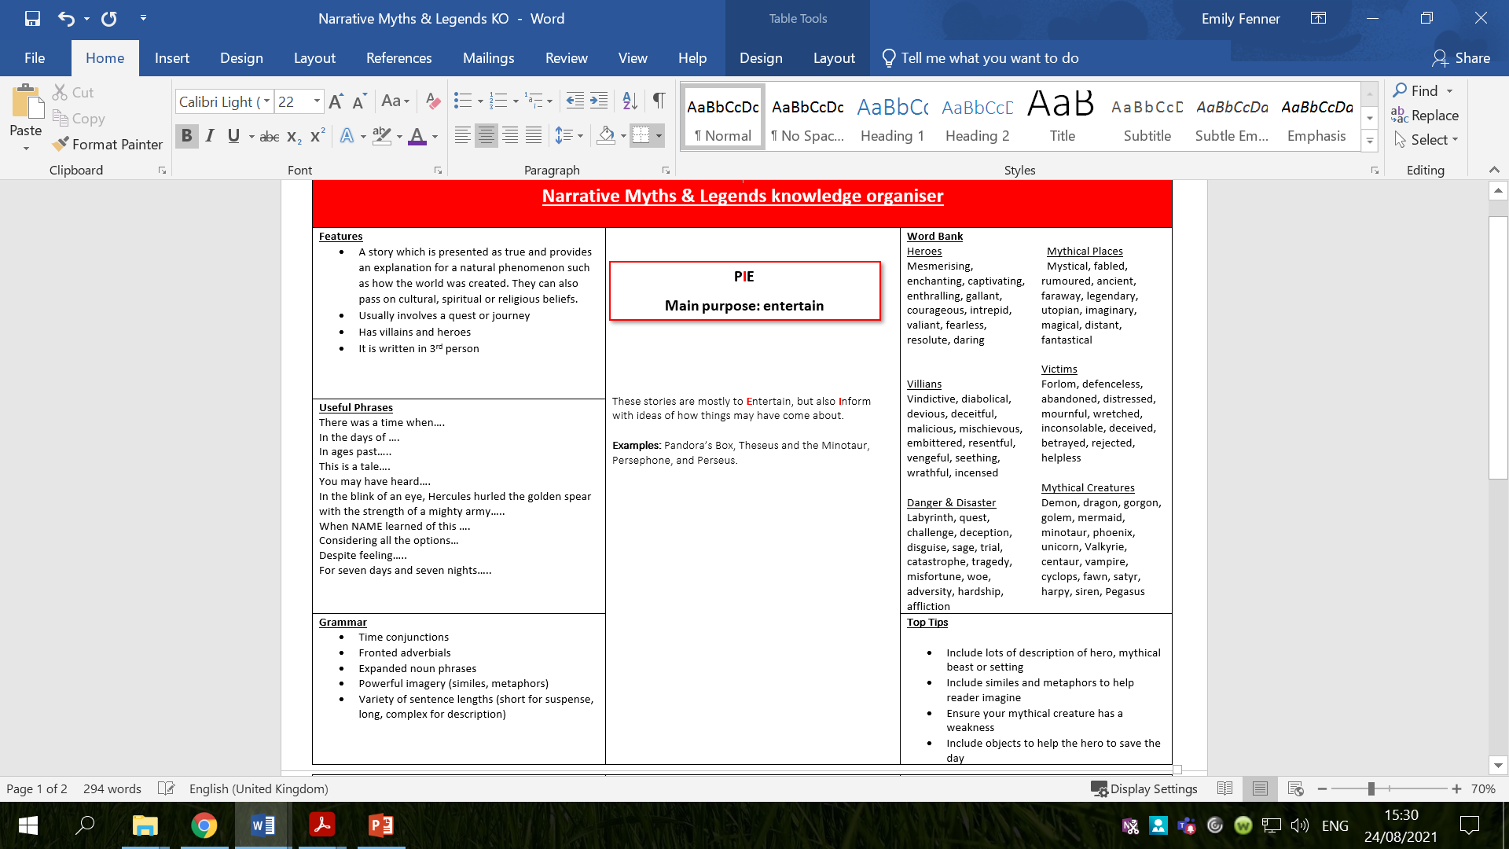
Look at the information on the knowledge organiser.
What are the features of myths?
What vocabulary might you see in myths?
Is there any vocabulary that you don’t understand?

Slide 16
Activity
1. Stick in the knowledge organiser.
2. Use the knowledge organiser to create a bubble map with key information about myths and the features of myths you will need to remember for this topic.
Red Pen: Write down any impressive vocabulary/sentence starters you would like to use in this topic.
Look back at the Pandora’s Box text – write down any words / phrases / sentence starters you would like to use in this topic.

Slide 17
Tuesday 7th September 2021
LO: to write with purpose
to use imaginative description
C: Pandora’s Box

Slide 18
You will be writing your own version of Pandora's Box over the next couple of weeks.
Your story will follow a similar structure and involve the same characters, but there will be some changes, such as setting and what is in the box.
You will be retelling the myth in a familiar setting, e.g. a forest, beach, field, playground, house, school etc.
Where will you set your story?

Slide 19
Zeus placed all of the evils of the world inside a sealed box. If he were to create another box, what could be kept inside?
The box might easily hold something which is good instead of something which is bad.
If the story was to be rewritten and set now, in the 21st century, which evils may come out of the box? Would they be the same or different? E.g. racism, sexism etc.
In the myth, ‘hope’ was the last remaining ‘creature’ in the box. What will you have remaining in your box in your version? E.g. love, positivity, happiness etc.

Slide 20
In this story, Pandora’s curiosity leads her to open the box which contains all the evils of the world. What characteristic will your hero have which leads them to make a grave error?
Zeus punishes man because he does not want others to have powers like a God. What will the gods punish mortals for in your story? Are they right to punish the mortals or is their punishment unjust?

Slide 21
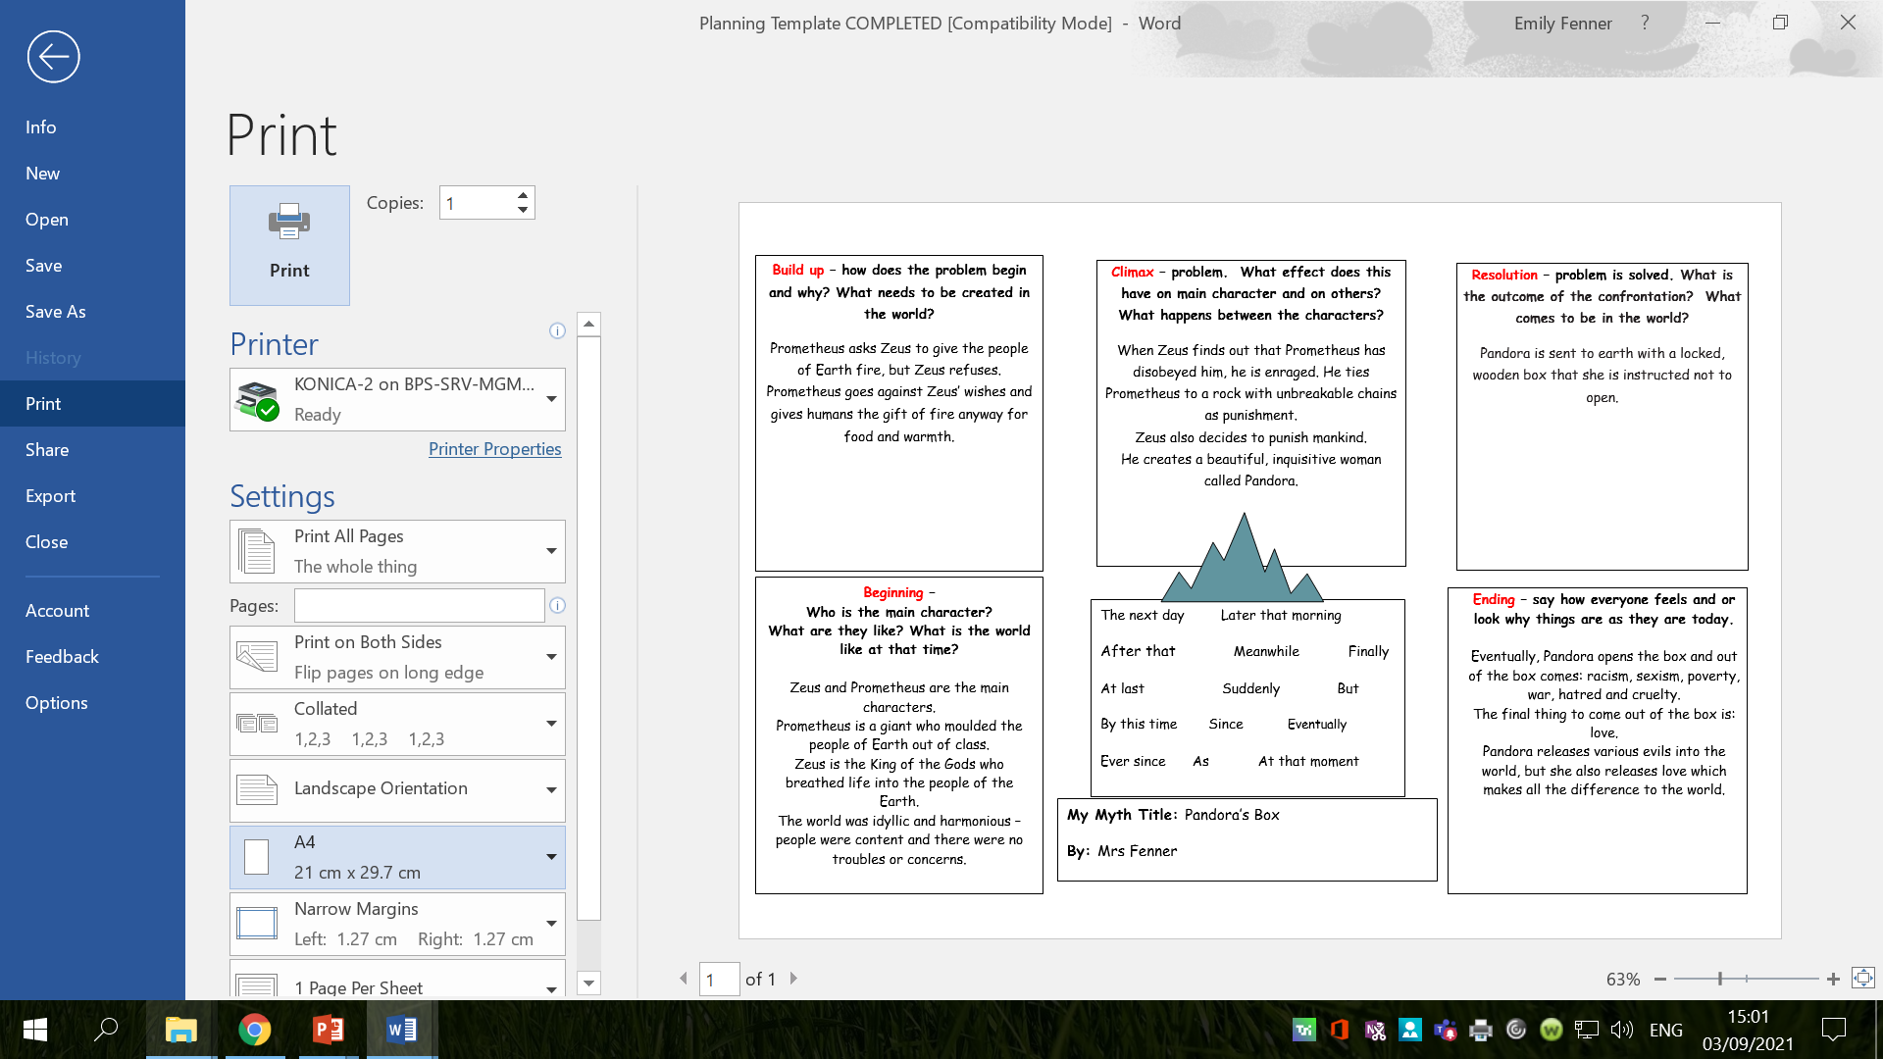
Here are my ideas:
What ideas can you think of for your story?

Slide 22
Activity
Plan your own version of Pandora’s Box using the planning template.
Remember to use a familiar setting for your story.
What aspects of the story will you change? e.g. what’s in the box.
Red Pen: using your story plan, practice saying your story out loud.
Try to use:
impressive vocabulary in your expanded noun phrases
Adverbial phrases
Conjunctions
Jot down any words/phrases that you say aloud which you would like to use in your writing next week.

Slide 23
Wednesday 8th September 2021
LO: to use imaginative description
to spell correctly
to punctuate accurately
C: Pandora’s Box

Slide 24

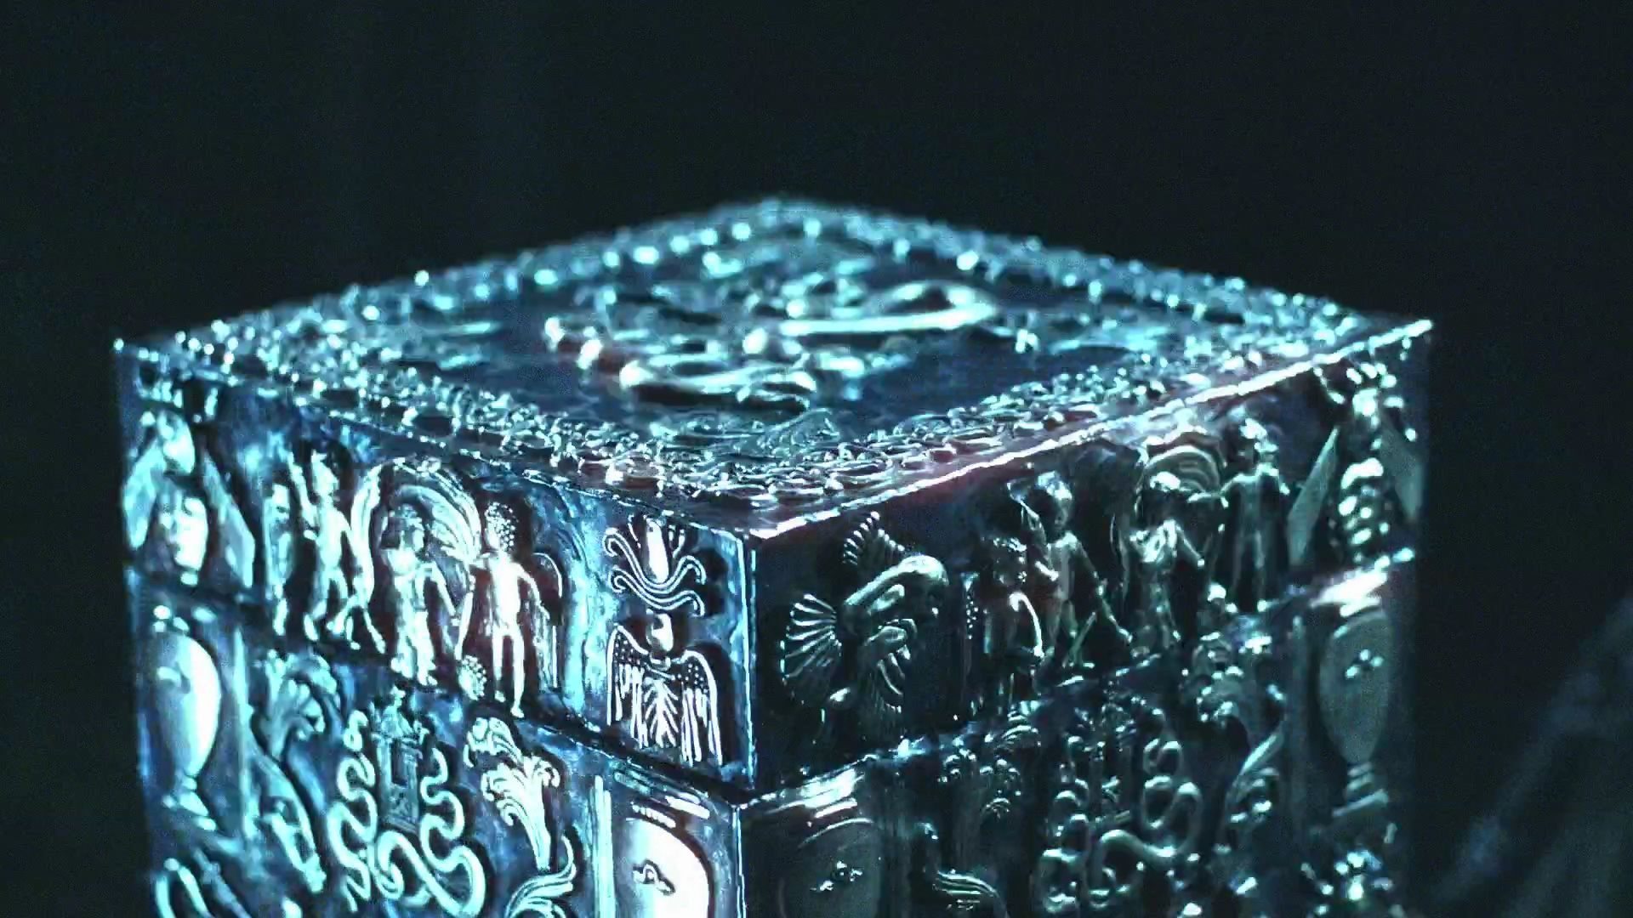
Starter
What expanded noun phrases can you think of to describe the boxes?
Try to use impressive vocabulary!

Slide 25
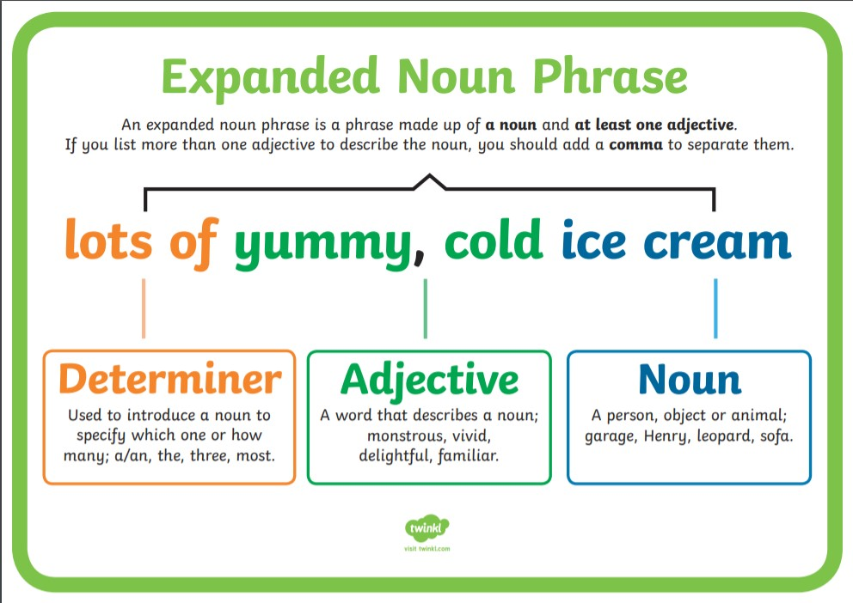
Remember:
An expanded noun phrase adds more detail to a noun by adding one or more adjectives.
It is made up of a noun and at least one adjective.
It needs a determiner, adjective(s) and a noun.
If you list more than one adjective to describe the noun, you need to add a comma to separate them.
delectable, sweet

Slide 26
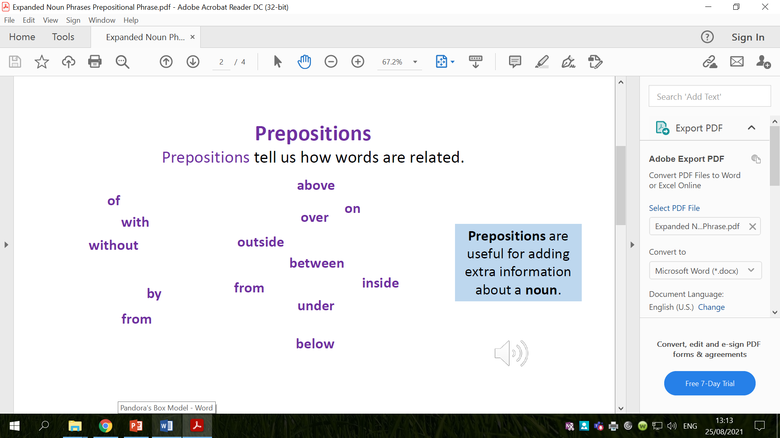
You can also use prepositions to add information to your expanded noun phrases.
Prepositions tell us how words are related and are useful for adding extra information about a noun.
Examples:
the weary, aged man with the vivid, red hat
an old, cloudy bottle with a hidden, coded message in
an old, cloudy bottle on the crowded, pebbled beach
an old, cloudy bottle from foreign shores
an old, crumpled treasure map in the rotting, wooden trunk
The wooden, rough planks from a wrecked ship
A weighty, gold coin with strange markings
Try to use prepositional phrases in your expanded noun phrases today.

Slide 27
How does the different packaging affect your interest?

Slide 28
Think back to the story of Pandora’s Box – do you think she would have been as interested in the box’s contents if the box had been plain?
Why / why not?

Slide 29

Are there any clues in the text which tell us what Pandora’s Box might have looked like?
She was sent to Earth and to Prometheus’ brother, Epimetheus. With Pandora, Zeus gave her a beautiful locked pithos, a jar, which she was expressly asked not to open.
“Take this box and keep it safe. Be warned, you must NEVER open it otherwise grievous things will occur.”
Pandora’s eyes twinkled and her fingers twitched. Prometheus had forewarned his brother never to accept anything from Zeus. However, the day when Pandora knocked on Epimetheus’ door and he opened it, his brother’s words floated from his mind. Captivated by her beauty, he asked her name.
“My name is Pandora,” she replied. “The God Zeus has sent me here to look after you. I bring a beautiful box too.”
Fearful of Zeus and allured by her ways, Epimetheus married Pandora. This he would deeply regret as her outer beauty did not replicate within her. He soon learnt that his wife was vain and self-centred. She would constantly berate, annoy and tease her husband. She was demanding, bossy and so, so curious. And every day she would pester her husband to open the locked jar.
“No Pandora! It is forbidden.”
“What’s the point in having a beautiful jar full of wonderful things if you can’t appreciate what’s inside?” Pandora sulked.
Epimetheus went as white as a sheet. Her husband’s stubbornness made Pandora even more determined, so convinced was she that the jar contained a bountiful treasure of jewels. Every day, she would gently stroke the jar and play around with the lock. She was convinced she could hear little voices inside calling, “Set us free! Set us free!”
One day, as Epimetheus slept, curiosity finally got the better of Pandora. She would open it.
“Just one little peek won’t harm anybody,” she convinced herself.
Hardly able to breathe, heart beating with excitement, Pandora broke the lock and slowly lifted the lid. Before she could peek inside, there was a terrible wailing noise from within. Jumping back in terror, Pandora watched with horror as, out of the box streamed all sorts of horrendous creatures which buzzed and hissed and moaned.
Hate, greed, envy, anger, jealousy, cruelty, hunger, poverty, pain, sickness. Pandora desperately tried to slam the lid down but to no avail. The creatures spread and flew everywhere, stinging and pricking humankind forever more.

Slide 30

Imagine your idea of what Pandora’s Box might have looked like.
Think about the important design elements, e.g. why shouldn't the box be easy to open? Why shouldn’t the box be plain?
Describe your ideas using expanded noun phrases.
Challenge: use prepositional phrases in your
expanded noun phrases too.

Slide 31
Now, you are going to turn your descriptive phrases into compound sentences with conjunctions.
What is a compound sentence?
Which conjunctions can be used with compound sentences?

Slide 32
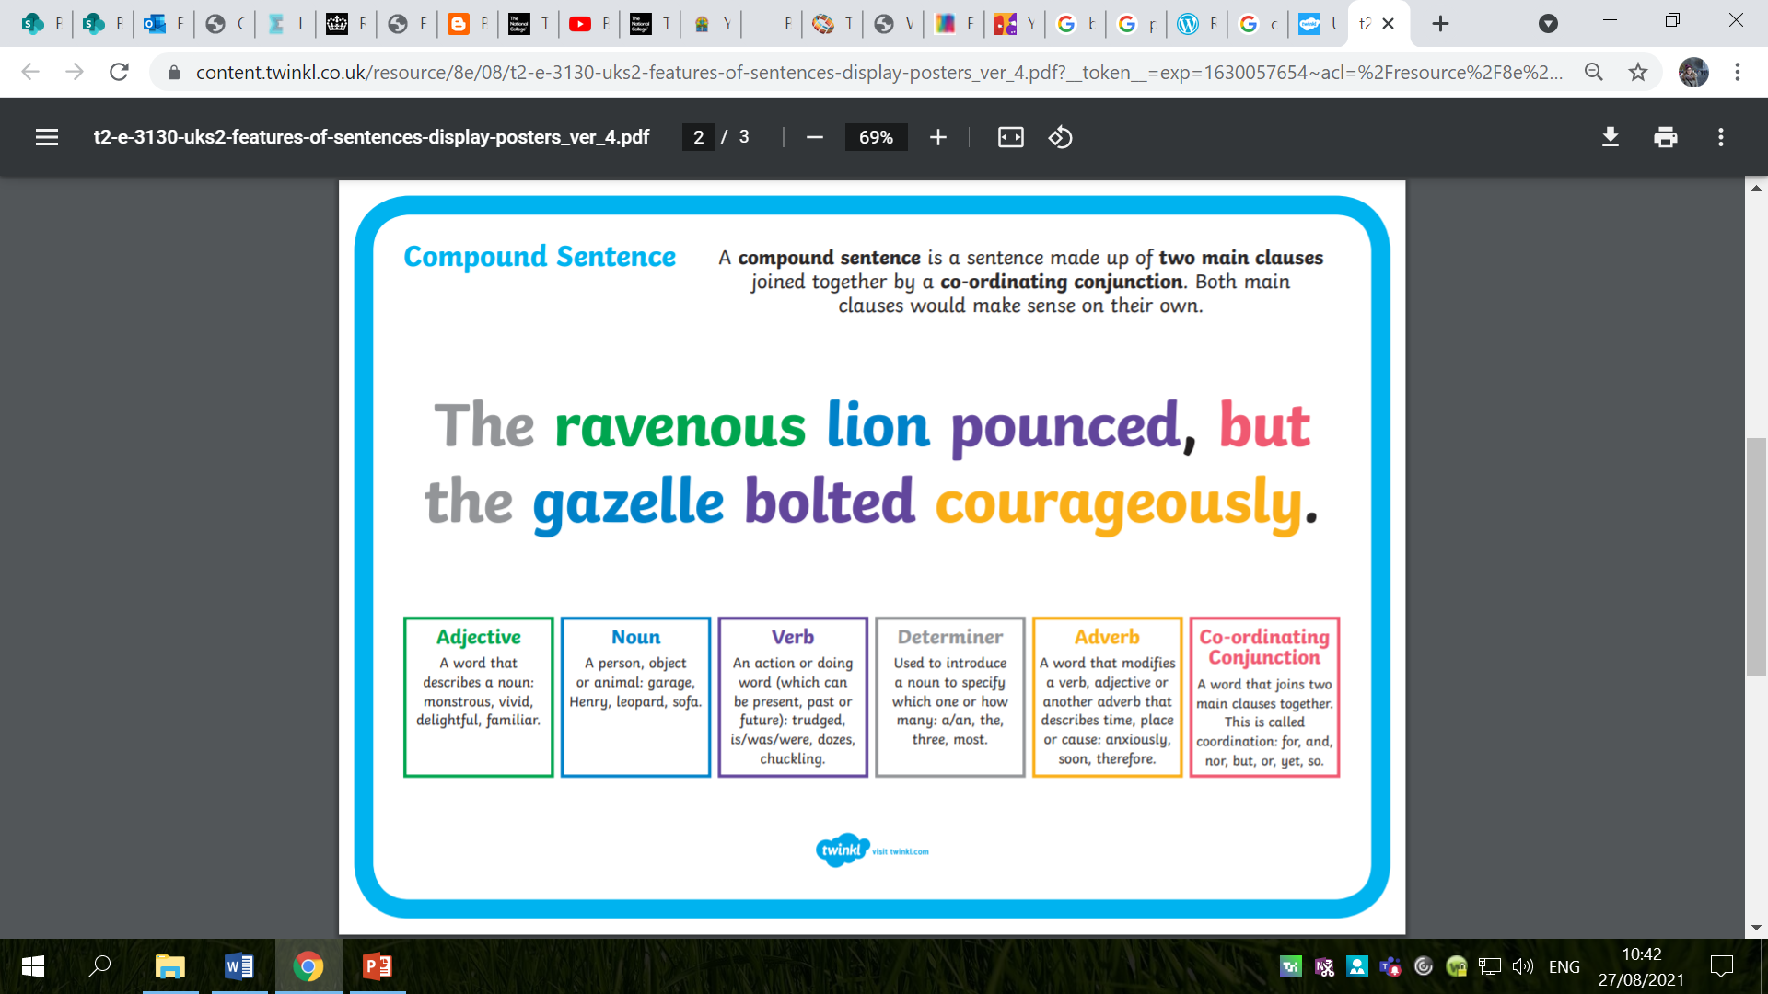

Slide 33
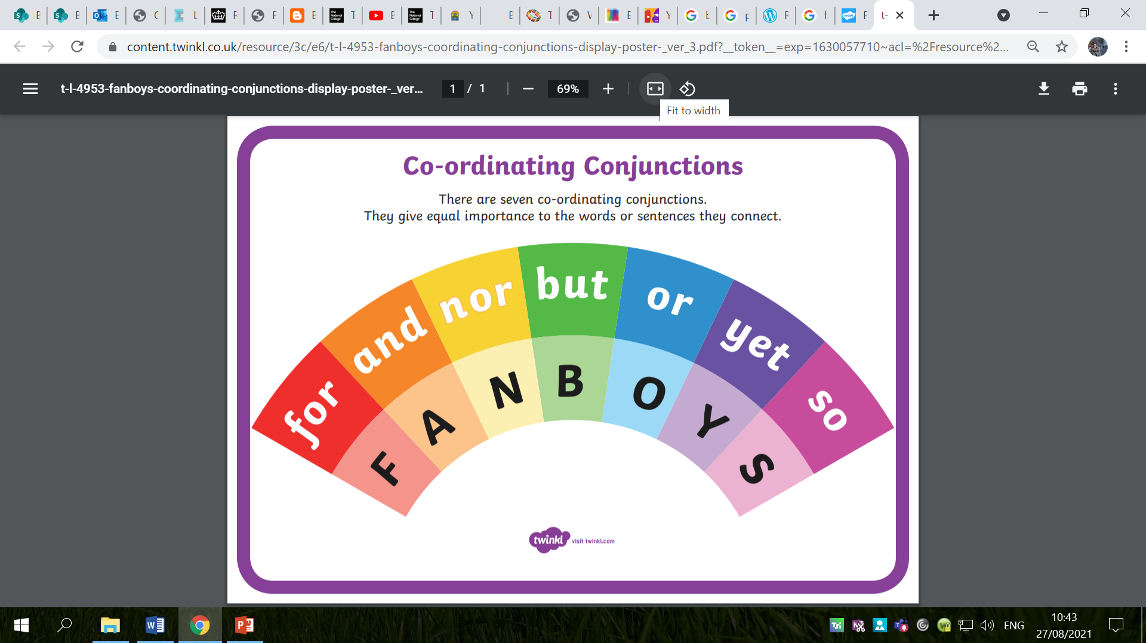

Slide 34
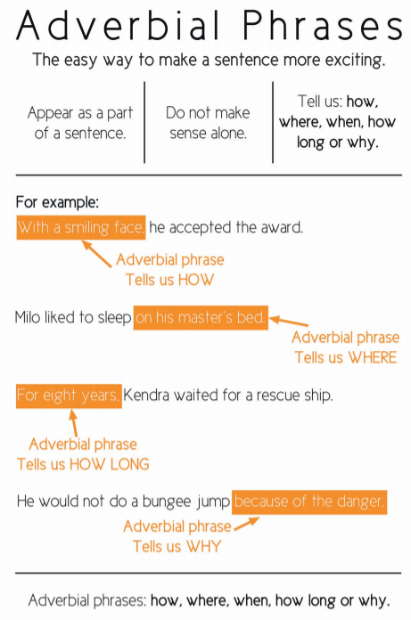
Adverbial Phrases
Remember: adverbial phrases are like adverbs – they add more information to the sentence, but they use more than one word to describe the verb.
Adverbial phrases can make a sentence more interesting and exciting.
They tell us how, when, where, why and how long a verb is done.

Slide 35
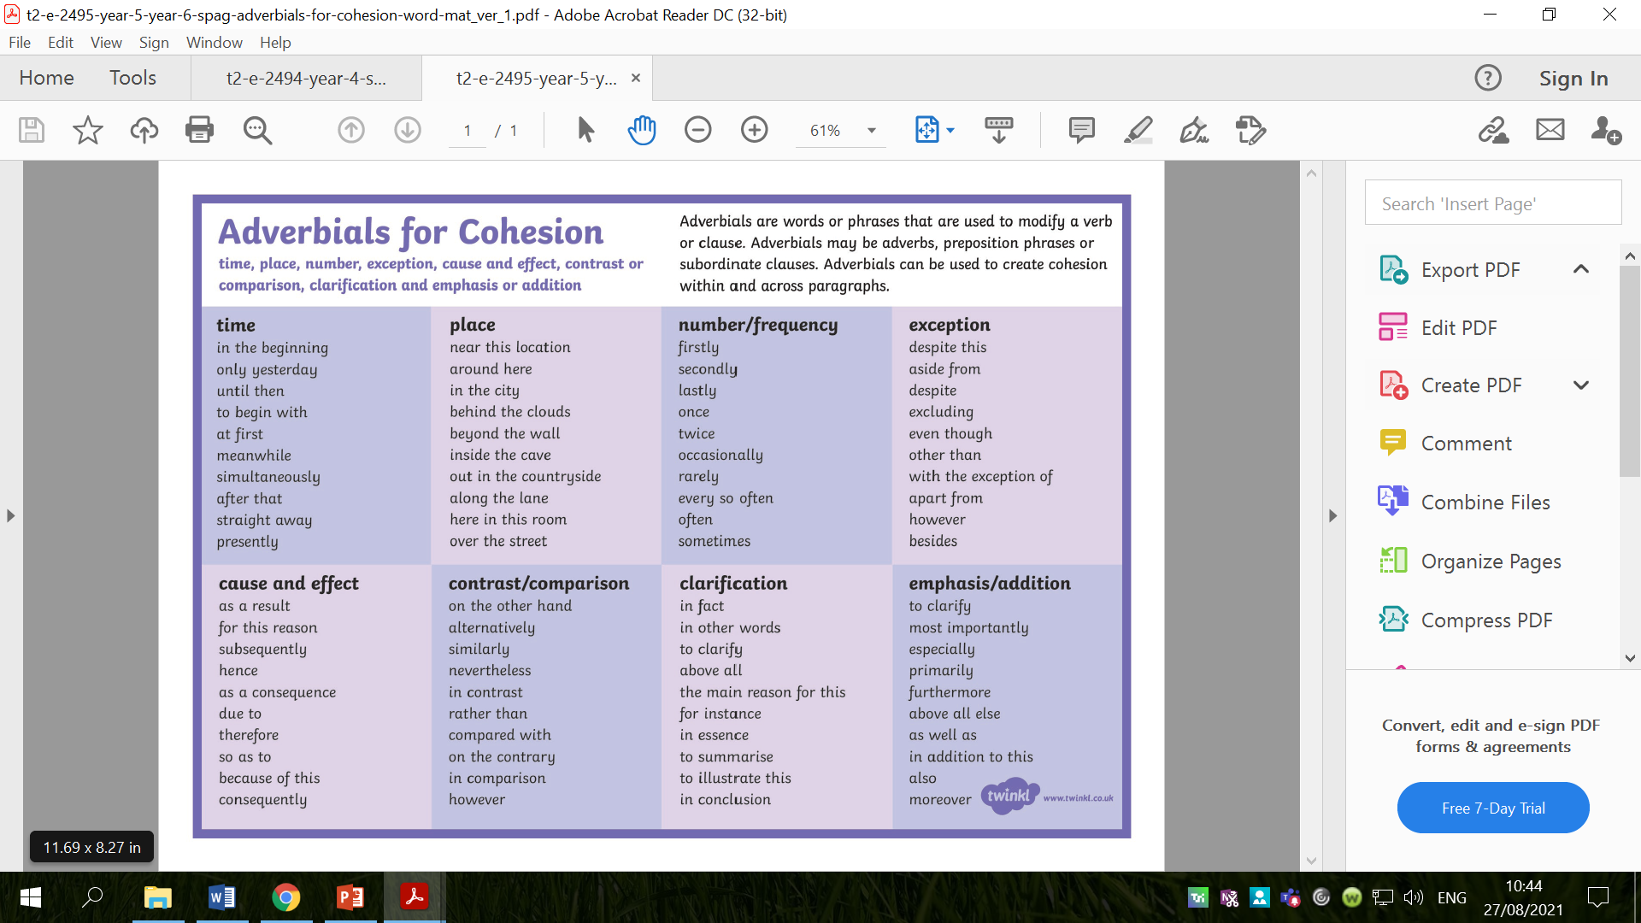
Create some compound sentences using the adverbial phrases from the list above.

Slide 36
Activity
Draw Pandora and her box. Label both Pandora and
her box with expanded noun phrases to describe.
Paddling: write expanded noun phrases to describe Pandora and her box. See if you can use some prepositional phrases, e.g. the golden, fragile box with an intricate design on top.
Snorkelling: write expanded noun phrases to describe Pandora and her box. Try to add prepositional phrases to your descriptions.
Diving: write expanded noun phrases to describe Pandora and her box. Ensure you have included prepositional phrases in your expanded noun phrases.

Slide 37
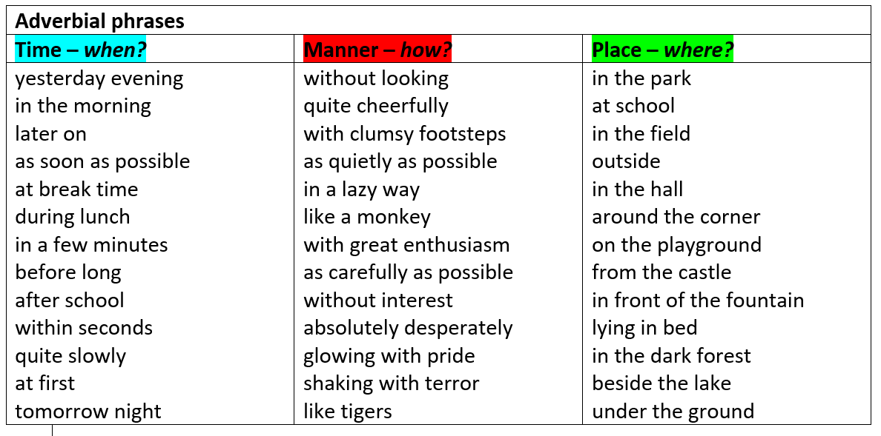
Red Pen
Turn your expanded noun phrases into compound sentences with conjunctions and adverbial phrases.
Use the list of adverbial phrases to help you.
Examples:
At first, Pandora could not tear her bright, twinkling eyes away from the intricately carved, wooden box, for she longed to know what was inside.
As carefully as possible, Pandora tried to lift the smooth, weighty lid on top of the curious box, yet it was hopeless. The lid remained firmly shut.

Slide 38
Thursday 9th September 2021
LO: to write with purpose
to punctuate accurately
C: Pandora’s Box

Slide 39

Starter
What punctuation mark is this?
When might it be used in our writing?

Slide 40
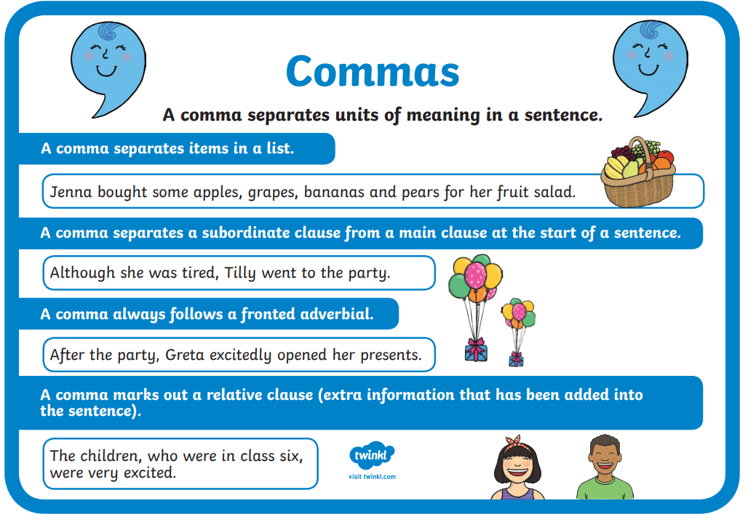
Starter

Slide 41

Commas should be used:
1. To separate items or adjectives in a list.
For example:
His favourites puddings were apple pie, rhubarb crumble and ice cream.
Monika wore a red, blue, purple and white jumper.
Can you punctuate this list with commas?
My three favourite foods are fish pie stir fry and pizza.

Slide 42

Commas should be used:
2. Before these conjunctions: for, and, nor, but, or, yet, so to separate two independent clauses.
For example:
She was a fantastic cook, but she would never be as good as her mother.
He had a toothache, so he rang the dentist.
Can you break up this sentence using a comma?
I wanted to the shops today but I decided to stay at home.

Slide 43
Commas should be used:
3. To separate a fronted adverbial from the rest of the sentence.
For example:
Given the terrible weather conditions, the crew of the yacht were lucky to complete the race.
As the last ray of sun disappeared, Yasmine crept silently out of the house.
Can you insert a comma after the fronted adverbial?
Fortunately the next bus came five minute later.

Slide 44
Commas should be used:
4. To indicate parenthesis.
Parenthesis in a sentence adds information and can be removed without changing the meaning.
For example:
Milan, the cleverest boy in the class, was often late for school.
CBBC, which is based in Manchester, is a popular children’s TV channel.
Can you separate the extra information in this sentence?
The sandwich which was the only one left was delicious.

Slide 45
Commas should be used:
5. To separate direct speech from the rest of a sentence.
For example:
“Martina,” called Mum, “it’s time to leave for school.”
“Stop right there,” the man commanded. “This is private property.”
Can you separate direct speech from the rest of the sentence below using a comma?
Tommy shouted “Help me please, I’m stuck in here!”

Slide 46

Commas should be used:
6. To separate main and subordinate clauses
For example:
While you’re waiting, you can read a magazine.
Although I love football, swimming is my favourite sport.
Can you use a comma to separate the subordinate clause below?
After she picks me up mum is taking me to buy shoes.

Slide 47
Comma splices
Comma splices occur when two independent clauses are joined by a comma. Comma splicing is inaccurate and should be avoided.
For example:
Julian usually gets on with everybody, he is an understanding person.

Slide 48
Comma splices
Instead of a comma splice, the writer could use:
a semi colon:
Julian usually gets on with everybody; he is an understanding person.
or a full stop:
Julian usually gets on with everybody. He is an understanding person.

Slide 49
Comma splices
Can you correct the sentences?
Tom read the novel, his friend saw the movie.
The dancers were beautiful, they were very well coordinated.
I am tired, I have to go to school.

Slide 50

Why are these commas in the sentences?
On Saturday, I’m going to the water park.
Michael said, “I’m not going.”
You can have your potatoes boiled, steamed, mashed or roasted.
I knew it was wrong, but I did it anyway.

Slide 51

Commas can be used to aid clarity, prevent ambiguity and indicate where you need to pause.
At times, commas – or the lack of them – can change the meaning.
https://www.youtube.com/watch?v=mjv5Vp7tHsU&t=110s

Slide 52
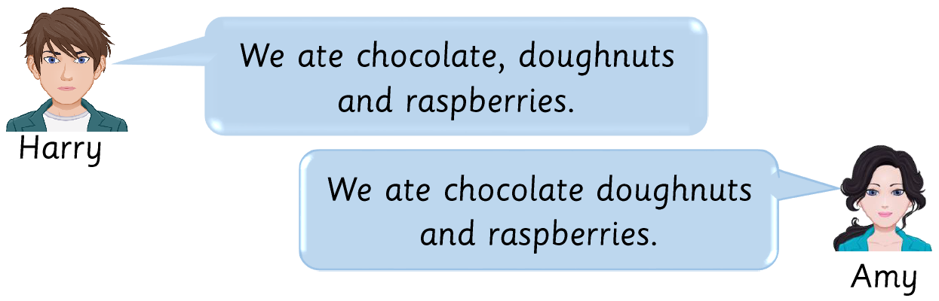
How is the meaning of the sentence changed by the addition of the comma?

Slide 53
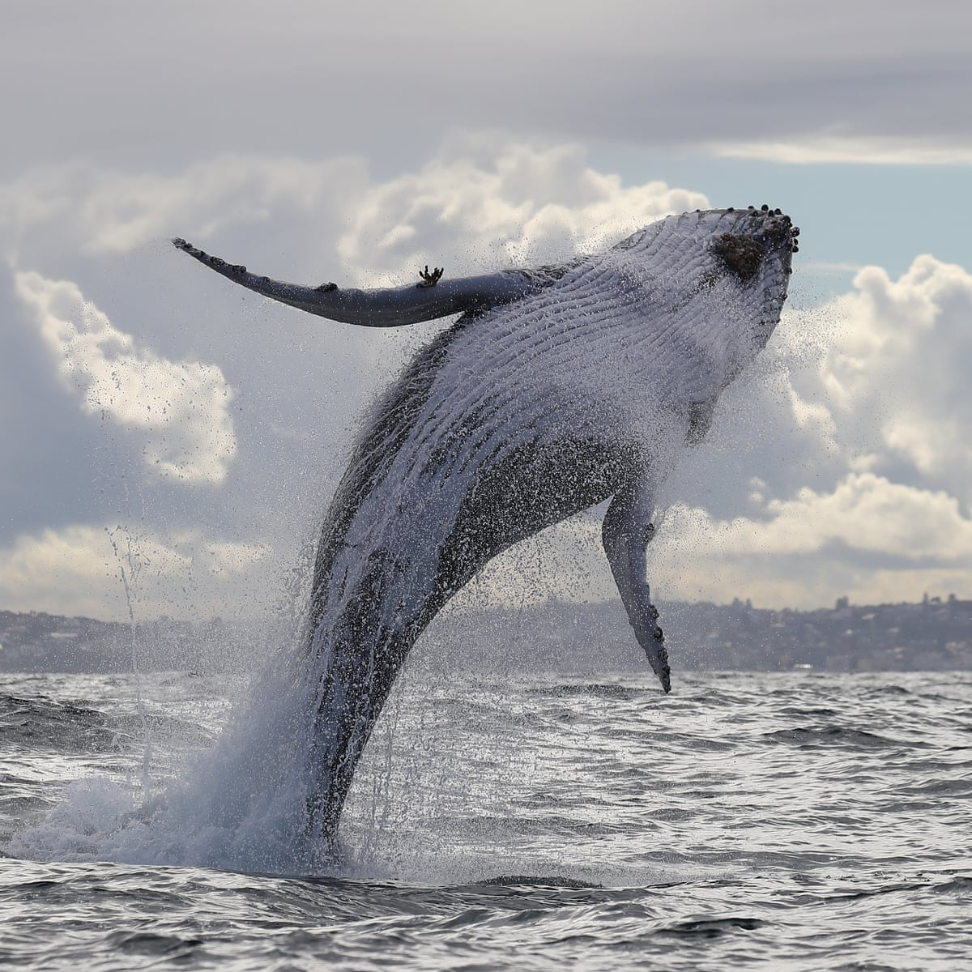
How is the meaning of the sentence changed by the addition of the comma?
The female humpback, said the diver, was at least fifteen metres long.
The female humpback said the diver was at least fifteen metres long.

Slide 54
How could you use commas to clarify meaning and avoid ambiguity in your Pandora’s Box myth?
Remember to use expanded noun phrases and prepositional phrases in your sentences.
Examples:
Zeus punished Prometheus, with a cruel plan.
As the humans shivered in the dark eating, Prometheus broke off a blazing beam of sun for his suffering people.
Zeus, said Prometheus, was enraged.

Slide 55
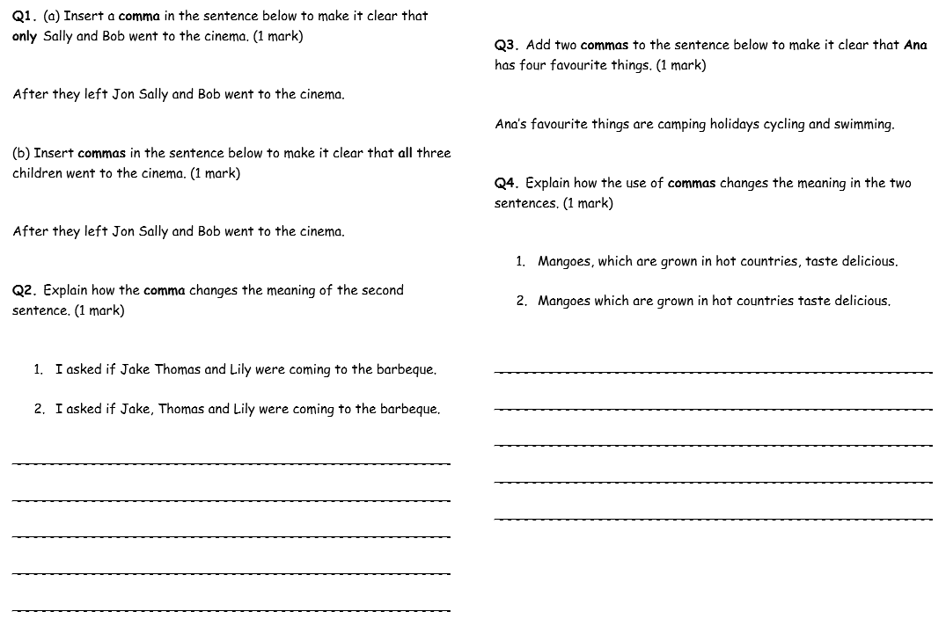
Activity
1. Complete the comma grammar
questions.
2. Write sentences linked to
Pandora’s Box using commas to
clarify meaning/avoid ambiguity.
Paddling: complete the sentence starters given
Snorkelling: ensure you use commas correctly in your writing.
Diving: ensure you use correctly commas and semi-colons in your writing.

Slide 56
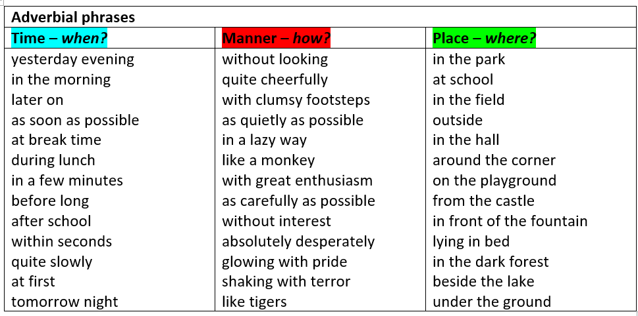
Red Pen:
Can you include expanded noun phrases with prepositional phrases in your writing?
What about adverbial phrases?

Slide 57

Divers
What can you remember about semi-colons?

Slide 58
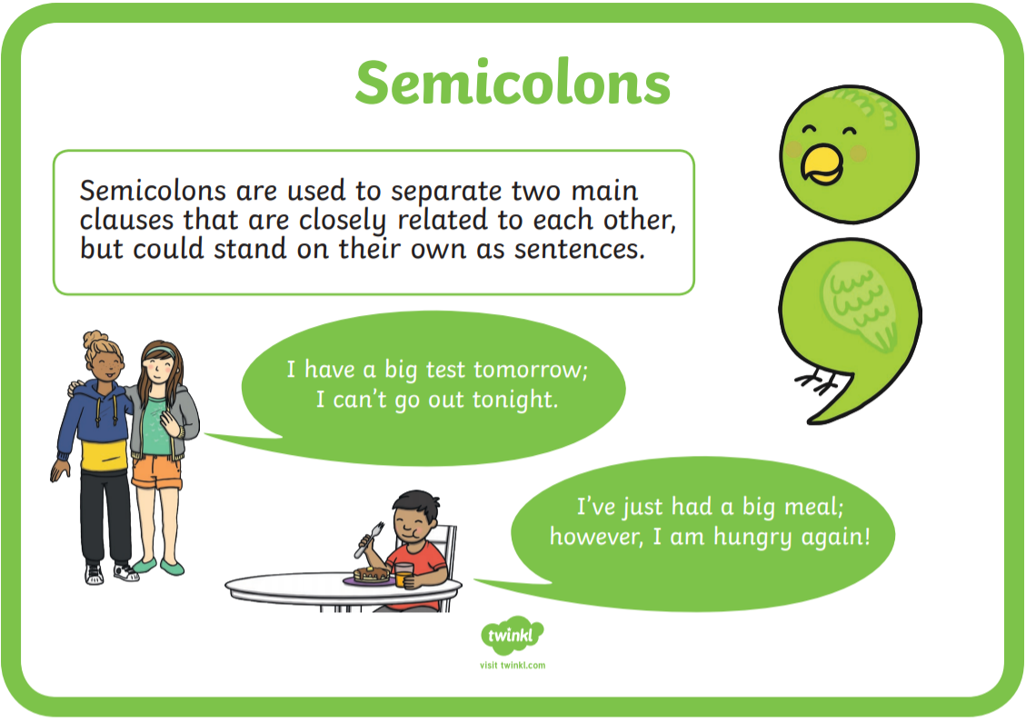
Divers
Semi-colons are to separate two independent (main) clauses that are closely related.
Semi-colons are mainly used within a sentence to separate clauses. The clauses must be on the same theme and not be joined together with a conjunction; the semi-colon takes the place of the conjunction within the sentence.
A semi-colon can sometimes replace a coordinating conjunction in a sentence - words like and, but, because or so that are used to link two clauses.

Slide 59
Divers
How could you use semi-colons in our Pandora’s Box myth?
Remember to use expanded noun phrases and prepositional phrases in your sentences.
Examples:
Pandora clutched the delicate, sealed box to her chest; she was desperate to open it.
Zeus roared wildly with anger; Prometheus must be punished.
The house was silent and absolutely still; Pandora realised this was her chance to open the curious, detailed box.
Pandora was determined; she believed the jar contained a bountiful treasure of jewels.

