Slide 1
Monday 14th June 2021
L.O: To use fractions.
C: Fractions on a Number Line.

Slide 2
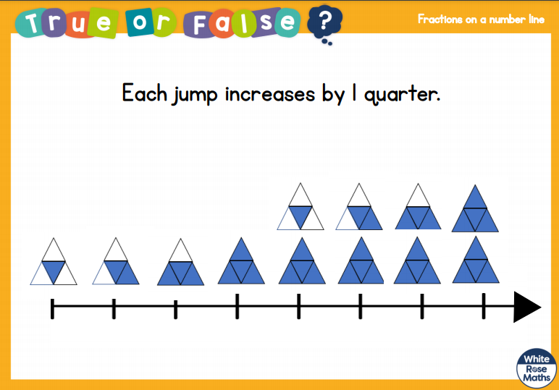
Monday 14th June 2021
L.O: To use fractions.
C: Fractions on a Number Line.

Slide 3
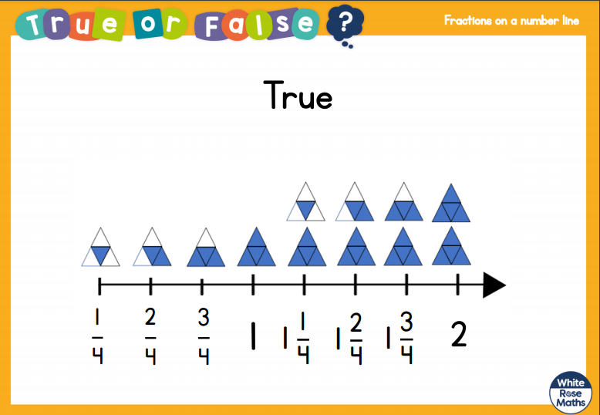
Monday 14th June 2021
L.O: To use fractions.
C: Fractions on a Number Line.

Slide 4

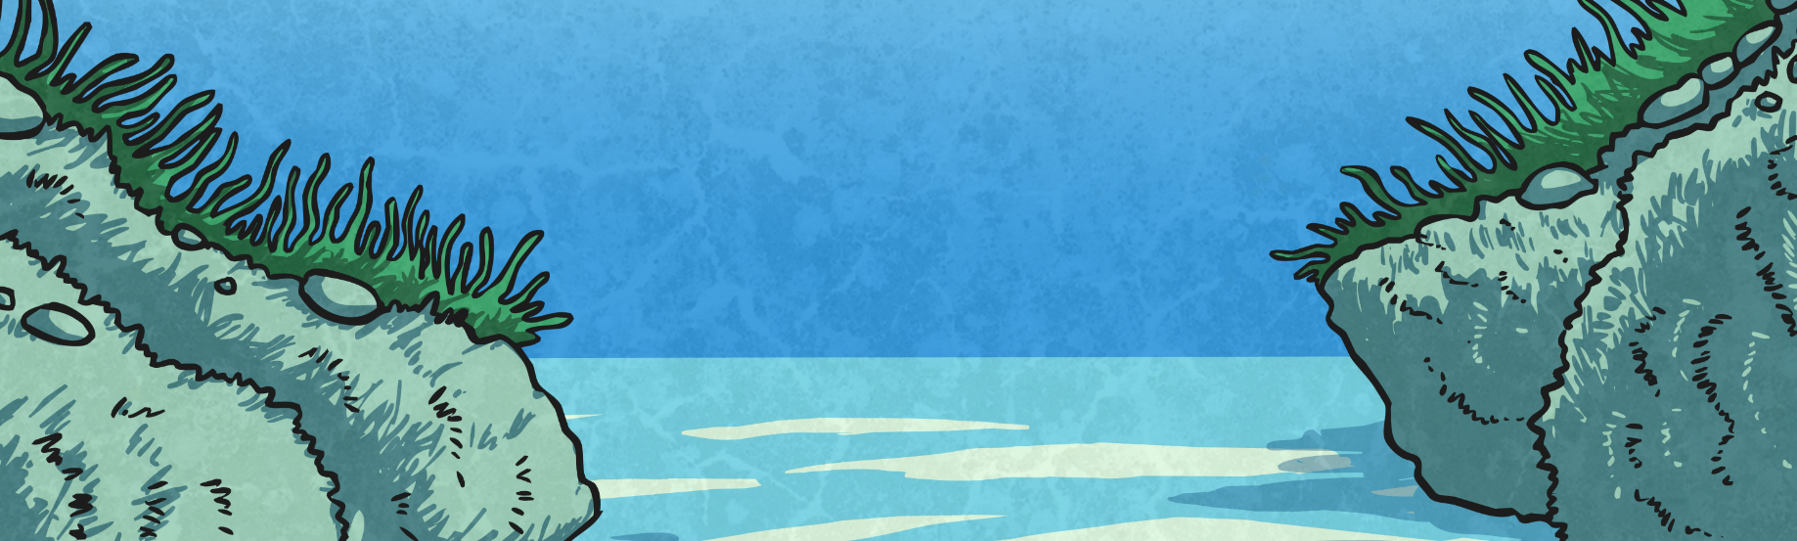
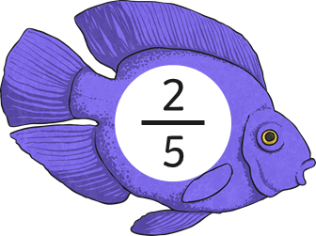
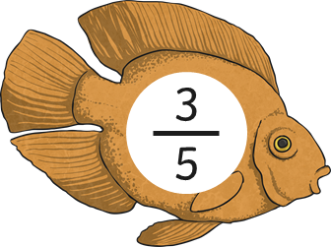
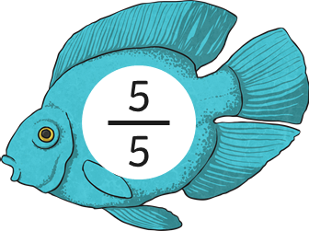
Fractions on a Number Line
Diving
Sophie loves fishing. When she catches fish of the same family, she sorts them into size order. Which of the fraction fish should Sophie try to catch if she wants to sort them on a number line into size order?
0
1

Slide 5
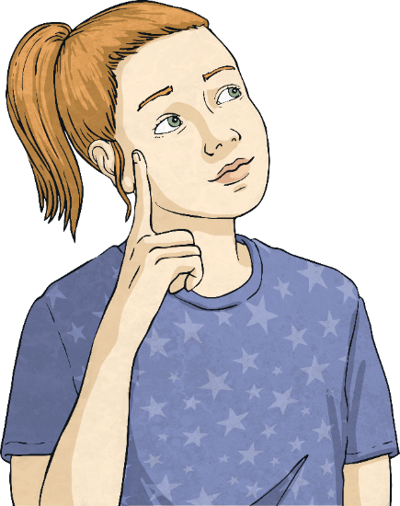
Fractions on a Number Line
Diving
The number line is divided into equal parts.
What fraction belongs in the middle of the number line?
0
1
1
4
1
5
1
2
1
1

Slide 6
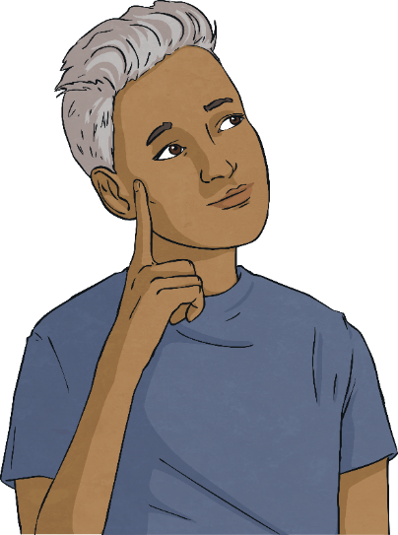
Fractions on a Number Line
Diving
The number line is divided into equal parts.
What fraction belongs here?
0
1
3
7
2
7
3
6
2
6

Slide 7

Fractions on a Number Line
Diving
The number line is divided into equal parts.
Where should 1 be placed?
4
6
a
b
c
1
2
4
6
1

Slide 8

Fractions on a Number Line
Diving
The number line is divided into equal parts.
Where should 3 be placed?
3
6
a
b
c
3
4
3
6
3

Slide 9
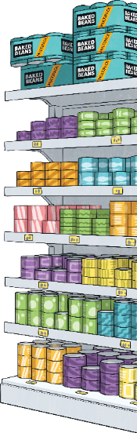
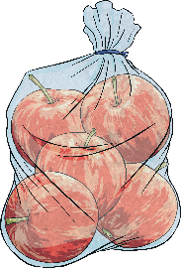
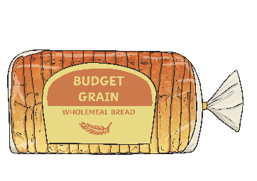

Fractions on a Number Line
Diving
1
7
Anna walked around the supermarket. She picked up some apples of the way to the till. Then, she picked up some bread of the way to the till.
5
7
Show Anna’s journey around the supermarket.
Picked up
apples.
Picked up
bread.
0
1
7
2
7
3
7
4
7
5
7
6
7
1
Enters
supermarket.
Arrives
at till.

Slide 10

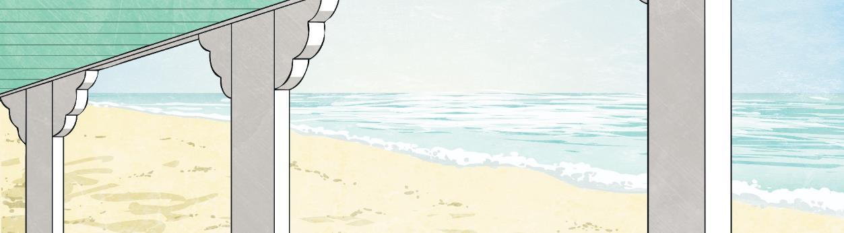

Fractions on a Number Line
Deeper
On my number line, I start at 1.
I move forwards 2 spaces, backwards 1 space and forwards
5 more spaces.
What number do I land on?
Anna lands on 2.
1
1
1
6
1
2
6
1
3
6
1
4
6
1
5
6
2

Slide 11
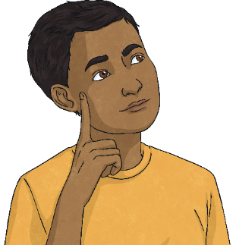
Fractions on a Number Line
Deeper
If I start at 1 and move backwards ,
I would land on zero.
1
6
No. 1 represents . Moving backwards by will put you onto .
6
6
1
6
5
6
5
6
1
1
1
6
1
2
6
1
3
6
1
4
6
1
5
6
2

Slide 12
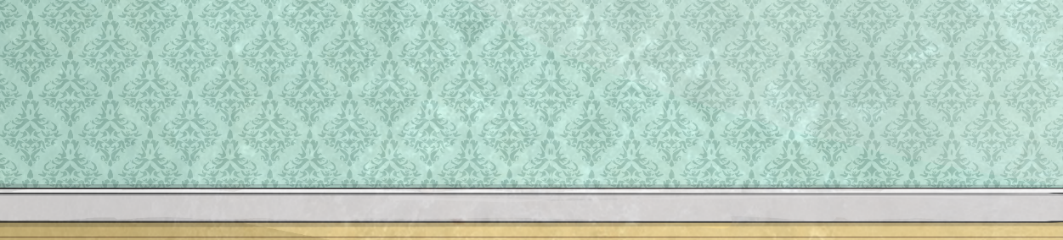
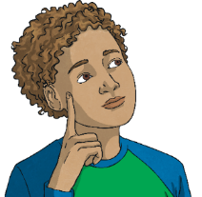
Fractions on a Number Line
Deeper
No. As you can see by the length of the number line, it takes more jumps to reach 1 (more than )
than it does it to reach 1 (more than ).
The number lines will go over 1 at the same points.
1
4
4
4
1
3
3
3
Do you agree? Explain your reasoning.
Does this mean is larger than ?
1
4
1
3
More than 1
0
1
3
2
3
3
3
1
1
3
More than 1
0
1
4
2
4
3
4
4
4
1
1
4

Slide 13



Fractions on a Number Line
Deepest
Some shapes have been removed from a number line.
0
1
I am 4 away from triangle.
I am at the half way point.
I am between two shapes.
I am two away from 1.

Slide 14
Fractions on a Number Line
Deepest
Only a fraction of each line is seen. The rest is hidden. Each line stops at a whole. Which whole line is longer?
Explain your reasoning.
1
4
Line A:
1
3
Line B:

Slide 15
Fractions on a Number Line
Deepest
Only a fraction of each line is seen. The rest is hidden. Each line stops at a whole. Which whole line is longer?
Explain your reasoning.
One whole
1
4
2
4
3
4
4
4
Line A:
One whole
1
3
2
3
3
3
Line B:
Line A needs 3 more increments to add to make a whole, whereas Line B would need an extra 2. Therefore, Line A is longer than Line B.

