Slide 1
L.O: Creating videos.
C: Macbeth

Slide 2
We have been using a software application to create an enhanced picture related to Macbeth.
We are going to be using the same app to create a short film trailer for Macbeth.
​
https://sumo.app/video/?lang=en ​

Slide 3

You will be able to use pictures, video clips and music to bring your trailer to life https://www.youtube.com/watch?v=8pVjNOVHr3k

Slide 4
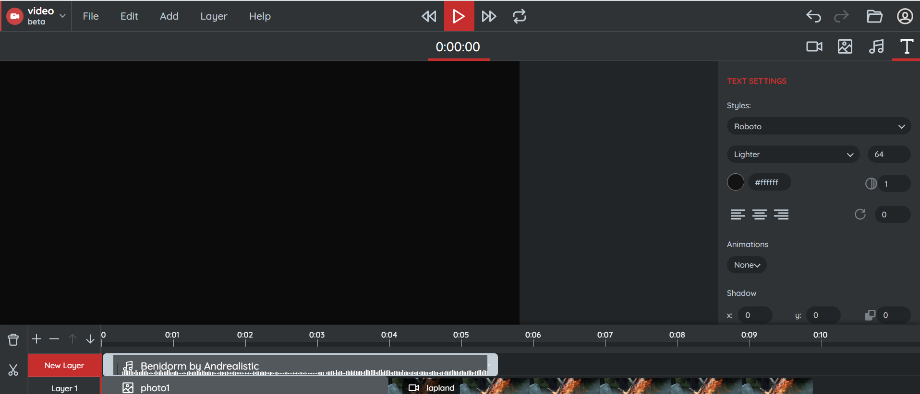
You have started your trailers, using this software. Today, you will continue to do this – using all of the features you have been learning about.

Slide 5

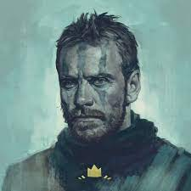
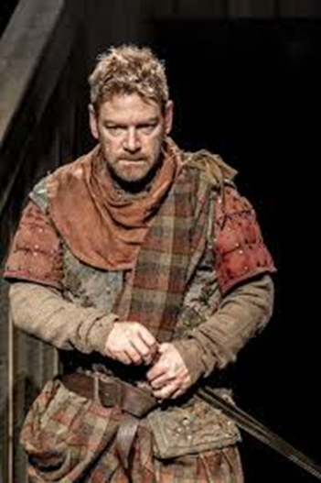


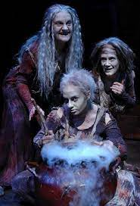
Use the skills you have learned to create your own trailer for an imaginary film. You can use any image from the internet in your trailer – use Kiddle only. Be as creative as possible – think about the story and include the most striking images. Create atmosphere – think about the setting and which aspects of the story you want to include in your trailer

Slide 6

Save the video you have created on your laptop and email it to your teacher using your Microsoft 365 account.
Click ‘Export’, when your video has been created, click on the three dots in the bottom right corner, then ‘Download’.
Your video will download to the bottom left of your screen – click on the arrow and then ‘Show in Folder’. When this opens, you will see your video, right click and then ‘Copy’.
Now you can save it in your laptops document file. Click on ‘Documents’, then right click and ‘Paste’.
Email to your teacher.

