Slide 1
LO: Use information to draw clear conclusions about locations.
C: Communicate geographically

Slide 2
Discuss: What is an empire?
An empire is a group of countries ruled over by a single monarch or ruling power.
An empire doesn't need an 'emperor’.
The British Empire comprised of Britain, the 'mother country', and the colonies, countries ruled to some degree by and from Britain.
https://www.bbc.co.uk/bitesize/guides/zf7fr82/revision/1

Slide 3
Key Words
Empire - a group of countries or peoples ruled over by an emperor, empress, or other powerful government.
Colonies - any country or people separate from but still ruled by another country.
Native People – people who have lived in a place throughout history.

Slide 4



Starter
Are empires good or evil?
In pairs discuss and make a list for good and a list for evil.

Slide 5
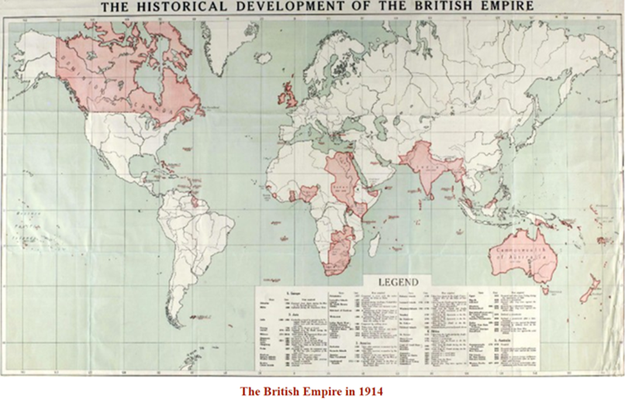
What was the British Empire?
The British Empire is a term used to describe all the places around the world that were once ruled by Britain. It included large areas of North America, Australia, New Zealand, Asia and Africa, as well as small parts of Central and South America, too.
The British Empire changed in size over the years. At its height in 1922, it was the largest empire the world had ever seen, covering around a quarter of Earth’s land surface and ruling over 458 million people.

Slide 6

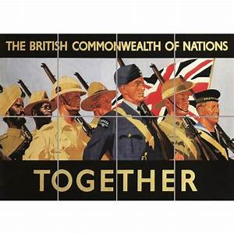
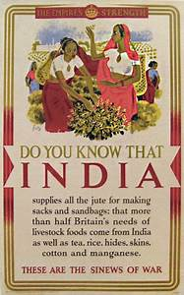
Why was the British Empire created?
England wanted more land overseas where it could build new communities, known as colonies. These colonies would provide England with valuable materials, like metals, sugar and tobacco, which they could trade with other countries.
The colonies also offered money-making opportunities for wealthy Englishmen and provided England’s poor and unemployed with new places to live and new jobs

Slide 7
Why did the British Empire collapse?
Over the course of the 20th century, Britain’s empire broke down in stages. In 1926, Canada, Australia, New Zealand and South Africa became independent.
Over the next decades, the remaining colonies continued to push for independence. After the Second World War, Britain no longer had the wealth or strength to manage an empire overseas.
In 1947, India won its independence, and from the 1950s to 1980s, African colonies also fought for and won their independence.
There are some small fragments of the British Empire that still exist today. These are self-governing countries that continue to share a bond with Britain. They include Anguilla, Bermuda, British Virgin Islands, Cayman Islands, Falkland Islands, Gibraltar and many more.

Slide 8
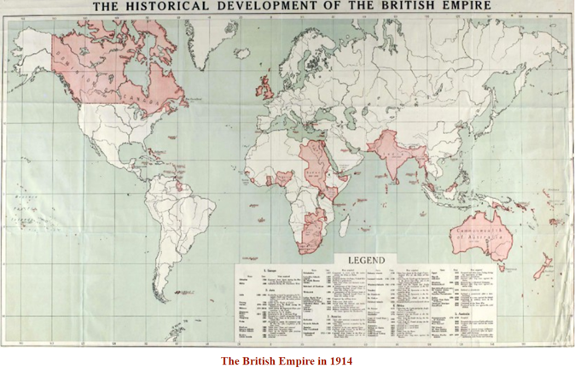
The British Empire; Good or Bad?
Some support the argument that the British Empire was GOOD.
Some support the argument that the British Empire was BAD.
What do the different viewpoints depend on?

Slide 9
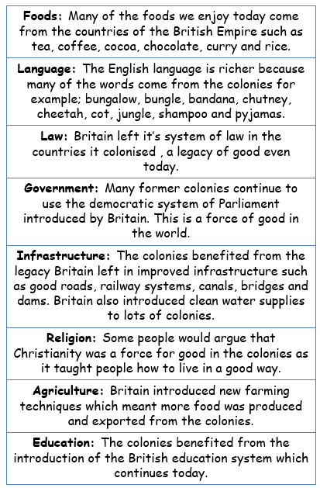
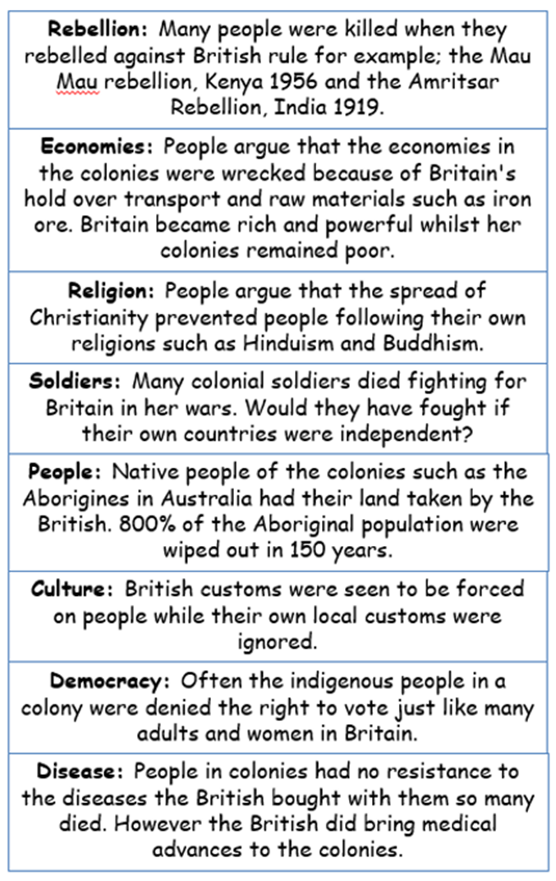
Talk to your partner and decide if the following statements are good or bad

Slide 10
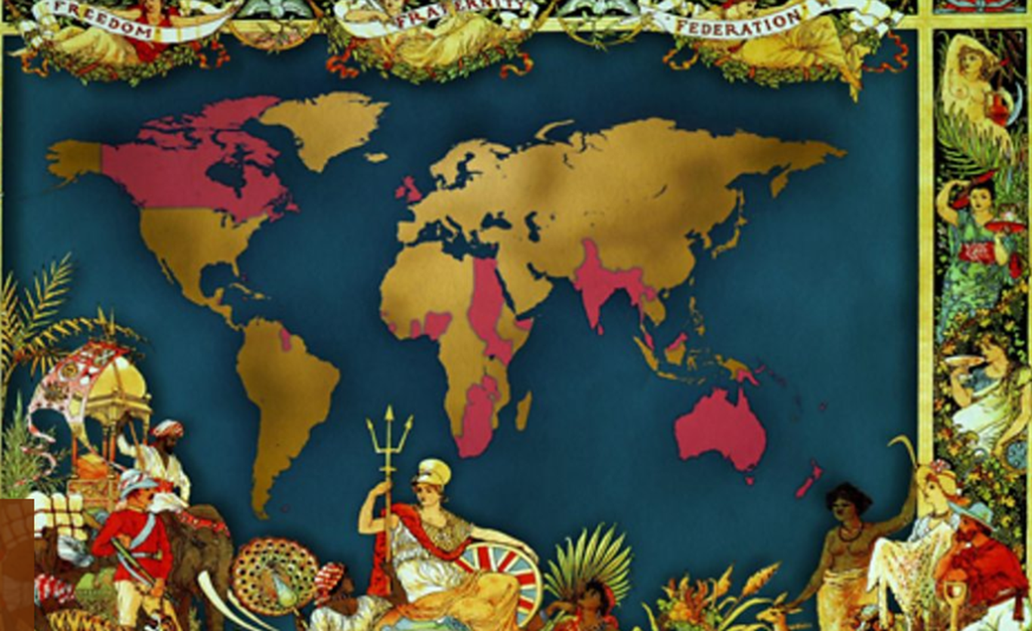
Talk to your partner:
Can we make a simple good or bad decision regarding the empire? Why/why not?
Can you think of any lasting impacts of the empire?
How different would Britain be today if the empire had never existed?
https://www.bbc.co.uk/teach/class-clips-video/history-gcse-what-legacy-has-the-british-empire-left-behind/zmyvrj6

Slide 11
Activity
Paddlers: Sort information from fact sheets into positive and negative consequences of the British Empire.
Snorkellers: Write two paragraphs - for and against the British Empire.
Divers: Write two paragraphs - for and against the British Empire - and finish with a balanced conclusion.
Red Pen: Should Britain apologise for the Empire or should Britain be proud of its achievements?

Slide 12
Should Britain apologise for its Empire?
Plenary
Absolutely not! Why should Britain apologise for something that her forefathers have done? I say let it be and work so that nothing of its magnitude happens again.
P Johnson
Britons should stop apologising for their colonial past and be proud of our Empire's achievements.
Michael Palin
I think the days of Britain having to apologise for our history are over; I think we should move forward
Gordon Brown
After all the atrocities that the British Empire brought, what harm can a simple apology in words do, except heal old wounds?
J Crew
No apology is necessary! Britain gave her colonies independence, surely that is enough?
P Isaac
Present governments should not be held liable for an act that occurred 200 years ago.
N Rhoads
It is an opportunity for the United Kingdom to express our deep sorrow and regret for our nation's role in the slave trade and for the unbearable suffering, individually and collectively, it caused.
Tony Blair

