Slide 1
LO: To understand how countries are interconnected.
C: globalisation

Slide 2
Globalisation – what do you think it means?
Globalisation is the process by which the world is becoming increasingly interconnected. We now communicate, trade, travel and share each other’s cultures more easily around the world.

Slide 3

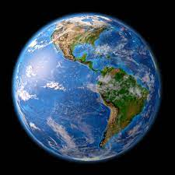
Talk to your partner:
Do you feel connected to the rest of the globe on a
regular basis?
How are you connected?
Perhaps you have travelled to other countries, or have contact with relatives abroad, or are first or second generation immigrants.
Let’s create a list on a flip chart of all the countries we are connected with.

Slide 4
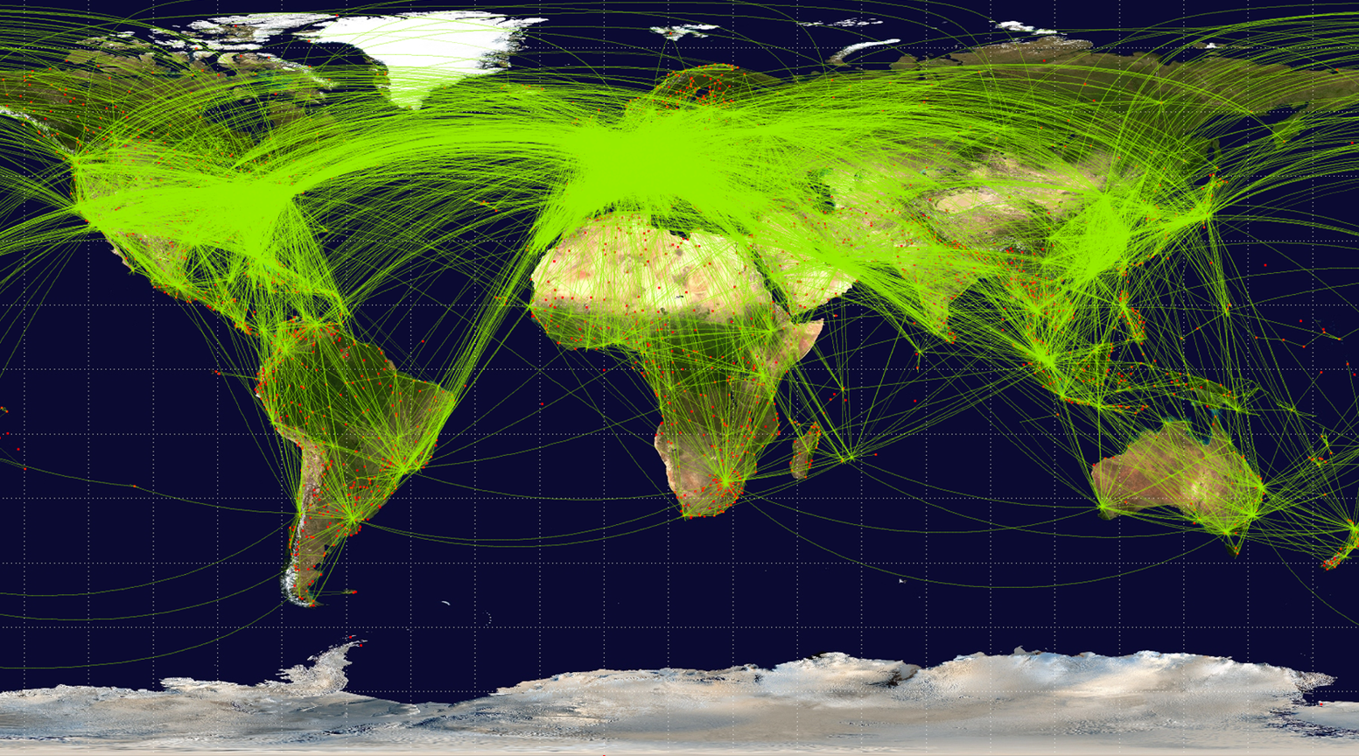
We are all globally connected on different levels.
Take one of your shoes off.
Look at the label – where was it made?
Look at the label on your partners shirt or jumper - where was it made.
Let’s add these countries to our list and then place them on a world map.
Can you tell me where they are?
https://mapchart.net/world.html

Slide 5
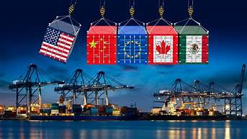
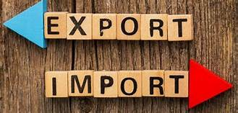
Trade – What do we mean by trade?
Watch video on the meaning of trade and think about what import and export might mean:
https://www.bbc.co.uk/bitesize/topics/zx72pv4/articles/zk4rmfr
Import means to bring from a foreign or external source; especially to bring merchandise into a place or country from another country
Export means to carry or send a commodity to another country.
This is a part of the process of globalisation – the increasing interconnectivity of the world.

Slide 6
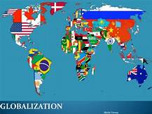
Talk to your partner:
Are there any interesting patterns on our map? (Where are most of the dots? Which areas do not have any dots?) Who is exporting and who is importing goods?
Who could benefit from globalisation and who might not benefit? Are some people or countries being exploited?
Watch these videos and list positive and negative effects of globalisation:
https://www.bbc.co.uk/bitesize/guides/zxm3srd/video
https://www.bbc.co.uk/bitesize/guides/zxpn2p3/video
Let’s create a bubble map of positive and negative effects.

Slide 7
Activity
Do multinational companies have a positive or negative affect on poorer nations?
Paddlers: create a bubble map of positive and negative effects
Snorkellers: write a balanced paragraph discussing positive and negative effects
Divers: write two balanced paragraphs discussing positive and negative effects
Red Pen: imagine you are a worker in a poorer country, making goods for a multinational company. Write a short diary entry about a day in your life.

Slide 8
Plenary
Discuss with your partner:
Is globalisation is good for everyone involved?
What could be the positive effects?
What could be the negative effects?

