Slide 1
Am I normal?
PSHCE

Slide 2

Complete the sentence
Being normal is…
This is your definition of being ‘normal.’

Slide 3

Consider whether you think these statements are ‘normal’ or ‘not normal.’
1. To go to work at the age of 10.
2. To be frightened of the dark.
3. To get at least 50 ‘likes’ for anything posted on the internet.
4. To wear glasses.
5. To have friends.
6. Boys being good at drama and dance.
7. To walk to school.
8. To spend at least 2 hours every day on a mobile phone or social media.
9. To eat dinner with your family around a table.
10. To have two legs.

Slide 4

normal
Normal is what you are used to or what you expect.
Some children abroad in the developing world do work at the age of 10, some children spend less than 2 hours a day on social media (!) etc.
Look back at the definition your wrote.
Do you need to change it?

Slide 5
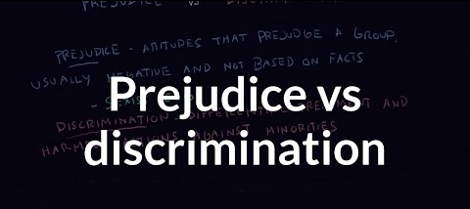
Sometimes people’s perceptions about what is normal can cause them to be prejudiced.
Do you know what the terms prejudice and discrimination mean?

Slide 6
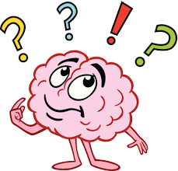
Prejudice: an opinion that is formed without knowing or considering all the facts.
Discrimination: unfair treatment of one particular person or group of people.
Can you think of any examples of prejudice and discrimination?

Slide 17
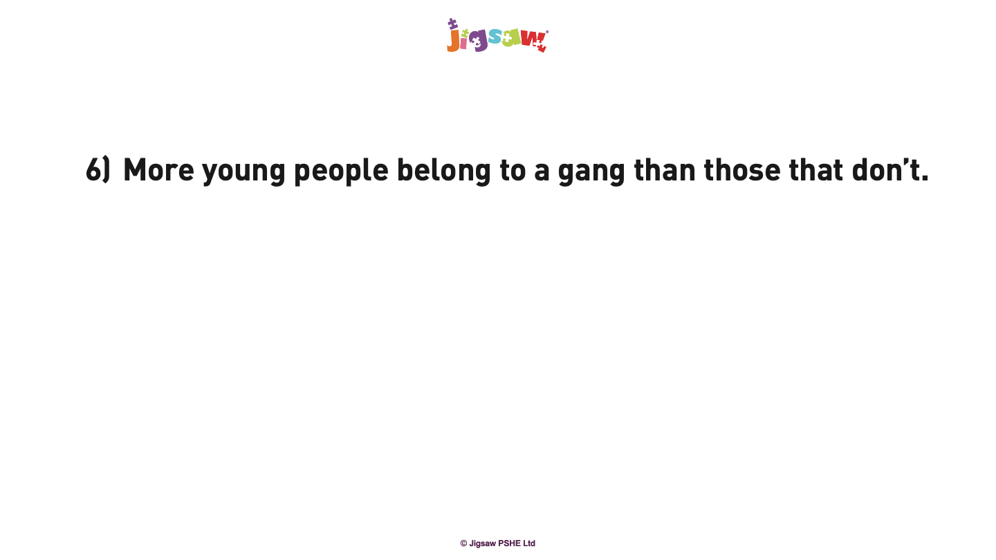

Slide 18
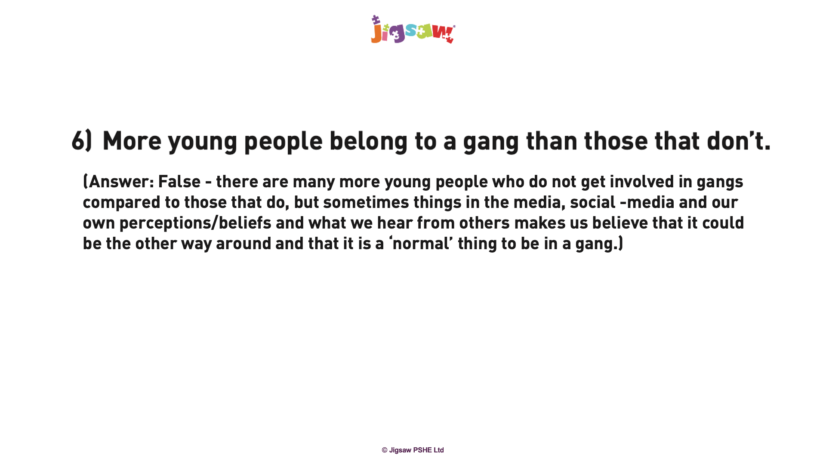

Slide 21

Can you see how perception of ‘normal’ have resulted in prejudice and discrimination?
What has this lesson has made you think about?
Write down what you feel about the word ‘normal.’

