Slide 1
LO: to understand beliefs and teachings.
to understand practices and lifestyles
C: Christianity

Slide 2

Starter
MESSIAH / SAVIOUR
Do you know what these words mean?
What can you remember about these words from your Year 5 Christmas topic?

Slide 3
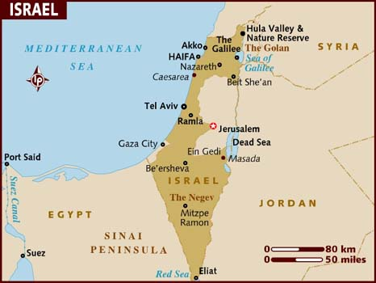
The idea of a ‘messiah’ or ‘saviour’ is important in Jewish culture and was central to Jewish belief in the years the Jesus lived and taught.
The land of Israel had been attacked and invaded since its creation 1,000 years previously.
In 586 BCE, the Jewish people were taken into exile in Babylon.
Fifty years later, they were allowed to return, but from then on, their land was continually under occupation by one foreign power or another.
From 63 BCE, the Romans were the occupying power.
The Jewish people hoped for a saviour, a messiah, who would vanquish their enemies and restore them to their homeland to live in peace under their own laws.

Slide 4
What did Jewish people hope for in a messiah or saviour?
What were Jesus’ followers starting to believe about him?
Think back to your Year 5 Christmas topic.

Slide 5
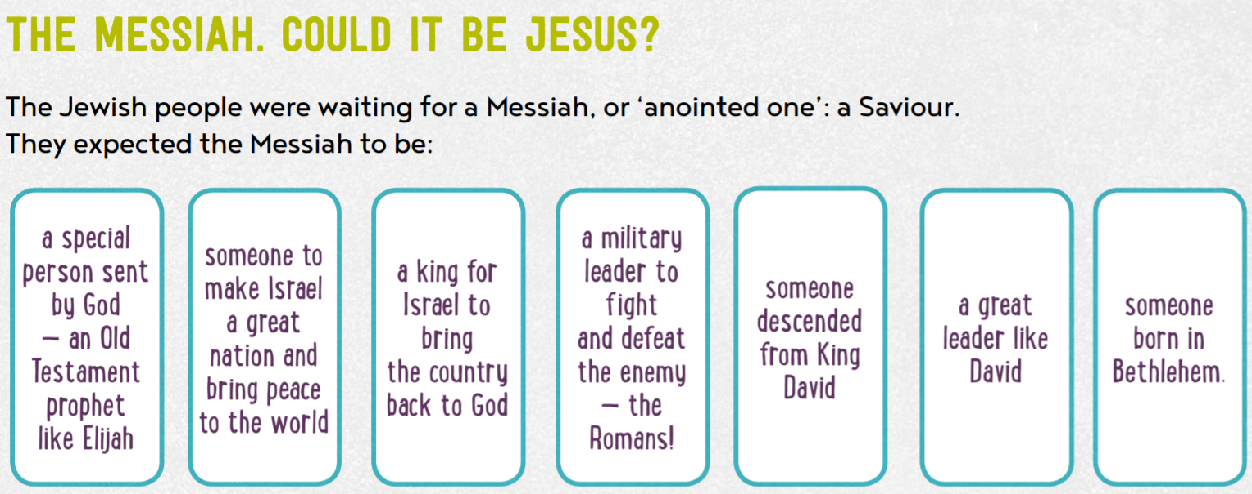

Slide 6
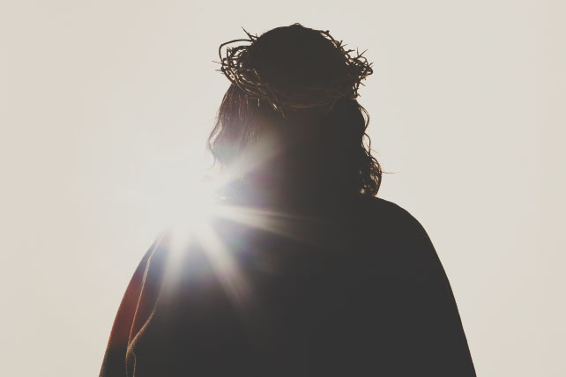
Expectations were high at the time of Jesus.
Different groups had different hopes and expectations, but the Messiah was widely expected to be a prophet who would re-establish the line of King David on the throne in Jerusalem, site of the Temple of God, drawing all nations to God.
As the extraordinary events of his life unfolded, Jesus’ followers started to think he could be the Messiah.

Slide 7
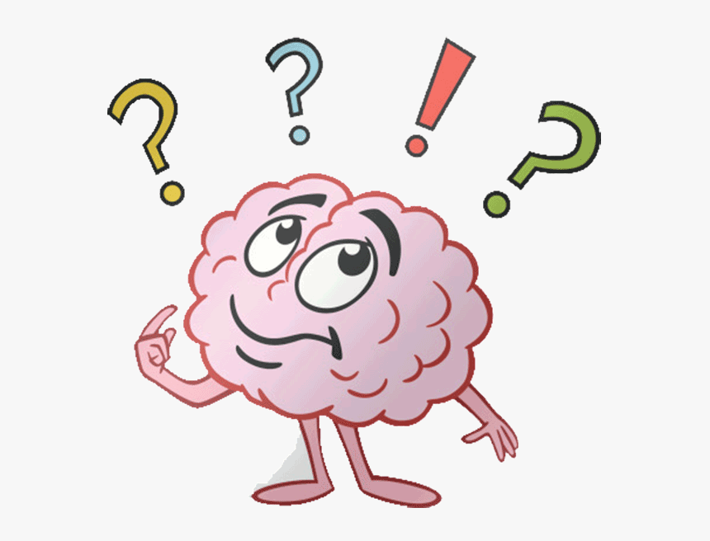
Which two things would make you believe that someone was sent by God to save people?

Slide 8
The Transfiguration - Matthew 17:1-13
After six days Jesus took with him Peter, James and John the brother of James, and led them up a high mountain by themselves. There he was transfigured before them. His face shone like the sun, and his clothes became as white as the light. Just then there appeared before them Moses and Elijah, talking with Jesus.
Peter said to Jesus, “Lord, it is good for us to be here. If you wish, I will put up three shelters—one for you, one for Moses and one for Elijah.” While he was still speaking, a bright cloud covered them, and a voice from the cloud said, “This is my Son, whom I love; with him I am well pleased. Listen to him!”
When the disciples heard this, they fell facedown to the ground, terrified. But Jesus came and touched them. “Get up,” he said. “Don’t be afraid.” When they looked up, they saw no one except Jesus.
As they were coming down the mountain, Jesus instructed them, “Don’t tell anyone what you have seen, until the Son of Man has been raised from the dead.” The disciples asked him, “Why then do the teachers of the law say that Elijah must come first?” Jesus replied, “To be sure, Elijah comes and will restore all things. But I tell you, Elijah has already come, and they did not recognize him, but have done to him everything they wished. In the same way the Son of Man is going to suffer at their hands.” Then the disciples understood that he was talking to them about John the Baptist.

Slide 9
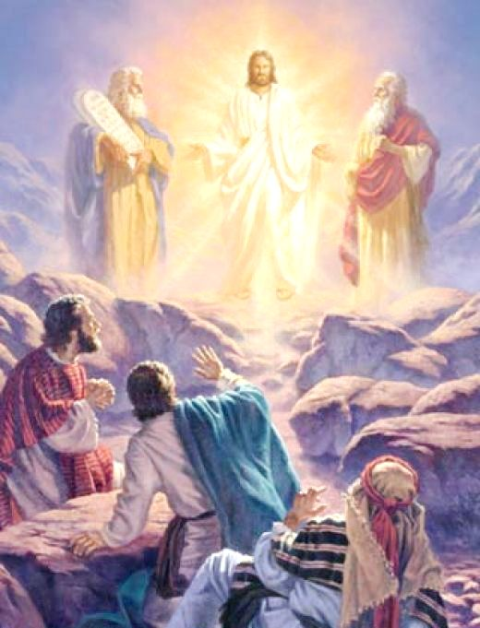
What happened in the text?
What might it mean?
What can you identify which seem to offer clues that Jesus is the Messiah?
What indications are there that Jesus is more than that – the Son of God?

Slide 10
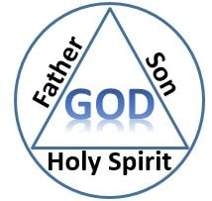
The Trinity: Father, Son and Holy Spirit
Can you find links to the Trinity in the Transfiguration passage?
The Son: in the person of Jesus
The Spirit: in the bright, overshadowing cloud
The Father: in the voice from the cloud
God the Father spoke from heaven
God the Son was the one being transfigured
God the Holy Spirit was present in the form of a cloud

Slide 11
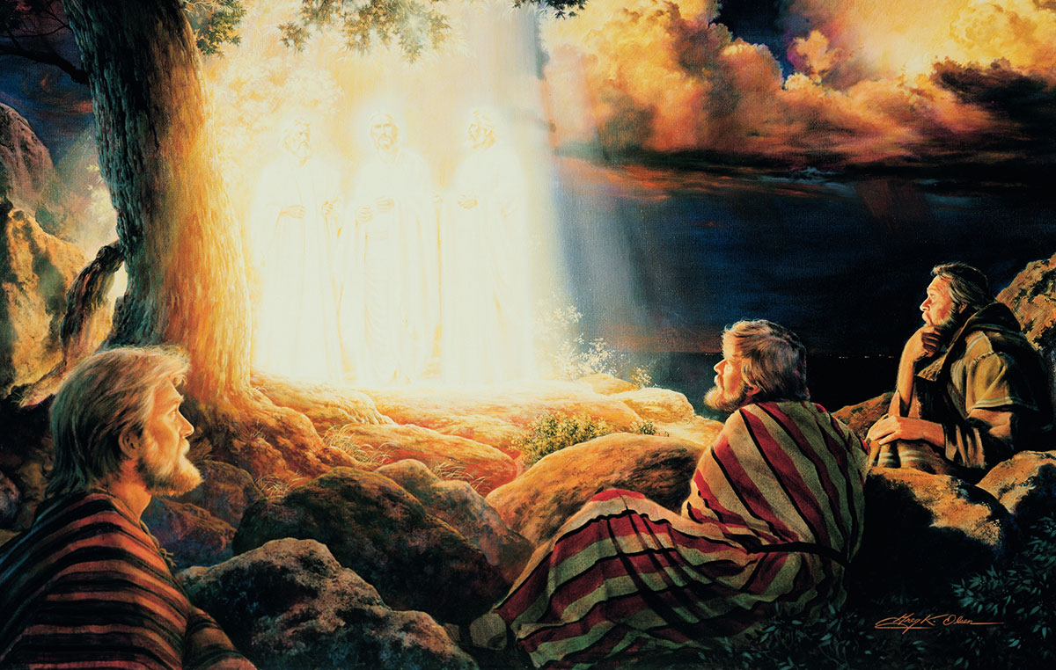
This is an event in Jesus’ life in which his followers received clues to his true nature.
They walk together on a hill top (a ‘mountain’) when a series of amazing things happen.
Jesus shines white, he is seen accompanied by Moses and Elijah, two major prophets of Judaism, and a voice from the heavens describes him as ‘my son.’

Slide 12
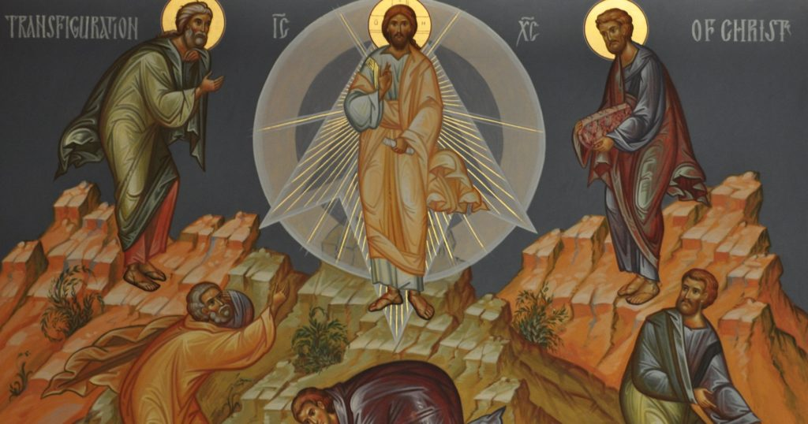
This event gives us an insight into a moment when Jesus’ followers realised he was special, connected to the old prophecies, and a link between God and humanity.
The text indicates where Christian beliefs about Jesus as God incarnate and the Messiah come from.
There are clues throughout the Bible, and Christians believe they have come to fruition in Jesus.

Slide 13
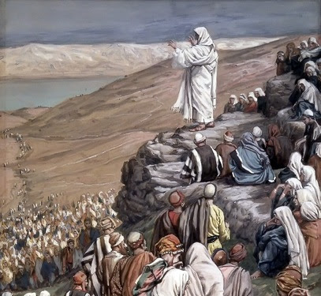
Although he has fulfilled the old prophecies, there are new twists to the story.
The longed-for Messiah is not a warrior, but the son of a humble carpenter, who teaches his followers to love their enemies and offers to save not just the Jewish people, but the whole human race.

Slide 14
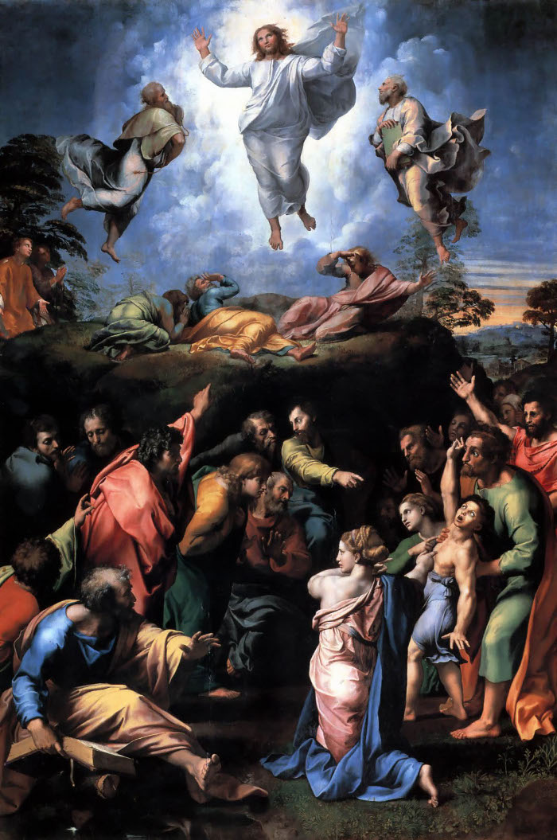
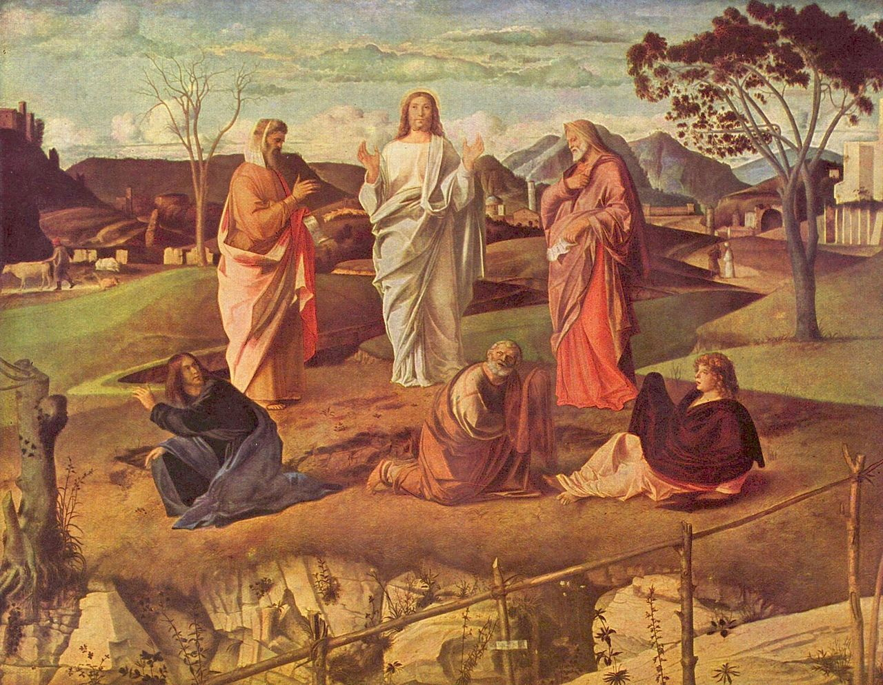
Can you see: shining white, Moses and Elijah, the mountain?
What do you think each of these might mean?
Raphael
Bellini

Slide 15
Raphael

Slide 16
Bellini

Slide 17
Activity
Paddling: with an adult Choose either Raphael or Bellini’s image and stick it in your book. Write the description to be put under the art when it is displayed in a gallery. Try to include the connections to the text, the meaning of this story for Christians and the clues this text gives that Jesus is more than the expected Messiah, and actually the Son of God. | Snorkelling: in pairs Stick both Raphael and Bellini’s image in your book. For each image: write the description to be put under the art when it is displayed in a gallery. Try to include the connections to the text, the meaning of this story for Christians and clues this text gives that Jesus is more than the expected Messiah, and actually the Son of God. | Diving: independently Stick both Raphael and Bellini’s image in your book. For each image: write the description to be put under the art when it is displayed in a gallery. Try to include the connections to the text, the meaning of this story for Christians and the clues this text gives that Jesus is more than the expected Messiah, and actually the Son of God.

Slide 18
Red Pen
Paddling Red Pen: Why do you think Jesus took Peter, James and John to the mountain with Him?
Snorkelling Red Pen: Imagine you’re one of the disciples. What do you think your impression of Jesus would be after this series of sayings and events?
Diving Red Pen: Jesus gives Peter, James and John an experience of His glory. How do you think this might have impacted on the disciples?

