Slide 1
LO: To investigate living things
To work scientifically
C: Classification System

Slide 2
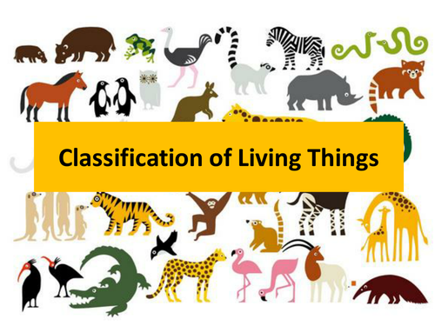
Starter
Kingdom
Class
Species
Genus
Order
Look at the classification names to the right.
Decide on the order of the classification names from the broadest level of classification to the most specific.

Slide 3
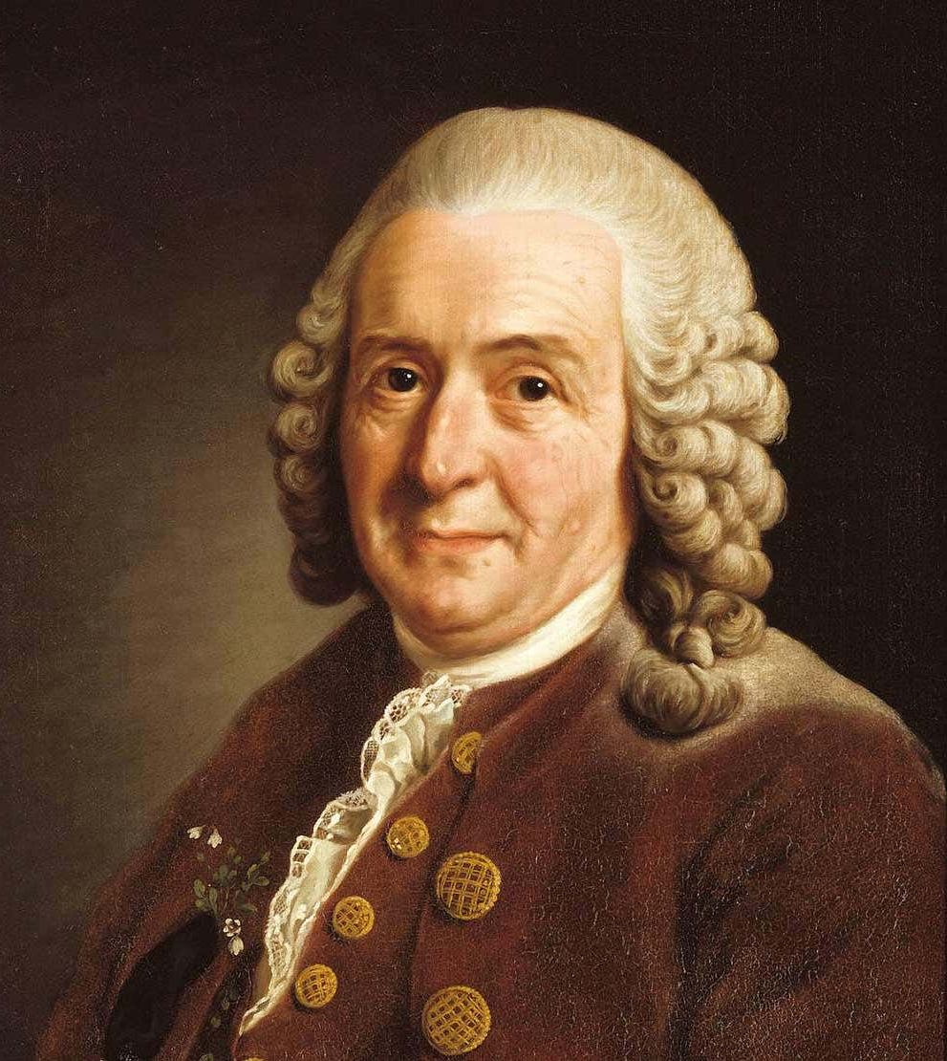
Starter
https://ed.ted.com/on/90vRVJZ6
Carl Linnaeus had 5 levels in his classification systems:
Kingdom, Class, Order, Genus and Species.
Did you order them correctly?

Slide 4
Starter
Phylum
Family
Now you have 2 extra levels.
Where do you think they should go?

Slide 5
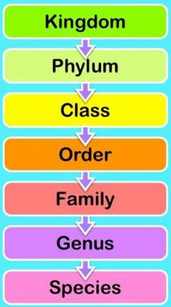
Starter
Kingdom: Most scientists now list 5 kingdoms – Animal, Plant, Protists (amoebas and such), Fungi and Montera (bacteria).
Phylum: There are more than 30 phyla in the Animal Kingdom and 9 or 10 in the Plant Kingdom. Phylum Chordata is the one we're most familiar with – it includes humans, birds, fish, and all other vertebrates (animals with a backbone). Phylum Arthropoda includes insects, spiders, lobsters, etc. Arthropods have segmented bodies with the segments grouped into two or three distinct sections. They have hard external skeletons, or exoskeletons, that are shed and regenerated as the animals grow.

Slide 6
Starter
Class: The various phyla are divided into classes – Phylum Chordata is divided into the classes: amphibians, birds, mammals, reptiles and fish.
Order: Scientific groupings don't follow hard and fast rules. Once we get to the ‘order’ of a living thing, there sometimes begins to be some disagreement about where it belongs. You may find that different sources group creatures in different orders or families. You may find that a creature has its order or family changed as more information is learned.

Slide 7
Starter
Family: The family is a relatively new scientific concept. It is a way scientists group similar genera together. This is not the ‘mum, dad, brother and sister’ type of family!
Genus: Two or more species that share unique body structures or other characteristics are considered to be closely related and are placed together in a genus. Sometimes a genus might include only a single species if there is nothing else in the world that has similarities with it. The genus is the first part of the scientific name of a species. The genus is always spelled with a capital letter and in italics.

Slide 8
Starter
Species: A species can be defined as a group of individuals that breed together to produce fertile offspring. Individuals of a species cannot breed with other such groups. It is sometimes possible for different species to breed, but the offspring will be sterile. A mule is the sterile offspring of a donkey and a horse, and the mule can never mate and reproduce itself. The species is the second part of the scientific name of a species. The species is always spelled with a lower-case letter and in italics.

Slide 9
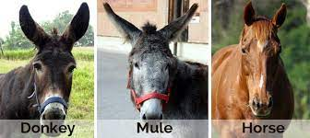
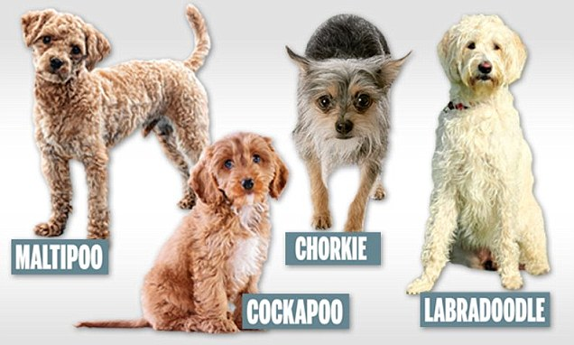
Starter
Animals from the same species can have offspring that can themselves have offspring, so dogs from separate breeds can still mate and have offspring because they are the same species.
Horses and donkeys are different species so any offspring they have are infertile.

Slide 10
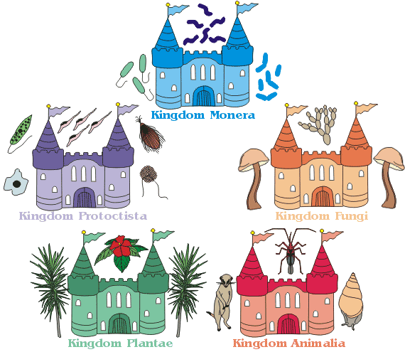
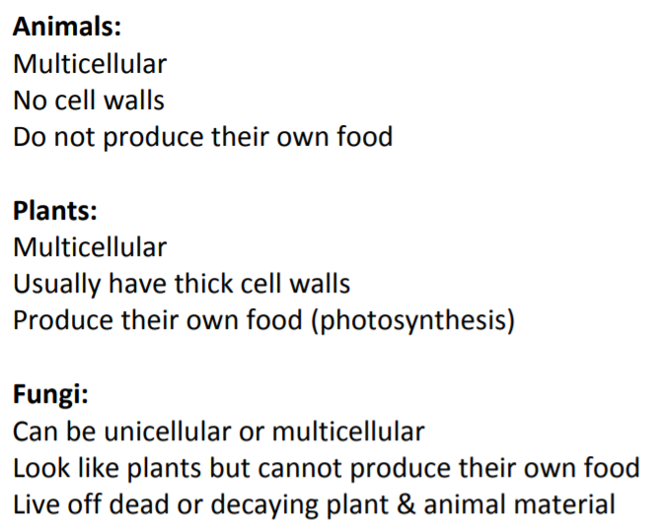
We sort living things into 5 kingdoms.
Do you know any of these groups already?

Slide 11
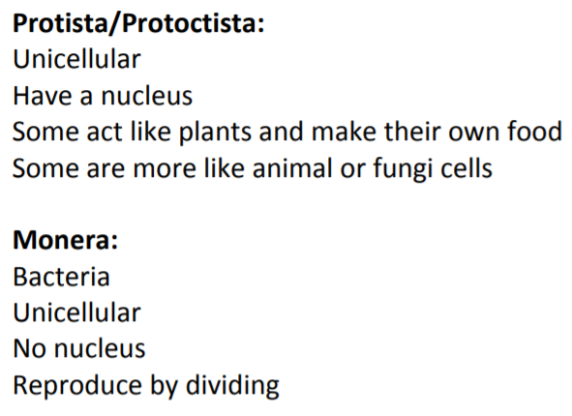
We sort living things into 5 kingdoms.
Do you know any of these groups already?

Slide 12
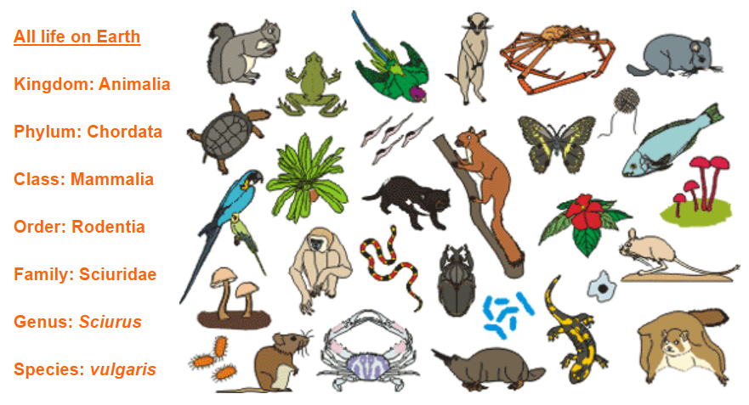
Squirrel Classification
http://www.oum.ox.ac.uk/thezone/animals/animalid/classify.htm
Look at each level of the squirrel’s classification.
You can see how other animals in that sub-grouping have more and more things in common, until at ‘genus’ level, you are left with just a grey squirrel and a red squirrel.
At species level, there is only the red squirrel.

Slide 13
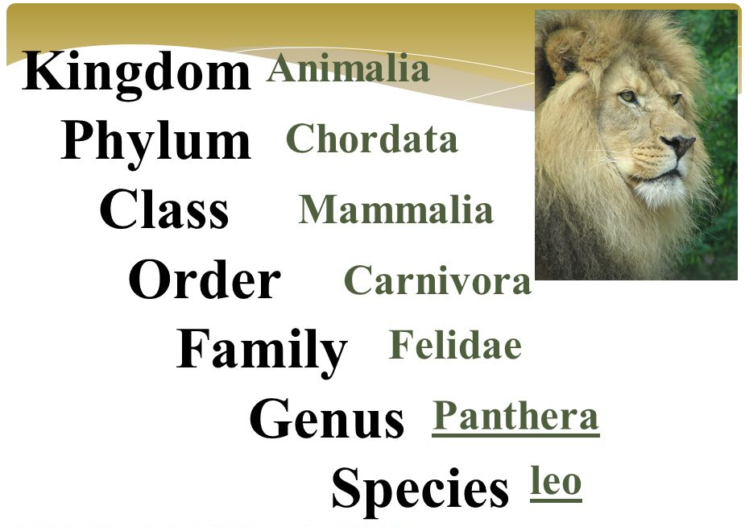
Classification of a Lion
https://www.youtube.com/watch?app=desktop&v=vqxomJIBGcY

Slide 14
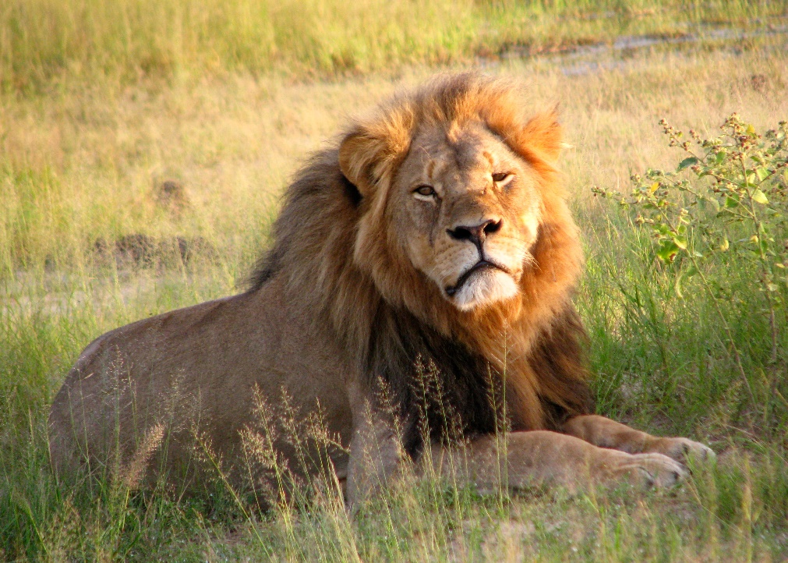
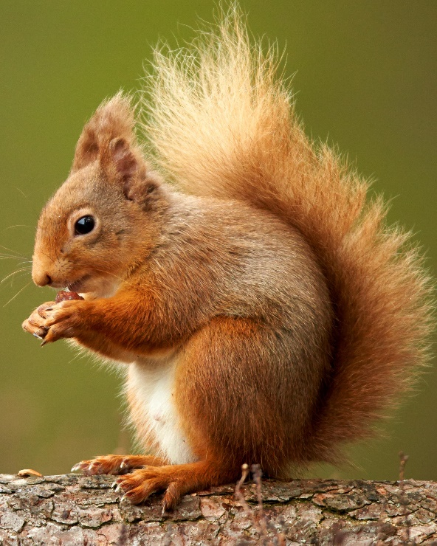
Note:
The red squirrel and the lion share levels in common!
Kingdom Animalia
Phylum Chordata
Class Mammalia
https://www.bbc.co.uk/bitesize/guides/zt4f8mn/revision/1

Slide 15
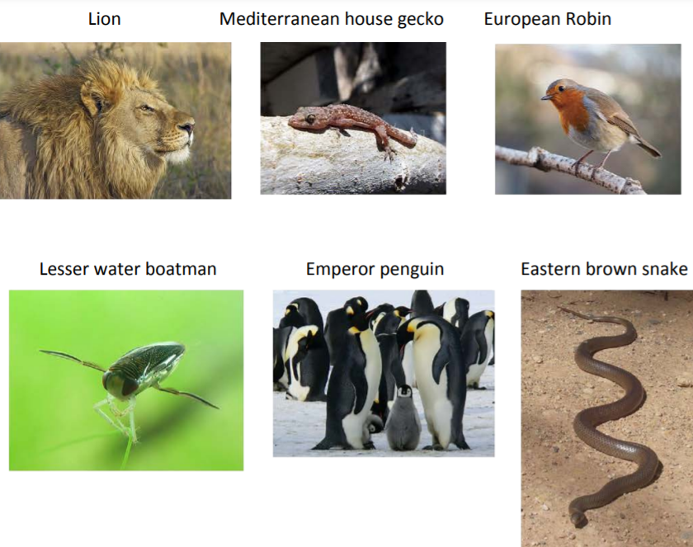
Activity 1
Look at a range of living things.
Sort the living things into the 5 kingdoms.
Now sort the living things into phylum groups.
Challenge: can you sort the living things in class groups?

Slide 16
5 Kingdoms

Slide 17
Help:
Phylum: There are more than 30 phyla in the Animal Kingdom and 9 or 10 in the Plant Kingdom. Phylum Chordata is the one we're most familiar with – it includes humans, birds, fish, and all other vertebrates (animals with a backbone). Phylum Arthropoda includes insects, spiders, lobsters, etc. Arthropods have segmented bodies with the segments grouped into two or three distinct sections. They have hard external skeletons, or exoskeletons, that are shed and regenerated as the animals grow.
Class: The various phyla are divided into classes – Phylum Chordata is divided into the classes: amphibians, birds, mammals, reptiles and fish.

Slide 18
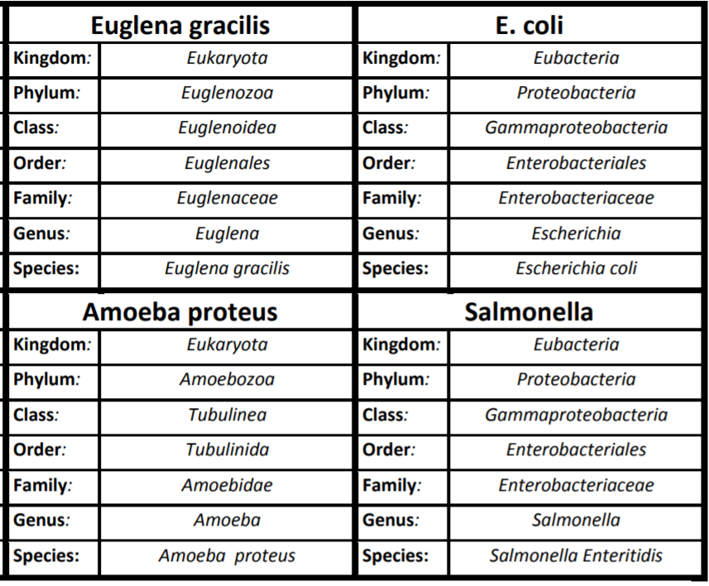
Activity 2
Look at the set of classification route cards.
Match the route cards to the corresponding images.
Now, colour code the route cards, matching those that are the most closely related.
Do this by colouring all the cards that have the same kingdom, phylum AND class.

Slide 19
Activity 2
Were your groups from Activity 1 correct?
Who is the most closely related and who is the least related in the Animalia set?
The Plantae set?
The micro-organism kingdoms?
Were there any surprises?

Slide 20

Red Pen
The classification of living organisms has changed over centuries.
Why do you think this has happened?

Slide 21
Plenary
Why do you think classification systems change?
  New species are discovered
  Scientific advances (e.g. microscopes, genetics, DNA etc.)
  New evidence/opinion

Slide 22

Plenary
There is even some disagreement about the number of kingdoms!
Some scientists use 6 or 7, but most agree on 5.

Slide 23
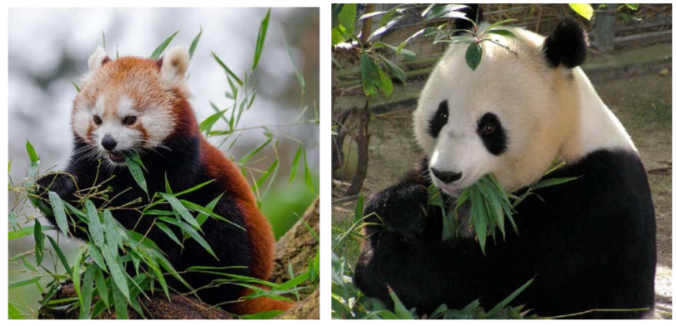
Plenary: The Tale of Two Pandas
Once upon a classification system the red panda and the giant panda were grouped together, although scientists disagreed over which family they were in:
  Bears?
  Raccoons?
  Something else?
They had both bear and raccoon characteristics!

Slide 24
Plenary: The Tale of Two Pandas
Eventually DNA sequencing held the answer. Giant pandas are true bears (Ursidae), while red pandas are in a family of their own (Ailuridae), which is closely related to raccoons.
Interestingly, and surprising to scientists, red and giant pandas aren't very closely related to each other!
The classification of these pandas changed due to DNA advances.

