Slide 1
Hook lesson – Fractions

Slide 2
Key vocabulary
Numerator
Improper Fraction
Decimal Equivalent
Simplest Form
Whole Number
Denominator
Factor
Simplify
Highest Common Multiple
Divide
Proper Fraction
Equivalent
Mixed
Number
Simplest Form
Lowest Common Multiple

Slide 3

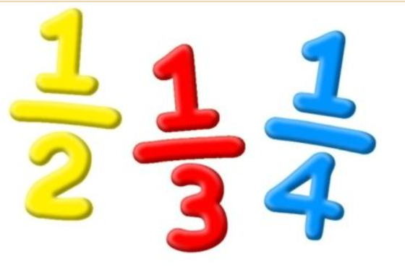
Work in pairs on your whiteboards.
You have approximately 20 seconds to write any fractions you can see in the image on the screen!

Slide 4



What fractions can you see?

Slide 5
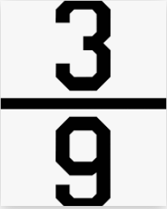
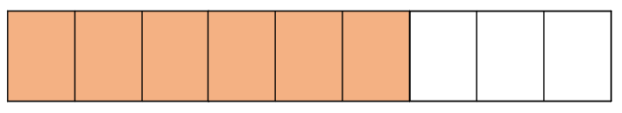
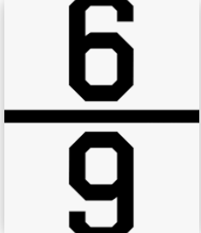
What fractions can you see?

Slide 6

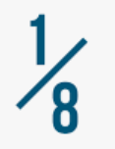


What fractions can you see?

Slide 7
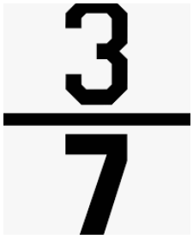
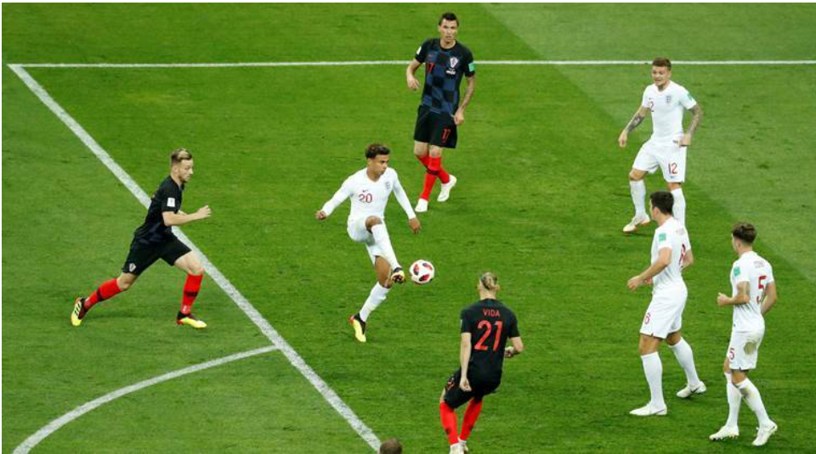

What fractions can you see?

Slide 8
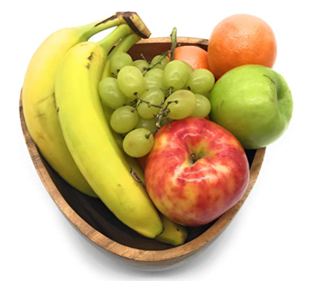
What fractions can you see?

Slide 9
We have identified three fractions in this bowl of fruit.
What does the denominator represent?
What does the numerator represent?

Slide 10
During the next few weeks we will be learning about Fractions
What do we mean by a fraction?
When might we need to use fractions in our daily life?
What resources can we use to help us?

Slide 11
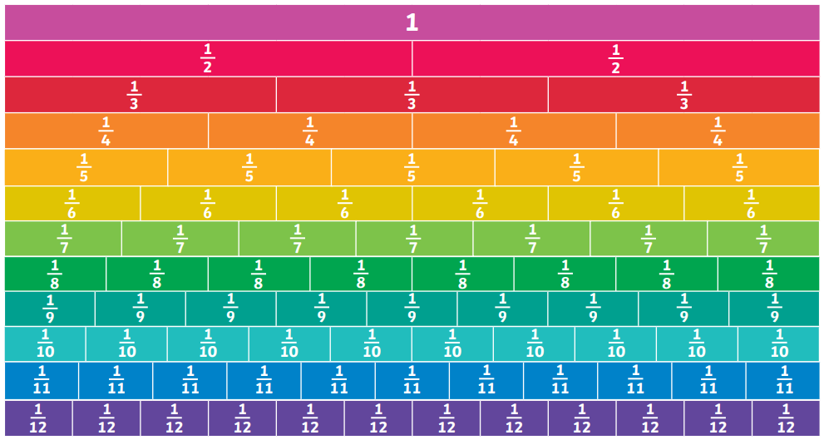
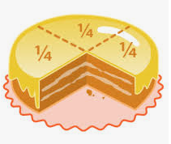
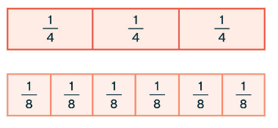
We could use some of these resources to help us.

Slide 12
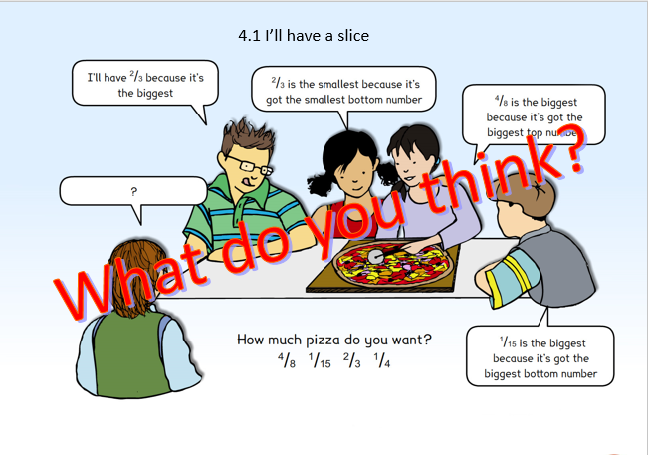

Slide 13
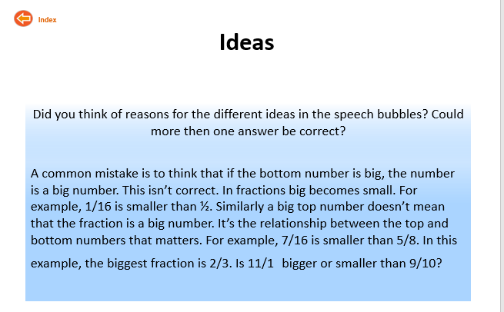

Slide 14

How many different ways can you represent Fractions visually?
Draw some examples on your whiteboard.

Slide 15
Your activity
You will be given some fraction games. In your designated groups, take turns to play the different games, try as many as you can.
Enjoy learning about fractions!

Slide 16

Plenary
Listen and visualise. Your teacher will read out a problem. Close your eyes and just listen. When this problem is repeated, draw what you hear. Compare your result with your partner.

