Slide 1
Monday 1st November 2021
LO: To write with purpose.
C: Playscripts

Slide 2
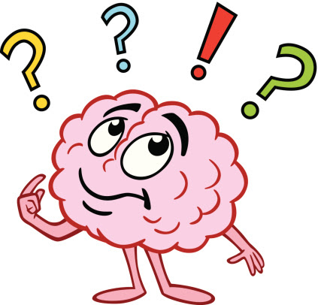
Playscripts
What can you tell me about playscripts?

Slide 3
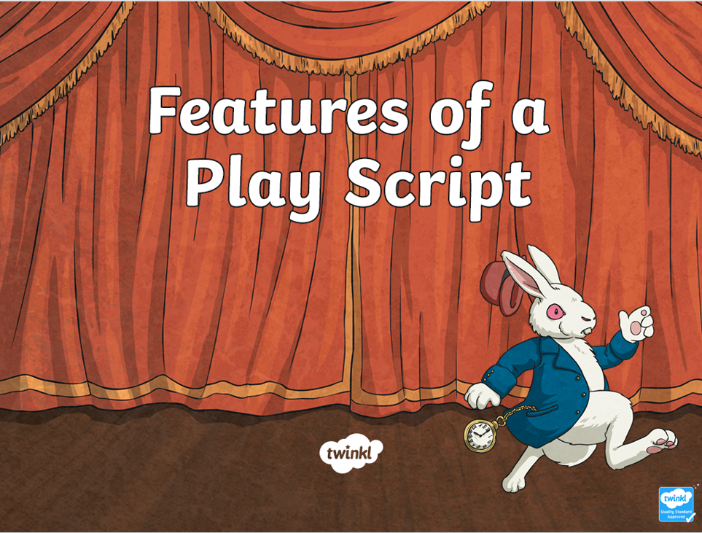
Plays are written to be performed.
A script is a written version of the play.
https://www.bbc.co.uk/bitesize/articles/z7thjsg

Slide 4

Scripts
Scripts are written in scenes.
Each scene has:
  A title
  A description of when and where it is set
  The characters that appear

Slide 5
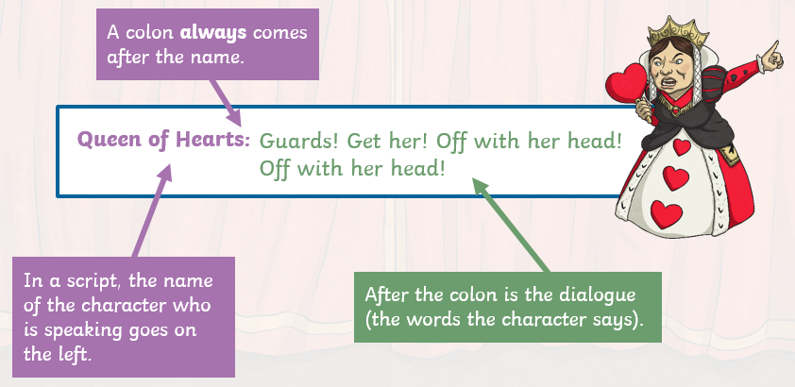
Dialogue (speech)
In most writing, inverted commas are used to show when a character is speaking.
In a script, you just write the dialogue (what the character is saying) without any inverted commas.
The character’s name goes on the left, followed by a colon (:).
What the character is saying goes to the right of this.

Slide 6
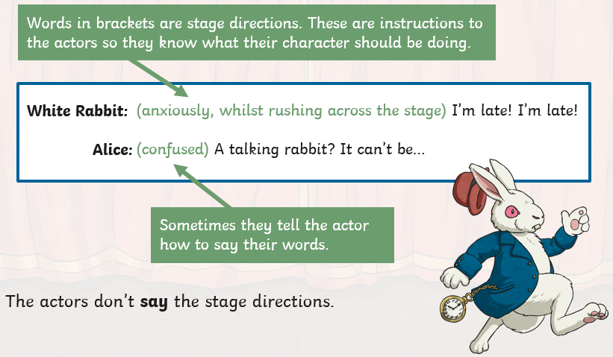
Stage Directions
A script doesn’t just list the characters’ lines, it also gives details of how an actor should say them and what they are doing in each scene.
These are called stage directions and they will tell you how a character moves, or what they should be doing with an object.
Stage directions can be written in brackets before or within the dialogue. They can also be written below the dialogue.

Slide 7
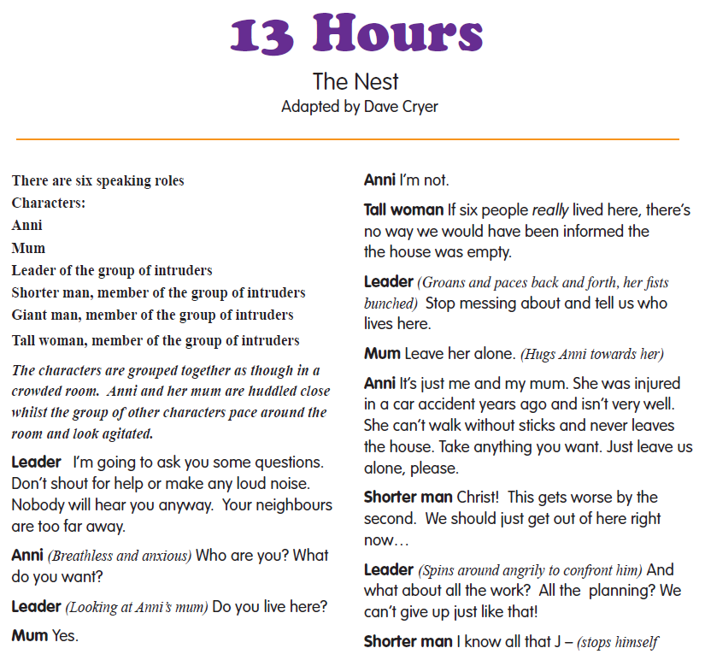
What features of playscripts can you identify?

Slide 8
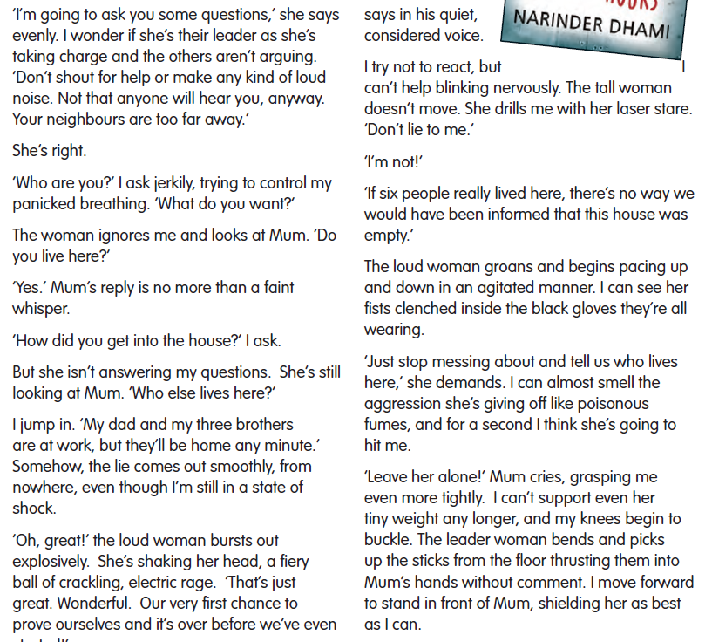
Read the two extracts.
Make a list of similarities and differences between the two.

Slide 9
What happens in the story?
Which extract is more effective? Why?
What are the advantages/disadvantages of novels and plays when it comes to description?
What are the differences between the way a novel and a play tell a story?
What are the differences in presentation between the two?
What are the purposes of the two formats?

Slide 10
Activity
Look at the 13 Hours playscript extract.
Highlight the features of playscripts in the extract and annotate the extract with the names of the features and some information about the features.
Snorkelling: make sure you have identified all of the features of playscripts.
Diving: try to add extra information about the features.

Slide 11
Activity:
Have you highlighted and labelled…
  The title of the scene
  The description of where and when it is set
  A list of characters which appear
  Dialogue (what the character is saying)
  Character’s name
  Colon between the character’s name and their dialogue
  Stage directions which tell us how a character moves or what they should be doing with an object
  Brackets for stage directions

Slide 12
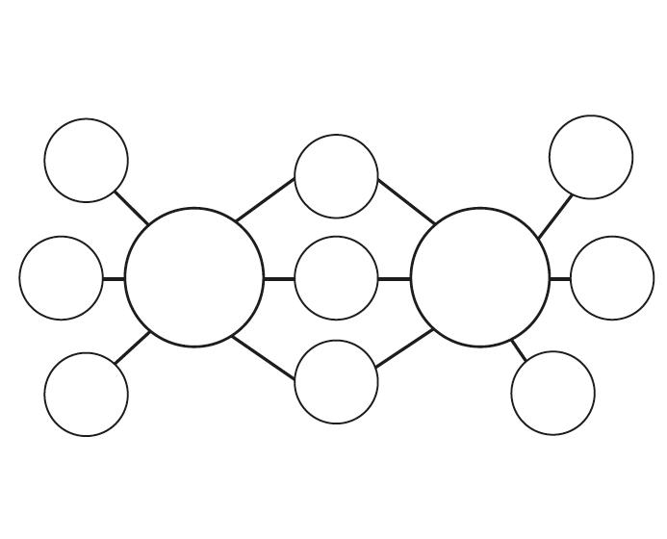
Red Pen
Create a double bubble map to compare playscripts and novels.
Which do you think is more effective?
Why?

Slide 13
Tuesday 2nd November 2021
LO: To write with purpose.
To use sentences appropriately.
C: Playscripts

Slide 14

Starter
What is happening?
Could anything else be happening?

Slide 15

Starter
When we explain the meaning of something, this is called an interpretation.
The meaning we see can differ from person to person due to how the person interprets it.

Slide 16




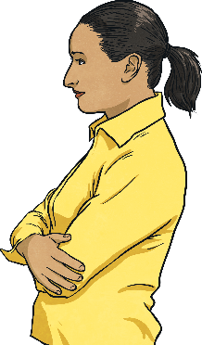
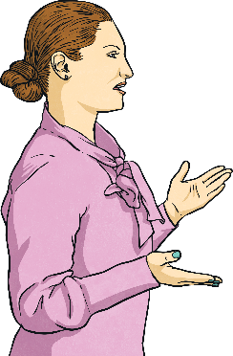
Starter
The following recounts, about an event that happened during assembly, are from teachers.
Teacher A: During assembly today Jackson in Year 2 was sad. He stood up in his red trainers and walked over to his teacher. His teacher, Mrs Smith, spoke with him and took him out of the assembly room through the double doors. After speaking, Mrs Smith found out Jackson was sad because he was feeling poorly.
Teacher B: In assembly today Jackson from year 2 was feeling sad. He walked to his teacher in his blue trainers. His teacher took him out of the assembly room through a single door. They had a chat and Mrs Smith found out that Jackson was feeling poorly which explained why he was sad.
In the recounts what parts of the story are important? Which bits in the story are just extra information?
What are the differences in the story?
Do these differences matter?
Do the differences change the key message in the story?

Slide 17
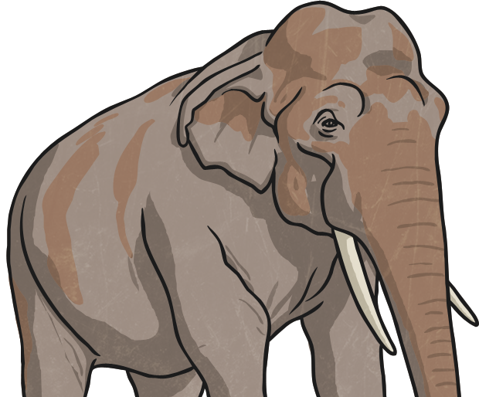
The Elephant and the Blind Men (Buddhism)
https://www.peacecorps.gov/educators/resources/story-blind-men-and-elephant/
What does this story suggest to us?
Would it give a clear picture?
Would the information be accurate?
If you only listened to one of the blind men’s descriptions of the elephant how much information would you get?
How could you get the best description?

Slide 18
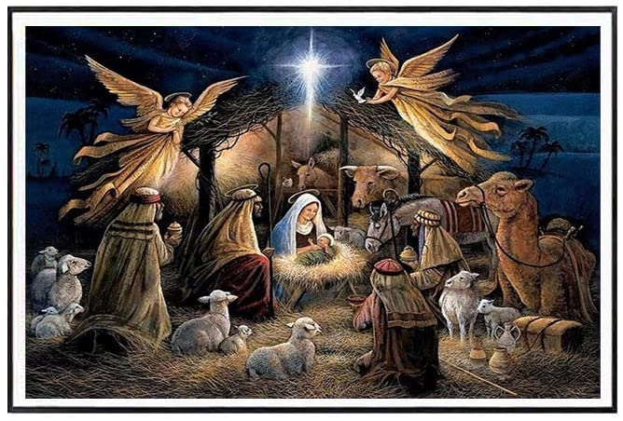
We are going to be writing playscripts about the Christmas story!
Can you identify the key characters?

Slide 19
Matthew 1: 18-25
Joseph Accepts Jesus as His Son
This is how the birth of Jesus the Messiah came about: His mother Mary was pledged to be married to Joseph, but before they came together, she was found to be pregnant through the Holy Spirit. Because Joseph her husband was faithful to the law, and yet did not want to expose her to public disgrace, he had in mind to divorce her quietly.
But after he had considered this, an angel of the Lord appeared to him in a dream and said, “Joseph son of David, do not be afraid to take Mary home as your wife, because what is conceived in her is from the Holy Spirit. She will give birth to a son, and you are to give him the name Jesus, because he will save his people from their sins.”
All this took place to fulfil what the Lord had said through the prophet: “The virgin will conceive and give birth to a son, and they will call him Immanuel” (which means “God with us”).
When Joseph woke up, he did what the angel of the Lord had commanded him and took Mary home as his wife. But he did not consummate their marriage until she gave birth to a son. And he gave him the name Jesus.

Slide 20
Matthew 2: 1-12
After Jesus was born in Bethlehem in Judea, during the time of King Herod, Magi from the east came to Jerusalem and asked, “Where is the one who has been born king of the Jews? We saw his star when it rose and have come to worship him.”
When King Herod heard this he was disturbed, and all Jerusalem with him. When he had called together all the people’s chief priests and teachers of the law, he asked them where the Messiah was to be born. “In Bethlehem in Judea,” they replied, “for this is what the prophet has written:
“‘But you, Bethlehem, in the land of Judah,
are by no means least among the rulers of Judah;
for out of you will come a ruler
who will shepherd my people Israel.’”
Then Herod called the Magi secretly and found out from them the exact time the star had appeared. He sent them to Bethlehem and said, “Go and search carefully for the child. As soon as you find him, report to me, so that I too may go and worship him.”
After they had heard the king, they went on their way, and the star they had seen when it rose went ahead of them until it stopped over the place where the child was. When they saw the star, they were overjoyed. On coming to the house, they saw the child with his mother Mary, and they bowed down and worshiped him. Then they opened their treasures and presented him with gifts of gold, frankincense and myrrh. And having been warned in a dream not to go back to Herod, they returned to their country by another route.

Slide 21
Matthew 2: 13-21
The Escape to Egypt
When they had gone, an angel of the Lord appeared to Joseph in a dream. “Get up,” he said, “take the child and his mother and escape to Egypt. Stay there until I tell you, for Herod is going to search for the child to kill him.”
So he got up, took the child and his mother during the night and left for Egypt, where he stayed until the death of Herod. And so was fulfilled what the Lord had said through the prophet: “Out of Egypt I called my son.”
When Herod realized that he had been outwitted by the Magi, he was furious, and he gave orders to kill all the boys in Bethlehem and its vicinity who were two years old and under, in accordance with the time he had learned from the Magi. Then what was said through the prophet Jeremiah was fulfilled:
“A voice is heard in Ramah, weeping and great mourning,
Rachel weeping for her children and refusing to be comforted, because they are no more.”
The Return to Nazareth
After Herod died, an angel of the Lord appeared in a dream to Joseph in Egypt and said, “Get up, take the child and his mother and go to the land of Israel, for those who were trying to take the child’s life are dead.”
So he got up, took the child and his mother and went to the land of Israel. But when he heard that Archelaus was reigning in Judea in place of his father Herod, he was afraid to go there. Having been warned in a dream, he withdrew to the district of Galilee, and he went and lived in a town called Nazareth. So was fulfilled what was said through the prophets, that he would be called a Nazarene.

Slide 22
Luke 1: 26-38
The Birth of Jesus Foretold
In the sixth month of Elizabeth’s pregnancy, God sent the angel Gabriel to Nazareth, a town in Galilee, to a virgin pledged to be married to a man named Joseph, a descendant of David. The virgin’s name was Mary. The angel went to her and said, “Greetings, you who are highly favoured! The Lord is with you.”
Mary was greatly troubled at his words and wondered what kind of greeting this might be. But the angel said to her, “Do not be afraid, Mary; you have found favour with God. You will conceive and give birth to a son, and you are to call him Jesus. He will be great and will be called the Son of the Most High. The Lord God will give him the throne of his father David, and he will reign over Jacob’s descendants forever; his kingdom will never end.”
“How will this be,” Mary asked the angel, “since I am a virgin?”
The angel answered, “The Holy Spirit will come on you, and the power of the Most High will overshadow you. So the holy one to be born will be called the Son of God. Even Elizabeth your relative is going to have a child in her old age, and she who was said to be unable to conceive is in her sixth month. For no word from God will ever fail.”
“I am the Lord’s servant,” Mary answered. “May your word to me be fulfilled.” Then the angel left her.

Slide 23
Luke 1: 39-56
At that time Mary got ready and hurried to a town in the hill country of Judea, where she entered Zechariah’s home and greeted Elizabeth. When Elizabeth heard Mary’s greeting, the baby leaped in her womb, and Elizabeth was filled with the Holy Spirit. In a loud voice she exclaimed: “Blessed are you among women, and blessed is the child you will bear! But why am I so favoured, that the mother of my Lord should come to me? As soon as the sound of your greeting reached my ears, the baby in my womb leaped for joy. Blessed is she who has believed that the Lord would fulfil his promises to her!”
Mary’s Song
And Mary said:
“My soul glorifies the Lord
and my spirit rejoices in God my Saviour,
or he has been mindful
of the humble state of his servant. From now on all generations will call me blessed,
for the Mighty One has done great things for me — holy is his name.
His mercy extends to those who fear him, from generation to generation.
He has performed mighty deeds with his arm; he has scattered those who are proud in their inmost thoughts.
He has brought down rulers from their throne but has lifted up the humble.
He has filled the hungry with good things but has sent the rich away empty.
He has helped his servant Israel, remembering to be merciful
to Abraham and his descendants forever, just as he promised our ancestors.”
Mary stayed with Elizabeth for about three months and then returned home.

Slide 24
Luke 2: 1-20
The Birth of Jesus
In those days Caesar Augustus issued a decree that a census should be taken of the entire Roman world. (This was the first census that took place while Quirinius was governor of Syria.) And everyone went to their own town to register.
So Joseph also went up from the town of Nazareth in Galilee to Judea, to Bethlehem the town of David, because he belonged to the house and line of David. He went there to register with Mary, who was pledged to be married to him and was expecting a child. While they were there, the time came for the baby to be born, and she gave birth to her firstborn, a son. She wrapped him in cloths and placed him in a manger, because there was no guest room available for them.
And there were shepherds living out in the fields nearby, keeping watch over their flocks at night. An angel of the Lord appeared to them, and the glory of the Lord shone around them, and they were terrified. But the angel said to them, “Do not be afraid. I bring you good news that will cause great joy for all the people. Today in the town of David a Saviour has been born to you; he is the Messiah, the Lord. This will be a sign to you: You will find a baby wrapped in cloths and lying in a manger.”
Suddenly a great company of the heavenly host appeared with the angel, praising God and saying,
“Glory to God in the highest heaven, and on earth peace to those on whom his favour rests.”
When the angels had left them and gone into heaven, the shepherds said to one another, “Let’s go to Bethlehem and see this thing that has happened, which the Lord has told us about.”
So they hurried off and found Mary and Joseph, and the baby, who was lying in the manger. When they had seen him, they spread the word concerning what had been told them about this child, and all who heard it were amazed at what the shepherds said to them. But Mary treasured up all these things and pondered them in her heart. The shepherds returned, glorifying and praising God for all the things they had heard and seen, which were just as they had been told.

Slide 25
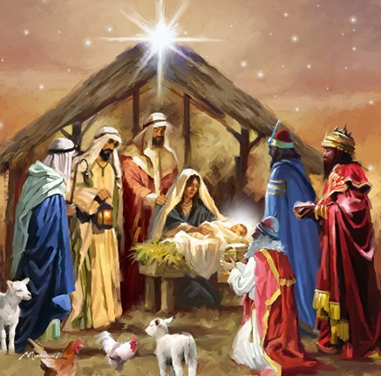
What are the key events from these different accounts?
Why are the events significant?
Which details are included/omitted in the different accounts?
Why do you think this might be?
Which details are key and must be included?
Which details are less important and could be left out?

Slide 26
Activity
Complete a storyboard for the Nativity story.
Use the Bible passages to help you.
Padding: use the template. Write a sentence for each event, ensuring your sentences are structured and punctuated correctly.
Snorkelling: in your books. Write a more detailed sentence for each event, including expanded noun phrases and conjunctions.
Diving: in your books. Write a more detailed sentence for each event using the features of writing we have explored this year, including fronted adverbials, conjunctions, relative clauses, descriptive language etc.
Challenge – annotate your storyboard with how the characters might be feeling/what they might be doing (e.g. stage directions – gasping in shock).

Slide 27
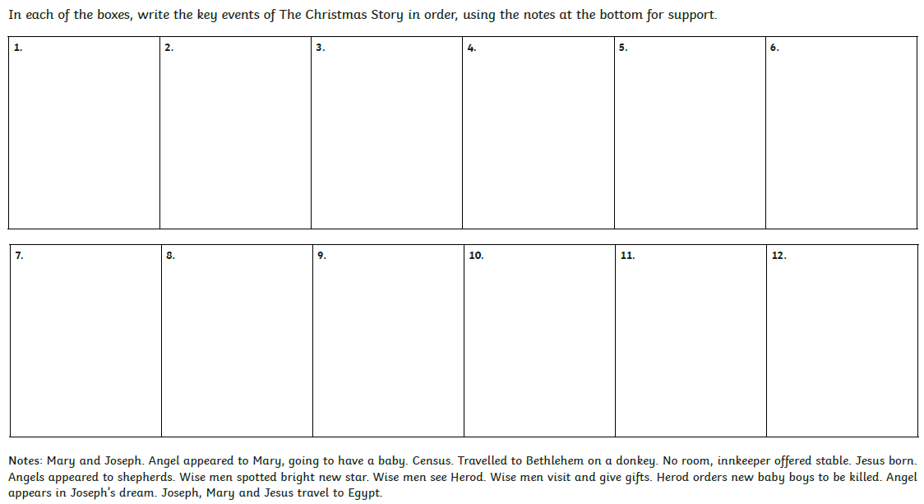

Slide 28
Red Pen
Consider the different accounts of Jesus’ birth and the different details that are present in the accounts.
Which details will you include in your playscript?
Which details will you leave out?
Why?

Slide 29
Wednesday 3rd November 2021
LO: To write with purpose.
To use imaginative description.
C: Playscripts

Slide 30
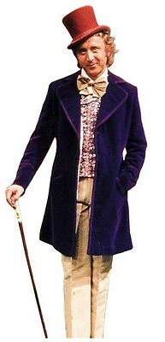
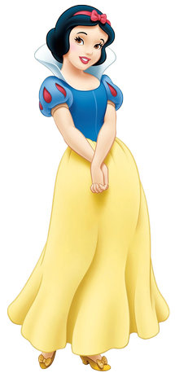
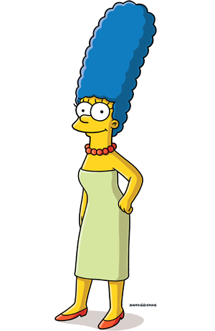
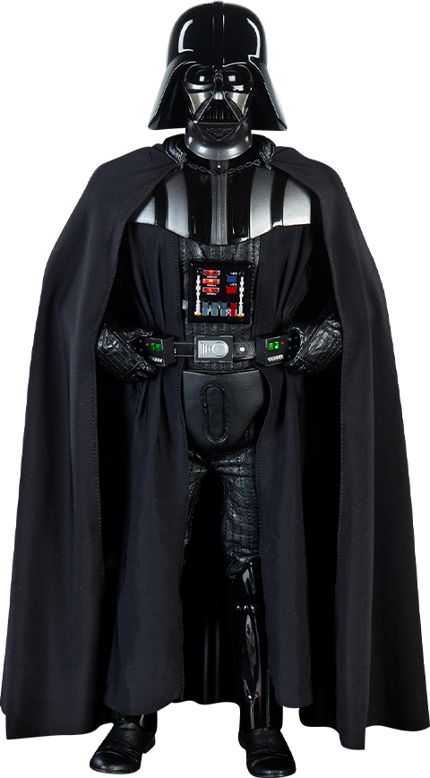
Starter
What are these characters like?

Slide 31
Starter
Think about voice and character.
Do you know any famous characters who adopt different dialects to emphasise character traits?
Consider how and why particular voices and dialects can be important in building characters.

Slide 32
Re-read the 13 Hours novel extract from Monday.
Write down any adjectives for each character that comes to mind as you read.
What makes you think these adjectives describe the characters?

Slide 33
How do you think this may be translated to a playscript?
The level of description in a novel can’t be included in a playscript.
How do we learn what a character is like when we watch something that’s scripted?
Think back to the characters from the starter.
Appearance, movement, clothing, speech, tone of voice etc.

Slide 34
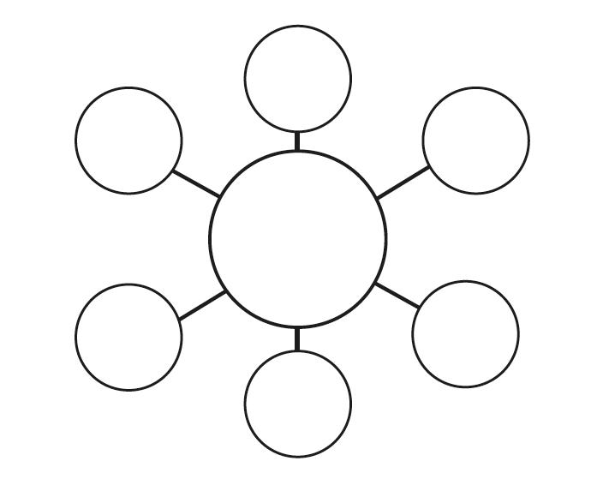
Activity
Create a bubble map about each character from the Nativity story (Joseph, Mary, the shepherds, the Wise Men, the angels, Herod), making reference to: their appearance, movement, speech, tone of voice, actions, feelings etc.
Try to add expanded noun phrases and adverbs to your bubble maps.
Consider: how the character’s felt, what they did in the story, what their first reactions would have been, how they might have moved around, how they would have spoken, what their tone of voice might be like etc.
Red Pen: use a thesaurus to improve some of the vocabulary you have included in your bubble maps.

Slide 35
Thursday 4th November 2021
LO: To write with purpose.
To use imaginative description.
To organise writing appropriately.
C: Playscripts

Slide 36
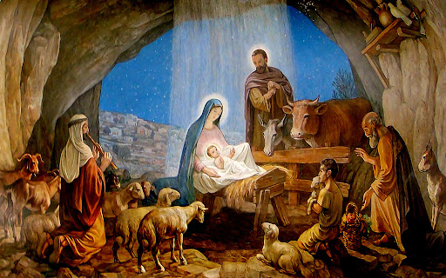
You are going to write a script which explains the points of view of each group of characters and what they experienced that night.
Choose one of the characters: Joseph, Mary, the shepherds, the Wise Men, the angels or Herod.

Slide 37
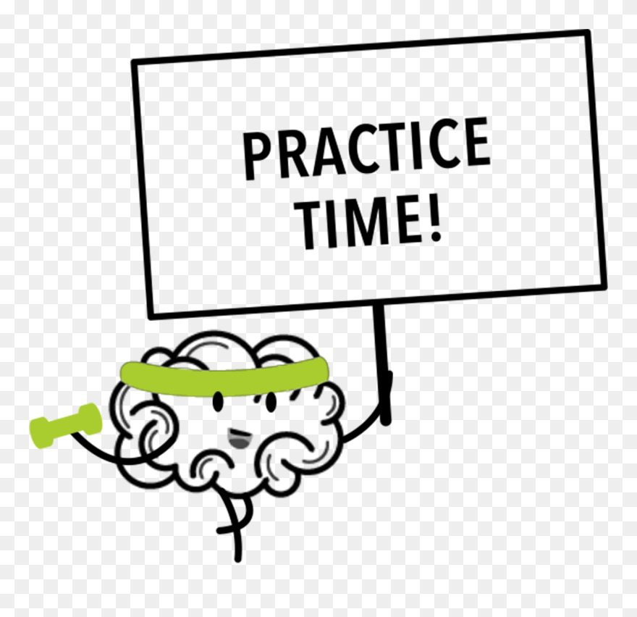
You are going to have a go at writing your own scene for the playscript today!
This is a practice so it won’t be perfect the first time!

Slide 38
What are the features of a playscript?

Slide 39
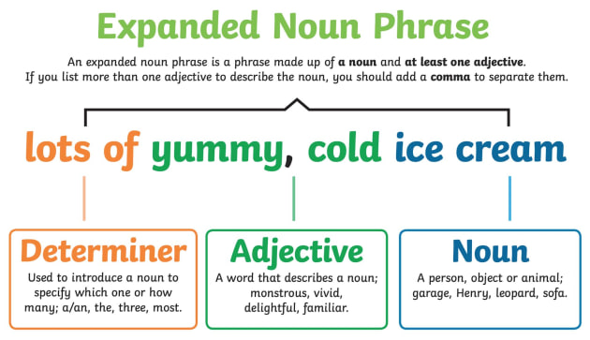
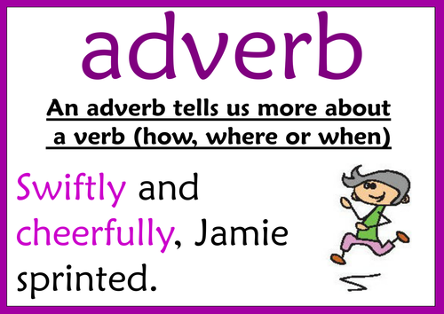
I would like to see you using expanded noun phrases and adverbs in your writing today.

Slide 40
When would we expect to see expanded noun phrases in playscripts?
When we would expect to see adverbs?

Slide 41
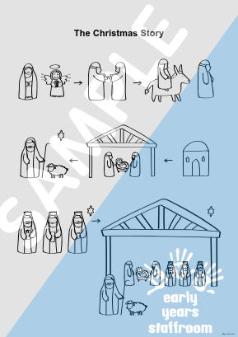
You are going to create a quick story map for your character(s)
While every character is part of the Nativity story, they will each have their own individual story map as they experienced the Nativity story differently.
For example: the shepherds were in a field watching their sheep, a host of angels appeared to them and told them to go and find the baby wrapped in a manger, the shepherds travel to Bethlehem, they find Jesus and then they spread the word about what they had seen/been told.

Slide 42
Activity 1
On one side of your paper, draw a quick story map for your character(s).
Use the prompts on the next slide to help you.

Slide 43
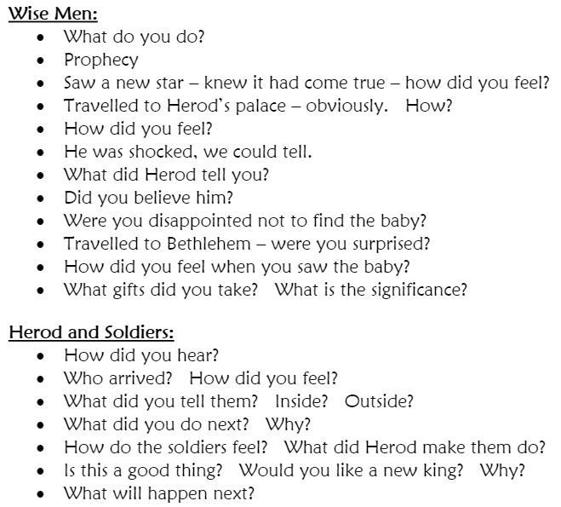
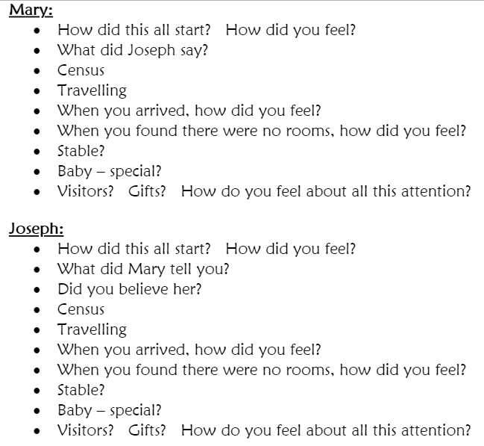
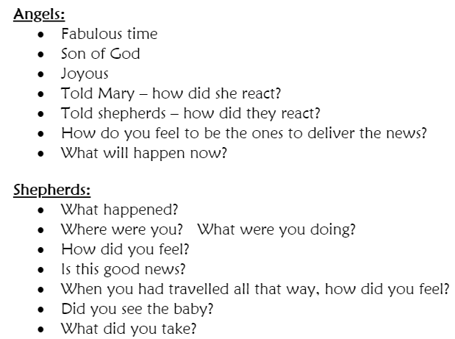

Slide 44
Activity 2
On the other side of your paper, begin writing your playscript for your character(s).
You should practice and experiment with using the different techniques of playscripts and ensure you are setting out your playscripts correctly.
The focus of your playscript practice today is: structure (i.e. title, description of when and where it’s set, list of characters that appear, the character’s name on the left followed by a colon, stage directions to tell you how a character moves or what they should be doing with an object.)
Try to use adverbs and expanded noun phases in your playscript too.

Slide 45
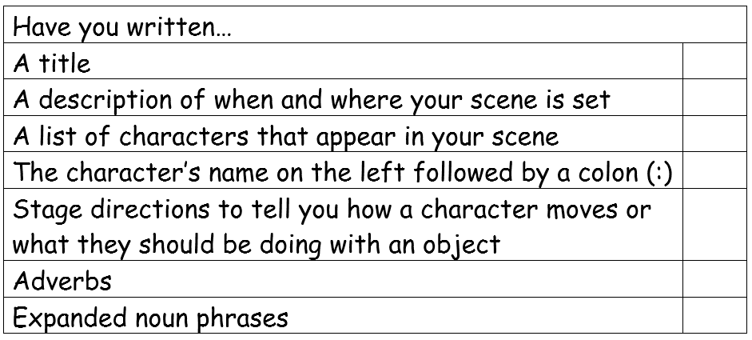
Use the checklist to help you!

Slide 46
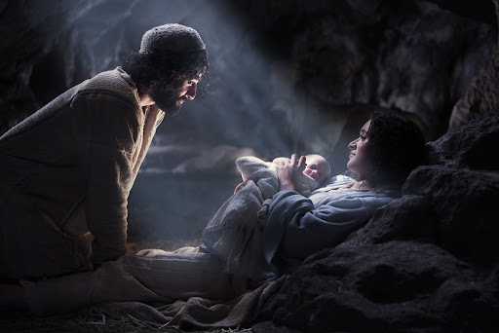
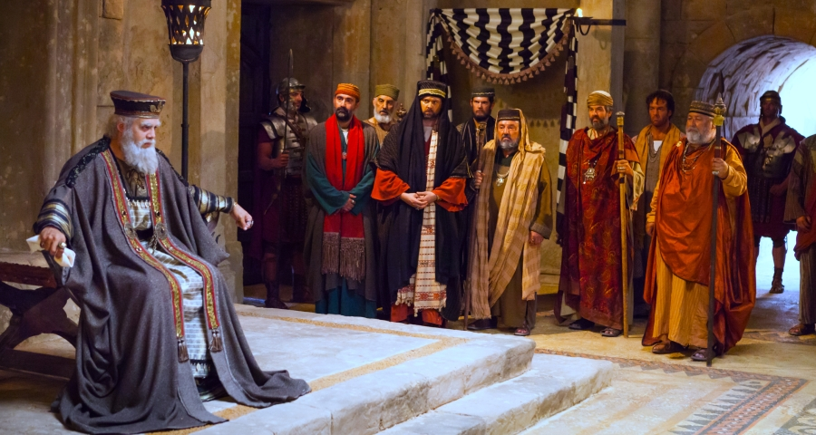
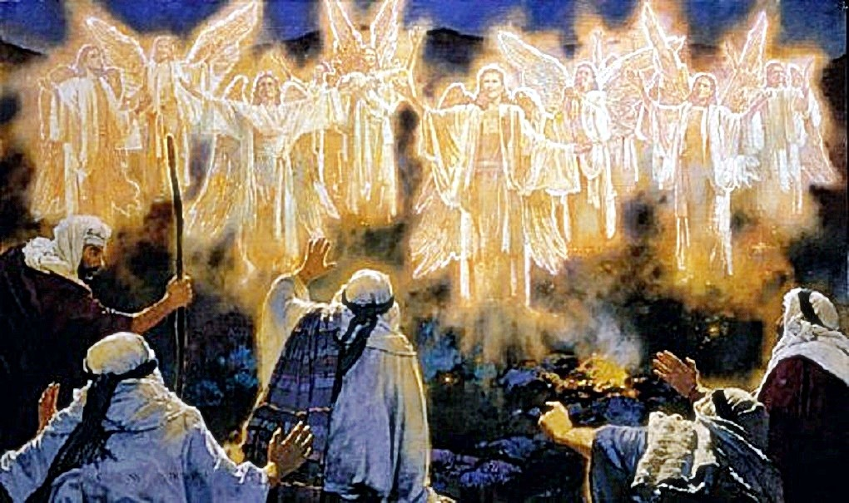
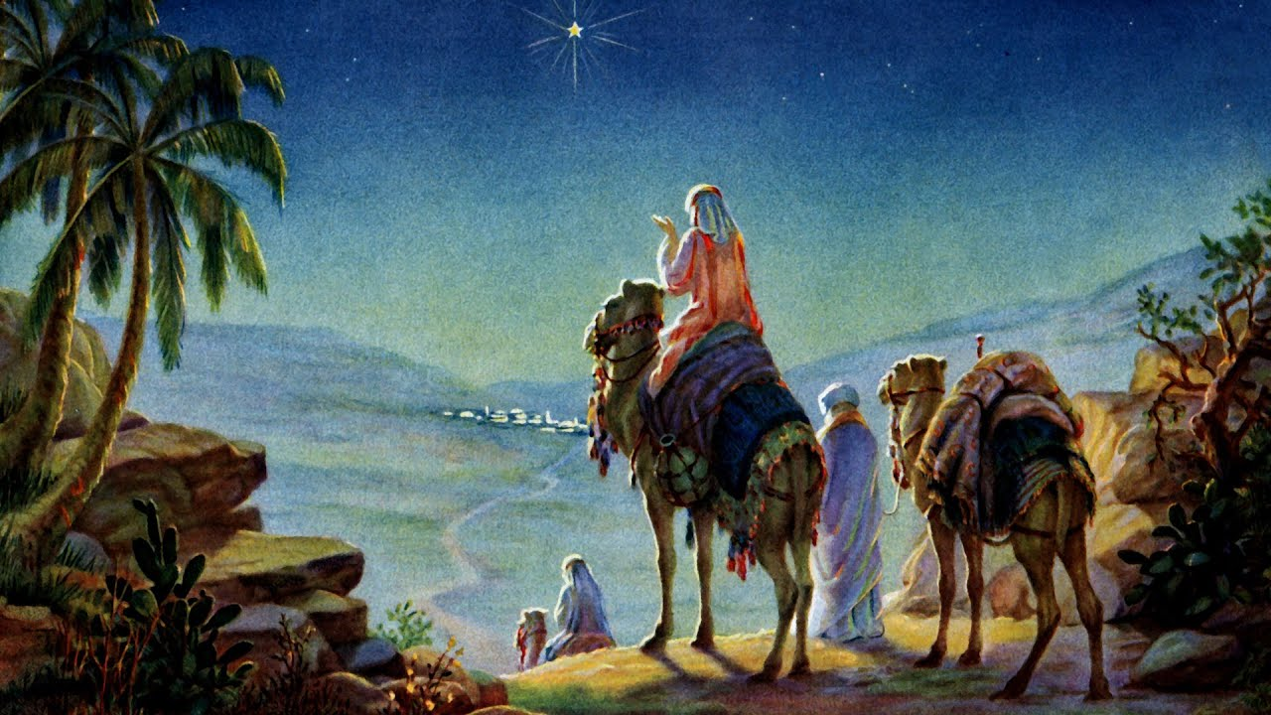
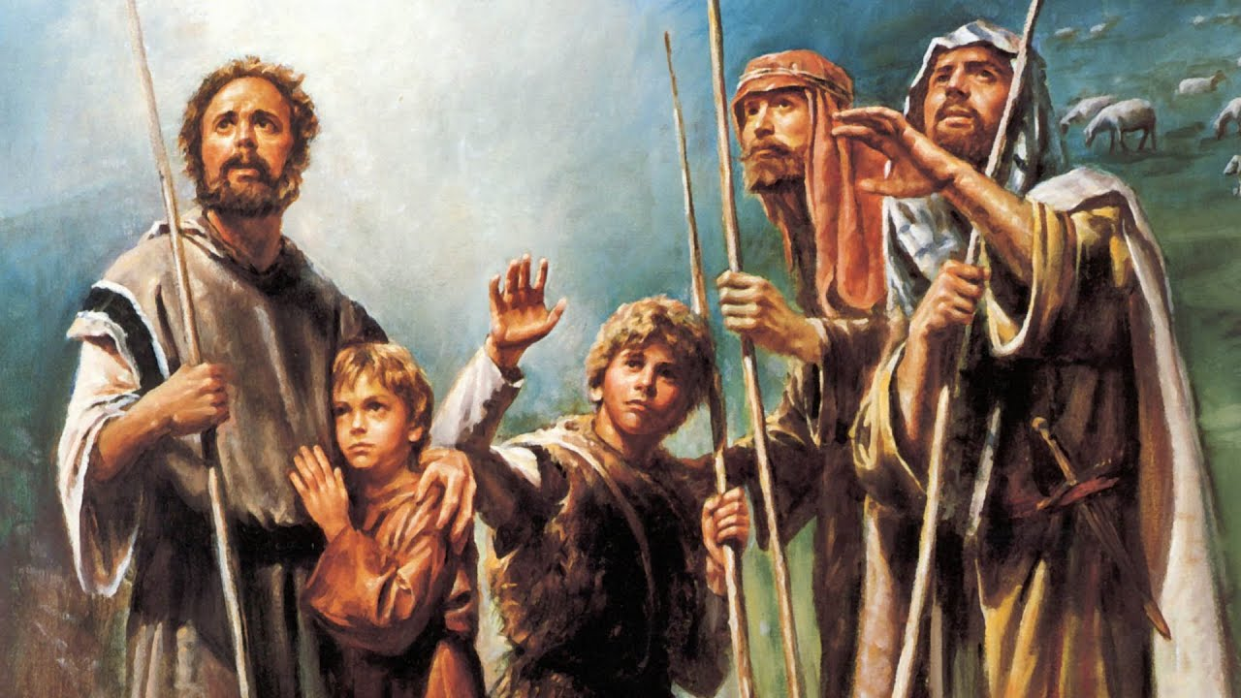

Slide 47
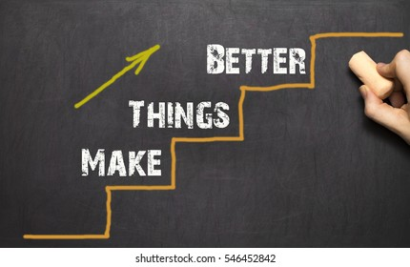
Red Pen
Ask an adult to read your playscript and give you feedback on how well the features of scripts have been met.
Set yourself a target for next week based on this conversation.
Write your target on a Post-It note, with two suggested ways you can meet it.
Keep hold of your Post-It note, so that you can work towards addressing this target next week.

