Slide 1

Today:
You are going to create your own prezi about a topic of your choosing!
It needs to link to something we have been learning about in Year 6 this year, e.g. Women in History, WWII, Electricity, Light, Macbeth etc.
I am looking for the most interesting, eye-catching prezis!

Slide 2
Try to use all of the items on the checklist in your prezi to show off what you can do!
Select theme
Add text area
Add background image
Add video
Add audio file
Present
Zoom in
Set size of box
Change order
Add a hyperlink
Move text
Change the shape and colour of a ‘topic’

Slide 3

Some ideas…
https://prezi.com/vnbaktxymvxq/famous-women-in-a-history/
https://prezi.com/uvyhxpw7gqig/when-did-world-war-ii-begin/
https://prezi.com/1zm8ho7uv9v-/shakespeares-macbeth/
https://prezi.com/tufkqg9azlom/electrical-circuits/
https://prezi.com/p/myejfb7mj06r/light-for-kids/?fallback=1

Slide 4
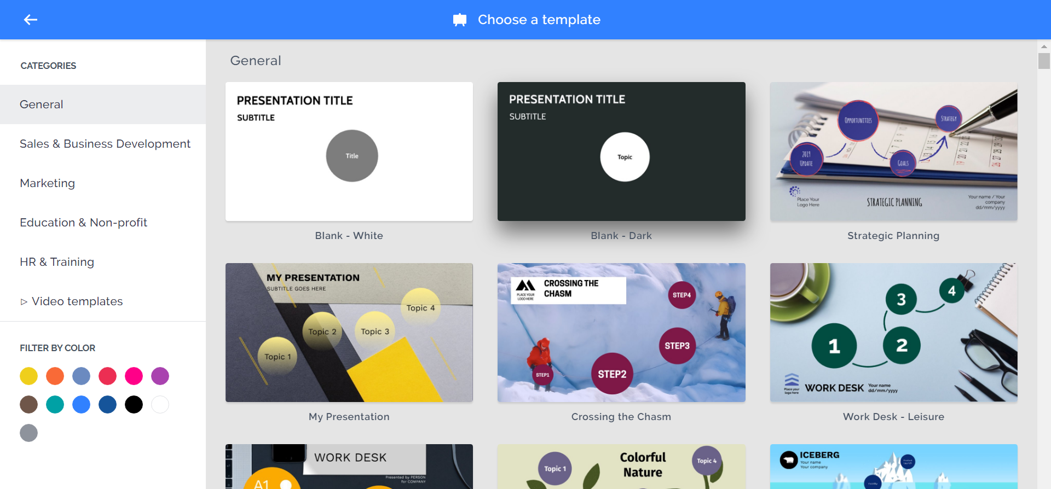
Choose a theme.

Slide 5
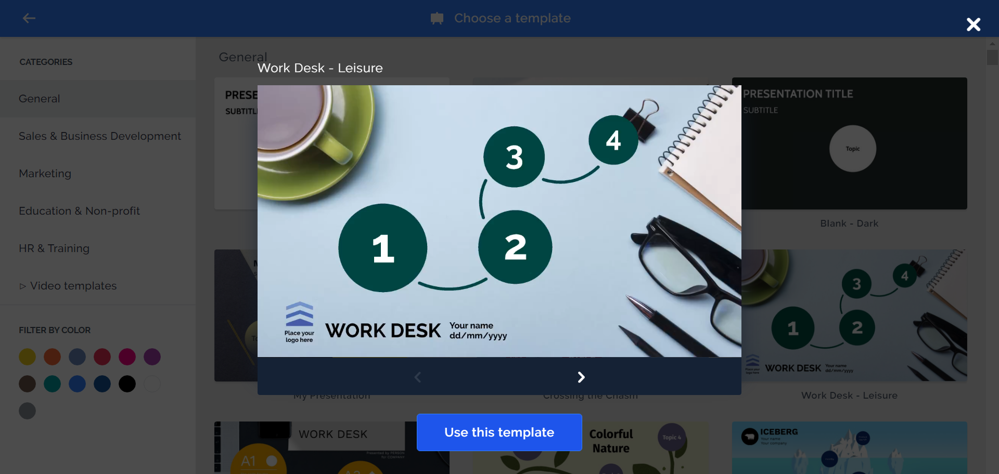

Slide 6
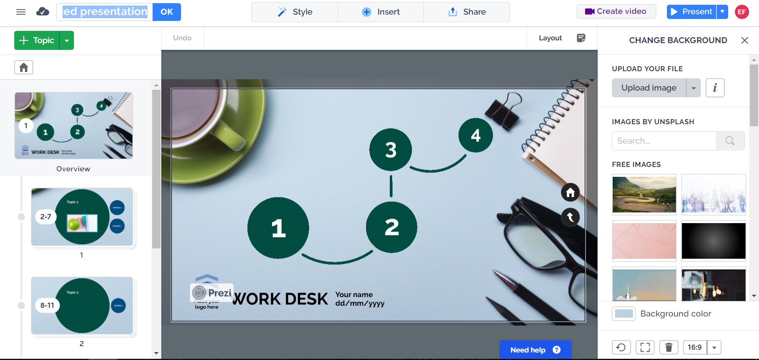
Name your presentation.
Click on ‘Untitled Presentation’ and write your name(s). Click ‘OK.’

Slide 7
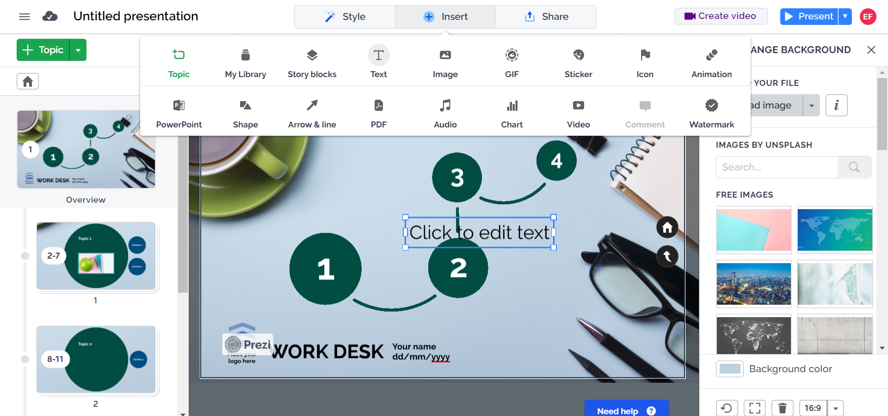
Add text area

Slide 8
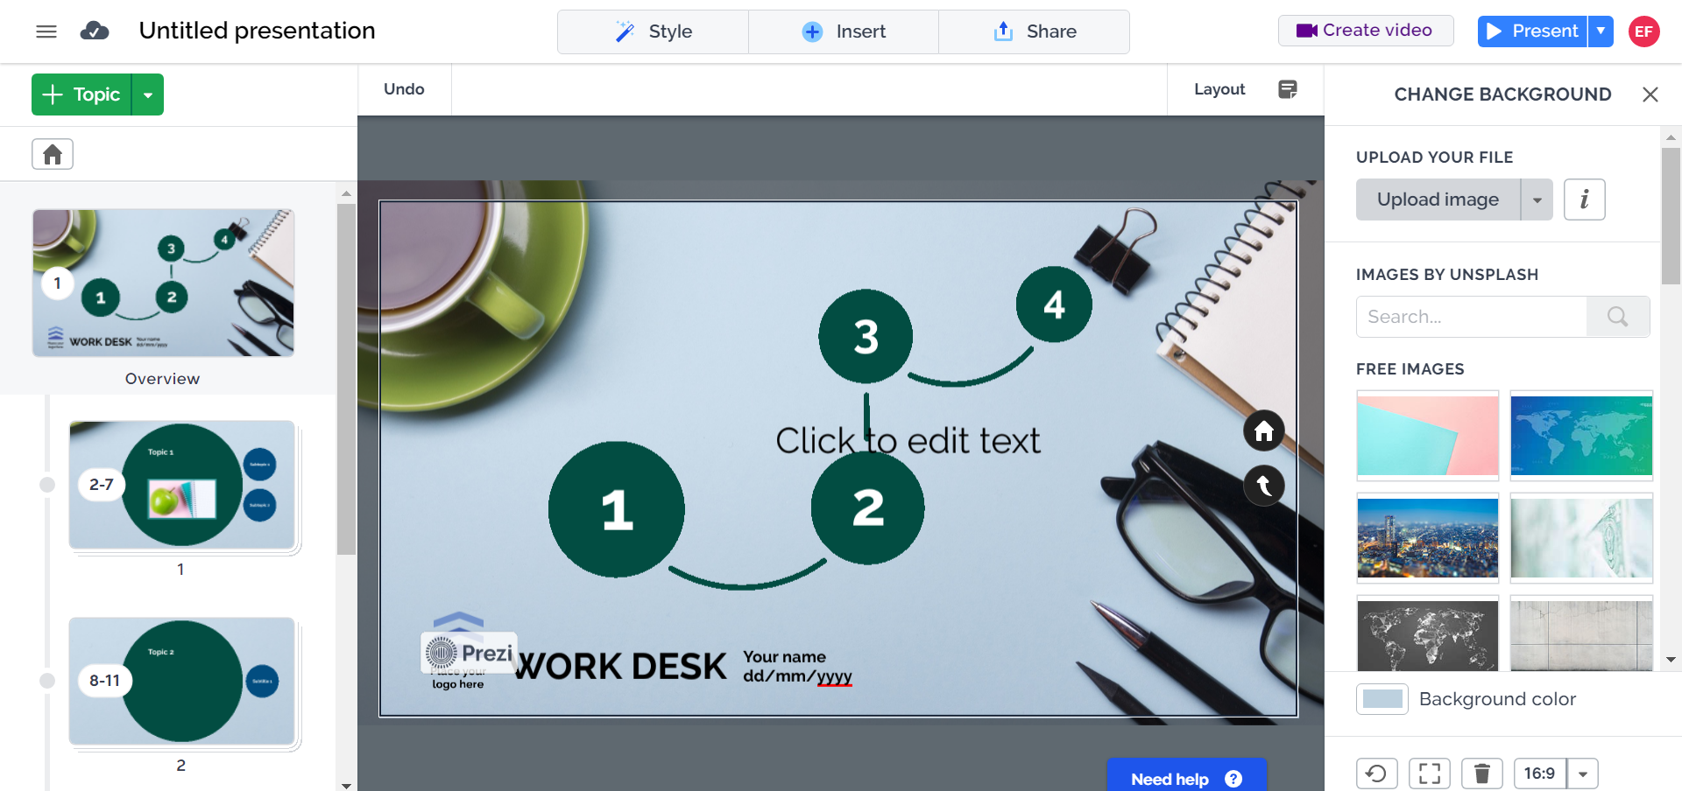
Add background image

Slide 9
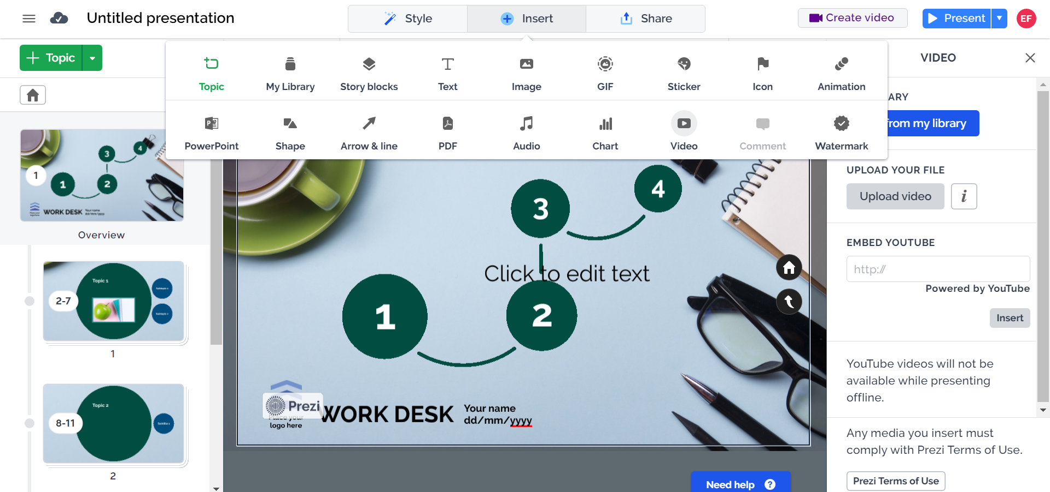
Add video

Slide 10
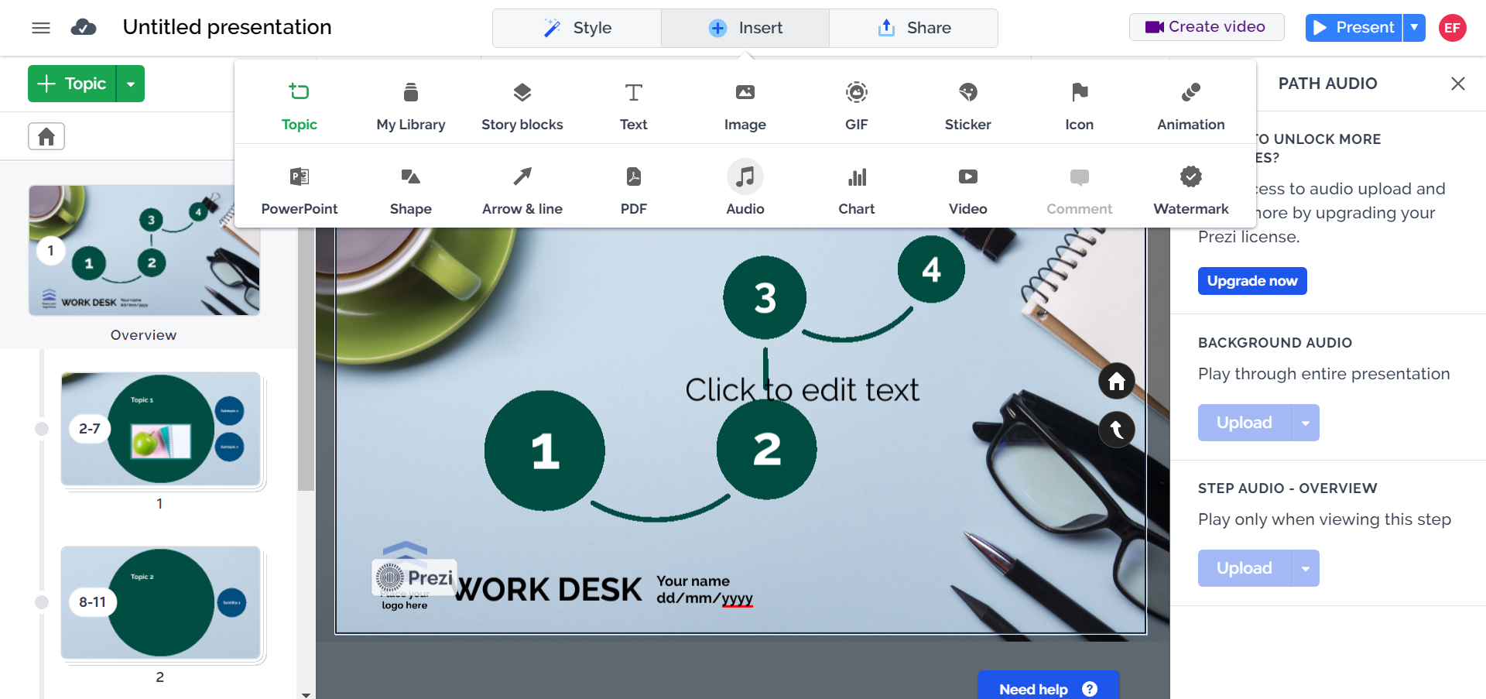
Add audio file
Can’t actually add audio due to Prezi account limitations.

Slide 11
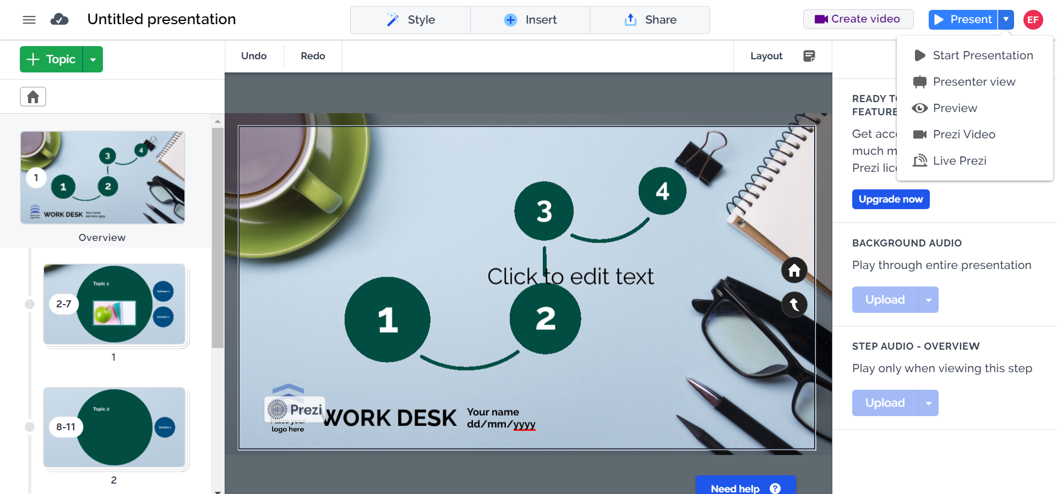
Present

Slide 12
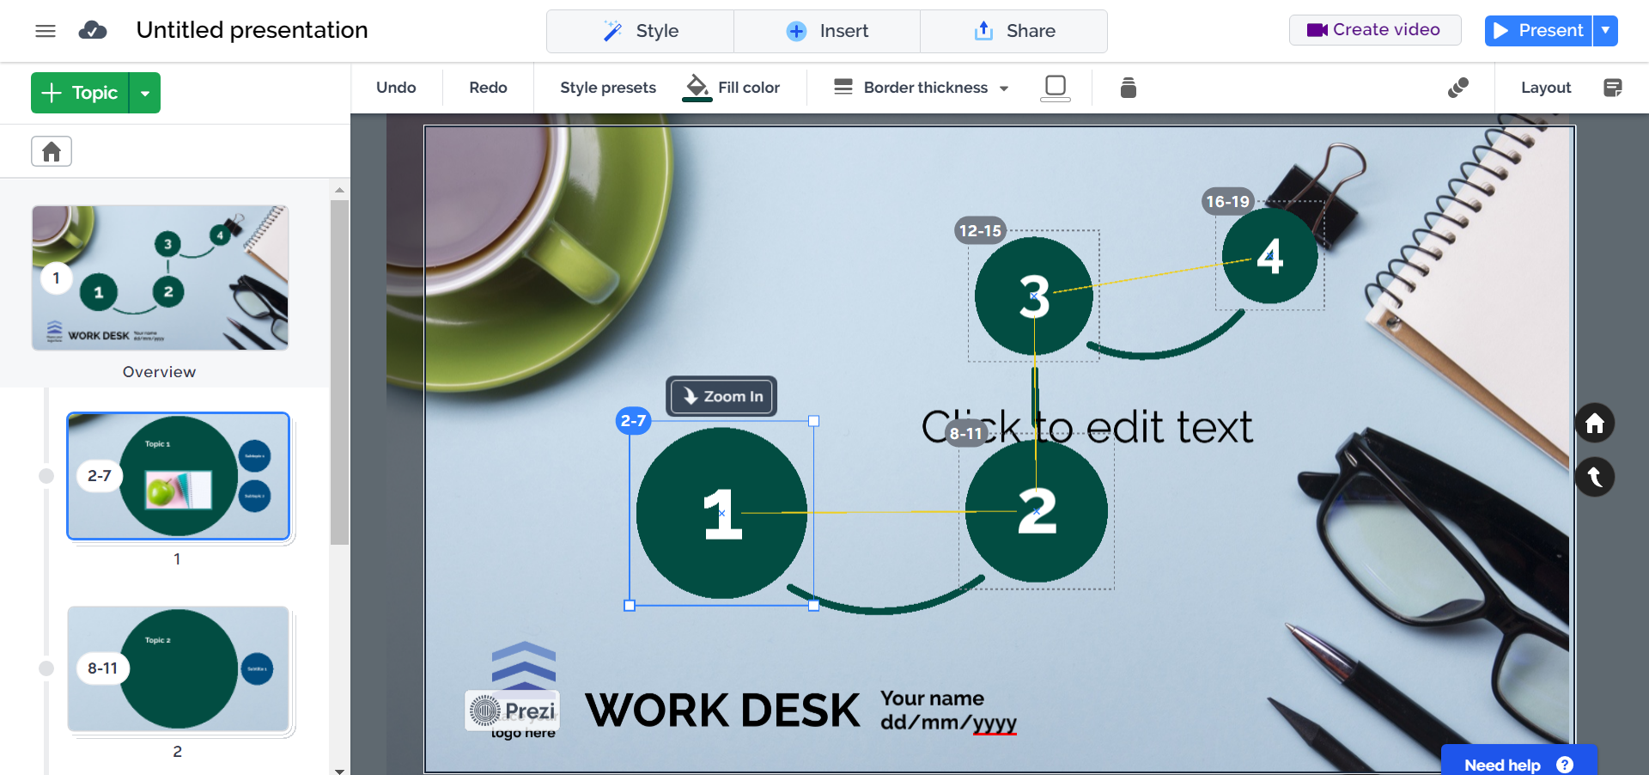
Zoom in
Or double click where you want to zoom.

Slide 13
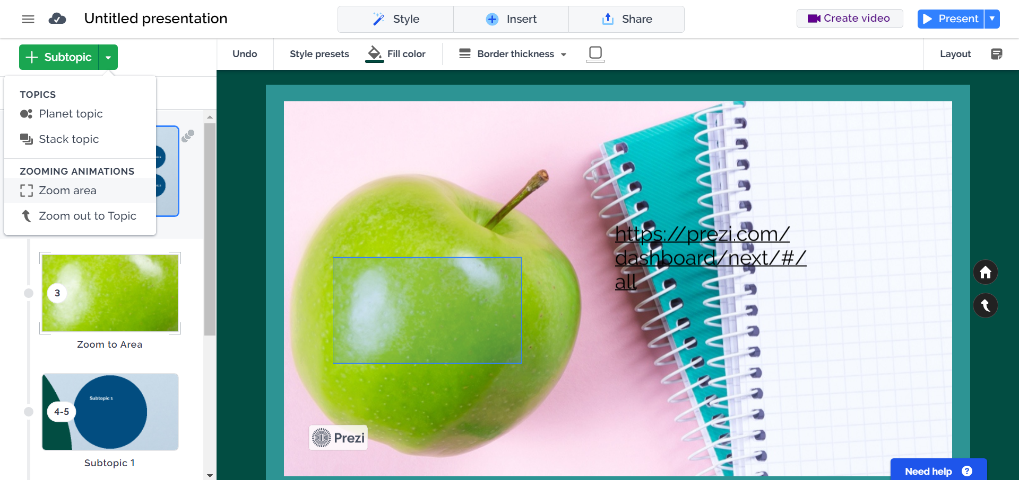
Zoom in

Slide 14
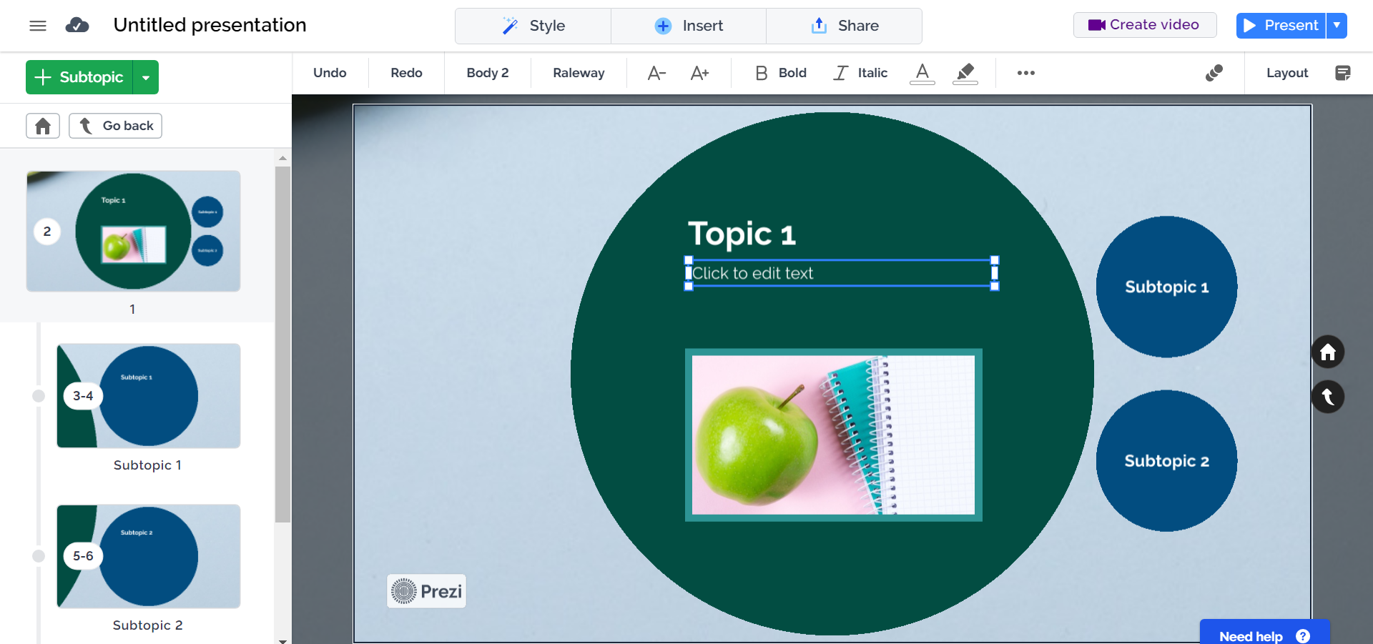
Set size of box

Slide 15
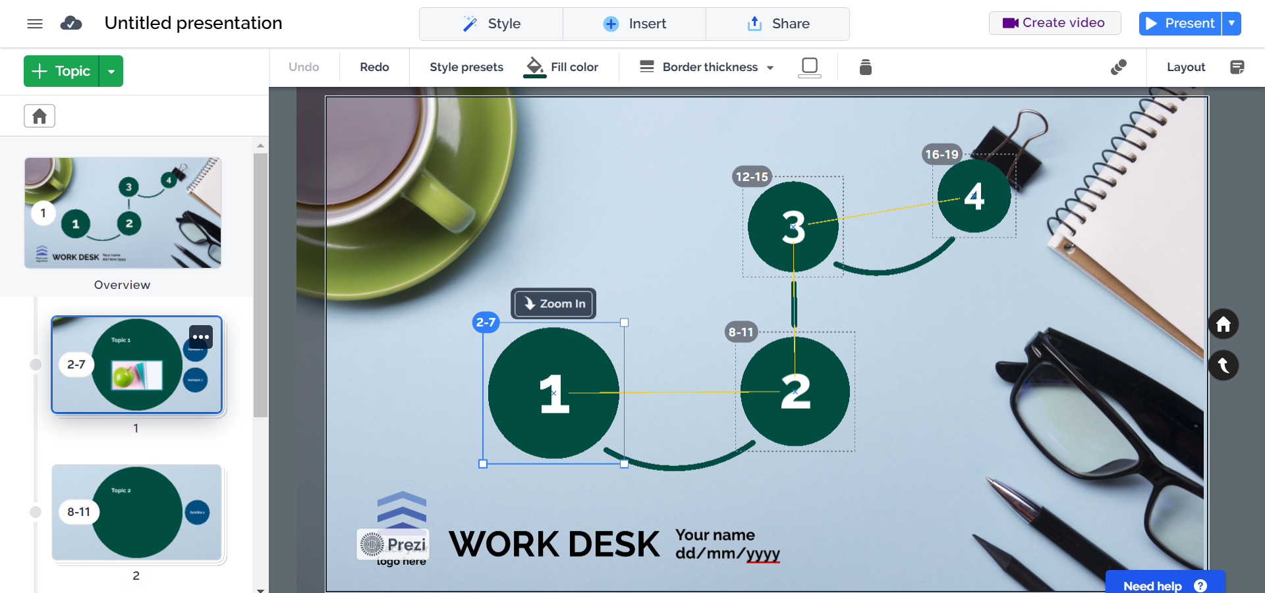

Change order
Click and drag to rearrange the blocks.

Slide 16
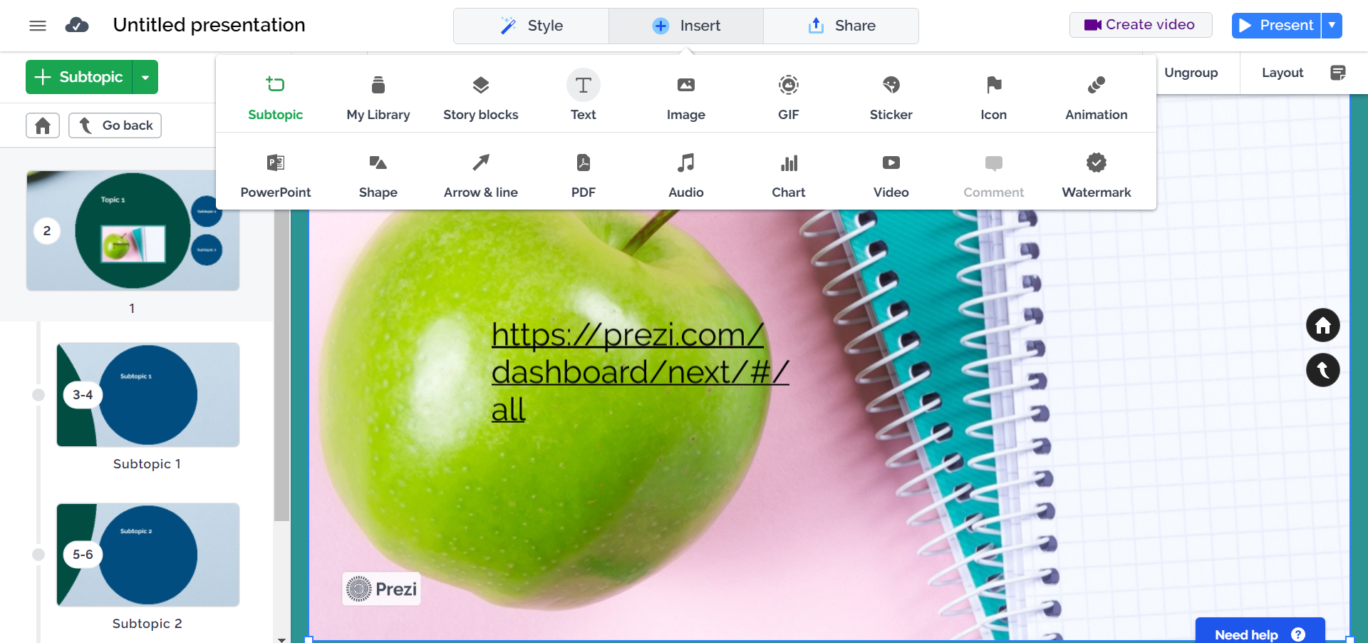
Add a hyperlink
Insert a text box, then copy and paste the URL.

Slide 17
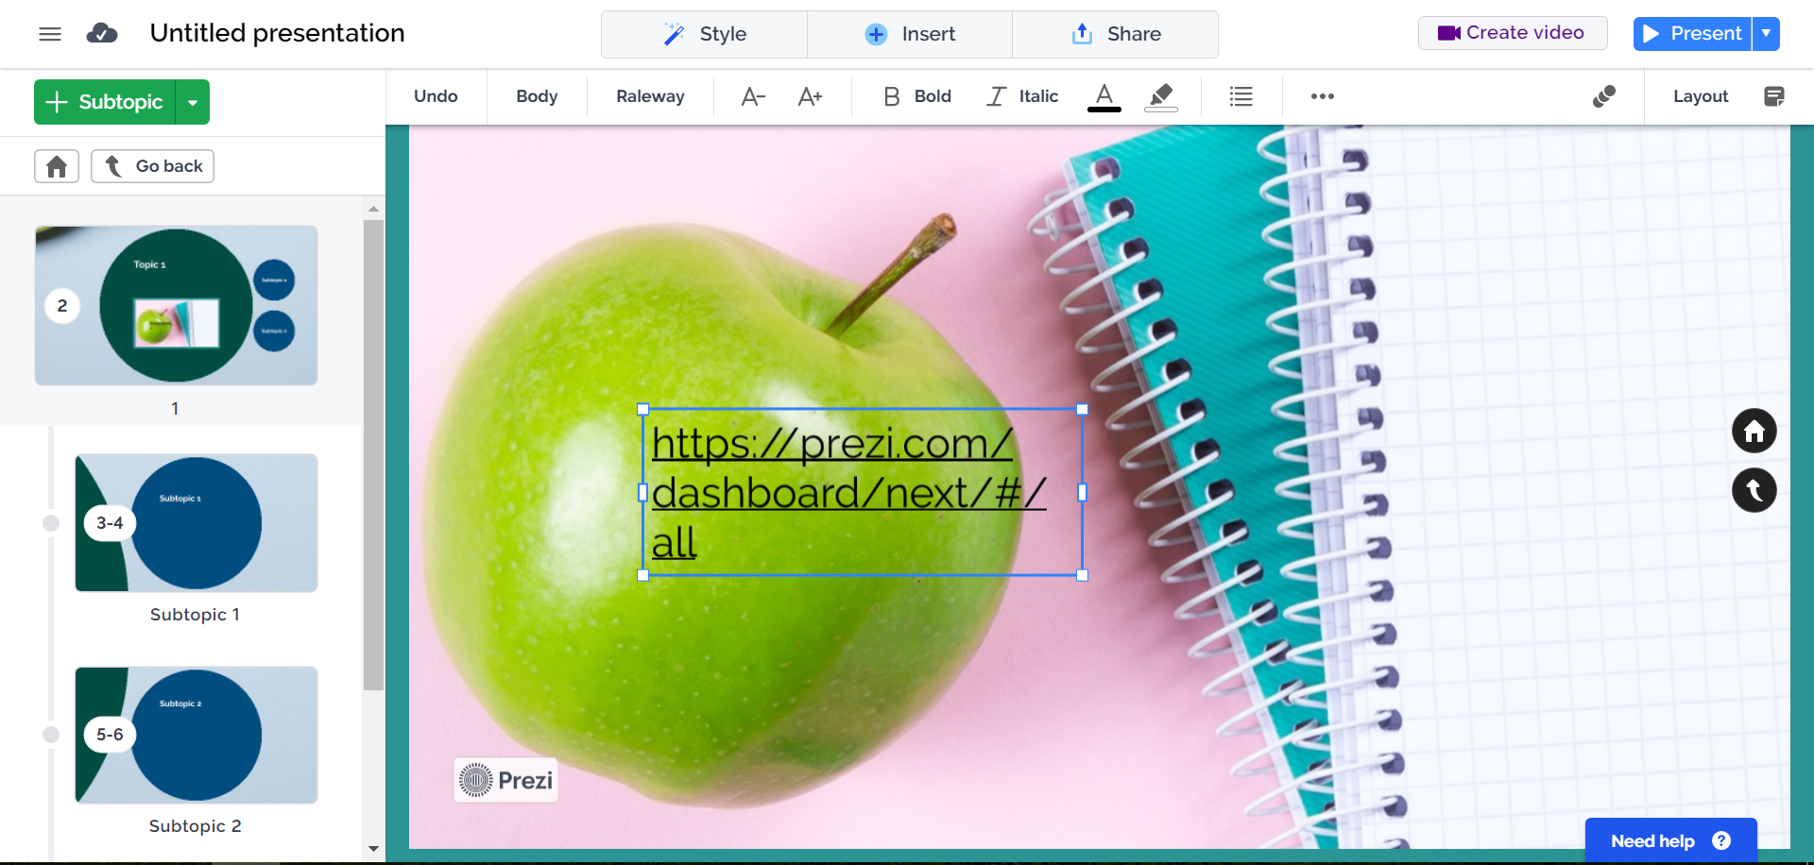
Move text
Select the text you want to move, then click and drag it.

Slide 18
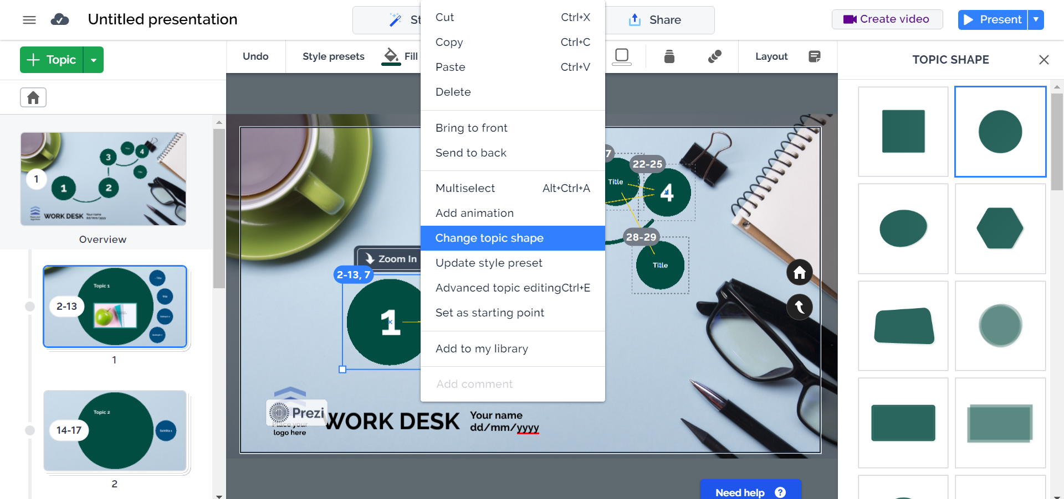
Change the shape and colour of a ‘topic’
Right click on the ‘topic’ you want to change.

Slide 19
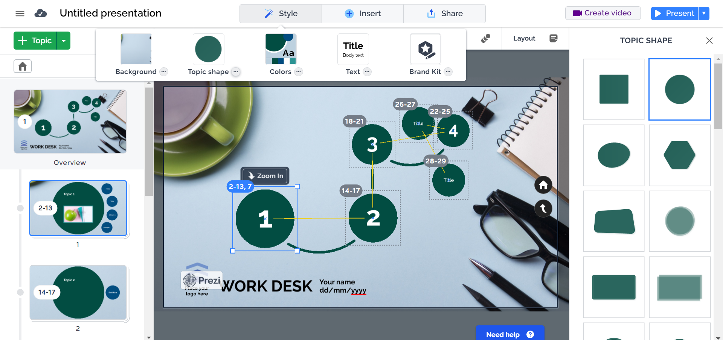
Change the shape and colour of a ‘topic’
Right click on the ‘topic’ you want to change.

Slide 20
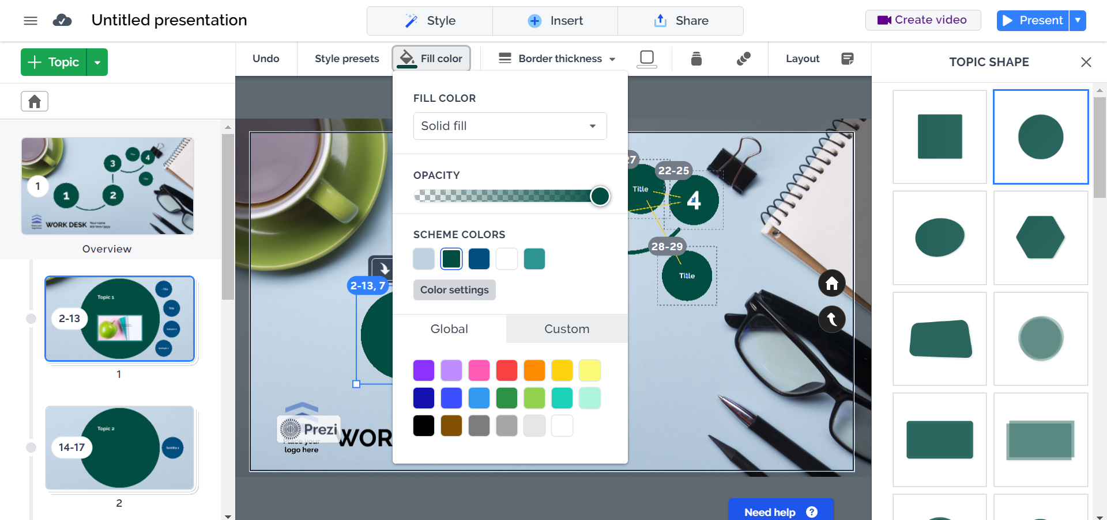
Change the shape and colour of a ‘topic’
Right click on the ‘topic’ you want to change.

Slide 21
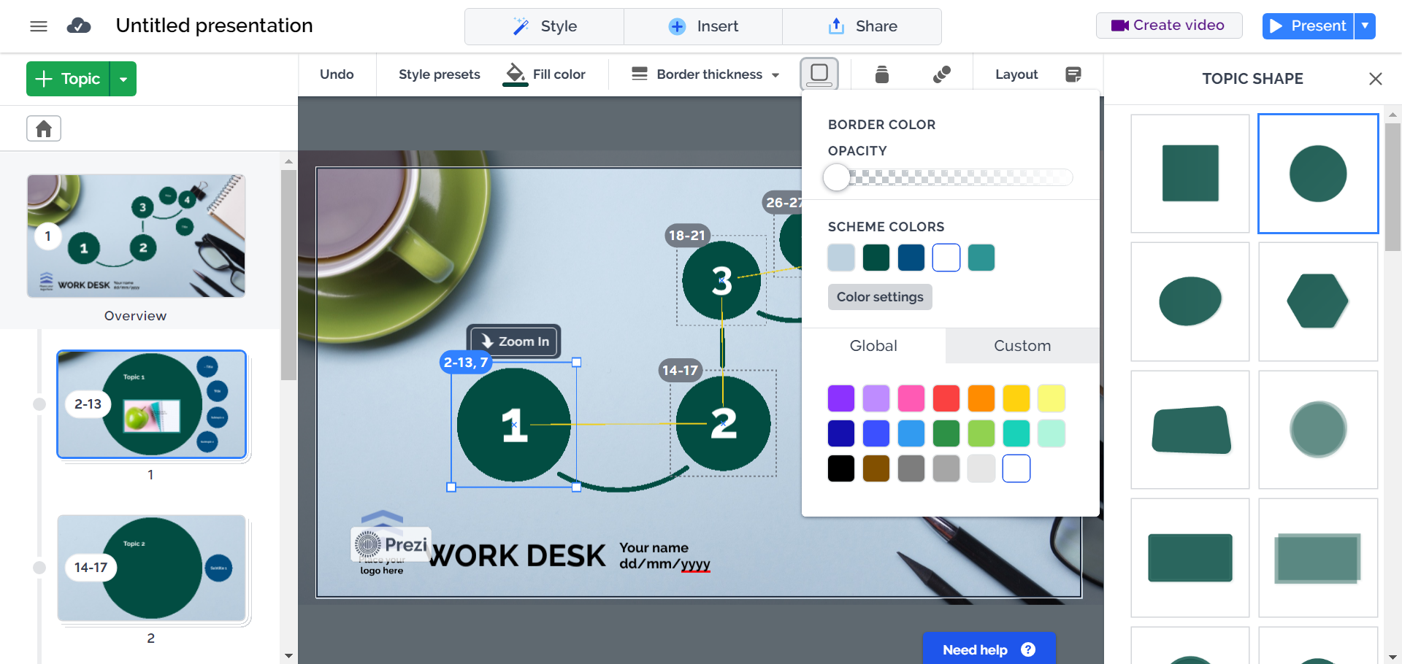
Change the shape and colour of a ‘topic’
Right click on the ‘topic’ you want to change.

