Slide 1
LO: To understand beliefs and teachings
To understand practices and lifestyles
To understand how beliefs are conveyed
C: Christianity

Slide 2
Transfiguration means ‘transformation.’
For many Christians, the belief that Jesus is more than the Messiah – but God in the flesh – means that faith in Jesus can transform individuals’ lives now: the Gospels are not just stories.
In all the ways Jesus turned expectations on their heads, God shows Christians how their lives can be transformed.

Slide 3
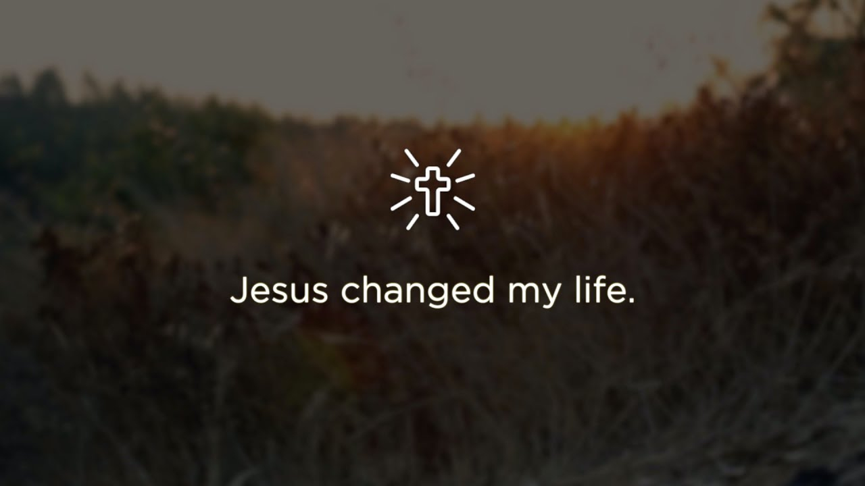
https://www.youtube.com/watch?v=cR1G7BX5U00
How have Jesus and God changed the lives of these Christians?

Slide 4
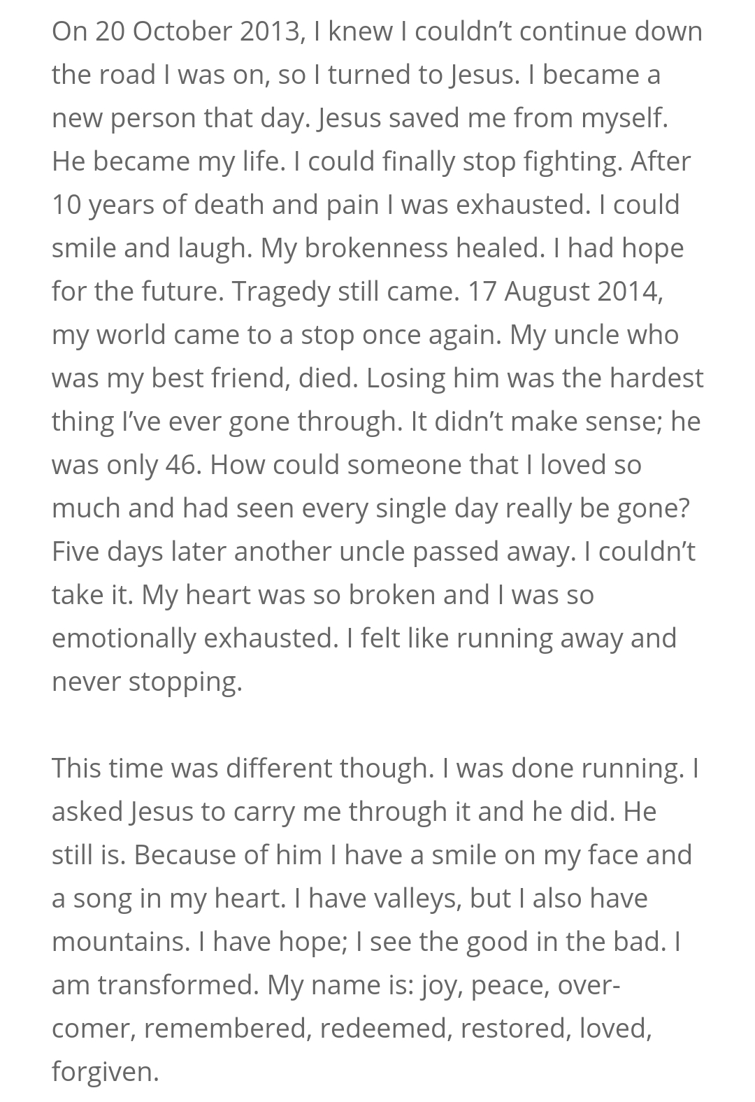

How has Jesus changed the life of this Christian?

Slide 5
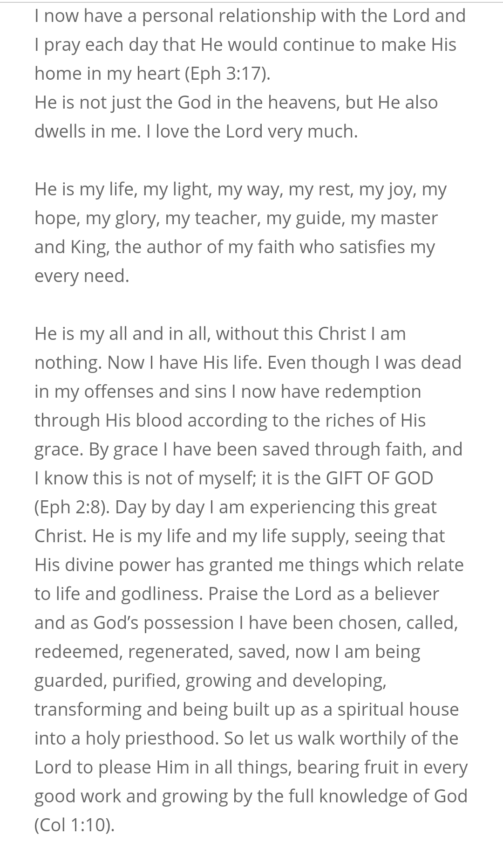
How has Jesus changed the life of this Christian?

Slide 6
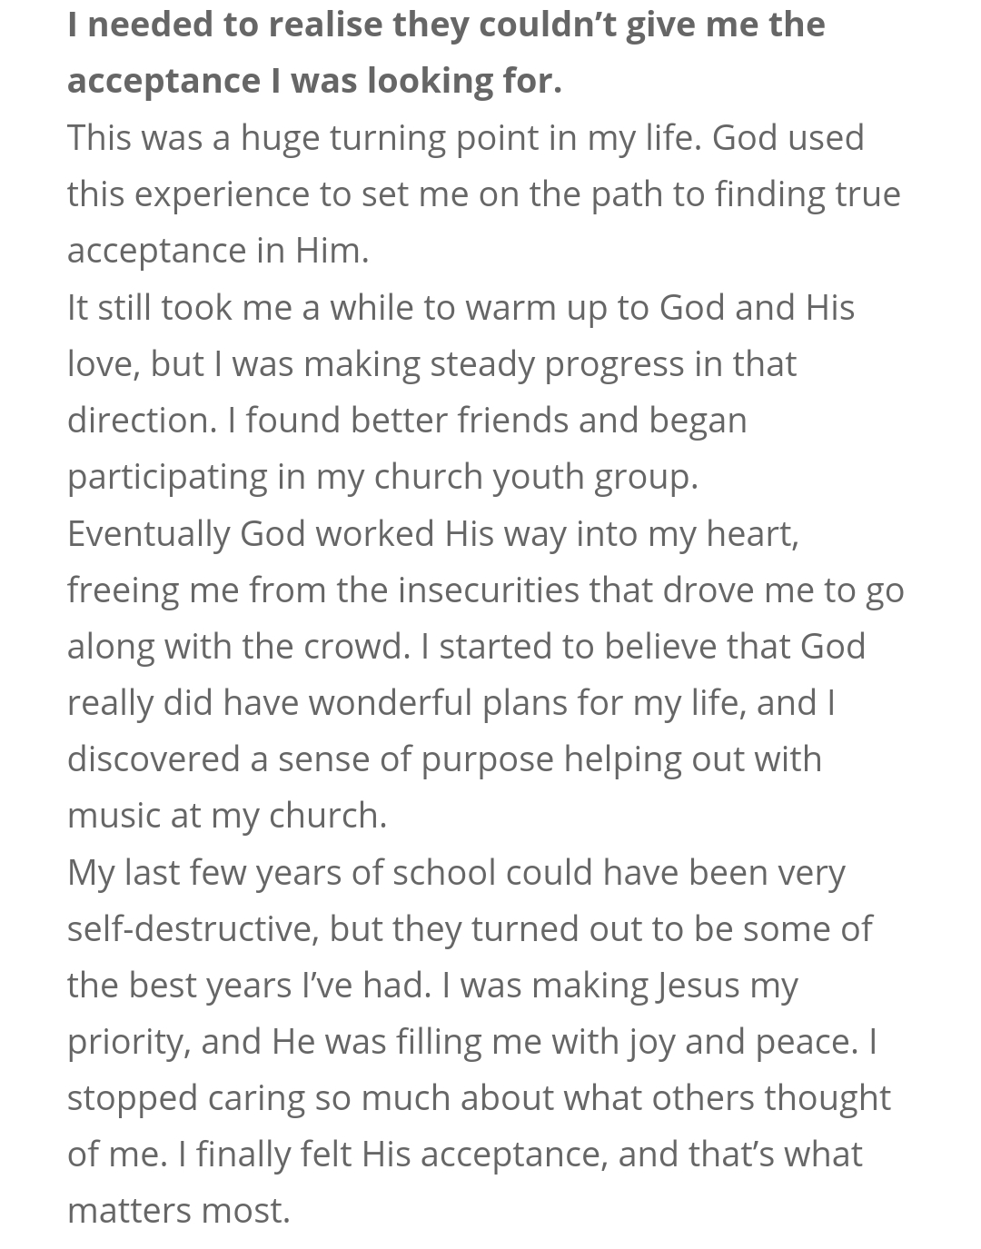
How has Jesus changed the life of this Christian?

Slide 7
List some simple ways a Christian’s life might be transformed by following Jesus, e.g.
  Having a purpose in life
  Feeling accepted by others (e.g. God)
  Trying to support somebody local by doing their shopping
  Giving away 10% of what they earn to charity
  ‘Loving your neighbour,’ i.e. helping others, showing kindness to others, forgiving others etc.
Create a bubble map.

Slide 8
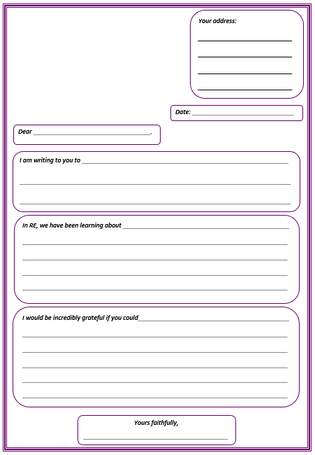
Activity
Write to your local church and ask for some examples from the congregation of how a Christian’s life might be transformed by following Jesus.
Ask for examples of testimonies of ways in which people believe their lives have been transformed by their faith in Jesus.
Paddling: use the letter template and sentence starters to help you.

Slide 9

Red Pen
Has your life ever been transformed by something?
How was it transformed?
How did you feel?

