Slide 1
LO: To investigate living things
To work scientifically
C: Classification Keys

Slide 2
https://www.youtube.com/watch?v=LzsgVWv8Fnc
Species need to be classified by sorting them into groups.
In order to sort them, you will need to come up with questions that will split the species into two new groups.
You will need to sort the species according to clear characteristics.
The questions need yes or no answers.

Slide 3
There is no wrong or right answer to this activity – different questions can be used by different groups or a similar question can be used at different levels of the classification key.

Slide 4
Activity
Bees, Birds and Butterflies
Create a classification key for one of the above species.
Cut out the photographs so that you can move them around on your key as you think of suitable questions to ask to separate them from each other.
Paddling – birds
Snorkelling – butterflies
Diving - bees

Slide 5
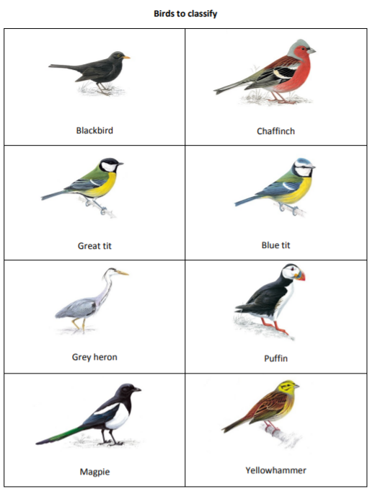
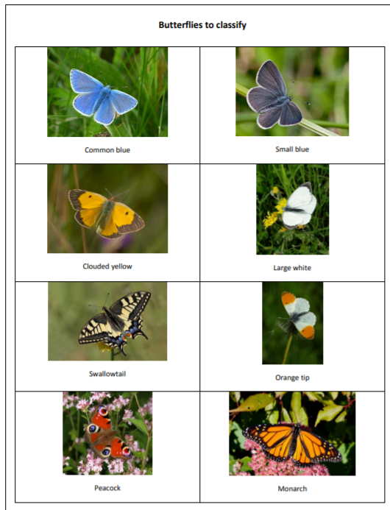
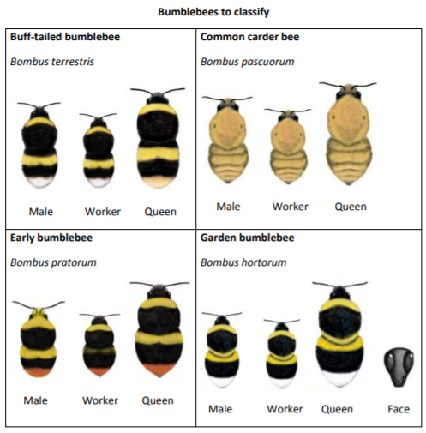

Slide 6

Red Pen
How many different ways can you classify the species?

Slide 7

Plenary
Look at the classification systems you created – what differences are there?
This is how systems often evolve in science, where different scientists have different ideas, arguments and opinions as well as new evidence or techniques.
This is an important part of science, as when scientists then share their ideas, they may find flaws in one another’s work through what is called ‘peer review.’

