Slide 1

Lesson 1
L.O.: To understand chronology.
C.: Understand why WWII began and place key events in chronological order.

Slide 2

Who can remember the date that Britain declared War on Germany? How long ago was this?
Why did WWII begin?
Discuss! TTYP, ready to feedback in 3 minutes

Slide 3
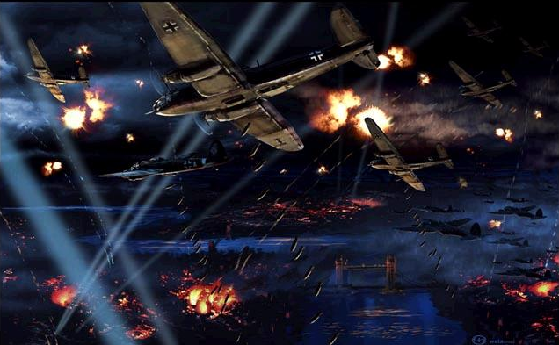
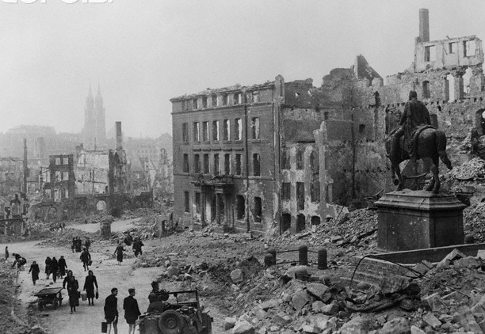
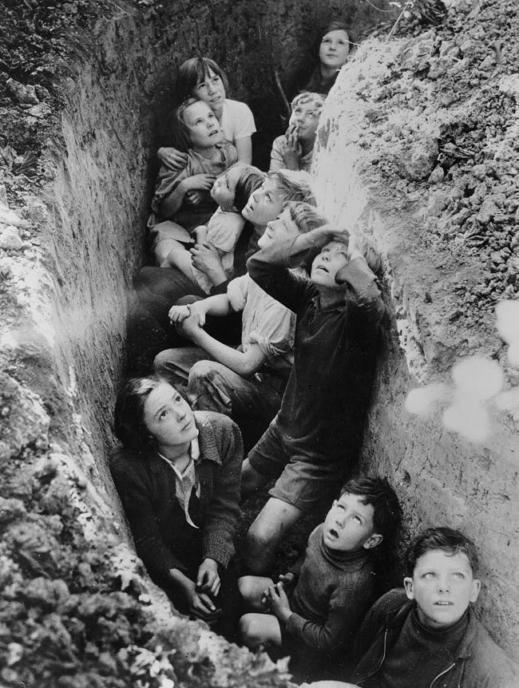
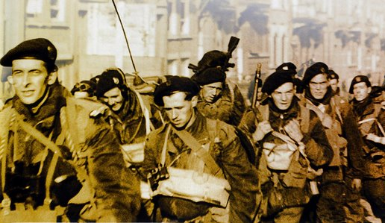
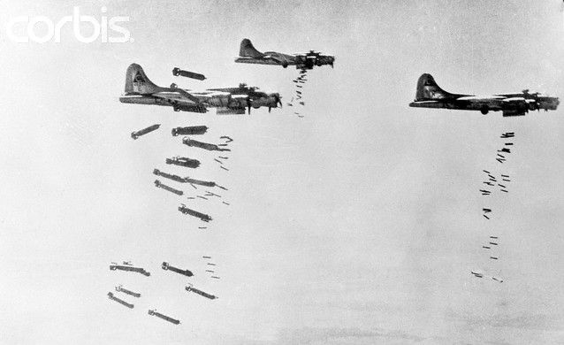
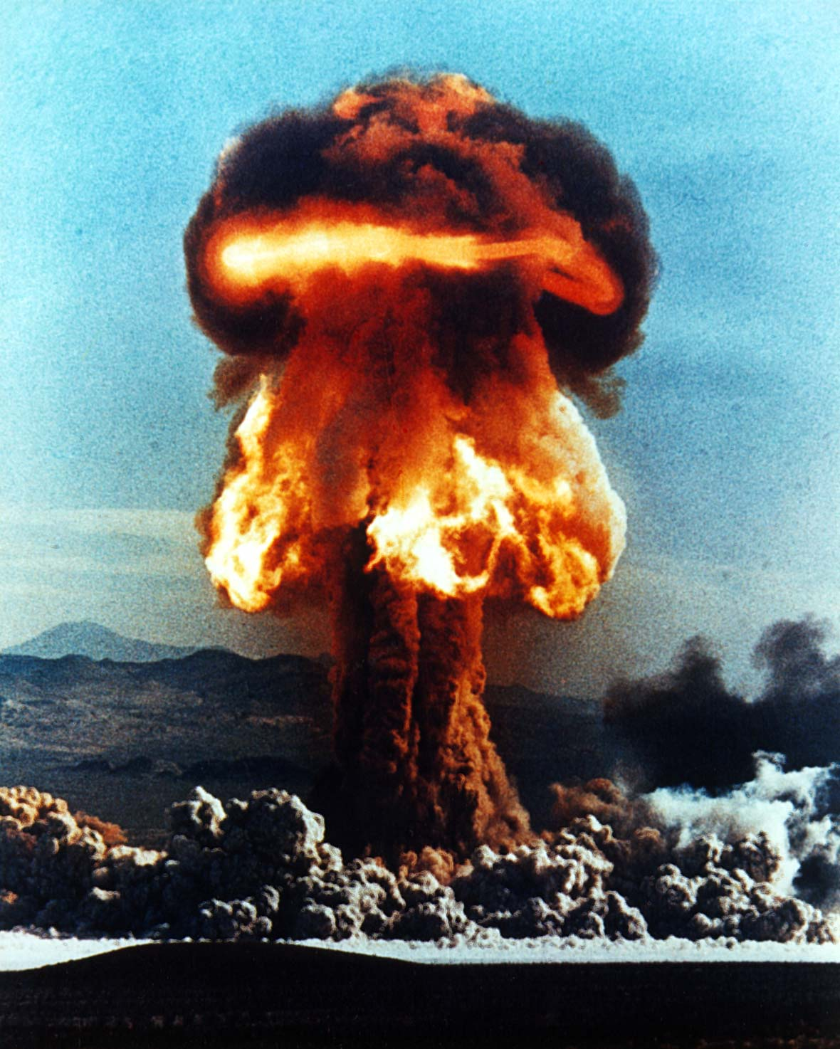
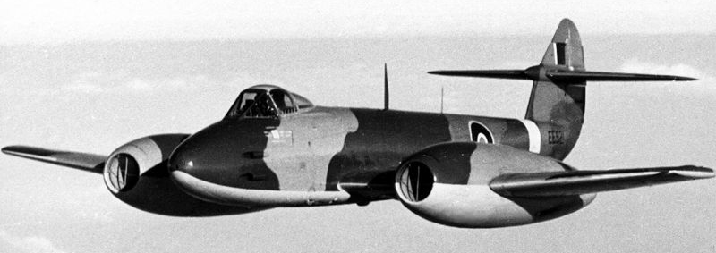
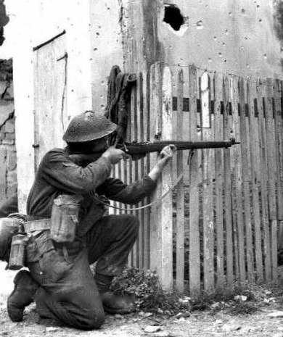
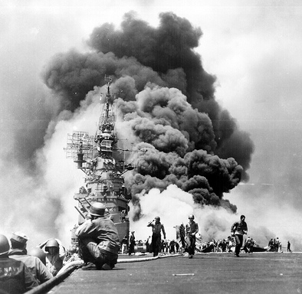
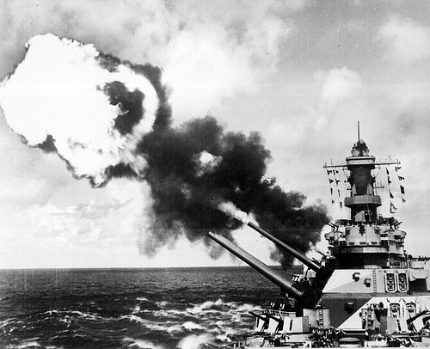
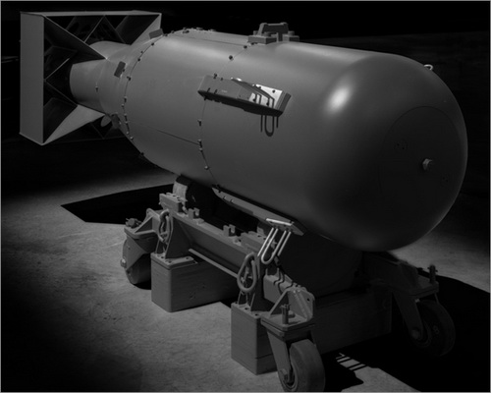
World War 2 was the biggest war that has ever happened in the history of the World.
It was the first war to take place across the entire planet of Earth.
It involved more than 60 different countries.
It was the first war to use large aeroplanes to bomb whole cities and, at the end of the war, atomic bombs.

Slide 4
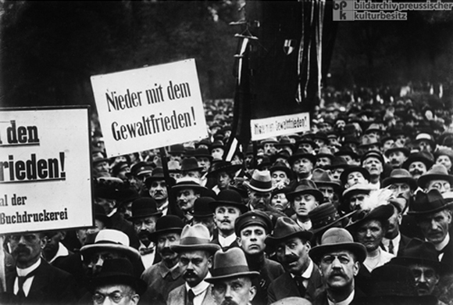
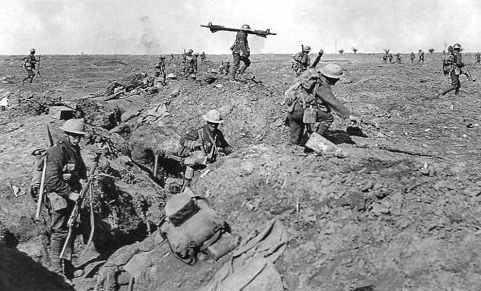
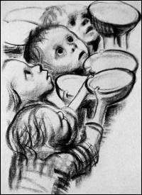
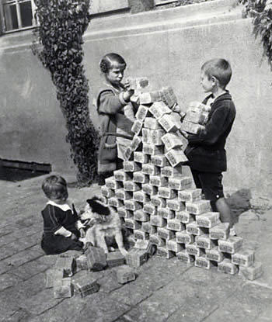
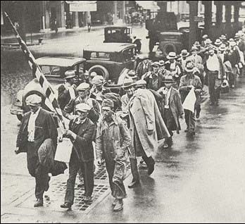
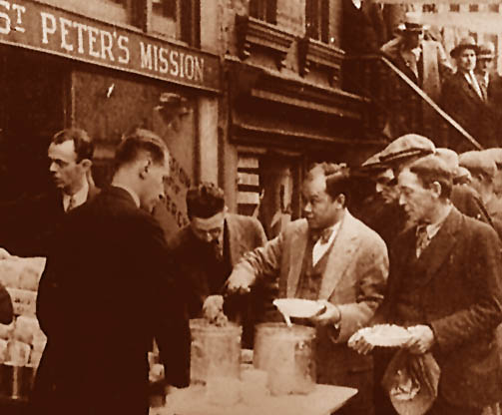
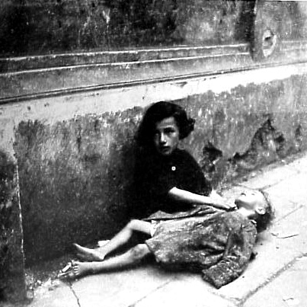
How did the Second World War start?
In 1918, Germany lost World War One. Germany had to give up land and was banned from having any army of its own.
Germany had to pay lots of money to Britain and France for starting the war.
By 1928 Germany had almost no money. There was no work for anyone and many people were starving.

Slide 5
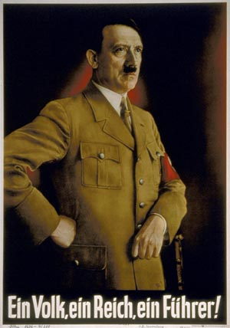
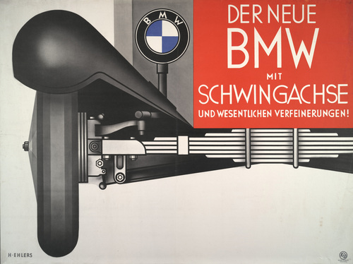
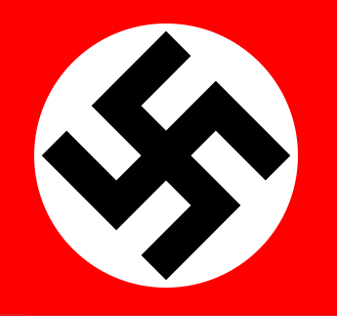
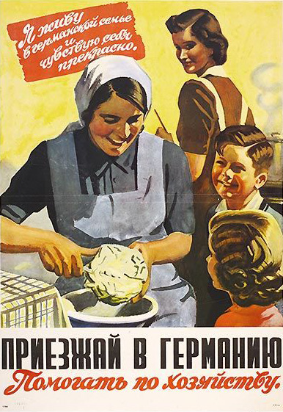
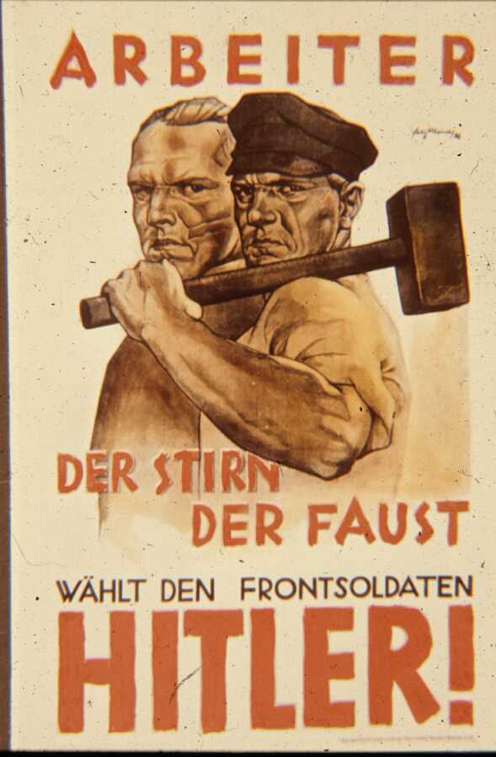
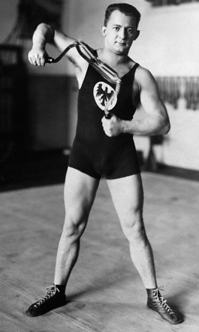
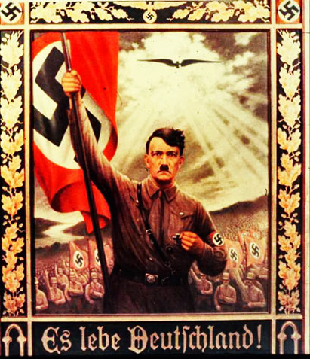
In 1933 a man named Adolph Hitler became the leader of the German government and the leader of Germany.
He had big plans for his country and started to build up Germany’s strength by putting people back to work building, manufacturing and becoming a fit and healthy people.

Slide 6
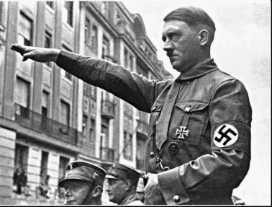
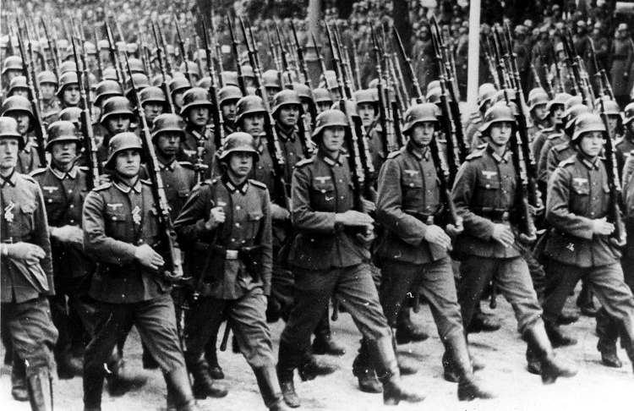
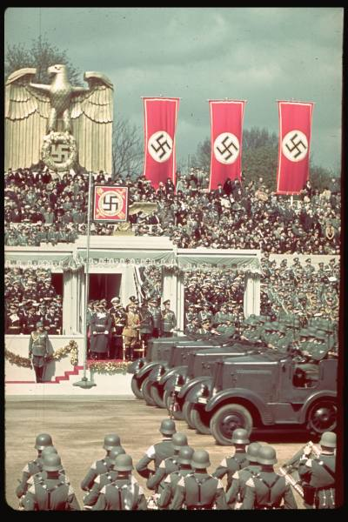
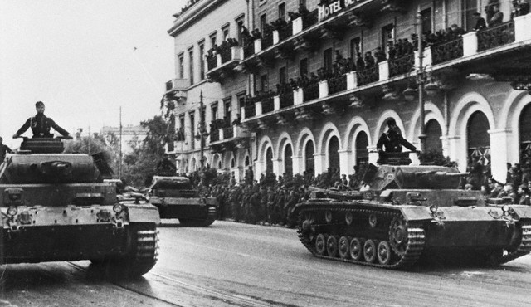
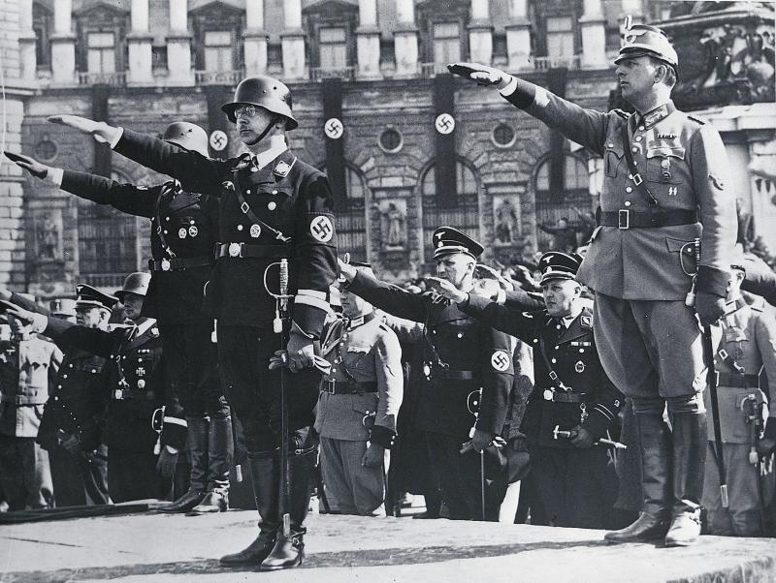
He also started to build up a huge army – but Germany had been banned from doing this – it was illegal. By 1935 Germany had become one of the strongest and most powerful countries in the world. Hitler believed the German people were the best in the world – he believed that they were superior to anyone else and thought Germany should rule the world.

Slide 7
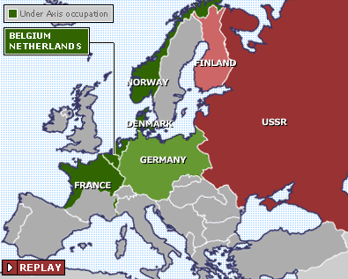
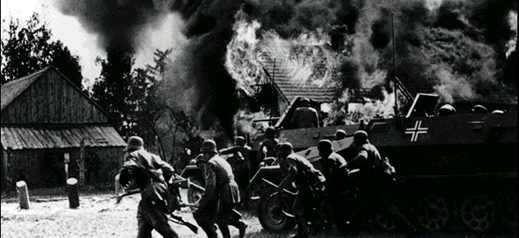
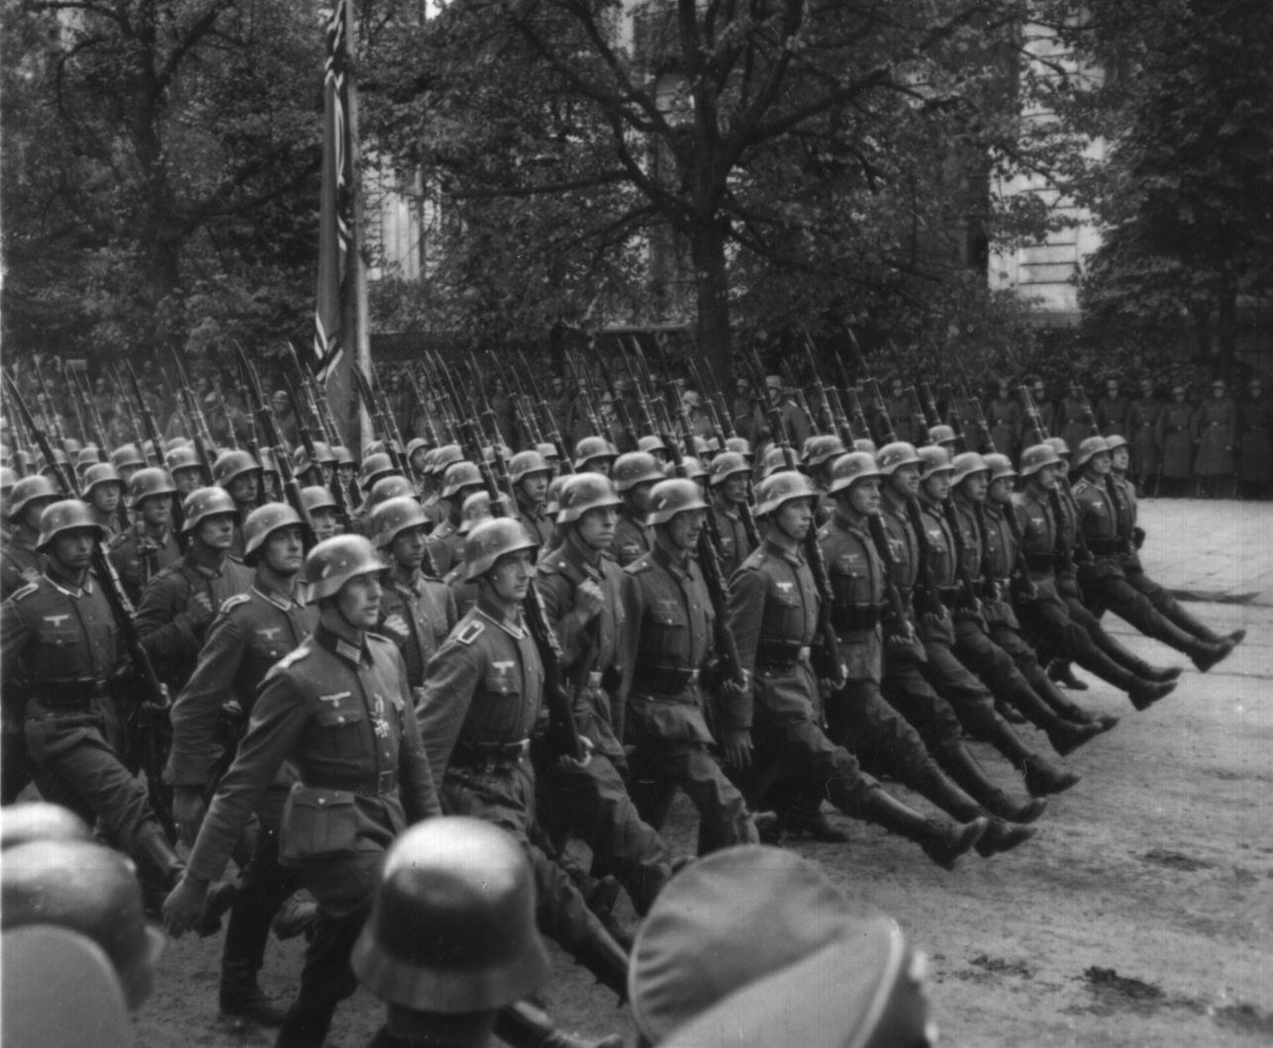
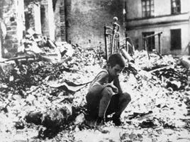
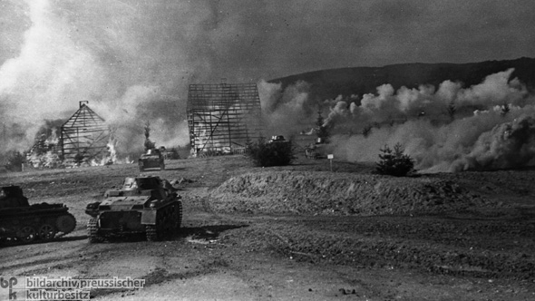
So he ordered his huge army to invade other countries. In 1939 the German armies invaded Poland, Holland, Czechoslovakia, Norway and Finland and took control of their peoples.
BRITAIN
POLAND
CZECHOSLOVAKIA

Slide 8
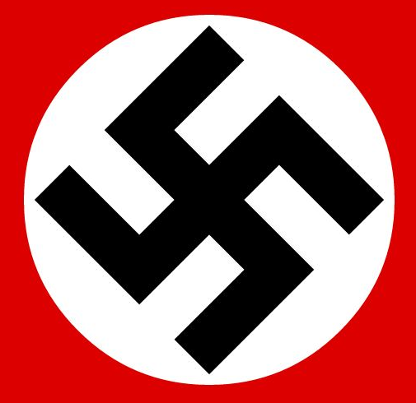
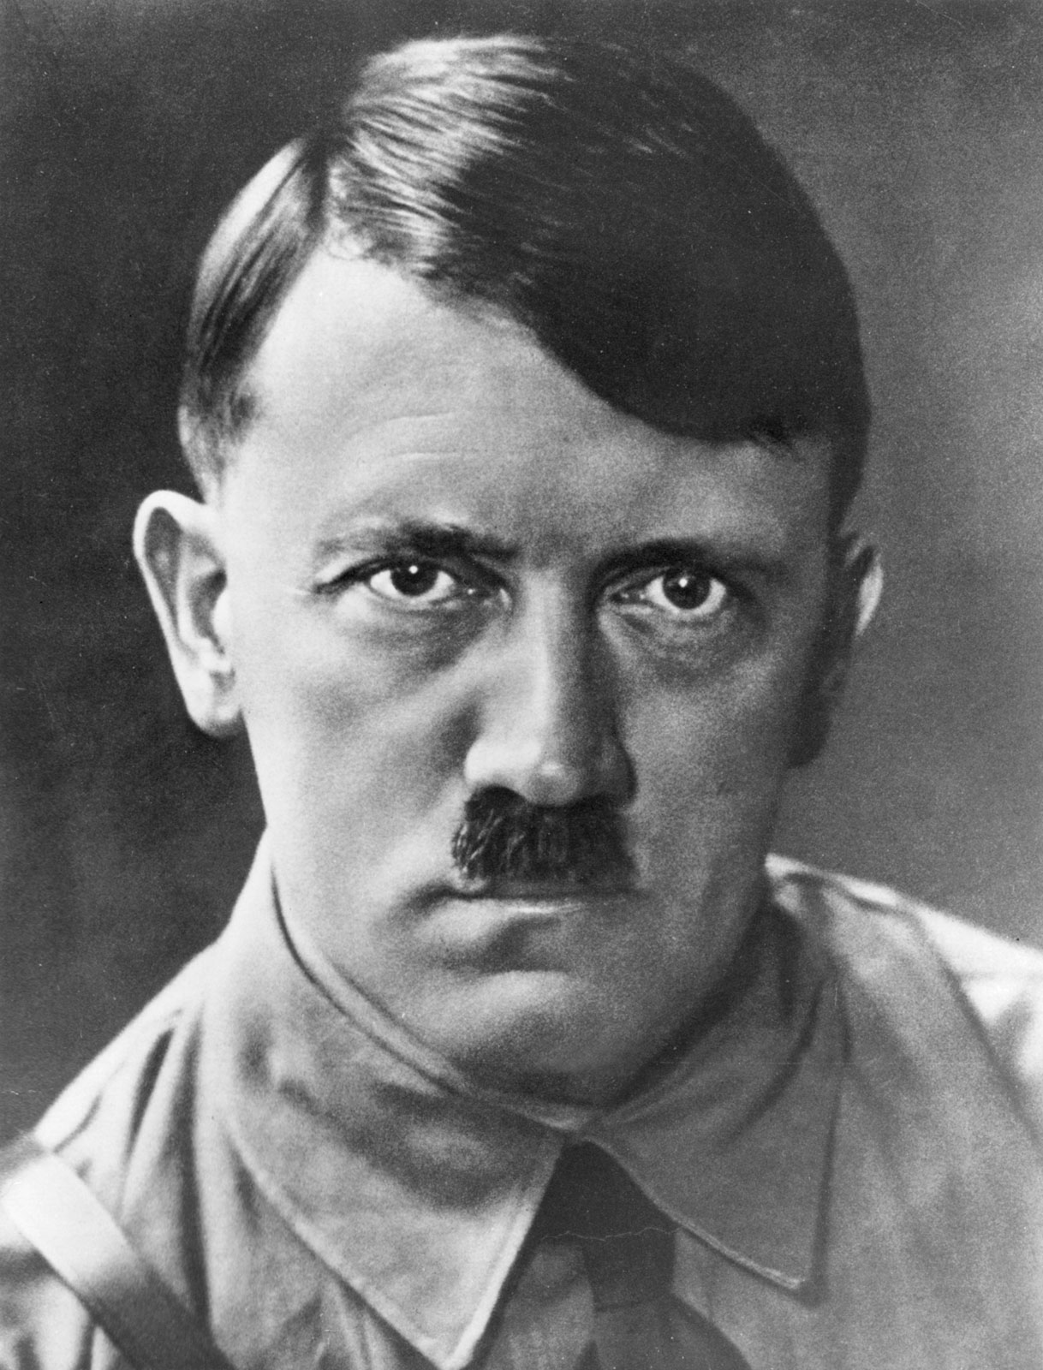
Why did World War II begin?
1. Vengeance for WW1 defeat:
Since 1933, Germany had been ruled by Adolf Hitler and his political party, the Nazis. They wanted to take revenge for Germany’s defeat in the Great War by expanding Germany’s empire. Hitler wanted to gain ‘Lebensraum’ (living space) for the German people.

Slide 9
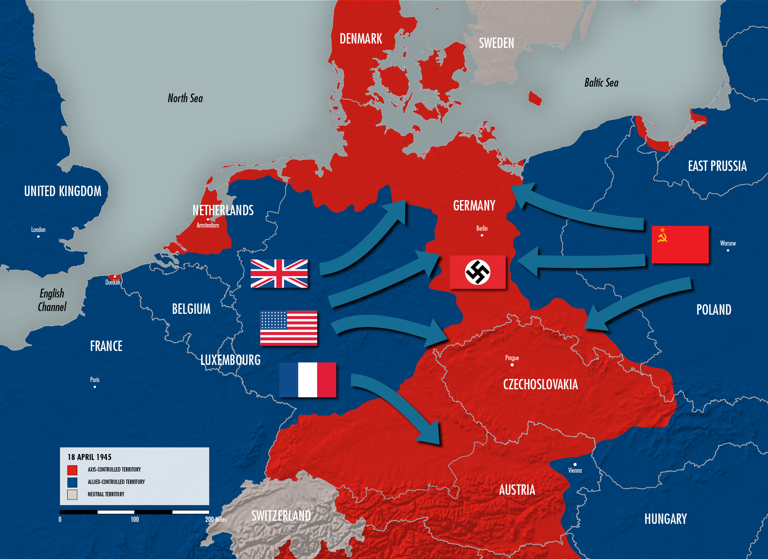
Why did World War II begin?
2. Invasions begin:
In March 1938, the Nazis invaded (annexed) Austria and it became part of Germany. On the 29th September 1938, worried about what Hitler’s next move could be, Britain, Italy and France signed a treaty called the Munich Agreement, which said that Hitler could annexe Czechoslovakia, as long as he didn’t then invade anywhere else. So, on 15th March 1939, Czechoslovakia was annexed. However, Hitler was not to be trusted, and on 1st September 1939, he broke the terms of the Munich Agreement when over a million Nazi troops then invaded Poland.

Slide 10
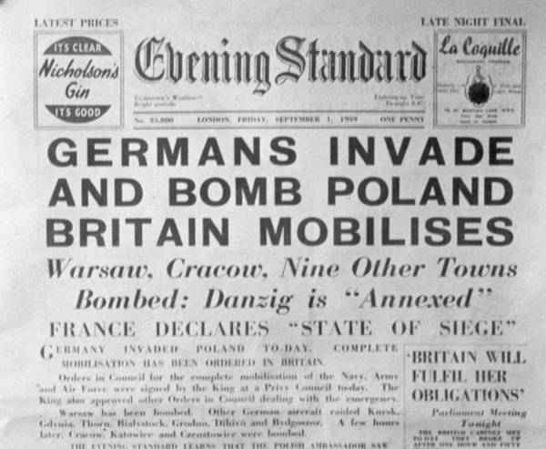
Why did World War II begin?
3. Britain and France threaten war:
Britain and France had promised to help the Poles if they were attacked so gave Hitler an ultimatum (final demand) by threatening war if his troops did not withdraw by 3rd September.

Slide 11
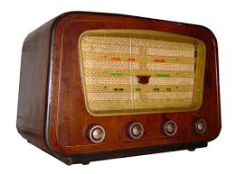
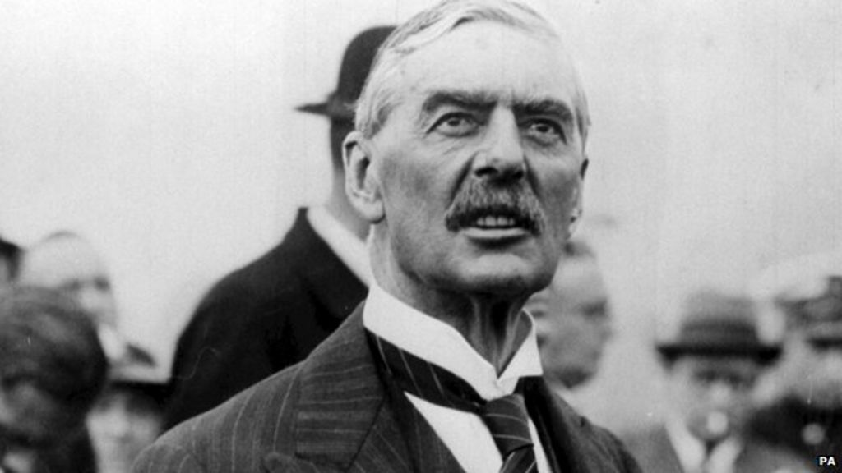
Why did World War II begin?
4. WAR IS DECLARED!
Hitler did not withdraw his troops from Poland by 3rd September. Hitler ignored the threat of war from Britain and France, and so, war was declared.
Most families in the UK heard the news on the radio, announced by the Prime Minister, Neville Chamberlain at 11:15am. He told them, “This country is at war with Germany”.
https://www.bbc.co.uk/teach/school-radio/history-ks2-world-war-2-clips-the-declaration-of-war/z4qn6v4

Slide 12
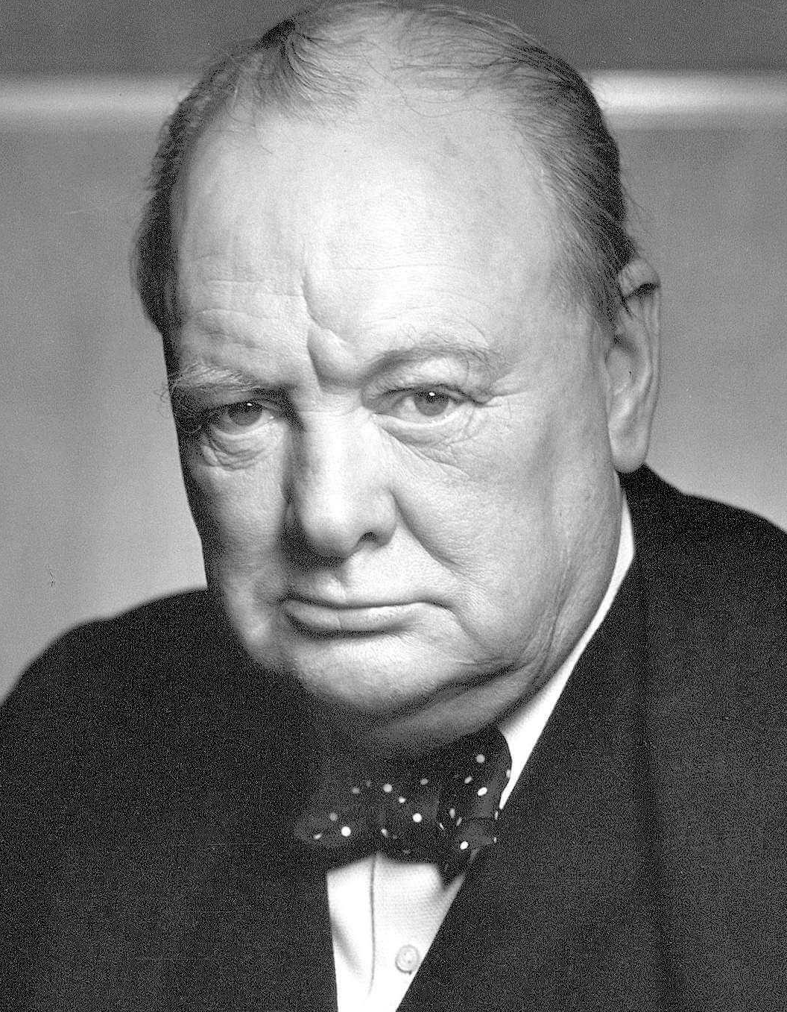
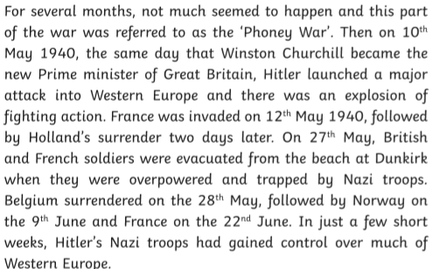
Why did World War II begin?
5. ‘Phoney’ war

Slide 13
Q: Can you summarise the FIVE steps towards the declaration of war?
Q: Imagine you were a child listening to the wireless when war was announced. Explain how you would have felt and why.
Q: What would your opinion of Germans have been?
Discuss! TTYP, ready to feedback in 3 minutes!

Slide 14
Task:
Place the key events leading up to the outbreak of WWII in chronological order on the timeline.
Draw a straight line across the middle of a double-page spread. Now, in your own words, add details for the five steps towards the declaration of WWII onto your timeline.
1. Nazi Germany seeks vengeance for defeat in WW1.
2. Invasions begin. (Austria, Czechoslovakia, Poland).
3. Britain and France threaten war.
4. War is declared!
5. Phoney war
Red pen: Illustrate each step if you have finished.

