Slide 1
Monday 15th November 2021
LO: To write with purpose
To use sentences appropriately
To punctuate accurately
C: Playscripts

Slide 2
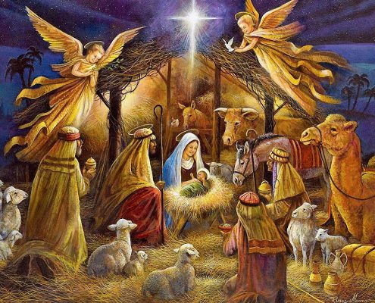
Starter
Get into your character groups.
Each character of the Nativity would have experienced a different part of the Nativity story, so each playscript will be different – they will centre on different aspects.
What would the Nativity story look like for your character?

Slide 3
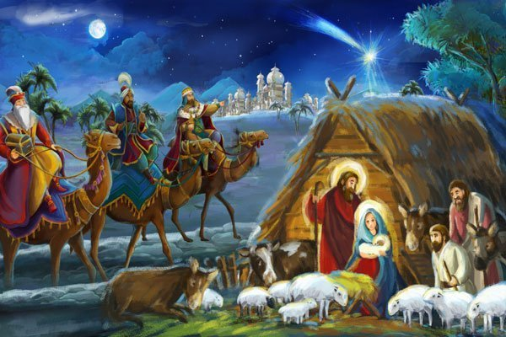
Starter
In your groups: retell your character’s version of the Nativity story.
Everyone in the group needs to agree on your version!
Make sure you have included all of the events that your character has experienced.

Slide 4
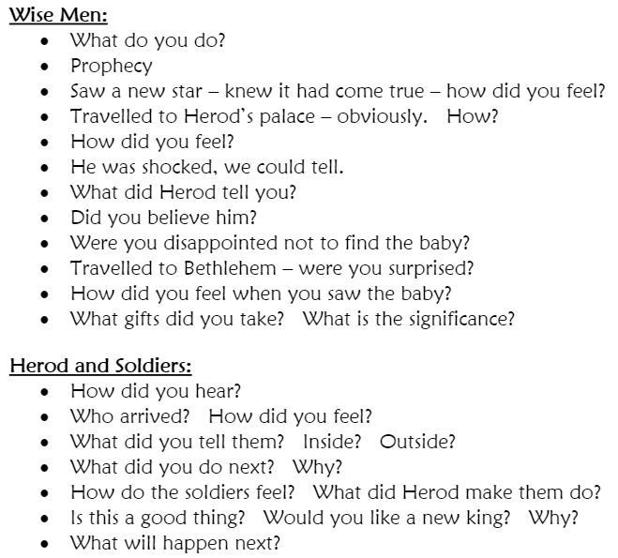
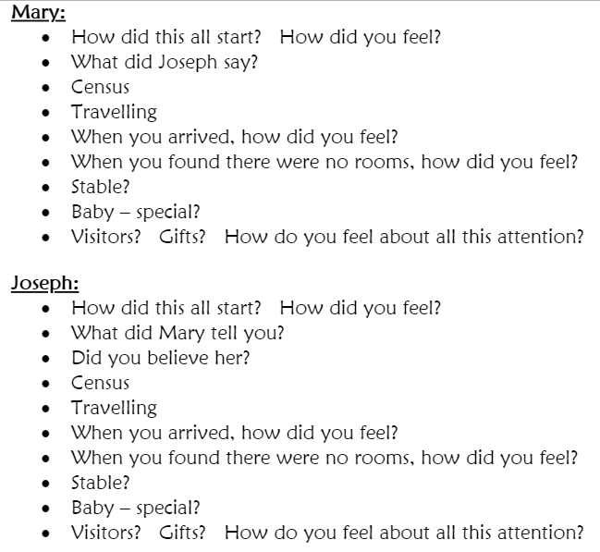
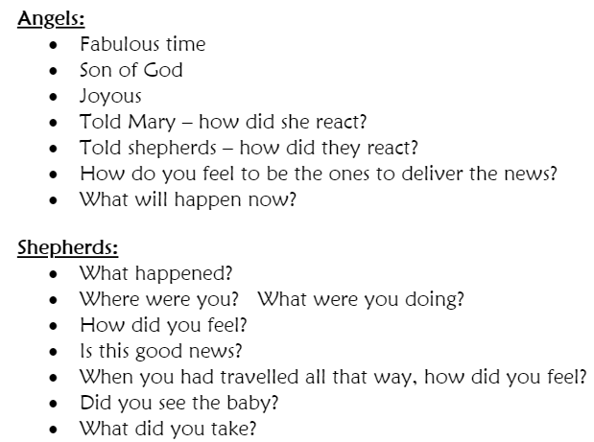
Activity: Read through the questions for your character and answer them in full sentences.

Slide 5
Tuesday 16th November 2021
LO: To write with purpose
To organise writing appropriately
To use sentences appropriately
To punctuate accurately
C: Playscripts

Slide 6
Perfect Tenses
Click on each of the following tenses to find out more about
when it can be used.
Past Perfect Tense
Present Perfect
Tense
Future Perfect Tense
Next

Slide 7
Past Perfect Tense
The past perfect tense is used to talk about…
things that were completed at some point in the past.
You might use the past perfect tense if you are talking to your friend about something that has happened at a specific time in the past.

Slide 8
Past Perfect Tense
How to Use the Past Perfect Tense
To use the past perfect tense, use the word ‘had’
and the past participle of the verb, e.g.
Mrs Wrigley had collected in our files.
I had forgotten to do my homework.
She had noticed that my book was missing.
All of these things happened in the past and do not continue to happen now.

Slide 9
Perfect Tenses
Click on each of the following tenses to find out more about
when it can be used.
Past Perfect Tense
Present Perfect
Tense
Future Perfect Tense
Next

Slide 10
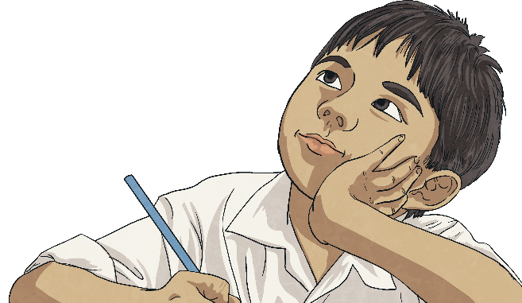

Present Perfect Tense
The present perfect tense is used to talk about things that happened in the past or things that began in the past and are still happening now.
You might use the present perfect tense if you are talking to your friend about something that happened or began at an unspecified time in the past.

Slide 11
Present Perfect Tense
How to Use the Present Perfect Tense
To use the present perfect tense, use the word ‘has’ or ‘have’
and the past participle of the verb, e.g.
Mrs Wrigley has collected in our files.
I have forgotten to do my homework.
She has noticed that my book was missing.
All of these things either happened in the past and do not continue to happen now or
started happening in the past and are still continuing now.

Slide 12
Perfect Tenses
Click on each of the following tenses to find out more about
when it can be used.
Past Perfect Tense
Present Perfect
Tense
Future Perfect Tense
Next

Slide 13
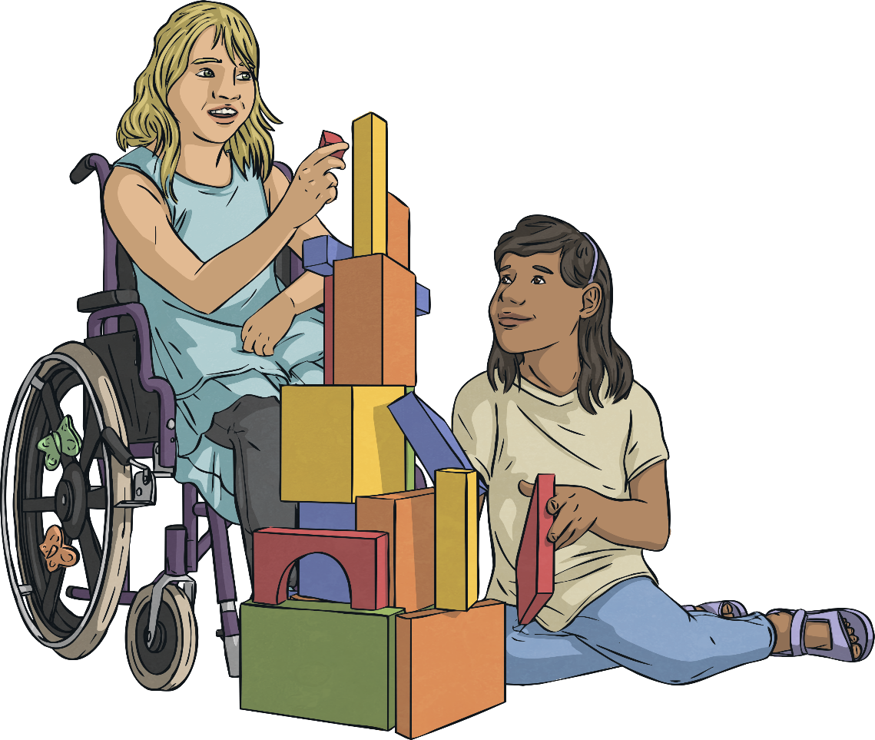
Future Perfect Tense
The future perfect tense is used to talk about things that will be completed before a set point in the future.
You might use the future perfect tense if you are talking to your friend about a problem in the future that will be caused by two events happening in the wrong order.

Slide 14
Future Perfect Tense
How to Use the Future Perfect Tense
To use the past perfect tense, use the words ‘will (not) have’ and the past participle of the verb, e.g.
Mrs Wrigley will have collected in our files before I get to school.
She will have noticed that my book was missing
before I’m able to sneak it into the pile.
All of these things will happen in the future
and rely on events being completed in a particular order.

Slide 15
Perfect Tenses
Click on each of the following tenses to find out more about
when it can be used.
Past Perfect Tense
Present Perfect
Tense
Future Perfect Tense
Next

Slide 16
Which Tense?
Which tense has the following sentence been written in?
A bee has stung me every time
I have been in the paddling pool.
Incorrect. Try again!
Correct!
Past Perfect Tense
Present Perfect Tense
Future Perfect Tense
Next Question

Slide 17
Which Tense?
Which tense has the following sentence been written in?
I had thrown my backpack over the fence before I had climbed up.
Incorrect. Try again!
Correct!
Past Perfect Tense
Present Perfect Tense
Future Perfect Tense
Next Question

Slide 18
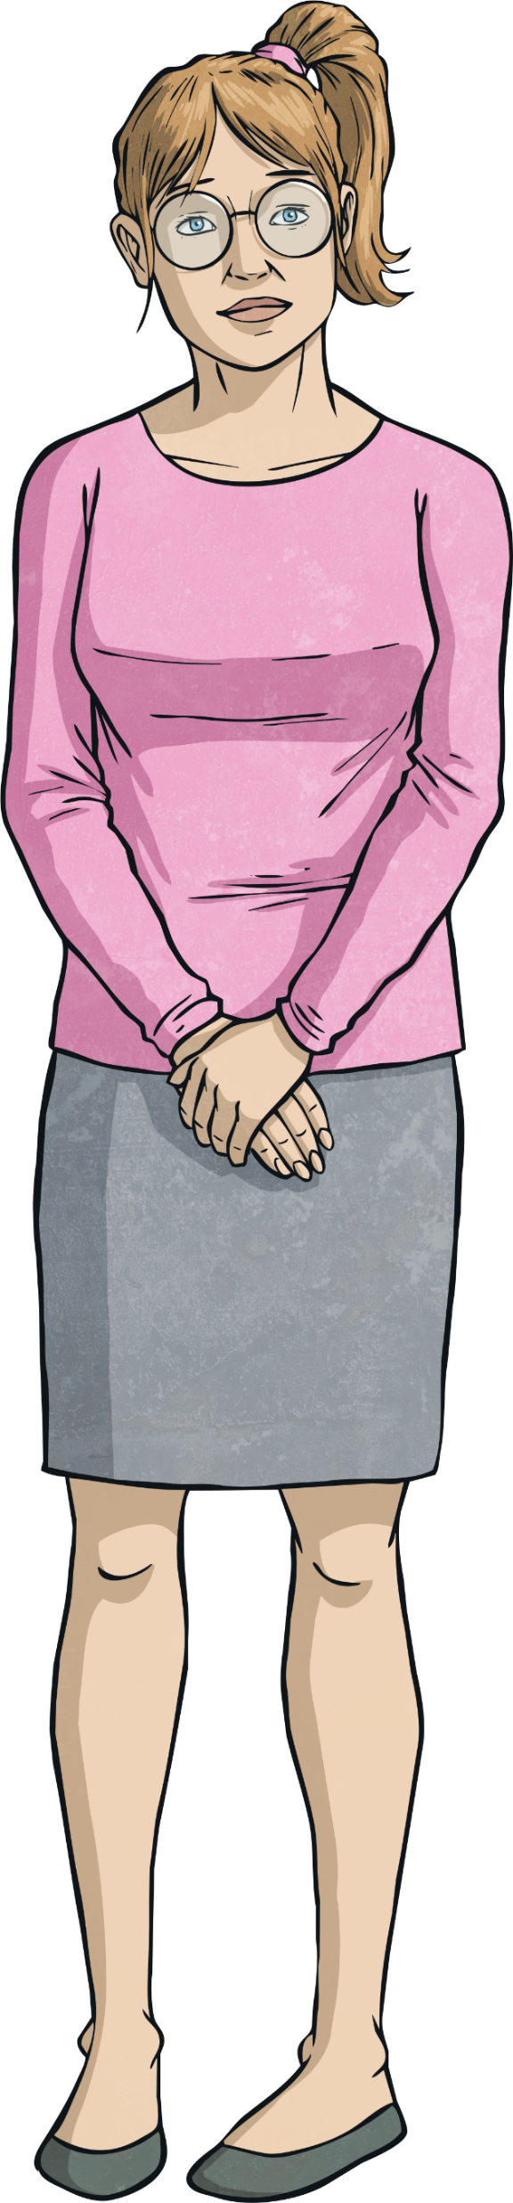

Which Tense?
Which tense has the following sentence been written in?
Beth has started to think about saving for retirement.
Incorrect. Try again!
Correct!
Past Perfect Tense
Present Perfect Tense
Future Perfect Tense
Next Question

Slide 19
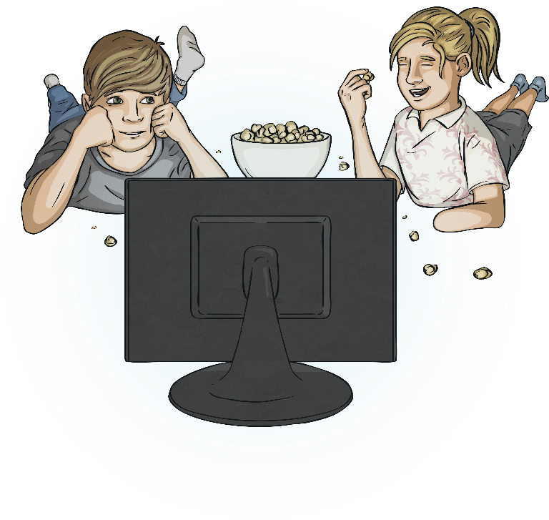
Which Tense?
Which tense has the following sentence been written in?
I will have watched 94 films by the end of the summer holidays.
Incorrect. Try again!
Correct!
Past Perfect Tense
Present Perfect Tense
Future Perfect Tense
Next Question

Slide 20
Which Tense?
Which tense has the following sentence been written in?
I had sown only four lettuce seeds initially but that was not enough.
Incorrect. Try again!
Correct!
Well done on passing the ‘Which Tense?’ quiz!
Past Perfect Tense
Present Perfect Tense
Future Perfect Tense
Finish

Slide 21
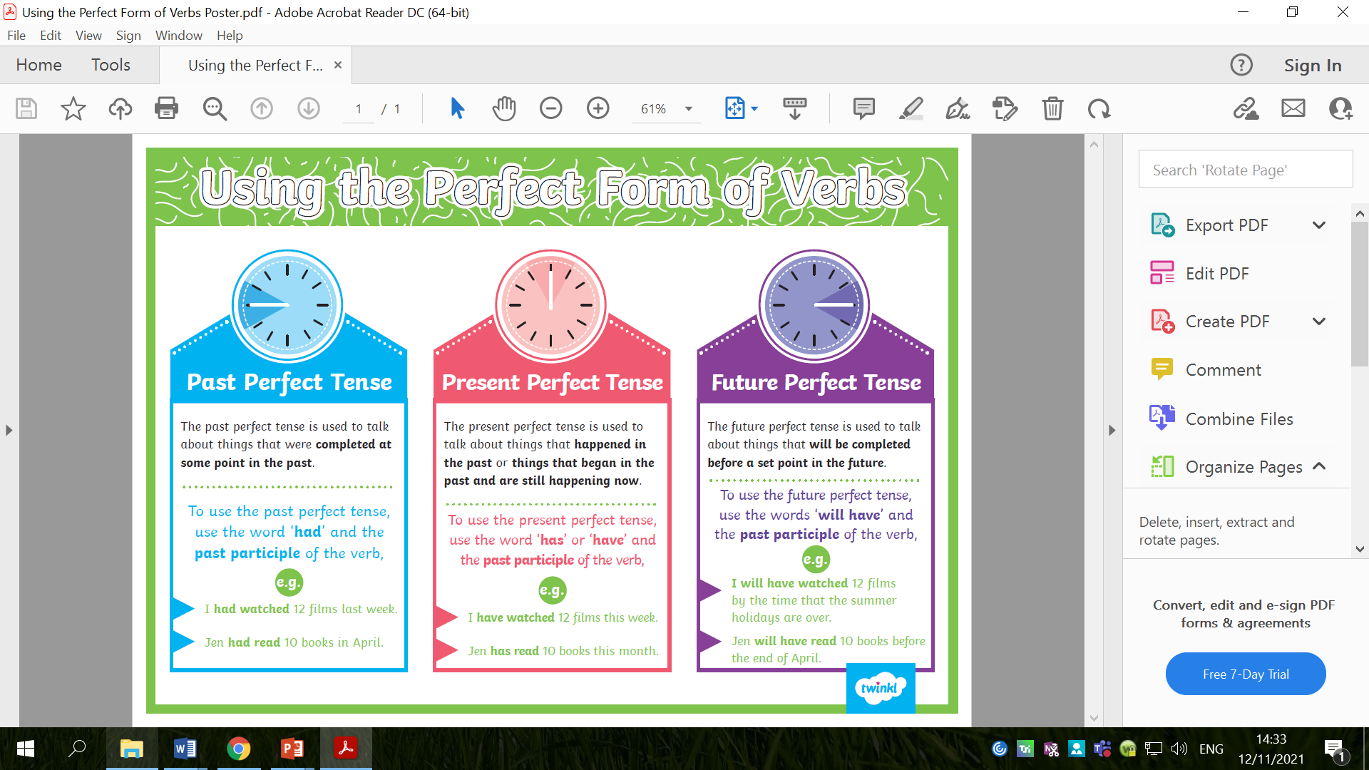

Slide 22

Starter
Which perfect tense do you think we could use in our playscripts?

Slide 23
Starter
Present perfect tense!
  While the events of the Nativity happened in the past, we are writing from the character’s POV as if the events were happening to us now, in the present.
  Example: We have been following the star for miles!
Future perfect tense!
  The characters may be talking about something that will happen in the future.
  Example: Baby Jesus will have left the stable before we arrive in Bethlehem!

Slide 24

Can you think of sentences using the perfect tenses that you could use in your playscripts?

Slide 25

You will begin writing your playscript today.
By the end of tomorrow’s lesson, I am expecting a complete playscript for your character’s version of the Nativity story.

Slide 26

Some things to consider:
Interesting content!!
  There will be an audience watching the play! They do not need to know boring, insignificant details! Try to make the dialogue interesting and exciting.
Detailed stage directions!
  Lots of you were writing adverbs or adjectives (which is great!), but what does intrigued or happy actually look like? How will the character show they are intrigued or happy? Facial expression, body language, movement etc.

Slide 27
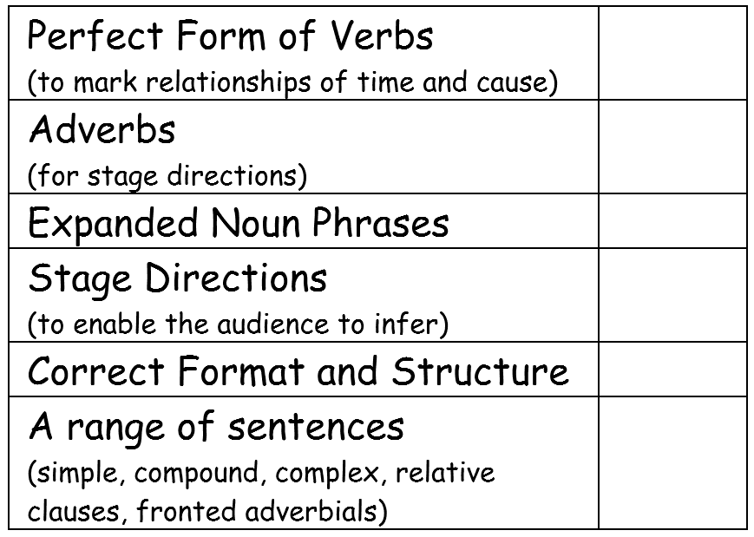

Slide 28
Verbally retell the Nativity story from your character’s POV.
Make sure you include the answers to these questions in your retelling!

Slide 29
Activity
Write your playscript.
You should use the checklist and the shared writing playscript from last lesson to help you.
Use the Bible Passages handout to help you include some quotes from the Bible.
Red Pen: can you improve the vocabulary you have used? Use a thesaurus to help you.

Slide 30
Wednesday 17th November 2021
LO: To write with purpose
To organise writing appropriately
To use sentences appropriately
To punctuate accurately
C: Playscripts

Slide 31

Starter
In your practice write last week, you were writing short, simple sentences for your dialogue.
Mary: I’m going to have a baby.
How many different ways can you think of to extend this sentence?
(Think back to your grammar lessons before half term)

Slide 32

Starter
You can extend a sentence with:
  Expanded noun phrases
  Conjunctions
  Fronted adverbials
  Relative clauses
  Adverbs
How many different ways can you think of to extend this simple sentence?
Mary: I’m going to have a baby.

Slide 33

Starter
Look back at your work from last lesson.
Can you identify any simple sentences in your writing?
Think of some ways to extend these sentences.
Edit and extend your existing sentences in red pen.

Slide 34
You will be finishing writing your playscripts today.
By the end of today’s lesson, I am expecting a complete playscript for your character’s version of the Nativity story.

Slide 35
Look back through your work – which features have you included? Which features do you need to include today?

Slide 36
Verbally retell the Nativity story from your character’s POV.
Make sure you include the answers to these questions in your retelling!
What parts of the story do you still have left to write?

Slide 37
Activity
Write your playscript.
You should use the checklist and the shared writing playscript from last lesson to help you.
Use the Bible Passages handout to help you include some quotes from the Bible.
Red Pen: have you extended your sentences with relative clauses? Fronted adverbials? Conjunctions? Make sure you are using a range of sentences in your writing.

Slide 38
Thursday 18th November 2021
LO: To write with purpose
To use sentences appropriately
To punctuate accurately
C: Playscripts

Slide 39

Starter
Read and try to act out your play based on your playscript (you may like to ask some adults at home to join in!)
While doing this activity, you should identify some improvements which could be made.
You will be given three Post-It Notes.
  On one Post-It Note, you should write down one thing that went well (something that was good about the playscript).
  On the second two Post-It Notes, you should write down two improvements (two things that you could do to make their playscript better or clearer)
You can refer to the checklist to help you if you want.

Slide 40
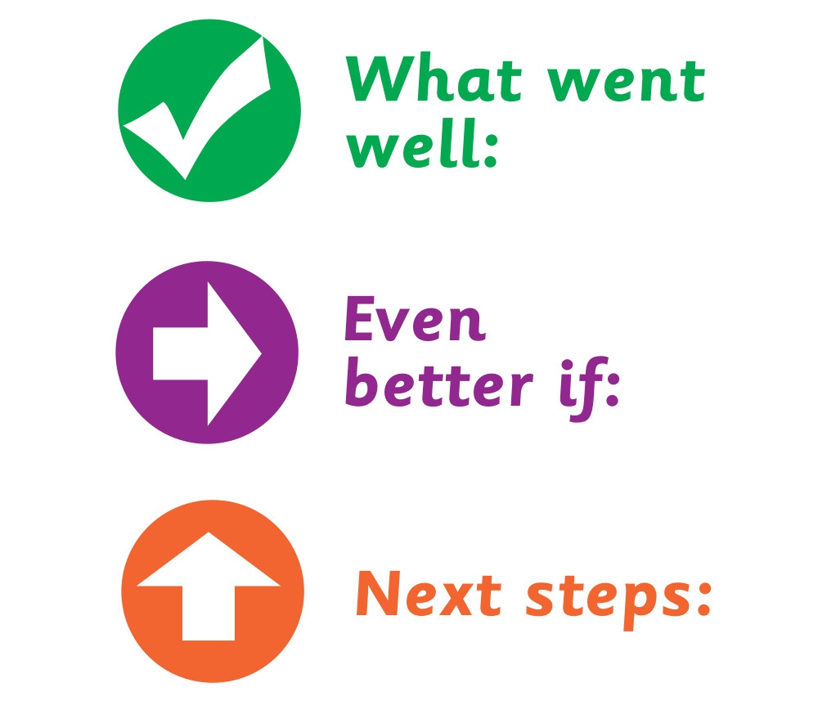
What strengths and areas for improvement did you identify?
What have you done well with writing playscripts?
What do you need to do to improve?
How could you make the improvements suggested?

Slide 41

Activity
Edit your playscripts.
To support you, you should use:
  The checklist
  The Post-It Note improvements
Red Pen: act out your final, edited playscript. How did your ‘play’ go? Are you happy with it? Any final changes/improvements you need to make?

