Slide 1
L.O: To master techniques.
C: embellishments

Slide 2
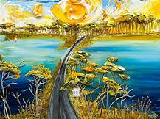
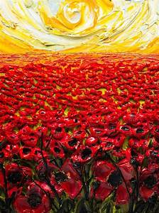
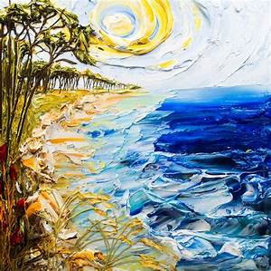
We have looked at creating texture using different resources. Today we are going to be looking at different techniques for creating texture when using paint.

Slide 3
Discuss the techniques the artists could have used to create these artworks.
Think about the texture of the paint and how it could have been applied to the canvas.

Slide 4
Materials can be added to paint to alter the texture. Some artists add sand, glue or soil to their paint. The paint can also be applied using different brushstrokes and different materials (such as knives). This can create a 3-D effect. Paint can be layered up after being left to dry.

Slide 5
Watch this video that illustrates how mixing sand, paint and glue together can alter the texture of paint:
https://www.youtube.com/watch?v=Qs-7yPwFVFM
Watch this video to get some ideas about different
ways you can apply your paint to create texture:
https://www.youtube.com/watch?v=RThOkw50R-0

Slide 6
Recap: some different techniques an artist might use to create texture with paint.
• They put paint down in short, fat dabs and long, sleek strokes.
• They twirl their brushes to make circles and curls.
• They apply paint in thick layers that stick out from the canvas.
• They put different colours on top of each other.
• They mix in sand, dirt, or other materials into the paint. Add water first.
• • They scratch through paint to show colours underneath.

Slide 7
Activity
Today you be experimenting with creating texture.
You can mix sand, glue and soil into your paint and apply it using different resources (paintbrushes, knives, spoons etc...).
Work on a page in your art books and concentrate on experimenting with different techniques to create texture.
Label the work with a brief description of the technique that has been used

Slide 8
Plenary
Explain to your partner which technique you prefer andgive reasons for this preference.
What technique was most successful at creating texture?

