Slide 1
LO: to communicate geographically
LO: to investigate places
C: Settlements

Slide 2

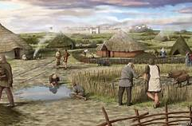
Settlements
What does the word settlement mean?
A settlement is the settling or establishment of a person or a group of people, as in a new region.
Imagine you are part of a group of families, in the distant past, roaming the countryside (there are no large towns or cities) and you would like to settle. What will you need? Discuss with your group and sketch a map of the things you think are essential to being able to survive.

Slide 3

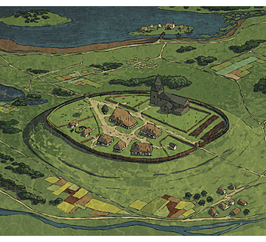
An early settlement would need some essential aspects: a source of fresh water, food (or land to grow crops), materials to make a shelter and perhaps some form of defence against potential rivals.

Slide 4
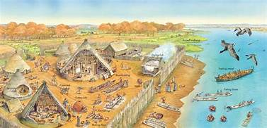
Settlements need reasons to start where they are.
The availability or lack of these factors also affect what sort of settlement is created.
Rivers are essential to early settlements.
Why do you think this is?

Slide 5
Different types of settlements
Early settlers forming villages would often live together for safety, for friendship, and to share services. These early settlements would take on distinctive patterns based on the shape of the land around them.
A settlement pattern refers to the shape of the settlement as seen from above. The shapes of early settlements were influenced by the surrounding landscape. Some examples of settlement patterns include, nucleated settlements, linear settlements and dispersed settlements.

Slide 6
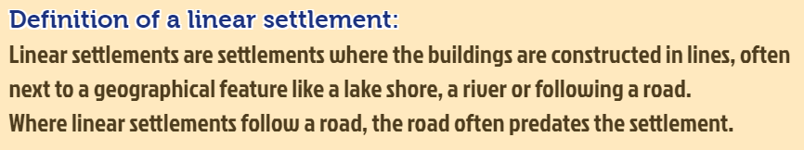
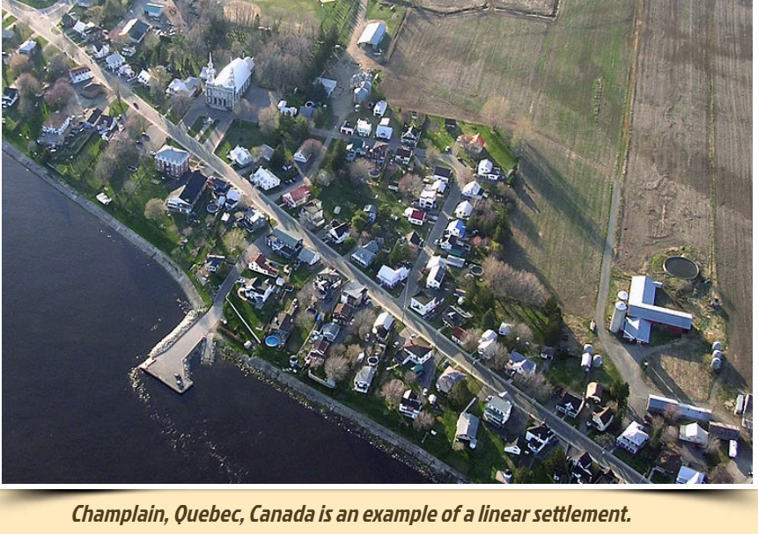

Slide 7
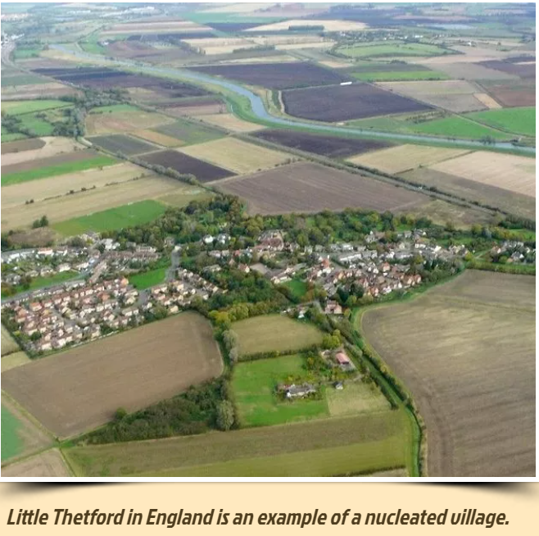
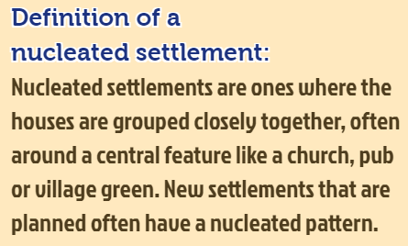

Slide 8
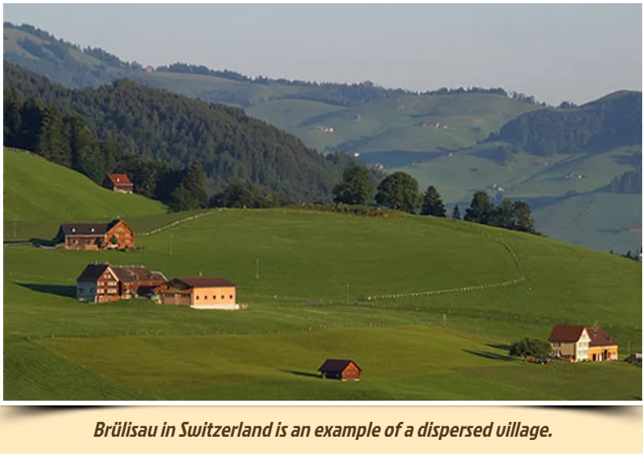
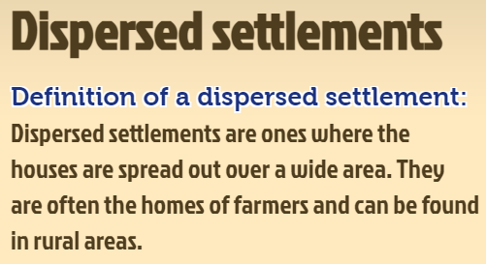

Slide 9
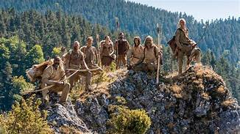
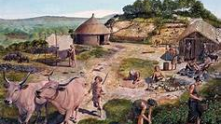
One day, your family see another group of people through the forest. They are also settling.
What could be the positives and negatives of being close to other settles? Make a list and add it to the map of your settlement.

Slide 10
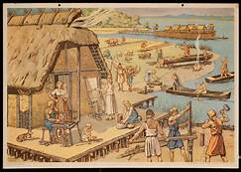
Some positives could be meeting people with other skills or products and company, more people to help hunt for food.
Some negatives could be competition for food, threat and competition for resources.

Slide 11
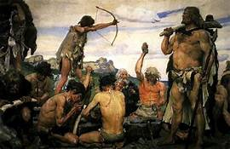
Conflict and co-operation
The other tribe have a source of flint, but have not got good land to graze cattle, like your village do. What could happen?
Why is the river so important in settlements?
The river allows other villagers to travel to trade. This allows your village to learn new skills and discover new products. It is also a source of water for washing, cooking and cleaning.
Climate change means that the river levels rise this year. What might have to happen? What could you do to your settlement? What if another, aggressive village were to approach? What could your village do?

Slide 12
Activity
You will go onto the playground in your groups and create your own settlement in chalk on the playground. Consider all the things you would need in a new settlement to be able to function as a civilisation (fresh water, land for crops/grazing of animals, materials to make shelter etc...).

