Slide 1
LO: To understand evolution and inheritance
To work scientifically
C: Evolution

Slide 2
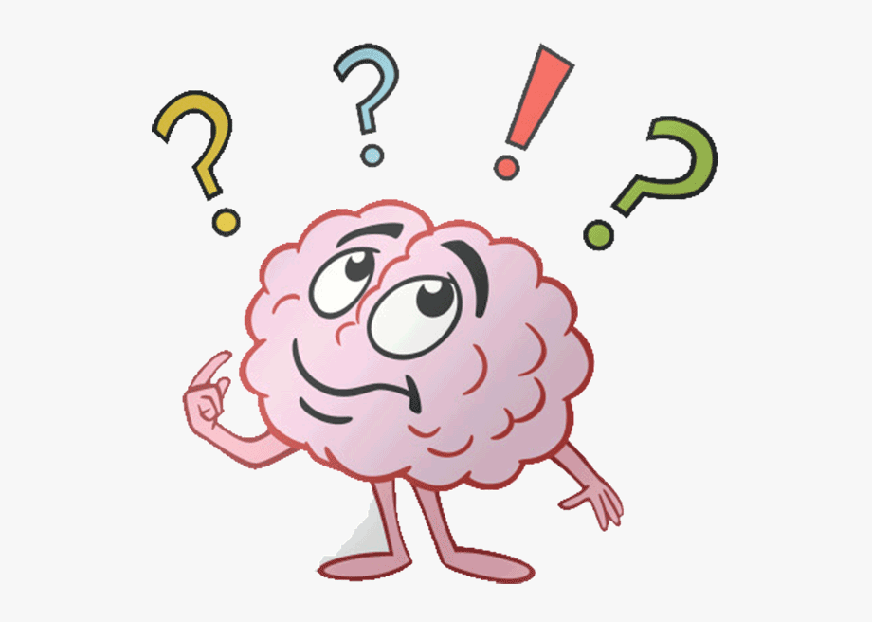
Evolution
What does this word mean?

Slide 3
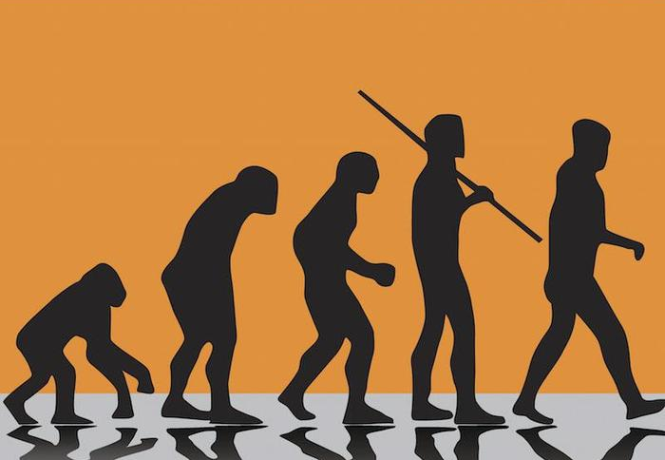
Evolution
Evolution describes the changes that happen in the same species, living in the same location, over a long time.
Evolution does not describe people changing their bodies by exercise or dyeing their hair.
Evolution happens over a much longer time and can only happen between parents and offspring through inheritance.

Slide 4
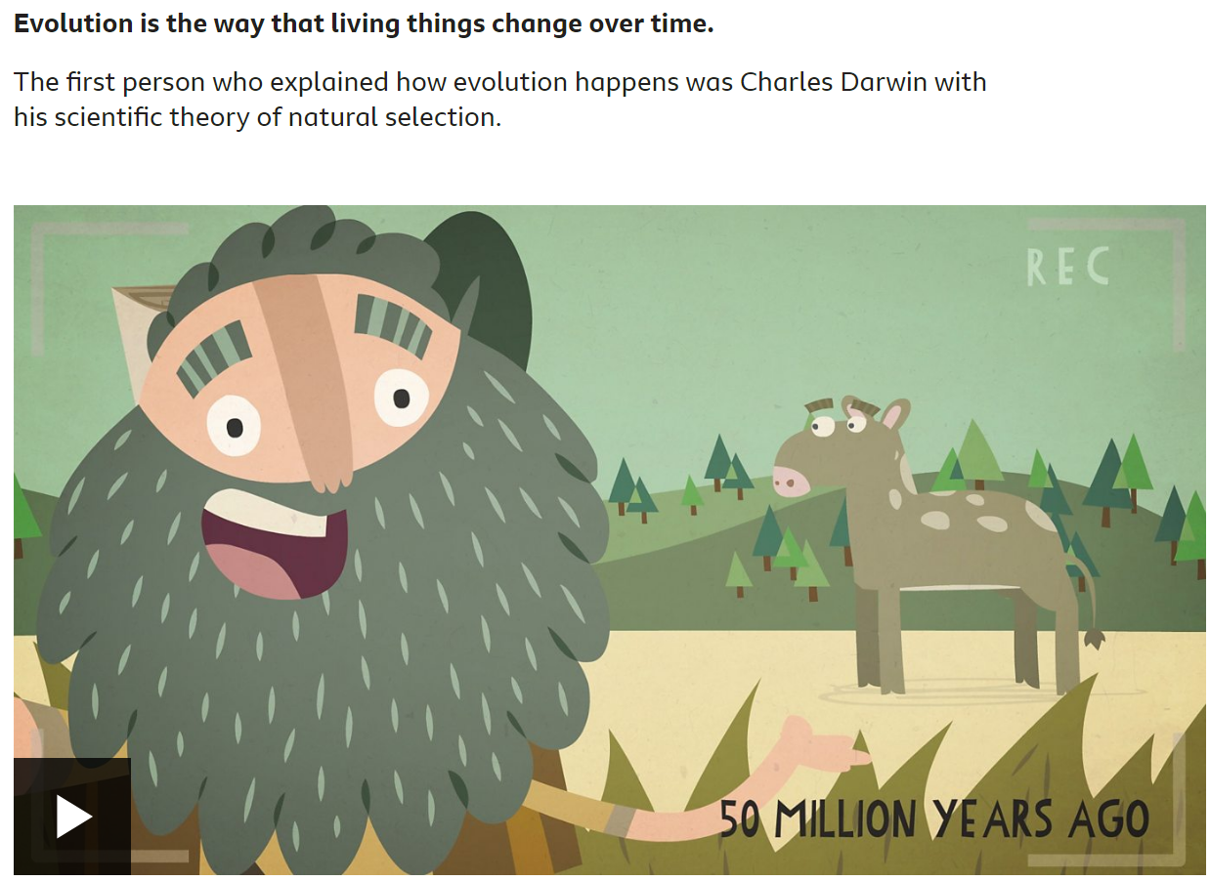
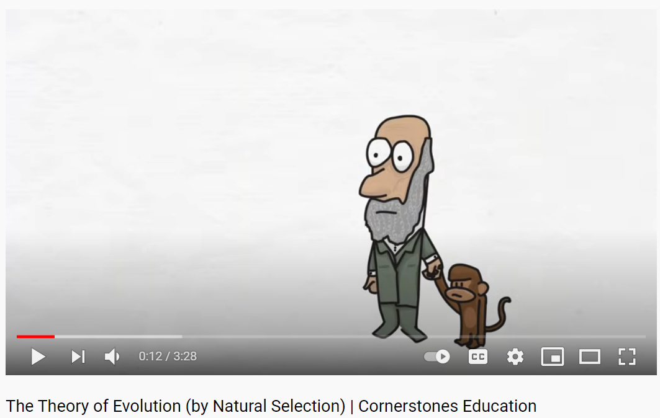
https://www.bbc.co.uk/bitesize/topics/zvhhvcw/articles/z9qs4qt
https://www.youtube.com/watch?v=BcpB_986wyk&t=39s

Slide 5
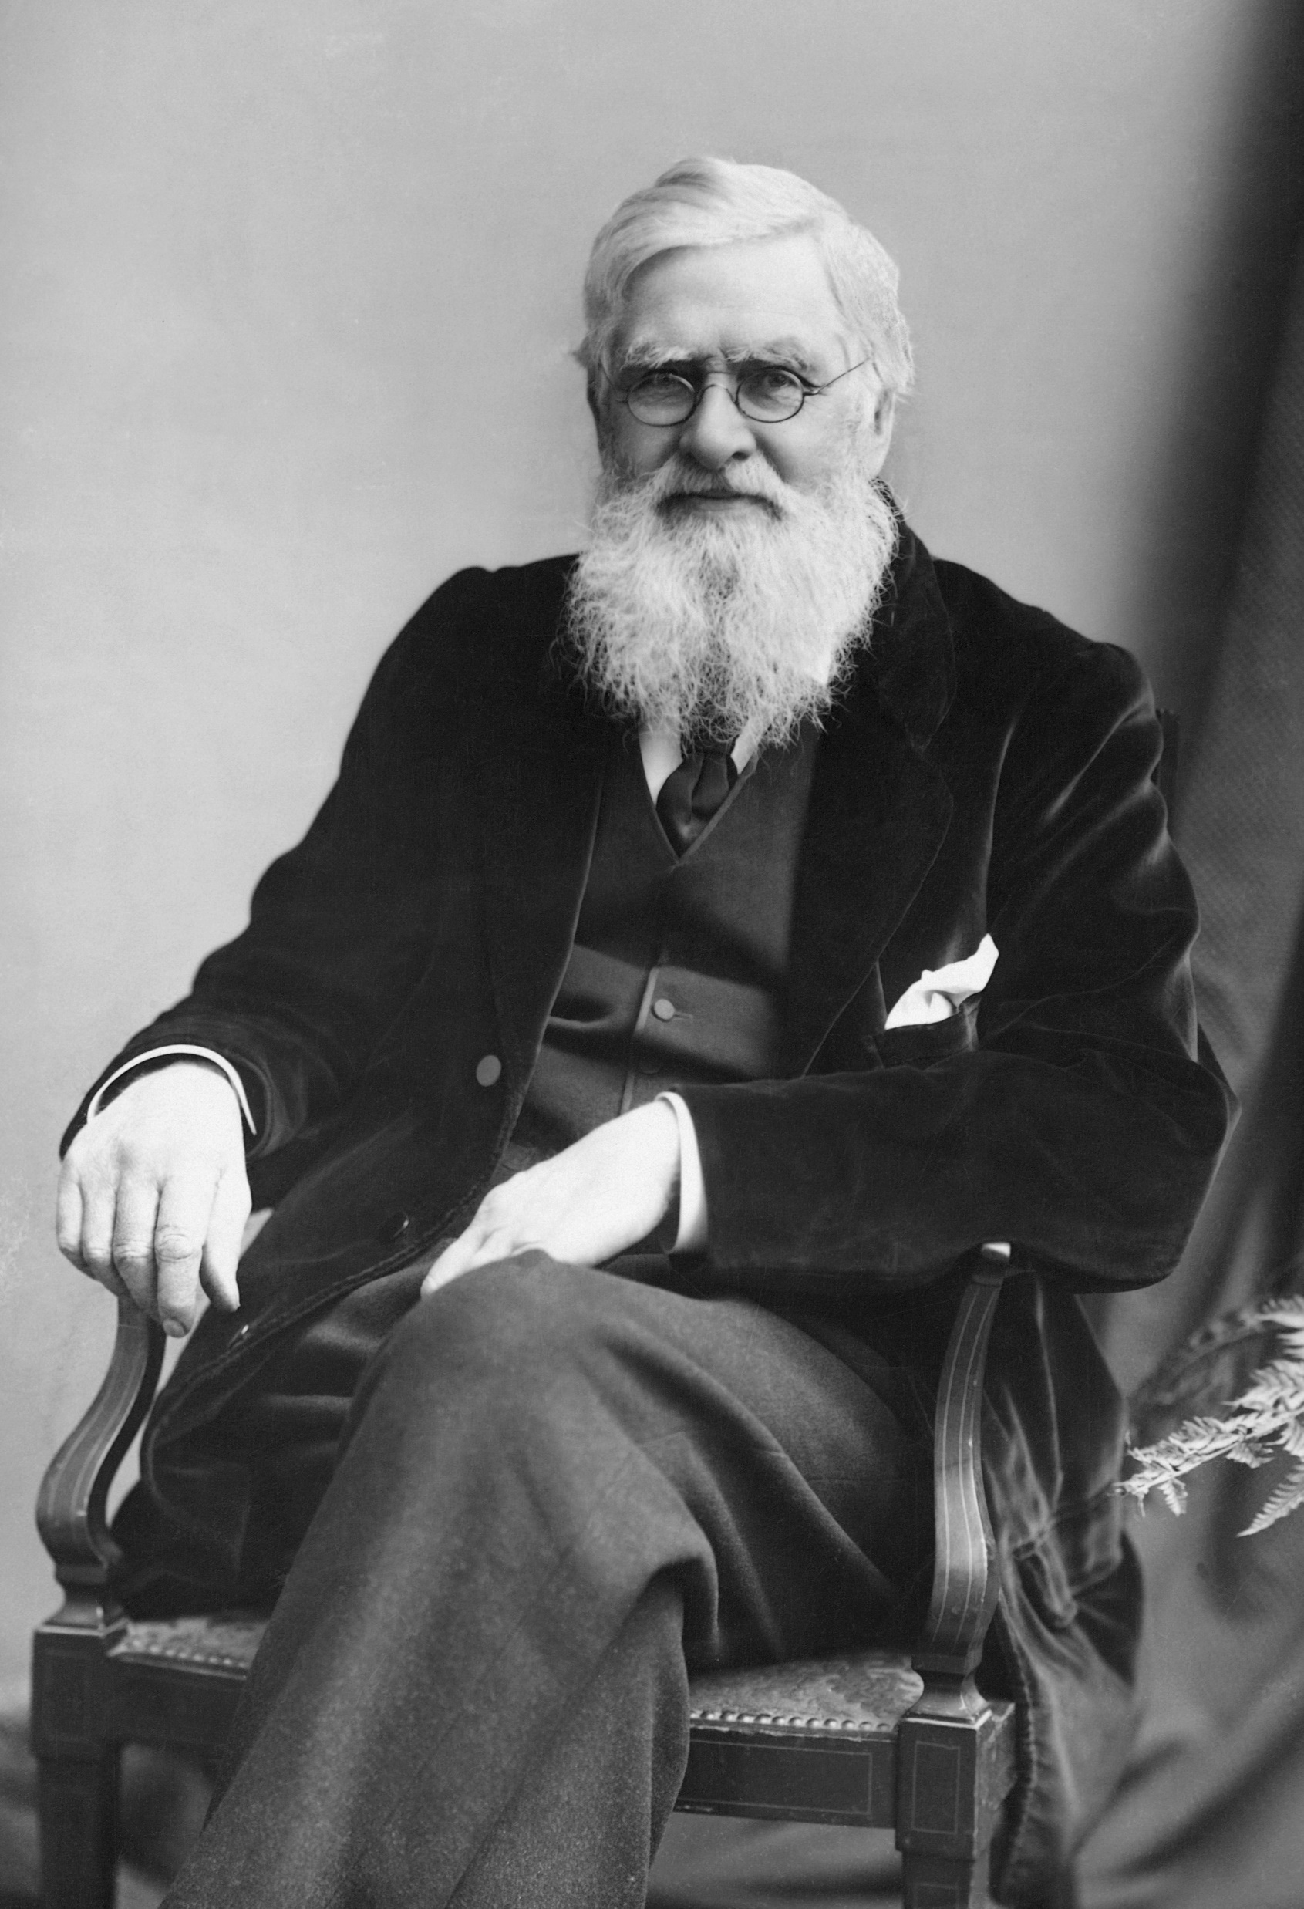
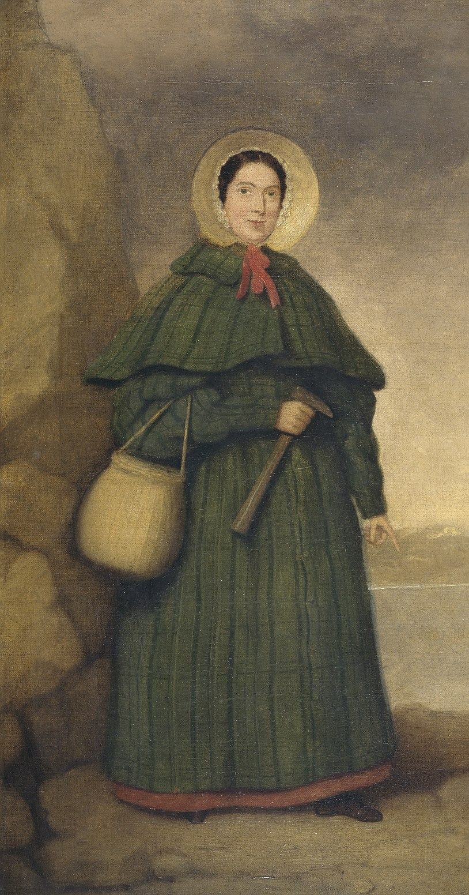
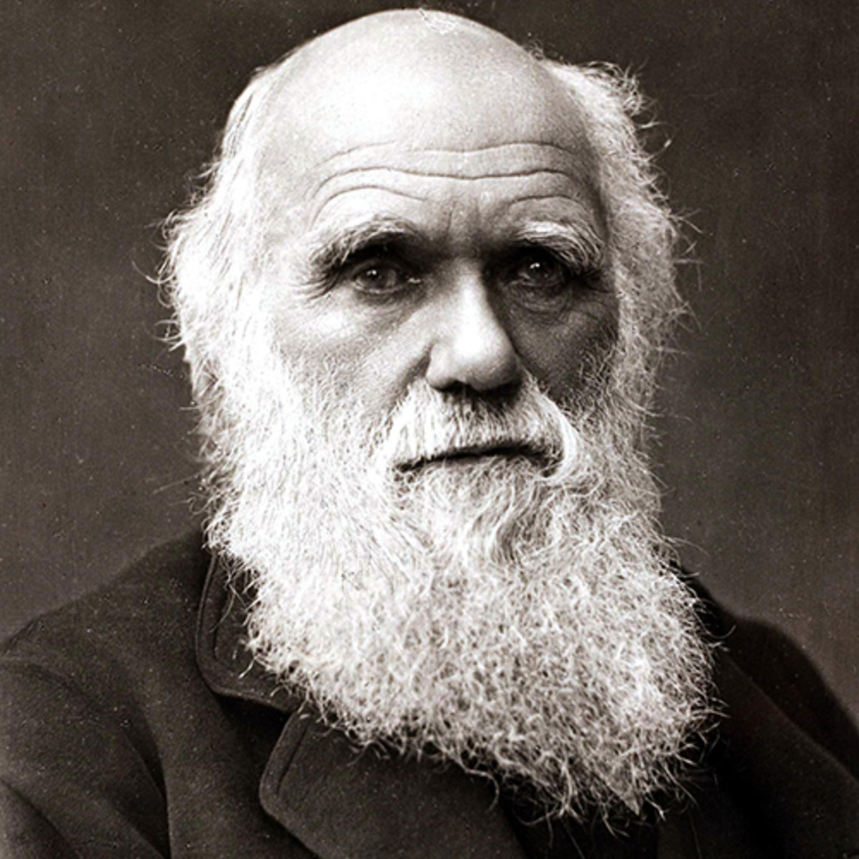
There are three key evolution scientists – Anning, Darwin and Wallace.
Today, you are going to be researching one of these scientists.
There are some websites on our class page to help you, but you can look at other webpages too.
You need to research:
  Their background and early life
  Their specific area of interest
  Their theory or finds of note
  Controversies
  Impact on modern scientific thinking

Slide 6
Web Pages
Anning: http://web.archive.org/web/20150503022220/http:/www.nhm.ac.uk/nature-online/science-of-natural-history/biographies/mary-anning/index.html
Darwin: http://web.archive.org/web/20150421031759/http:/www.nhm.ac.uk/nature-online/science-of-natural-history/biographies/charles-darwin/index.html
Wallace: http://web.archive.org/web/20150425013333/http:/www.nhm.ac.uk/nature-online/science-of-natural-history/biographies/wallace/index.html

Slide 7
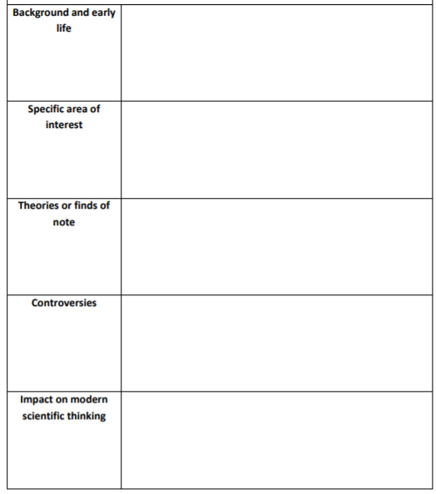
Activity
Research your scientist and tomplete the key facts template.
Use these facts to create a poster about your key evolution scientist.
You should include information about your scientists:
  Background and early life
  Specific area of interest
  Theory or finds of note
  Controversies
  Impact on modern scientific thinking
You should try to include scientific vocabulary in your posters, e.g. evolution, natural selection, variation

Slide 8
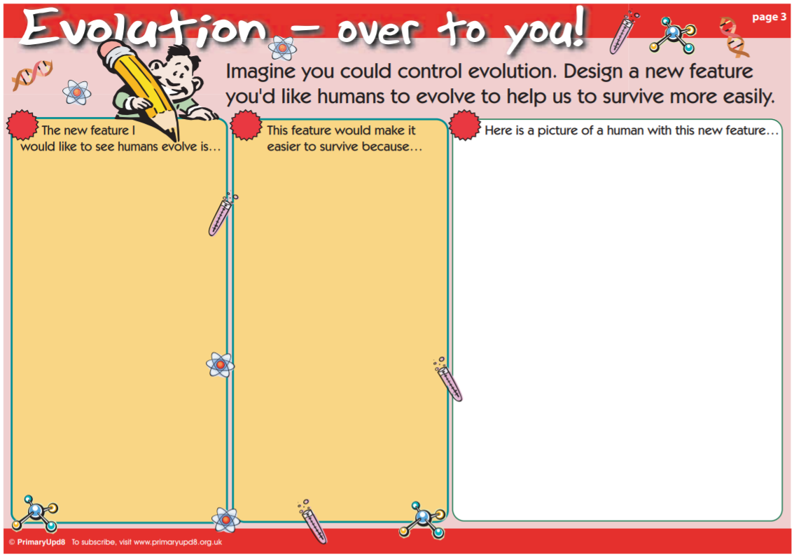
Red Pen
Imagine you could control evolution.
Design a new feature you would like humans to evolve to help us to survive more easily.

Slide 9
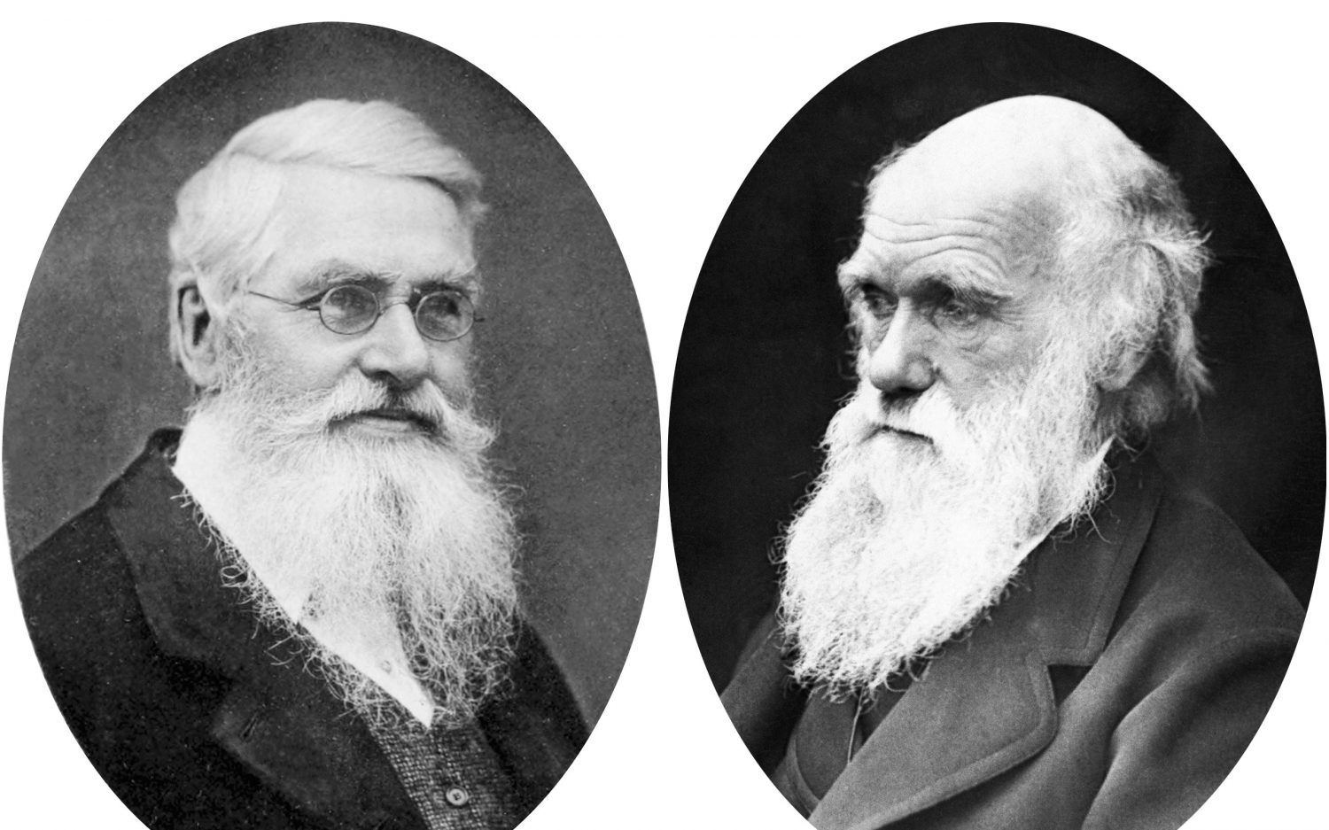
Plenary
Darwin and Wallace worked out the theory of evolution separately.
Although Darwin is best remembered today, credit should also be given to Wallace.
He wrote to Darwin about his ideas and Darwin recognised them as being the same as the ideas he had been working on for nearly 20 years (so Darwin did think of it first, but didn’t publish his work).
A scientific paper by them both was published, and the following year, Darwin published his book which the general public read.

