Slide 1
The learning charter
PSHCE

Slide 2
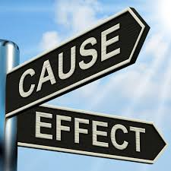
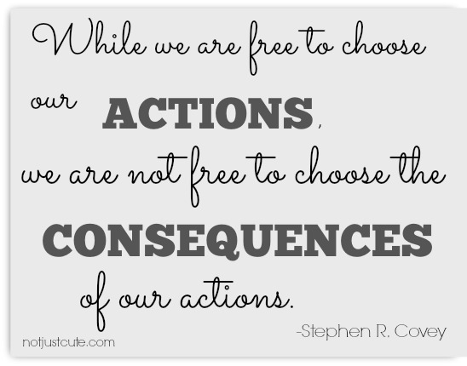
consequences
What does this word mean?
A result of a particular action or situation, often one that is bad or not convenient.

Slide 3

Activity
Create a bubble map with your learning goal for this year in the middle.
  Around your learning goal, write 3 possible obstacles to your learning.
  What might stop you from achieving your goal?
  Are there people, things or behaviours that might get in the way of your learning?
For each of the obstacles, write a solution to overcoming it.
  For each of your solutions, write a reward you would like to receive when you have achieved your learning and overcome the obstacle.
  (Remember: rewards do not have to be material rewards and should be proportionate to your achievement!)

Slide 5
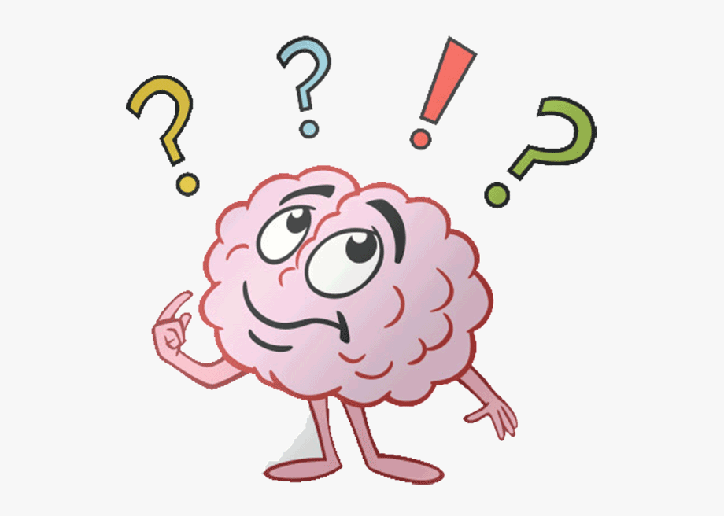
We have rights and responsibilities which create a learning environment in which everyone can learn well.
When people take their responsibilities seriously, they gain rewards.
When they do not do this, there are consequences.
Think about what you would like your school or class Learning Charter to look like.
  Which are the 6 most important rights you would like us all to share at our school?
  What responsibilities go with these rights?
  Which rewards would be most motivating for you?
  Which consequences would you least want to deal with?

Slide 6
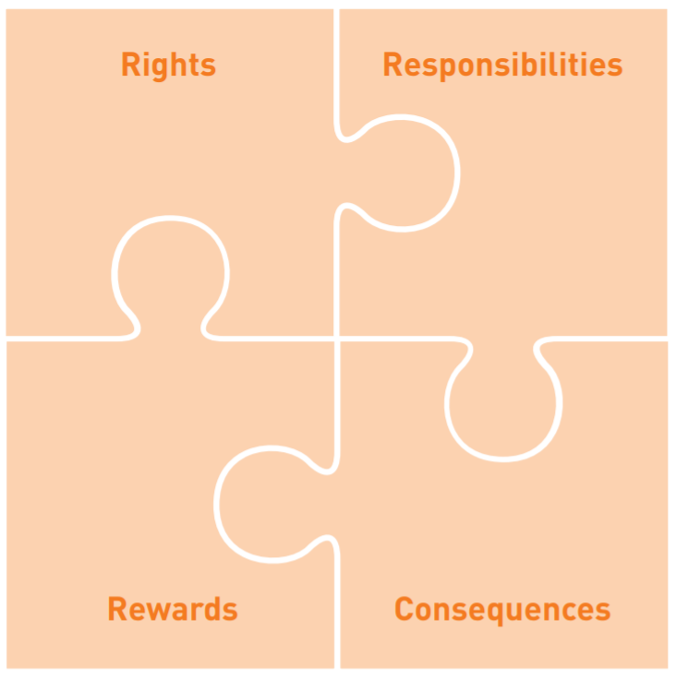
activity
Look at the blank Learning Charter template.
Fill in the rights, responsibilities, rewards and consequences that would be the most meaningful to you.

