Slide 1
LO: to understand values
to understand practices and lifestyles
C: Islam

Slide 2
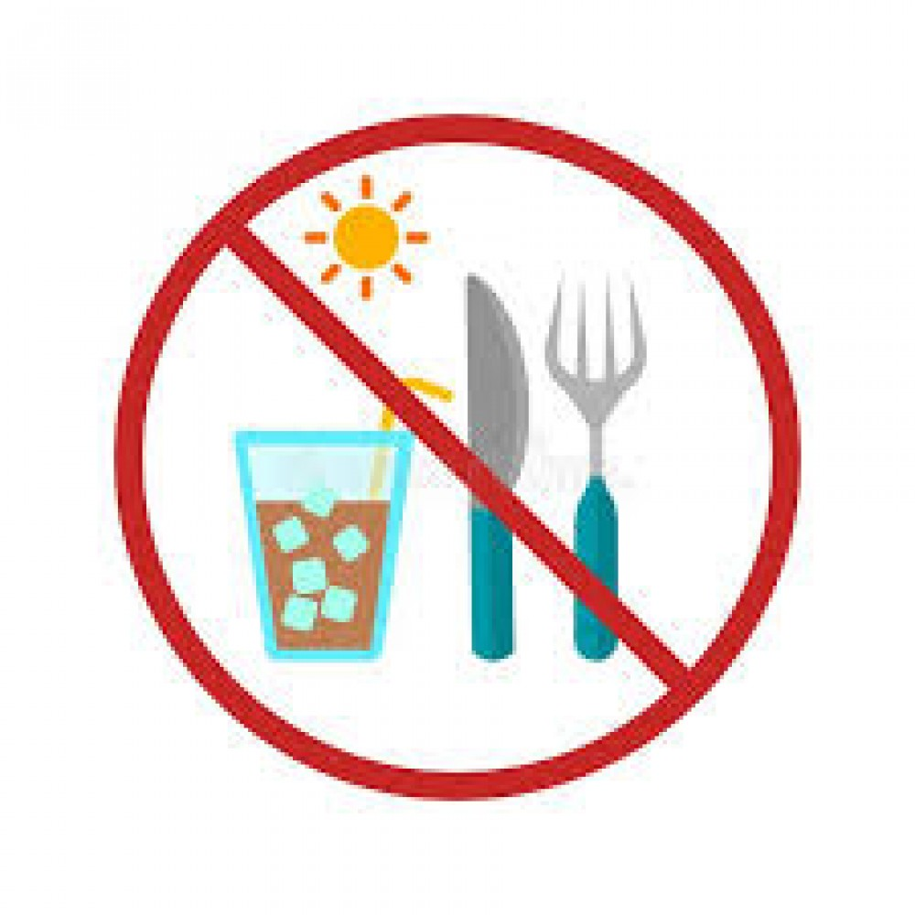
Sawm
The fourth pillar of Islam is ‘Sawm.’
Sawm is an Arabic word meaning ‘fasting.’
During the month of Ramadan (the ninth month of the Islamic calendar) every year, all adult Muslims must give up the following things during the hours of daylight:
  Food or drink of any sort
  Smoking

Slide 3
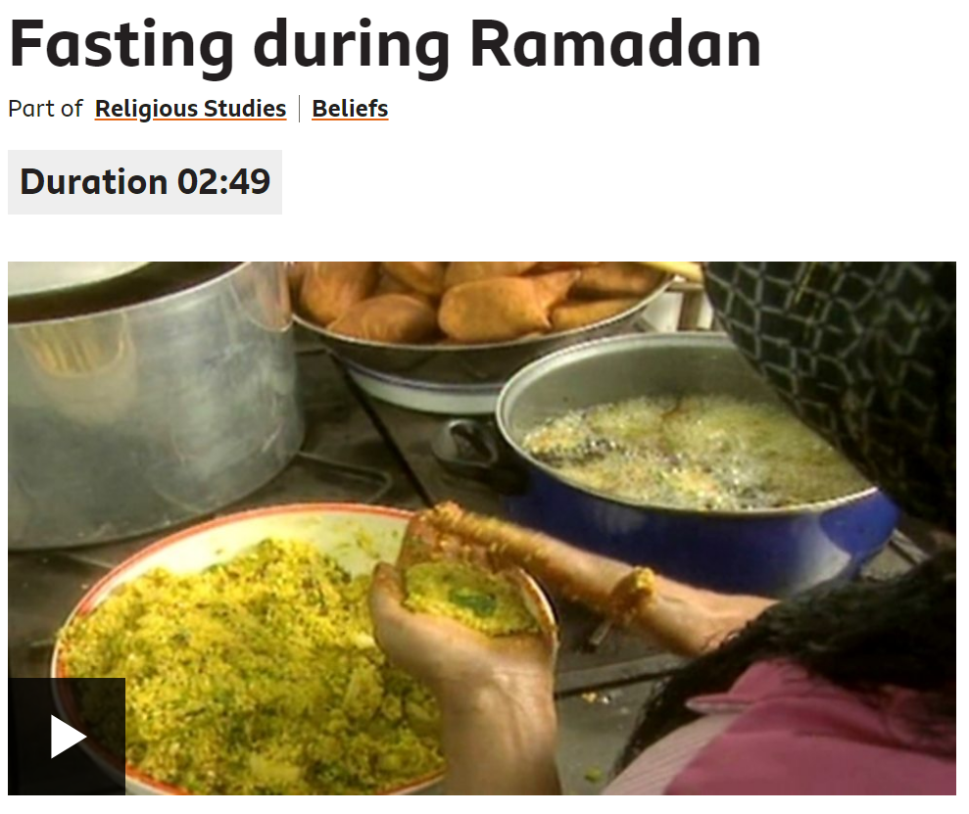
www.bbc.co.uk/education/clips/zw37tfr
Why do Muslims fast?

Slide 4
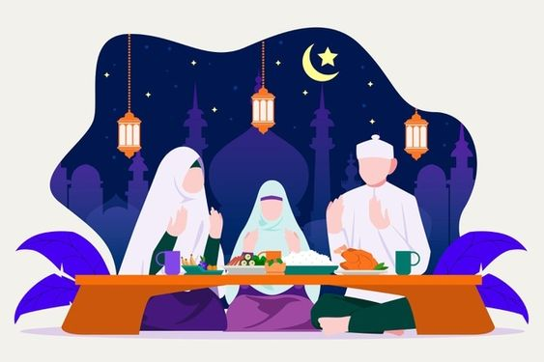
Many Muslims fast because Allah says in the Qur’an that they should.
Therefore, it is considered a religious duty.
According to the Qur’an, one may eat and drink at any time during the night ‘until you can plainly distinguish a white threat from a black threat by the daylight: then keep the fast until night.’

Slide 5
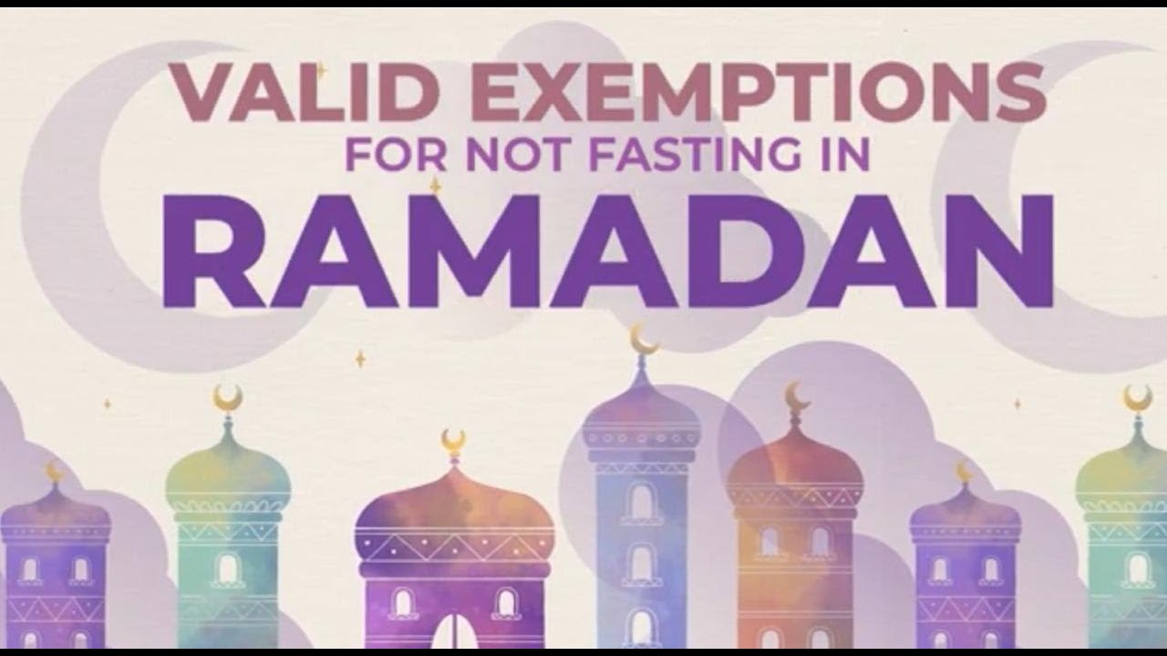
Not everyone fasts during Ramadan:
  Children (under 12 years old), pregnant women, the elderly, and those who are ill, or travelling, don’t have to fast.
If an adult does not fast for the reasons above, they should try to make up the fast at a later date, or make a donation to the poor instead.

Slide 6
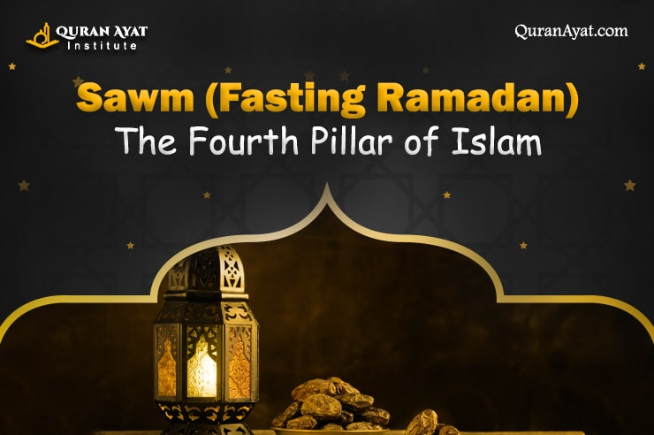
Fasting is a way of showing that they are living in the way that God wants and remembering people who are hungry.
They believe it shows that their religion is the most important thing in their lives – far more important than eating or drinking.
Muslims do not only abstain from physical things during Ramadan. They are also expected to do their best to avoid evil thoughts and deeds as well.

Slide 7
There are many good reasons for this fast, including:
Obeying God (Allah)
Learning self-discipline
Becoming spiritually stronger
Appreciating God’s gifts to us
Sharing the sufferings of the poor and developing sympathy for them
Realising the value of charity and generosity
Giving thanks for the Holy Qur’an which was first revealed during the month of Ramadan
Sharing fellowship with other Muslims

Slide 8
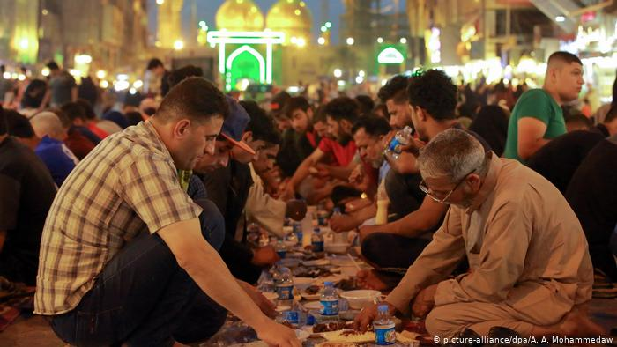
Eating in Ramadan
During Ramadan, many Muslims will try to eat a large meal called suhur just before dawn.
When daylight is over, most Muslims will break or open the fast with dates or water, following the example of the Prophet Muhammad, before having a proper meal later.
The evening meals during Ramadan are occasions for family and community get-togethers.

Slide 9
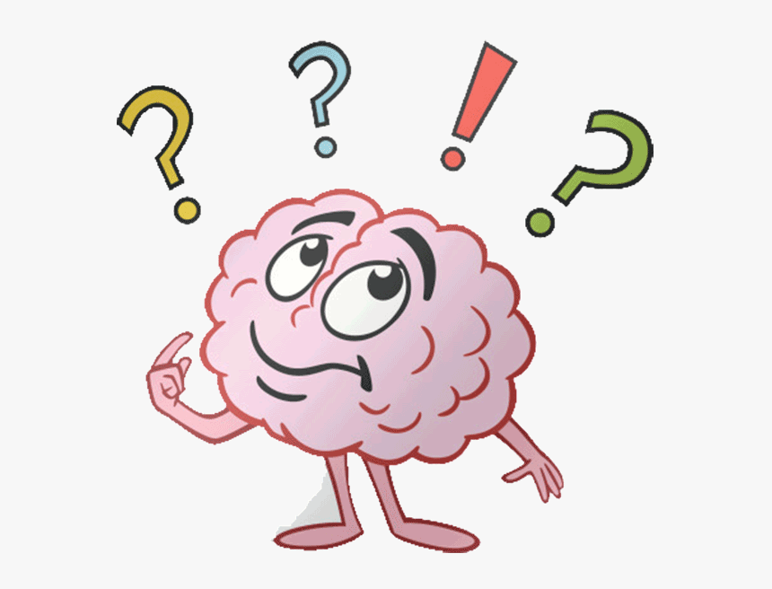
Do you think that fasting is necessary for Muslims to show their commitment to God?
If a Muslim was really hungry and ate something, would this mean that he/she is not a good Muslims?

Slide 10
Activity
Paddling: Write a short paragraph answering the question below.
  Why do Muslims believe fasting is important?
Snorkelling: Complete a double bubble map showing ‘the benefits of fasting’ compared with ‘the challenges of fasting.’
  e.g. being hungry (but also being reminded of hungry people around the world), missing out on social events with friends (giving more time to pray)
Diving: Write a paragraph answering the question below.
  How can the challenges of fasting help a believer to show their commitment to Allah?

Slide 11
Red Pen
Paddling: Have you ever given anything up?
What for? How did you feel about giving it up?
How long did you give it up for? Did you find it easy or difficult?
Did you take it up again afterwards?
Snorkelling: Can you think of any links between Sawm and Christianity?
Diving: What links can you make between Sawm in Islam and other religions that you have learned about?

Slide 12
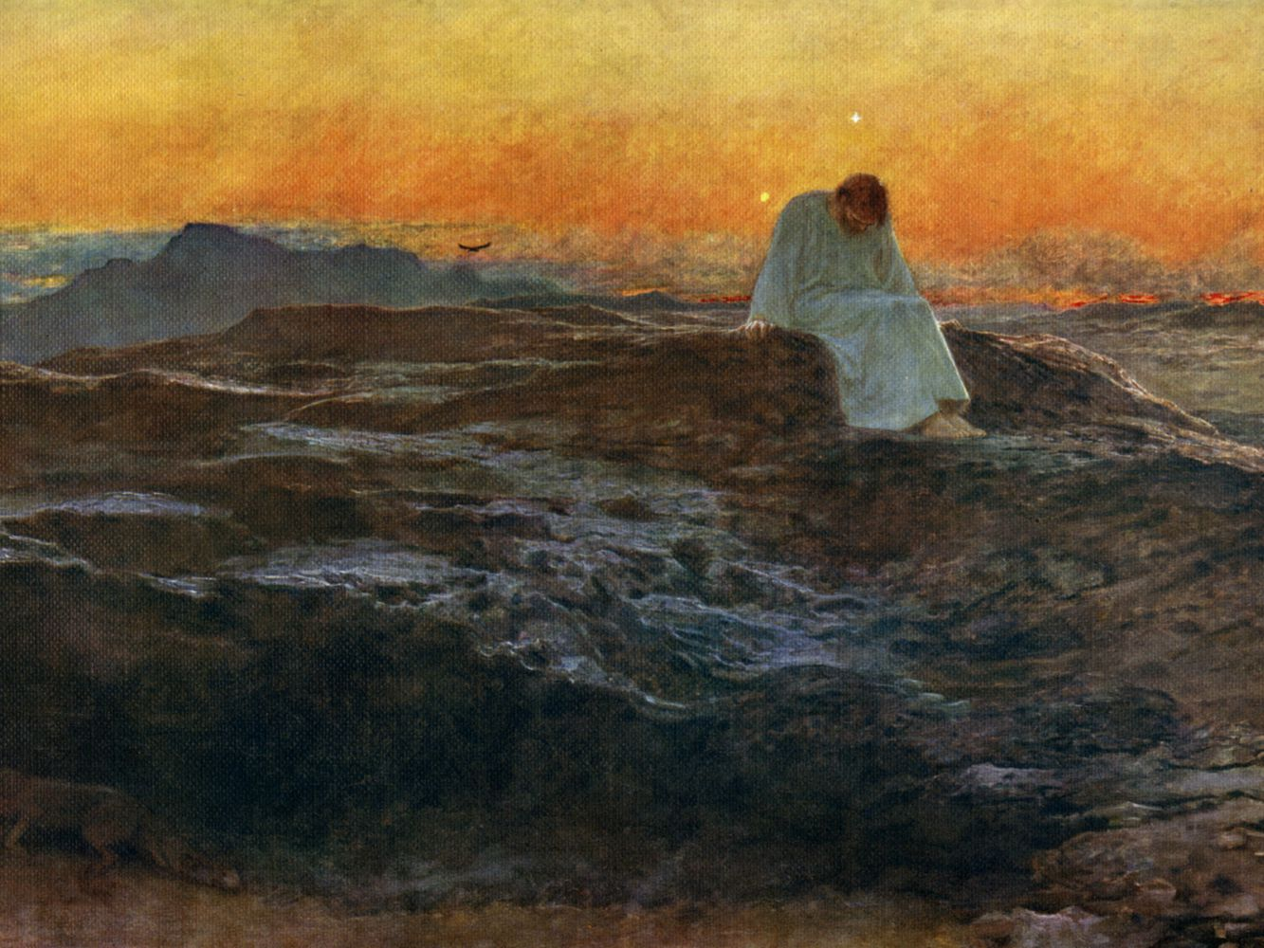
Plenary - Lent
Lent allows Christians to remember Jesus’ fasting in the desert for 40 days.
It is a time of giving things up and a test of self-discipline.
In the Bible’s New Testament, while Jesus was in the desert, Satan tempted him to turn away from God and worship him instead, but Jesus refused to.
This is why people might give up something too – in order to test their own self-discipline too.
There are many foods that some Christians do not eat in Lent, such as meat, fish, fats, eggs and milky foods.
Some Christians give up something they really enjoy, such as cakes or chocolate.
Lent is meant to focus Christians’ minds on God, but it also helps them to think of others who are not as fortunate as they are.

Slide 13
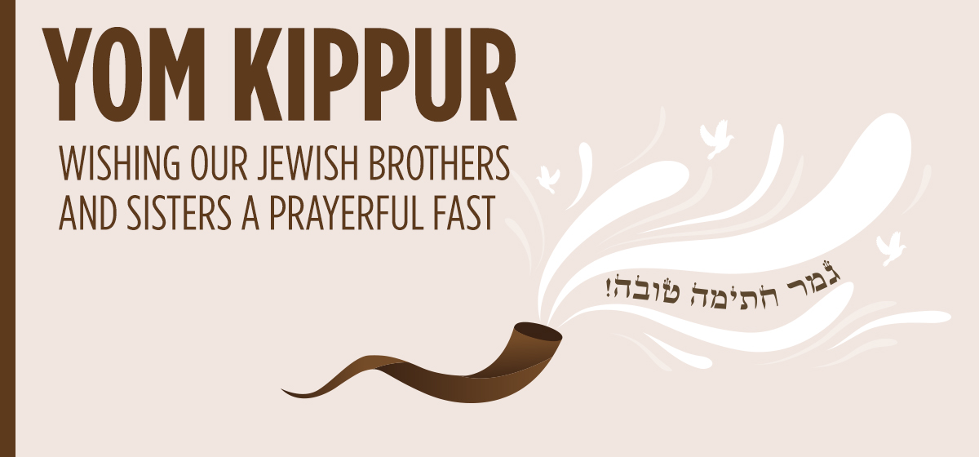
Plenary – Yom Kippur
In English, Yom Kippur means ‘Day of Atonement.’
Atonement means making up for something you have done wrong by asking for forgiveness from God.
Fasting is a vehicle for reflecting and repenting for your sins.
Many Jewish people fast for 25 hours during Yom Kippur.
They do not eat or drink.

Slide 14
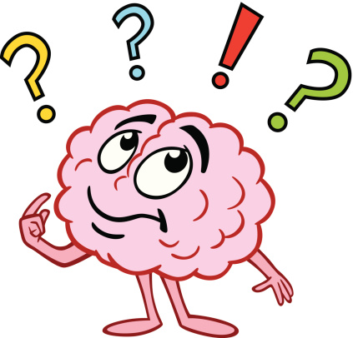
Plenary
What are the similarities/differences between these acts of fasting?

