Slide 1
Year 6 | Week 3 | Day 4

Slide 2
Year 6 | Week 3 | Day 4

Slide 3


Arithmetic Starter

Slide 4
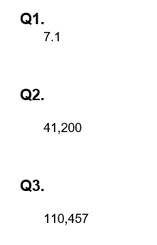
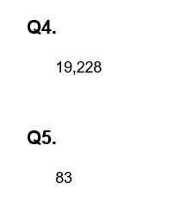
Arithmetic Starter - Answers

Slide 5


Slide 6
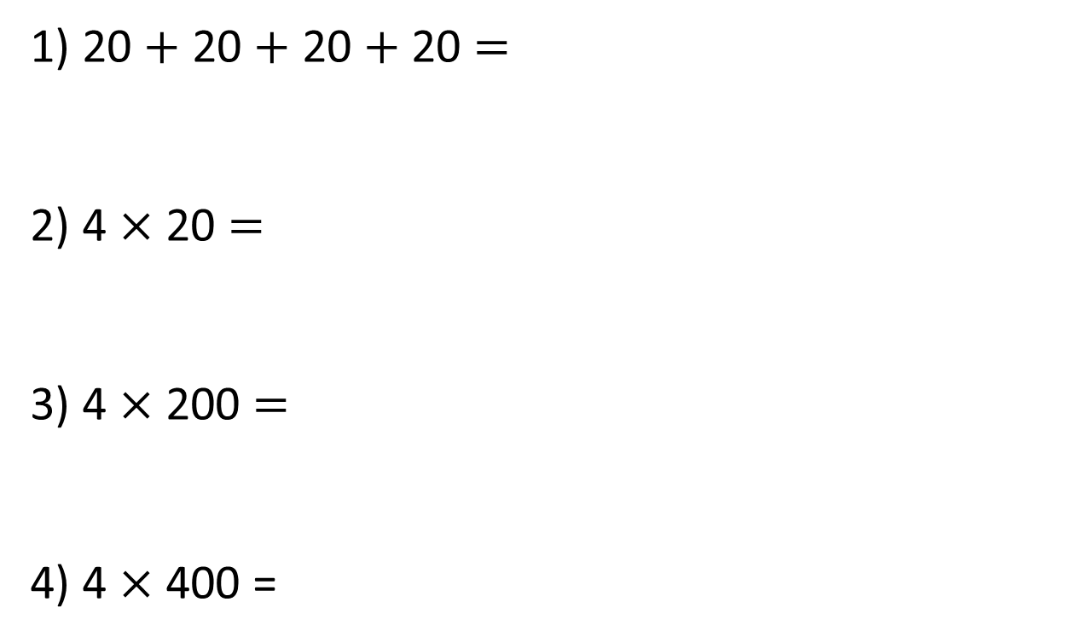
1) 20 $+$ 20 $+$ 20 $+$ 20 $=$
2) 4 $×$ 20 $=$
3) 4 $×$ 200 $=$
4) 4 $×$ 400 =

Slide 7
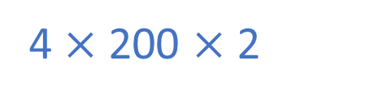
1) 20 $+$ 20 $+$ 20 $+$ 20 $=$
2) 4 $×$ 20 $=$
3) 4 $×$ 200 $=$
4) 4 $×$ 400 =
80
80
800
1,600
4 $×$ 200 $×$ 2

Slide 8





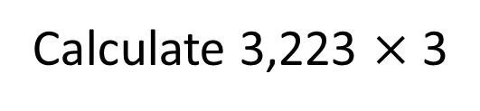
Calculate 3,223 $×$ 3
Thousands | Hundreds | Tens | Ones
Th | H | T | O
3 | 2 | 2 | 3
 |  |  | 3
$$×$$
9
6
6
9
9,669

Slide 9



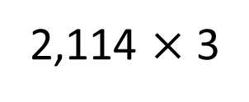
There are 2,114 seats in a theatre. The theatre is fully
booked for 3 shows. How many people attended overall?
2,114 $×$ 3
Thousands | Hundreds | Tens | Ones
Th | H | T | O
2 | 1 | 1 | 4
 |  |  | 3
$$×$$
6
3
4
2
1
Have a think
6,342 people attended

Slide 10


2,420 $×$ 4 $=$ 968
Thousands | Hundreds | Tens | Ones
Have a think

Slide 11

2,420 $×$ 4 $=$ 968
Thousands | Hundreds | Tens | Ones
Th | H | T | O
 | 2 | 4 | 2
 |  |  | 4
$$×$$
9
6
8
1

Slide 12

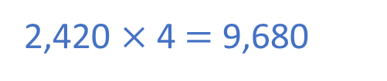
2,420 $×$ 4 $=$ 968
Thousands | Hundreds | Tens | Ones
Th | H | T | O
2 | 4 | 2 | 0
 |  |  | 4
$$×$$
9
6
8
0
1
2,420 $×$ 4 $=$ 9,680

Slide 13
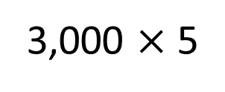
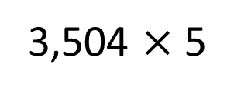
TTh | Th | H | T | O
3,504 $×$ 5
3,000 $×$ 5
TTh | Th | H | T | O
 | 3 | 5 | 0 | 4
 |  |  |  | 5

Slide 14

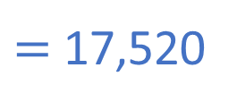
TTh | Th | H | T | O
3,504 $×$ 5
$=$ 17,520
TTh | Th | H | T | O
 | 3 | 5 | 0 | 4
 |  |  |  | 5
1
7
5
2
0
1
2
2

Slide 15
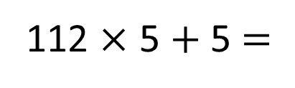
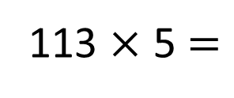
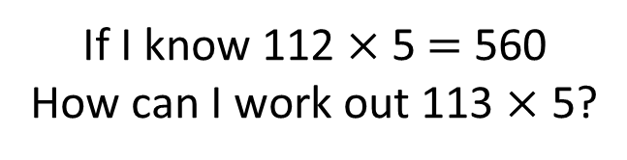
If I know 112 $×$ 5 $=$ 560
How can I work out 113 $×$ 5?
113
112
5
560
5
113 $×$ 5 $=$
112 $×$ 5 $+$ 5 $=$
565

Slide 16
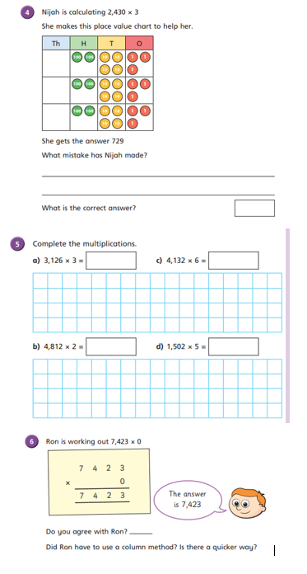
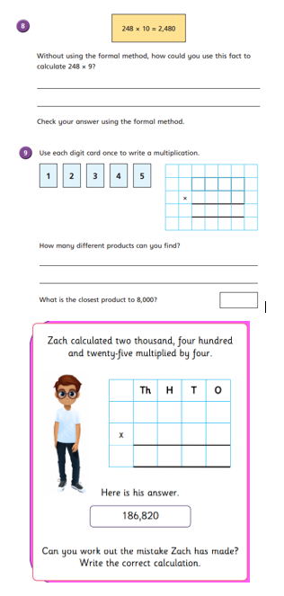
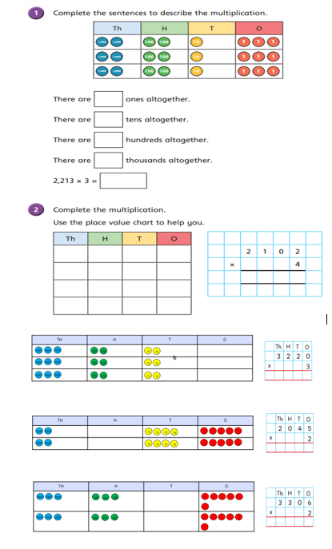
Independent Activity
Paddling Snorkelling Diving

Slide 17
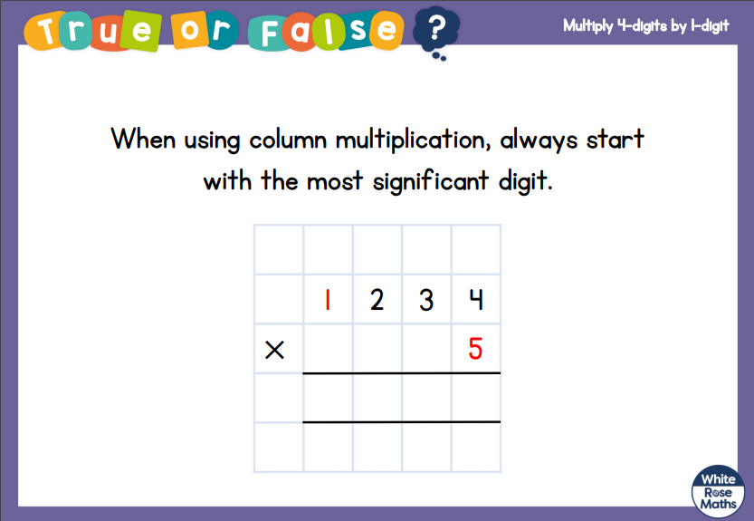


Slide 18


