Slide 1


Year 6 | Week 3 | Day 3

Slide 2
Year 6 | Week 3 | Day 3

Slide 3


Arithmetic Starter

Slide 4
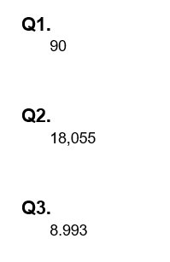
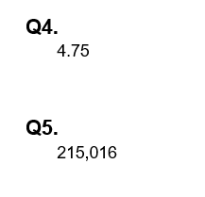
Arithmetic Starter - Answers

Slide 5


Slide 6

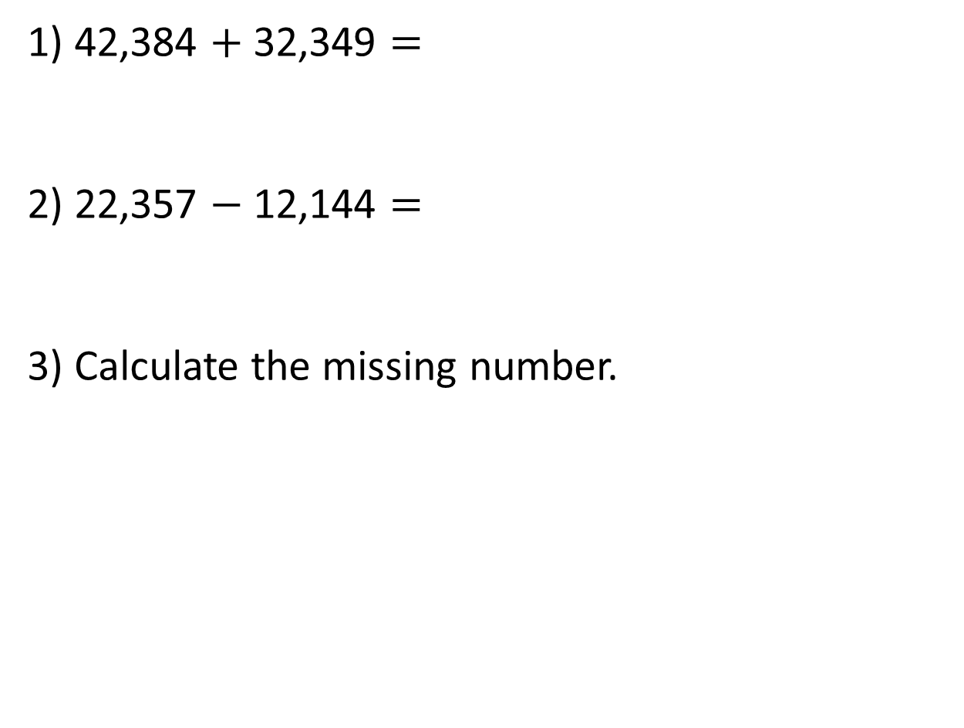
1) 42,384 $+$ 32,349 $=$
2) 22,357 $−$ 12,144 $=$
3) Calculate the missing number.
13,523
?
2,313

Slide 7
1) 42,384 $+$ 32,349 $=$
2) 22,357 $−$ 12,144 $=$
3) Calculate the missing number.
74,733
10,213
13,523
11,210
?
2,313

Slide 8



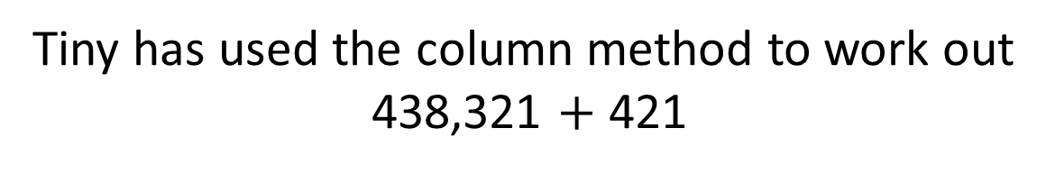
Tiny has used the column method to work out
438,321 $+$ 421
HTh | TTh | Th | H | T | O
4 | 3 | 8 | 3 | 2 | 1
8 | 5 | 9 | 3 | 2 | 1
4
2
1
$$+$$
The answer is 859,321
Have a think

Slide 9
Tiny has used the column method to work out
438,321 $+$ 421
HTh | TTh | Th | H | T | O
4 | 3 | 8 | 3 | 2 | 1
4
2
1
$$+$$
4
3
8
7
4
2
The answer is 859,321
The answer is 438,742

Slide 10


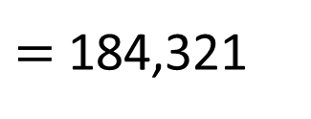
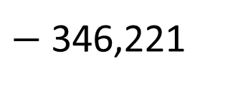

530,542
$−$ 346,221
346,221
$=$ 184,321
184,321
HTh | TTh | Th | H | T | O
3 | 4 | 6 | 2 | 2 | 1
1 | 8 | 4 | 3 | 2 | 1
?
$$+$$
5
3
0
5
4
2
1
1
Part $+$ part $=$ whole
Whole $−$ part $=$ part

Slide 11
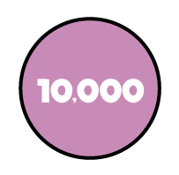





TTh | Th | H | T | O
4 |  |  | 4 | 7
 | 3 | 6 | 8
8 | 1 | 9 |  | 8
TTh | Th | H | T | O
8
2
3
1
2
1
1
$$+$$
8
1
9
2
8

Slide 12

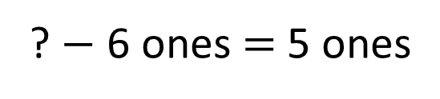
? $−$ 6 ones $=$ 5 ones
TTh | Th | H | T | O
6 |  | 1 | 3
1 | 4 |  |  | 6
 | 8 | 1 | 1 | 5
2
11 ones
1
?
1
$$−$$
0
1
5 ones
6 ones
TTh | Th | H | T | O

Slide 13
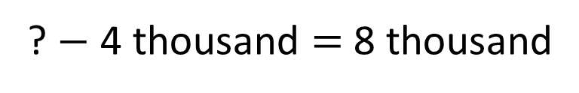
? $−$ 4 thousand $=$ 8 thousand
TTh | Th | H | T | O
6 |  | 1 | 3
1 | 4 |  |  | 6
 | 8 | 1 | 1 | 5
5
1
1
12 thousand
2
?
2
1
$$−$$
0
1
8 Th
4 Th
4
TTh | Th | H | T | O

Slide 14

Have a think
I’m thinking of a number.
I add half a million to it, then subtract 100,000 and I get three million.
What is my number?

Slide 15
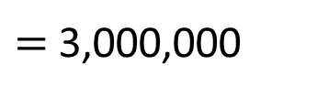
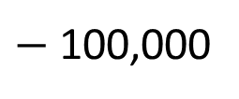
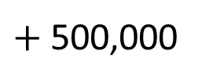
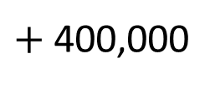
?
I’m thinking of a number.
I add half a million to it, then subtract 100,000 and I get three million.
What is my number?
Whole
$+$ 500,000
$−$ 100,000
$=$ 3,000,000
?
2,600,000
$+$ 400,000
3,000,000
?
400,000

Slide 16
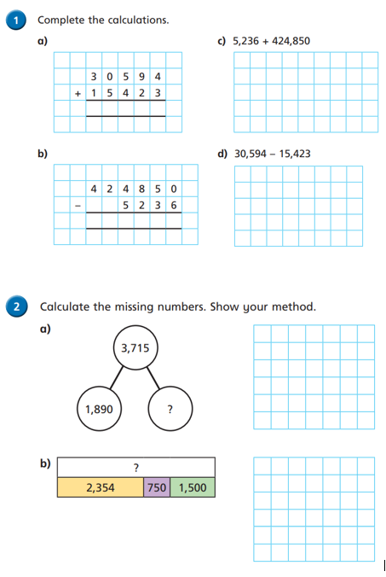
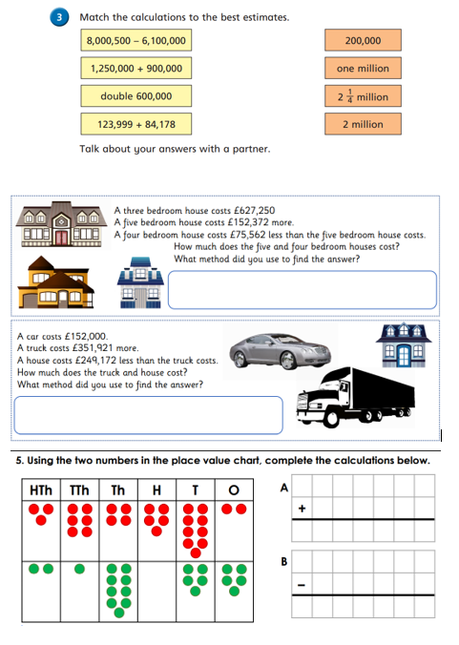
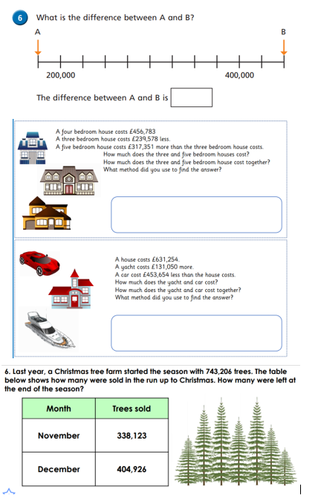
Independent Activity
Paddling Snorkelling Diving

Slide 17
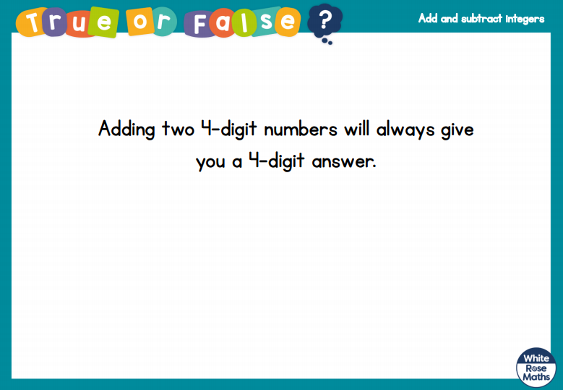


Slide 18


