Slide 1
Year 6 | Week 3 | Day 2

Slide 2
Year 6 | Week 3 | Day 2

Slide 3


Arithmetic Starter

Slide 4
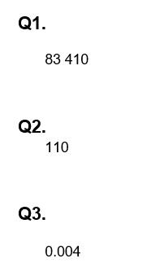
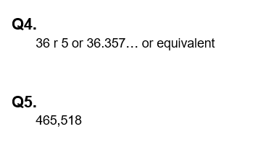
Arithmetic Starter - Answers

Slide 5


Slide 6





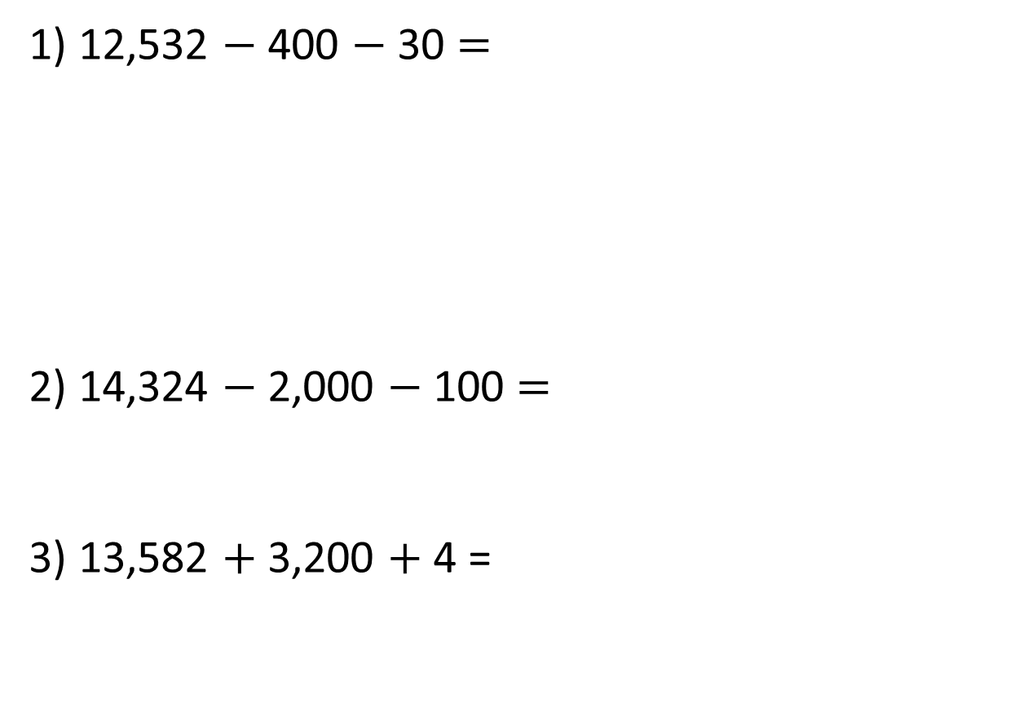
1) 12,532 $−$ 400 $−$ 30 $=$
2) 14,324 $−$ 2,000 $−$ 100 $=$
3) 13,582 $+$ 3,200 $+$ 4 =
TTh | Th | H | T | O

Slide 7
12,102
1) 12,532 $−$ 400 $−$ 30 $=$
2) 14,324 $−$ 2,000 $−$ 100 $=$
3) 13,582 $+$ 3,200 $+$ 4 =
TTh | Th | H | T | O
12,224
16,786

Slide 8




Have a think
I have 520 stickers.
Alex
I have 370 more stickers than Alex.
Mo
I have 120 more stickers than both of you combined!
Whitney
How many stickers does Whitney have?

Slide 9
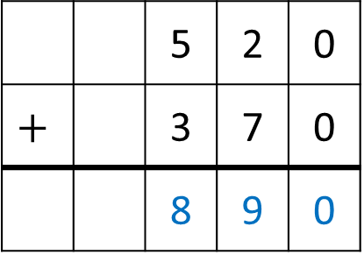
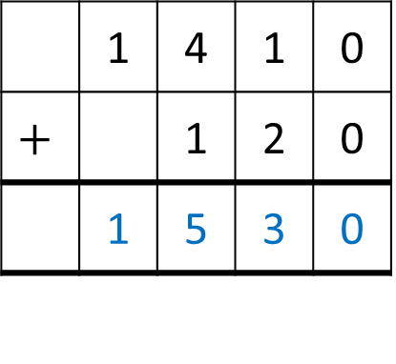
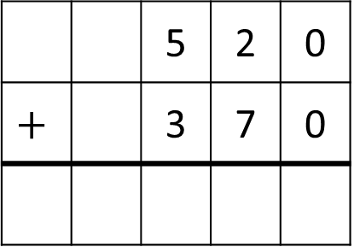
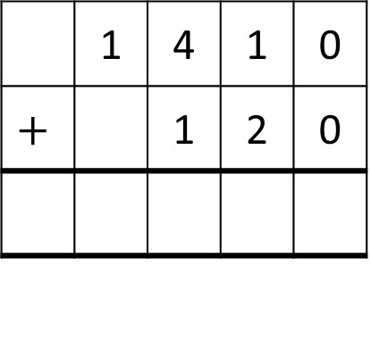
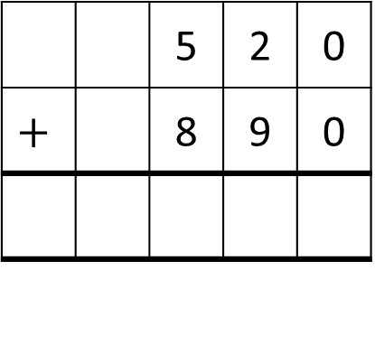
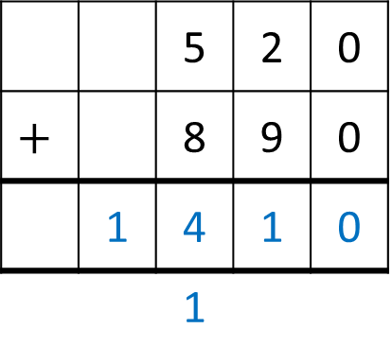
I have 520 stickers.
I have 120 more stickers than both of you combined!
I have 370 more stickers than Alex.
Alex
Mo
Whitney
 |  | 5 | 2 | 0
$$+$$ |  | 3 | 7 | 0
 |  | 8 | 9 | 0
 | 1 | 4 | 1 | 0
$$+$$ |  | 1 | 2 | 0
 |  | 5 | 2 | 0
$$+$$ |  | 3 | 7 | 0
 |  | 5 | 2 | 0
$$+$$ |  | 8 | 9 | 0
 | 1 | 4 | 1 | 0
 |  | 1
 | 1 | 4 | 1 | 0
$$+$$ |  | 1 | 2 | 0
 | 1 | 5 | 3 | 0
 |  | 5 | 2 | 0
$$+$$ |  | 8 | 9 | 0
Alex
520
890
Mo
520
370
1410
120
520
890
Whitney
1530

Slide 10

There are 14,364 people at a football match.
3,301 of the crowd are children.
How many more adults than children are there?
TTh | Th | H | T | O
1 | 4 | 3 | 6 | 4
 | 3 | 3 | 0 | 1
14,364
3,301
$$−$$
11,063
?
1
1
0
6
3

Slide 11

There are 14,364 people at a football match.
3,301 of the crowd are children.
How many more adults than children are there?
7,762
3,301
?
Children
Adults
11,063
TTh | Th | H | T | O
1 | 1 | 0 | 6 | 3
 | 3 | 3 | 0 | 1
0
1
1
0
7,762 more adults
$$−$$
7
7
6
2

Slide 12


Dora, Jack and Tommy are discussing how much money they have in their piggy bank.
I have 3 times as much money as Dora.
Jack
I have £50 more than Dora.
Tommy
They have £250 altogether. How much money do they each have?
Dora
Jack
£250
Tommy
£50

Slide 13

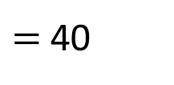
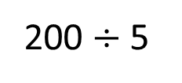



£40
Dora
?
250 $−$ 50
?
£40
?
Jack
£40
?
£40
£250
£200
£40
£50
Tommy
?
200 $÷$ 5
$=$ 40
Dora $=$ £40
Jack $=$ £120
Tommy $=$ £90

Slide 14
Two numbers have a total of 5,648 and a difference of 1,000
What are the two numbers?
1,000
Number 1
?
5,648
Number 2
?
Have a think

Slide 15
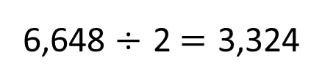
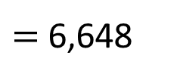
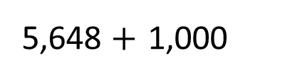
Two numbers have a total of 5,648 and a difference of 1,000.
What are the two numbers?
Number 1
3,324
1,000
?
5,648
3,324
5,648 $+$ 1,000
Number 2
?
$=$ 6,648
6,648 $÷$ 2 $=$ 3,324

Slide 16
Two numbers have a total of 5,648 and a difference of 1,000.
What are the two numbers?
1,000
Number 1
2,324
5,648
Number 2
3,324
5,648 $+$ 1,000
$=$ 6,648
6,648 $÷$ 2 $=$ 3,324
2,324 and 3,324

Slide 17
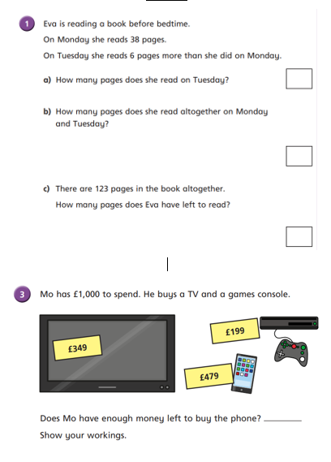
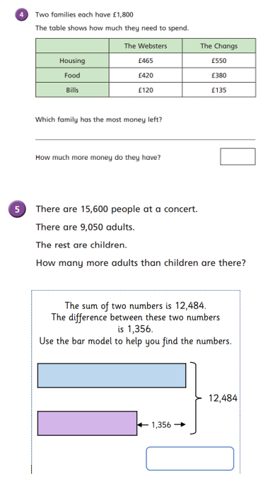
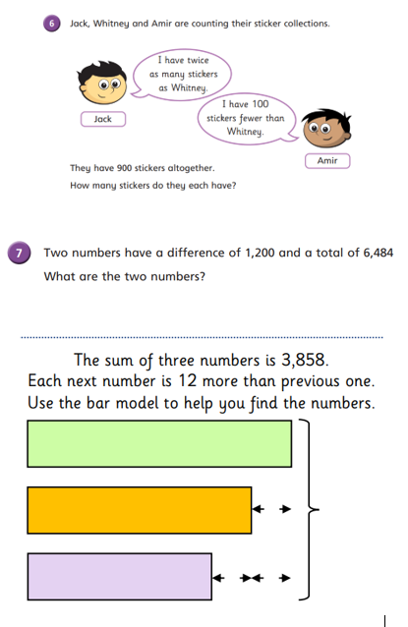
Independent Activity
Paddling Snorkelling Diving

Slide 18
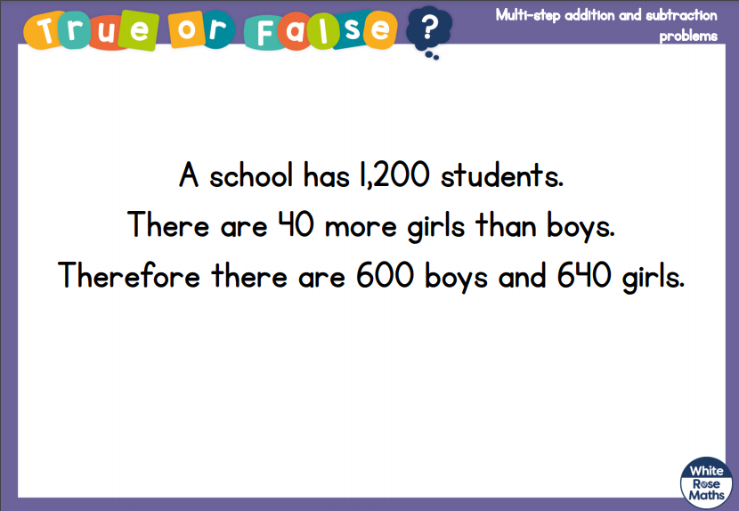
Plenary

Slide 19


