Slide 1
Monday 27th September 2021
LO: To write with purpose
To organise writing appropriately
C: Newspaper Reports

Slide 2
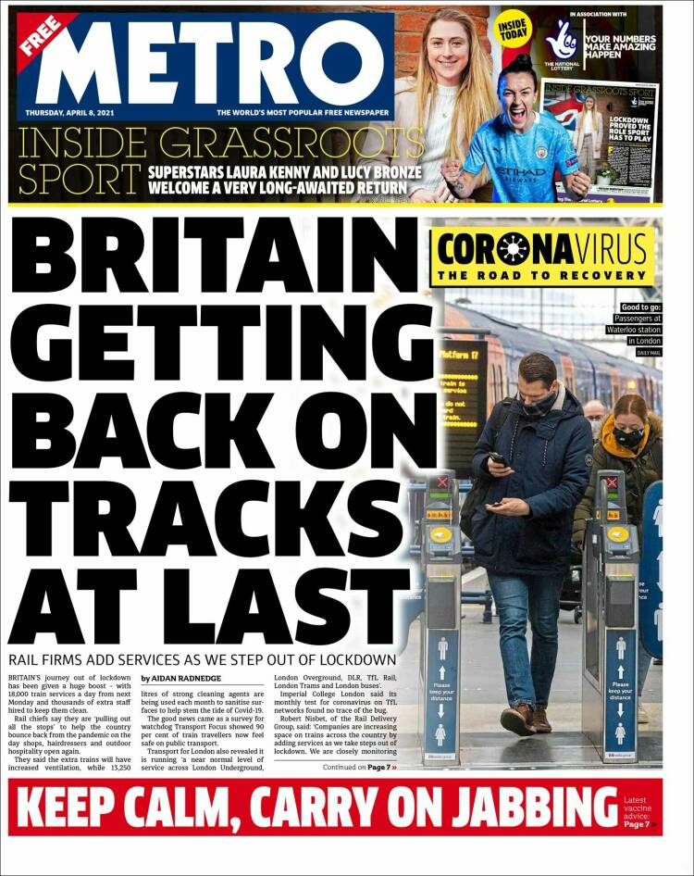
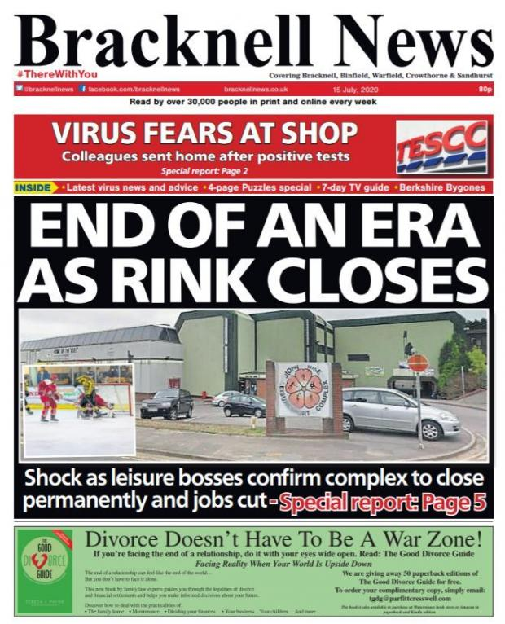
This week you will be writing your newspaper reports!
How should a newspaper be laid out?
What should it look like?
e.g. name of the newspaper, columns, the price of the newspaper, the newspaper website etc.

Slide 3
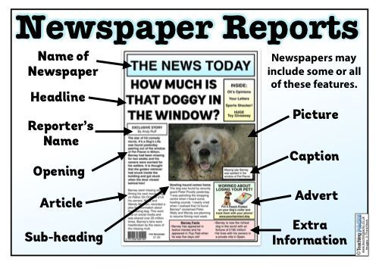
Recap:
The key features of a newspaper report
Newspaper name: the name of the newspaper is always at the top of the page.
Headline: a headline is an eye-catching title for your story, which summarises the information in just a few words.
Short subtitle: the subtitle is a short title that gives more information about the report.
Pictures: pictures usually have captions beneath them to explain what is being shown.
Conclusion paragraph: the conclusion paragraph can explain what might happen next.

Slide 4
Recap:
Writing style in newspaper articles
5Ws: the first paragraph should contain all of the 5Ws - what, where, when, who and why.
Clear paragraphs: each paragraph should give more detail about the story and be presented in a clear way.
Speech: can be used to show the what other people have said about the event.
Facts: facts or statistics can be used to support your points and avoid using your own opinion.
Formal language: avoid chatty, friendly language in your report as it should be written to inform.
Third person: newspaper reports are written in the third person using the names of those involved and pronouns such as ‘he’, ‘she’ or ‘they’.
Past tense: the main part of the report should be written in the past as the event has already happened.

Slide 5
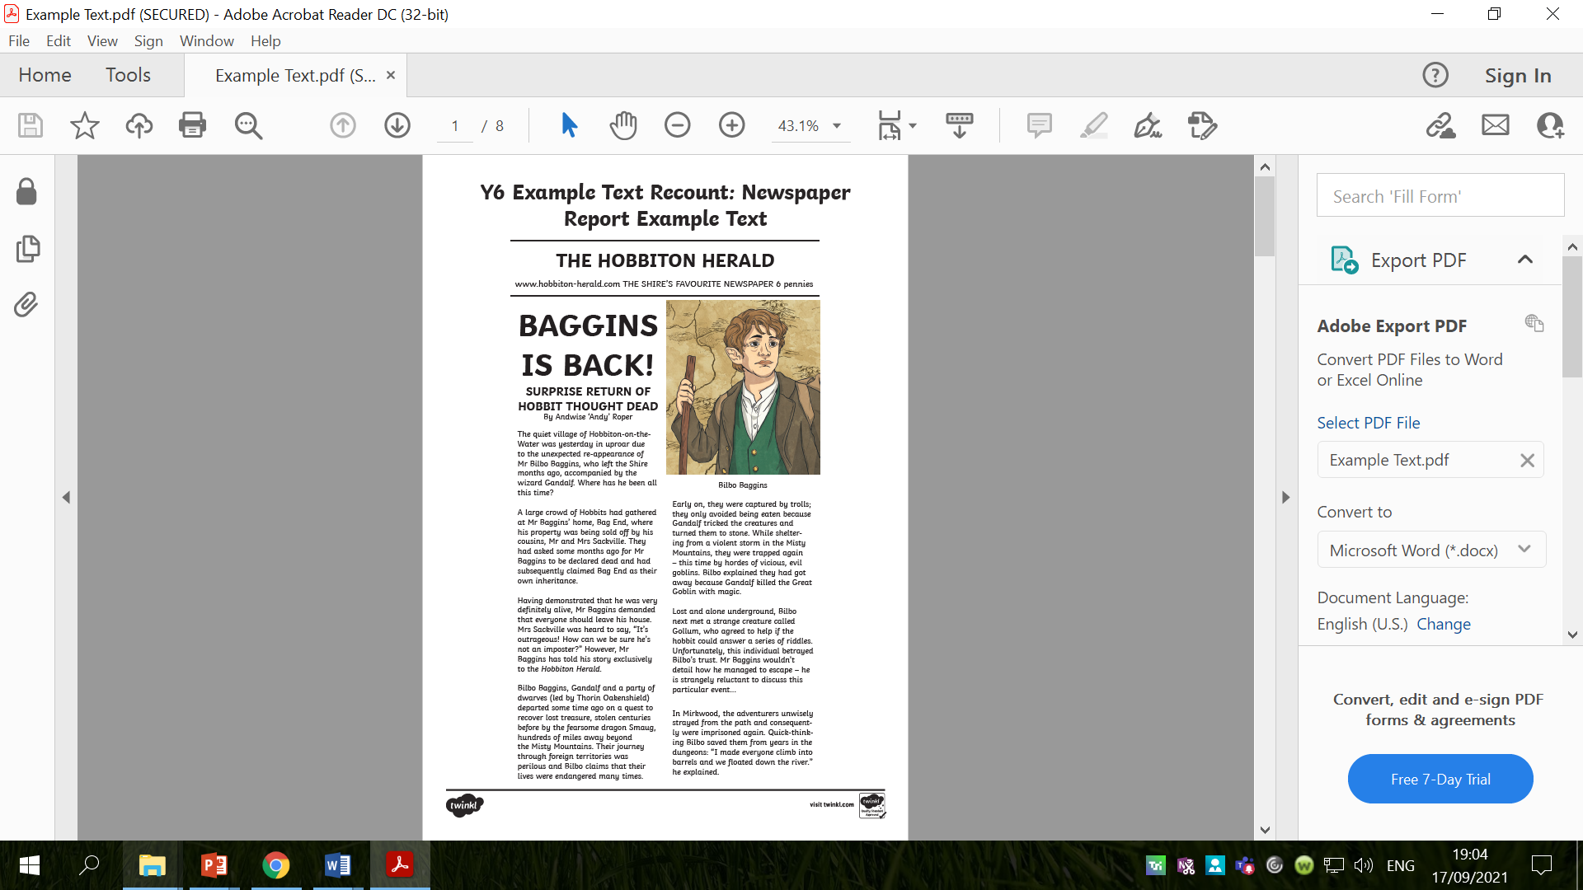
Before you begin writing your newspaper report today, you need to set your newspaper out correctly!
You can fold your page in half to create columns.

Slide 6
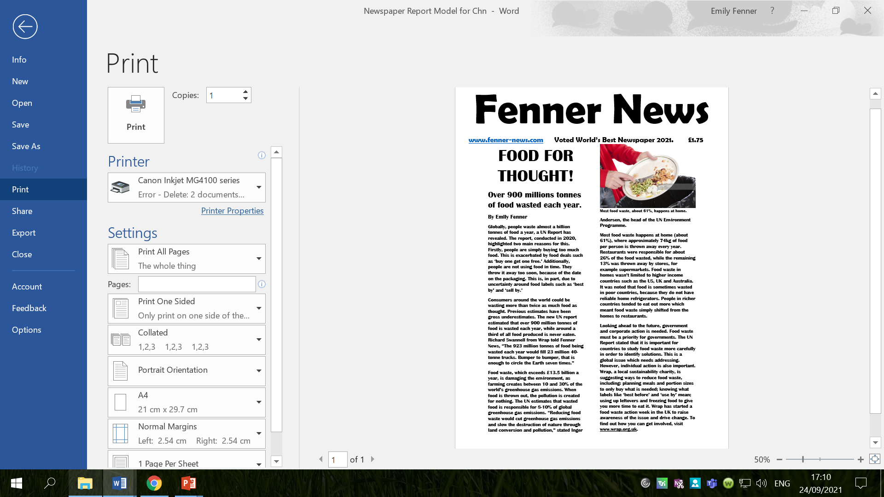

Slide 7
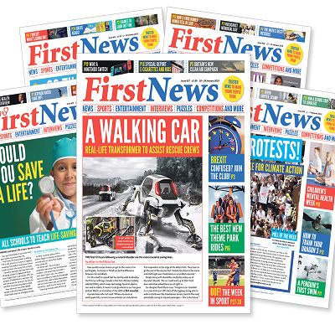
Remember, the headline should be large, bold and eye-catching.
How will you write your headline? What size will it be?
Think about the headlines and subtitles we thought of last week.
What headline and subtitle are you going to use?

Slide 8
Activity 1
Set your page up like a newspaper!
1. Fold the page in half (to create columns)
2. Write the name of the newspaper at the top of your page
3. Write the price of the newspaper and the newspaper website underneath
4. Write the headline of your newspaper report
5. Write the subtitle of your newspaper report
6. Write your name (as the journalist) underneath

Slide 9
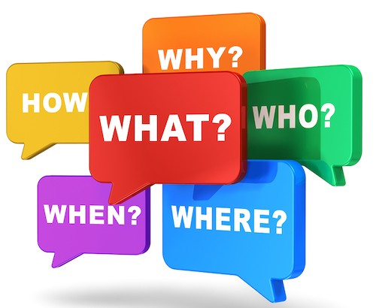
You will be writing the first paragraph of your newspaper report today.
What can you remember about the first paragraph?
What does it need?
It needs to answer the 5Ws.

Slide 10
What are the answers to these questions for your newspaper article?
What will you include in your first paragraph?

Slide 11
My Introduction
What features of writing can you spot?
What has impressed you with my writing?
Is there anything I could do to improve?
What have I included from the checklist?
What is left to include?
Jot down any impressive words/phrases you would like to magpie on your whiteboards.
Globally, people waste almost a billion tonnes of food a year, a UN Report has revealed. The report, conducted in 2020, highlighted two main reasons for this. Firstly, people are simply buying too much food. This is exacerbated by food deals such as ‘buy one get one free.’ Additionally, people are not using food in time. They throw it away too soon, because of the date on the packaging. This is, in part, due to uncertainty around food labels such as ‘best by’ and ‘sell by.’

Slide 12
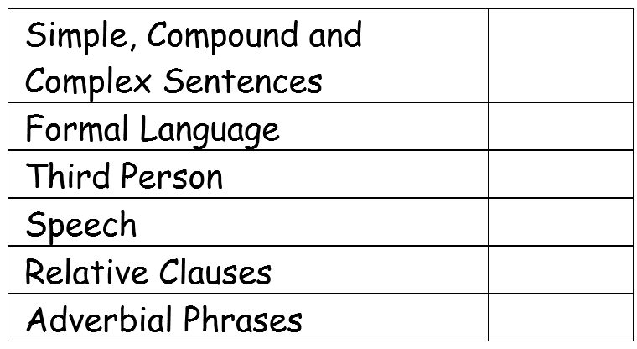
I am looking for all of these things in your writing this week.
You don’t have to include everything on the checklist in your writing today.
We have looked at each of the features on the checklist in our English lessons over the last week or so.

Slide 13
Activity: modelled writing
Use your planning template to write the introduction for your newspaper report.

Slide 14
Red Pen
Read back over your work and check that it makes sense.
Have you omitted any words?
Are your words spelt correctly?
Have you used commas in the correct places – especially with your relative clauses?
Have you written formally?
Edit and improve your work.

Slide 15
Tuesday 28th September 2021
LO: to write with purpose
to organise writing appropriately
C: Newspaper Reports

Slide 16
Homophones
What do you know about homophones?
Homophones are words which are spelt and pronounced the same but have different meanings. 'Homo' means 'same' and 'phone' comes from the Greek word meaning 'sound,’ so the literal meaning of 'homophone' is 'same sound.'
Lots of children are using the wrong homophones in their writing!

Slide 17
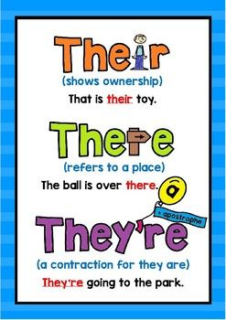

Slide 18
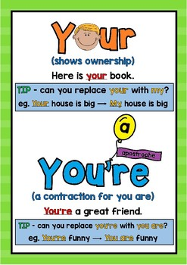

Slide 19
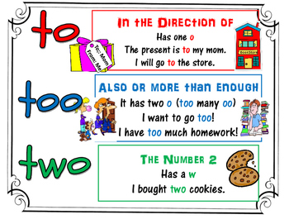

Slide 20

Think of some sentences involving these homophones that you could use in your newspaper reports this week!
Note: we will not be using they’re or you’re in our newspaper reports as these are contractions!
Contractions should not be used when writing formally.

Slide 21
Remember: I am looking for all of these things in your writing this week.
You don’t have to include everything on the checklist in your writing today.
We have looked at each of the features on the checklist in our English lessons over the last week or so.

Slide 22
What features of writing can you spot?
What has impressed you with my writing?
Is there anything I could do to improve?
What have I included from the checklist?
What is left to include?
Jot down any impressive words/phrases you would like to magpie on your whiteboards.
Consumers around the world could be wasting more than twice as much food as thought. Previous estimates have been gross underestimates. The new UN report estimated that over 900 million tonnes of food is wasted each year, while around a third of all food produced is never eaten. Richard Swannell from Wrap told Fenner News, “The 923 million tonnes of food being wasted each year would fill 23 million 40-tonne trucks. Bumper to bumper, that is enough to circle the Earth seven times.”
Food waste, which exceeds £13.5 billion a year, is damaging the environment, as farming creates between 10 and 30% of the world’s greenhouse gas emissions. When food is thrown out, the pollution is created for nothing. The UN estimates that wasted food is responsible for 8-10% of global greenhouse gas emissions. “Reducing food waste would cut greenhouse gas emissions and slow the destruction of nature through land conversion and pollution,” stated Inger Andersen, the head of the UN Environment Programme.

Slide 23
Did you notice that I have written in columns and paragraphs?
You should be writing in columns and paragraphs this week.
Remember, you have already created your columns in your books and your plan is structured into 4 different paragraphs!

Slide 24
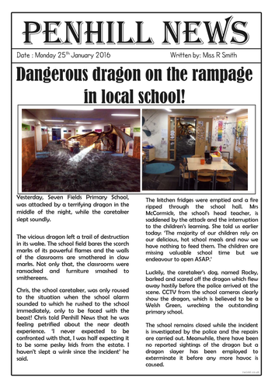
Activity
Use the planning template from last week to write paragraphs 2 and 3.
*You may not finish paragraph 3 today*
Look at the food waste pictures.
Choose one or two to include in your newspaper.
Cut out the picture(s), stick it on your page and write a caption underneath.
Think about where you want the picture to go – near the beginning, at the top of the second column, at the end?

Slide 25
Red Pen
Look back over your writing from today.
Do all of your sentences make sense?
Have you written in the third person?
Have you remembered all of your punctuation, e.g. commas?
Check your use of punctuation for speech carefully.
How many features of the checklist have you included?
Have you used them correctly?
Could you write a sentence or two now to tick off any more items on the checklist?

Slide 26
Wednesday 29th September 2021
LO: to write with purpose
to organise writing appropriately
C: Newspaper Report

Slide 27
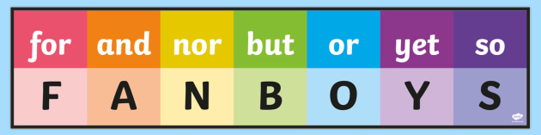
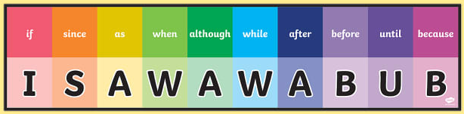
Do you know what these words are?
Conjunctions are joining words that link together parts of a sentence.
Do you know the difference between the two sets of conjunctions?

Slide 28
FANBOYS conjunctions are coordinating conjunctions.
They can be used to join together two clauses in a sentence.
The clauses need to make sense on their own.
Coordinating conjunctions join two parts of a sentence that are of equal weight or importance.
Coordinating conjunctions DO NOT start a sentence. They can only go in the middle of the sentence between the two clauses.
Coordinating conjunctions are used in compound sentences.

Slide 29
Subordinating conjunctions introduce a subordinate clause (a clause that does not make sense on its own).
A subordinating clause is a part of a sentence that adds additional information to the main clause.
A subordinating conjunction is simply the word that is used to join a subordinating clause to another clause or sentence.
Subordinating conjunctions can go at the start of the sentence as we can swap the main clause and the subordinate clause.
E.g. Make sure you turn off the oven if it gets too hot.
If it gets too hot, make sure you turn the oven off.

Slide 30
What a difference!
Because | Until | If
Although | While | When
Before | After | As
All the schools were closed.
The clause introduced by the conjunction can begin the sentence, or continue the sentence.
E.g. because aliens had landed in the area, all the schools were closed.
All the schools were closed, because aliens had landed in the area.
Write sentences including the main clause using each conjunction in turn to see how the conjunction can change the direction of a sentence.
If the subordinating conjunction begins the sentence, the end of the clause it introduced should be marked by a comma.

Slide 31
Remember: we have looked at each of the features on the checklist in our English lessons over the last week or so.
Look back in your books to remind yourself.
Look at the checklist in your books to see which features you have included in your writing already and which features you will need to include in your writing today.

Slide 32
What features of writing can you spot?
What has impressed you with my writing?
Is there anything I could do to improve?
What have I included from the checklist?
What is left to include?
Jot down any impressive words/phrases you would like to magpie on your whiteboards.
Most food waste happens at home (about 61%), where approximately 74kg of food per person is thrown away every year. Restaurants were responsible for about 26% of the food wasted, while the remaining 13% was thrown away by stores, for example supermarkets. Food waste in homes wasn’t limited to higher income countries such as the US, UK and Australia. It was noted that food is sometimes wasted in poor countries, because they do not have reliable home refrigerators. People in richer countries tended to eat out more which meant food waste simply shifted from the homes to restaurants.
Looking ahead to the future, government and corporate action is needed. Food waste must be a priority for governments. The UN Report stated that it is important for countries to study food waste more carefully in order to identify solutions. This is a global issue which needs addressing. However, individual action is also important. Wrap, a local sustainability charity, is suggesting ways to reduce food waste, including: planning meals and portion sizes to only buy what is needed; knowing what labels like ‘best before’ and ‘use by’ mean; using up leftovers and freezing food to give you more time to eat it. Wrap has started a food waste action week in the UK to raise awareness of the issue and drive change. To find out how you can get involved, visit www.wrap.org.uk.

Slide 33

Remember: you should be writing in columns and paragraphs this week.
Remember, you have already created your columns in your books and your plan is structured into 4 different paragraphs!

Slide 34
Activity
Use the planning template from last week to finish writing paragraph 3 and your conclusion.
If you didn’t do this yesterday:
Look at the food waste pictures.
Choose one or two to include in your newspaper.
Cut out the picture(s), stick it on your page and write a caption underneath.
Think about where you want the picture to go – near the beginning, at the top of the second column, at the end?

Slide 35
Red Pen
Look back over your writing from today.
Do all of your sentences make sense?
Have you written in the third person?
Have you remembered all of your punctuation, e.g. commas?
Check your use of punctuation for speech carefully.
How many features of the checklist have you included?
Have you used them correctly?
Could you write a sentence or two now to tick off any more items on the checklist?

Slide 36
Thursday 30th September 2021
LO: to write with purpose
to organise writing appropriately
C: Newspaper Reports

Slide 37
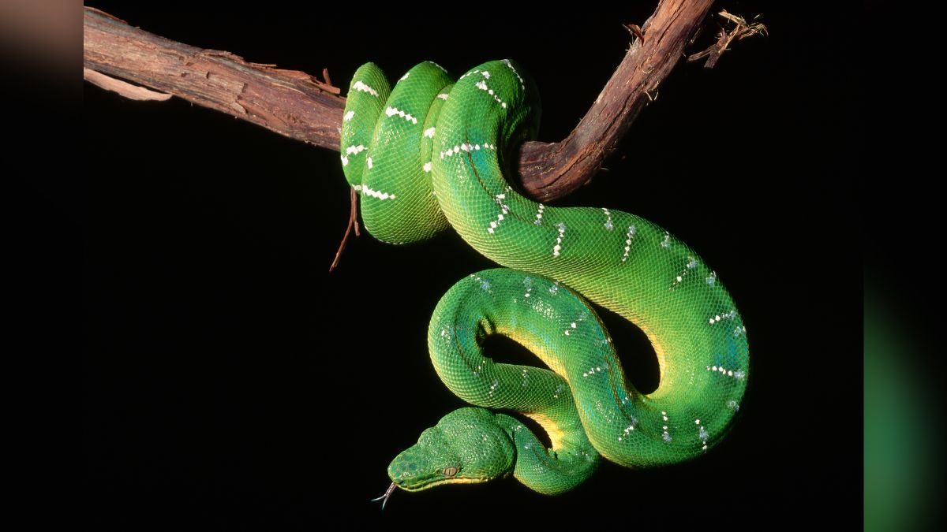
Making Sentences
Snake
Write a sentence containing this word rapidly on a sheet of paper
Your sentence MUST have a capital letter, full stop and it must make sense.
Reread your sentence before sharing it with an adult.
E.g. The snake slithered along the top of the sand dune.

Slide 38
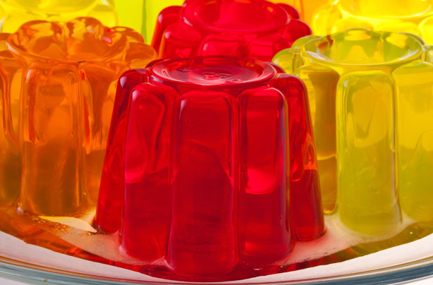
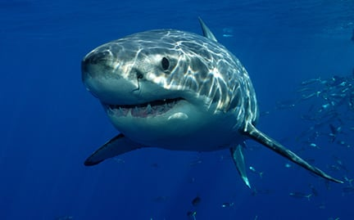
Jelly / shark
Write a sentence containing these words rapidly on a piece of paper.
Your sentence MUST have a capital letter, full stop and it must make sense.
Reread your sentence before sharing it with an adult.
You might think of some funny sentences but watch out! As soon as the brain becomes excited about the sentence, you run the risk of forgetting the full stop!
Challenge: add in a word, choose a ‘better’ word, extend the sentence using a conjunction etc.

Slide 39

Look back at your work.
What have you done well?
What features have you correctly used?
What do you need to improve?
What features have you not included from the checklist?

Slide 40
Activity
Edit and improve your newspaper reports.

