Slide 1
LO: to understand how a network works
C: The school’s network

Slide 2

Can you remember what a network is?

Slide 3
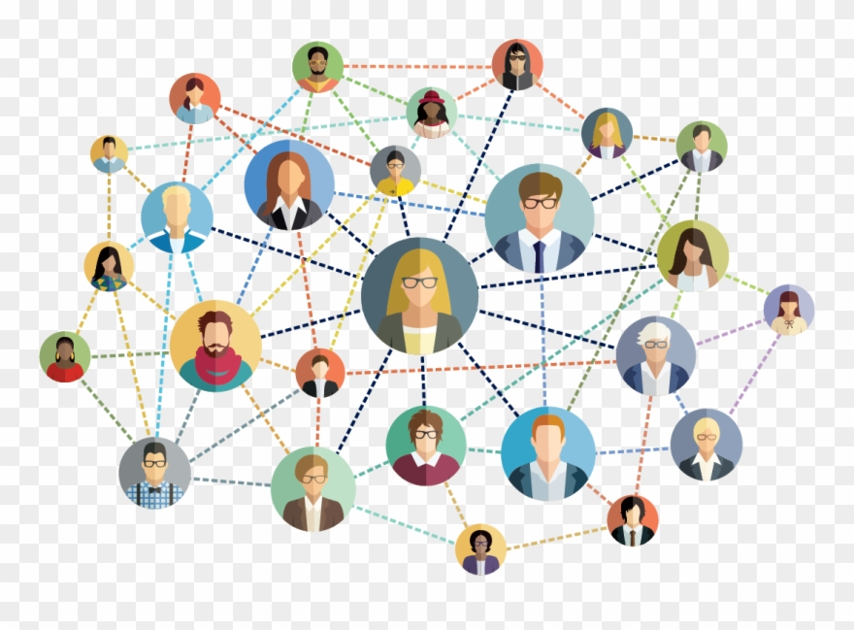
Network
A network is a group or system of interconnected people or things.
We have a school computer network that is a system of interconnected things.

Slide 4
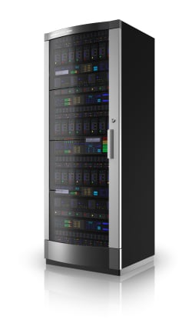
Server
The server is the most important computer in the school.
It is typically 10 times more expensive than other school computers.
It has a list of everyone’s names who are allowed on the school network and it holds everyone’s saved files.
What projects have you saved on your school account?

Slide 5
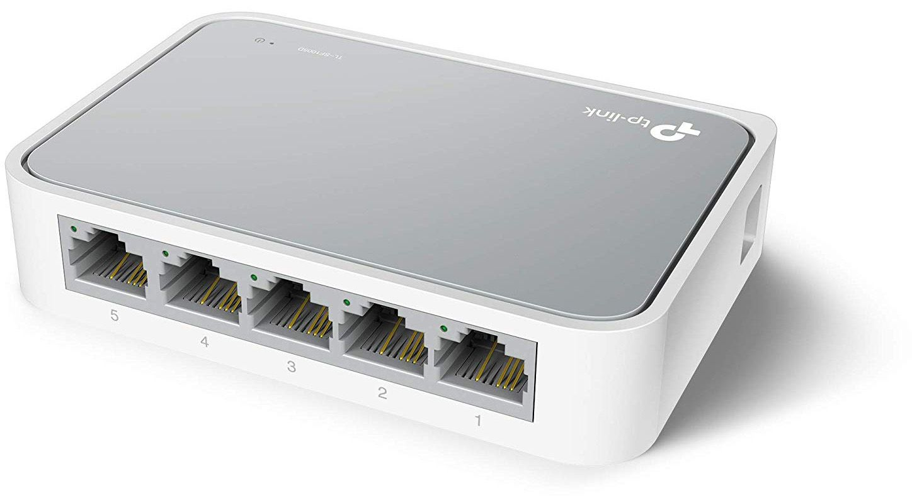
Switch
The server is connected to the switch box.
The switch carries signals from the server to every other computer on the network and back again.

Slide 6
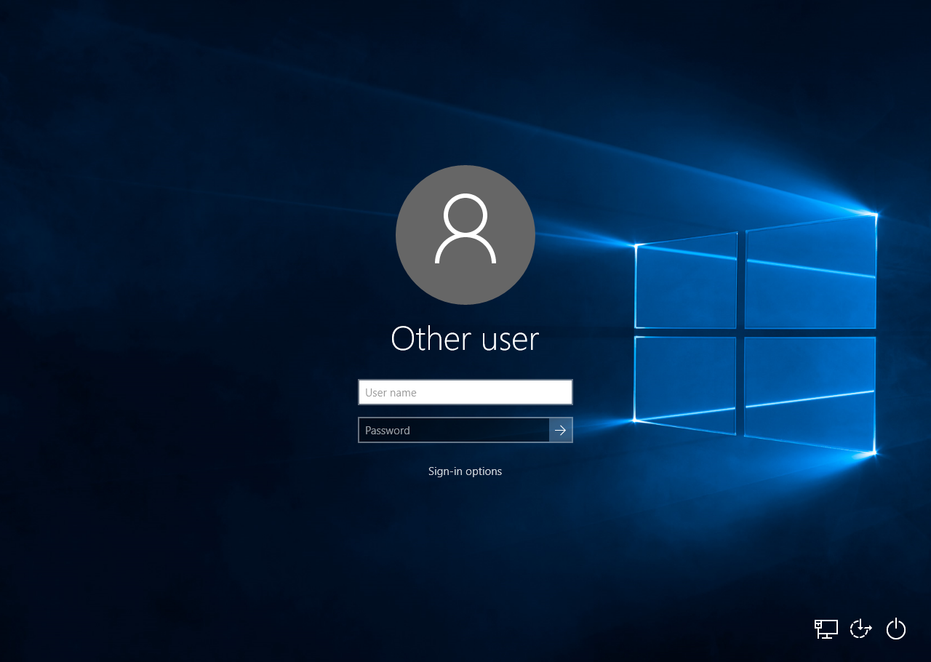
Log on
The switch box is connected to a wired computer (PC).
Logging on!
What message should needs to be sent to the
server?
Username and Password.

Slide 7
The data (username and password) is carried to the server along the wires.
When the data gets to the server, it will tell the server the information.
The server will check this information and, if it is the same, will send the data back to tell the computer to log on.

Slide 8
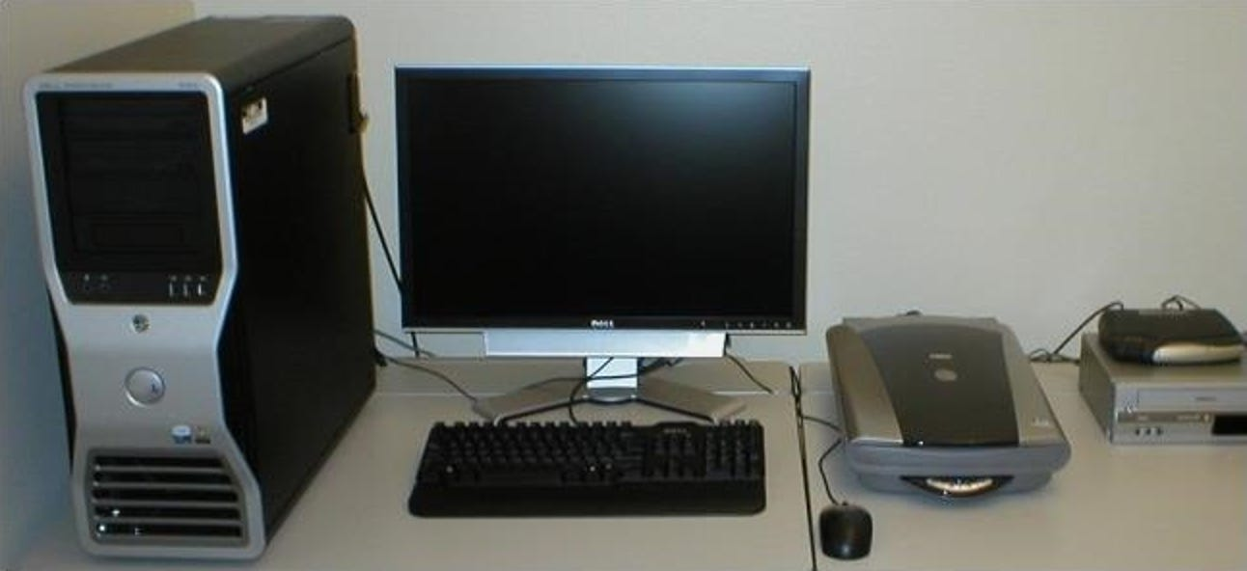
Other wired computers can be connected too!

Slide 9
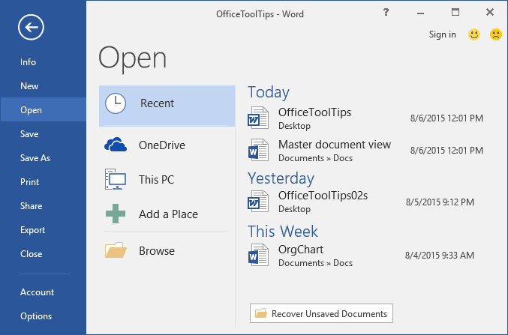
Opening files
Think of a piece of work you saved recently.
The data will go through the switch to the server in order to open the file.
When it is saved and closed, the data will take it back to the server.

Slide 10
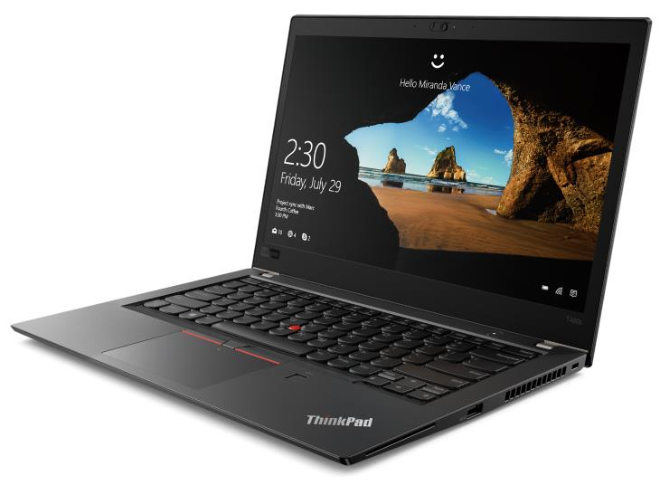
Connecting wireless computers
The switch can be wired to the wireless access point.
This converts the signal from data in a wire to data that can be carried through the air.
You can log on and open a file in exactly the same way as the wired computers.

Slide 11
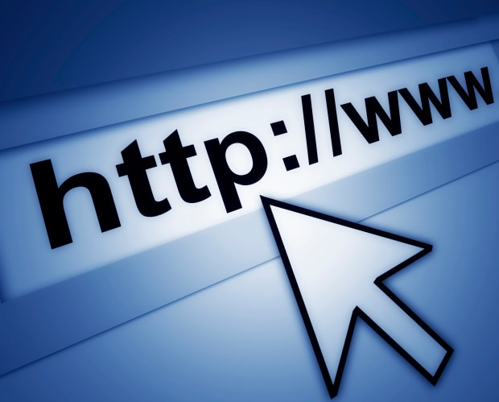
Connecting to the internet
Not every computer on the network is controlled by the server.
iPads and android tablets don’t log on to the server and many don’t save work on the server either.
However, they do connect to the internet through the school network.
The tablets can be connected to our network!
The switch can connected to the router too.
The router carries signals beyond the school all over the world to fetch web pages, emails, videos and other internet services.

Slide 12
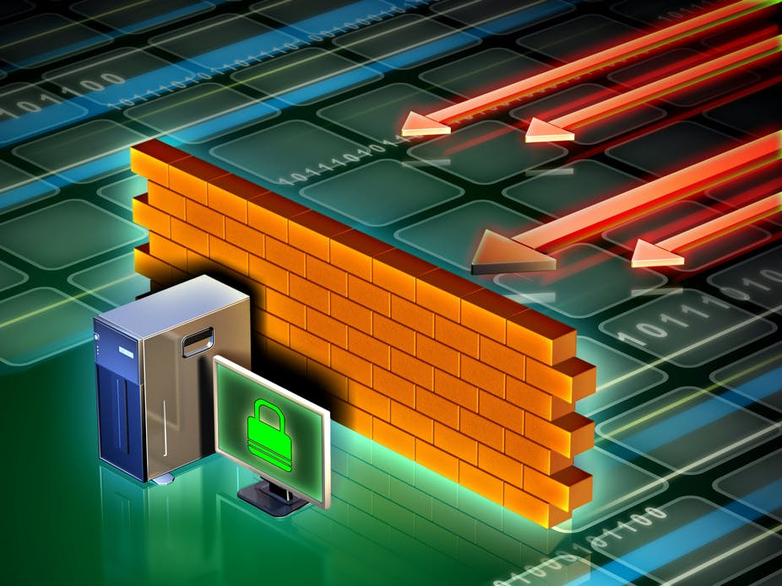
firewall
The router can join to the firewall.
The firewall checks data to see if it has viruses before letting it in or out of the school.
If it does find a virus, it locks the data down so it can be cleaned or deleted.
The firewall can connect to the routers and websites.
If you were looking up a webpage on a tablet, laptop or PC, the data would go to find the webpage, through the switch, through the router, through the firewall, through other routers until they find the web server.
The data would collect the page and return it back to your original device.
This takes less than half a second typically!

Slide 13
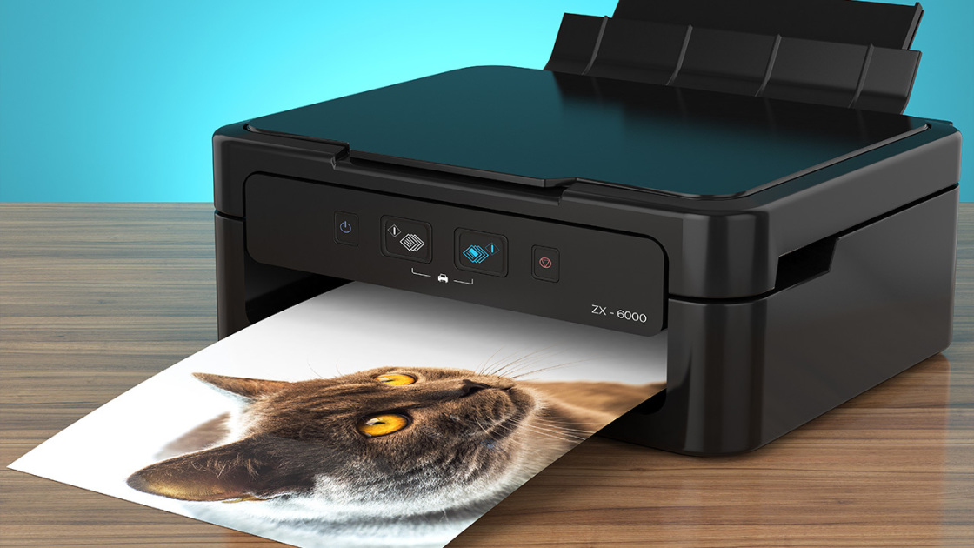
Network printing
You can add a printer to our network!
You can send an open document to the server and then to the printer.
On your school network, your servers manage the printing queues.
If you were at home, the page would go straight to the printer.

Slide 14
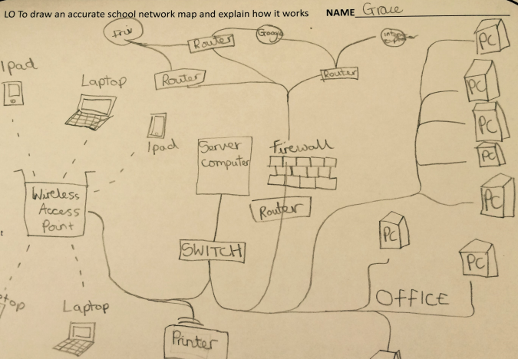
Activity
You are going to draw the network and explain how some of it works.
Your network should look something like this:

