Slide 1
Being a global citizen (2)
PSHCE

Slide 2

Children should not be allowed to work on the cocoa plantations in Ghana.
Do you agree or disagree with the statement?
Think of reasons to support your arguement.

Slide 3
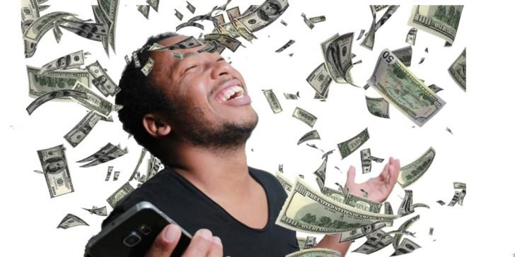
Write down all of the things you would buy if you won a huge amount of money.
You have one minute.

Slide 4


We often have a lot of wants, e.g. birthday present or Christmas presents list.
Go through your list and cross out all the things you don’t really ‘need.’
What are you left with?
Note: There is a difference between what we want and what we need.

Slide 5

What do you need in order to learn?

Slide 6
This is Maslow’s hierarchy of human need.
Which of the human needs must be met in order for learning to happen?

Slide 7
Activity: on Maslow’s triangle -
1. Highlight the needs you think are met for you. Around the triangle, write notes on how and when these are mets.
2. In a different colour, underline the needs that are not yet met for you.

Slide 8

How do you think your unmet needs might be affecting your ability to learn?
Can you think of ways to support each other in meeting some of these needs?

Slide 9
Is it ever possible to have all of the needs in Maslow’s triangle met?
Which ones do you think are essential to enable you to learn?

Slide 10
Think about the child worker on a Ghanaian cocoa plantation
Activity: On your second Maslow’s triangle - highlight which of the needs might not be met.
Write notes around the triangle showing your understanding of how these unmet needs might affect the children and their ability to learn.

