Slide 1
LO: To master techniques
C: Texture carousel

Slide 2
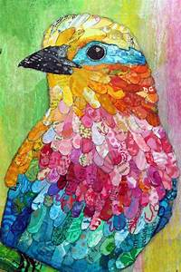
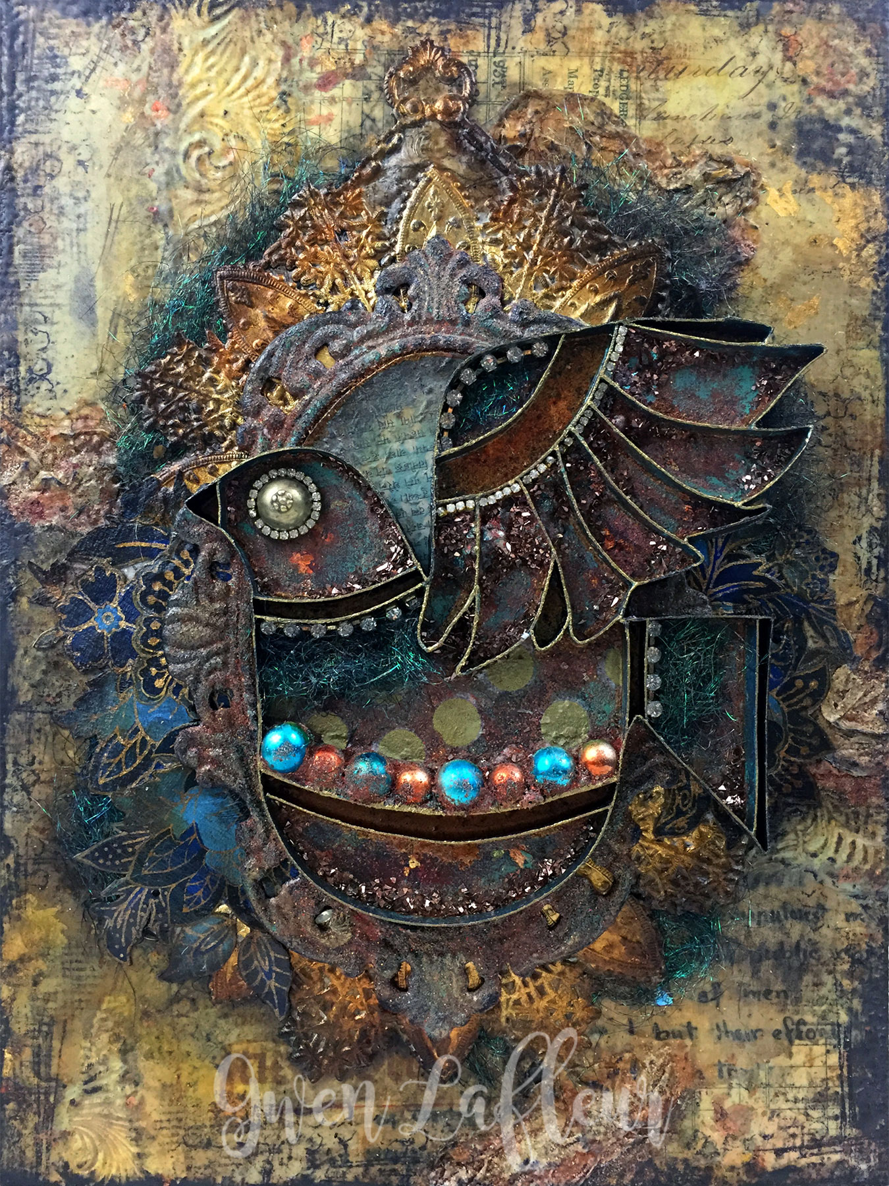
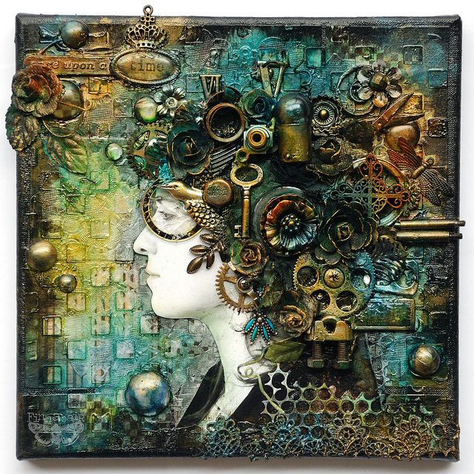
Can you remember what mixed media means?
Mixed media is a term used to describe artworks composed from a combination of different media or materials.

Slide 3
What different types of material has the artist used?
What affect does it have on you?

Slide 4
What different types of material has the artist used?
What affect does it have on you?

Slide 5

What different types of material has the artist used?
What affect does it have on you?
How would the three pictures be different if they
were 2 dimensional pieces?

Slide 6
Can you think how the artist has managed to create the effect we have seen in these pieces of art?
Watch this video that explains how different artists create texture in their work:
https://www.youtube.com/watch?v=YoOb3JSDAUo

Slide 7
A simple way to create texture is by using paint. Can you think of some techniques that an artist might use to create texture with paint?
• They brush paint on in watery strokes and thick drips.
• They put paint down in short, fat dabs and long, sleek strokes.
• They twirl their brushes to make circles and curls.
• They apply paint in thick layers that stick out from the canvas.
• They put different colours on top of each other.
• They mix in sand, dirt, or other materials into the paint. Add water first.
• They add white highlights to make things look shiny.
• They scratch through paint to show colours underneath.

Slide 8
Activity
Use whatever resources you are able to acquire: charcoal, pencils, wax crayons, watercolours, tissue paper, paint etc...
Experiment using the materials to create different textures.
Colour is not important – you need to try to create texture.
Think of different ways to use the media, e.g. applied with a knife, different sided brushes, with glue, applied by blowing through a straw etc…
Next to your experimental artwork, label the technique you have tried.

Slide 9
Plenary
What technique was most successful at creating texture?
Remember: you will be creating a collage on a subject you feel strongly about.
It would be great idea to start collecting resources you would like to use: materials that would be useful in a collage (buttons, foil, ribbon etc.)

