Slide 1
LO: to understand evolution and inheritance
C: Adaptation

Slide 2
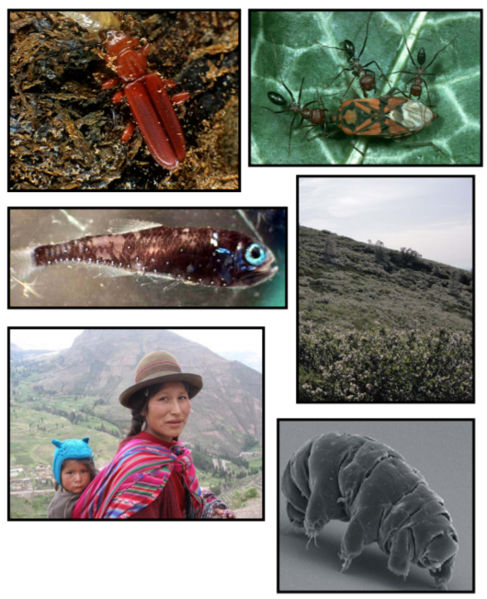
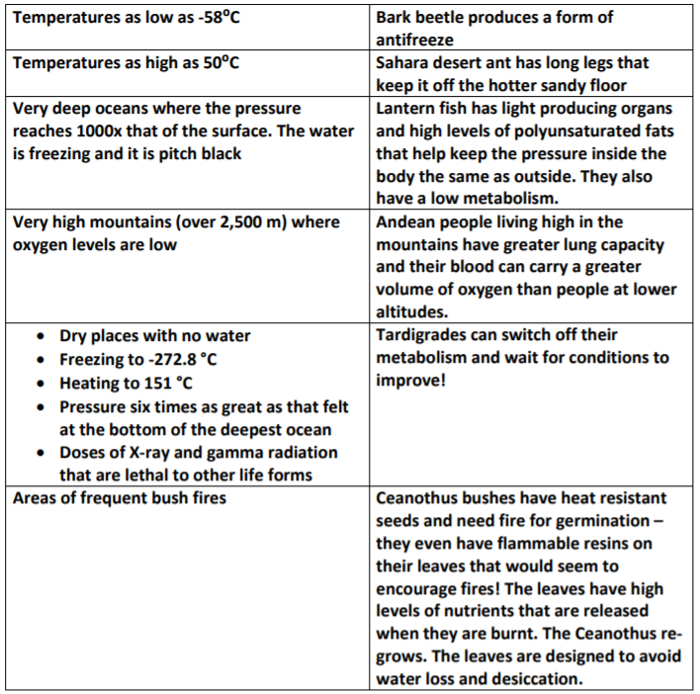
Starter
Play the Extreme Survivor game.
Match the living thing to the extreme environment.

Slide 3
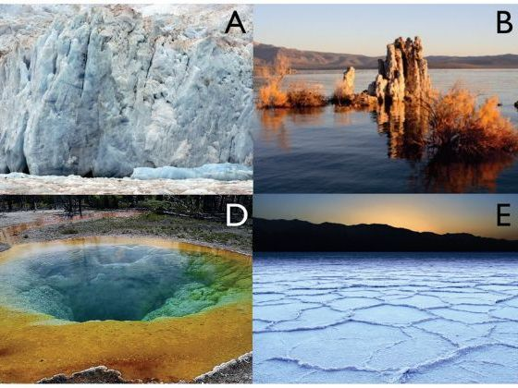
Most environments, however extreme, have some form of life in them – living things that have evolved to survive in those conditions against the odds.
We are going to explore extreme survival in our lesson today and the adaptations that enable living things to thrive in such conditions.

Slide 4
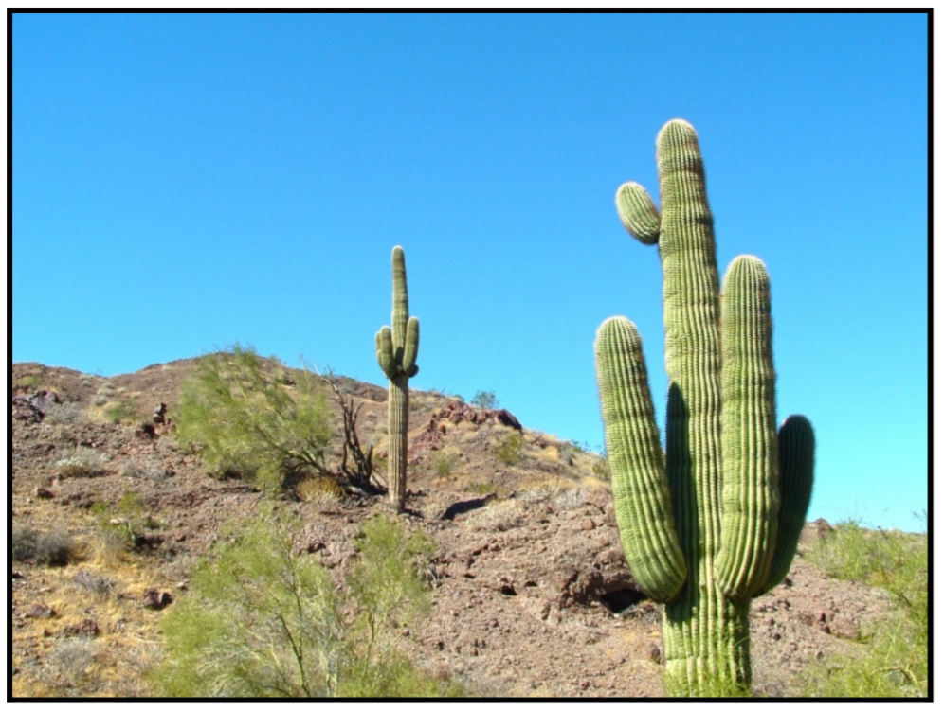
How are cacti adapted to living in desert areas?
Very dry conditions as well as extremes of temperature.

Slide 5
Cacti have:
  Stems which can store water (they swell after a rain storm and can store a supply of water for many months)
  A widespread shallow root system that can collect water from a large area (the roots are shallow so that they collect the water in the top layers of the soil as soon as it has fallen)
  Spines instead of leaves which minimises the surface area of the plant, in turn reducing water loss through transpiration (water evaporating from the leaves). The spines also protect cacti from animals that might want to eat them.

Slide 6
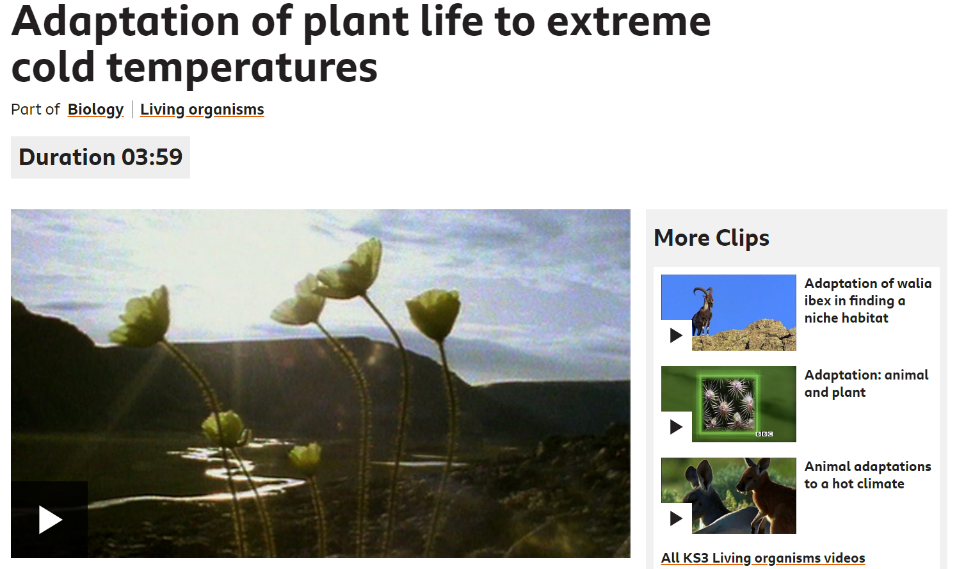
https://www.bbc.co.uk/bitesize/clips/z8sjxnb

Slide 7
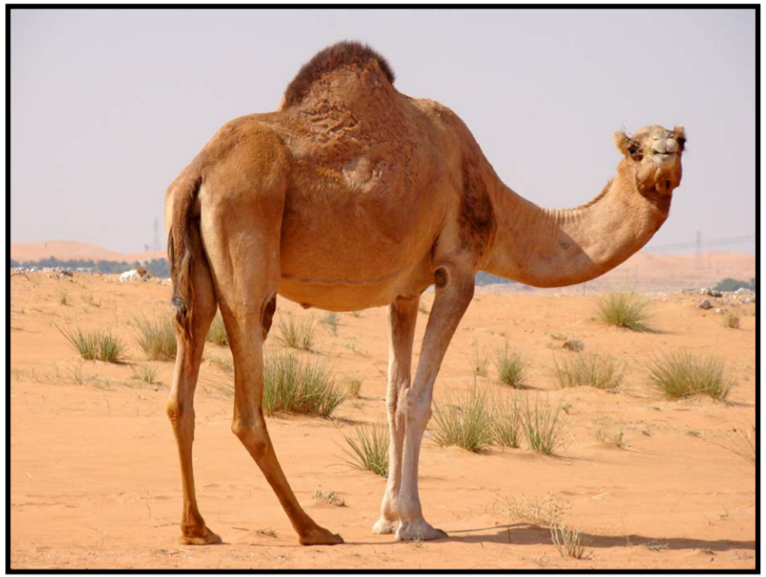
What features does a camel have to survive in sandy deserts?

Slide 8
A double row of long eyelashes
Nostrils which can close
Store of fat in their hump
,long, strong legs
Thick, leathery pads on flat, wide feet and on knees
Thick fur to keep them warm during cold, desert nights
https://www.bbc.co.uk/bitesize/clips/z8fpyrd

Slide 9
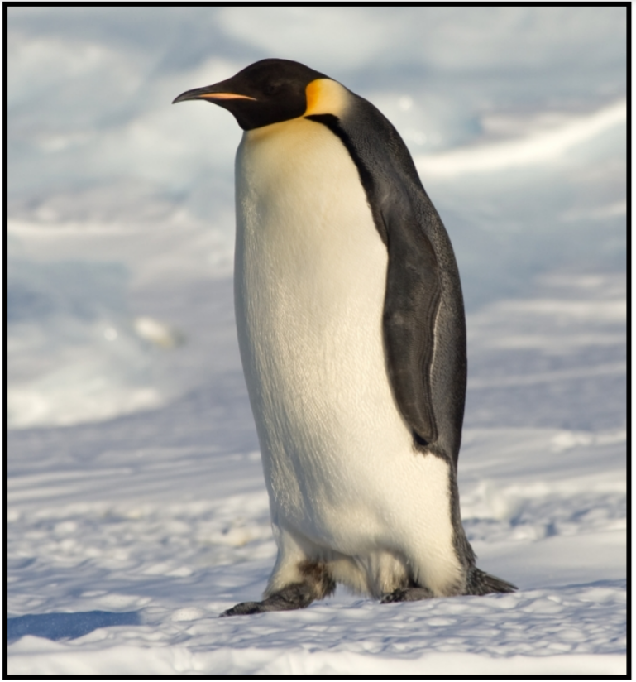
Penguins have:
  Webbed feet for powerful swimming
  Streamlined bodies to reduce drag (water resistance) in water
  Wings shaped like flippers to help them fly underwater at speeds of up to 15mph
  Tightly packed, overlapping feathers which provide waterproofing and warmth
  Thick skins with a layer of blubber (fat) underneath to keep them warm
  Black, back feathers to absorb warmth from the sun

Slide 10
While these adaptations might help, penguins can get overheated if the sun is shining, so they have also had to evolve patches which have few or no feathers, e.g. around the foot of their beak and their eyes, to allow heat to escape from their bodies.
They lift up their wings to lose heat too by increasing their surface area and allowing air to circulate under their wings where there are not many feathers.
They also pant like a dog sometimes.

Slide 11
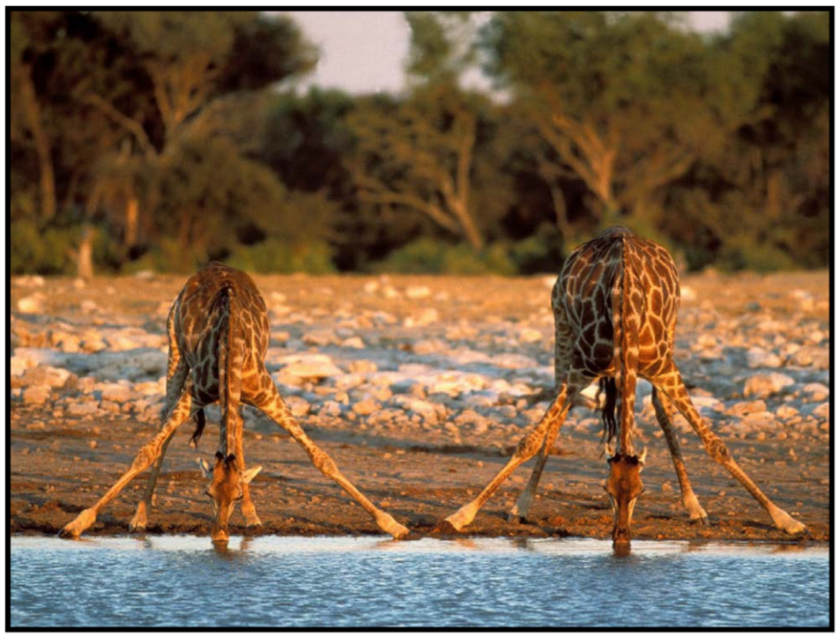
Note the position that the giraffe has to use because of its long legs!
This is dangerous, because giraffes are quite vulnerable in this position if suddenly attacked by a predator.
While height is an advantage for finding food and a good view of its surroundings, it’s a disadvantage for drinking water.

Slide 12
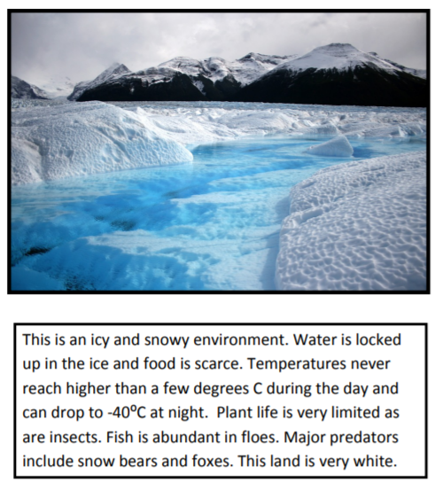
Activity
Design your own survivor.
Choose one environment from the document below.
Consider each aspect of your environment first to plan out the kind of features that will ideally allow your animal and plant to survive successfully.

Slide 13
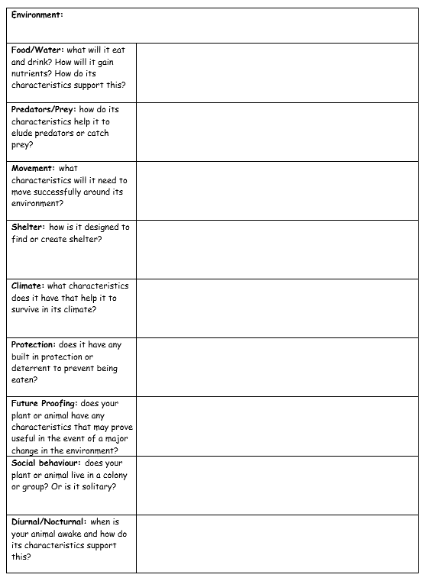
Activity
Use the design questions to plan, then draw an illustration of your animal or plant.
Paddling: design an animal OR a plant
Snorkelling: design both an animal and a plant.
Diving: design both an animal and a plant. Explain why your living thing will survive.

Slide 14
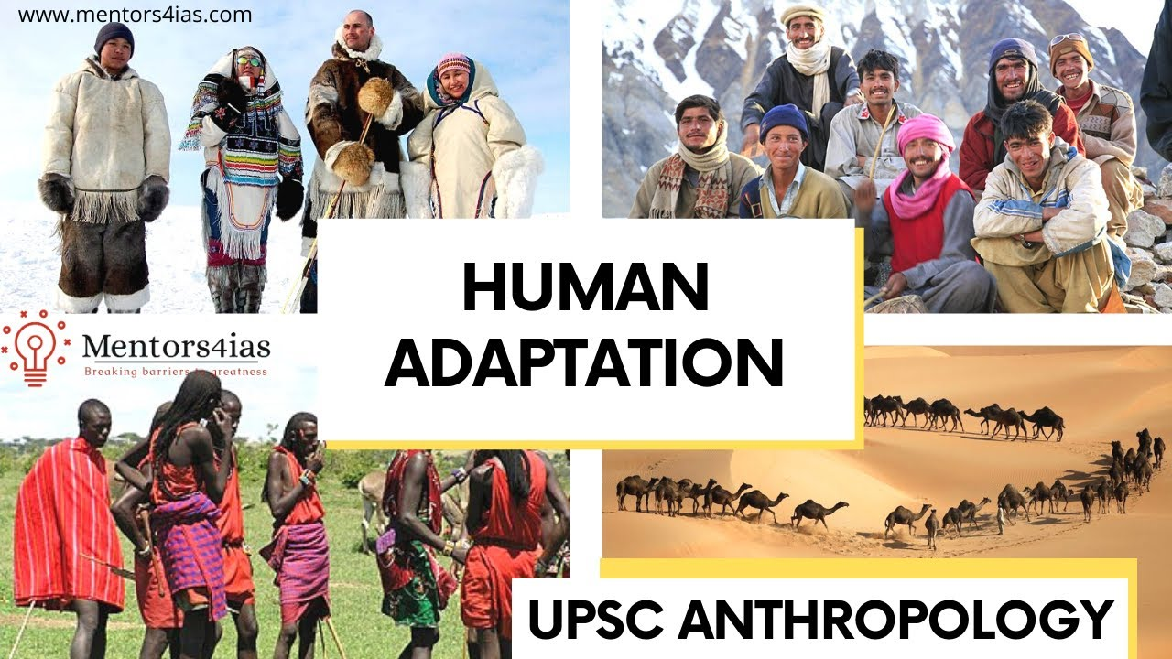
Red Pen
What habitats do humans live in?
Are there any humans they are not able to live in?
Can you identify adaptive traits that humans have which enable them to live in such a range of different habitats and environments?

Slide 15

Plenary
What might happen if a new predator or disease or a change in climate occurs?
What characteristics might some individuals select over others?
(thicker fur, larger eyes, disease resistant strains of plant etc.)
Extinction – sometimes changes or events can be too extreme for a specific species to survive and it will die out.

