Slide 1
Monday 20th September 2021
LO: to understand values
to understand beliefs and teachings
to understand practices and lifestyles
C: Islam

Slide 2

Zakah
The third pillar of Islam is Zakah – giving money to charity.
www.bbc.co.uk/education/clips/z4yjxnb
While you are watching, consider why you think Muslims are required to give to charity.
What did you learn from the video clip?

Slide 3
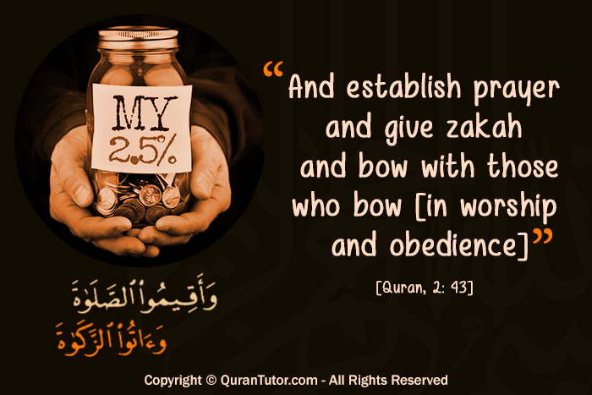
‘And establish prayer and give Zakah, and whatever good you put forward for yourselves – you will find it with Allah.’
(2:1 10, Qur’an).

Slide 4
Zakah
Zakah is the compulsory giving of a set proportion of one’s wealth to charity.
It is considered a type of worship and a spiritual duty.
Zakah does not refer to charitable gifts given out of kindness or generosity, but to the systematic giving of 2.5% of one’s wealth each year to benefit the poor.
Muslims believe that it is their duty to ensure Allah’s wealth has been distributed equally as everyone is the same – Allah created everyone equally.
Zakah refers to a Muslims giving 2.5% of their earnings to charity, after they have paid for what is necessary to support themselves and their family. This means that people who are too poor are not required to suffer hardship in order to give Zakah.
Helping one another is seen as helping Allah.

Slide 5

Who has to pay Zakah?
You have to be Muslim
You have to be above the age of puberty
You have to meet the condition of nisab – a threshold that indicates your financial eligibility to pay Zakah

Slide 6
What should Zakah be spent on?
The poor; those receiving little or no income.
The needy; someone who is struggling to meet their basic needs
Those whose hearts are to be reconciled; those who are new to Islam
Those in bondage; freeing those who are enslaved/held captive
Those in debt; as long as the debts were not incurred through acts against Islamic law
In the cause of Allah; anything promoting Islamic values such as funding educational programmes

Slide 7
The benefits of Zakah
Helping the poor
Obeying Allah
Helping a person acknowledge that everything comes from Allah on loan and that we do not really own anything ourselves and since we cannot take anything with us when we die, we need not cling to it.
Acknowledging that whether we are rich or poor is Allah’s choice, so we should help those he has chosen to make poor.
Learning self-discipline
Freeing oneself from the love of possessions and greed
Freeing oneself from the love of money
Behaving honestly.

Slide 8

Many Muslims believe it is their duty to give Zakah as everything they own belongs to God.
Muslims donate 2.5% of their earnings to charity, after they have paid for what is necessary to support themselves and their families.
This means that people who are too poor will not be required to suffer hardship to give Zakah.

Slide 9

Lots of people choose to donate money to charity on a regular basis.
Why is it a good idea to help charities?
What other ways do Muslims help people less fortunate than themselves?
Other than giving money, what other ways can we help people?

Slide 10

Would somebody still be a good Muslims if he/she did not give any money to charity?
Share your ideas with the class.

Slide 11
Activity
Answer the following question: It is not only Muslims that give money to charity, so what is unique about ‘Zakah’ for Muslims?
Paddling: list the reasons ‘Zakah’ is unique.
Snorkelling/Diving: write a written response to the question.
You may like to use the sentence starters below to help you:
Zakah is unique because…
It is not just about giving money to charity. It’s about…
Zakah is different to just giving money to charity because…
Lots of people give money to charity but Zakah is different because…

Slide 12
Red Pen
Paddling: Should Muslims have a choice about how much money to give or not give?
Snorkelling/Diving: Should Zakah be a duty or should Muslims have a choice whether or not to give their money to charity and how much? Justify your answer.

Slide 13
Plenary – Daswandh (Sikhism)
This involves Sikhs selflessly helping others by sharing their material wealth.
This could be donating one tenth of their income to charities, which is known as daswandh.
Sikhs contribute one tenth of their earnings towards the common resources of the community in the name of the Guru.
It is a Sikh’s religious obligation – a religious requirement or duty.
‘O Nanak, knoweth the way who eats out of what he earneth by his honest labour and yet shareth part of it with others.’ – Guru Nanak.
Dasvandh should be distinguished from charity – it essentially attends to the needs of the community and contributions are made specifically for the maintenance of its religious institutions such as gurdwaras and langars and projects of social welfare and uplift.
What are the similarities/differences between these acts of giving to charity?

