Slide 1
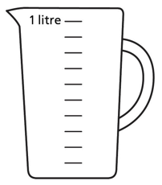

Year 6 | Week 3 | Day 1

Slide 2
Year 6 | Week 3 | Day 1

Slide 3


Arithmetic Starter

Slide 4
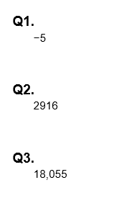
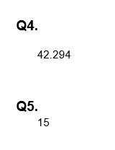
Arithmetic Starter - Answers

Slide 5


Slide 6
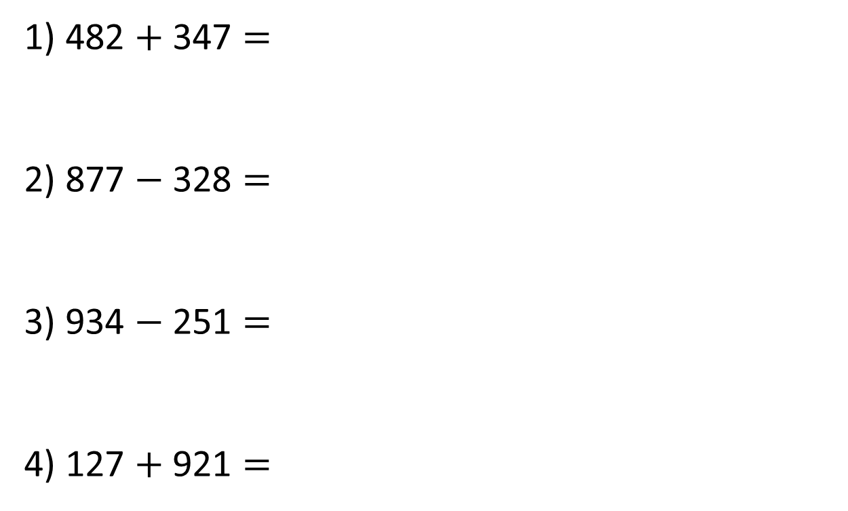
1) 482 $+$ 347 $=$
2) 877 $−$ 328 $=$
3) 934 $−$ 251 $=$
4) 127 $+$ 921 $=$

Slide 7
1) 482 $+$ 347 $=$
2) 877 $−$ 328 $=$
3) 934 $−$ 251 $=$
4) 127 $+$ 921 $=$
829
549
683
1,048

Slide 8
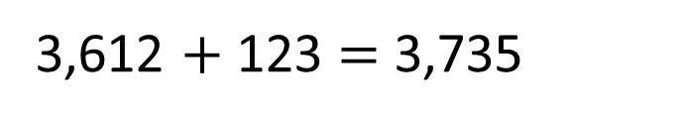
3,612 $+$ 123 $=$ 3,735
3,735
Whole or total
3,612
123
Part
Part

Slide 9
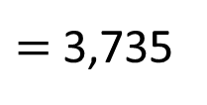

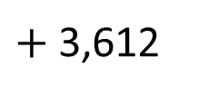
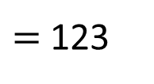
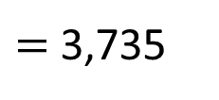
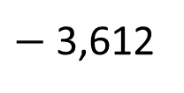
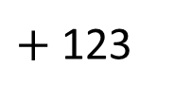
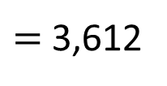
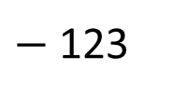

3,735
3,612
123
3,612
$+$ 123
$=$ 3,735
Part $+$ part $=$ whole
123
$+$ 3,612
$=$ 3,735
3,735
$−$ 123
$=$ 3,612
Whole $−$ part $=$ part
3,735
$−$ 3,612
$=$ 123

Slide 10



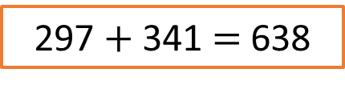



Alex wants to check this addition calculation:
297 $+$ 341 $=$ 638
Which subtraction calculations can be used to check Alex’s addition calculation?
638 $−$ 341
297 $−$ 341
341 $−$ 638
638 $−$ 297
Have a think

Slide 11






Alex wants to check this addition calculation:
297 $+$ 341 $=$ 638
Part $+$ part $=$ whole
Part
Part
Whole
Whole $−$ part $=$ part
638
297
341
638 $−$ 341
297 $−$ 341
341 $−$ 638
638 $−$ 297

Slide 12

Have a think
I’m thinking of a number.
When I add 920 to it, I get 3,921
What is my number?

Slide 13
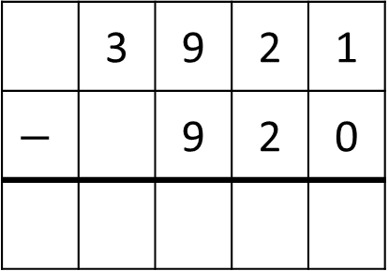
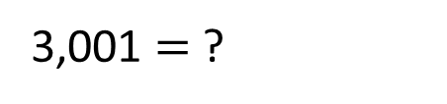
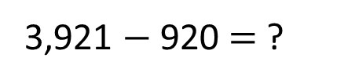
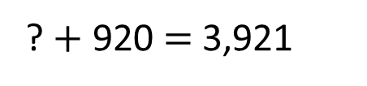
?
I’m thinking of a number.
When I add 920 to it, I get 3,921
What is my number?
Whole
3,921
?
920
 | 3 | 9 | 2 | 1
$$−$$ |  | 9 | 2 | 0
 |  |  |  | 1
 |  |  | 0
 |  | 0
 | 3
? $+$ 920 $=$ 3,921
Inverse
3,921 $−$ 920 $=$ ?
3,001 $=$ ?

Slide 14

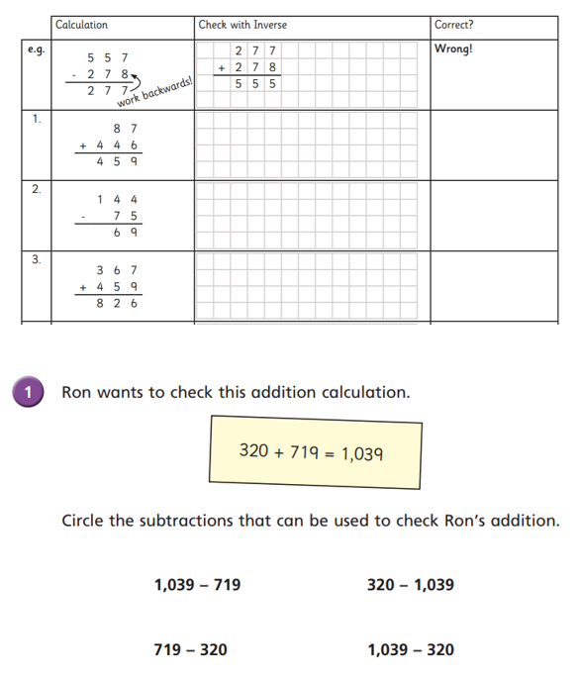
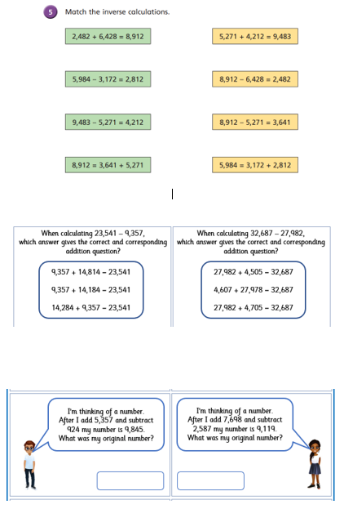
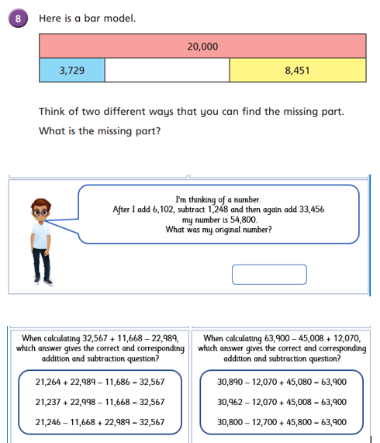
Independent Activity
Paddling Snorkelling Diving

Slide 15
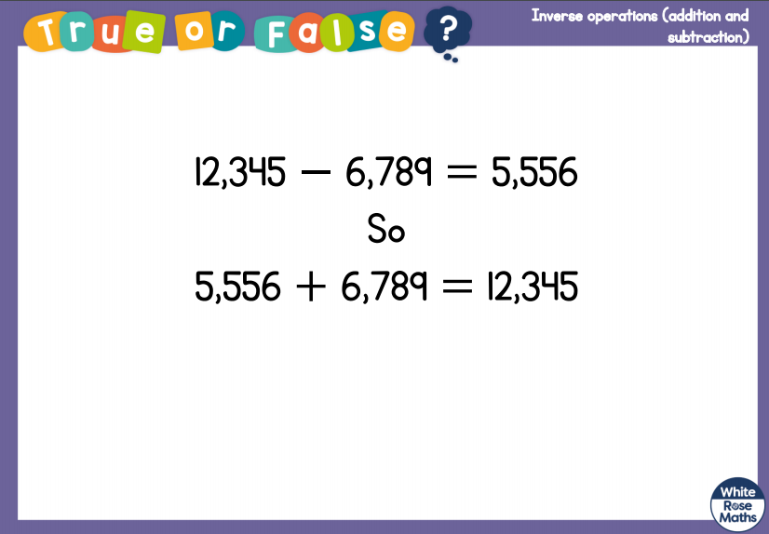
Plenary

Slide 16


