Slide 1
Year 6 | Week 1 | Day 2

Slide 2
Year 6 | Week 1 | Day 2

Slide 3


Arithmetic Starter

Slide 4
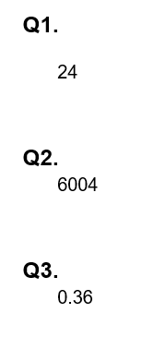
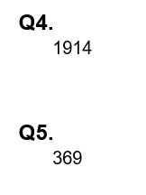
Arithmetic Starter - Answers

Slide 5


Slide 6
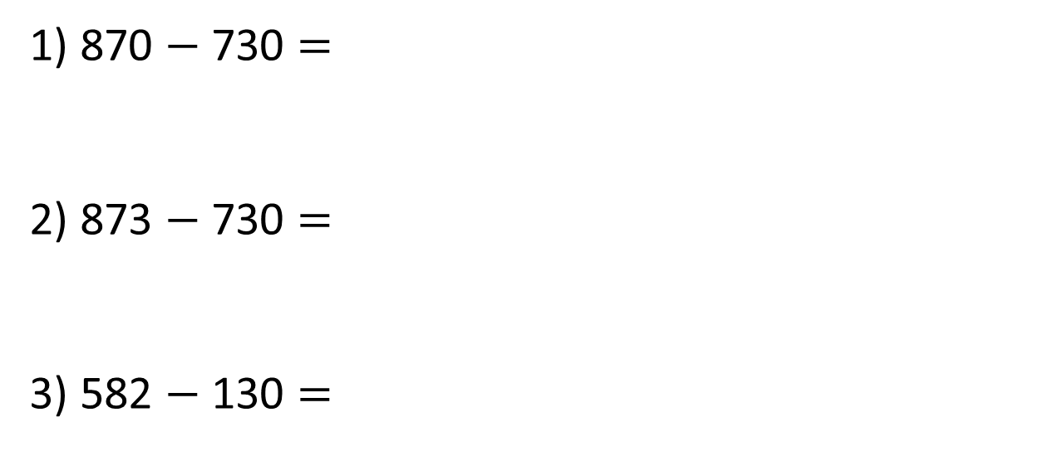
1) 870 $−$ 730 $=$
2) 873 $−$ 730 $=$
3) 582 $−$ 130 $=$

Slide 7
1) 870 $−$ 730 $=$
2) 873 $−$ 730 $=$
3) 582 $−$ 130 $=$
140
143
452

Slide 8
There are 14,364 people at a football match.
3,301 of the crowd are children.
How many adults are there?
14,364
3,301
14,364
?
3,301
?

Slide 9





There are 14,364 people at a football match.
3,301 of the crowd are children.
How many adults are there?
11,063 adults
TTh | Th | H | T | O
TTh | Th | H | T | O
1 | 4 | 3 | 6 | 4
 | 3 | 3 | 0 | 1
1
1
0
6
3

Slide 10
There are 14,364 people at a football match.
of the crowd are children.
How many adults are there?
3,306
3,301
11,058 adults
TTh | Th | H | T | O
TTh | Th | H | T | O
1 | 4 | 3 | 6 | 4
 | 3 | 3 | 0 | 1
TTh | Th | H | T | O
1 | 4 | 3 | 6 | 4
 | 3 | 3 | 0 | 6
5
1
1
1
0
5
8
64
60
50
14
4

Slide 11




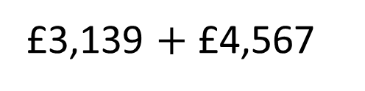
Dexter has £3,139
Rosie has £4,567
How much more money does Rosie have than Dexter?
Have a think
£3,139 $+$ £4,567

Slide 12
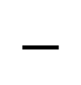
Dexter has £3,139
Rosie has £4,567
How much more money does Rosie have than Dexter?
Have a think
?
Dexter
3,139
Rosie
4,567
Th | H | T | O
4 | 5 | 6 | 7
3 | 1 | 3 | 9
5
1
$$−$$
1
4
2
8

Slide 13


H | T | O
4 |  | 7
 | 3 | 4
2 | 9
? $−$ 3 tens = 9 tens
?
3
12 tens
1
2
$$−$$
1
9 tens
3 tens
3
Hundreds | Tens | Ones

Slide 14

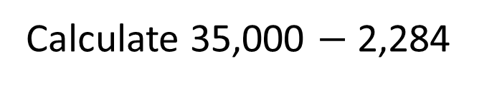
Calculate 35,000 $−$ 2,284
Have a think
TTh | Th | H | T | O
3 | 5 | 0 | 0 | 0
 | 2 | 2 | 8 | 4
4
9
9
1
1
1
$$−$$
3
2
7
1
6

Slide 15
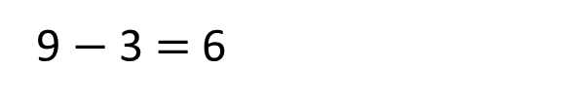

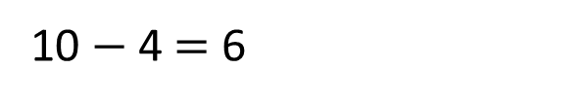
Calculate 35,000 $−$ 2,284
What is the difference between the two numbers?
6
4
10
$−$ 1
6
$−$ 1
3
9
10 $−$ 4 $=$ 6
9 $−$ 3 $=$ 6

Slide 16


Calculate 35,000 $−$ 2,284
?
2,284
35,000
$−$ 1
?
$−$ 1
2,283
34,999

Slide 17
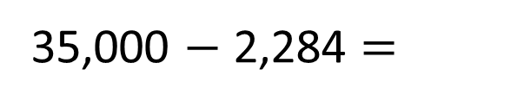


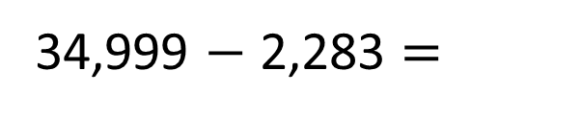
Calculate 35,000 $−$ 2,284
TTh | Th | H | T | O
3 | 5 | 0 | 0 | 0
 | 2 | 2 | 8 | 4
TTh | Th | H | T | O
3 | 4 | 9 | 9 | 9
 | 2 | 2 | 8 | 3
4
9
9
1
1
1
$$−$$
$$−$$
3
2
7
1
6
3
2
7
1
6
32,716
35,000 $−$ 2,284 $=$
34,999 $−$ 2,283 $=$

Slide 18
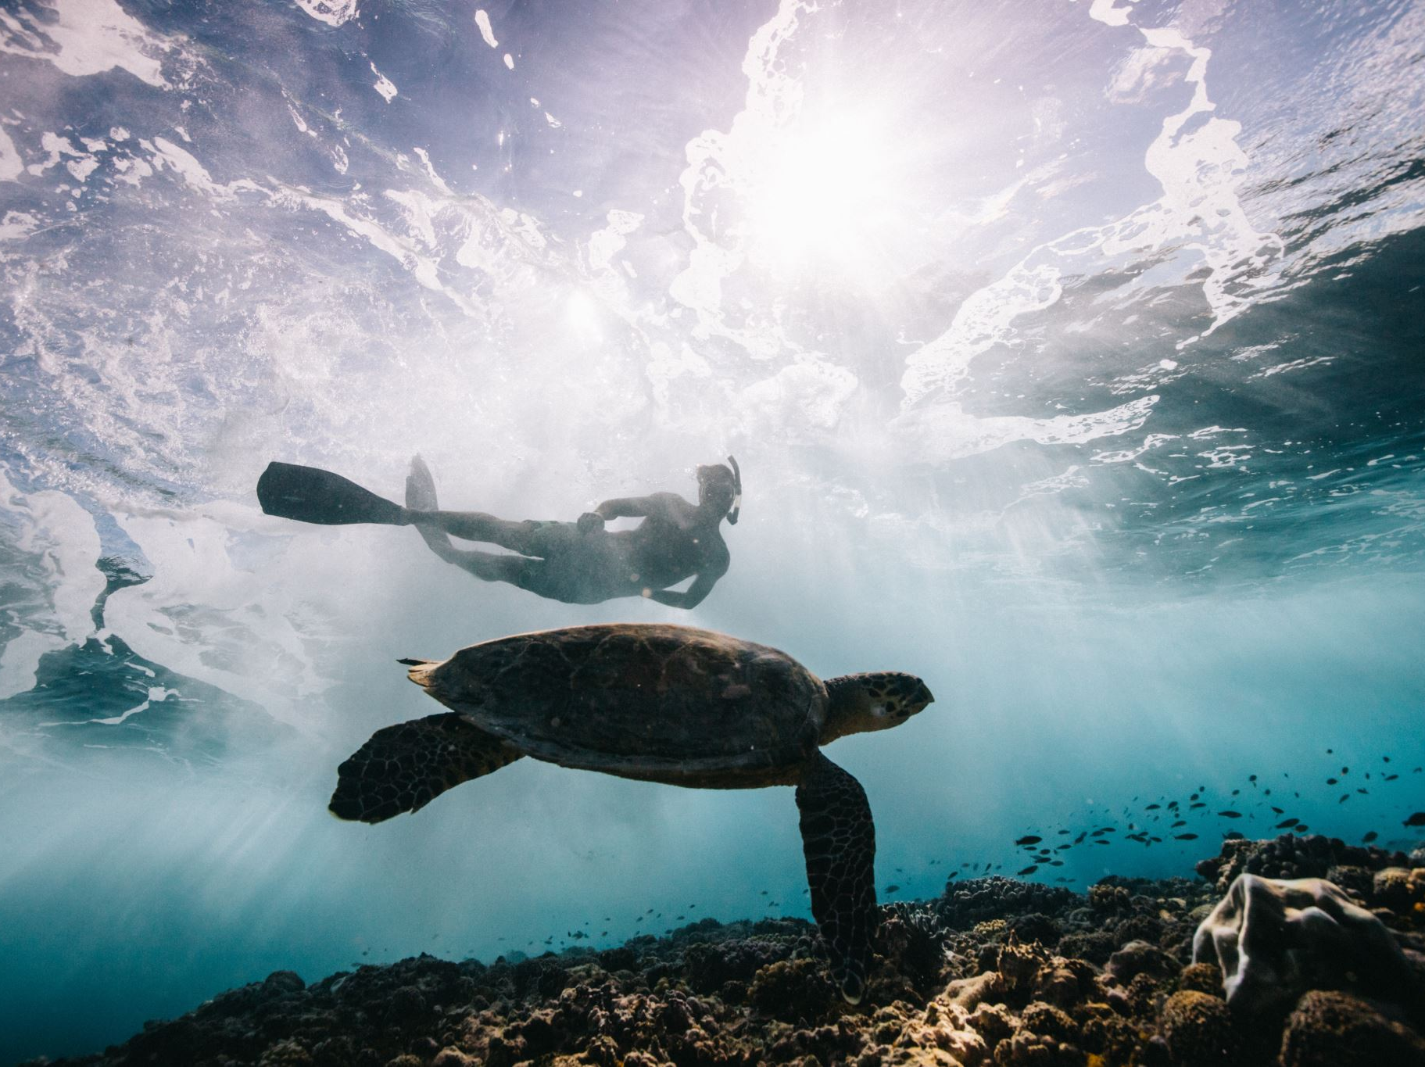
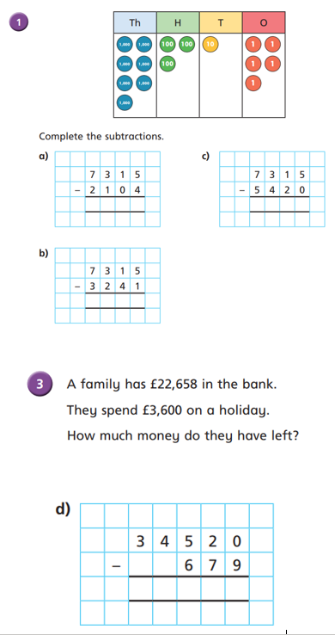
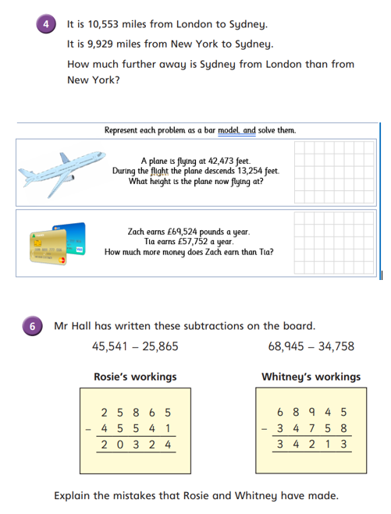
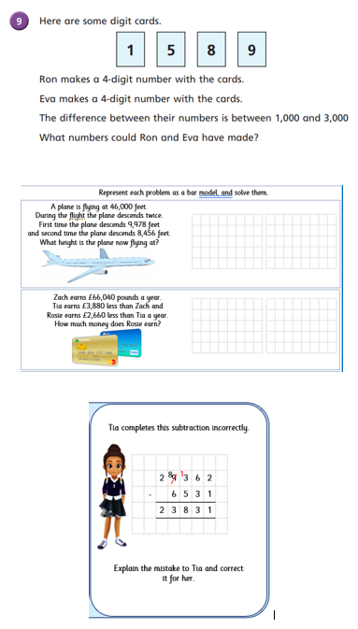
Independent Activity
Paddling Snorkelling Diving

Slide 19
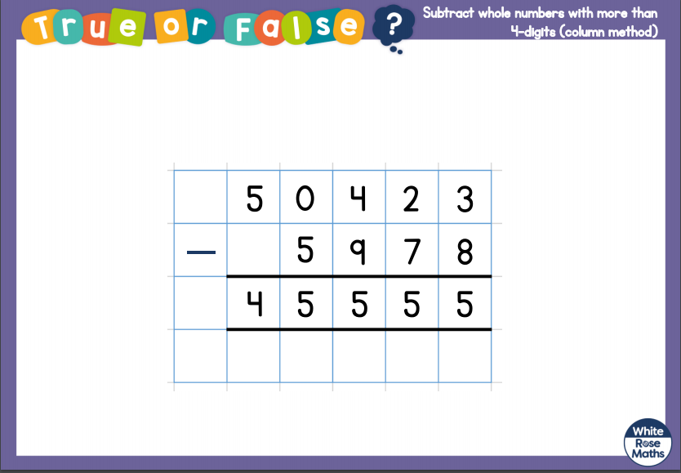
Plenary

Slide 20


