Slide 1
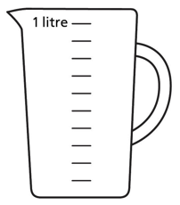

Year 6 | Week 3 | Day 1

Slide 2
Year 6 | Week 3 | Day 1

Slide 3


Arithmetic Starter

Slide 4
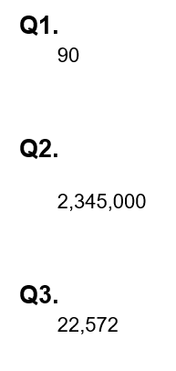
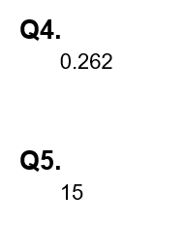
Arithmetic Starter - Answers

Slide 5


Slide 6
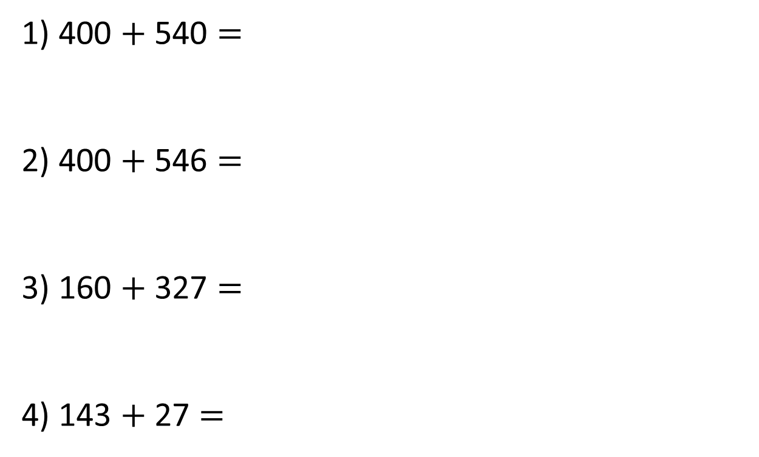
1) 400 $+$ 540 $=$
2) 400 $+$ 546 $=$
3) 160 $+$ 327 $=$
4) 143 $+$ 27 $=$

Slide 7
1) 400 $+$ 540 $=$
2) 400 $+$ 546 $=$
3) 160 $+$ 327 $=$
4) 143 $+$ 27 $=$
940
946
487
170

Slide 8


Dexter scores 12,304 points in a game.
Rosie scores 1,263 points.
How much do they score altogether?

Slide 9





Dexter scores 12,304 Rosie scores 1,263
TTh | Th | H | T | O
TTh | Th | H | T | O
1 | 2 | 3 | 0 | 4
 | 1 | 2 | 6 | 3
1
3
5
6
7
1
3
5
6
7

Slide 10



Dexter scores 12,304 points in a game.
Rosie scores 1,263 points.
How much do they score altogether?
Have a think
13,567
Mo scores 12,304 points in a game.
Eva scores 1,268 points.
How much do they score altogether?

Slide 11

Mo scores 12,304 Eva scores 1,268
TTh | Th | H | T | O
TTh | Th | H | T | O
1 | 2 | 3 | 0 | 4
 | 1 | 2 | 6 | 8
1
3
5
7
12
2
1
1
3
5
7
12
2

Slide 12
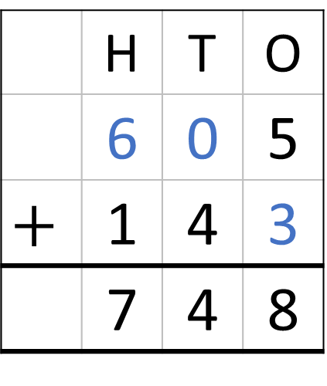
 | Hundreds | Tens | Ones
 | H | T | O
 | 6 | 0 | 5
$$+$$ | 1 | 4 | 3
 | 7 | 4 | 8
7
4
8

Slide 13
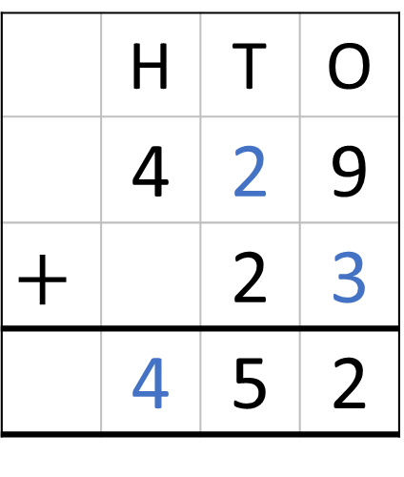
 | Hundreds | Tens | Ones
 | H | T | O
 | 4 | 2 | 9
$$+$$ |  | 2 | 3
 | 4 | 5 | 2
1
5
2

Slide 14

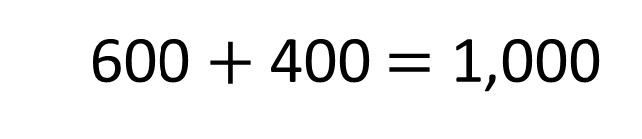

Have a think
6
4
7
$+$ 463 $=$ 1,000
The missing number is 647
600 $+$ 400 $=$ 1,000

Slide 15
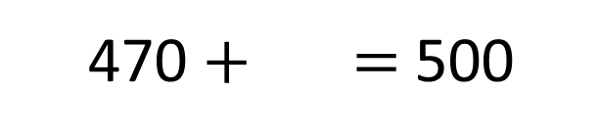
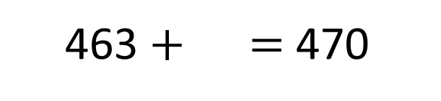
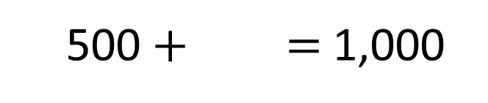
537
$+$ 463 $=$ 1,000
7
463 $+$ $=$ 470
30
470 $+$ $=$ 500
500
500 $+$ $=$ 1,000

Slide 16
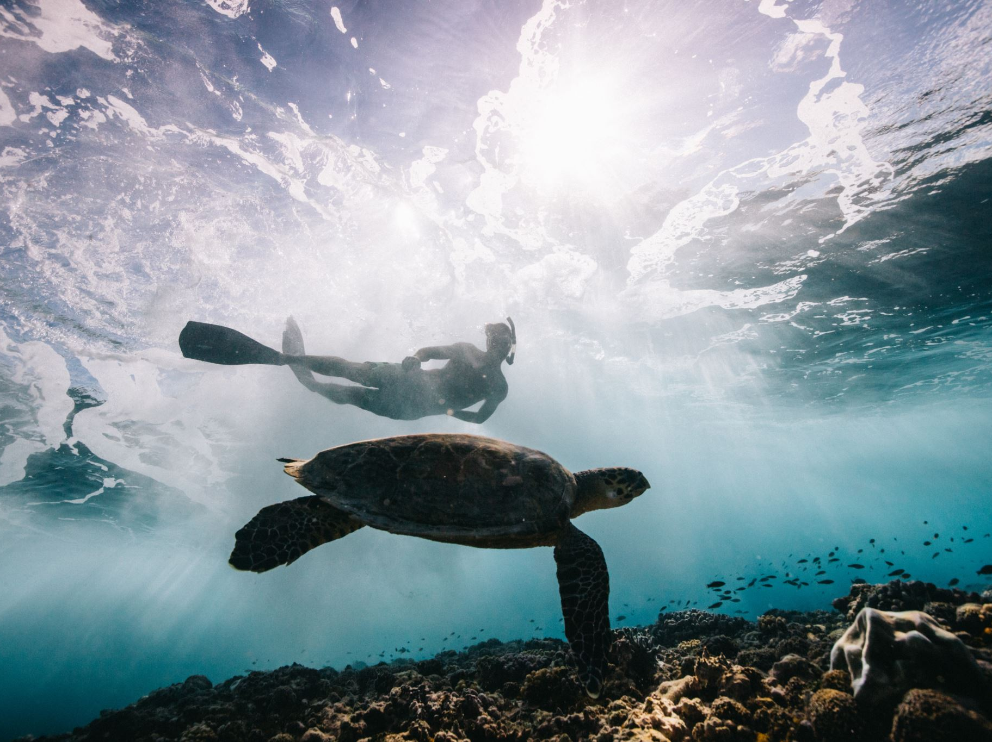
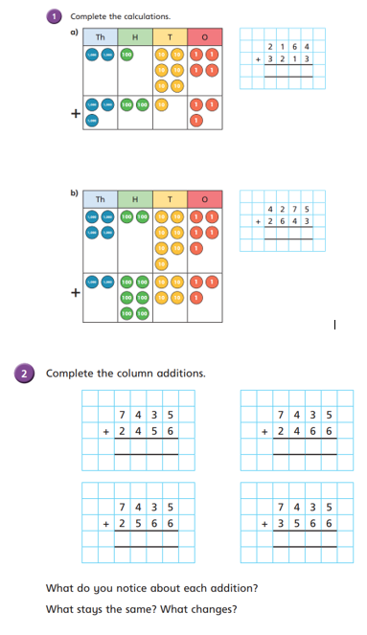
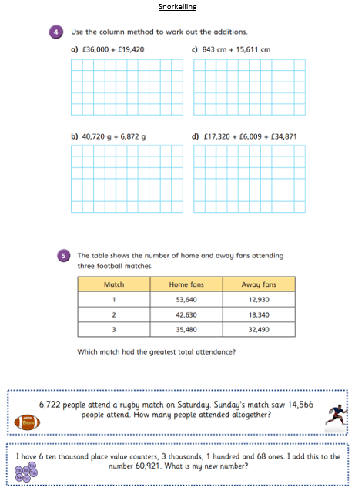
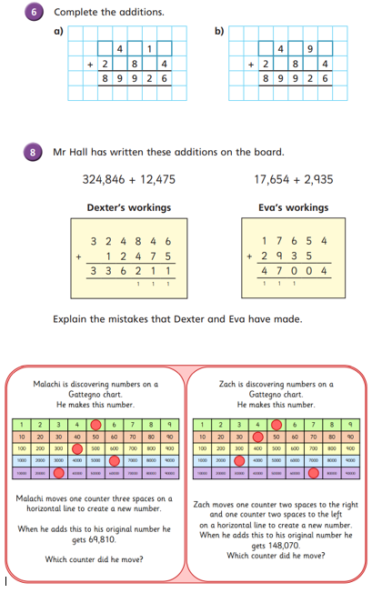
Independent Activity
Paddling Snorkelling Diving

Slide 17
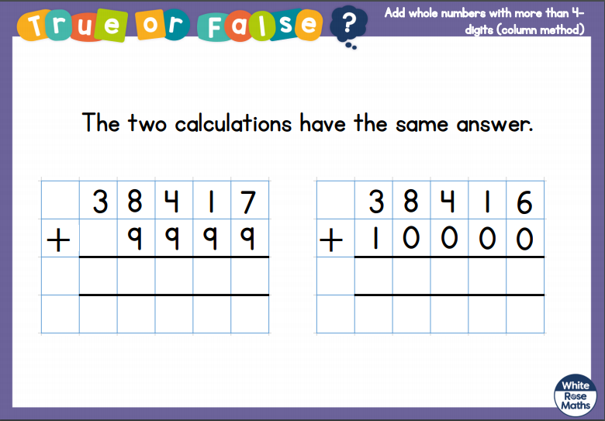
Plenary

Slide 18


