Slide 1
Hook lesson – Four Operations

Slide 2
Key vocabulary
Sum
Altogether
Difference
Column Method
Inverse Operation
Estimate
Number Facts
Division
Exchange
Order of Operations

Slide 3
During the next few weeks we will be learning about the four operations
What are the four operations?
When will we use these operations in everyday life?
What rules, strategies or methods do you know to help you when using the four operations?
What resources can we use to help us?

Slide 4
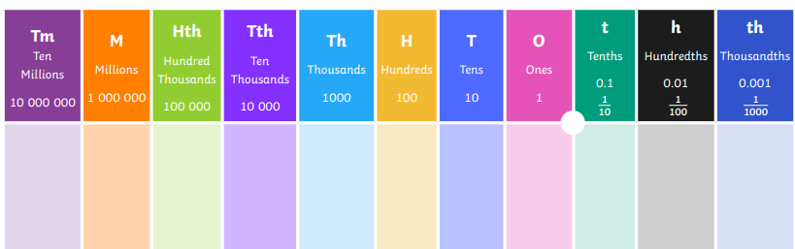
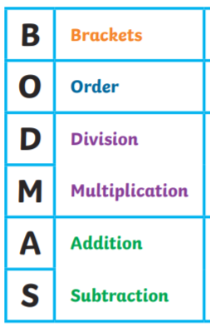
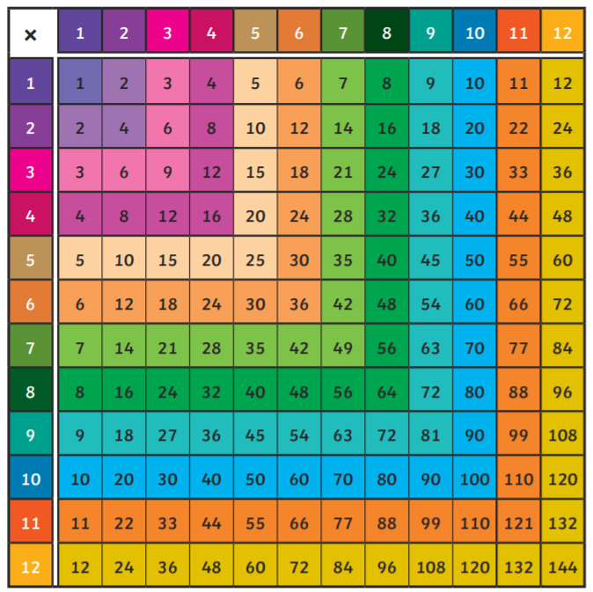

We could use some of these resources to help us.

Slide 5
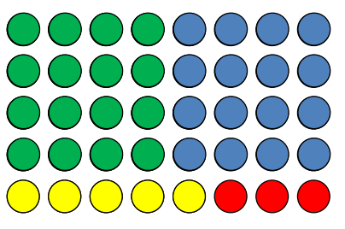
What calculations relating to the four operations can you see here?

Slide 6
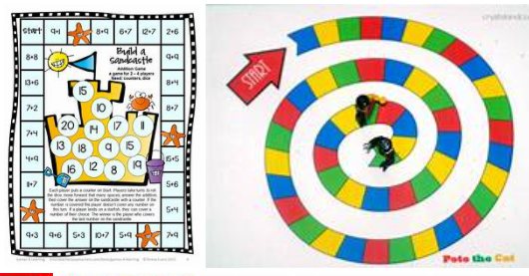
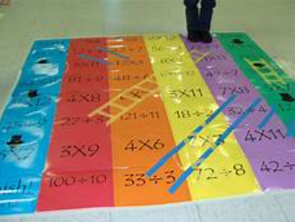
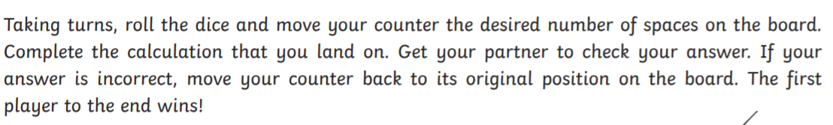
Your activity
Your teacher will put you into groups – your task is to create a board game. This must involve creating rules and answering questions based on the four operations.

Slide 7
Plenary
Write down some facts that you have learnt about the four operations.
Tell your partner something you need to remember from today’s lesson. Ask your partner what they need to remember.

