Slide 1
Tuesday 4th May 2021
LO: To give a broad overview of life in Britain.
C: Early People

Slide 2
Let’s remind ourselves of our inquiry question…
Would you rather live in the Stone Age or the Iron Age?

Slide 3
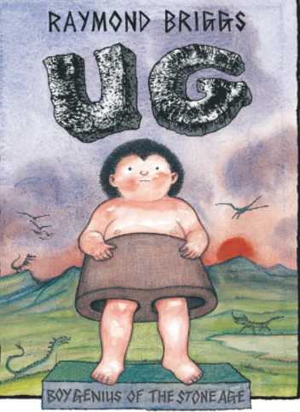
Today we are going to investigate….
Where they lived!
Let’s begin by reading about Ug!

Slide 4
Some thinking questions….
How do the homes of Early People compare to our homes today?
Let’s find out a bit more about how they were built….

Slide 5
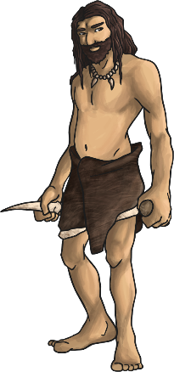
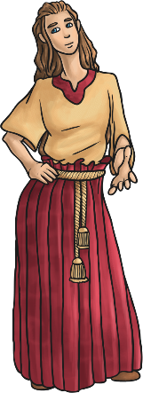
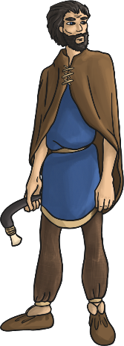
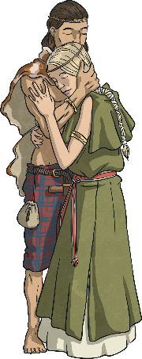

Prehistoric Times
There is a large period of time for which we have no written records – we call this ‘prehistory’. Starting from evidence of the first early humans, it is split into three sections:
The Stone Age
800 000BC
The Bronze Age
2100BC
The Iron Age
750BC
There is no recorded history of this time that we can read, just clues left behind, which archaeologists have to try to and interpret.

Slide 6
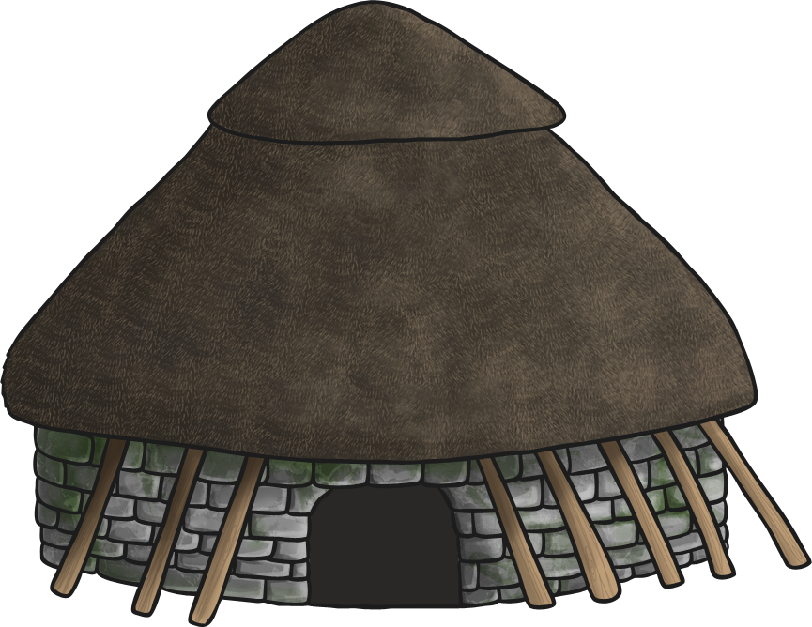
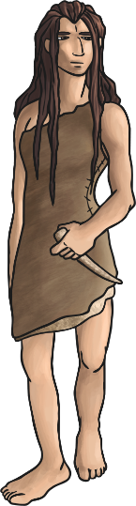

Stone Age Houses
Discuss
What shelter might early humans have found or made in Britain?
What materials would they have had available?

Slide 7
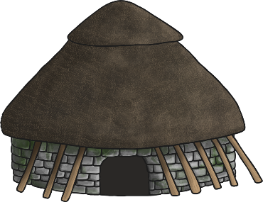
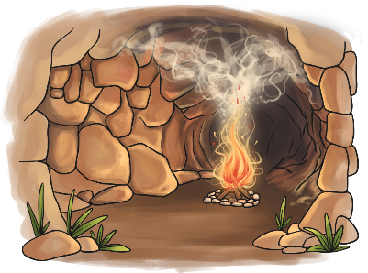
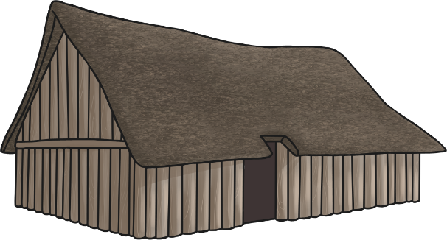
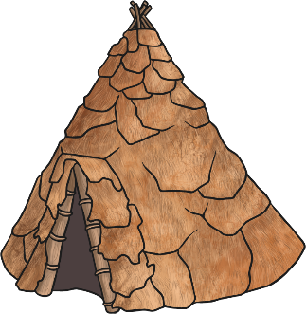
Stone Age Houses
In Britain, archaeologists have found evidence of four different types of Stone Age dwelling across the country.
What materials have been used to make each of these houses?

Slide 8
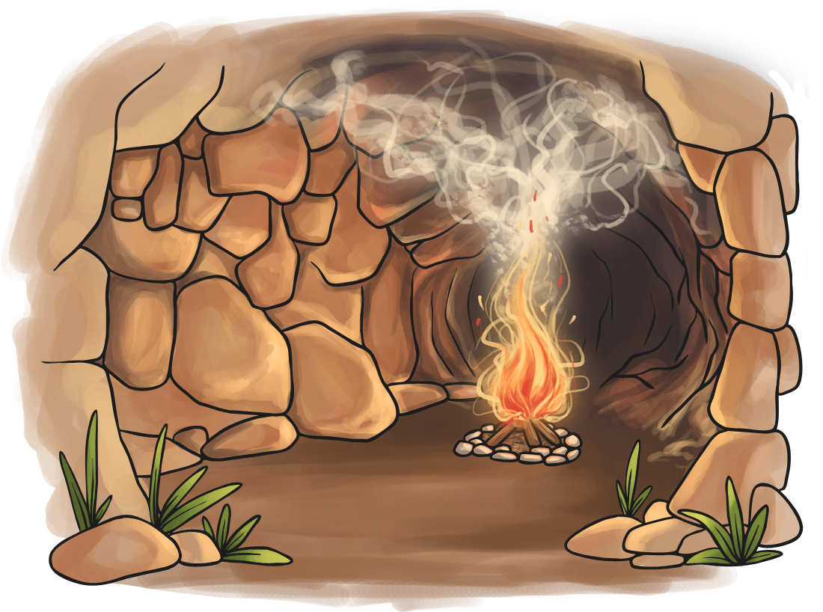
Stone Age Houses
During the Palaeolithic period (around 800 000BC – 10 000BC), humans in Britain sheltered from ice and cold inside caves.
These were ready-made houses for them to take shelter in quickly.

Slide 9
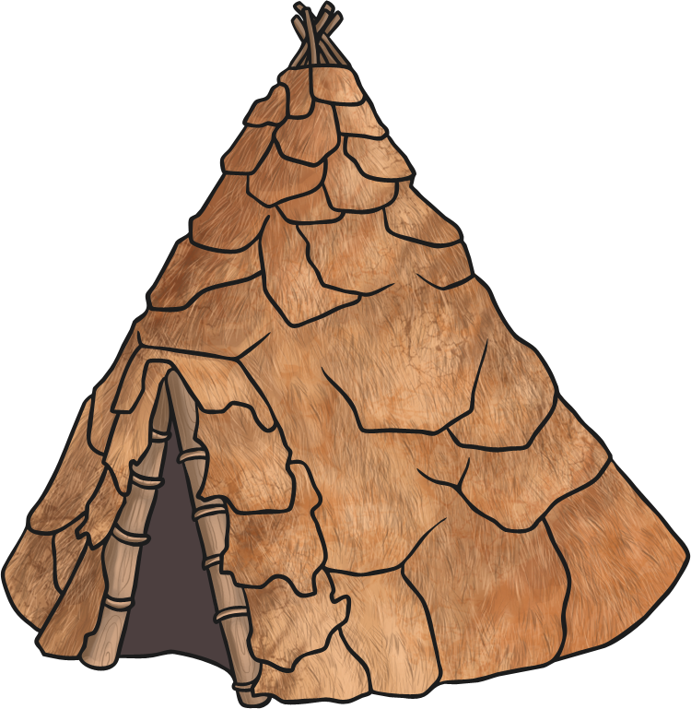
Stone Age Houses
Evidence found from Mesolithic times (around 15 000BC) indicates a circular structure made from wooden posts.
There are no houses remaining, but archaeologists have found marks in the ground that they believe were made from timber poles.
The frame may have been round or conical, like a tepee.
They may have used animal skin, thatch or turf to cover the frame.
There was evidence to suggest that the floor was covered with a layer of moss, reeds and other soft plant materials.

Slide 10
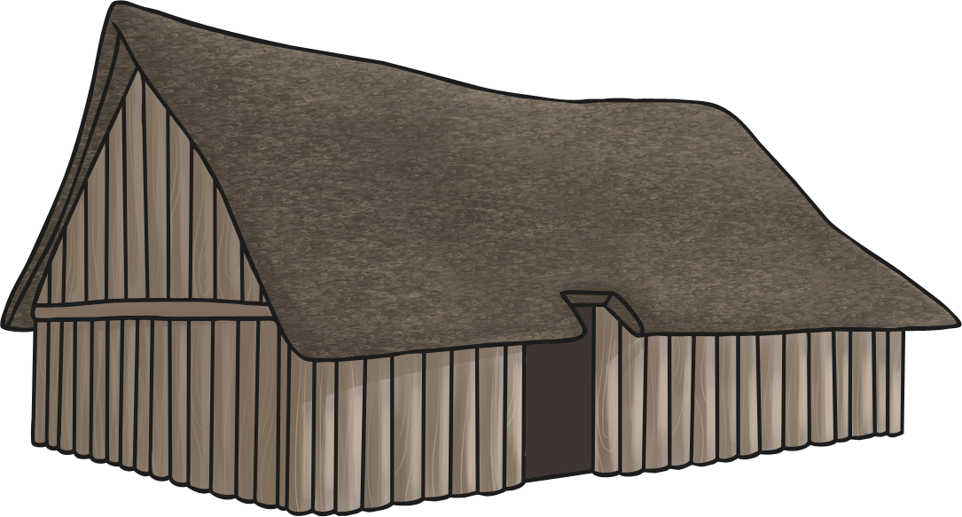
Stone Age Houses
During the Neolithic period (4000BC and 2500BC), Stone Age houses were rectangular and constructed from timber.
None of these houses remain but we can see the foundations. Some houses used wattle (woven wood) and daub (mud and straw) for the walls and had thatched roofs.

Slide 11
Stone Age Houses
Other houses from the Neolithic period, like the ones uncovered at Skara Brae, were built from stone.
They were built into mounds of rubbish known as midden. Midden could include small stones, shells, mud and animal bones.
It provided some stability as well as insulation.
These houses were usually round.
They had beds, storage shelves and a hearth in the middle.
Roofs were made from materials such as straw, animal skins or turf laid over driftwood.

Slide 12
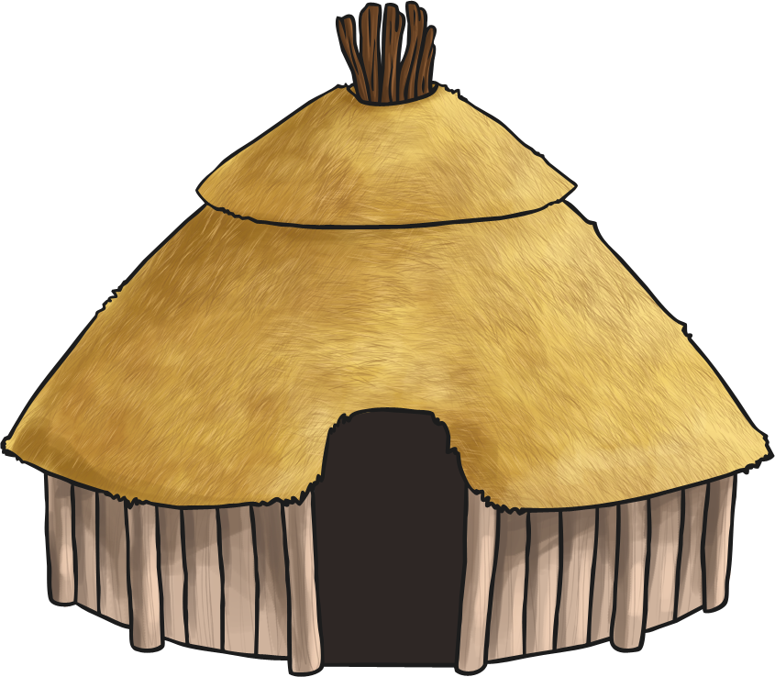
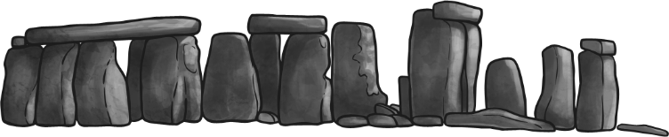
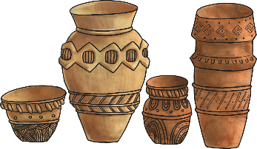
Bronze Age Houses
The weather in Britain had become warmer and drier at the end of the Stone Age.
The Bronze Age (from 2100BC) saw another change in climate. The wetter weather forced people to move from the hills, which were easier to defend, in to the valleys, where it was easier to grow food and find shelter.
The spread of farming meant the end of large burial sites, as the fields were needed for animals to graze. Large areas of woodland started to be cut down to make more land available for farming.

Slide 13
Bronze Age Houses
Bronze Age roundhouses were circular structures with a wattle (woven wood) and daub (mud and straw) wall or a dry stone wall.
Some houses had to be built on stilts as they were constructed on wetlands.
Roundhouses usually had thatched roofs or were covered with turf that lay over a wooden cone of beams.
They would have a fireplace in the centre of the house that would always be kept burning. The fire was important for cooking and keeping warm.

Slide 14
Bronze Age Houses
In the Bronze Age, people no longer used one dwelling for everything.
A farming household might have consisted of two houses.
A main house would be used to live in and an outhouse used for cooking and textile production.
Do you think using more than one dwelling was a good change? Why?

Slide 15
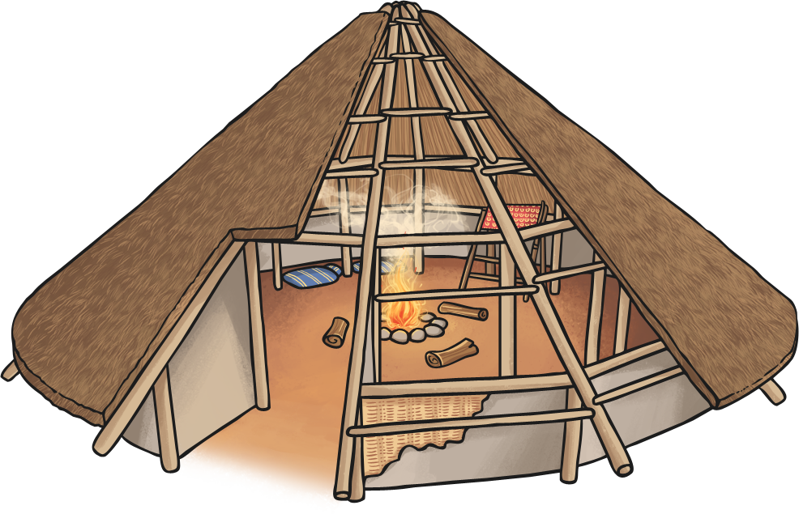
Iron Age Houses
Archaeologists have discovered that typical Iron Age roundhouses were similar to Bronze Age houses. Some were very large and housed many people.
In the centre of the house, there would have been a fire used for cooking and as a source of heat and light. Some roundhouses may have contained ovens for baking bread.
Roundhouses didn’t have chimneys, as the smoke dispersed through the thatched roof.
The frame was constructed out of large timbers and the walls were made from wattle and daub.

Slide 16
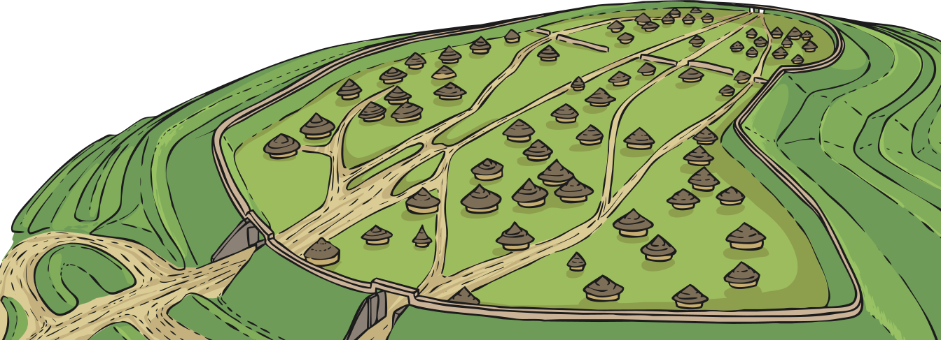
Iron Age Houses
A big change in the Iron Age era was the development of hill forts. These were large settlements built on land higher than the surrounding area. They often had a ditch around the outside, for defence.
A hill fort would be densely populated with a large number of roundhouses and roads.
The first hillforts were constructed from around 800BC. One of the biggest hillforts in Europe was discovered in Maiden Castle, Dorset.

Slide 17
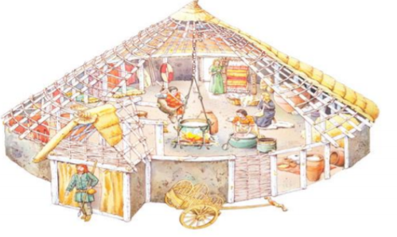
Our task!
Let’s label an Iron Age house together!
Then you can label a Stone Age house on your own.

Slide 18
Our task!
Let’s label an Iron Age house together!
Then you can label a Stone Age house on your own.

Slide 19
Our next task!
Can you write a paragraph explaining what Early People did when it rained or snowed?
RP: Did Ug really have to live in a stone be? Use what you know from history to answer the question.

Slide 20
Our next task!
The Early People kept warm in the cold weather by …
The Early People kept dry in the wet weather by...
We read "Ug" as a class. I think he would/would not have had a stone bed because...

