Slide 1
Monday 20th September 2021
LO: To write with purpose
C: Newspaper Reports

Slide 2
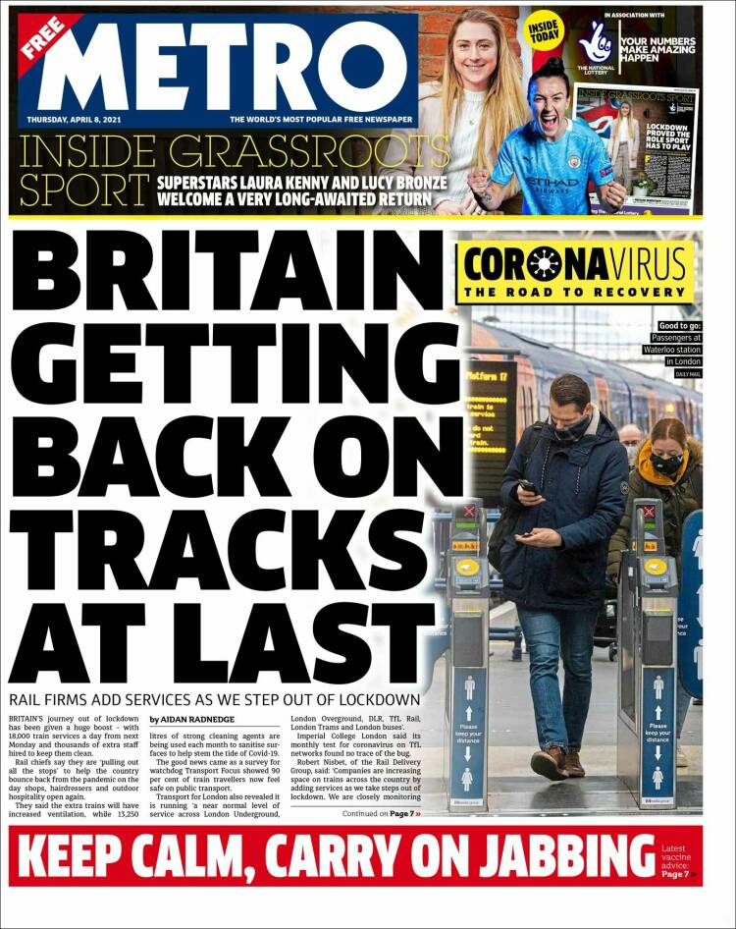
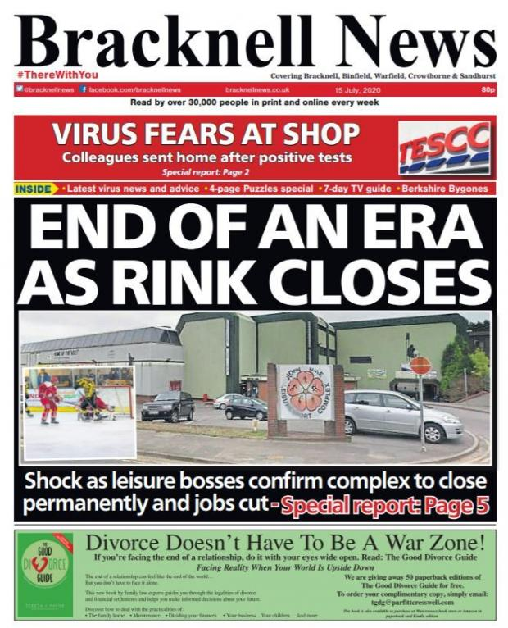
What type of information could I read about in a newspaper?
What language would I expect to read in this type of text?

Slide 3
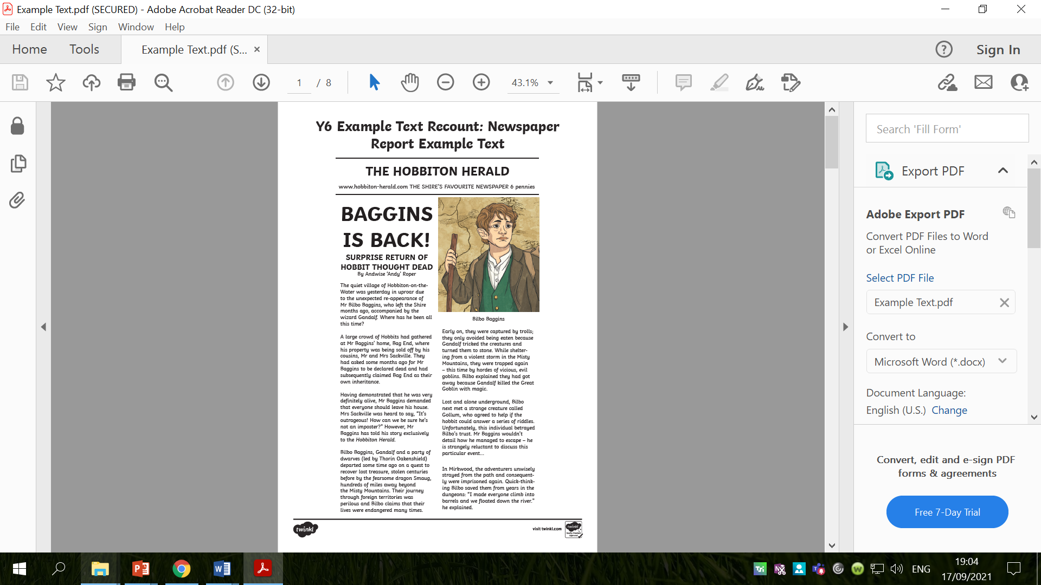
Read the article and think about what you have read.

Slide 4
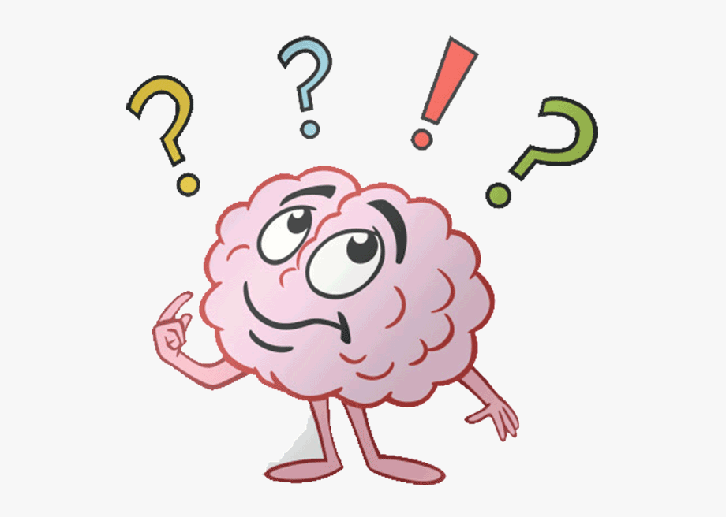
What is the purpose of newspapers?
What are the features of newspapers?
Create a bubble map of your ideas!

Slide 5
How is a newspaper report different to other types of writing?

Slide 6
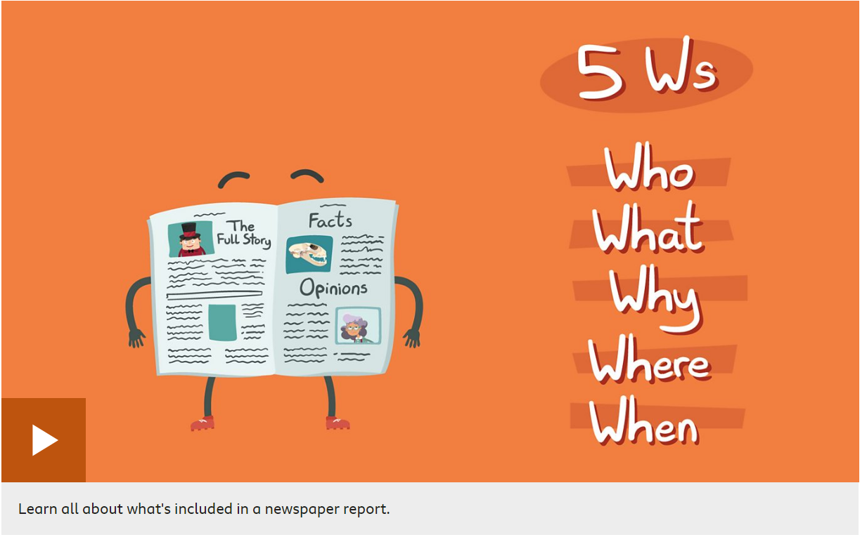
https://www.bbc.co.uk/bitesize/topics/z2yycdm/articles/z2gk9qt

Slide 7
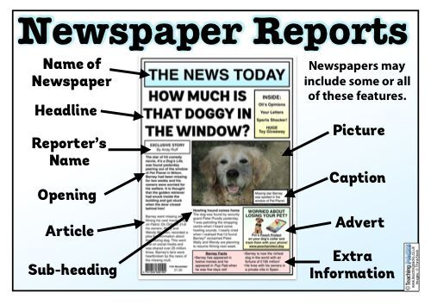
The key features of a newspaper report
Newspaper name: the name of the newspaper is always at the top of the page.
Headline: a headline is an eye-catching title for your story, which summarises the information in just a few words.
Short subtitle: the subtitle is a short title that gives more information about the report.
Pictures: pictures usually have captions beneath them to explain what is being shown.
Conclusion paragraph: the conclusion paragraph can explain what might happen next.

Slide 8
Writing style in newspaper articles
5Ws: the first paragraph should contain all of the 5Ws - what, where, when, who and why.
Clear paragraphs: each paragraph should give more detail about the story and be presented in a clear way.
Speech: can be used to show the what other people have said about the event.
Facts: facts or statistics can be used to support your points and avoid using your own opinion.
Formal language: avoid chatty, friendly language in your report as it should be written to inform.
Third person: newspaper reports are written in the third person using the names of those involved and pronouns such as ‘he’, ‘she’ or ‘they’.
Past tense: the main part of the report should be written in the past as the event has already happened.

Slide 9
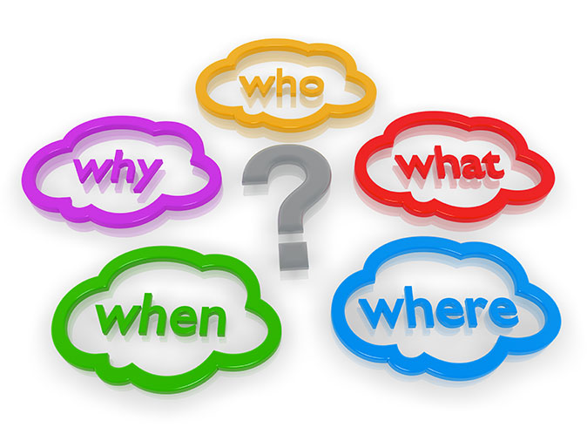
Newspaper articles try to answer five ‘W’ questions.
Look back at the newspaper example from earlier and try to answer the 5 ‘W’ questions based on what you have read.

Slide 10
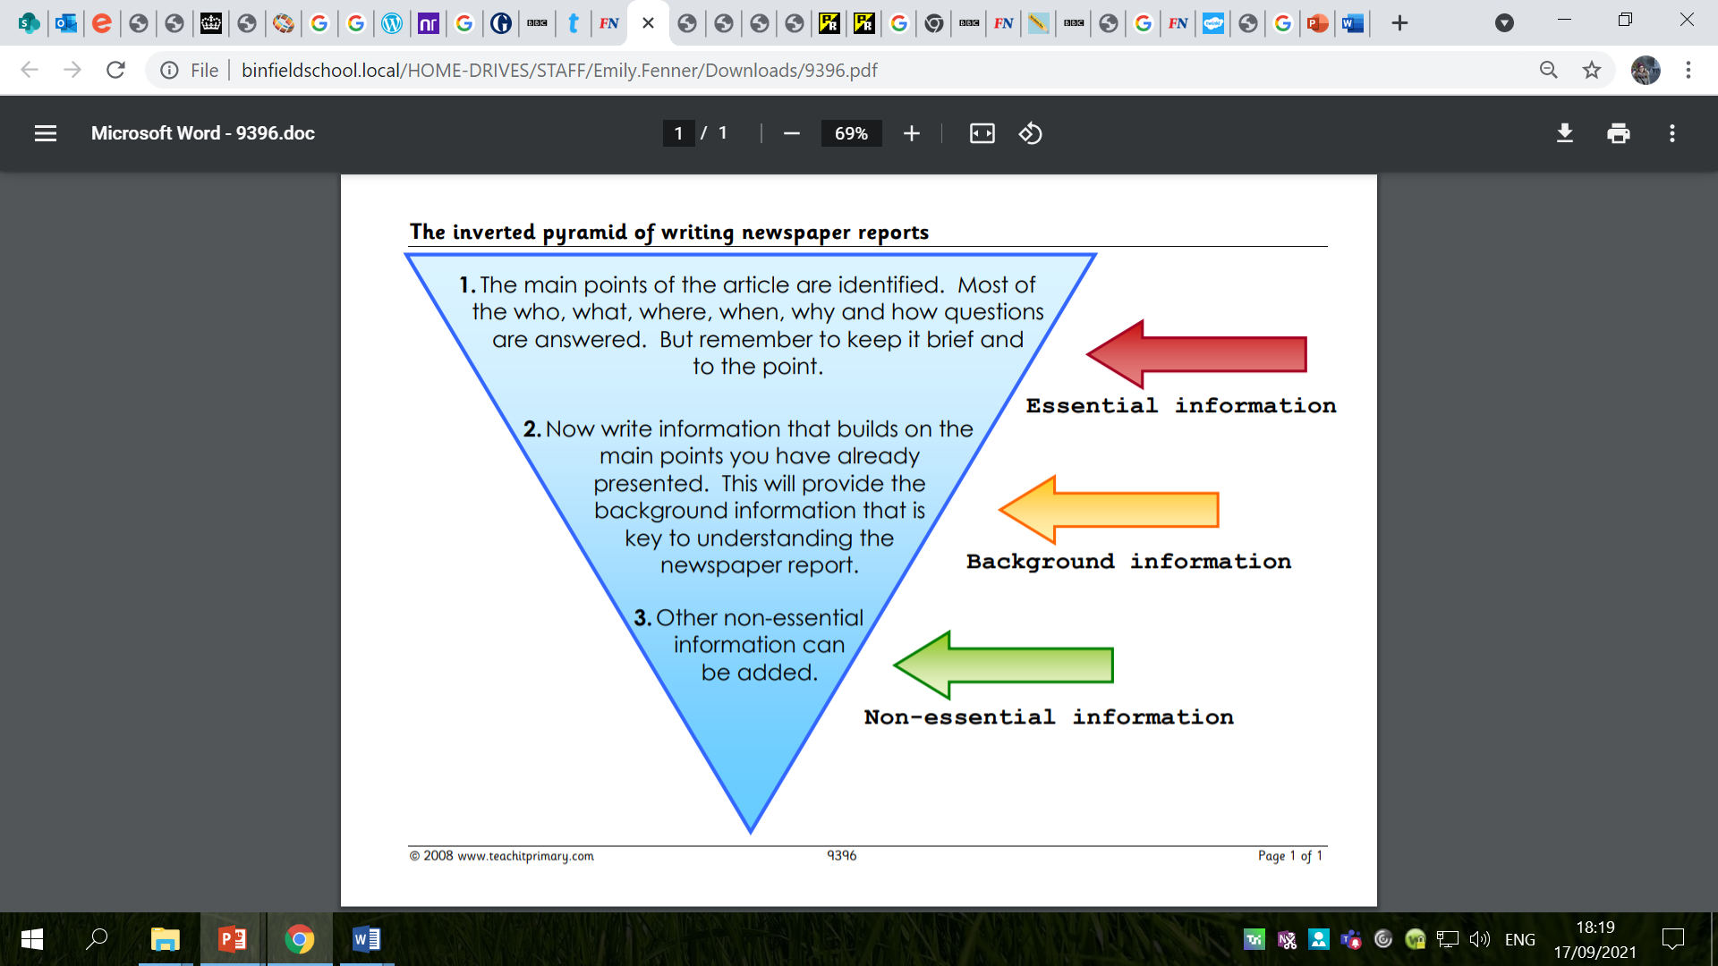

Slide 11
Activity:
Look at the example newspaper article and highlight/annotate the features of newspapers that you have found.
Snorkelling/Diving – try to explain the purpose of the features you are labelling, e.g. The headline summarises the information in just a few words.
Red Pen: What is the purpose of newspaper texts?
  How do they go about fulfilling this?
  Which reports are more interesting and engaging? Why?

Slide 12
Tuesday 21st September 2021
LO: To write with purpose
To use sentences appropriately
To punctuate accurately
C: Newspaper Reports

Slide 13
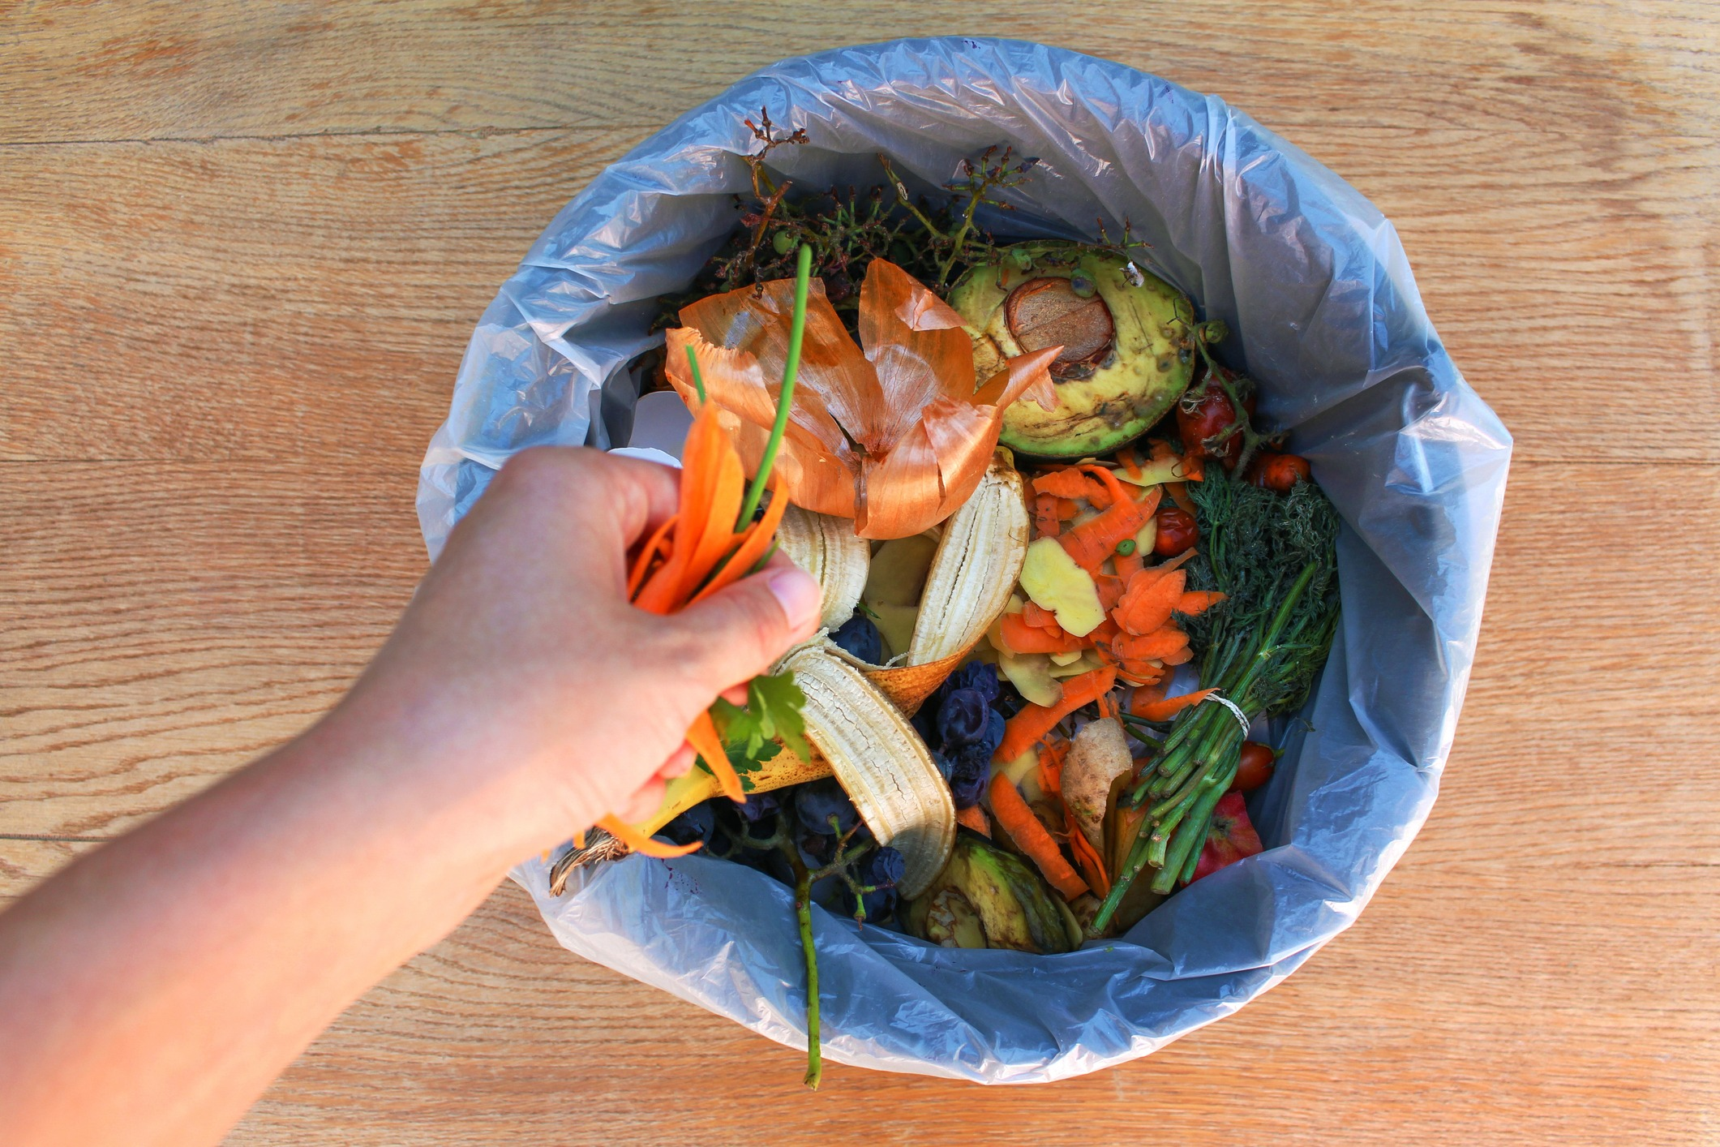
Starter
Over the next few weeks, you will be writing a newspaper report on food waste.
Food is in short supply for many people in the world, yet in the UK we throw away seven million tonnes of food and drink every year, most of which could have been consumed.
Most of this food is, or was once, perfectly good food.
We’re not talking egg shells or chicken bones – we mean the last few bites from your plate that you couldn’t quite manage, or your bread crusts, or potato peelings – all stuff which could have been transformed into something delicious.
About 1/3 of all UK food is wasted.
Food worth £13.5 billion is wasted in homes.
The average UK family wastes about £470 each year.
795 million people are seriously undernourished.
About 2 million people in the UK do not get enough proper food.

Slide 14
Headline
Can you remember what a newspaper headline should be?

Slide 15
A headline is an eye-catching title for your story, which summarises the information in just a few words.
They are designed to grab a reader’s attention and hook them into the story. The job of a headline is to ultimately “tell and sell” so it must tell the reader enough to attract their attention but leave them wanting to know more so they read the full story.
The perfect headline is short, accurate and attention grabbing.
It could include puns, word play or alliteration.
Headlines should be:
Short
To the point.
Eye-Catching
BIG
Bold
Interesting

Slide 16
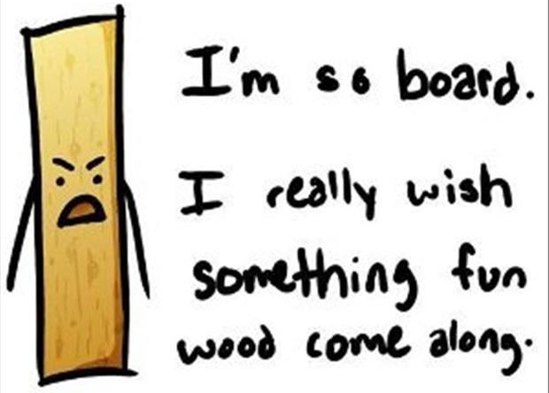
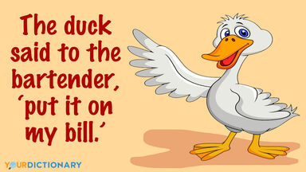
Puns
A word in a sentence that can have two meanings.
This word is called a homophone – this is a word that sounds the same as another but is spelt differently and has a different meaning.
Puns are employed a lot in newspaper headline and use the altering of words to attract attention.
For example:
  Peace of cake
  Sew it’s time
  Christmas shoppers stocking up
  Baa-rilliant news!

Slide 17
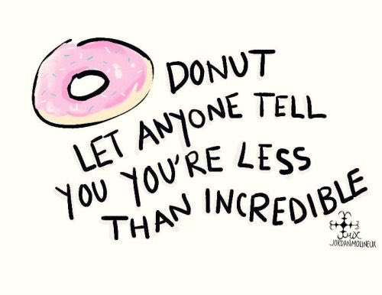
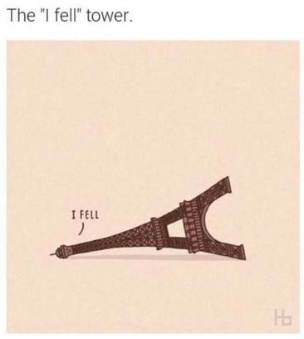
Play on words
Sometimes the writer will change a letter or a part of the word to give a double meaning.
For example:
  Truck by lightning
  Tantastic!
  A jab well done.

Slide 18
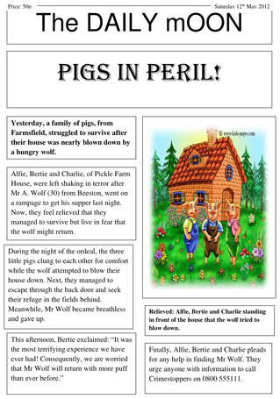
Alliteration
Often using the same letter sound at the start of your words can create an interesting effect.
For example:
  Greedy girl gobbles gruel.
  Big bad bear bites boy.
  Bamboo bikes in Britain

Slide 19
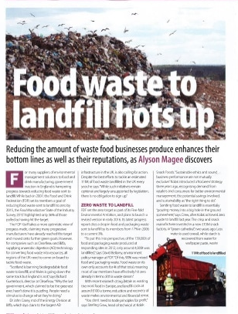
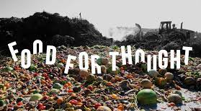
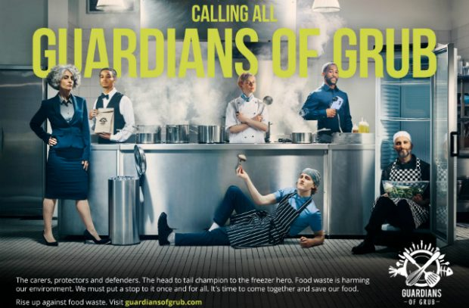
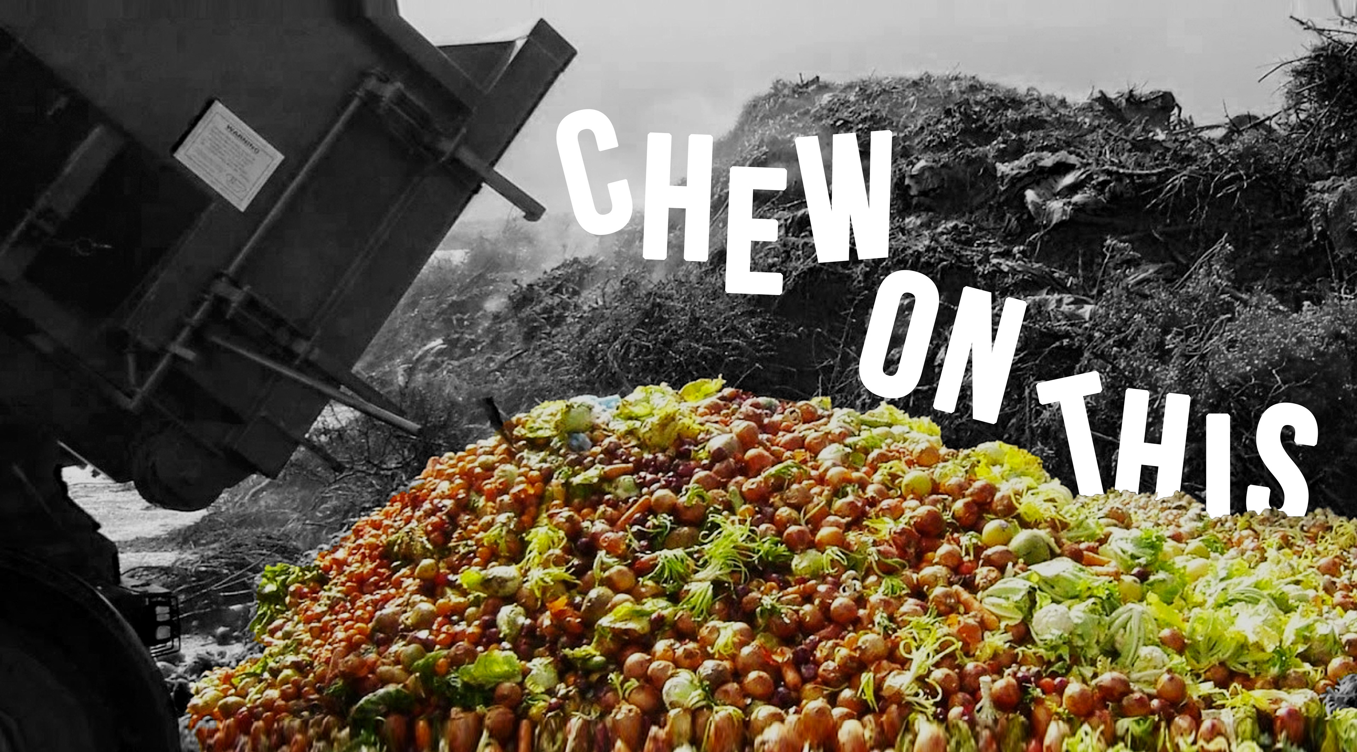
Bubble map some potential headlines for your food waste article.

Slide 20
Subtitle
What is the purpose of subtitles in a newspaper?

Slide 21
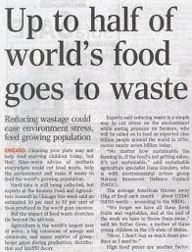
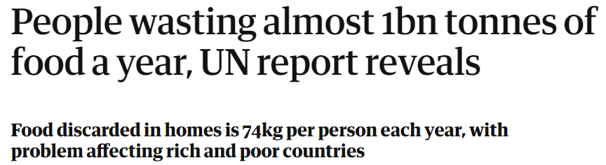
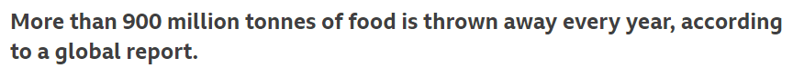
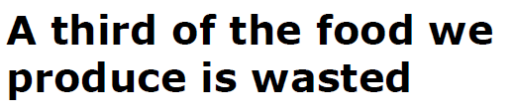
The subtitle is a short title that gives more information about the report.
Create some subtitles you could use in your newspaper article.
Make sure you sentences make sense and are punctuated correctly!

Slide 22
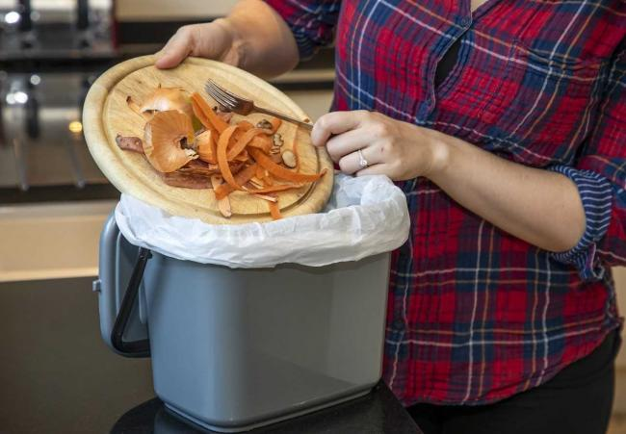
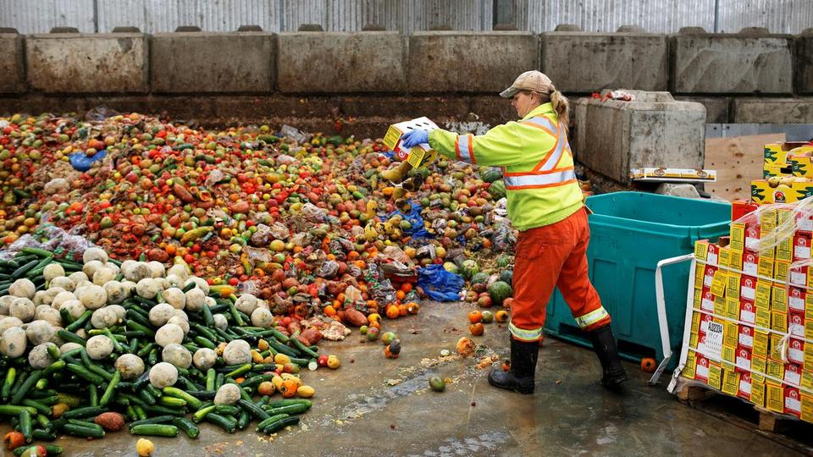
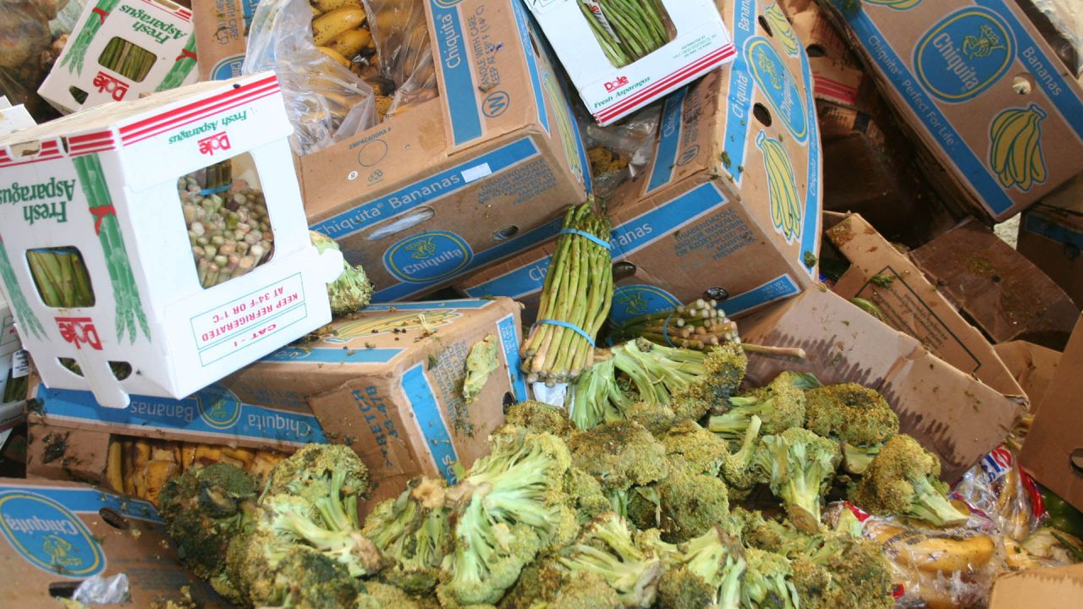
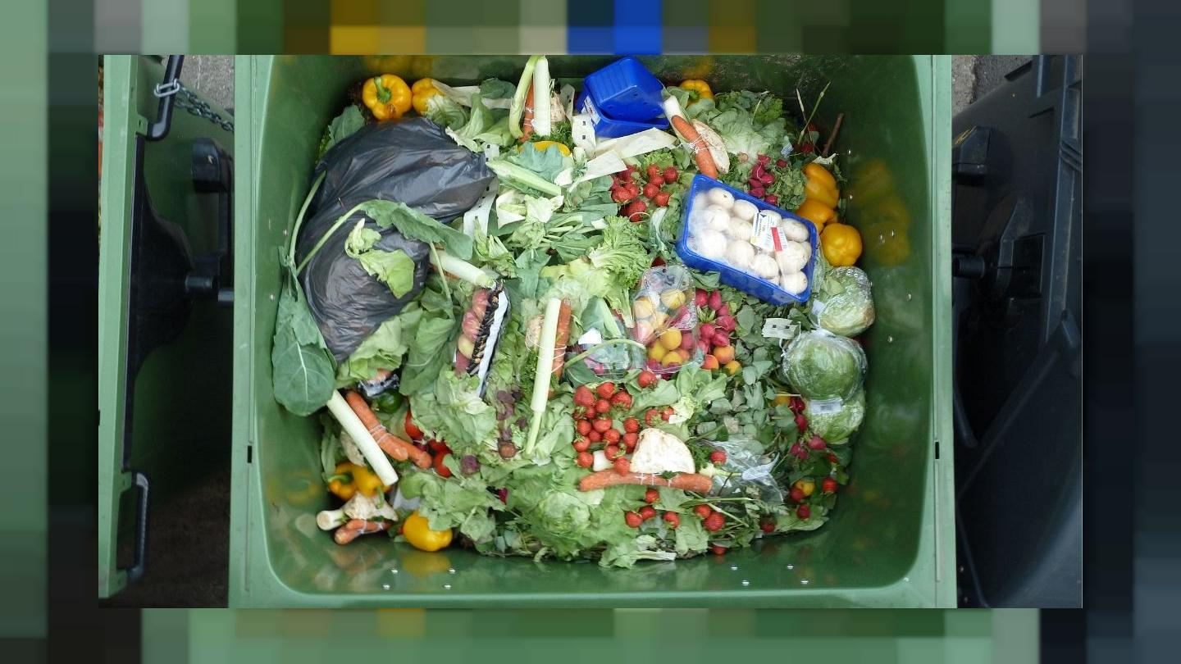
Could we include these images in our newspaper articles?
What would the photographs need?

Slide 23
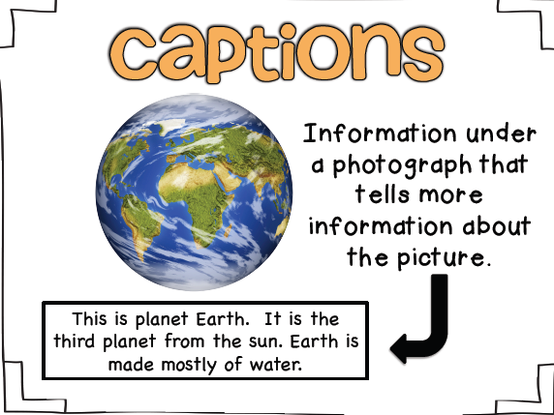
Captions
The information in or under a photograph which explains what the picture is about.
They are brief descriptions or explanations.
They describe an illustration, graph or picture.
The main purpose of a caption is to help the newspaper reader to understand what they see in the newspaper.
It should be brief, witty, and straight to the point.

Slide 24
What captions can you think of for these pictures?
Ensure your sentences make sense and are punctuated correctly.

Slide 25
Formal language
What do you know about formal language?

Slide 26
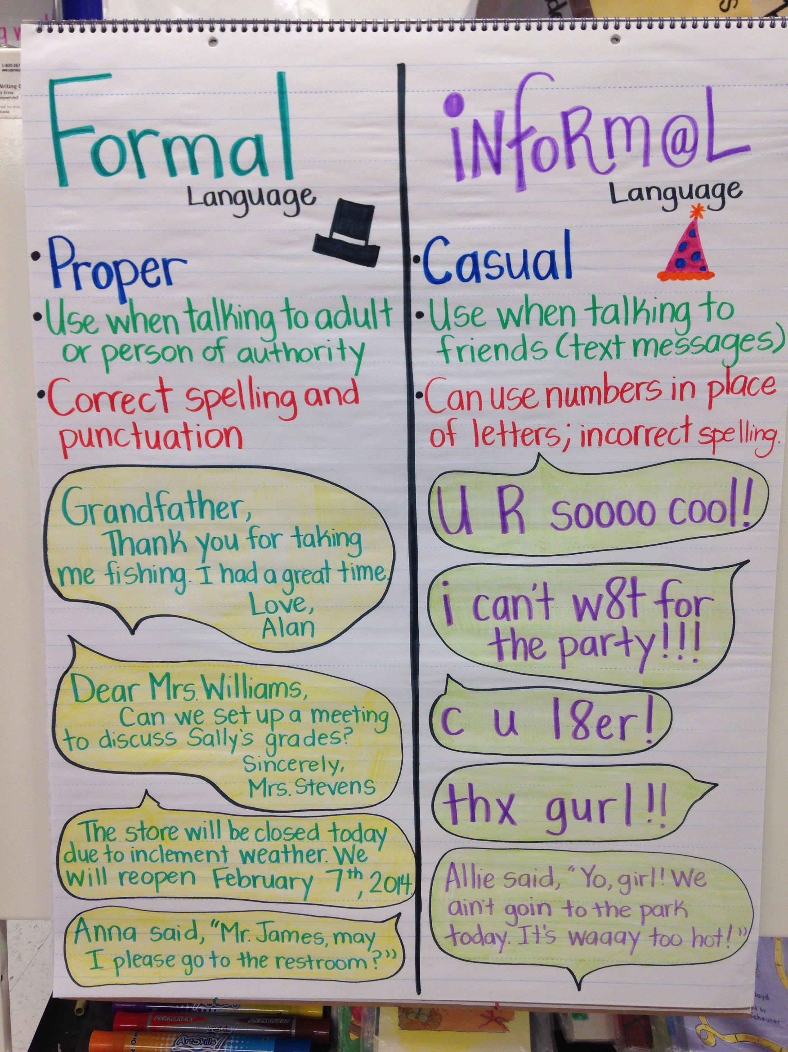
Formal language is used when we are communicating with people we don’t know very well and want to impress or show respect to.
Formal language does not use colloquialisms or contractions.

Slide 27
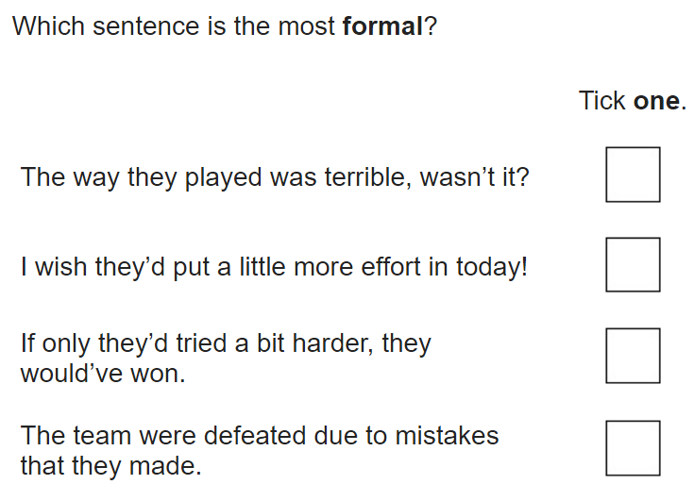

Slide 28
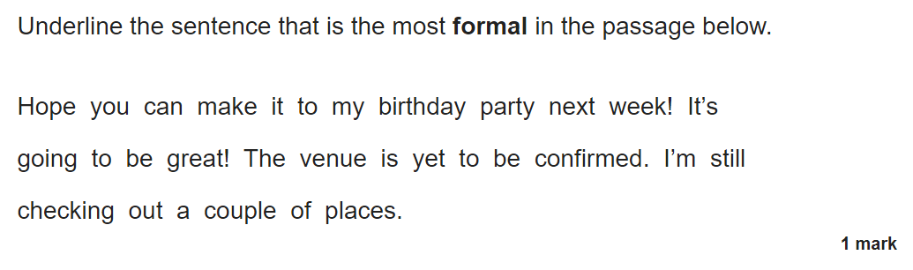

Slide 29
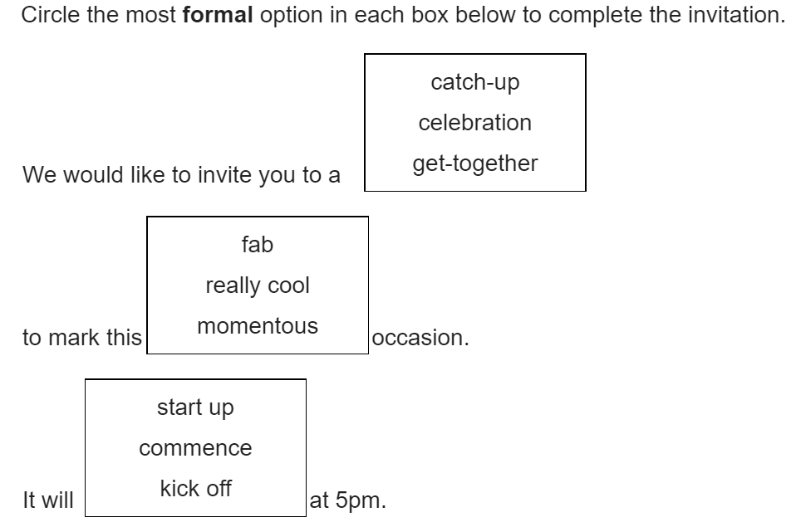

Slide 30
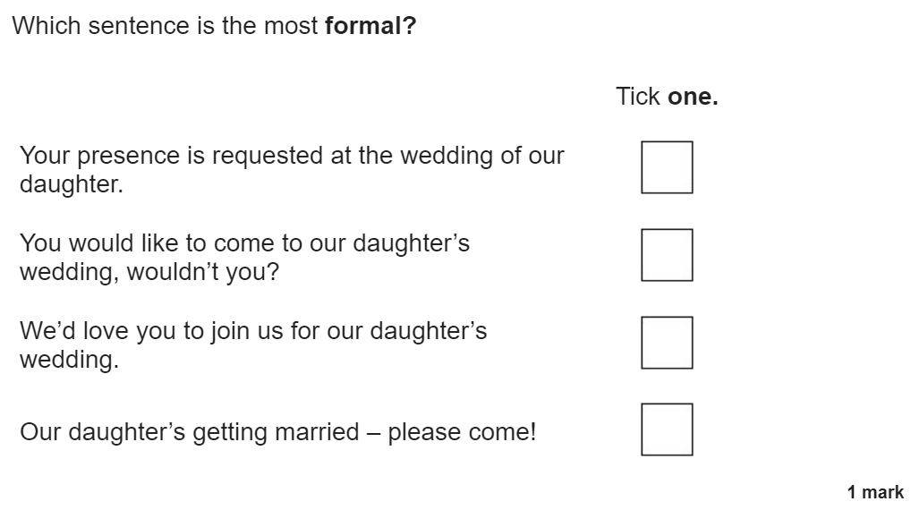

Slide 31
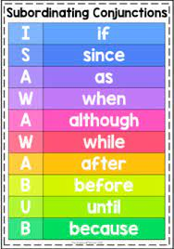
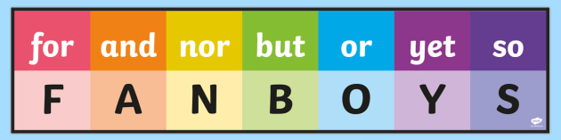
What formal sentences can you think of for your newspaper article?
Make sure your sentences make sense and are punctuated correctly.
Challenge 1: can you use coordinating conjunctions in your sentences?
Challenge 2: what about subordinating conjunctions?

Slide 32
Activity
Activity 1: create a bubble map of potential headlines for your food waste article.
Activity 2: write a selection of potential subtitles for your articles.
Activity 3: select 2 images of food waste and write captions for these.
Red Pen: check your headlines, subtitles and captions are written in formal language. Rewrite any of your ideas if they are too informal.

Slide 33
Wednesday 22nd September 2021
LO: To write with purpose
To use sentences appropriately
To punctuate accurately
C: Newspaper articles

Slide 34

Starter
My daughter’s hair is very curly, which makes it hard to brush.
Take it to Sarah, who is in the kitchen.
Snow, which is very cold, can be used to make snowmen.
Usain Bolt, whose home is in Jamaica, has won lots of gold medals.
What do you notice about these sentences?

Slide 35
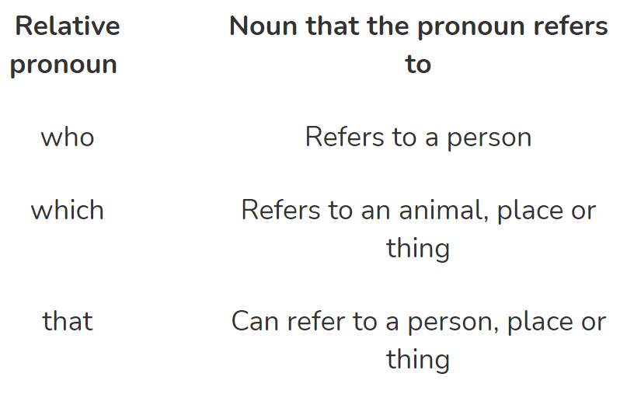
Relative Clauses
A relative clause can be used to give additional information about a noun.
Relative clauses add information to sentences by using a relative pronoun such as 'that', 'which', 'who', 'whose', 'where' and 'when’.
A relative clause can also be an embedded clause if it is positioned in the middle of a sentence.

Slide 36
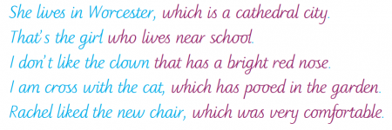

https://www.bbc.co.uk/bitesize/topics/zwwp8mn/articles/zsrt4qt

Slide 37
Think of some sentences containing relative clauses.
(They do not have to link to food waste, but they could do!)

Slide 38
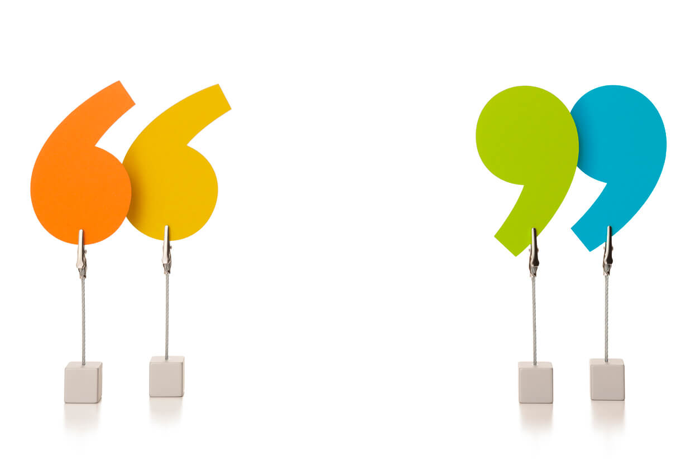
What is this punctuation mark?
What is it used for?
What do we need to remember when using inverted commas?

Slide 39
Rules for punctuating speech | Example
Use a capital letter at the beginning of the sentence. | “Hi Mum!” said Luke.
Put inverted commas around the spoken words. | “I love this song!” exclaimed Mariam.
Put punctuation BEFORE the closing inverted commas. | “Who’s still making a noise?” asked the teacher.
Tell the reader which person is speaking. | “Let’s go to the shop!” suggested Dad.
Use a synonym for said. | “Can we still bring our pets?” queried Tom.

Slide 40
When might we use inverted commas in our newspaper articles?
Who might we include a quote from in our food waste newspaper report?
e.g. a householder who throws away waste, someone who works for a food waste charity, someone who doesn’t have any food, someone who works for or goes to a food bank etc.

Slide 41

Alternative words for said
Stated
Told
Declared
Described
Suggested
According to
Continued
Noted
Asked
Stated
Advised
Explained

Slide 42
Create some quotes for your newspaper article.
Make sure your quotes are correctly punctuated!

Slide 43
Are your quotes facts or opinions?
How do you know?
When should facts be used in a newspaper article?
When should opinions be used?

Slide 44
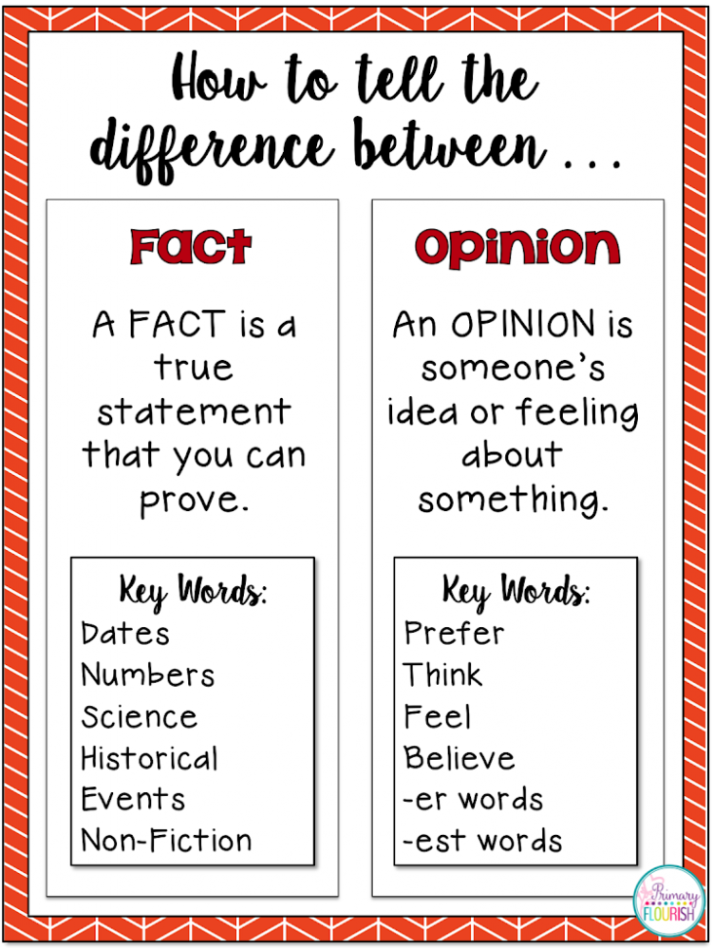
An opinion expresses a belief or a feeling about something, while a fact is a statement that can be proved true with evidence.

Slide 45
Fact or Opinion?
The car was blue.
Mum had lost his coat.
Reading are the best football club in the world.
It’s not a very good television programme.
I believe that he can win.
We think Mar stole the car.
I didn’t have a coat.
The church is the tallest building in the town.
The sun is shining.

Slide 46
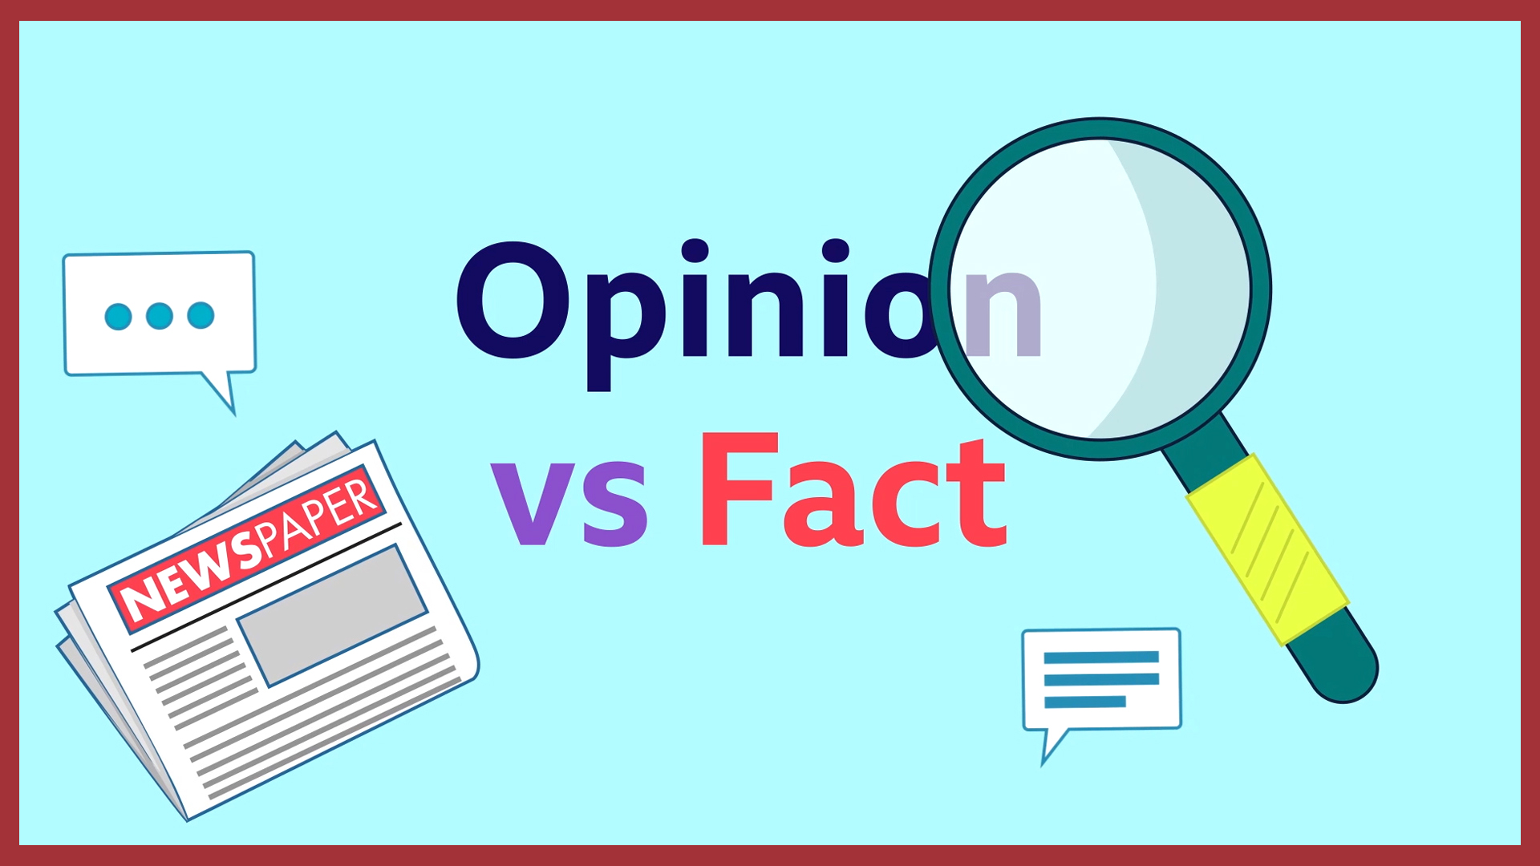
Tell me:
  Two facts about a sports team.
  Two opinions about a sports team.
  Two facts about school.
  Two opinions about school.
  Two facts about food.
  Two opinions about food.

Slide 47
Activity
Activity 1: Write 5 quotes that you could use in your newspaper article.
Challenge: can you include a relative clause in your quote sentence?
E.g. Sustainability charity Wrap, the UN’s partner organisation, stated, “People need to plan their shopping and their meals more carefully.”
Activity 2: Write formal sentences with relative clauses about food waste which you can use in your newspaper article.
Red Pen: Can you write a quote with a coordinating or subordinating conjunction?

Slide 48
Thursday 23rd September 2021
LO: To write with purpose
To use sentences appropriately
C: Newspaper Reports

Slide 49
Starter
What can you remember about adverbial phrases?
An adverbial phrase is like an adverb, it adds more information to the sentence, but it uses more than one word to describe the verb.
Adverbs and adverbial phrases can describe how, when or where a verb is done.
E.g. He turned down the road without thinking.

Slide 50
Starter
What do you think a fronted adverbial might be?
A fronted adverbial is when the adverbial word or phrase is moved to the front of the sentence, before the verb.
E.g. He turned down the road without thinking.
  Without thinking, he turned down the road.

Slide 51
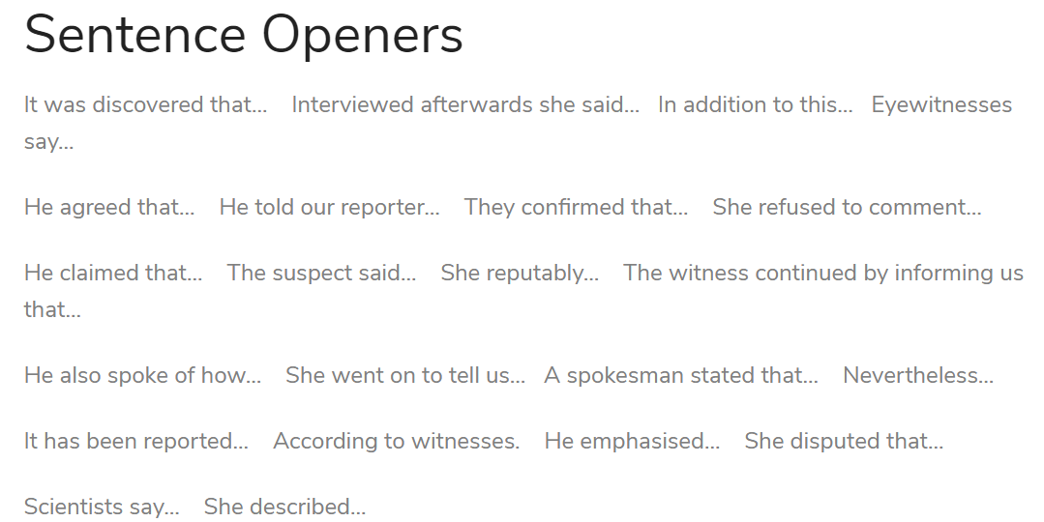
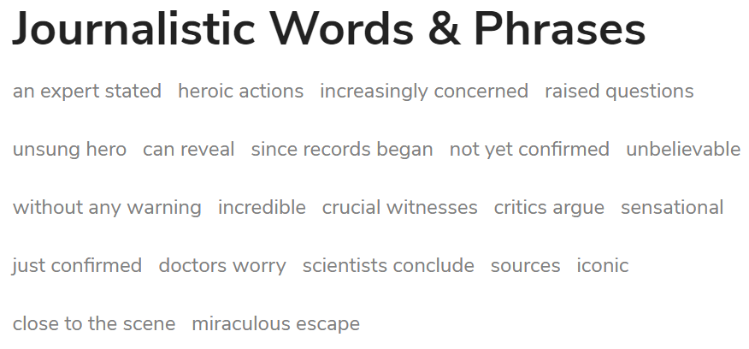
Look at the newspaper word mat given and the newspaper articles we have looked at this week.
What fronted adverbials or interesting sentence starters can you find?
Create a class list.

Slide 52
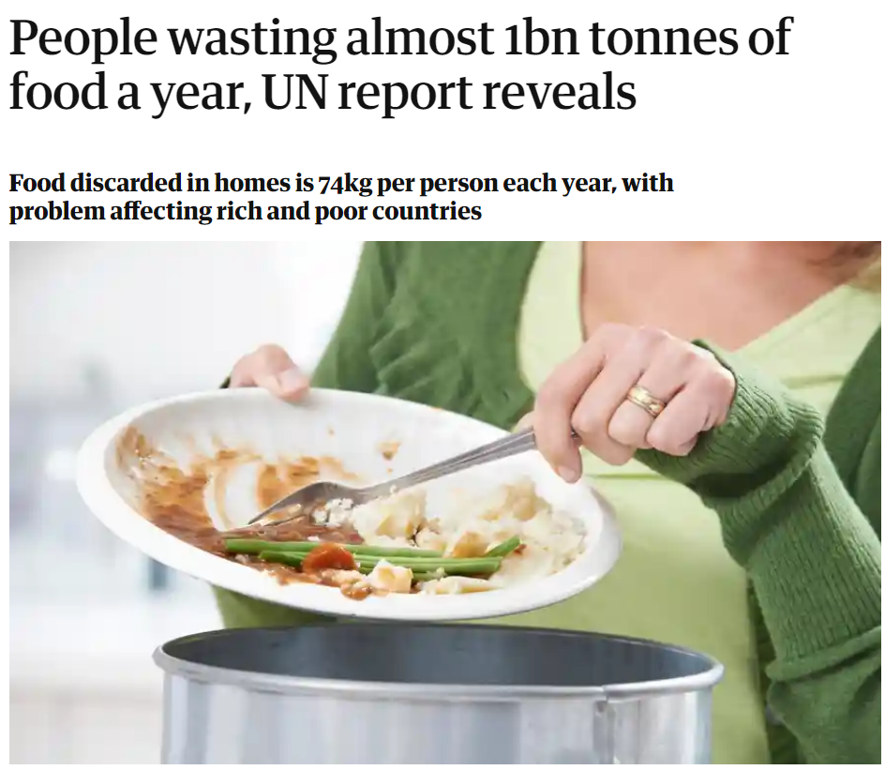
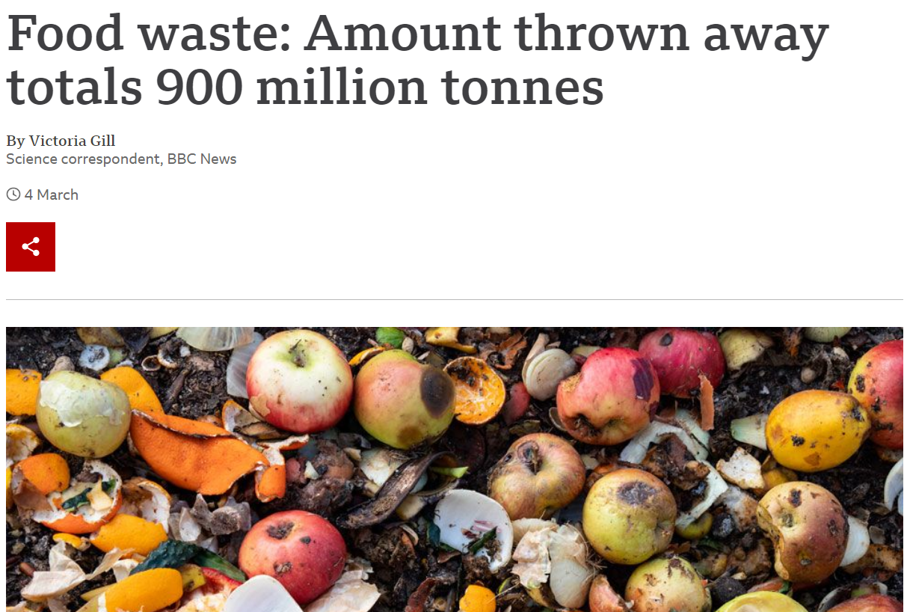
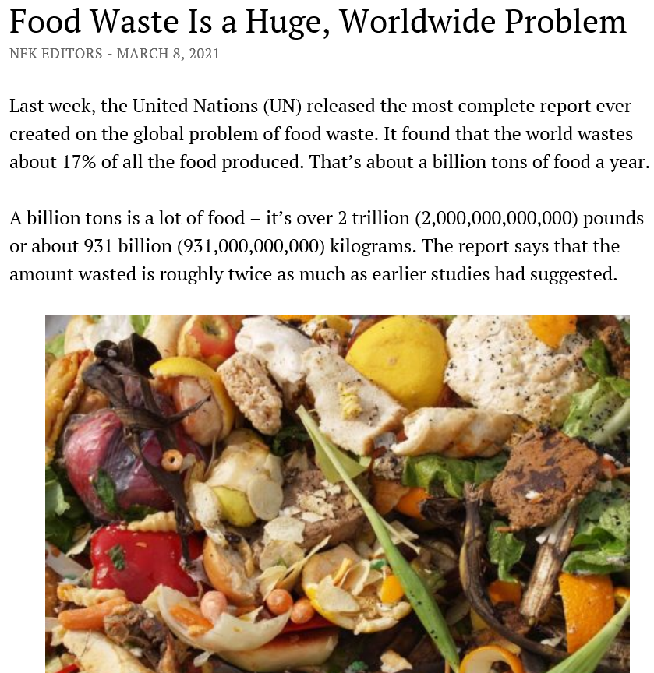
You are going to plan your newspaper report today.
Look at the food waste resources: read them carefully and think about what you have learned.
Your newspaper report will detail the current food waste situation and suggest ways that readers can reduce food waste.

Slide 53
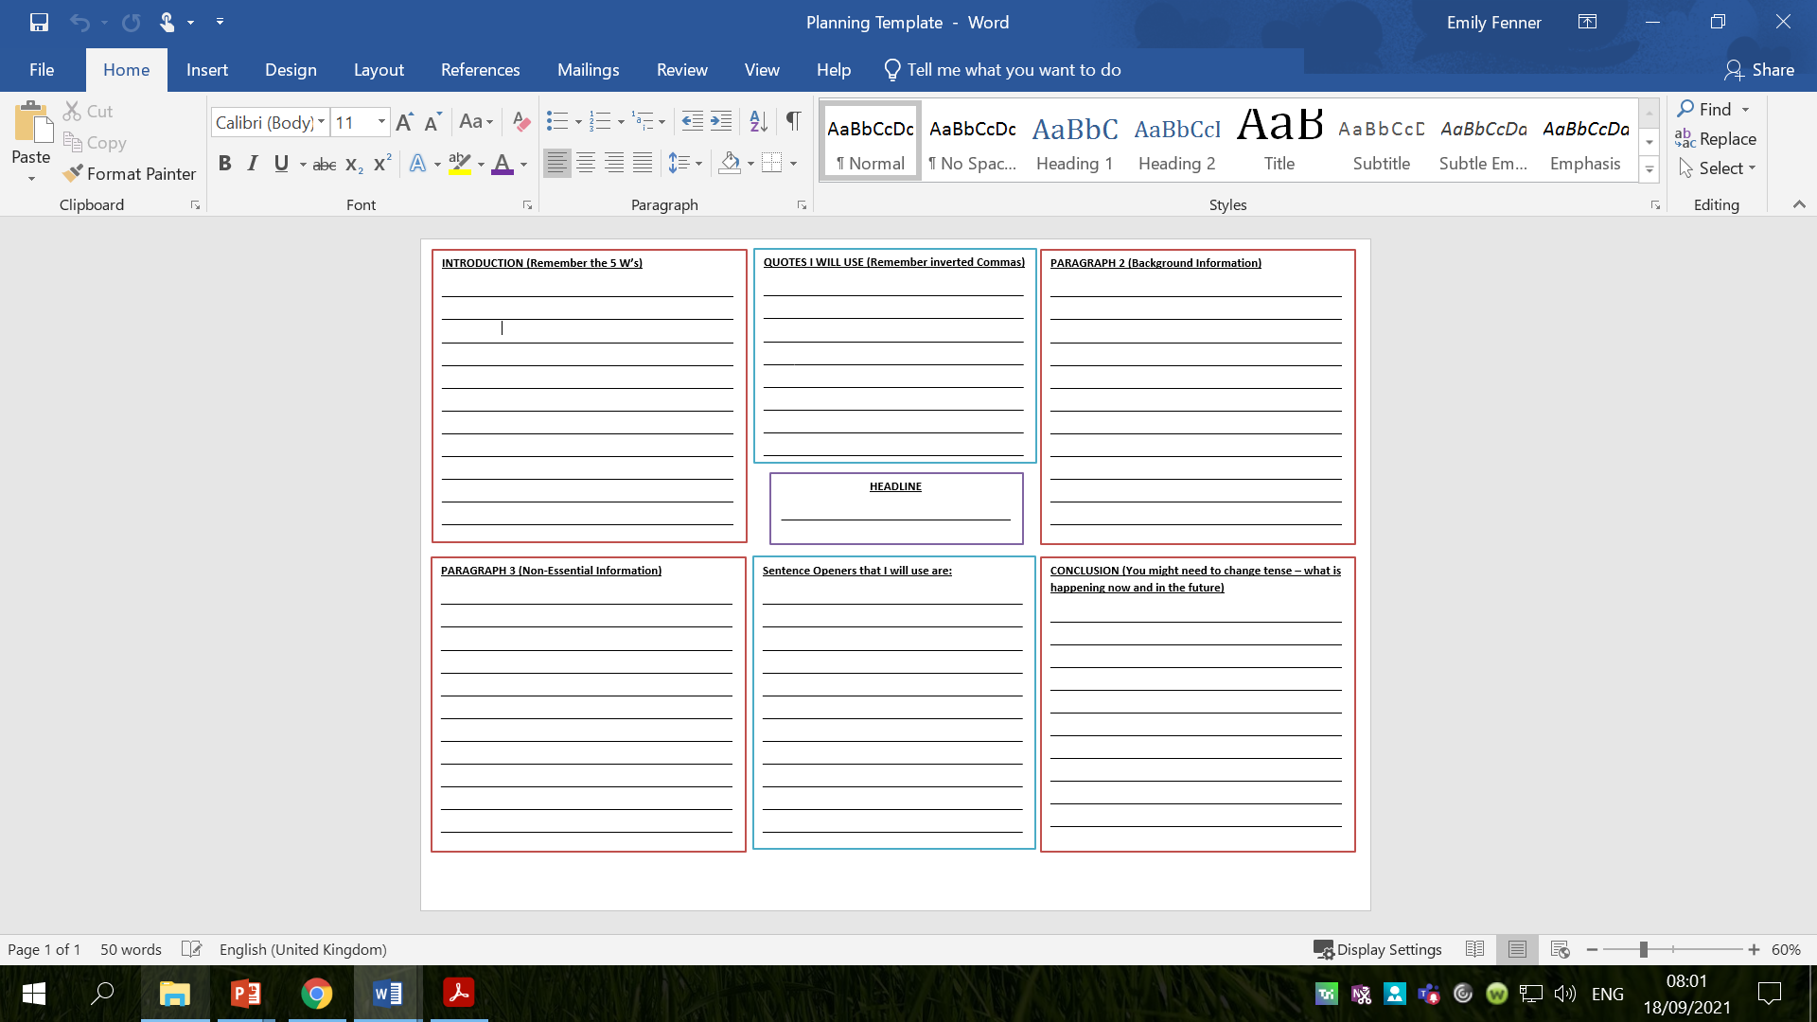

Slide 54
Activity
Plan your newspaper report using the template.
Red Pen: create a list of sentence starters/fronted adverbials which you could use in your newspaper article next week.

