Slide 1
Understanding difference
PSHCE

Slide 2
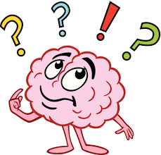

fairness
To me, being fair is when…

Slide 3
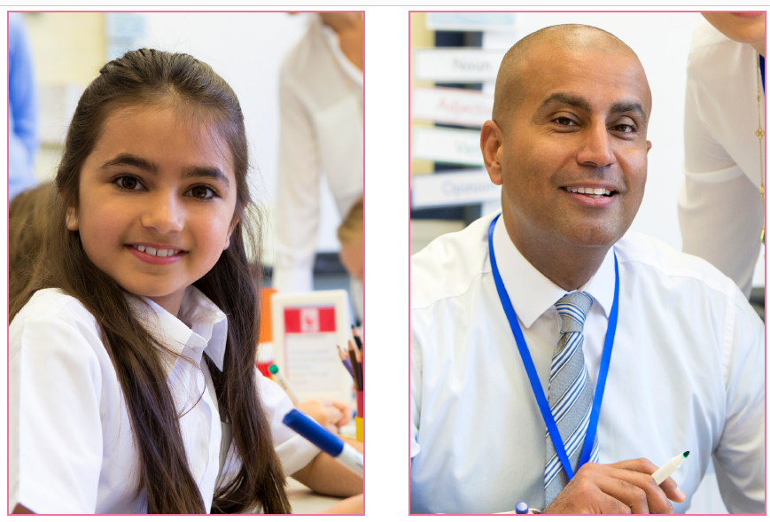
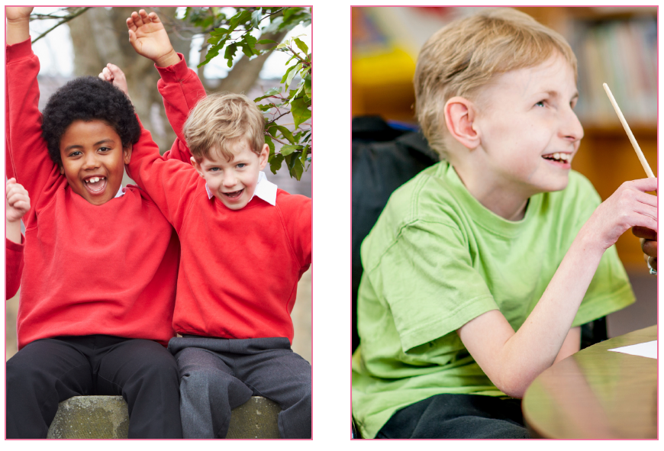
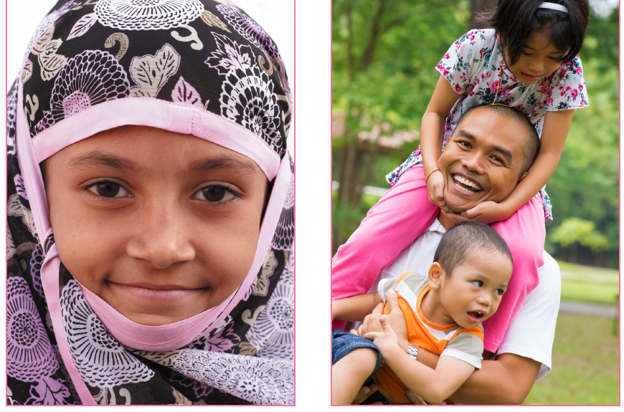
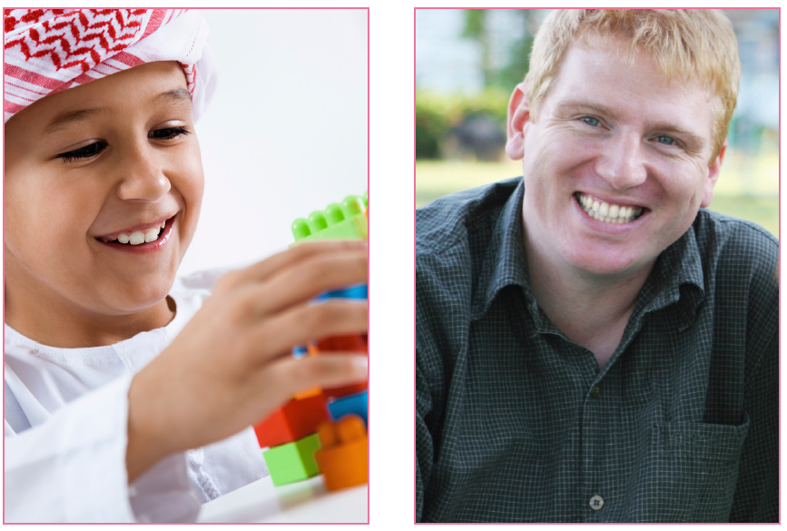
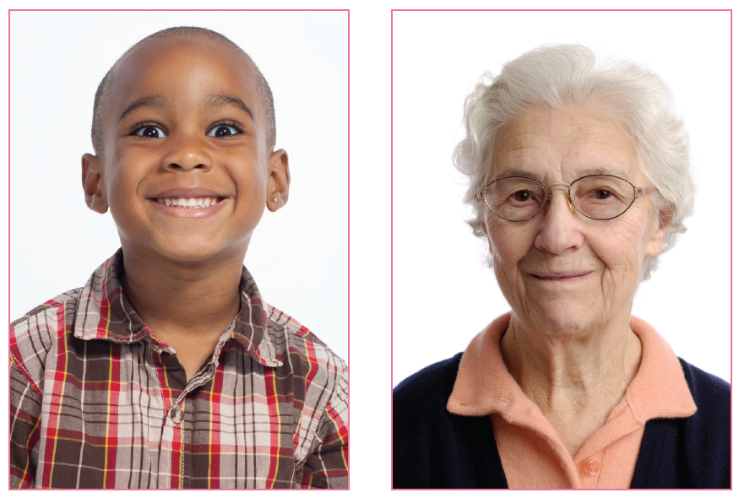
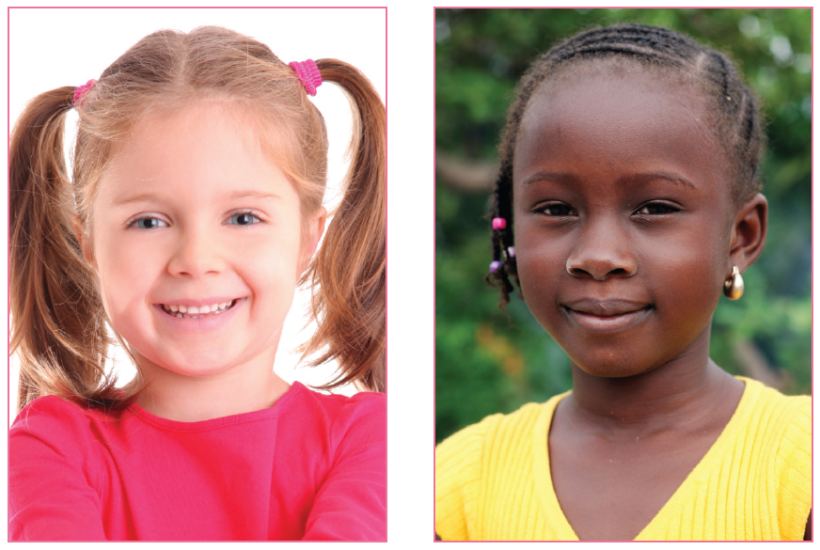
What
What differences and similarities can you easily spot between the people in the pictures?
What differences/similarities are more difficult to spot? What can’t we see?

Slide 4
What
Our society is diverse and sometimes this diversity causes some people to be treated unfairly.
Can you give any examples?

Slide 5
There is a law in England and Wales (The Equality Act) that protects people’s rights, even if they have ‘differences.’

Slide 7
This is an amazing story about a real person called Robert. He led an incredible life in lots of different ways as you will find out. There are some BIG surprises in the story too!
Robert Marshall Cowell was born in London in 1918. His father was a famous surgeon, who eventually became the doctor for the Royal Family.
Robert went to an all boys’ school and during his time there he became keen on cars and motor racing. He spent as much time as he could learning about motor sport and how to fix cars. He was so keen he even used to sneak into motor racing events disguised as a mechanic! After leaving school Robert went to university to study engineering, and eventually became the motor racing driver he had always dreamed of being. He competed in the 1939 Belgium Grand Prix, but his motor racing career was cut short by the outbreak of World War 2.
He was drafted into the Royal Air Force to fight for the British forces in the war. Because Robert was an expert engineer he learnt how to repair and fly aeroplanes. He became a skilled fighter pilot and was involved in several air battles, where he flew a special type of fighter plane called a Spitfire. Towards the end of the war Robert was involved in an attack on enemy cannons and his plane was hit by gunfire and crashed. He escaped with his life but was captured by the enemy army and imprisoned until the end of the war. Robert planned two escape attempts from the prison camp but he was caught each time. He was a very brave and courageous person.
What are your impressions of Robert so far?

Slide 8
Once the war was over and the world was peaceful again, Robert returned to motor racing and he competed in other Grand Prix events. But then Robert had to find a different sort of courage. Three years after the war was over, Robert became sad. Very sad. He was diagnosed with depression (which is like being sad all the time) and doctors couldn’t work out the reason behind it. He became so depressed that he had to leave his wife and children as they were being upset too. Eventually Robert saw a doctor who helped him work out why he was depressed.
Robert had always felt different from the other men he knew. Robert was transgender, which meant that he was born with a male body but felt like a female. The doctors helped Robert realise that this was the reason behind his depression and helped him start a special process called transitioning, where he changed his male body into a female one.
Robert felt much happier living as a female and changed his name to Roberta. People made nasty remarks to Roberta and made fun of her, but she had to use all the courage she had shown in her earlier life to stand up for who she was, and make the changes she needed to be happy and healthy. At that time people didn’t understand that some people are born transgender, unlike nowadays where it is recognised that transgender people are a welcome part of our society. Unlike Roberta some transgender people feel male but are born with a female body, and some transgender people are happy not to transition but stay with the body they were born with. There are a whole range of transgender people, and this called gender diversity.
Roberta carried on driving in motor sport events and had a very successful career until she died in 2011 at the age of 93!
What an incredible life!
What are your impressions of Roberta?

Slide 9
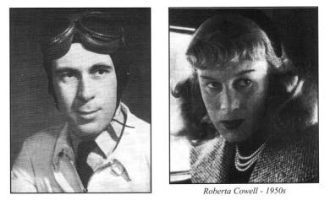
• Why was Robert unhappy?
• Why do you think Robert waited until he was an adult to transition?
• Why do you think people were unkind when Robert changed to Roberta?
• Do you think that was fair?
• Have you heard about people being transgender before?
• What do you think it would feel like not being happy with who you are?
• Does gender make someone a good or bad person?

Slide 10

A kind community is accepting of all sorts of different people.
We have shared rights and responsibilities to help that happen.
Does the Equality Act help transgender people?

Slide 11
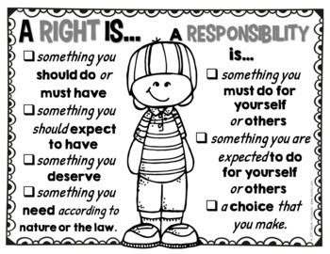
Activity
Fold you a sheet of paper in half.
Starting with ‘Rights’ – list three things that are important in a welcoming community.
Write these on one side of the paper.
Now, list a corresponding ‘Responsibility’ for each of the ‘Rights’ on the other side of the paper.

Slide 12

For example:

Slide 13
Look at the Rights and the corresponding Responsibilities you thought of.
Which ones on your list would have helped Robert?

