Slide 1

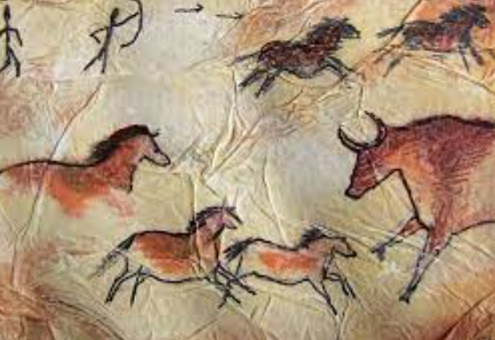
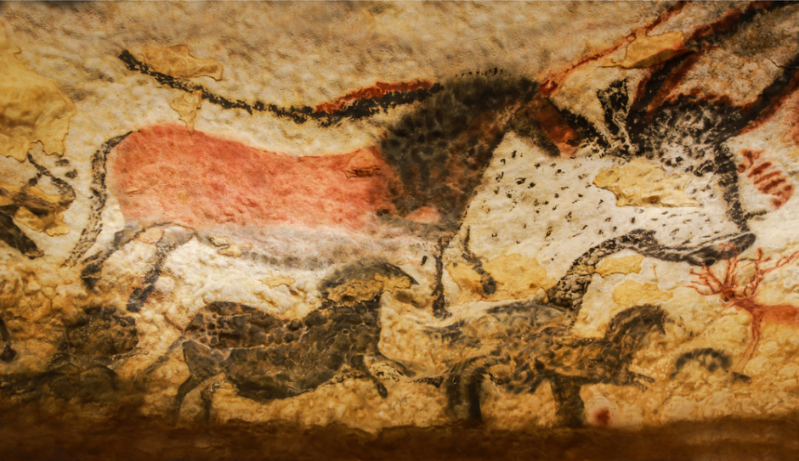
Thursday 6th May 2021
L.O: To improve their mastery of art and design techniques.
C: Drawing

Slide 2
Our new art focus is to design and draw a Stone-Age inspired cave painting!
Today we are going to begin practicing some pencil techniques.

Slide 3
Thinking Question:
How many colours are there between black and white?

Slide 4
Today we are going to use pencil to practice creating different tones and textures.
https://www.bbc.co.uk/bitesize/guides/z8pfcj6/revision/2

Slide 5
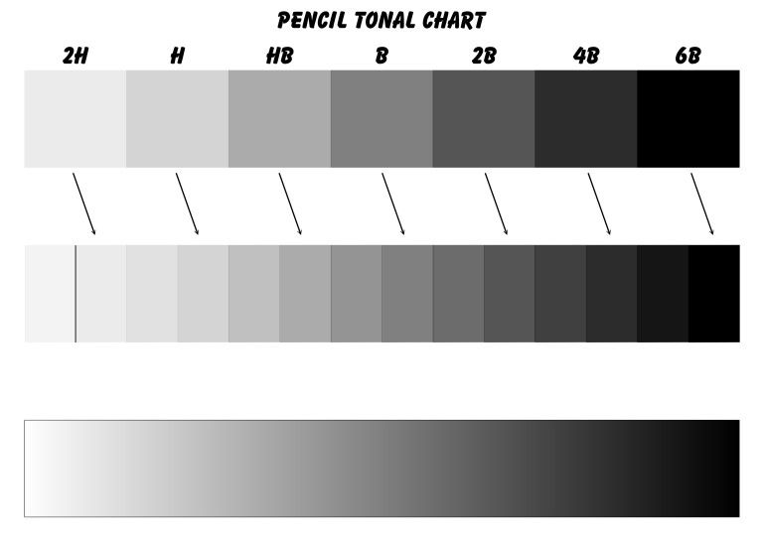
We are going to create a swatch test of our pencils!
I will model this for you.

Slide 6
Red Pen Question!
Which pencil felt the softest, the hardest, the smoothest, the scratchiest?

