Slide 1
LO: To investigate living things
To work scientifically
C: Classification Keys

Slide 2
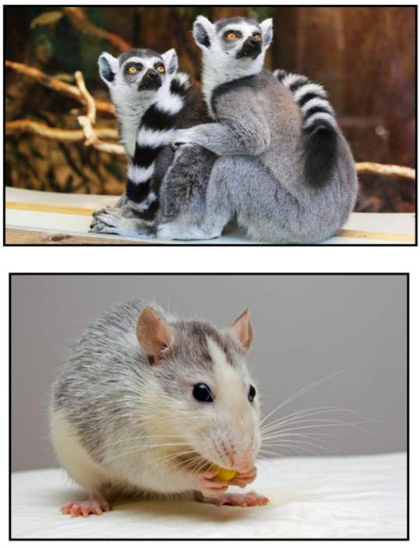
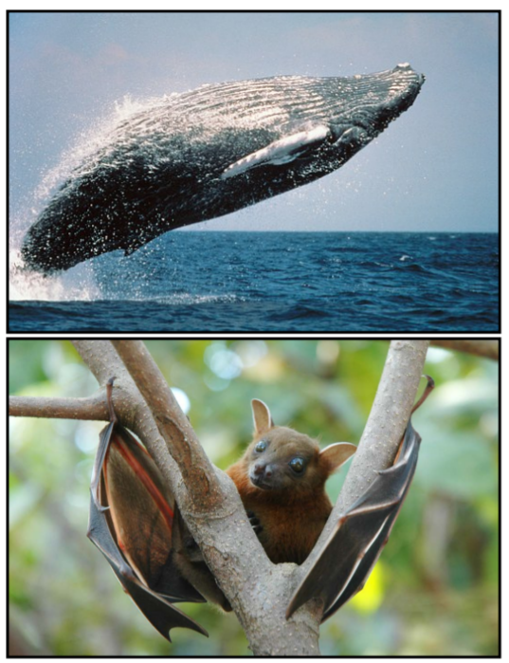
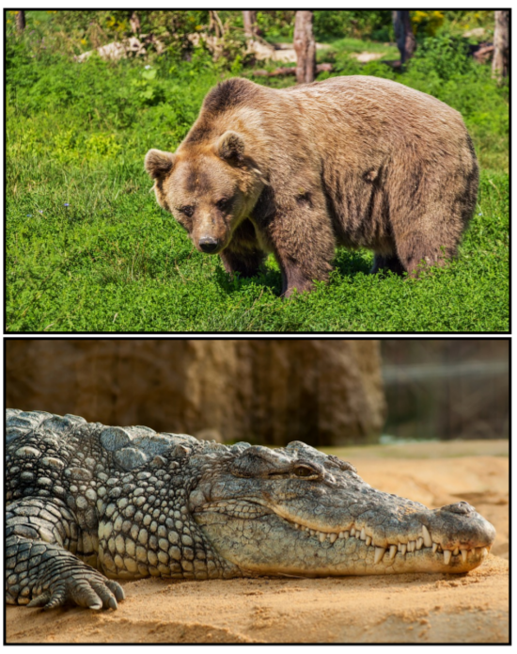
Starter: Odd One Out
Can you spot the odd one out?
Why do you think it is the odd one out?

Slide 3
One of the living things is not ‘classified’ in the same kingdom or phylum.
The Nile Crocodile is the odd one out as it is not an amphibian or a mammal.

Slide 4
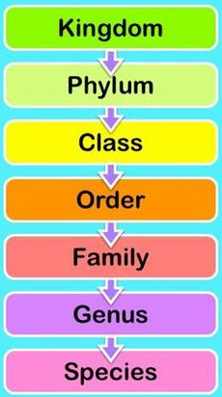
Vocabulary Recap
Kingdom: Most scientists now list 5 kingdoms – Animal, Plant, Protists (amoebas and such), Fungi and Montera (bacteria).
Phylum: There are more than 30 phyla in the Animal Kingdom and 9 or 10 in the Plant Kingdom. Phylum Chordata is the one we're most familiar with – it includes humans, birds, fish, and all other vertebrates (animals with a backbone). Phylum Arthropoda includes insects, spiders, lobsters, etc. Arthropods have segmented bodies with the segments grouped into two or three distinct sections. They have hard external skeletons, or exoskeletons, that are shed and regenerated as the animals grow.

Slide 5
Vocabulary Recap
Class: The various phyla are divided into classes – Phylum Chordata is divided into the classes: amphibians, birds, mammals, reptiles and fish.
Order: Scientific groupings don't follow hard and fast rules. Once we get to the ‘order’ of a living thing, there sometimes begins to be some disagreement about where it belongs. You may find that different sources group creatures in different orders or families. You may find that a creature has its order or family changed as more information is learned.

Slide 6
Vocabulary Recap
Family: The family is a relatively new scientific concept. It is a way scientists group similar genera together. This is not the ‘mum, dad, brother and sister’ type of family!
Genus: Two or more species that share unique body structures or other characteristics are considered to be closely related and are placed together in a genus. Sometimes a genus might include only a single species if there is nothing else in the world that has similarities with it. The genus is the first part of the scientific name of a species. The genus is always spelled with a capital letter and in italics.

Slide 7
Vocabulary Recap
Species: A species can be defined as a group of individuals that breed together to produce fertile offspring. Individuals of a species cannot breed with other such groups. It is sometimes possible for different species to breed, but the offspring will be sterile. A mule is the sterile offspring of a donkey and a horse, and the mule can never mate and reproduce itself. The species is the second part of the scientific name of a species. The species is always spelled with a lower-case letter and in italics.

Slide 8
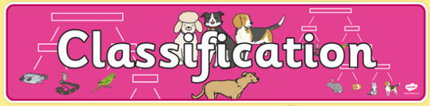
We are going to be using classification keys today!
They will be more complex keys than in Year 4!

Slide 9
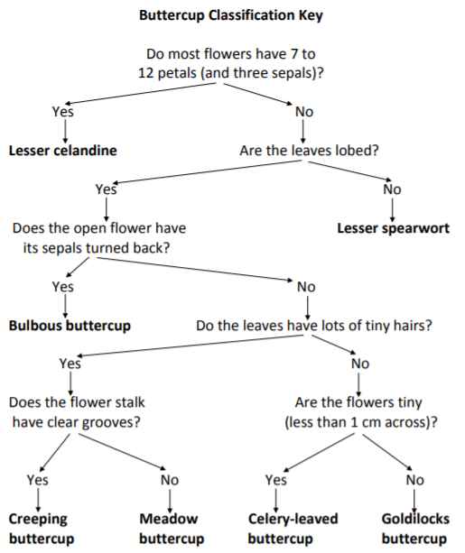
Buttercup Branching Database
(Dichotomous Key)
This is a type of classification key, similar to those we used in Year 4, but this one is separating closely related plants from the genus Ranunculus (Buttercups).

Slide 10
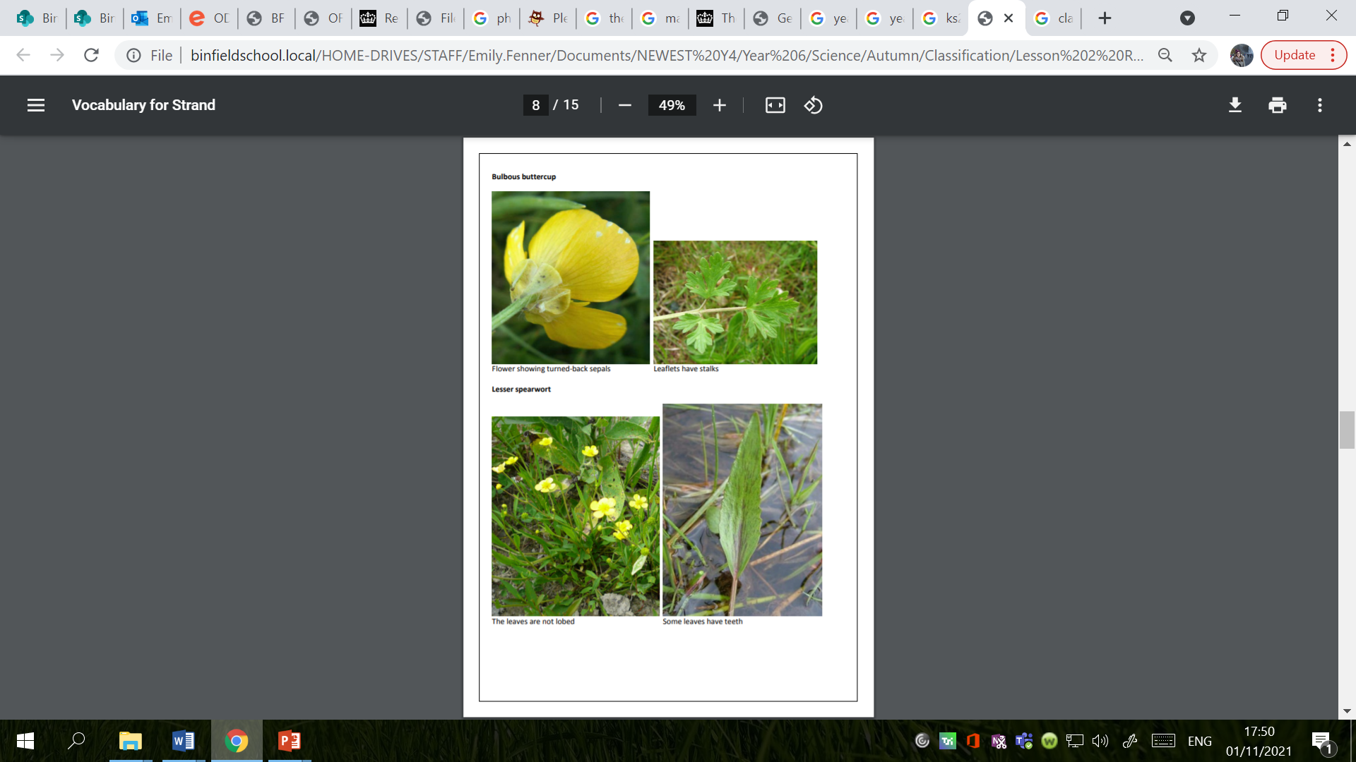
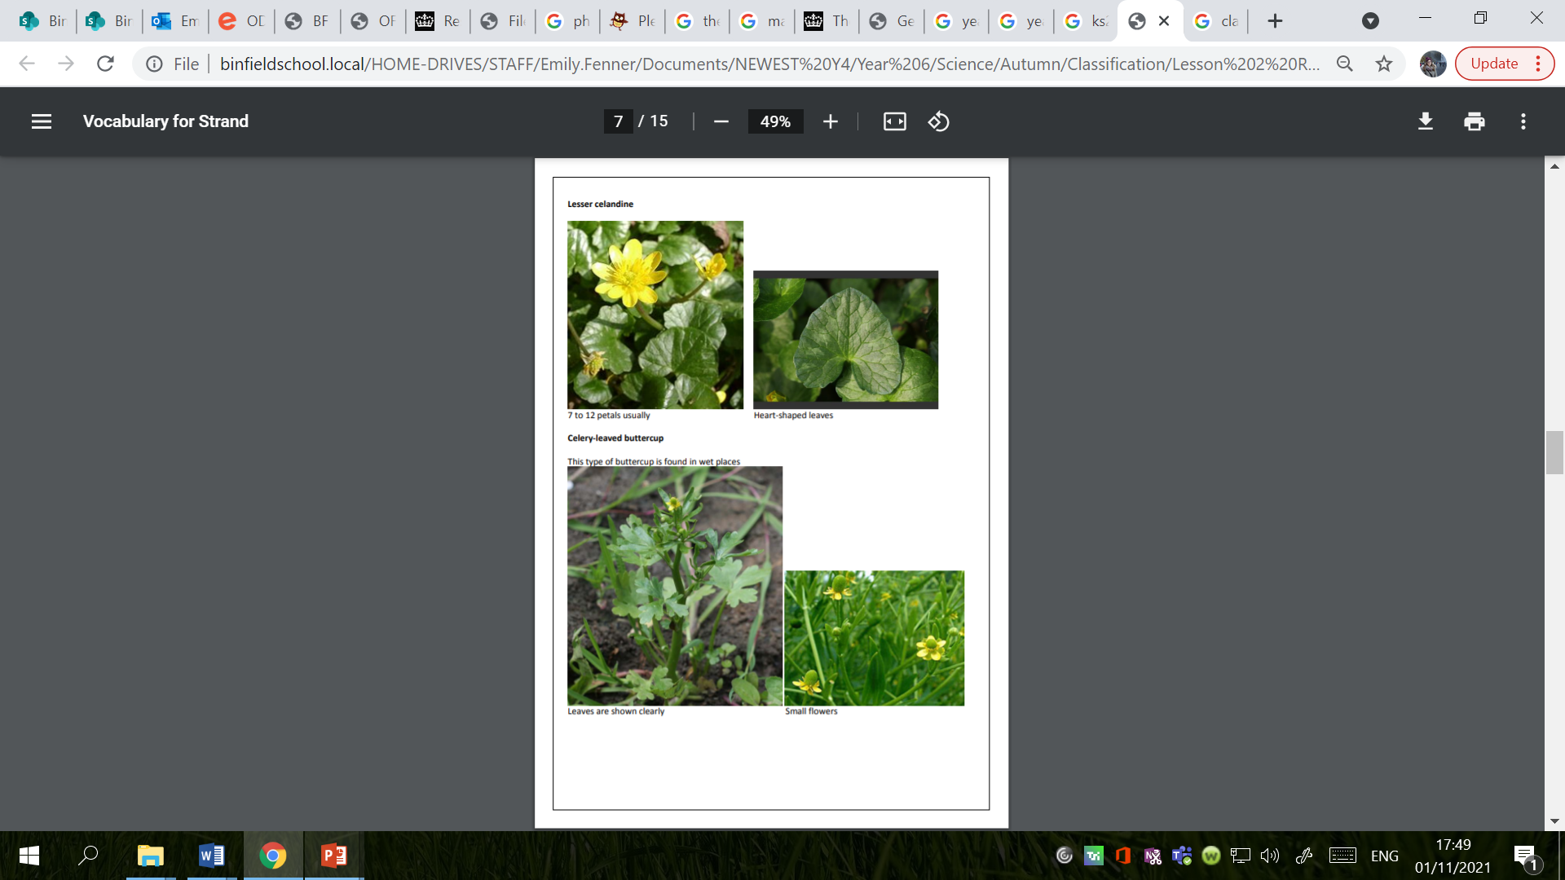
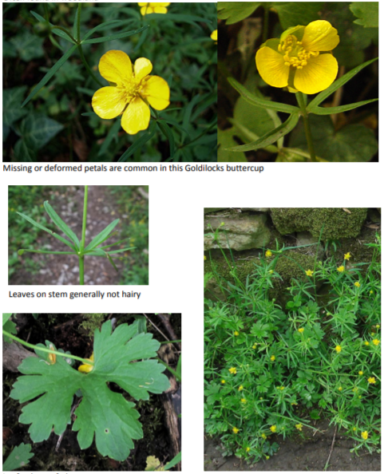
What is your first impression?
At first glance, all of the different buttercups look quite similar, but there are small differences.

Slide 11
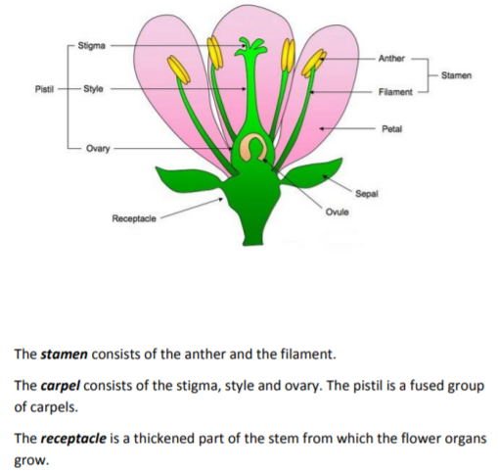
It is details like these that Linnaeus used to classify plants.
When he was only 23 years old, he used the number and position of the stamens to group flowers into 24 classes.
He then divided the classes into orders based on the pistils.
The orders were then divided into genera (plural of genus) by the form of fruit.
Linnaeus had to observe the flowers very carefully.

Slide 12
Try to classify these buttercups!

Slide 13
Try to classify these buttercups!

Slide 14
Try to classify these buttercups!

Slide 15
Try to classify these buttercups!

Slide 16
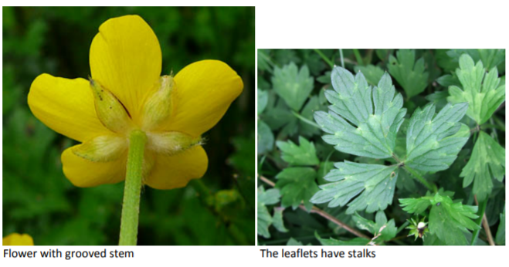
Try to classify these buttercups!

Slide 17
Try to classify these buttercups!

Slide 18
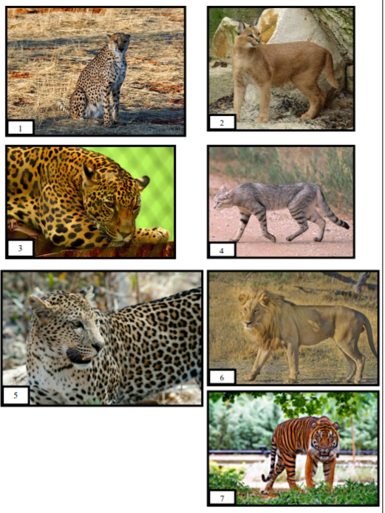
Activity 1 – Animalia Classification Keys
Use the cat classification key to identify individual species through specific features.
Once you have identified the species, you should write the name of the cat underneath the picture.

Slide 19
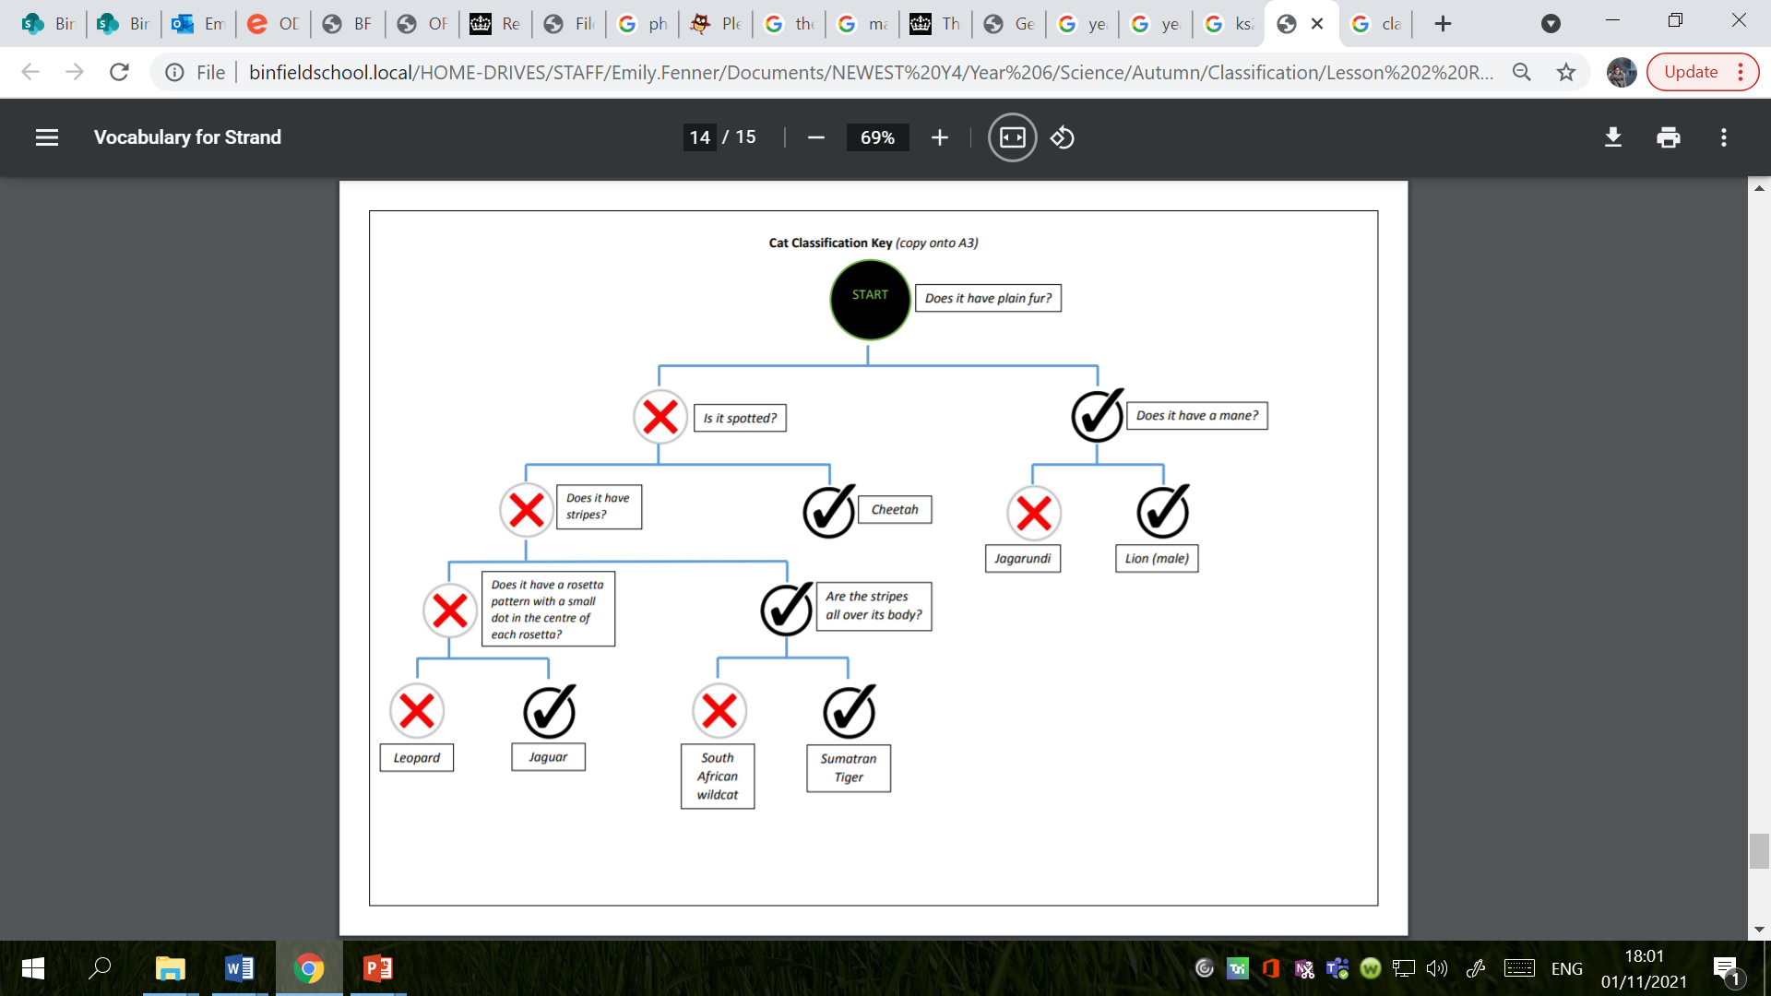

Slide 20
Activity 2 – Plantae Classification
Use the buttercup classification key to classify the plants.

Slide 21
Extension
1. Complete the fish classification on the website below:
https://fergusonfoundation.org/btw-students/fish-identification/
2. Complete the plant classification on the website below:
https://fergusonfoundation.org/btw-students/plant-identification/

Slide 22
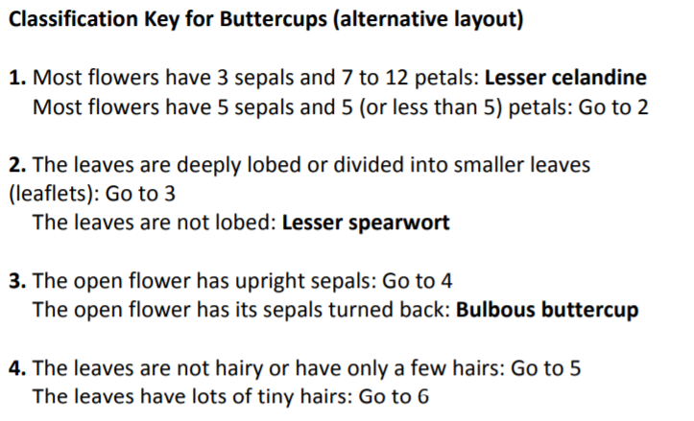
Red Pen
Look at the alternative layout for the buttercup classification key.
Can you complete the final two questions?

Slide 23
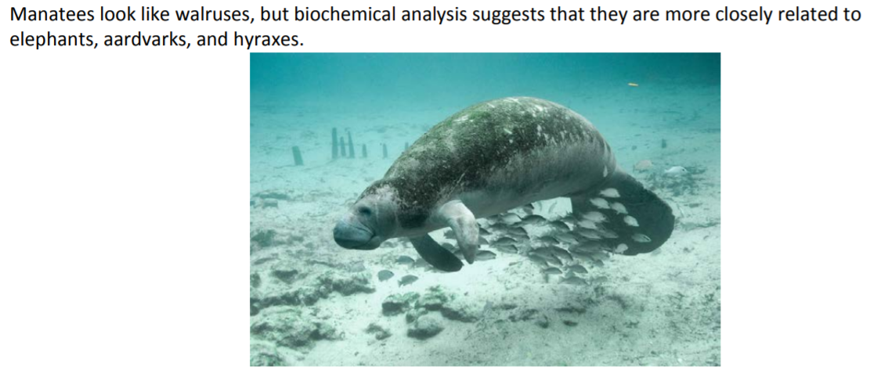
Plenary

Slide 24
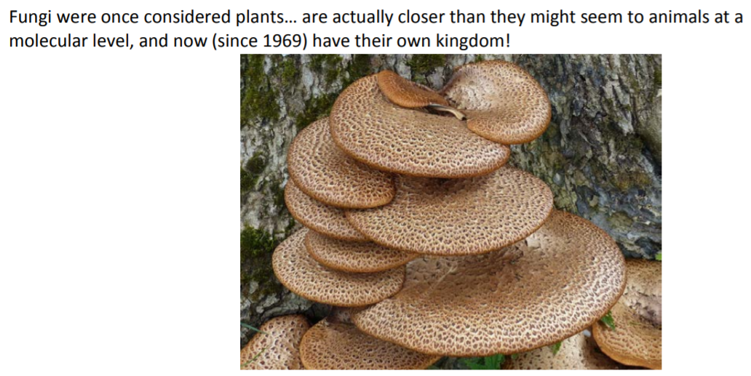
Plenary

Slide 25
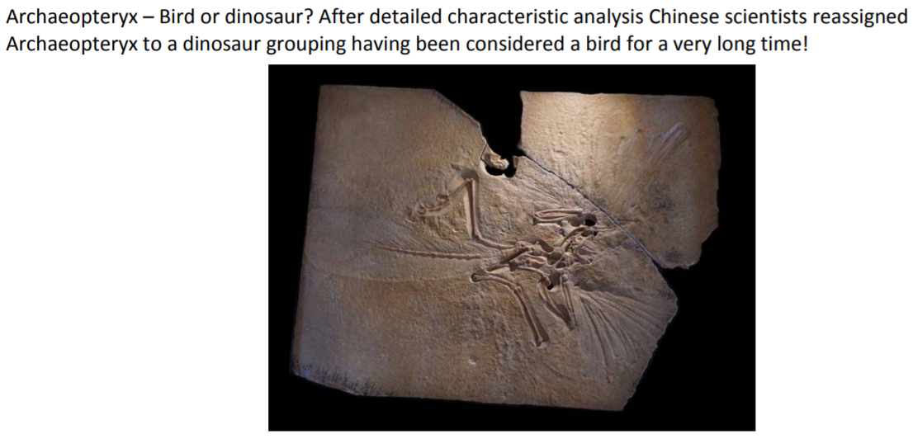
Plenary

Slide 26
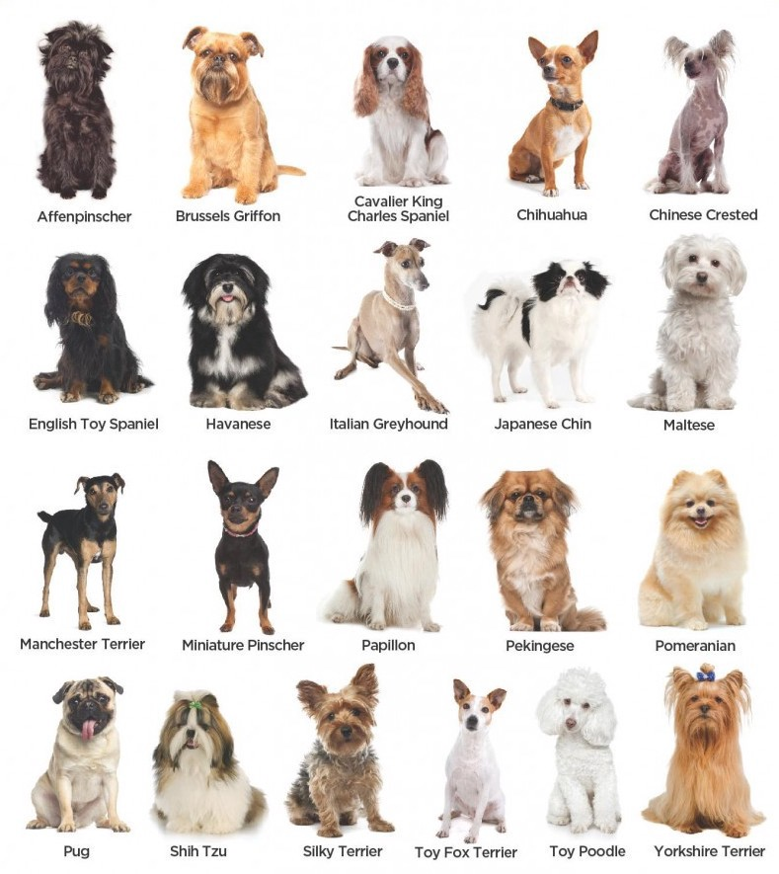
Plenary
These are examples of how disputes arise among the scientific community about how things are classified.
Modern scientific techniques, as well as more traditional reinvestigation of observable characteristics, cause lots of debate!
Remember: living things of one species do not always look alike, e.g. different breeds of dog.

